Slide 1
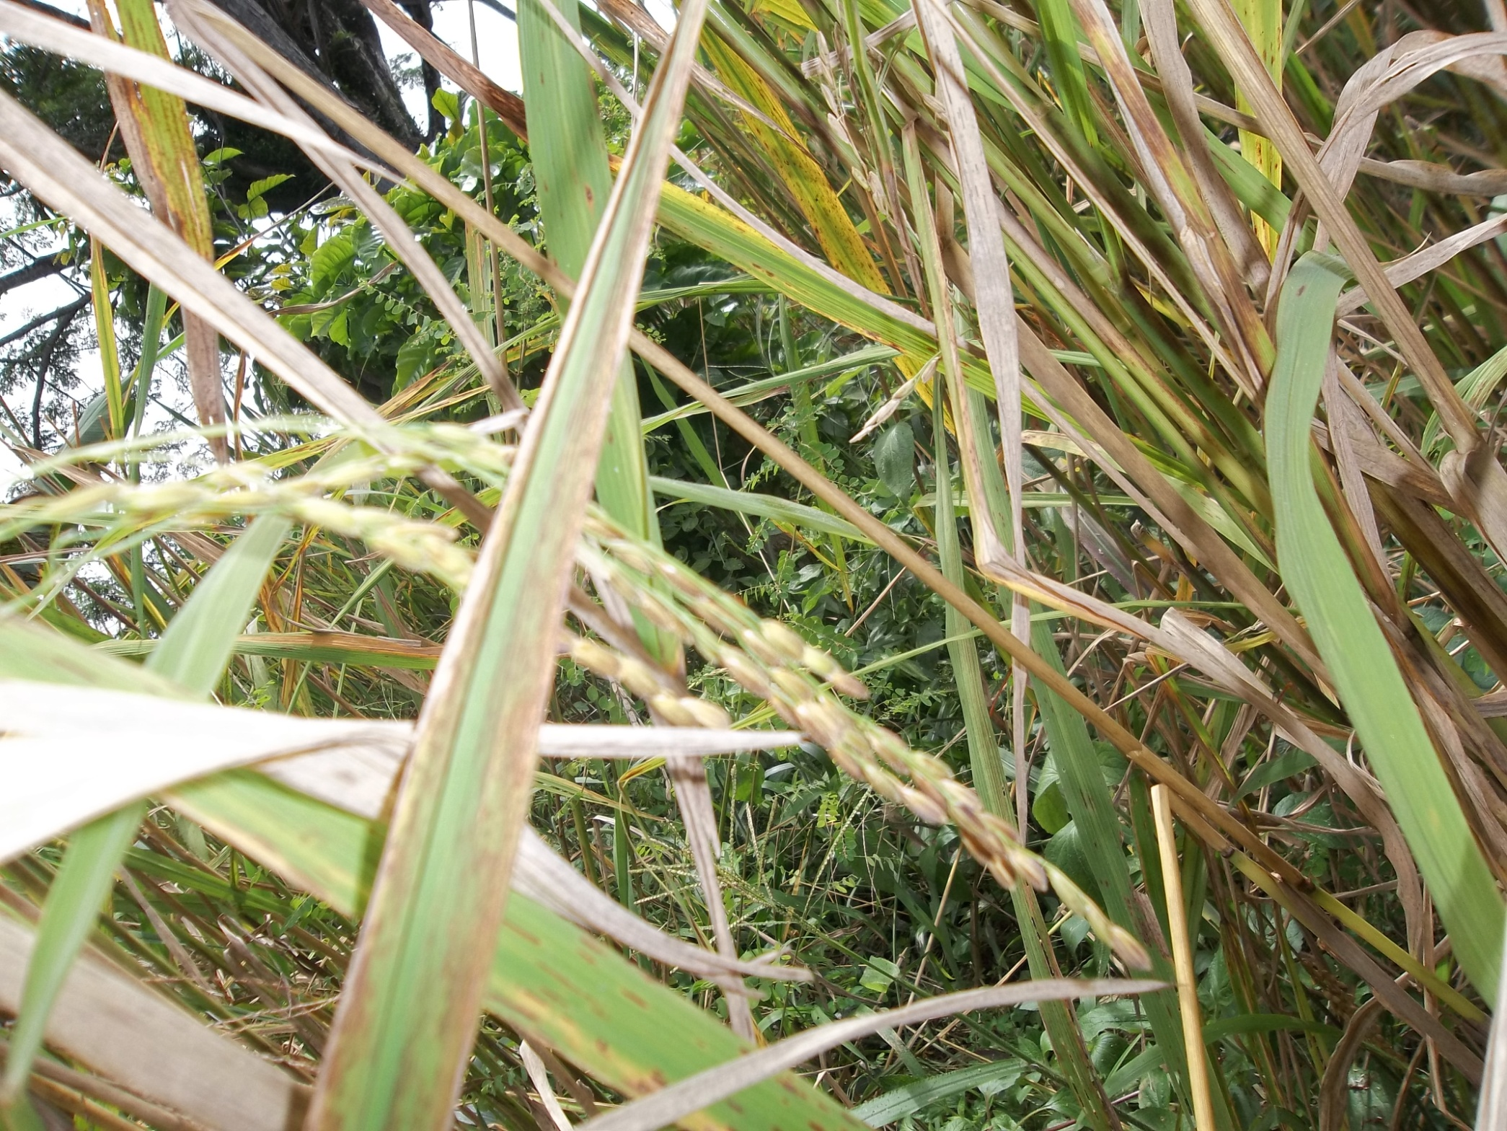
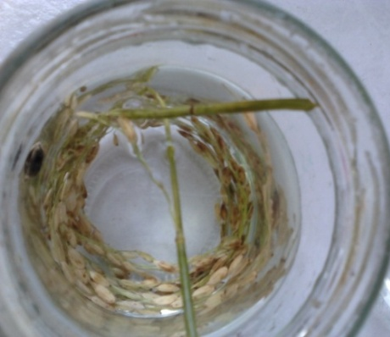
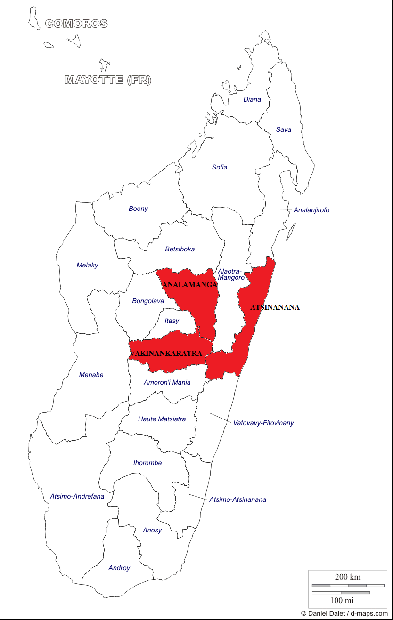
SURVEY OF RICE DISEASES IN THREE REGIONS IN MADAGASCAR
Razanakoto M. L.¹, De Clerck C.², Zalmine F. ³, Rabemanantsoa C.³, El Jaziri M.⁴ and Jijakli M. H.²
²Laboratory of Phytopathology (Gembloux Agro-Bio Tech, Ulg, Belgium), ³IMRA (Madagascar), ⁴ULB (Belgium) and ¹University of Antananarivo (Madagascar)
INTRODUCTION
Rice (Oryza sativa) constitutes the most cultivated crop and is the staple food in Madagascar. It covers 47 % of crop land with one or two harvests a year. However, the country has never achieved food self-sufficiency and continues to import rice abroad. Rice diseases are one of the factors limiting rice production and causing significant yield reductions.
Our study aims to identify the rice pathogens present in three region of Madagascar: two of these regions (Analamanga and Vakinankaratra) represent central highlands regions and one region (Atsinanana) represents east coastal regions.
METHODOLOGY
Collect of samples and information about deseases in farmer fields.
Rice samples were harvested at any stages of development of the culture.
Samples surface desinfection with sodium hypochlorite 1%.
Isolement on Nutrient Agar with Nystatin and Potato dextrose Agar with chloramphénicol. Strains purification on new media without antimicrobial molecules.
Identification of each strain isolated by microscopic observation of colonial morphology and cultural characters. In particular, Gram and shape were characterized for bacteria.
Pure strains’ 16S DNA and 18S DNA were amplifiedd using universal primer. Amplicon obtained were sequenced then analyseed using BAST.
BLAST results were confirmed with selective media, Koch’s postulate and compared with information about samples like symptoms and the results of macroscopic and microscopic observations.
RESULTS AND DISCUSSION
ANALAMANGA AND VAKINANKARATRA REGIONS :
Alternaria sp. seems to be the predominant fungi and Xanthomonas oryzae pv. oryzae was the most often detected bacterium.
These regions are on the central highlands of the country at altitudes between 1200 – 1500 m, where weather is warm and humid on summer and dry and cold in winter. Moreover irrigated rice is cultivated in these regions.
These conditions tend to favours Xanthomonas oryzae pv. oryzae and Alternaria sp. growth. These pathogens can survive on rice debris left on field and they restart grow when water and new plant arrive. Irrigation can explain the rapid spread of these diseases in the region.
ATSINANANA REGION :
Curvularia lunata seems to be the predominant fungi and Pseudomonas fuscovaginae was the most often detected bacterium.
This region are on the east costal of the country, at altitudes between 0 0 – 800 m, where climat is tropical humid, meaning high temperatures and humidity all through the year.
This region is exposed directly to the trade winds. This may the reason of the presence of Curvularia lunata in all fields. Conidies on the lesions can effectively be transported by wind to healthy plants as source of first infection. Rainfed rice is practised in this region.
In all the country, farmers use their own harvest as the seeds for the next season and moreover they don’t treat their seed before sowing so diseases cause more and more losses.
CONCLUSION
The survey of rice diseases made in three regions of Madagascar shows that symptoms and the occurrence of rice pathogens in east coastal region is different from those detected in central highlands regions. These differences can depend on cultural mode and weather. Other studies fund also the same frequence of isolation of these four pathogens in other country. Identification of rice pathogens is important for the future deployment of research in desease management.
ACKOWLEDGEMENT AND REFERENCE
These studies was realized at laboratory of Phytopathology (Gembloux Agro-bio Tech, ULg) and IMRA (Madagascar) and financially supported by CUD « Comminssion Universitaire pour le Développement » (Belgium)
[1] - Singh S. P., Kiran R., Kiran A. and Prasad B. K. (2008) Significance of pre harvest seedborne fungi of paddy var. sita. J. Phytol. Res. 21(1) : 89 – 94
[2] – Ora N., Faruq A. N., Islam M. T., Akhtar N. and Rahman M. M. (2011) Detection and Identification of Seed Borne Pathogens from Cultivated Hybrid Rice Varieties in Banglades. Middle-East Journal of Scientific Research 10(4) : 482 - 488

