Slide 1
Physicochemical properties of lipids extracted from Tenebrio molitor larvae
University of Liege
Gembloux Agro-Bio Tech
Danthine S, Blecker C, Paul A*, Frederich M, Taofic A, Lognay G, Fauconier M-L & Francis F

Slide 2
Contents
Concept: Entomophagy
Introduction
Objectives
Material and Methods
Result and Discussion
Conclusion

Slide 3
Entomophagy
What is Entomophagy ?
Consumption of insects as human food
Heavily influenced by local cultural and religious practices
Why to eat insects?
Nutritionally superior to conventional meats
Insects are not closely related to humans, so chances of transmission of diseases are negligible
High social value to people who believe they have good nutritive and pharmaceutical properties
Important source of proteins, lipids and some minor components
Over 1900 insect species are popularly eaten in many parts of the world
Higher feed conversion ratio and percentage edibility
Production results in lesser emission of green house gases and ammonia
Much less water requirement

Slide 4
Introduction
Nutrient Richness
1. Protein content of insects ranges from 15% to 81% (dry basis), which is of good quality and high digestibility (Ramos - Elorduy et al., 1997)
2. They are also rich sources of fat, vitamins and minerals, especially iron and zinc (Akinnawo & Ketiku, 2000)
Lipid Content
1. Fat content among various edible insects ranges from 1.5% (Coleoptera) to 77% (Lepidoptera) (Raksakantong et al., 2010)
2. Insects often establish metabolic reserves, such as fats, especially during immature stages, for example larvae
Unsaturated Fatty Acids
1. PUFA were most predominant fatty acids, followed by saturated fatty acids and MUFA in all the investigated insects (Raksakantong et al., 2010)
2. Insects are good source of important fatty acid, which should be considered for human consumption

Slide 5
Objectives
Lipids from Tenebrio molitor larvae (mealworms)
Quantity & Quantity
Substitute of oilseeds

Slide 6
Material and Methods
Samples
Two batches of Tenebrio molitor larvae (mealworms) were purchased from a local supplier
Three batches reared in lab were considered
Methods
All the larvae were freeze dried during 48h before analysis and stored at 4°C before analysis
Protein estimation was done using dumas method
Lipid extraction was done by a cold extraction technique using 2:1 chloroform/methanol as solvent
Fatty acid compositions were determined by gas chromatography on a HP 6890 Series GC System apparatus fitted with a HP 7683 Series injector and flame ionization detector
Thermal profile was analyzed by differential scanning calorimetry Q1000 DSC connected to refrigerated cooling system

Slide 7
Result and Discussion
Protein & Fat Content
(% dry matter) of Tenebrio molitor larvae
% MUFA & PUFA
Sample | Protein content | Fat content
Commercial | 58% | 30%
Lab reared | 52% | 36%
Sample | MUFA | PUFA
Commercial | 41% | 31%
Lab reared | 53-56% | 16%

Slide 8
Fatty Acid profile of Tenebrio molitor larvae
Fatty Acid % | Lab Reared 1 | Lab Reared 2 | Commercial 1 | Lab Reared 3
C 12:0 | 0.34±0.00 | 0.36±0.00 | 0.36±0.00 | 0.33±0.00
C 14:0 | 1.52±0.26 | 4.30±0.07 | 2.36±0.66 | 4.19±0.01
C 16:0 | 20.75±0.01 | 17.31±0.03 | 14.36±0.01 | 17.23±0.01
C 18:0 | 2.05±0.05 | 4.00±0.00 | 2.33±0.02 | 3.40±0.02
C 16:1 | 1.00±0.00 | 1.54±0.00 | 1.30±0.00 | 1.60±0.00
C 18:1 | 51.84±0.01 | 53.12±0.08 | 40.34±0.06 | 54.18±0.01
C 18:2 | 16.06±0.01 | 15.67±0.08 | 29.74±0.06 | 15.71±0.03
C 18:3 | 0.13±0.00 | 0.17±0.00 | 1.13±0.03 | 0.14±0.00
Note: Unsaturated fatty acids represent 70% of total fatty acids in commercial as well as lab reared samples.

Slide 9
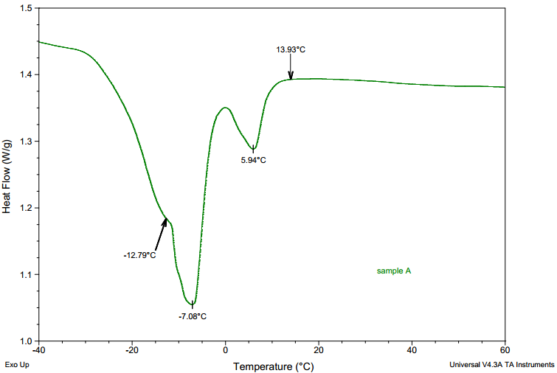
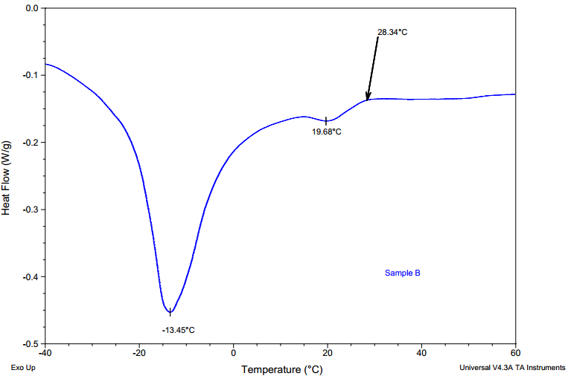
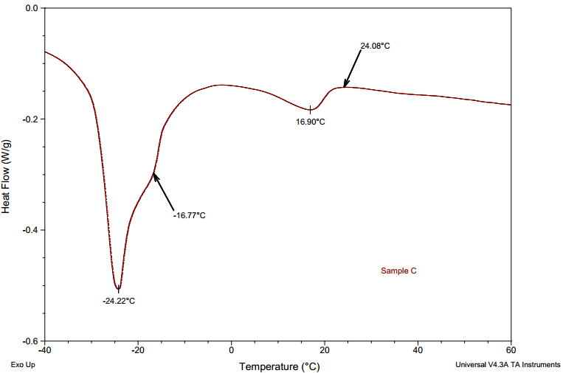
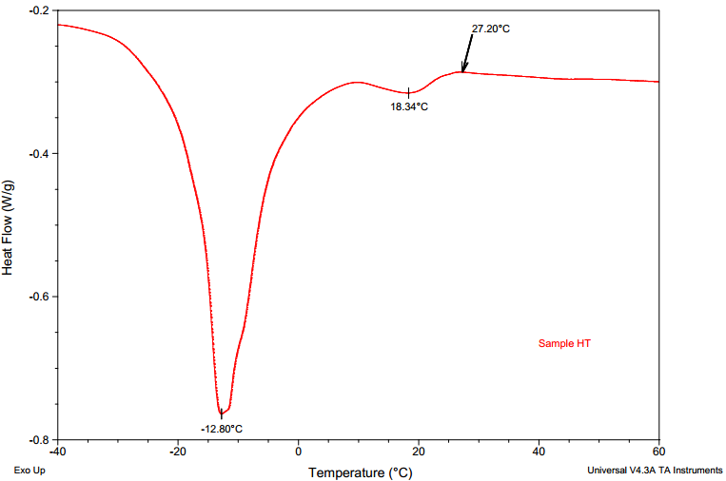
Thermal profiles (DSC Curves)
Lab Reared 1
Lab Reared 2
Commercial
Lab Reared 3

Slide 10
Conclusion
The level and quality of lipid content could be considered as sufficient & it offers potential for
oilseed substitute
Tenebrio molitor larvae (mealworms) are potentially important source of unsaturated fatty acids specially oleic and linoleic acids
The chemical composition and the thermal properties of the samples varied according to
their origin.
It should be interesting to further investigate the effect of diet on the fat composition

Slide 11
Thank you!

