Slide 1

Libraries and their Role in Open Access
2013 Charleston Conference - “Too Much Is Not Enough!”
November 6 – 9, 2013
Challenges and Opportunities
Laura Morse, Harvard University
François Renaville, University of Liège
Christine Stohn, Ex Libris

Slide 2
Abstract
The open access movement gains momentum with an increasing number of institutions and funders adopting open access mandates for their funded research. Consequently, an increasing amount of material becomes freely available, either from institutional repositories or from traditional or newly established journals. Libraries can play a dual role in supporting this movement: Firstly, they can provide services supporting the deposit of research output in their institutional repositories, including support for making it widely discoverable via indexes such as Google Scholar and library discovery systems. Secondly, libraries can make open access materials discoverable by their patrons through such indexes, thus expanding their collection to include materials that they would not necessarily license.
This session will describe the experience of the University Libraries of Liège in Belgium and Harvard. University of Liège chose a top-down approach and made it compulsory for researchers to deposit their output in the institutional repository—ORBi. To support this mandate, the library offers services that help researchers deposit and disseminate their publications. Both libraries—Liège and Harvard—enable their students and faculty to discover open access content beyond their library’s acquired collection via their library discovery system.
The session will also address challenges that arise from indexing open access publications and how index providers and libraries can deal with such publications, especially with articles that are deposited in different institutional repositories or published in so-called hybrid journals that contain a mix of open access and subscription articles.
Finally, we will discuss with the audience how they see libraries’ role evolving in this area, what challenges they are currently facing, and the solutions and opportunities they have found.

Slide 3
Agenda
Introduction – Christine Stohn
Open Access at Harvard University – Laura Morse
Open Access at the University of Liège – François Renaville
Open Access discovery in Primo Central– Christine Stohn

Slide 4
The ecosystem of scholarly communication is changing
Funding bodies are enforcing open access policies
Public awareness for cost of knowledge increases

Slide 5
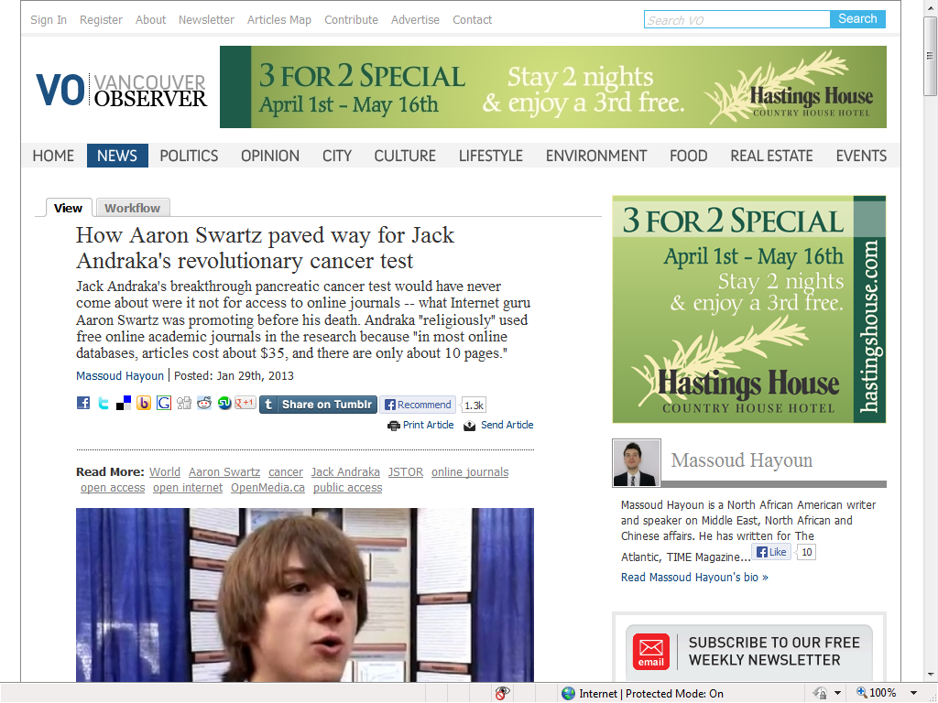
“I used them [free online academic journals] religiously. Just because, in most online databases, articles cost about [US]$35 …
… The public funds a lot of this research. Shouldn't the public have access to it?”

Slide 6
The eco system of scholarly communication changes
Funding bodies are enforcing open access policies
Public awareness for cost of knowledge increases
Traditional publishers embrace Open Access
Science-metrix report: half of publications published in 2011 are available free
Many institutions adopt institutional mandates (ROARmap)
ARL, AAU and APLU propose SHARE – a network of digital repositories
HSBC, 2013 https://www.research.hsbc.com/midas/Res/RDV?ao=20&key=RxArFbnG1P&n=360010.PDF
http://www.science-metrix.com/eng/news_13_08.htm
http://roarmap.eprints.org/

Slide 7
Open Access leads to more diversity
More publication and access models
Not just one place, many places
Shorter publication cycle of research, quicker (and different) review processes
More diverse readers
More openly available supplementary material (e.g. research data)
Wider usage - more impact metrics

Slide 8
Roles for librarians
Managing institutional research output
  Managing article processing charges
  Providing author support with information about funding policies
  Providing meta data and distribution services
  Providing impact metrics services (e.g. altmetrics)
Providing discovery
  Discovery of articles and research data beyond the institutional subscriptions
    Open access journals
    Open access articles in hybrid journals
    Open access articles from institutional repositories

Slide 9
Open Access at Harvard University
Laura Morse, Harvard University

Slide 10


Established
1636
Faculty
About 2,100 faculty members and more than 10,000 academic appointments in affiliated teaching hospitals
Students
Harvard College – About 6,700
Graduate and professional students – About 14,500
Total – About 21,000
Faculties, Schools, and an Institute
Harvard University is made up of 11 principal academic units – ten faculties and the Radcliffe Institute for Advanced Study. The ten faculties oversee schools and divisions that offer courses and award academic degrees.

Slide 11

70 separate library units
nearly 1,000 fulltime employees
18.9 million volumes
42 million digital files
174,000 serial titles
10 million photographs
an estimated 400 million manuscript items

Slide 12
Open Access at Harvard University
Open Access at Harvard began in 2008 when the Faculty of Arts and Sciences passed the first Open Access Policy. The Office for Scholarly Communication was established in support of the school policy. This office spearheads campus-wide initiatives to open, share, and preserve scholarship. With support from OSC, open-access policies are now in place at the following schools:
  Harvard Faculty of Arts and Sciences - 2008
  Harvard Graduate School of Education - 2009
  Harvard Graduate School of Design - 2011
  Harvard Business School - 2010
  Harvard Law School – 2008
  Harvard Kennedy School of Government - 2009
  Harvard Divinity School – 2010
  Harvard School of Public Health – 2012
Overview - https://osc.hul.harvard.edu/about
Harvard OA Policies - https://osc.hul.harvard.edu/
Notes:
Note: Med School does not yet have a policy, but they are largely under the NIH public policy mandate.
Policies are not identical, but the major themese are the same.

Slide 13
Open Access at Harvard University
Policies are not identical, but the major themes are the same.
These policies all:
  Grant the institution certain non-exclusive rights to future research articles published by faculty
  Require deposit in the repository
  Offer a waiver option or opt-out for individual articles
Notes:
Under 5% choose to pursue a waiver

Slide 14
Office for Scholarly Communications
OSC Services for Faculty:
  Provide guidance for Harvard Open Access Policy participation
  Evaluate and amend licensing agreements
  Make use of alternative publishing models
  Provide broader access to faculty works
  Offer reimbursement to scholars for the processing fees of articles published in eligible open-access journals and for which no alternative funding is available

Slide 15
Office for Scholarly Communications
Promotion of services:
  Liaison program for every school
  Offer training for existing faculty assistants and market services to new hires
  Work with department chairs and deans to highlight services at department meetings
  Provide monthly usage stats to authors, including download, unique user count, and countries represented

Slide 16

The OSC also develops and maintains a central, open-access repository for Harvard Community - DASH
The deposit process begins with authorization
  Assistance Authorization Form – grants OSC staff rights to make deposit and distribution decisions and confirms the non-exclusive license (Copyright 205e act)
Many pathways are offered to remove barriers for use
  Email to OSC Staff
  Quick deposit webform
  In person assistance from open access fellows
  Directly via DASH Deposit Interface
Notes:
For pre-2008 works, non OAP rights apply

Slide 17
Metadata in DASH
  Extensive data can be collected for each article in addition to expected citation data, provenance, and publishing information, such as:
    Classification Number (Dewey, LC, other)
    Subject Headings (MESH, LC, other)
    Abstract
    Peer Reviewed Status

Slide 18
Verifying metadata
  OSC program staff first verify publishers permission via the SHERPA/Romeo website
  Verify accurate citation information
  Conduct bibliographic research to ensure accurate and complete metadata
Basic Facts About DASH
  Built on DSPACE
  Solely a full text repository
  86% of the content is bright (14% dark)
  http://dash.harvard.edu/
  Usage Dashboard - https://osc.hul.harvard.edu/dash/mydash

Slide 19
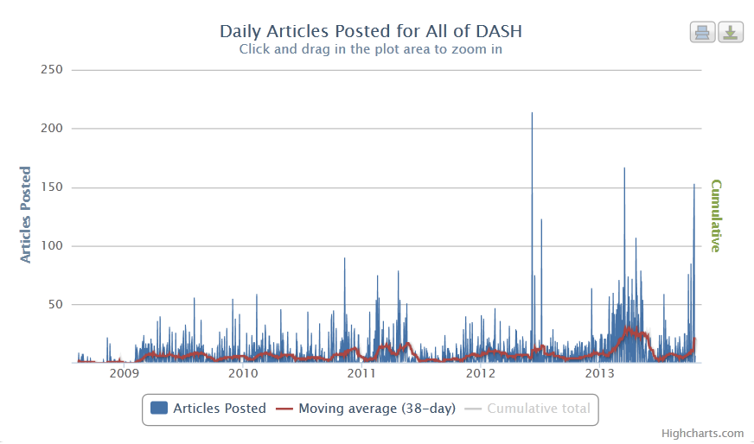
13,491 deposited articles

Slide 20
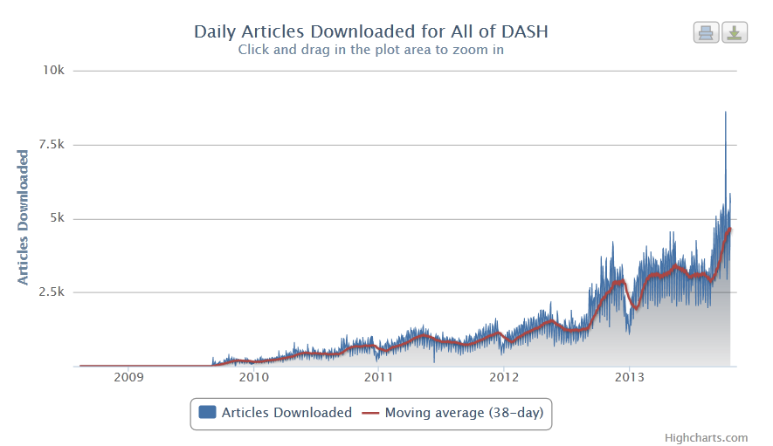
2,063,438 downloads

Slide 21
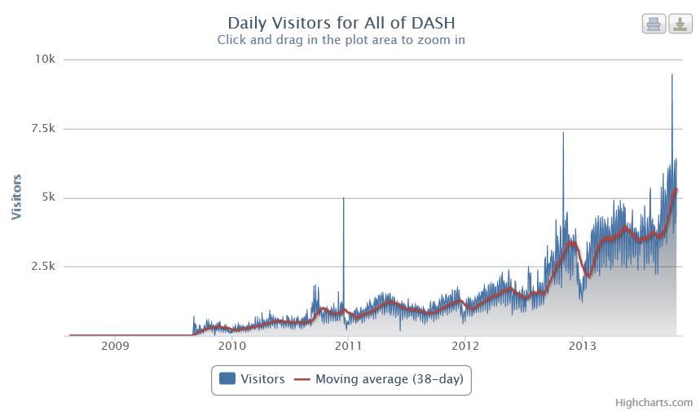
1,377,477 unique visitors

Slide 22
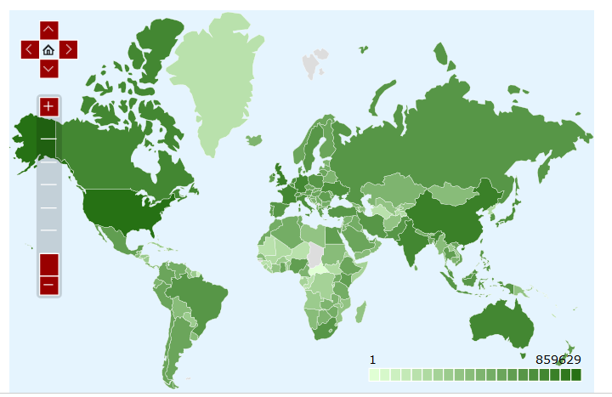
And those visits are from around the globe
https://osc.hul.harvard.edu/dash/mydash?v=geomap&gi=alldash&t=1&p=alltime

Slide 23
Emphasis for OSC is to promote discoverability in as many places as possible – not solely from DASH search interface
  60% from google services
  20% referred from other systems
  20% direct DASH access
Each cover page includes citation information, links to publisher, terms of use, etc.
Users can provide stories of how DASH has been helpful. 1 – 3 stories a day are submitted, and provide a valuable testament to the use of the service.
  https://osc.hul.harvard.edu/dash/stories
Notes:
Note – less than 5% from google scholar, 28% google.com. 25% international google sites.
“I am the director of a private foundation, and access to research such as this is really helpful as we develop and adjust our own strategy. Open Access means I can also share the paper with relevant grantees who are working with (or without) us on civil society issues in Africa.”
–Director, Private Foundation
“Very helpful for my research on ideology. Our library doesn’t get this journal.”
–College Professor

Slide 24
So, how is DASH content made discoverable?
    OpenSearch API and OAI-PMH
    http://openmetadata.lib.harvard.edu/content/digital-access-scholarship-harvard-dash-dataset
Metadata is made available for harvest for:
  a. personal study;
  b. teaching (including distribution of copies to students and use in coursepacks and courseware programs);
  c. research and scholarship (including computational research uses such as data-mining and text-mining); and
  d. provision of value-added services (including full-text searching, cross-referencing, and citation extraction)

Slide 25
But, not all records in DASH have complete descriptive metadata. This is an new opportunity for libraries to help promote discoverability of this content.

Slide 26
NISO RP-19-201x, Open Discovery Initiative: Promoting Transparency in Discovery (currently in comment period) recommends providing the following information for all content provided citation data, provenance, publishing information:
  Subject
  Contributor
  Abstract/description
  Full text flag
  Open Access flag
  Component Of (Title)
  Component Of (Title ID)

Slide 27
OSC and Library Technology Services
LTS hosts all OSC systems
Lead OSC developer has bi-weekly check-ins with the Director, Systems Development
OSC Developers attend LTS Monthly Staff Meeting
But, most importantly, we collaborate on integrated projects, like thesis deposit workflows into DASH, ILS, and Digital Preservation Repository and, upcoming, providing linking service to DASH content in our OpenURL resolver.
Many thanks to Suzanne Kriegsman (OSC Program Manager ) and Reinhard Engels (OSC Digital Library Software Engineer) for providing information for this presentation.

Slide 28
Open Access at the University of Liège
François Renaville, ULg

Slide 29

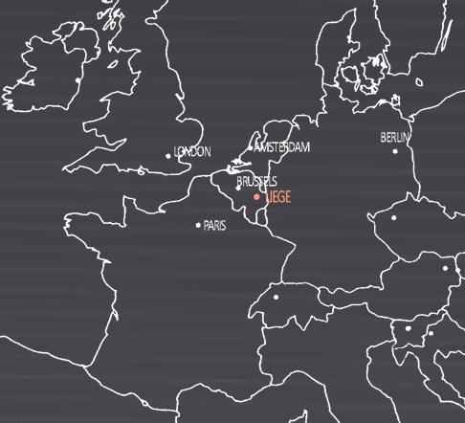
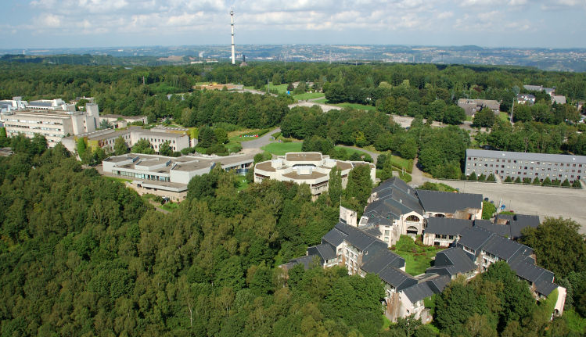
University of Liège (ULg)
Funded in 1817
Public and pluralist
One of the 3 main universities of the French-speaking part of Belgium
20,000 students (122 nationalities)
3,300 staff (lecturers-researchers)
Complete university
(9 Faculties, 1 School, 1 Institute)
  38 bachelor degrees
  193 master degrees (33% of which are unique in French-speaking Belgium)
  68 complementary master degrees

Slide 30
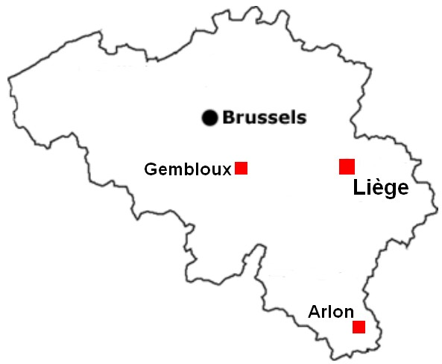
University of Liège Library
5 main libraries:
  Arts & Humanities Library
  Agronomy Library
  Law & Social Sciences Library
  Life Sciences Library
  Science & Technology Library
Spread on 4 campuses:
  Liège Sart-Tilman (main campus)
  Liège City centre
  Gembloux
  Arlon
Collections:
  2,000,000 books
  89,000 e-books
  5,400 current print subscriptions
  57,000 e-journals
  565 incunables
  6,500 manuscripts
17 library facilities
Staff: about 115 people (ca 82 FTE)

Slide 31
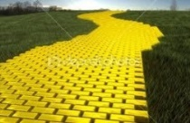

Open Access at the University of Liège
Long-standing story
Based on a real conviction shared by
  University Authorities
    Chancellor Bernard Rentier, active advocate for OA, http://recteur.blogs.ulg.ac.be/?cat=10
  and librarians:
    Chief librarian Paul Thirion
Concrete Open Access initiatives from the Library:
  PoPuPs: portal and toolbox for diffusion of open access journals published by ULg members (since 2005), http://popups.ulg.ac.be
  BICTEL/e: repository for PhD theses (since 2006), http://bictel.ulg.ac.be
  ORBi: institutional repository (since 2008), http://orbi.ulg.ac.be
University of Liège
  has been subscribing to Biomed Central since 2004
  doesn’t support any publication in hybrid journals

Slide 32
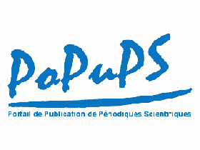
PoPuPS
Platform for OA publishing of academic journals (since 2005)
14 journals
  2,600 scholarly articles in PDF and/or XML
  2 journals have got an IF
  no APC!!
Built on Lodel software (http://lodel.org)
Statistics since February 2011:
  more than 459,000 PDF downloads
  more than 1,184,000 XML visualisations
Titles already included in:
  EBSCO A-to-Z®
  Ex Libris SFX®
  Ex Libris Primo Central® (+ articles harvested)
Directly available at http://popups.ulg.ac.be
VISIBILITY!

Slide 33

ORBi
http://orbi.ulg.ac.be
May 2007:
  Decision from the Administrative Board to create an institutional bibliography and a repository
  Strong institutional mandate:
Built on DSpace
July 2008: Beta launch with some volonteers
November 2008: official launch of ORBi (Open Repository and Bibliography)
top
down
Introduction of references for all publications by ULg members, backdated to 2002
Deposit of the full electronic version of all articles published by ULg members, backdated to 2002 FT in Open Access or restricted access according to the publishers’ policy

Slide 34

ORBi: successful project
From August 2008 until end of October 2013:
  1,872,676 full text downloads (spiders excluded)

Slide 35
Towards exhaustiveness…
Remember: Repositories with no mandate have max. 15% of exhaustiveness (see Harnad et al. (2009) http://eprints.soton.ac.uk/266616)
  → Libraries must convince the Institution Authorities to have a strong, ambitious and coherent mandate!
Journal articles published between 2009 and 2012 to be found in ORBi and Scopus
Better visibility of the scholarly production of the University
On November 1st, 2013

Slide 36
A Stimulating Mandate
Immediate-Deposit/Optional-Access (ID/OA) Mandate (http://roarmap.eprints.org/56/)
Already communicated to the University Community before the official Decision (http://recteur.blogs.ulg.ac.be/?p=103)
Motivation: ORBi = single source for evaluations and promotions
  → only references listed in ORBi are taken into account (“if it is not in the IR, it doesn’t exist”)
Full text in ORBi
New references with FT in OA

Slide 37
A whole concept
Development of ORBi : more than a technique, a whole concept
  Librarians as coaches : Help authors depositing
    Users’ guides, FAQ, automatic and contextual help…
    Legal help by ORBi staff and a lawyer librarian
    Training sessions
    Very active hotline by phone and e-mail
  Put the author at the core : concerned AND responsible
    Role of the « back office »: Quality Control from the Library
    Authors concerned and sole responsible of the quality of the records
      no correction made by ORBi staff!!
      eventual suppression: only by ORBi staff
    Faulty behavior warned to authors by the University Authorities themselves
    Ensure that metadata is comprehensive enough for discovery

Slide 38

A whole concept
  Reduce constraints for authors:
    Work sharing between University authors
    User-friendliness + quick deposit webform
    Whole deposit process thought over
    Pre-import & import functionalities (PubMed, WOS, Scopus, Nasa, EndNote, BibTex…)
    Permanent updating of the periodical database
    Tools
      for personalised publication reports
      to follow the « in press », « in progress », imports…
      for redundancy detection
      for incoherent data detection
      for false full text detection
      to export references (RIS, BibTex…)
    …
(See Thirion et al. (2010), http://hdl.handle.net/2268/65254)
http://www.chrisg.com/overcoming-your-own-constraints/

Slide 39
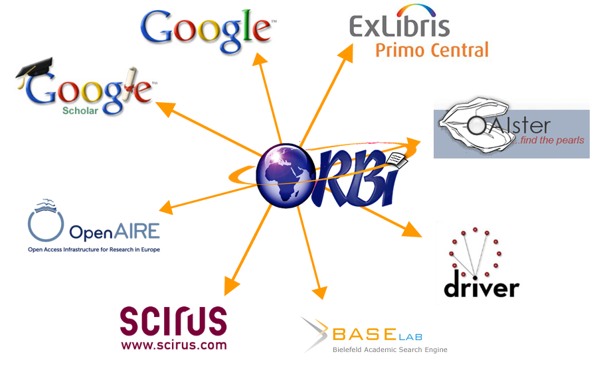
Being seen…
We don’t expect anyone coming on ORBi to make searches and discover the institutional research output
→ Long work to be indexed and harvested
  available through Google one hour after validation
  harvested by Primo Central Index (Ex Libris) and in many other tools
  open to any new collaboration!!

Slide 40
Open Access discovery in Primo Central
Christine Stohn, Ex Libris

Slide 41
Goal
Discovery of open access material via the library
Including
  Open Access journals
  Articles in hybrid journals
  Material in repositories, e.g. ORBi and DASH
    Institutional repositories
    Community based repositories, e.g. arXiv

Slide 42
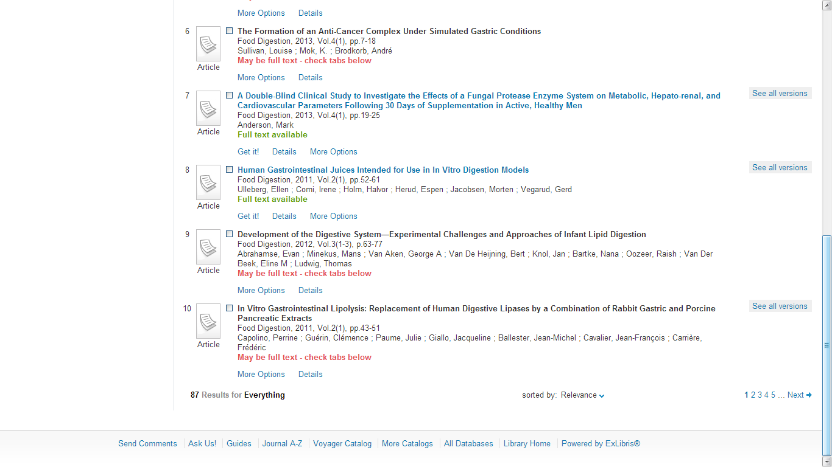
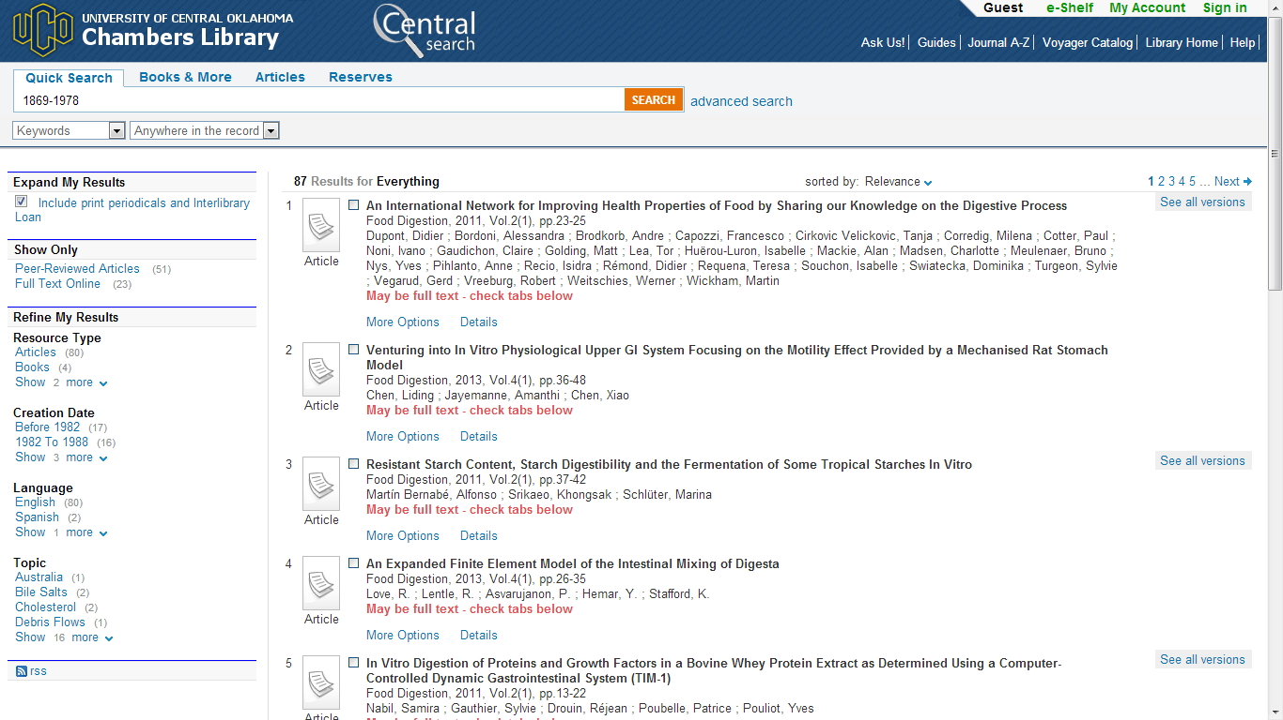
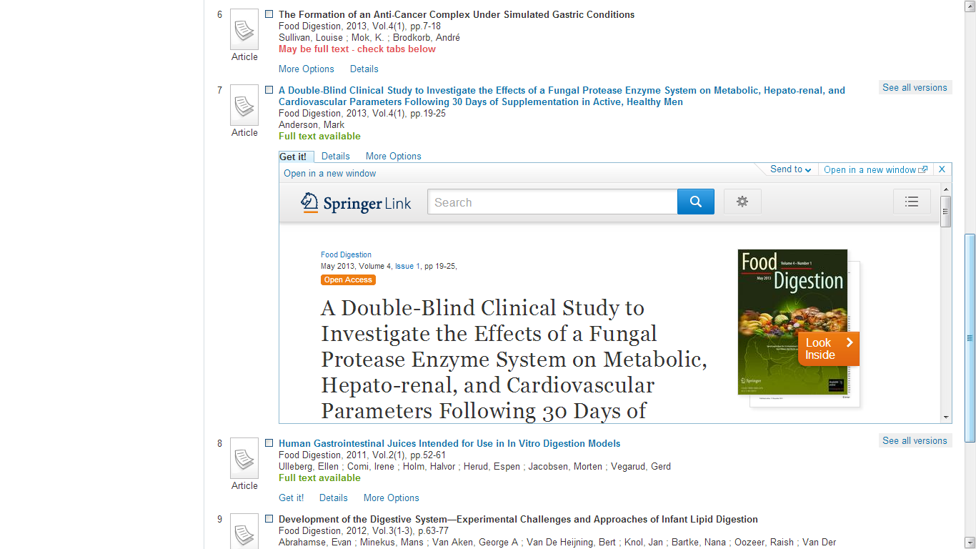

Availability on article level – Hybrid journals

Slide 43
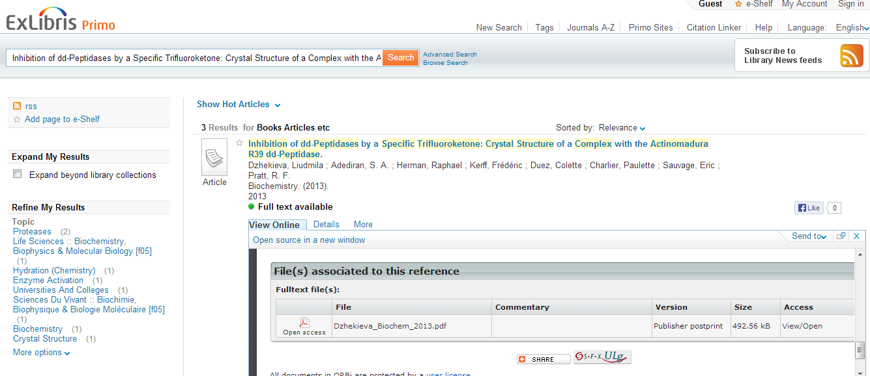
Availability on article level – institutional repositories

Slide 44
Institutional publications - valuable for global use
Is it relevant to a global user community?
Is it globally accessible for reading?
Can you provide
  OAI-PMH for harvesting?
  Correctly tagged meta data (with an OA or free-to-read tag)?
  Consistent and good metadata?

Slide 45

Open Access Metadata and Indicators
  Recommendations for a standard set of metadata to easily identify
    Availability of individual articles (e.g. in hybrid journals)
    Reuse rights for such items
KBART – KnowledgeBase Recommendations
New recommendations contain OA flag on journal level

Slide 46
Summary and discussion
Managing institutional research output
  Managing article processing charges
  Providing author support with information about funding policies
  Providing meta data services
  Providing impact metrics services (e.g. altmetrics)
Providing discovery
  Discovery of articles and research data beyond the institutional subscriptions
    Open access journal
    Open access articles in hybrid journals
    Open access articles from institutional repositories

Slide 47
Bibliography
EU recommendations on access to and preservation of scientific information: http://ec.europa.eu/research/science-society/document_library/pdf_06/recommendation-access-and-preservation-scientific-information_en.pdf
Harnad, Stevan, Carr, Les, Swan, Alma, Sale, Arthur and Bosc, Helene. (2009). Maximizing and Measuring Research Impact Through University and Research-Funder Open-Access Self-Archiving Mandates. Wissenschaftsmanagement , 15, (4), 36-41. http://eprints.soton.ac.uk/266616/
HSBC (2013). Academic Publishing https://www.research.hsbc.com/midas/Res/RDV?ao=20&key=RxArFbnG1P&n=360010.PDF
Rentier, B (2007, March 10). La politique de l’ULg en matière d’Open Access. [Blog post] http://recteur.blogs.ulg.ac.be/?p=103
ROARMAP: Registry of Open Access Repositories Mandatory Archiving Policies http://roarmap.eprints.org
Science-metrix (2013). Proportion of Open Access Peer-Reviewed Papers at the European and World Levels—2004-2011 http://www.science-metrix.com/eng/news_13_08.htm
Thirion, P, Renaville, F, Bastin, M, & Chalono, D. (2010, July 07). ORBi in orbit, a user-oriented IR for multiple wins: why scholars take a real part in the success story. Paper presented at OR2010 - The 5th international conference on Open Repositories, Madrid, Spain. http://hdl.handle.net/2268/65254
NISO RP-19-201x, Open Discovery Initiative: Promoting Transparency in Discovery
  http://www.niso.org/apps/group_public/document.php?document_id=11606

Slide 48
laura_morse@harvard.edu
francois.renaville@ulg.ac.be
christine.stohn@exlibrisgroup.com
Thank You!

