Slide 1


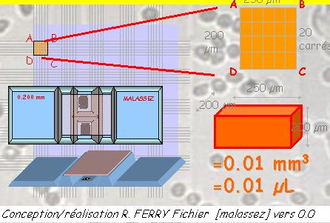
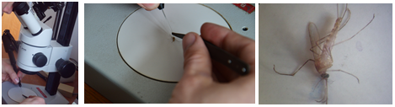
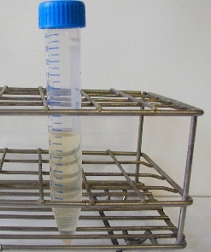
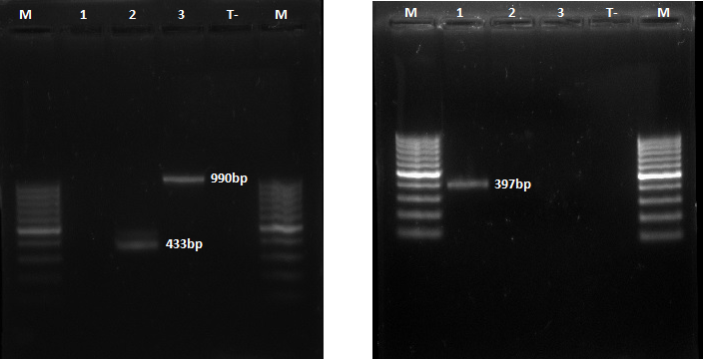
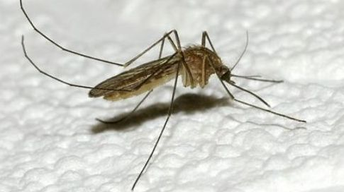
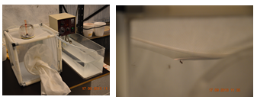
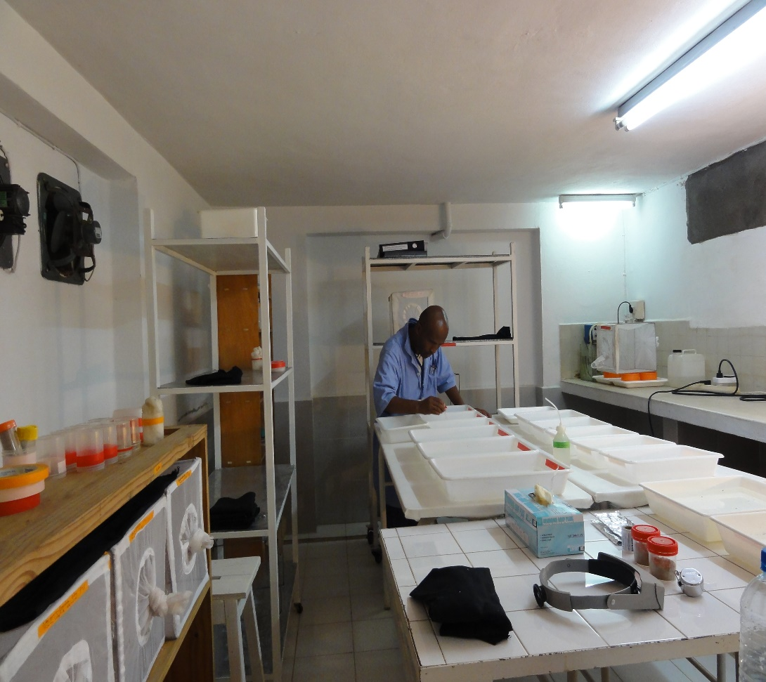
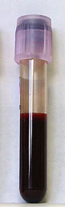
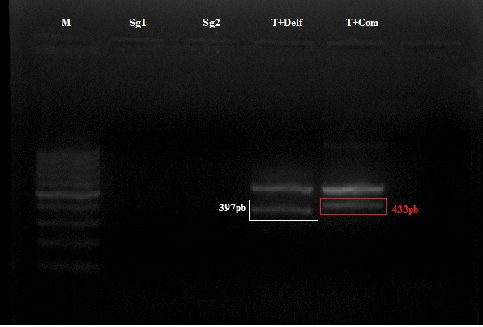
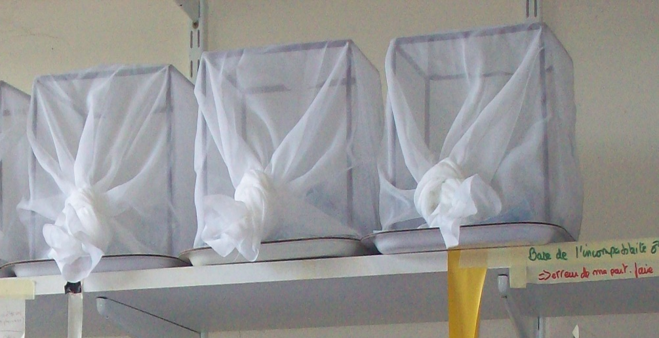
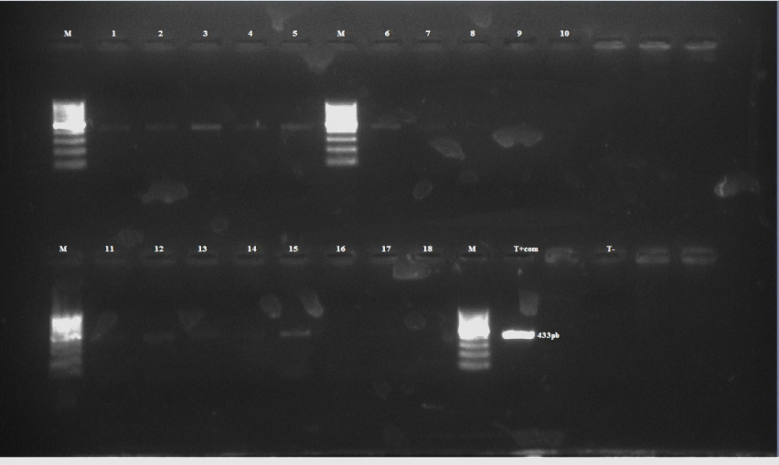
Assessment of bacterial persistence in mosquitoes according to microinjection assays in Belgium
F.N. Raharimalala ^{1 , 2,} T. Bawin ¹, S. Boukraa¹ , J.-Y. Zimmer ¹, F. Francis ¹
¹Functional and Evolutionary Entomology – University of Liege (GxABT) – Belgium; ²Institut Pasteur – Madagascar; E-mail: entomologie.gembloux@ulg.ac.be
Abstract:
The problems caused by the massive used of pesticides have resulted in the establishment of resistant vectors besides the destruction of the environment. Furthermore, climate change has consequently modified the comportment of disease vectors. Current research tends to look for alternative means to overcome the problem (1). The aims of our research were to study the effect of the introduction of endosymbiotic bacteria in the mosquito species exempted, that could be potential vectors of disease in Belgium, by microinjection method (2) or artificial blood feeder. Research has been done with Culex quinquefasciatus, a reference strain from the University of Montpellier II and in breeding in our laboratory until 2011. For bacteria, Commamonas sp was used for infection because of it was absent in Cx. quinquefasciatus.
Materials and methods:
A
1st Step: Culture, bacterial counts and test on PCR of bacteria, blood for the artificial feeder and mosquito
Method for intrathoracic microinjection
Mosquitoes were anesthetized in the ice for 45 seconds, then infected by intrathoracic inoculation with 500nl of Commamonas sp
Commamonas sp was grown in a liquid medium and then tested by PCR and enumerate on Malassez cell
1st Step
2nd Step
Method for artificial blood feeder
2nd Step: Microinjection and infection with artificial blood feeder. Presence of Commamonas was checked by PCR in J0, J7 and J10
Female mosquitoes were feed with blood infected by Commamonas sp, then engorged females were caged for laying. Adults and larvae were screening for the presence of Commamonas sp
Presence of Commamonas sp in blood was tested by PCR before the infectious artificial blood meal
J: day
Results:
A with arrow: abdomen colored in blue
Density of bacteria per mililiter used for the infection was 8,78*10⁻⁷.
For microinjection: on the 30 females and 30 males used, 20 have survived to the injection. Four were sacrificed in J0 and tested with PCR for the presence of Commamonas sp, all were positive. In J7, another four individuals were sacrificed for test PCR. None was positive. In J10, the remains of individuals, 14 were killed and tested by PCR, but none was positive.
For artificial blood feeder infected: on the 30 females used for the artificial blood feeder infected, 15 females were taken blood. Two were sacrificed in J0 and tested with PCR for the presence of Commamonas sp. All were positive. In J7, two females having laid were sacrificed and then tested by PCR, but none was positive. The eggs hatched only at J10, we could therefore not have usable stages (L3 or L4) for PCR.
Discussion:
We have chosen to work with Commamonas sp because of its absence in Cx. quinquefasciatus and its likely role in regulating the biology of the mosquito (3, 4), but very little was known in the literature for the real action of this bacterium within the mosquito. The PCR test shows that to J0, bacteria was really incorporate inside the mosquito. To check, we injected a dye instead of the bacteria and it was found in the abdomen of the mosquito (arrow A). But the absence of the bacterium to J7 and J10 means that she was unable to remain inside the mosquito. This non subsistence can be explained by two factors: either the amount of injected or ingested bacteria were not dense enough to allow the proliferation in-mosquito, either that the bacteria have been eliminated by the different barriers inside the mosquito.
Conclusion:
These preliminary results show us that the introduction of Commamonas sp inside of Cx. quinquefasciatus (which has been demonstrate free) was possible, either by microinjection or artificial infected blood meal. However its persistence within the mosquito still requires updates to the points which have been limited by time, the availability of necessary biological material and the repeat of the manipulations.
Key words: Bio-manipulation, Microinjection, Endosymbiotic bacteria, Mosquito, vector
References:
Christodoulou M., 2011. Biological vector control of mosquito-borne diseases. Lancet Infect Dis 11: 84–85.
Kumar, S., S. & Puttaraju H.P., 2012. Improvised microinjection technique for mosquito vectors. Indian J Med Res (136): 971-978
Lindh, J., 2007. Identification of bacteria associated with malaria mosquitoes –Their characterisation and potential use. Doctoral thesis, comprehensive summary (Other academic). Stockholm University, Faculty of Science, Department of Genetics, Microbiology and Toxicology.
Zouache, K., Voronin, D., Tran-Van V., Mousson, L., Failloux, A-B & Mavingui, P., 2009. Persistent Wolbachia and cultivable bacteria infection in the reproductive and somatic tissues of the mosquito vector Aedes albopictus. PLoS ONE 4: e6388.

