Slide 1
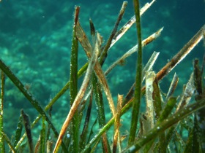
Recent advances in the biomonitoring of trace elements using Posidonia oceanica (L.) Dellile
Jonathan Richir and Sylvie Gobert
Is Posidonia oceanica a good candidate to biomonitor the coastal pollution by trace elements (TEs) of “environmental emerging concern”?
How do the environmental pollution and the plant ecophysiology influence TE kinetics in Posidonia oceanica?

Slide 2
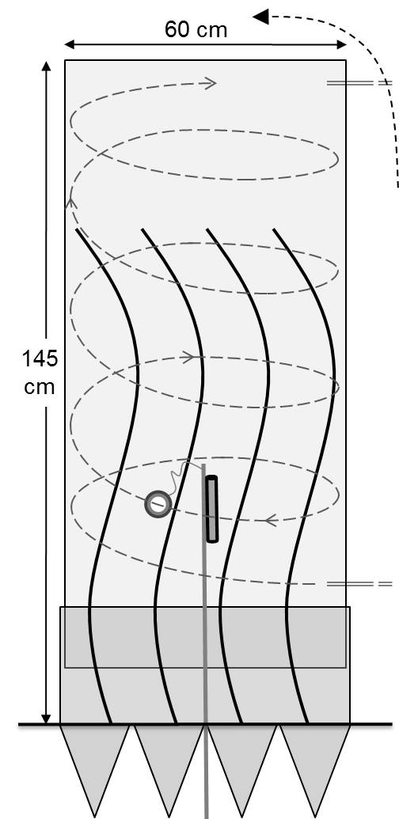
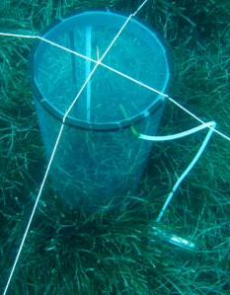
TEs like As, V, Ag, Be, Al, Mn, Co, Se, Mo, Sn, Sb and Bi have been subject to nearly no ecotoxicological survey with P. oceanica.
Very little is known about TE kinetics within P. oceanica meadows.
We studied:
1. the spatial variability of TE levels at the scale of the French Mediterranean littoral.
2. TE kinetics in P. oceanica through in situ
contaminations.

Slide 3
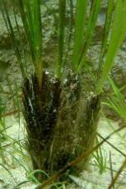
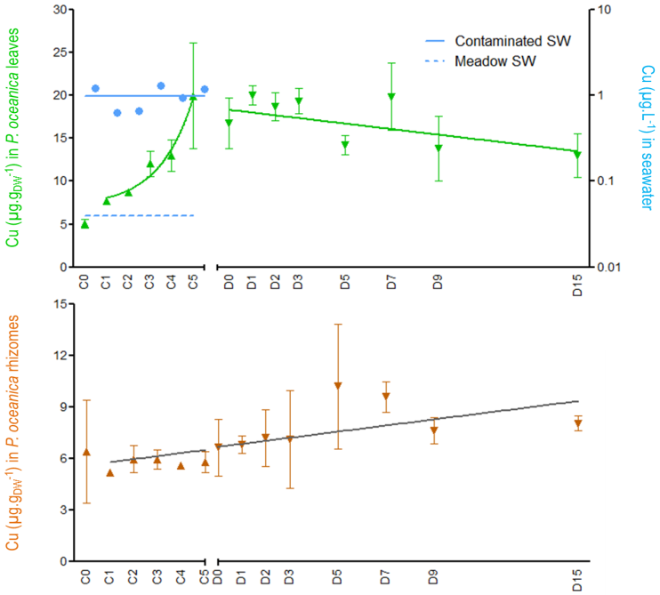
1. TEs of emerging concern ARE of concern.
2. P. oceanica is a sensitive bioindicator for the monitoring of past and present coastal pollutions by TEs.
Related to anthropic activities: mining (Sb), agriculture (Mo), storage and refinement of oil products (V), presence of major urban centres (Bi).

