Slide 1
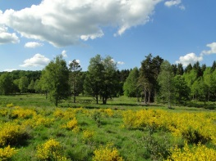
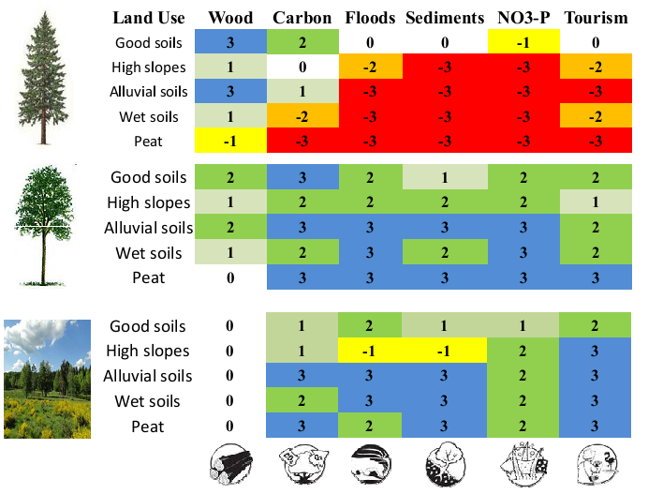
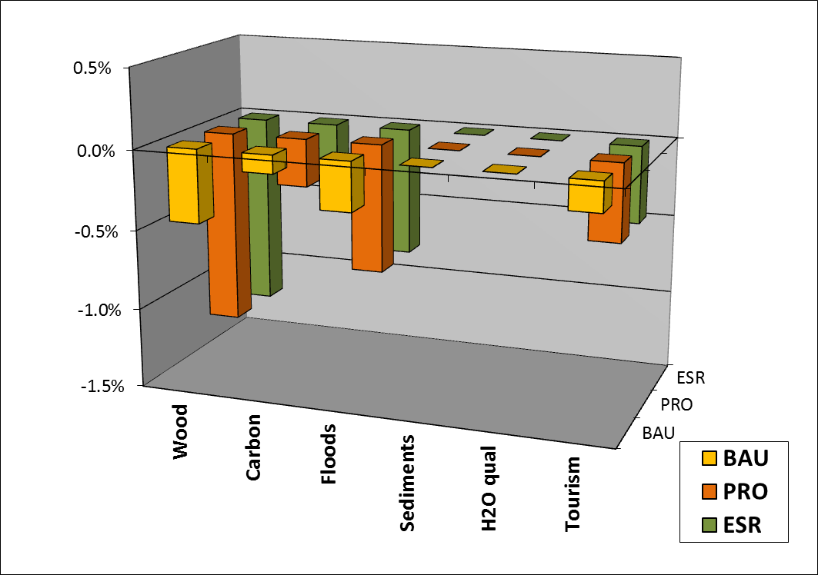
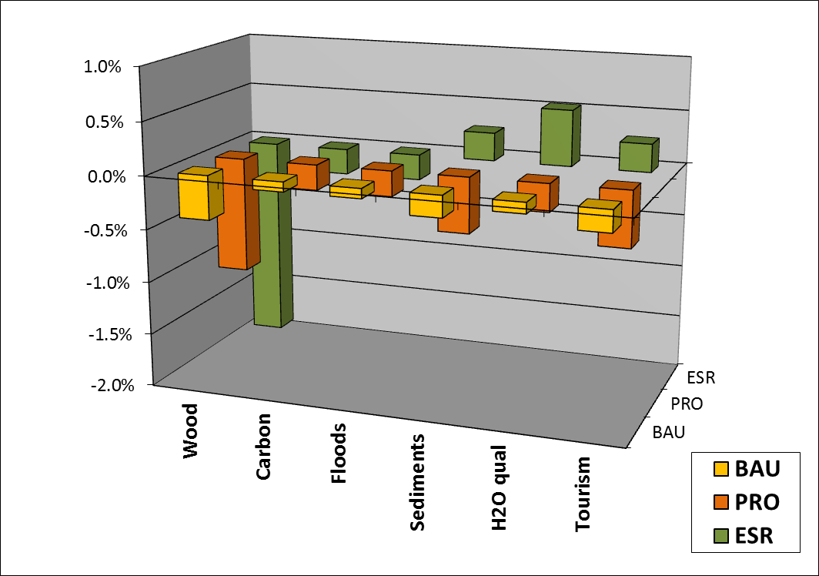
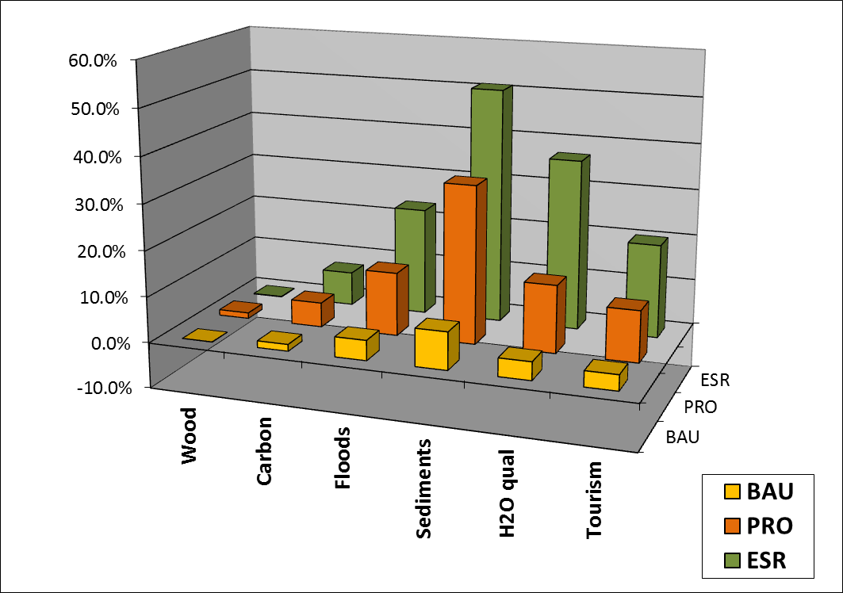
Impacts of local ecological conditions on ecosystem services delivery
Marc Dufrêne & Fanny Boeraeve
Ulg- Gembloux Agro-Bio Tech
CONTEXT:
To assess bundles of ecosystem services (ES), the method presented by Burkhard et al. (2009) is a widely-used reference. However, this method relies on broad land use classes (eg. CORINE) which often fail to represent landscape heterogeneity. The impact of using more detailed landuse classes was illustrated to Forestry master students who applied the Burkhard approach taking in account soil conditions for deciduous and spruce forests. The students’ outcomes (C) were then compared to the ones of Burkhard (A) and the ones of a Walloon case (B). Each matrix (A, B, C) was applied to three scenarios of landuse change between deciduous forests, spruce plantations and restored open habitats.
SCENARIOS (2010 => 2030):
BAU (Business As Usual) = Present trends
PROD (Production) = Active restoration of spruce plantations but with deciduous compensation
ESR (Ecosystem Service Restoration) = Active restoration of spruce plantations but without deciduous compensation
Open habitats
(Nature conservation)
STEPS:
Defining expected surface for each habitat for each scenarios
Use LU x ES matrix (Burkhard et al, 2009) to estimate ES quantities
Multiply surface x ES quantities and sum for each ES
Deciduous plantations
(Multi-fonctionnal) 300.000 ha
Spruce plantations
(Wood production) 230.000 ha
A. Original Burkhard matrix
B. Provisional Walloon matrix
C. Deliberative process with forestry students
Impacts are low but negative. As ES are identical for spruce and deciduous, PRO = ESR.
ESR scenario seems to be more positive but not for wood, carbon and floods
ESR scenario seems to be MUCH more positive. No effect on wood.
CONCLUSIONS:
Each matrix leads to substantial divergent conclusions regarding the scenarios in terms of ES performance.
This clearly underlines the limitation of Burkhard’s qualitative method using large landuse classes;
In terms on policy making and spatial planning it is therefore important to rely on more detailed landuse classes since the outcomes are highly dependent on the factor precision and field heterogeneity fidelity taken into account in the matrix;
For students, this exercise reveals the sensitivity of outcomes, the importance of scientific background to rank the landuse class and the diversity of opinion by working on small groups.

