Slide 1
Groupe de Recherches Asie de l’Est et du Sud Est
GRAESE
The impact of industrialization upon rural – urban relations in Vietnam
Nguyen Thi Dien, HUA, Vietnam
Philippe Lebailly, ULg, Belgium
Vu Dinh Ton, HUA, Vietnam
Notes:
Notes:

Slide 2
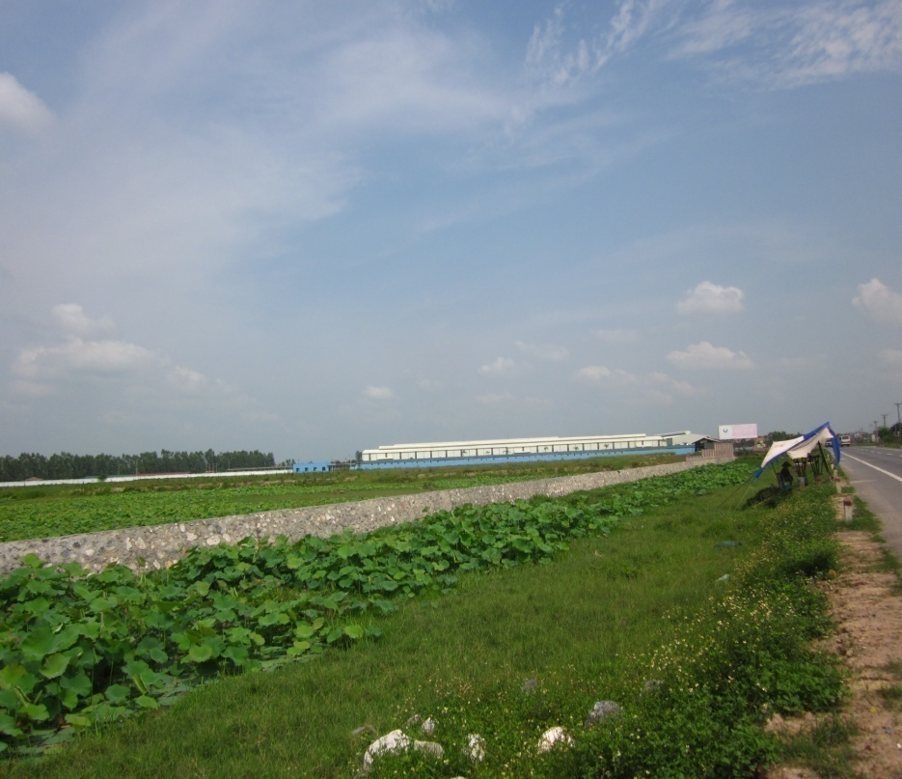
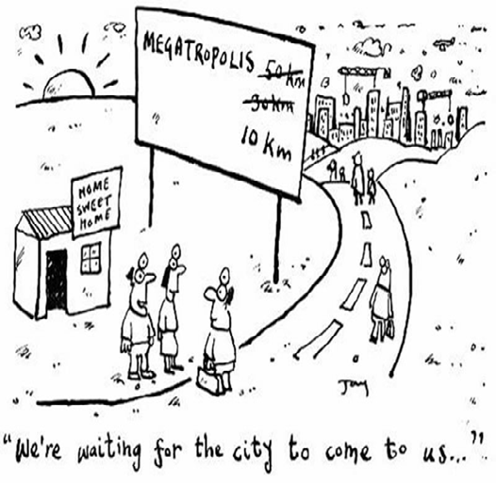
Introduction
Complex impacts of agricultural land conversion for industrialization as the driving forces for livelihood adaptations.
Peasant livelihood shifts between the farm and non-farm sectors along rural – urban continuum.

Slide 3
Theoretical perspectives on rural – urban relations
Rural-urban as dichotomous categories
Distinguishes rural from urban by the differences in occupation, environment, size of community, density of population, social stratification, social mobility and migration direction→ the debate between “urban bias” and “rural ideal society”
Both village and city are elements of the same civilization.
The institutions such as religion, castle, kinship can be found in both village and city → simplifies the similarity between village and city
Rural – urban continuum
There are no sharp breaking points in the degree or quantity of rural urban differences. The rapid process of urbanization through the establishment of industries, urban traits and facilities have decreased the differences between villages and cities.

Slide 4
In this research
Rural – urban continuum is used to explain the socio-economical changes in the rural areas in which there are the interface of farm and non-farm livelihood activities that joint rural and urban spaces

Slide 5
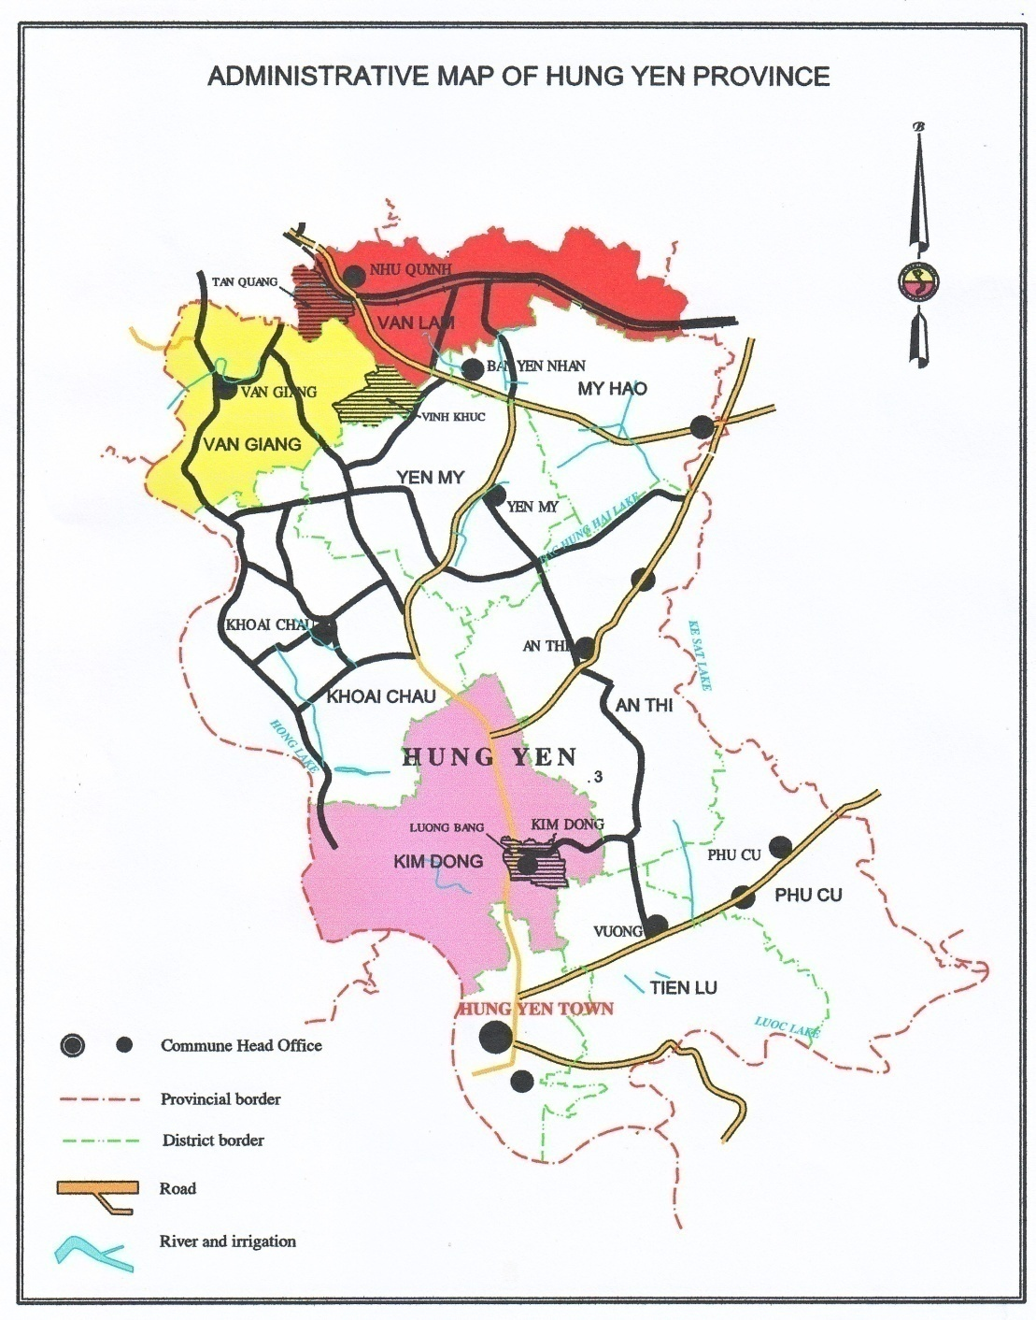
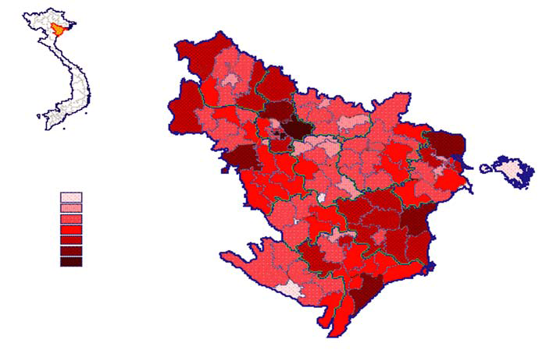
Research site: Hung Yen province
Hung Yen represented to the main features of industrialization in RRD region
High level of land conversion
Impacts on large number of pop
Impacts on environment and land

Slide 6
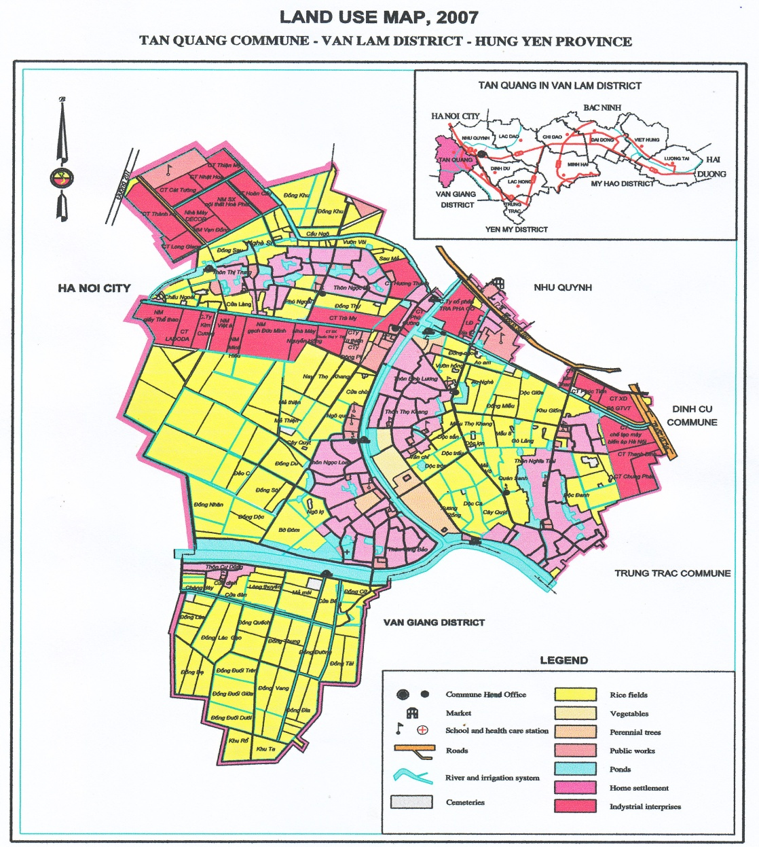
Land use in Tân Quang commune (2007)

Slide 7
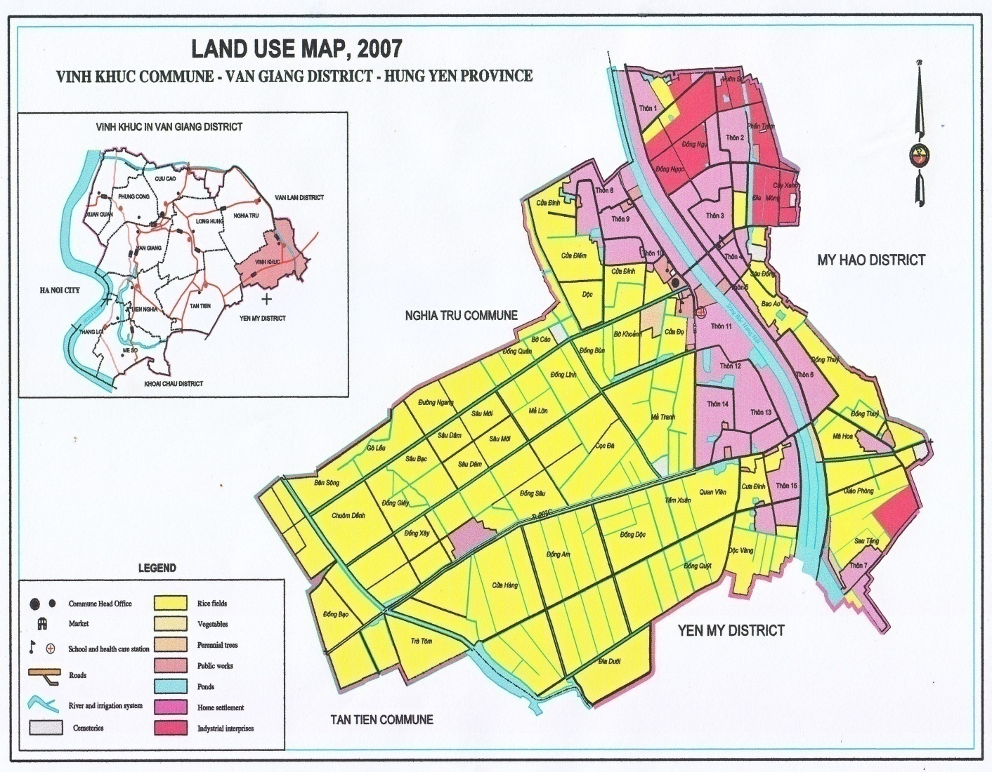
Land use in Vĩnh Khúc commune 2007
Notes:
Circle: Targeted village: Chieu Dong

Slide 8
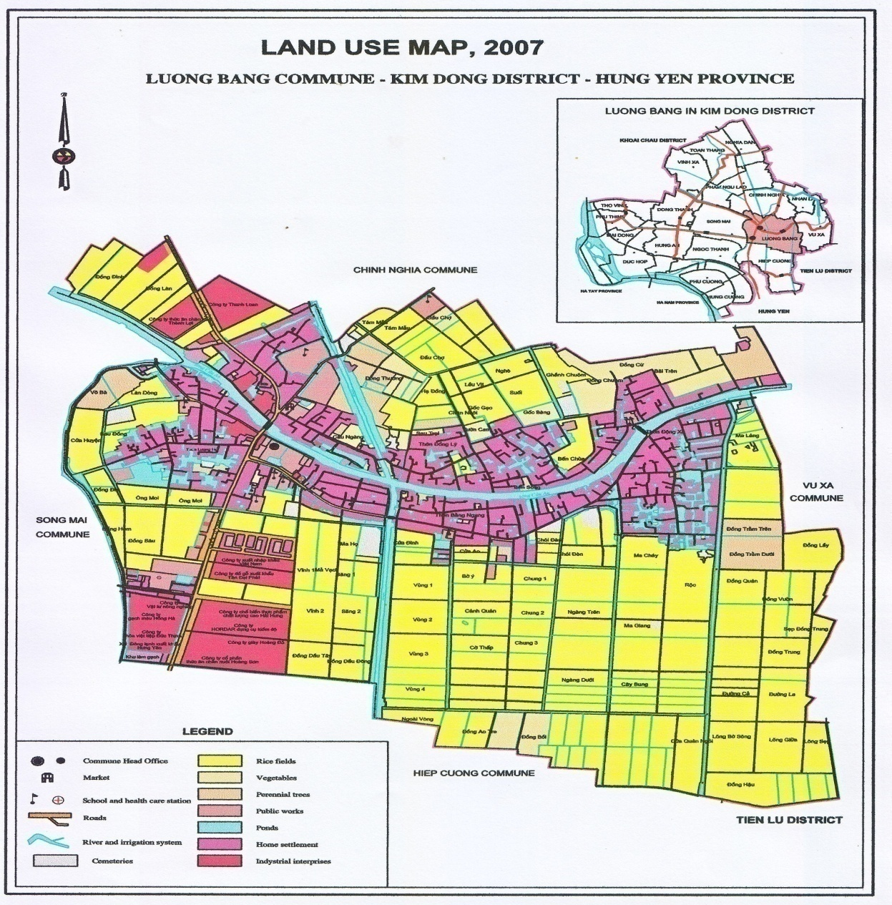
Land use in Lương Bằng (2007)
Notes:
Circle: Targeted village: Luong Hoi

Slide 9
Data collection
Secondary data
The documents and researches relates to land conversion, industrialization and rural – urban relations.
The data and information related to the land use, economic activities, population, labor in the annual reports and statistical data of province, target districts and communes.

Slide 10
Primary data
Household survey
Indicators to select surveyed households
+ The rate of agricultural land lost
+ The professional background of household before land conversion
Sample size: 135 Households
PRA techniques
Interview (household, key informants, local leaders) Group discussion, participation observation, case studies

Slide 11
Research results
1. Impacts of industrialization and socio-economic contexts of rural – urban relations

Slide 12
The decline of household agricultural landholdings

Slide 13
Evolution of job structure

Slide 14
Changes of working location

Slide 15
Changes in household income

Slide 16
Job types and working conditions
3D (Dirty, Dangerous and Demeaning) job
Informal job (71.5% of total laborers)
The constraints in accessing to the social services (social and health insurance)

Slide 17
Infrastructure
Infrastructure (road, transportation vehicles, electricity,…) is improved
Facilitate the rural – urban linkages by reducing the transportation cost and time

Slide 18
2. Livelihood adaptations and rural – urban relations

Slide 19
Livelihood activities

Slide 20
2.1 Agricultural production and rural – urban relations
Increasing demand for agricultural products as agricultural land decline and population growth
City oriented agricultural production (orchard, bonsai, fighting cock, fish for wedding dishes…)
Agricultural concentration (large – scale farms) and production for sales
Small and medium towns play important roles in providing market information for producers and consumers and create the close linkages between rural - urban

Slide 21
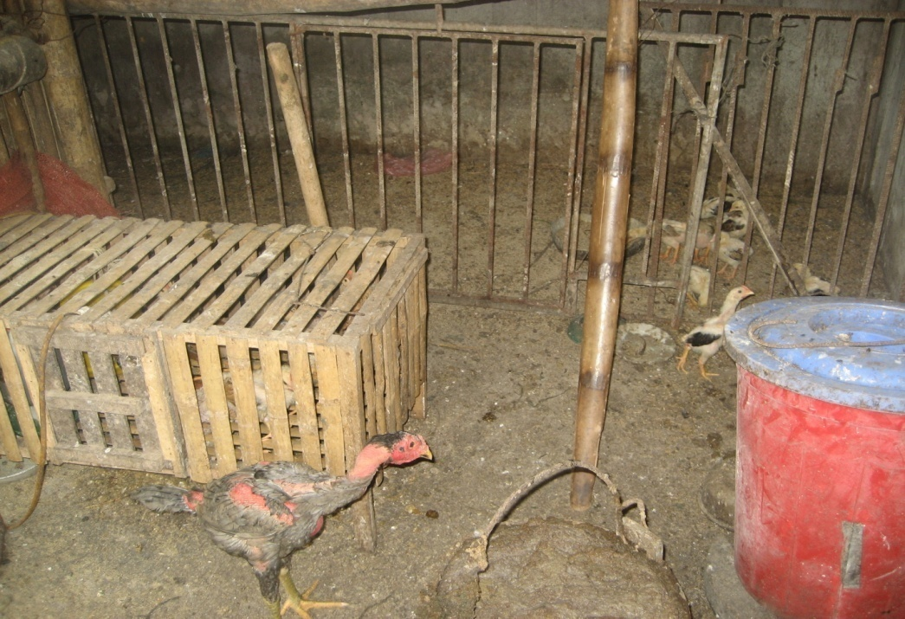
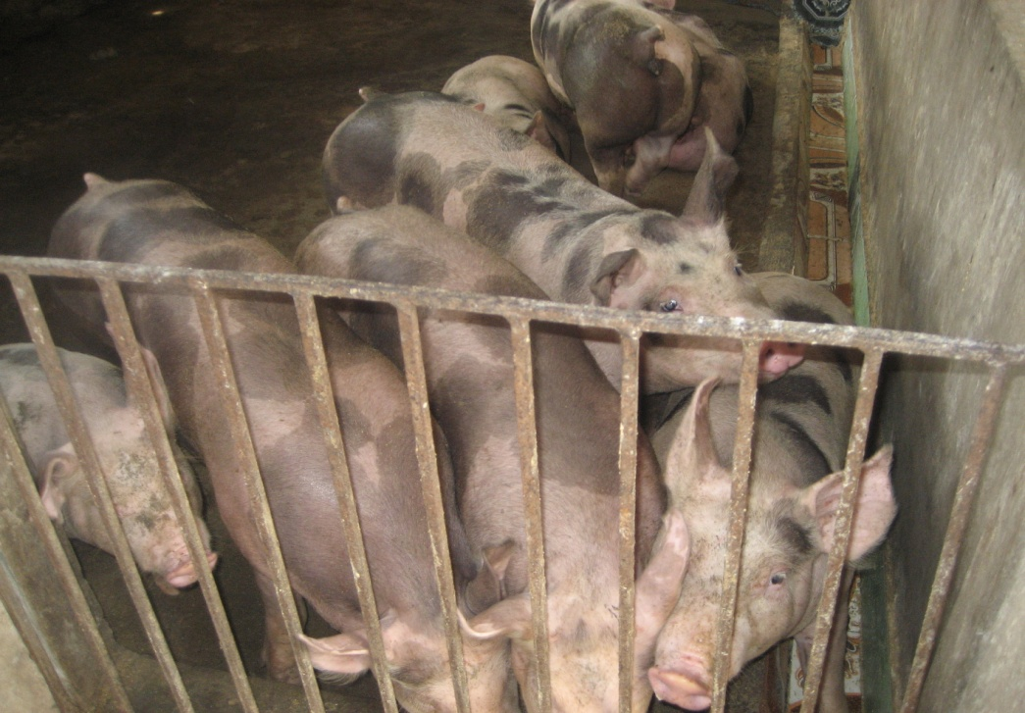
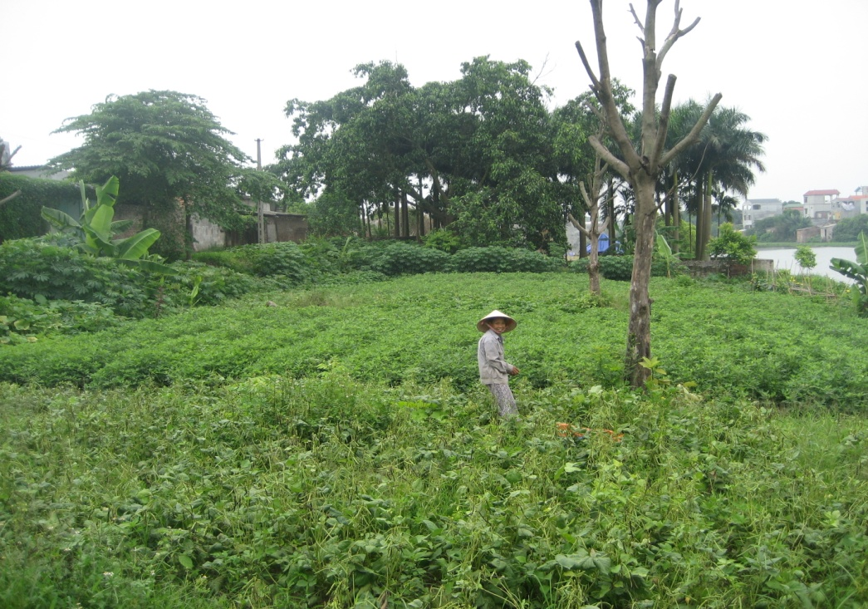
Agricultural production

Slide 22
Market of agricultural production

Slide 23
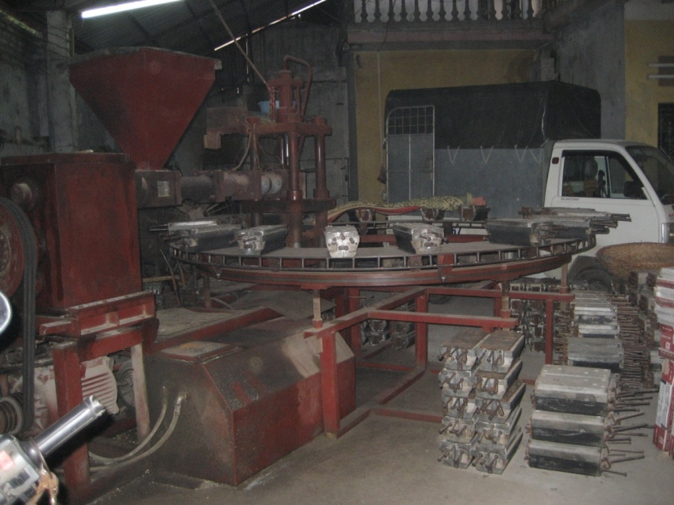
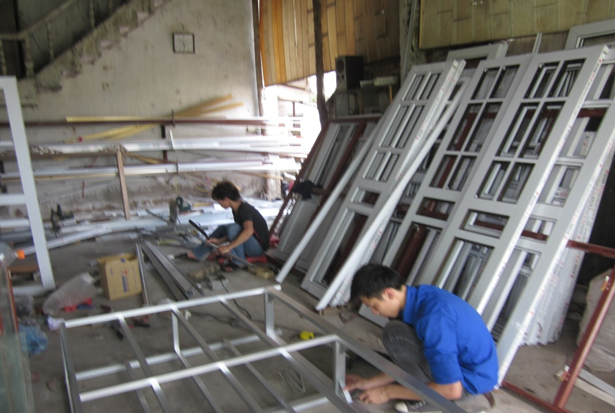
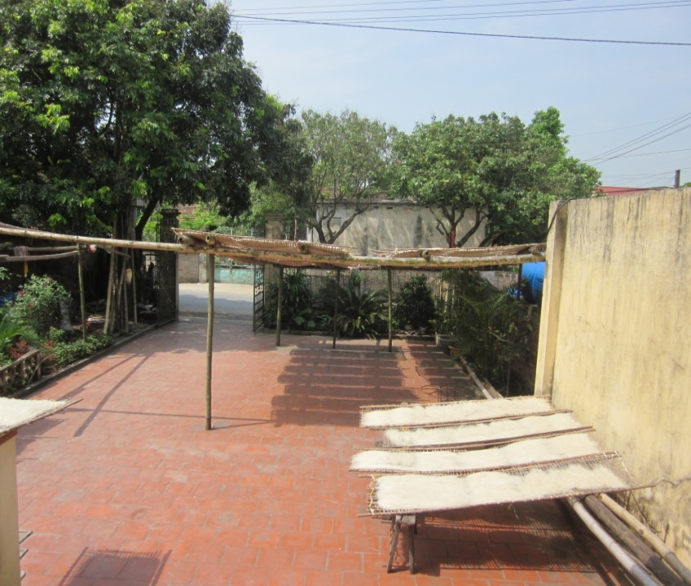
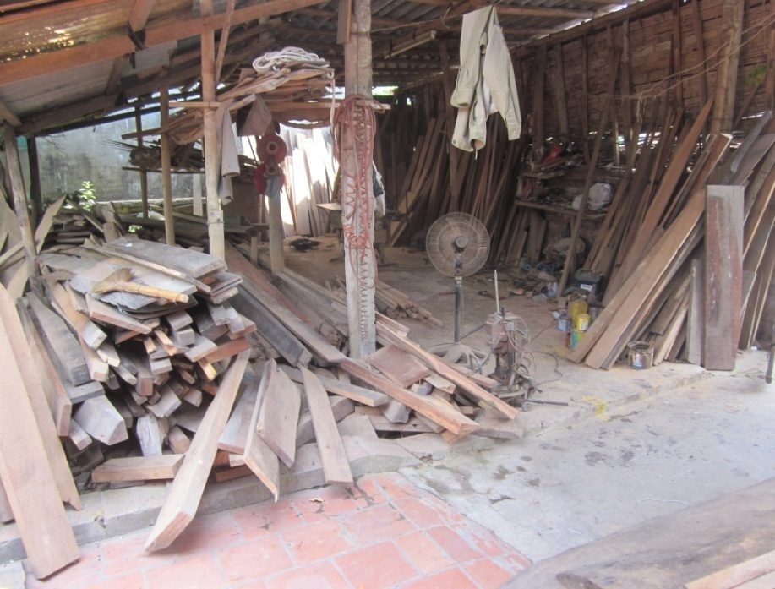
2.2 Rural small industry and artisan

Slide 24
Main characteristics of rural industry and artisan
The concentration of production
Diversification of industry activities
Using mainly family labor and few hired labor
Market places for production depend on the types of industry

Slide 25
Market place of rural industry and artisan

Slide 26
2.3 Trade and services
Rural – urban trade and the economic linkages: information and people flows
Important roles of human and social capitals in trade and services
The differentiation of traders and service owners.

Slide 27
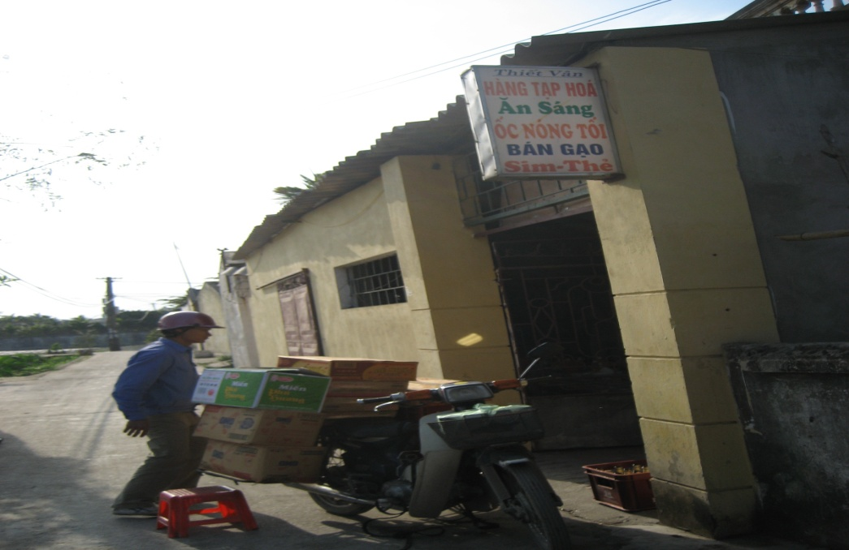
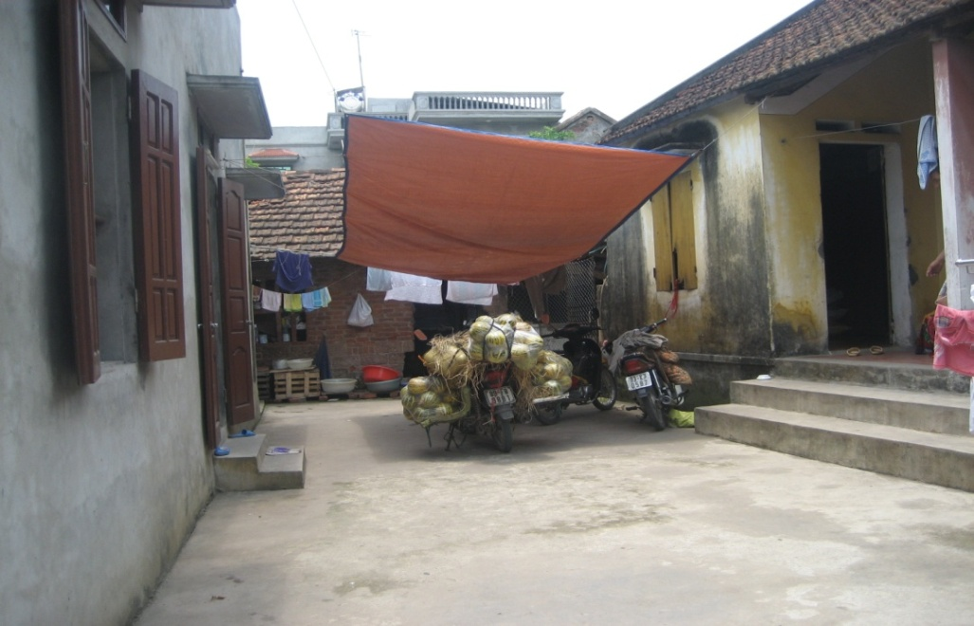
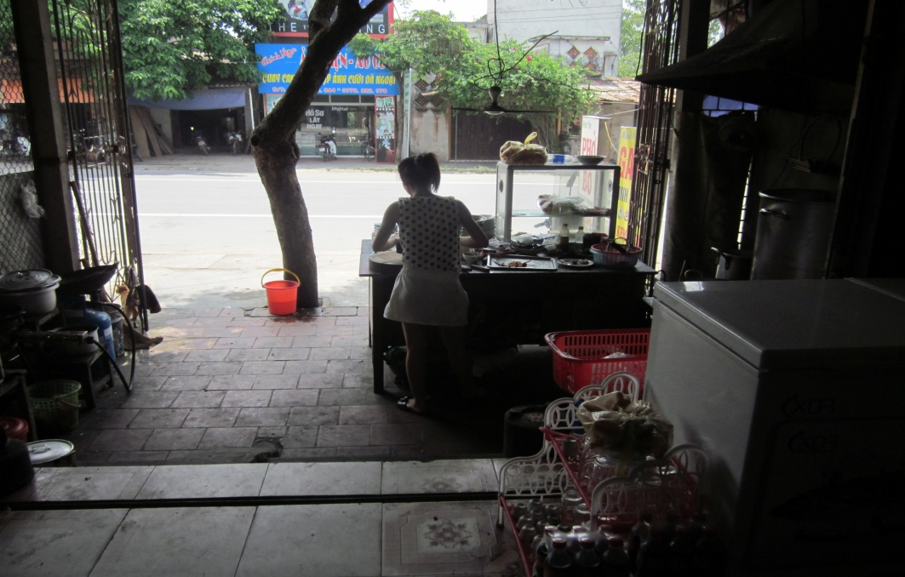
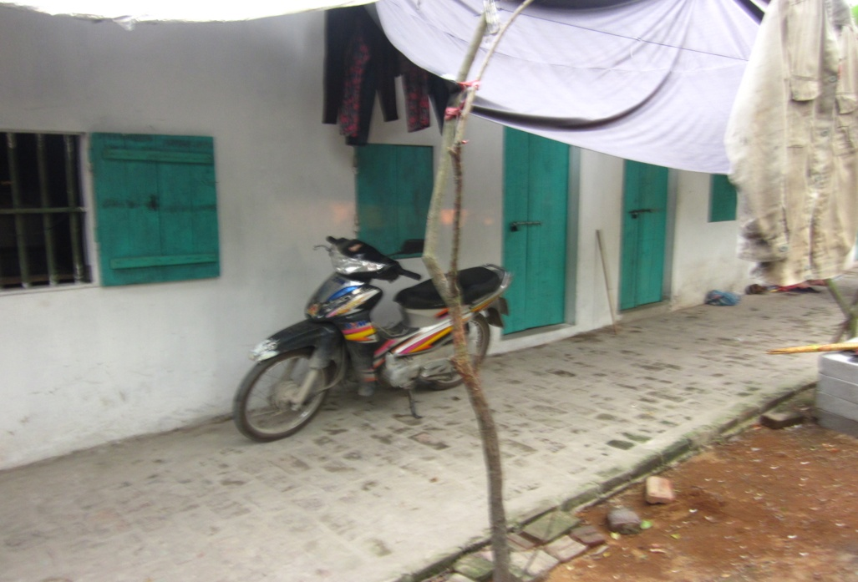
Diversification of pattern and size in trading and service activities

Slide 28
2.4 Migration and rural – urban relations
53.5% of surveyed households participate in migration
Different migration patterns in which workforce commuting is the most typical indicator of rural – urban relations.
Social networks play the important roles in migration
The mixed impacts of migration on household economy

Slide 29
Social networks in migration

Slide 30
3. Results of livelihood adaptations

Slide 31
a. Income: structure and distribution

Slide 32
Evolution of Income distribution

Slide 33
b. Land usage

Slide 34
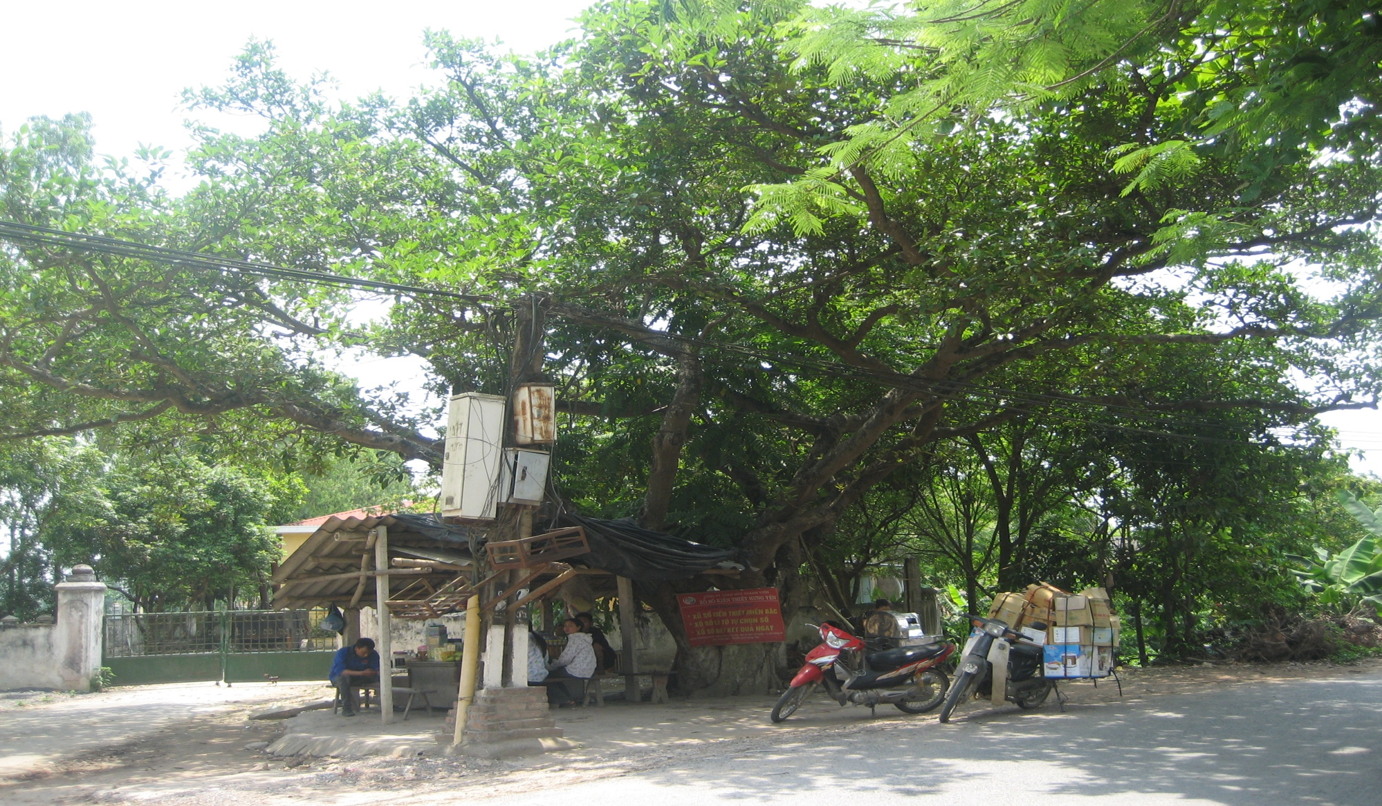
3. Conclusion

Slide 35
Industrialization has the complex impacts on peasant households.
Diversification of livelihood toward the non-farm activities along rural – urban continuum is the main trend of livelihood adaptation.
The small and medium cities play the increasing important roles in peasant livelihood and create the different levels and patterns of rural – urban linkages
Livelihood adaptation is resulted of industrialization and urbanization meantime it contributes to the rural – urban interactions

Slide 36
Thank you!

