Slide 1



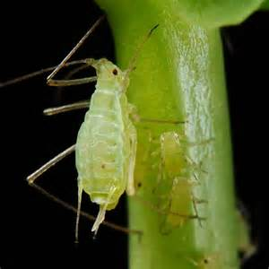
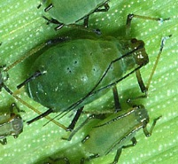
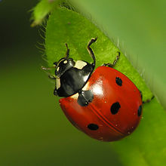

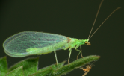
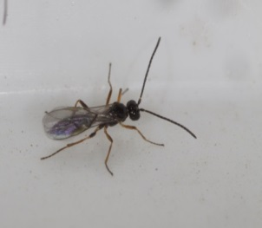
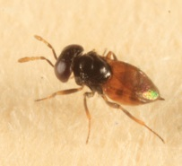
Functional and evolutionary entomology
Crop association to improve biological control: case study on pea and wheat aphids
Lopes, Thomas¹; Bodson, Bernard² and Francis, Frédéric¹
¹Functional & Evolutionary Entomology, Gembloux Agro-Bio-Tech, University of Liège, Gembloux, Belgium
²Crop Production Unit, Gembloux Agro-Bio-Tech, University of Liège, Gembloux, Belgium

Slide 2
Introduction
Aphids: important pests of pea and wheat
Yield losses
weakening of plants (sap sucking)
transmission of phytoviruses
Alternative control methods:
Cultural practices and plant management systems
Increase the diversity within crops

Slide 3
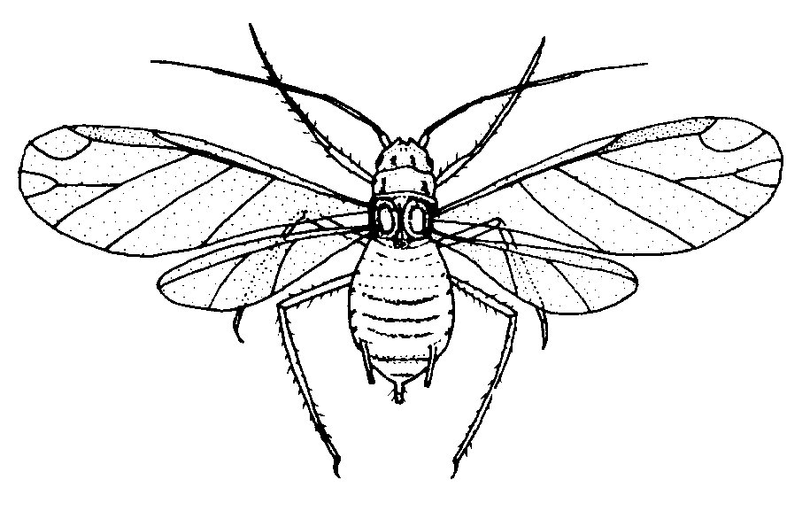
Pests point of view
resource concentration hypothesis (Root, 1973)
“Specialist herbivores are more likely to find and remain on host plants that are concentrated in dense or pure stands.”
Where is my host plant?

Slide 4
Natural enemies point of view
enemy hypothesis (Root, 1973)
“natural enemies are expected to be more abundant in complex environments and therefore supress herbivores more efficiently“
Aphidiphagous beneficial insects:
Ladybirds Hoverflies Lacewings Parasitoid wasps

Slide 5
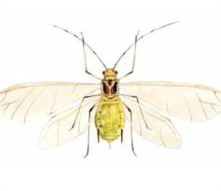
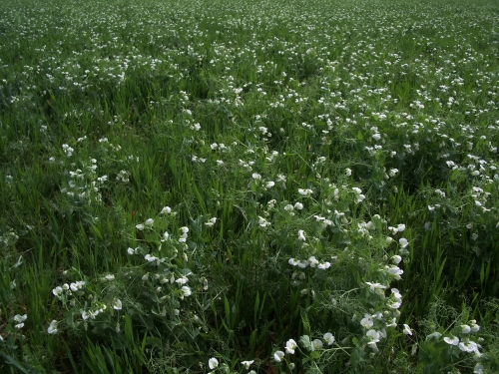
Objective
Study the effect of cultural associations on the populations of aphids and aphidophagous beneficials
Host plants?
More abundant?
Notes:
Concerning aphids, there is a lot of beneficials, such as: ladybirds, hoverflies, lacewings and parasitic wasps
Conservation biological control: “Enhancement of naturally occurring wild populations of natural enemies, by means of habitat management or manipulation of their behaviour”

Slide 6
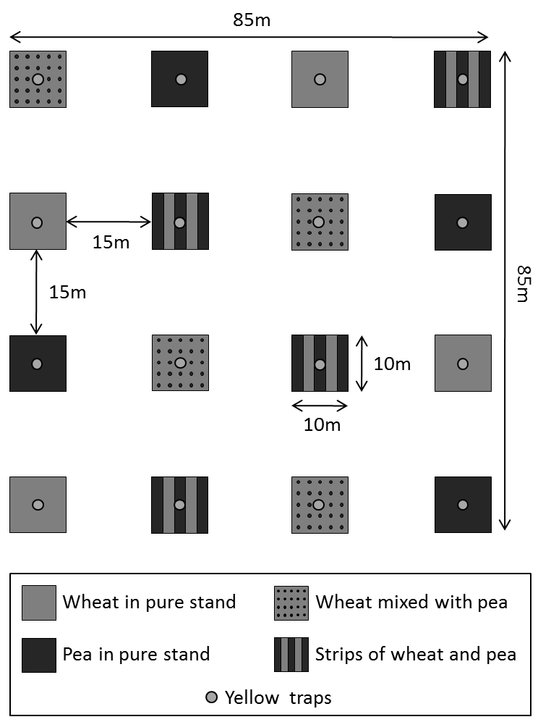
Material & methods
4x4 Latin Square design
4 treatments
4 replicates per treatment
100 m² plots

Slide 7
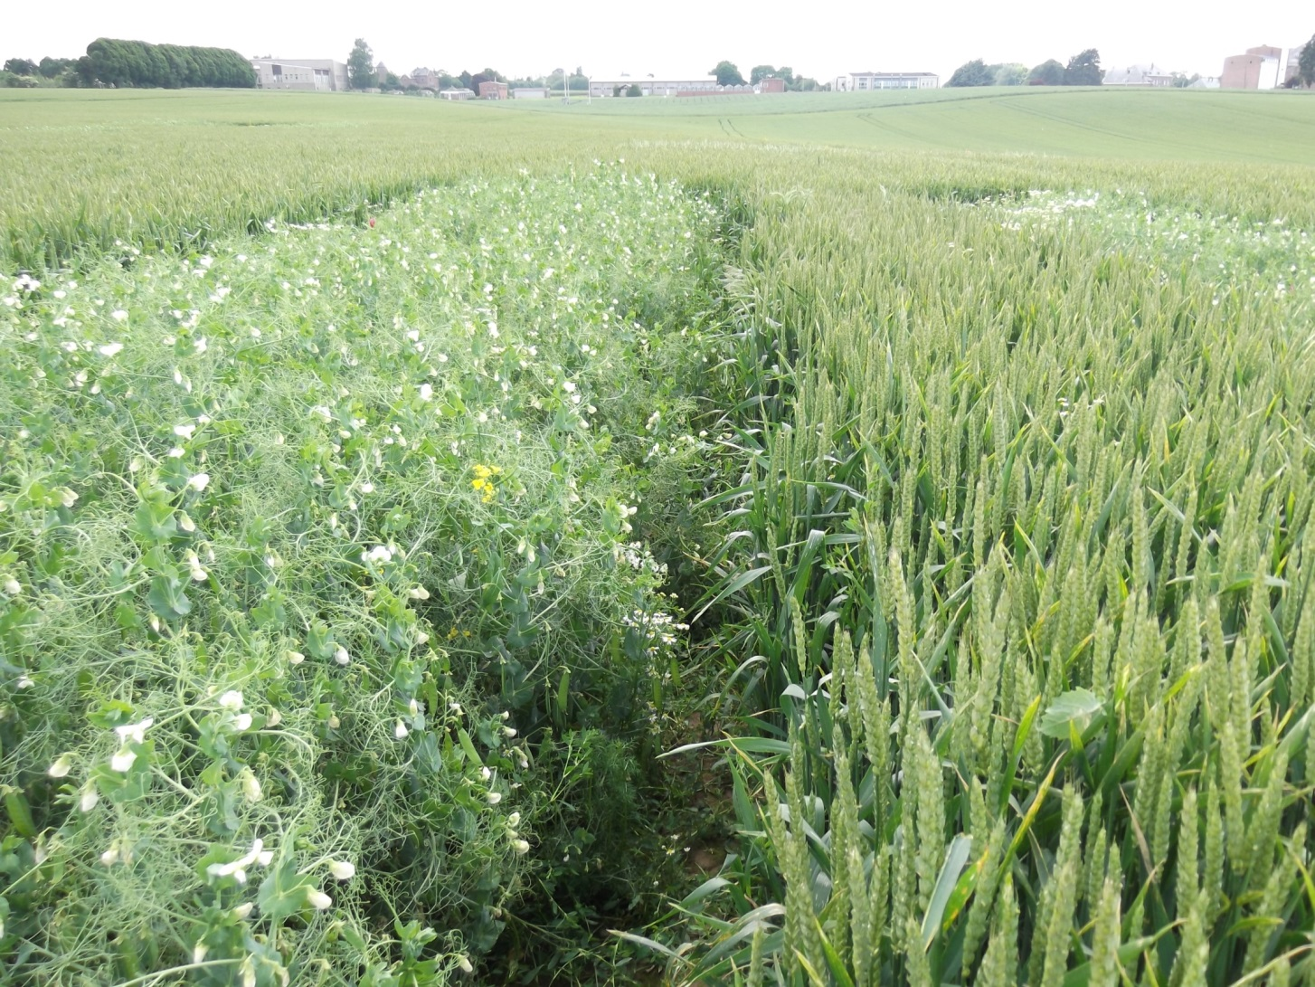
Strips
2 m
2 m
Pea:
80 seeds/m²
Wheat:
350 seeds/m²

Slide 8
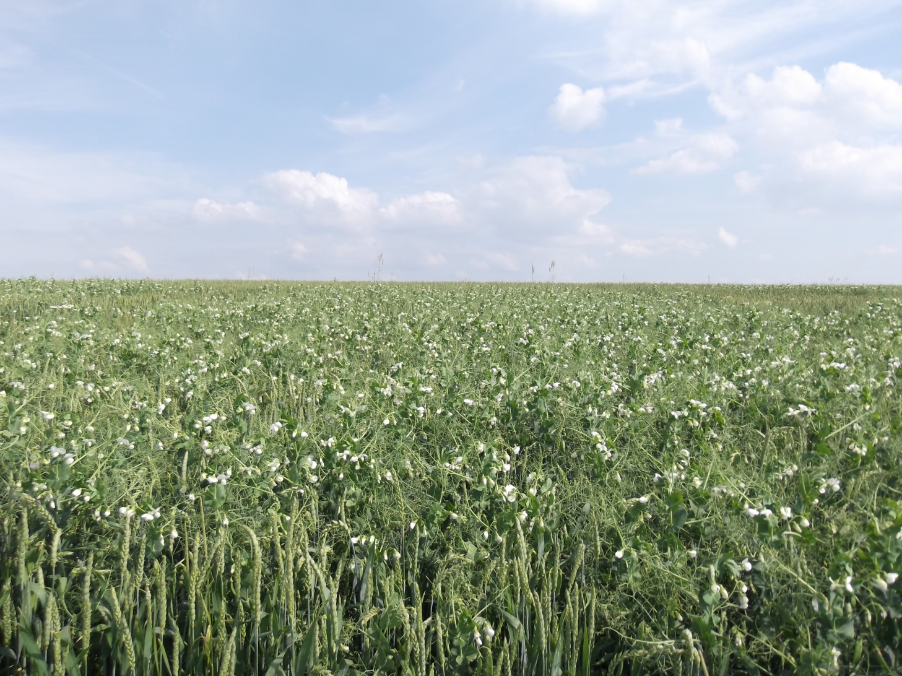
Mixing
Pea: 35 seeds/m²
Wheat: 350 seeds/m²

Slide 9
Insect trapping
water + soap
Predators
Parasitoids
Collected weekly between 16 May and 11 July

Slide 10
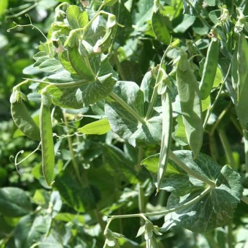
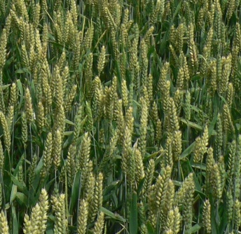
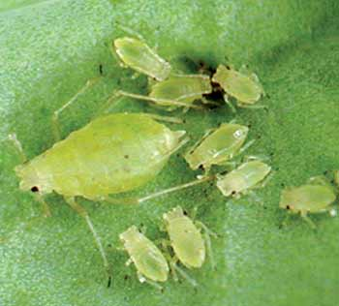
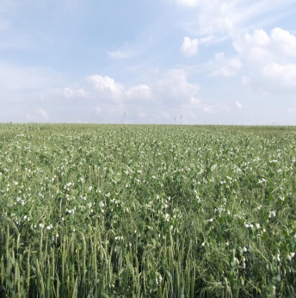

Observations on plants
20
20
Aphids
Pea in pure stand
Wheat in pure stand
20 + 20
20 + 20
Mixing
Strip cropping
Quantitative food web

Slide 11
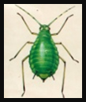
Results
Observations on plants – Aphid species
M, SC, mixing and strip cropping respectively; WPS, PPS, wheat in pure stand and pea in pure stand respectively

Slide 12
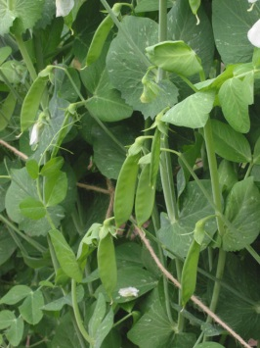
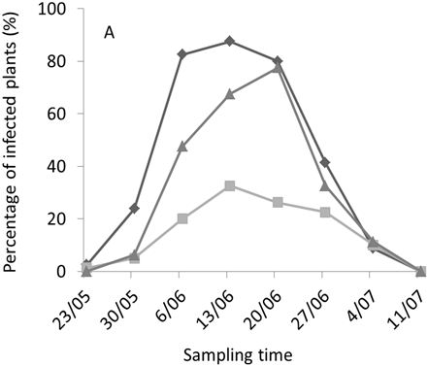
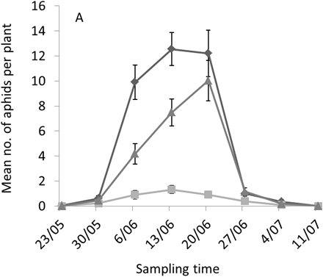
Observations on plants
***
***
***
***
***
***
**
***

Slide 13

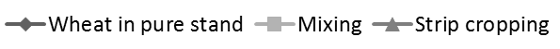
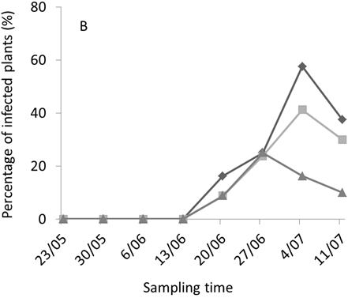
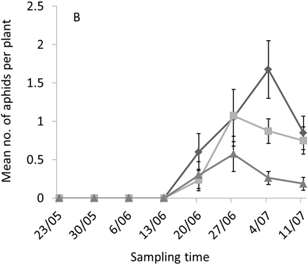
Observations on plants
***
***
***
***

Slide 14

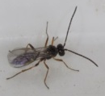
Yellow traps - Aphidophagous beneficials

Slide 15
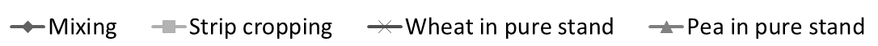
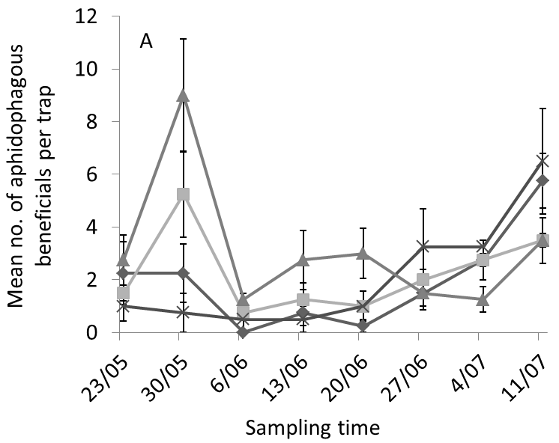
Yellow traps - Aphidophagous beneficials

Slide 16
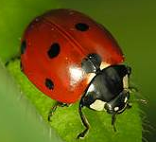
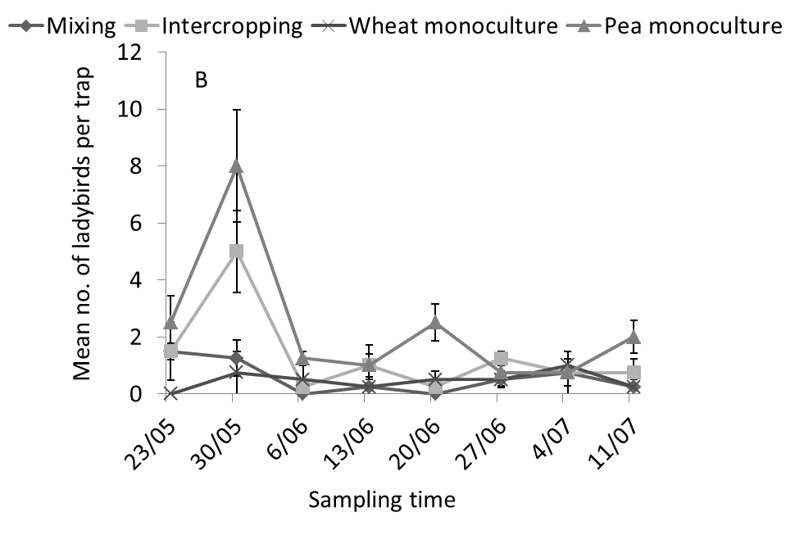
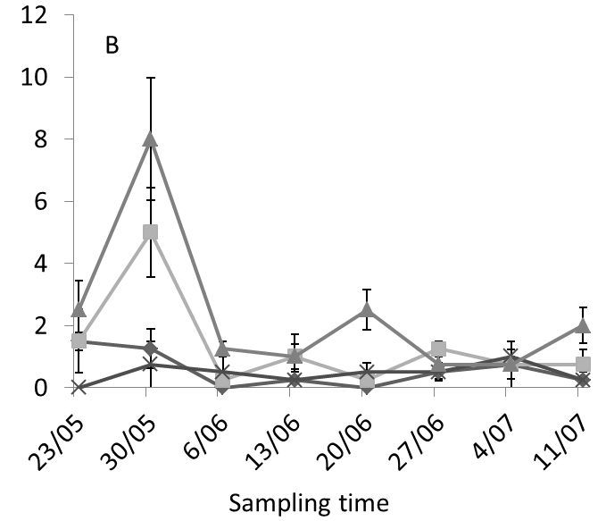




Yellow traps - Ladybirds

Slide 17

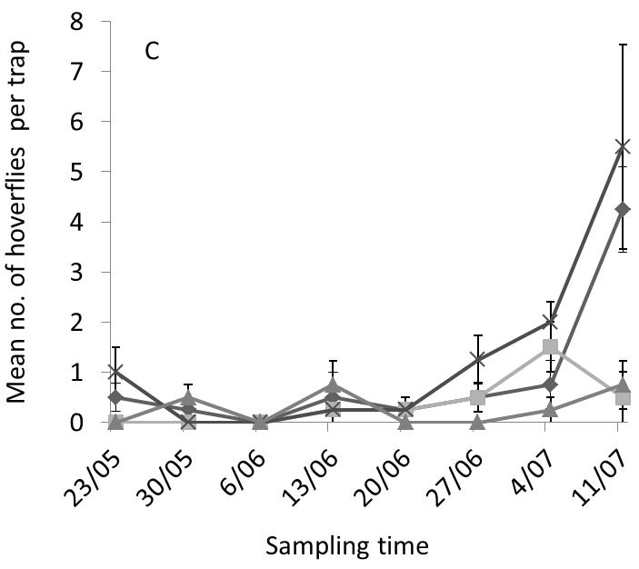


Yellow traps - Hoverflies

Slide 18
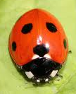
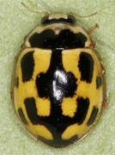
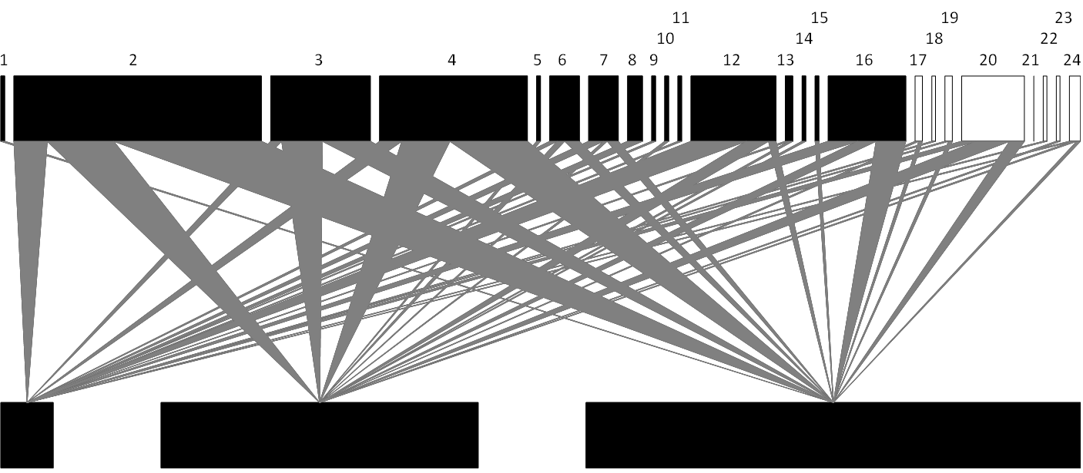
Food web - Pea
Mixing Strip cropping Pea in pure stand
Total density of Acyrthosiphon pisum

Slide 19
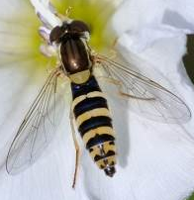
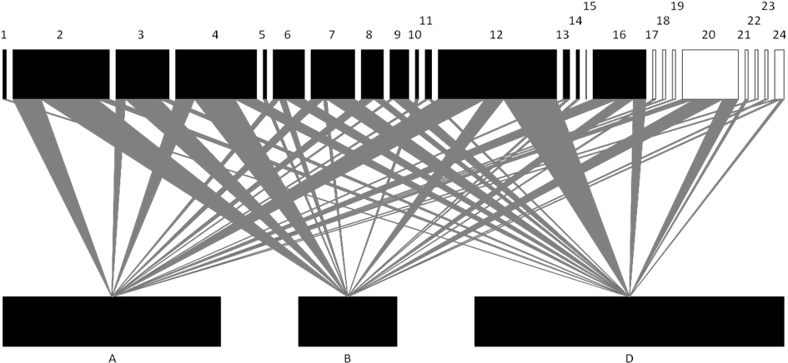
Food web - wheat
Mixing Strip cropping Wheat in pure stand
Total density of Sitobion avenae + Metopolophium dirhodum

Slide 20

Discussion
resource concentration hypothesis (Root, 1973)
Where is my host plant?
physical obstruction (Perrin & Phillips, 1978)
visual camouflage (Smith, 1969; 1976)
masking of host plant odours (Tahvanainen & Root, 1972)

Slide 21
enemy hypothesis (Root, 1973)
Direct relationship between the presence of aphids and the abundance of their natural enemies.
Infected plants emit HIPVs (herbivore-induced plant volatiles)
Indicate the availability of prey for natural enemies
(Dicke et al., 1990; Turlings et al., 1990; Han & Chen, 2002)
Indirect defence strategy

Slide 22
Conclusions
The mixing is specially efficient for the pea
This practice may be effective in keeping aphid populations below the economic threshold in years of high pest pressure
Additional methods are needed to attract beneficials into associations
Perspective: combine the mixing with semiochemicals

Slide 23

Thank you for your attention!
tlopes@doct.ulg.ac.be

