Slide 1
SIZING MODELS AND PERFORMANCE ANALYSIS OF WASTE HEAT RECOVERY ORGANIC RANKINE CYCLES FOR HEAVY DUTY TRUCKS (HDT)
Ludovic GUILLAUME¹
& co-workers : A. Legros¹, S. Quoilin¹, S. Declaye¹ , V. Lemort¹ , V.Grelet²
¹Thermodynamics Laboratory, University of Liège (Belgium)
²Volvo Group Trucks Technology, Lyon (France)
October 07th 2013
ASME ORC 2013, Rotterdam, The Netherlands

Slide 2
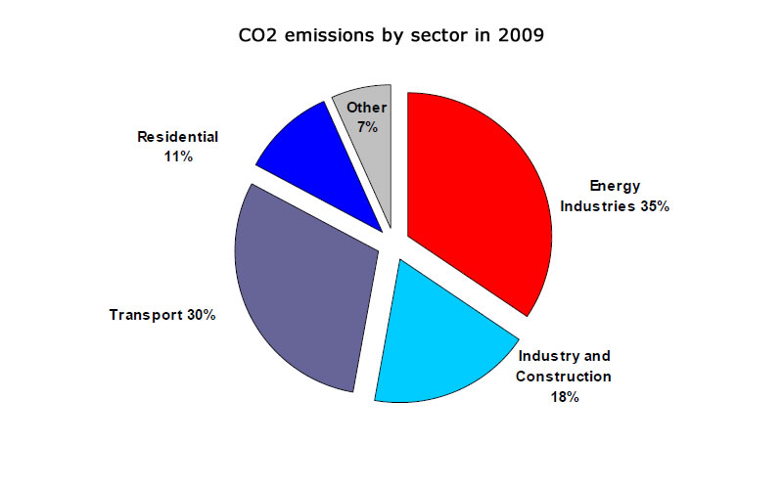
Introduction Context
http://ec.europa.eu/energy/energy2020/energy2020_en.htm
Notes:
“Heavy-Duty Vehicles (HDV) represent about a quarter of EU road transport CO2 emissions and some 6-7% of the total EU emissions.”

Slide 3
Introduction Context
Reduction of emissions (European norms)
Units: [g/kWh]
Norms | HC | CO | NOx | PM | Implementation
Euro 0 | 2.40 | 11.20 | 14.40 | - | 01/10/1990
Euro 1 | 1.23 | 4.90 | 9.00 | 0.36 | 01/10/1993
Euro 2 | 1.10 | 4.00 | 7.00 | 0.15 | 01/10/1996
Euro 3 | 0.66 | 2.10 | 5.00 | 0.13 | 01/10/2001
Euro 4 | 0.46 | 1.50 | 3.50 | 0.02 | 01/10/2006
Euro 5 | 0.46 | 1.50 | 2.00 | 0.02 | 01/10/2009
Euro 6 | 0.13 | 1.50 | 0.40 | 0.01 | 01/01/2014
http://www.europe-camions.com/
Notes:
Standards more and more restrictive.
NOx emissions are reduced by 80%, a level of 0.40 g / kWh (cycle in steady state)
NOx emissions are reduced by 77%, a level of 0.46 g / kWh (transient cycle)
Particulate emissions are reduced by 50%, a level of 0.01 g / kWh
Rajouter norme co2

Slide 4
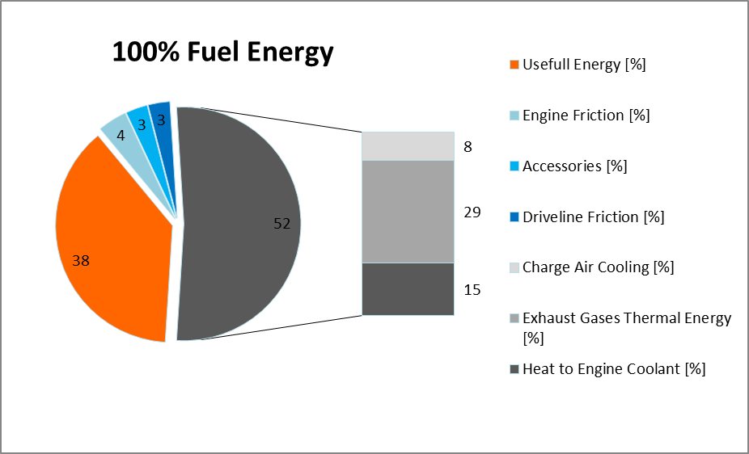
Introduction Why WHR on HDV?
=> Reduce fuel consumption
A very promising solution: Waste heat ≈ 60% of the combustion energy.
Notes:
The interest in organic Rankine cycles for waste heat recovery on internal combustion engines has grown significantly for the past few years. Indeed, in such engines, only about one third of the energy available is actually converted into effective power, what remains being dissipated into heat
Transforming it into mechanical or electrical energy (to increase the overall vehicle energy efficiency)
Heat re-use can be performed by means of a thermodynamic cycle (e.g. organic or non-organic Rankine cycles).
NoWaste project.

Slide 5
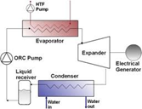
Introduction ORC on HDV
Specific R&D activities required to
select and develop the system components,
identify the most appropriate system architectures and level of integration,
achieve sustainable costs (payback time) and the required level of reliability (life time).
First task: System concept definition
0D modeling (design)
1D dynamic simulation models
Overall system definition
Notes:
The adoption of such technology in the automotive domain requires a specific R&D activity to select and develop the components and identify the most appropriate system architecture. Particularly, the selection of the working fluid and of the expansion machine technology constitutes an important part of this research.

Slide 6
System concept Design: 0D Modeling
Definition of the working conditions on which the systems will be sized and optimized
exhaust gases flow rate and temperature, coolant loop flow rate and temperature, fuel consumption, ...
Comparison of different Rankine cycle architectures through steady state simulations (Efficiency, power recuperation potential, heat rejection requirements and technical complexity)
Different heat sources available on the vehicle.
Thermodynamic analysis of working fluids and working fluid mixtures
Expansion machines comparison

Slide 7
System concept 0D Modeling
Several heat sources are available on a vehicle:
The more interesting sources: Exhaust gases and EGR gases (higher temperature leads to the usage of higher energy content fluid)
Heat Source | Temperature | Capacity flow rate
Exhaust gases | mid to high | high
EGR gases | high | low
Charge Air | low to mid | high
Coolant | low | high
Oil | low | low
Retarder | Low | high
Notes:
Increasing the number of source will increase the level of complexity in terms of packaging and control.
Constraint on the hot source.

Slide 8
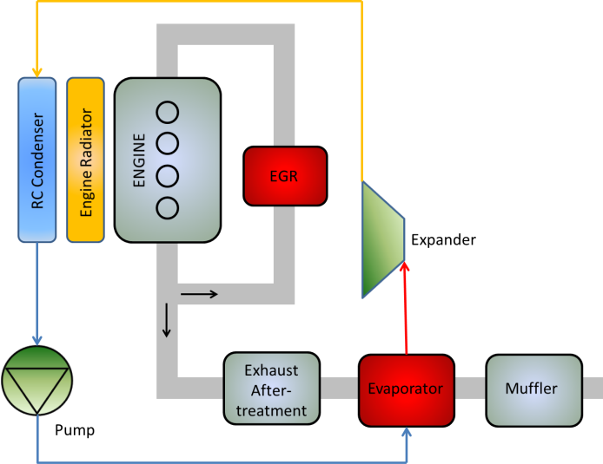
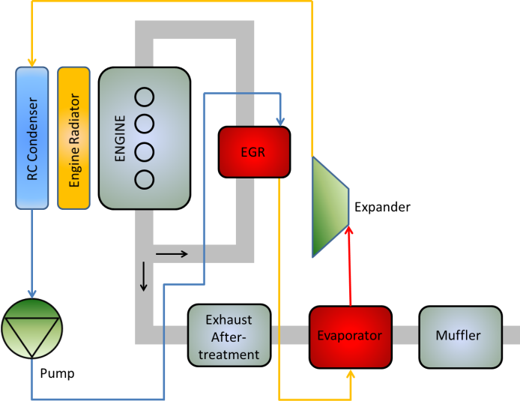
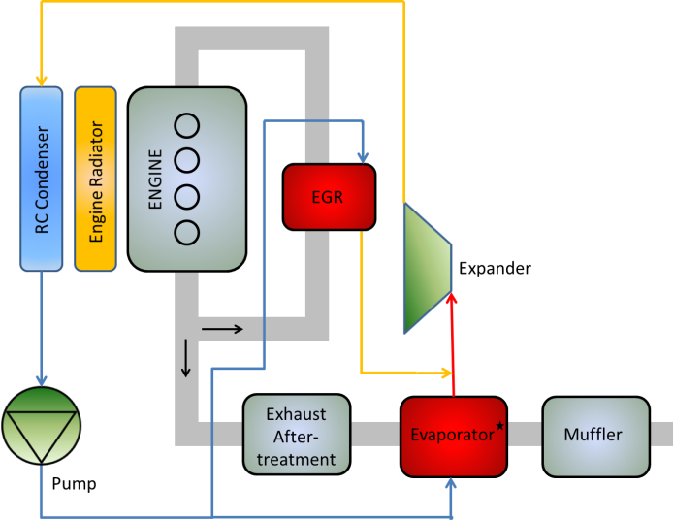
System concept 0D Modeling
3 architectures investigated:
WHR on exhaust gases only
WHR on exhaust gases and EGR gases in serial
WHR on exhaust gases and EGR gases in parallel
Notes:
The expander models can then be integrated into complete cycle models. Several architectures of Rankine systems, depending on the heat sources available on the vehicle, could be studied. But in the frame of this paper, only three architectures (figure 2) using at most two heat
sources (the exhaust gases and the EGR gases) are investigated.
Thus, the systems can be sized and their can be predicted and compared for the three architectures, the three expanders and the three working fluids (i.e., 27 systems to compare). This comparison is achieved in the following for nominal conditions of a truck engine.

Slide 9
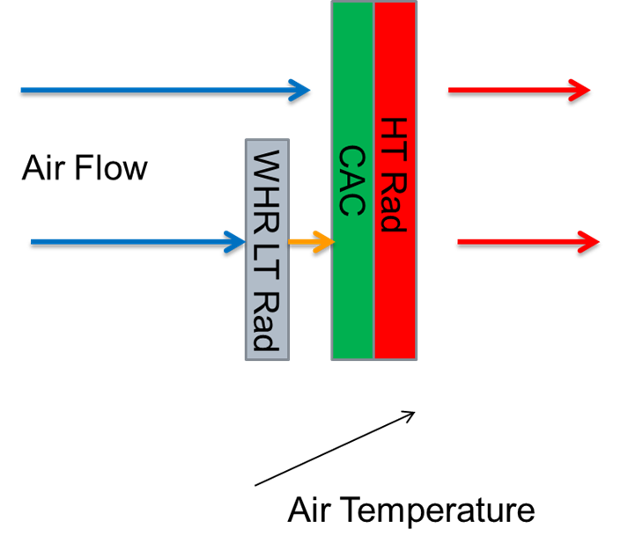
System concept 0D Modeling
Major design constraints:
Heat rejection added to the cooling package:
waste heat re-use system: risk to increase the heat rejection needs of the vehicle.
Air temperature increases through dedicated Rankine LT Rad or Condenser having an impact on other components of the cooling package
Increase of the intake air temperature
Increase of the coolant temperature

Slide 10
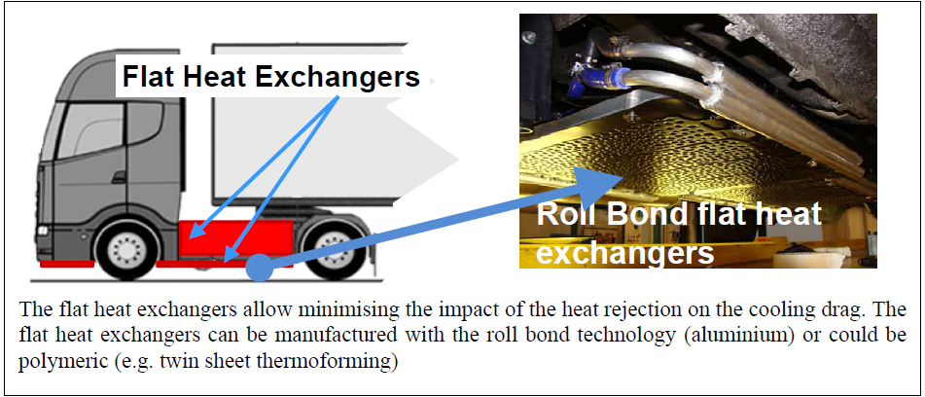
System concept 0D Modeling
Minimize its impact
Additional innovative heat exchangers integrated in the vehicle body panels.

Slide 11
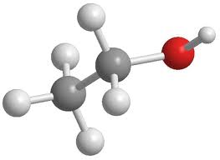
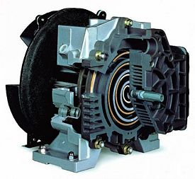
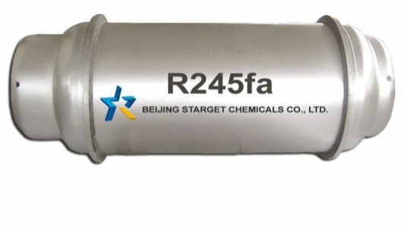
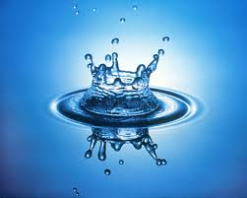
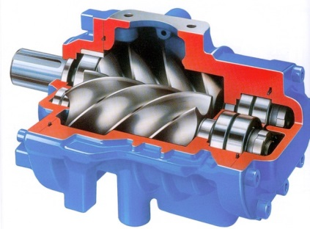
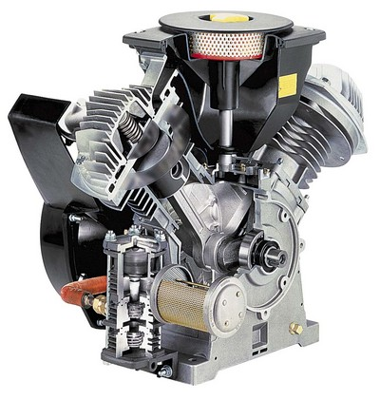
System concept Goal of the study
Notes:
This paper attempts to address this problematic of selecting the architecture, the expander and the working fluid for a waste heat recovery organic (or non-organic) Rankine cycle on a truck engine. It focuses especially on three expander technologies: the scroll, the piston and the screw expanders, and three working fluids: R245fa, ethanol and water.

Slide 12
System concept 0D Modeling
Working fluid selection:
Several criteria to take in account:
Environmental aspect:
in 2017 GWP < 150
The GADSL (Global Automotive Declarable Substance List)
Physical properties:
Freezing point
thermal stability
…
Safety:
Fluids ranked as F+ (EEC) or 4 in NFPA (red class) have to be avoided.
Flash point and auto-ignition temperature (vehicle crash).
Notes:
Verifier gwp

Slide 13
System concept State of the art
Expander technology | Scroll | Screw | Piston
Rotational speed [RPM] | <10000 | <25000 | 500-6000
Max. Inlet temperature [°C] | 215 [2] | 490 [3] | >500 [4]
Built-in volume ratio [-] | 1.5-4.1 | 4-5 | 6-14
Pressure ratio [-] | 25 [5] | 50 [6] | Same as in ICE
Notes:
First a state of the art of the expansion machines was drawn. It is based on information available in open access scientific literature and data coming from manufacturers as well as on the experience gained at the Laboratory of Thermodynamics of Liège in the field of expansion machines.
Limitations in terms of rotational speed, pressure and temperature
A summary is given in this table.
Scroll limité en t entrée
Screw vitesse élevé
Piston gran rv

Slide 14
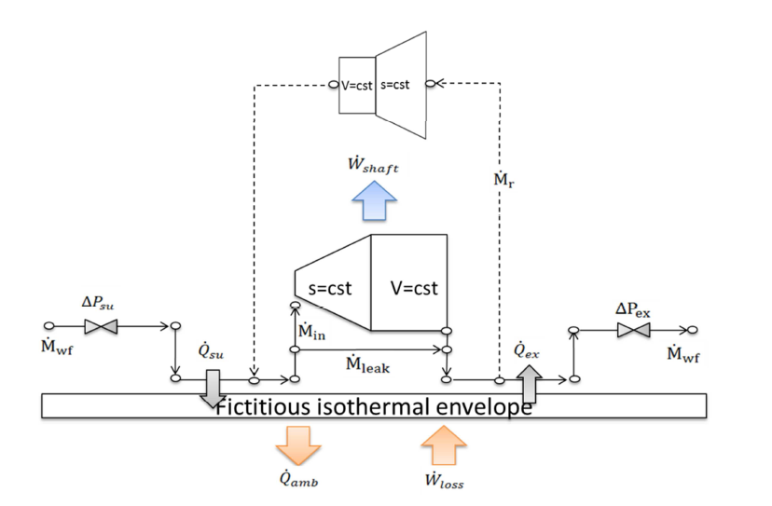
System concept 0D Modeling
Simulation models for the 3 volumetric expanders:
Around 10 parameters to retain the most important physical phenomena inherent the expansion machine.
Notes:
The basic model used is the one proposed by Lemort and Quoilin [6] which has been validated for the scroll expander (Figure 1). This model is well suited for the scroll and screw devices. For the piston expander, in addition, the model has to take the recompression of the dead volume into account. The resulting model is then the one developed in [7].
Studies in laboratory showed that these models are able to predict the performance of the expansion machines with good accuracy. Moreover,
their semi-empirical nature enables to extrapolate the performance of the machine for different operating conditions and design characteristics (displacement, sections of the inlet and exhaust ports, etc…).
Lister oralement les phénomènes importants

Slide 15
System concept 0D Modeling
Simulation models for the volumetric expanders:
Calibration of the models on existing machines using experimental data.
References
Scaling of the parameters to adapt the models to the machine being currently designed (characteristic length).
Scaling relations applied to the model parameters
Model calibrated on a existing machine (reference)
Model of the machine being designed for the truck application
Notes:
As mentioned above, the different parameters involved in the models are identified using measurements performed on real machines. This identification is realized for the three machines by minimizing the error between the predicted and measured values of the shaft power of the expander, of the outlet temperature of the expander and of the fluid mass flow rate.
The parameters obtained after calibration are the model parameters of the machines tested experimentally. To determine the model parameters of the machines being currently sized and thus adapt the models to these new machines, scaling relations on the basics of the characteristics length of the machines are used.

Slide 16
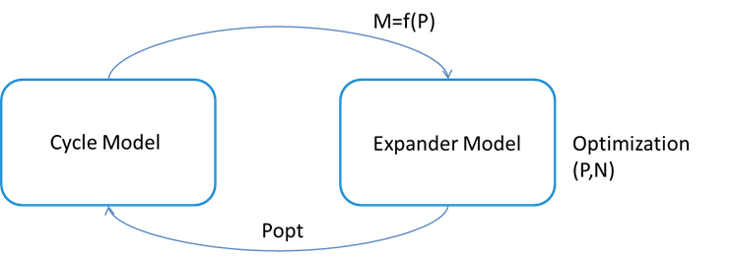
System concept 0D Modeling
Optimization strategy (iterative algorithm)
The evaporating pressure and the rotational speed were optimized in order to maximize the power output of the different systems.
Performance are obtained (Shaft power, optimal rotational speed,…)
From this optimization also results the size of the different components (design):
Displacement of the expanders
Exchange area of the exchangers
Notes:
The sizing is performed by mean of an optimization calculation. The goal of this optimization is to get for each different Rankine system (according to the architecture, expander and working fluid that are selected) the best performance in terms of shaft power. Basically, the evaporating pressure of the cycle and the rotational speed of the expanders remain the two only degrees of freedom of the system model. These values are therefore optimized, taking into account the limitations presented in the state of the art, in order to maximize the shaft power and size the systems that lead to these performance.

Slide 17
System concept 0D Modeling
Selected operating conditions
Exhaust gases temperature [°C] | 300-400
Exhaust gases mass flow rate [kg/s] | 0,2-0,4
Recirculated exhaust gases temperature [°C] | 400-500
Recirculated exhaust gases mass flow rate [kg/s] | 0,05-0,06
Cooling liquid temperature [°C] | ~ 60
Cooling liquid mass flow rate [kg/s] | ~ 0,65
Superheating [°C] | 5
Subcooling [°C] | 5

Slide 18
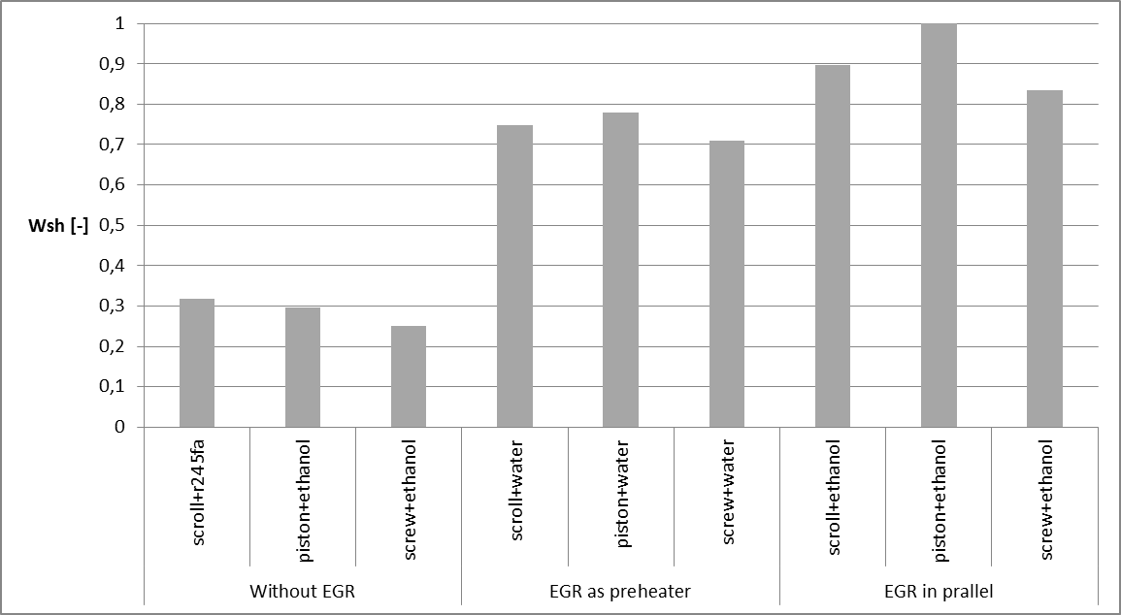
System concept 0D Modeling
Nominal results
Notes:
For each architecture, the performance obtained for the different couples of expander and working fluid can be compared in terms of shaft power. The figure shows the best performance reached by the three machines for the three investigated architectures.
Pourquoi ethanol meilleur que eau?
Plus de détails sur gel de l’eau (Arnaud)

Slide 19
System concept 0D Modeling
Conclusion
Help ORC designers to best select the expansion machine and working fluid for truck applications.
Selection of the fluid and expansion machine together
Preliminary design
Performance is not the only criteria
Decision array to select the components
Future work
Fluids comparison
Mixtures water/ethanol
1D dynamic simulations for best “solutions “(driving cycle)

Slide 20
Acknowledgement
Thank you
Notes:
Juste thank you

