Slide 1



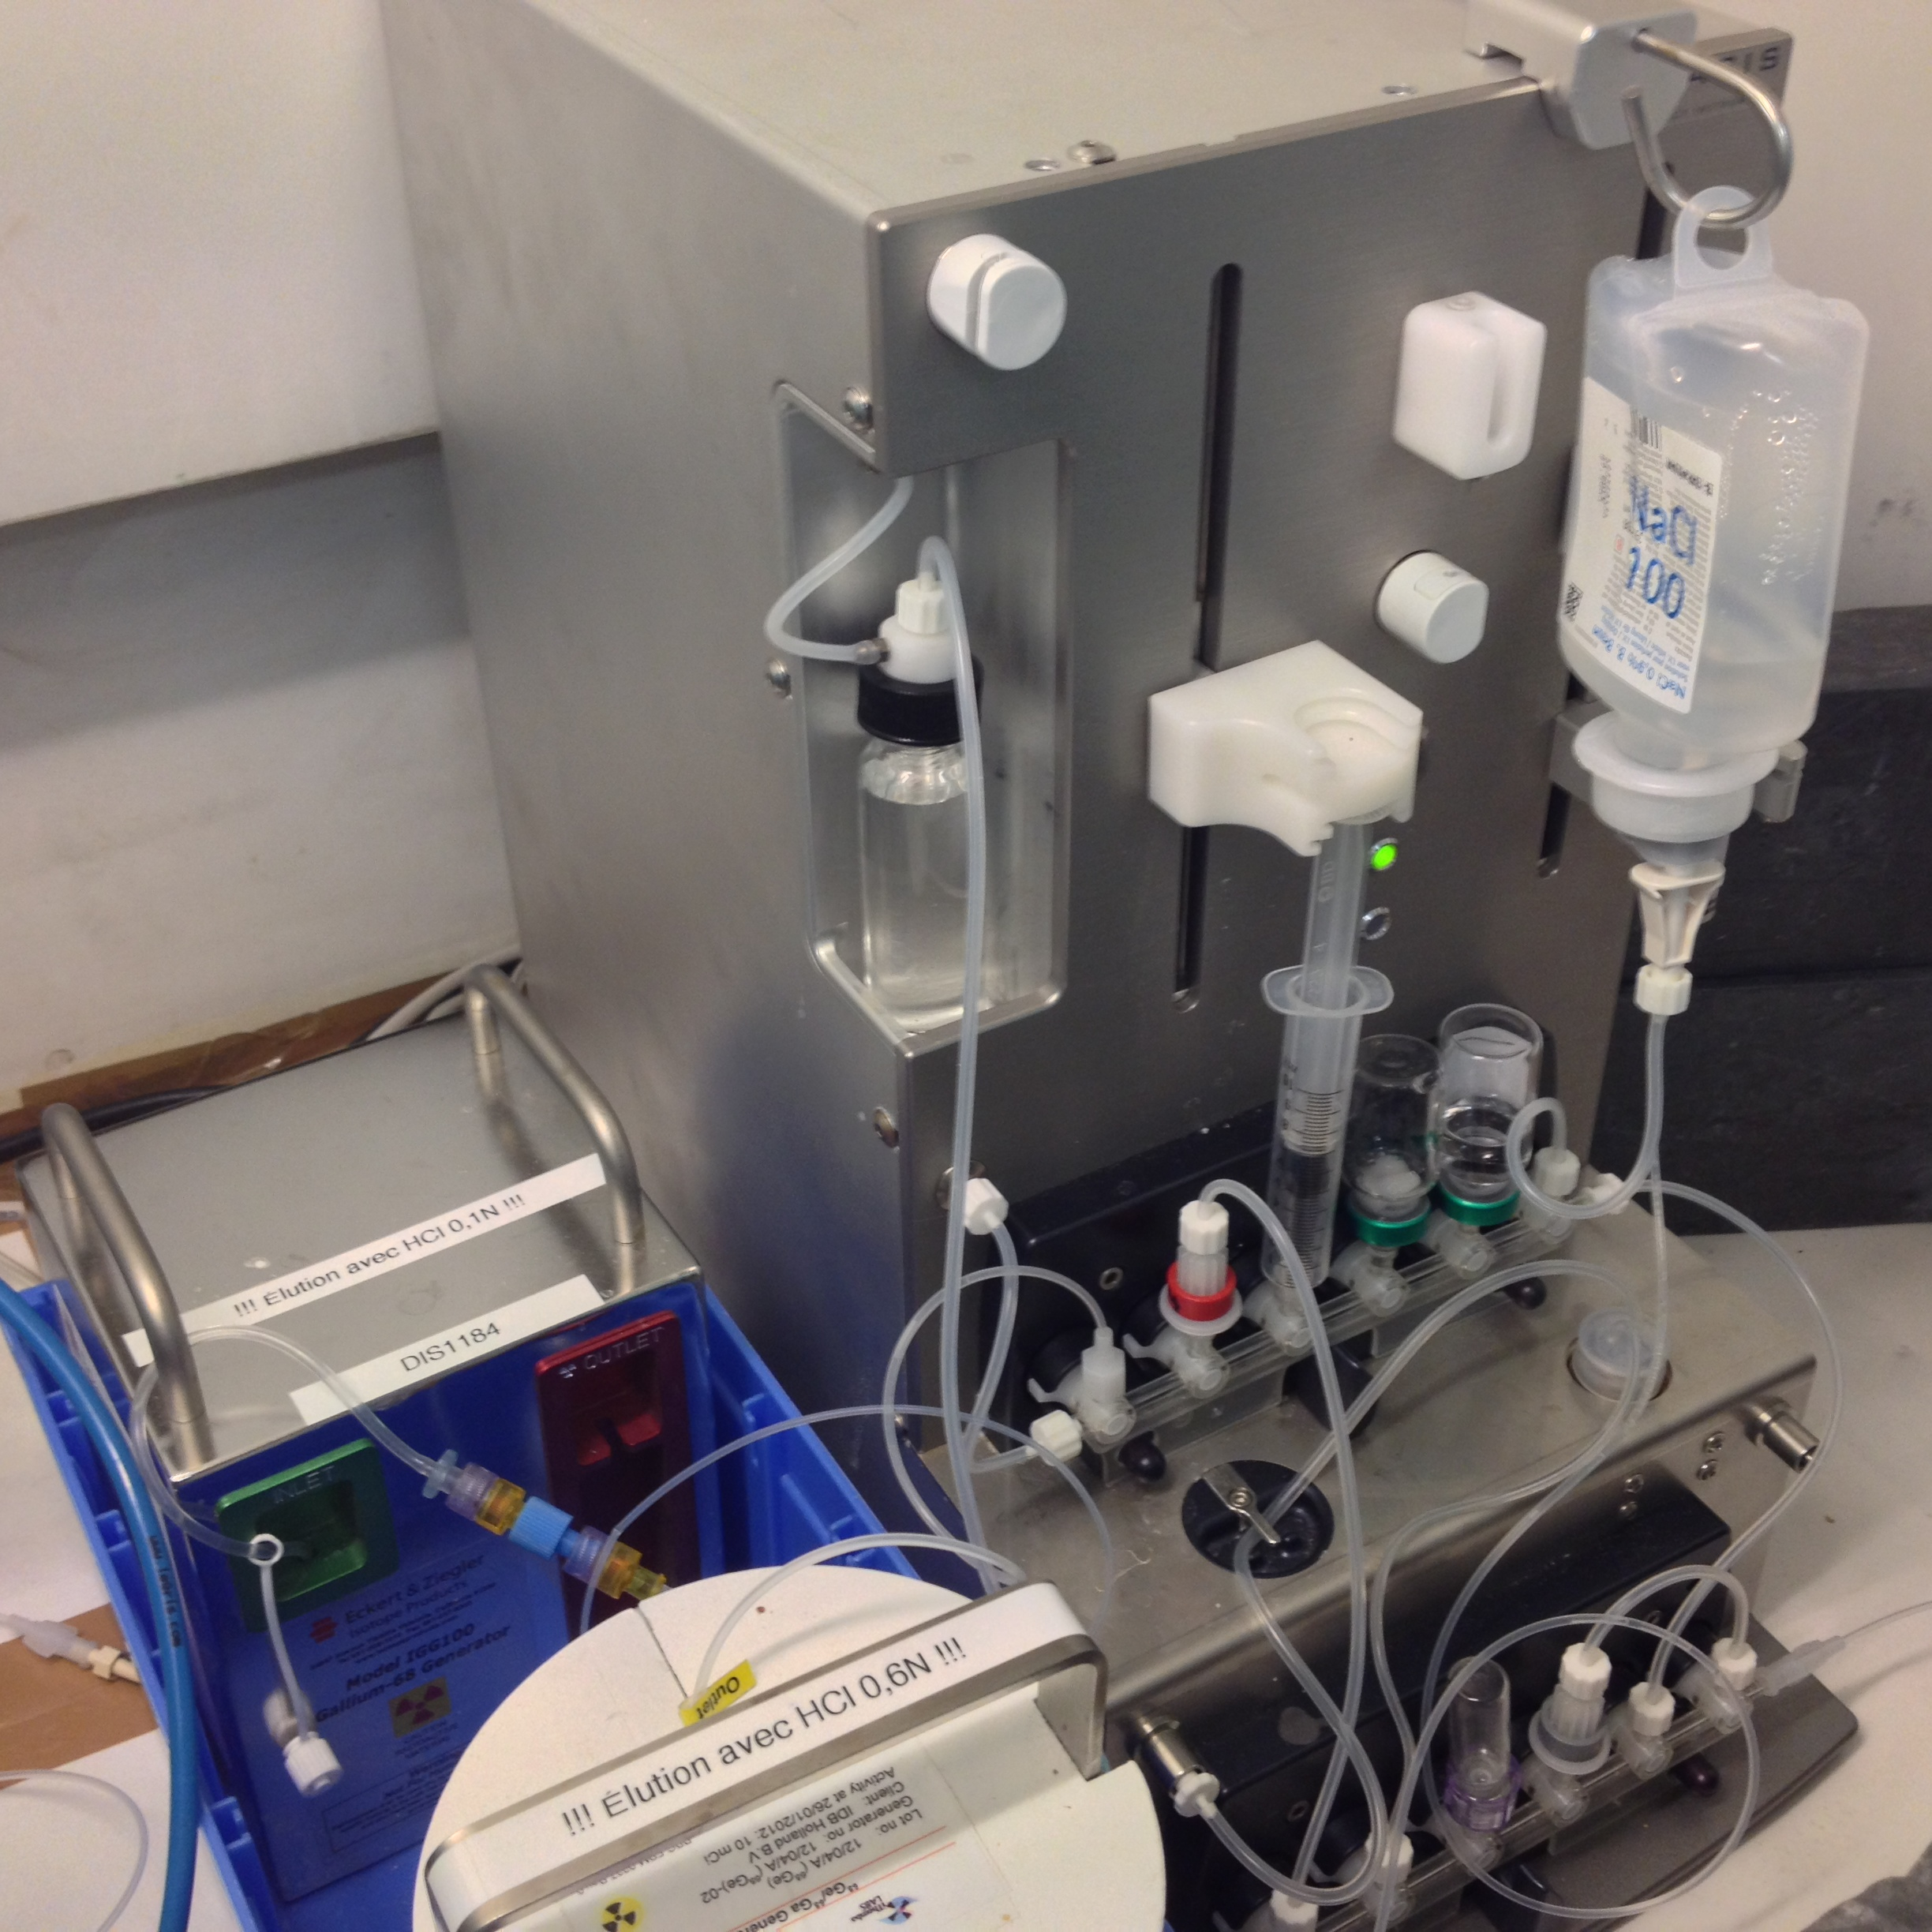
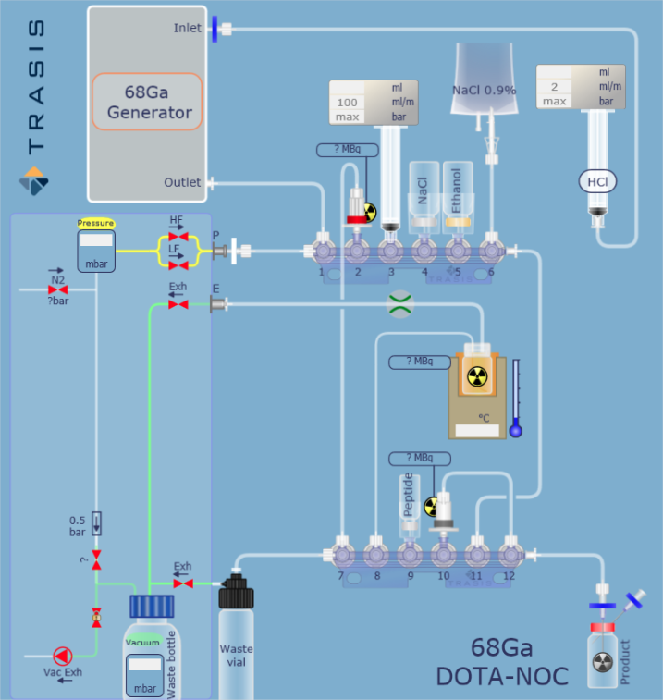
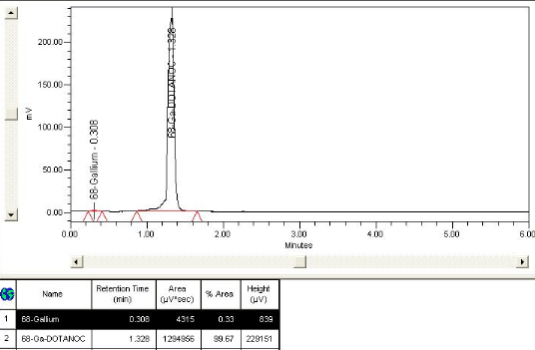
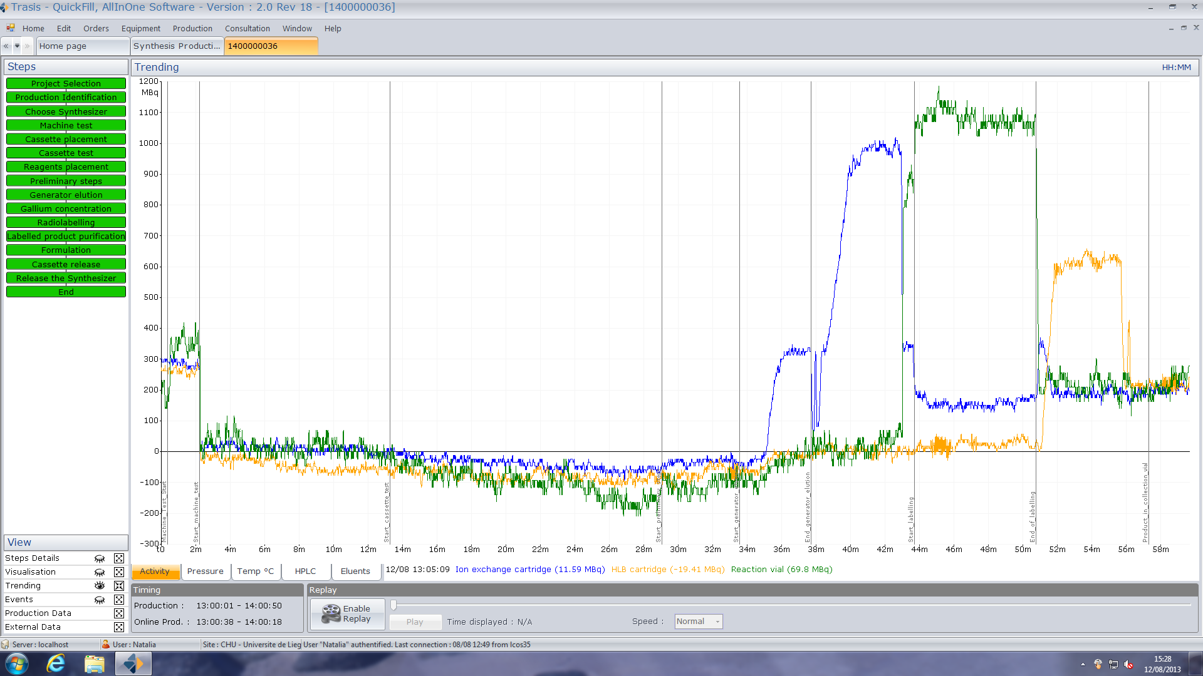

Fully Automated Production of ⁶⁸Ga-DOTA-NOC with a Trasis miniAIO® Synthesizer.
Marc Léonard^{1,@}, Joël Aerts¹, Samuel Voccia², Christian Lemaire¹, Jean Luc Morelle², Gauthier Philippart² and André Luxen¹
¹ Centre de Recherches du Cyclotron, Université de Liège, BELGIUM
² Trasis SA, Ans, BELGIUM
Aim
Materials and methods
Our objective was to develop a fast and reproducible fully automated method for the preparation of ⁶⁸Ga-labelled DOTA-peptide with the miniAIO® synthesis module made by Trasis SA (Figure 1). The labelling of an easily commercially available peptide, DOTA-NOC, was designated as a proof of concept for this purpose.
The synthesis of ⁶⁸Ga-DOTA-NOC was performed on a miniAIO® synthesizer which has several advantages: using single-use cassettes (Figure 2), monitoring the radiosynthesis by means of radioactivity detectors (Figure 4) and being small and easily implantable in GMP hot cells. The leachable of metallic contaminants was taken in account for the choice of the cassette materials.
The synthesis includes the following steps:
Elution of ⁶⁸Ga from a ⁶⁸Ge/⁶⁸Ga generator with 8 mL of a HCl solution. Two different generators were tested: iThemba‘s 370 MBq eluted with 0.6N HCl and Eckert-Ziegler‘s 1850 MBq eluted with 0.1N HCl (Figure 1).
The eluate was saturated with NaCl and then passed through a strong anion exchange resin (Waters OASIS MAX) to concentrate ⁶⁸GaCl⁴⁻ (method derived from [1]).
⁶⁸Ga was then eluted from the resin with 200 µL of physiologic liquid (NaCl 0,9%) directly into the reaction vial containing the peptide solubilized in acetate buffer.
The mixture was heated at 95°C for 7 min.
The crude reaction media was passed through a hydrophilic/lipophilic resin (Waters OASIS HLB) and the resin was rinsed with NaCl 0,9% to remove free ⁶⁸Ga³⁺.
⁶⁸Ga-DOTA-NOC was eluted with 0.5 mL of ethanol and diluted with NaCl 0.9% and filtered with a 0.22 µm filter.
The quality of the product was assessed by UHPLC with UV and radiochemical detection, GC, pH determination.
Figure 1 : miniAIO® synthesis module and the two generators in use
Figure 2 : ⁶⁸Ga-DOTA-NOC cassette layout
Results and conclusion
⁶⁸Ga-DOTA-NOC was obtained with reproducible yields of 60% (decay corrected, calculated on the total activity eluted from the generator) within 25 minutes including generator elution, clean-up and concentration of the eluate, radiolabeling, final SPE purification and formulation. Radiochemical purity was > 99.5% (Figure 3) ; ethanol concentration < 10% v/v ; acetic acid content < 5000 ppm ; pH between 4.5 and 7.0. No ⁶⁸Ge was detected in the vial after decay of ⁶⁸Ga by gamma spectroscopy. Using miniAIO®, the method described allows a safe, fast and reliable synthesis of ⁶⁸Ga-DOTA-NOC from a ⁶⁸Ge/⁶⁸Ga generator and should be easily transposable for the production of any other ⁶⁸Ga-labelled DOTA-peptides.
Figure 3 : Radiochemical UHPLC profile of ⁶⁸Ga-DOTA-NOC ;
Acquity UPLC BEH C18, 130Å, 1,7 µm, 2,1 mm X 50 mm ;
Radio-detector : Berthold fLumo LB 500 ;
flow at 0,6 ml/min :
Time (min) | TFA 0,1% | Acetonitrile
0 | 90% | 10%
3 | 10% | 90%
3,5 | 10% | 90%
4 | 90% | 10%
6 | 90% | 10%
References
[1] Eur J Nucl Med Mol Imaging (2004) 31:1097–1104
Acknowledgements
We acknowledge the financial support from the BIOWIN Project of the Walloon Region (GaGe).
Download abstract here :
Figure 4 : Typical radioactivity profile during a synthesis of 68Ga-DOTA-NOC on a miniAIO® synthesis module :
blue: OASIS MAX cartridge ; green : reaction vial ; yellow : OASIS HLB cartridge.
@ - corresponding author : marc.leonard@ulg.ac.be

