Slide 1

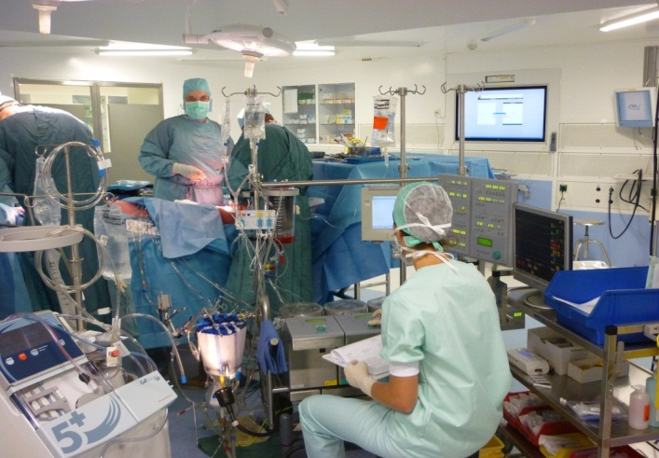
Quel est l’avenir de la CEC ?
(et de la profession)
☺
☹

Slide 2
MON « CV »
Infirmière perfusionniste depuis 1976
CHU de Liège
Formation « on the job »
Coordinatrice du service
Enseignement
Membre du comité de la BelSECT
Membre commission hémovigilance…

Slide 3
Définition de la fonction: les mots clefs
Le perfusionniste est un acteur de la santé habilité à conduire toute circulation extracorporelle dans le cadre de la chirurgie cardiaque ou autre.
Dans les limites de son expertise, il doit poser des diagnostics et mettre en œuvre des protocoles et moyens thérapeutiques afin de garantir ou rétablir l’homéostasie du patient.
Il est aussi impliqué dans différents actes nécessitant une expertise spécifique au bloc opératoire, aux USI…

Slide 4
Définition de la fonction: évolution
Interact Cardiovasc Thorac Surg. 2010 Apr;10(4):496-7. doi: 10.1510/icvts.2010.235085.
From pump technicians to qualified health personnel--the evolution of the perfusionist profession.
Merkle F.

Slide 5
Descriptif de la fonction
CEC
Assistances
Autotransfusion
CHIP, traitements oncologiques
Point of care (coagulation)
Recherche
Enseignement
Greffes, préservation organes
CPIA, pacing…
NON LIMITATIF

Slide 6
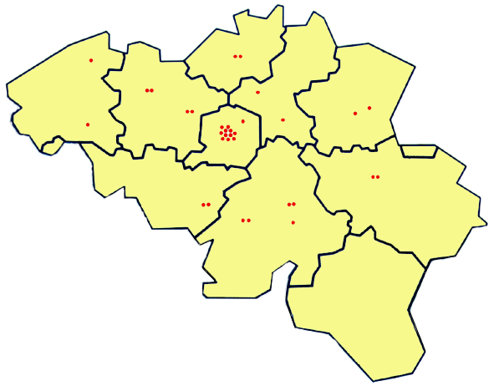
La singularité en Belgique
Pléthore de centres de chirurgie cardiaque
http://www.ebcp.org/about-us/map.html : map

Slide 7
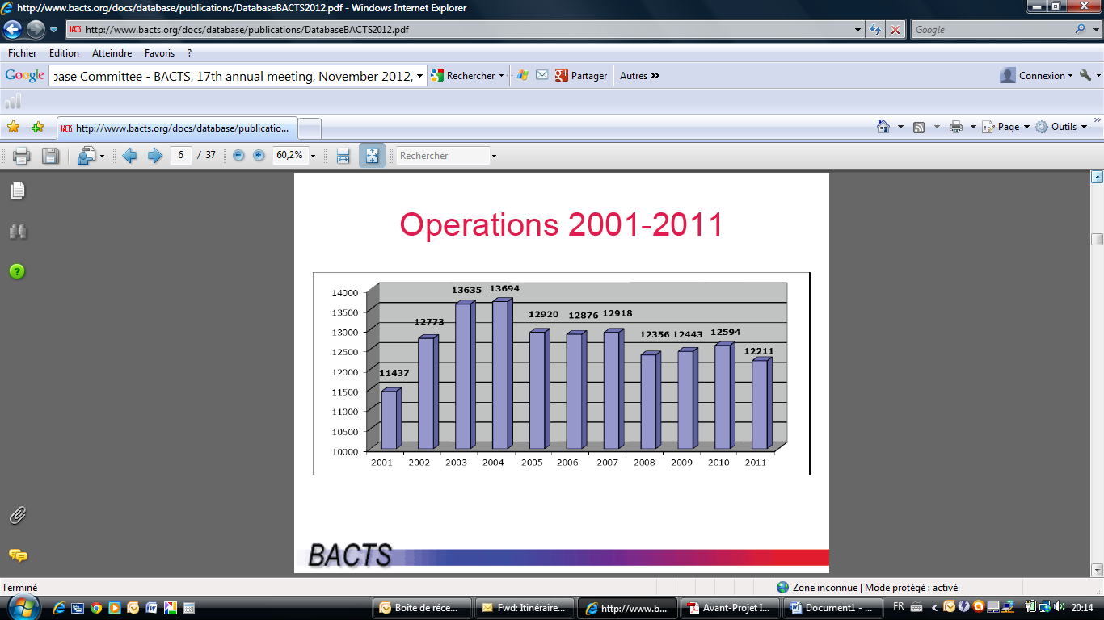
La situation en Belgique

Slide 8
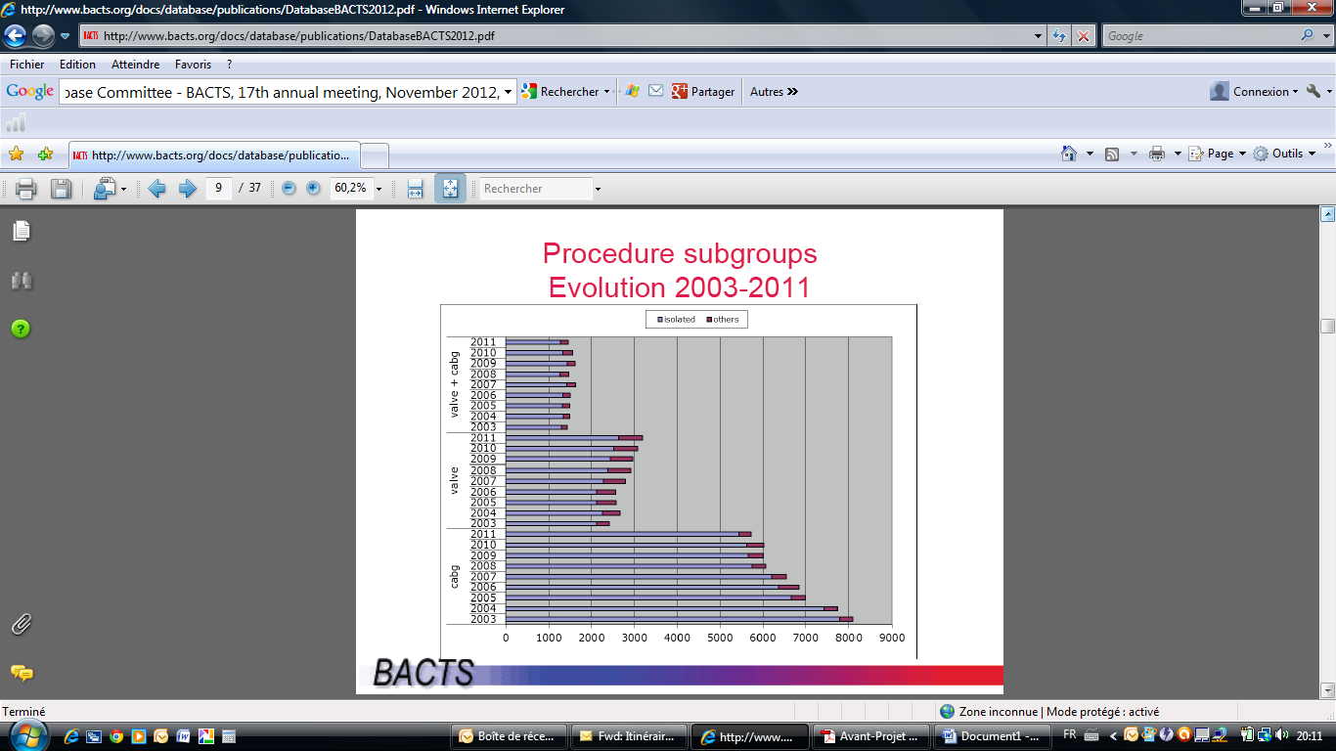
La situation en Belgique

Slide 9
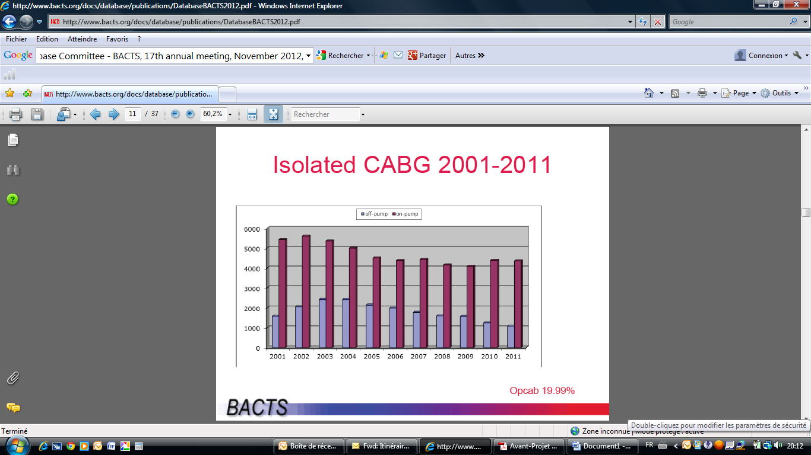
La situation en Belgique

Slide 10
La situation en Belgique: cursus officiel
Le programme de formation spécifique:
1996: 2 écoles de perfusion, KUL (flamande) et ULg (francophone)
2008: Master à l’Université de Leuven et de Liège - Dept des Sciences de la Santé Publique, Faculté de Médecine = 2 ans = 60 crédits KUL - 120 crédits Ulg.
2006: Ministère de la Santé publique: obtention d’un titre (à définir)

Slide 11

La Situation en Europe (EBCP)
Pour en savoir plus: site du Board
www.ebcp.org

Slide 12
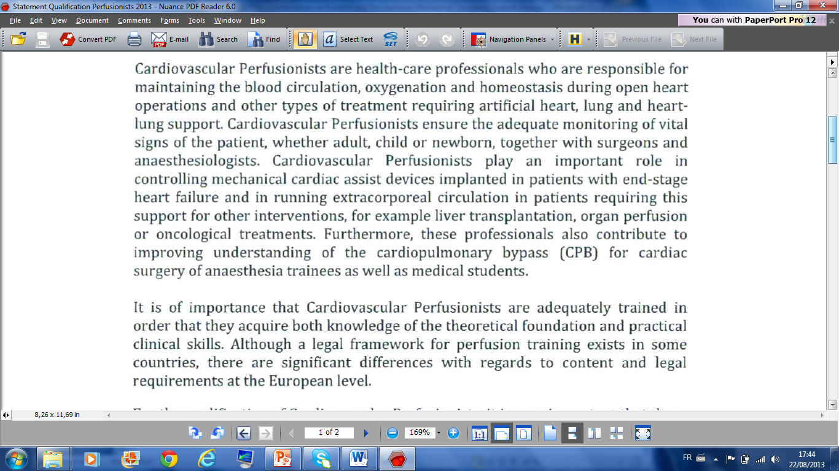
La vision européenne (EBCP)

Slide 13
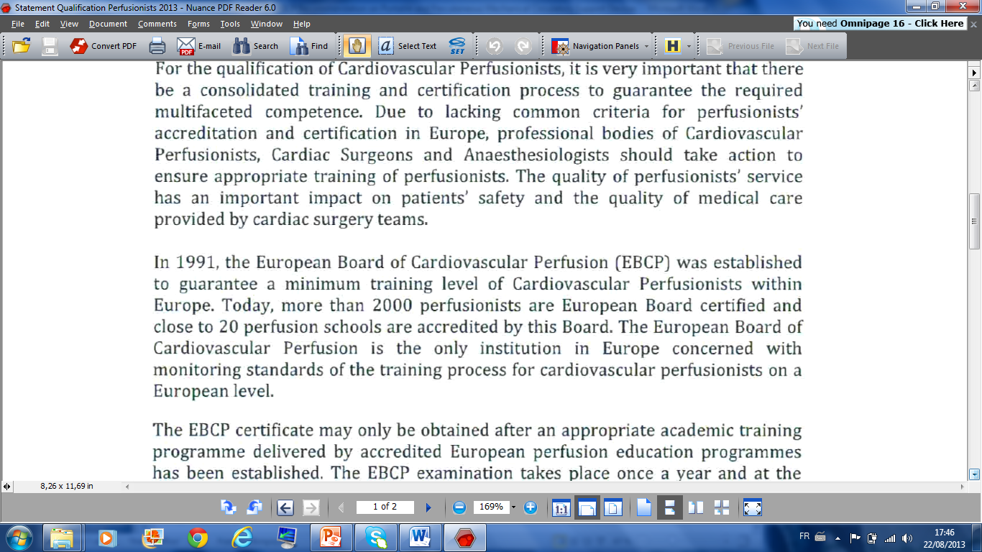
La vision européenne (EBCP)

Slide 14

La vision européenne (EBCP)

Slide 15
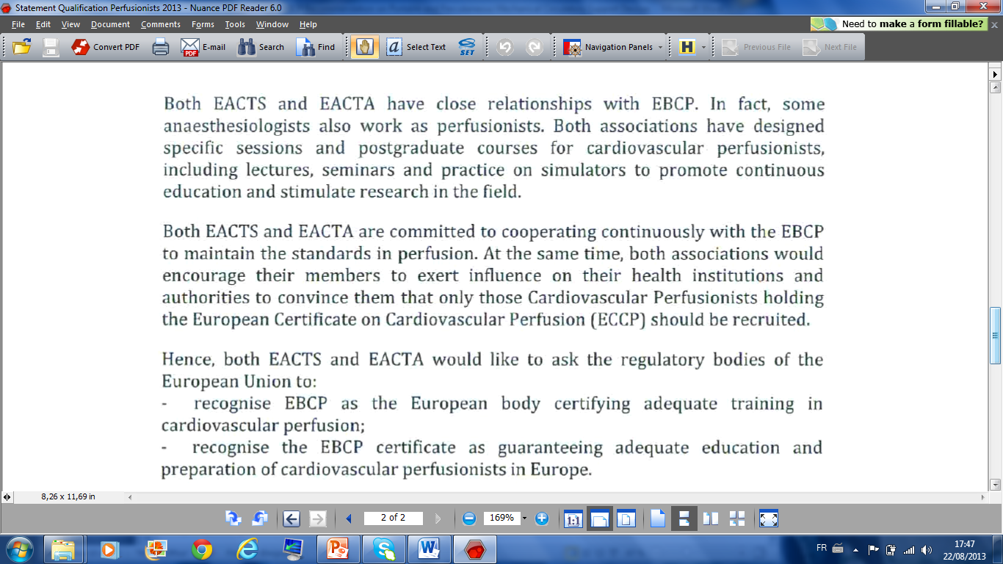
La vision européenne (EBCP)

Slide 16
La vision européenne (EBCP)
The European Board of Cardiovascular Perfusion (EBCP) is the largest professional organisation of cardiovascular perfusionists in Europe. The EBCP aims to improve the educational standards of perfusionists so as to enhance the safety and outcomes of patients supported by extracorporeal mechanical circulatory devices. Perfusionists are the only professional body whose scope of practice includes the application of extracorporeal devices to support patients in a variety of clinical setting. These perfusionists should have qualified from an EBCP accredited educational programmes as well as be certified by the EBCP. MCS devices, that are either a variation of, or substantially equivalent to, the systems which are currently operated by perfusionists, are beginning to be applied by other health care providers. The position of the EBCP is that optimal care and safety of patients undergoing mechanical circulatory support (MCS) must not be compromised by being operated by personnel who are not qualified perfusionists. The EBCP believes that the safe and effective operation of these mechanical, life-supporting systems requires that a qualified perfusionist should participate directly in or supervise the use of MCS. The introduction into the clinical setting of such MCS devices without the involvement of a properly trained team threatens patient safety and subjects them to substantial and unnecessary risk of injury. The EBCP strongly recommends that throughout the implementation, operation and management of all MCS-systems, a perfusionist who is qualified by a formal education and possesses the appropriate clinical expertise should either directly operate the equipment or supervise its application. These recommendations are based on the position-paper that was published by the ECLS Working–Group entitled Position article for the use of extracorporeal life support in adult patients European Journal of Cardiothoracic Surgery 2011.
EBCP Recommendation on Portable and Percutaneous Mechanical Circulatory Support Devices

Slide 17

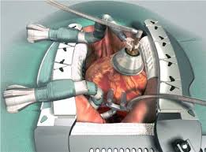
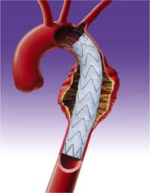
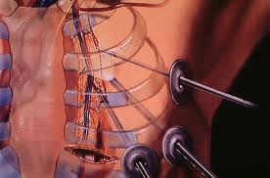
Le « Darwinisme » de la profession
Reformater notre image.
Compétence accrue et reconnue: meilleure qualité de la CEC.
Flexibilité et diversification de nos compétences.

Slide 18
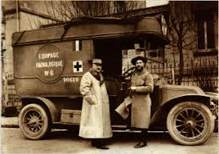

Le « Darwinisme » de la profession

Slide 19
L’évolution de la patientèle
The end organ protection in cardiac surgery. Minerva Anestesiol. 2012 Nov 22.
De Somer F.
Source
Universitair Ziekenhuis Gent - Belgium - Filip.DeSomer@UGent.be.
Abstract
Mortality and morbidity post cardiac surgery with cardiopulmonary bypass (CPB) remain relative stable over the last decades, while the number of patients with increased co-morbidity and more complex cardiac disease increases. Nevertheless end organ dysfunction and/or failure remain an issue. Multiple peri-operative variables, such as non optimal oxygen delivery, manipulation of the aorta, hyperlactatemia, type of anesthesia, surgical procedure and myocardial protection can be hold responsible for end organ failure post cardiac surgery. However, it becomes more and more evident that also pre-existing factors, such as metabolic syndrome, renal insufficiency, hypertension, stroke and infection exacerbate mortality and morbidity. Unfortunately these predisposing risk factors cannot be influenced peri-operative. Therefore therapy should focus on controlling peri-operative variables that in combination with the predisposing factors will further exacerbate organ dysfunction. In order to achieve this more emphasis should be given to a patient specific, goal directed approach perfusion approach.
Notes:
bien que les données statistiques du devenir des patients soient stables, la morbidité préop des patients référés à la chirurgie cardiaque a sensiblement augmenté (…)
C’est pourquoi nous devons mettre en œuvre des protocoles et techniques nouvelles afin de maitriser au mieux ces variables pré opératoires

Slide 20
Pérennité de la chirurgie cardiaque?😐
Chin Med J (Engl). 2012 Jan;125(2):338-44.
Meta-analysis of randomized trials comparing the effectiveness of on-pump and off-pump coronary artery bypass.
Chen YB, Shu J, Yang WT, Shi L, Guo XF, Wang FG, Qian YY.
.Abstract
BACKGROUND:
The growing enthusiasm for coronary artery bypass grafting (CABG) without cardiopulmonary bypass (CPB) is emerging, but the role of off-pump coronary artery bypass (OPCAB) in clinical practice remains controversial. The purpose of this study was to assess differences in the incidences of stroke, atrial fibrillation (AF), and myocardial infarction (MI) between OPCAB and conventional coronary artery bypass grafting (CCABG) by meta-analyses of randomized clinical trials.
METHODS:
A literature search for the period before March 2010 supplemented with manual bibliographic review was performed for all Chinese or English publications in Medline, the Science Citation Index Expanded, the Cochrane Central Register of Controlled Trials (CENTRAL) and CBMdisc. A systematic overview (meta-analyses) of randomized clinical trials was conducted to evaluate the differences between OPCAB and CCABG in the incidences of stroke, AF, and MI. The meta-analysis was performed using RevMan 5 software.
RESULTS:
Forty-three randomized clinical trials were selected for meta-analysis after screening a total of 356 references, with 8104 patients in the OPCAB group and 8724 cases in the CCABG group. The meta-analyses of these trials showed no significant difference between OPCAB and CCABG in the incidences of stroke (odds ratio (OR) = 0.80, 95% confidence interval (CI) = 0.52 - 1.22, P = 0.30) and MI (OR = 0.73, 95%CI = 0.52 - 1.02, P = 0.06). However, we found a significantly reduced risk of AF (OR = 0.65, 95%CI = 0.52 - 0.82, P = 0.0002) in off-pump patients.
CONCLUSIONS:
Our meta-analyses suggest that OPCAB reduces the risk of postoperative AF compared with CCABG, but there is no significant difference in the incidences of stroke and MI between OPCAB and CCABG.

Slide 21
Pérennité de la Chirurgie Cardiaque ?☺
Off-pump versus on-pump coronary artery bypass grafting for ischaemic heart disease.
Møller CH, Penninga L, Wetterslev J, Steinbrüchel DA, Gluud C.
Cochrane Database Syst Rev. 2012 Mar 14;3:CD007224. doi: 10.1002/14651858.CD007224.pub2.
Abstract
BACKGROUND:
Coronary artery bypass grafting (CABG) is performed both without and with cardiopulmonary bypass, referred to as off-pump and on-pump CABG respectively. However, the preferable technique is unclear.
OBJECTIVES:
To assess the benefits and harms of off-pump versus on-pump CABG in patients with ischaemic heart disease.
SEARCH METHODS:
We searched the Cochrane Central Register of Controlled Trials (CENTRAL) on The Cochrane Library (Issue 1, 2011), MEDLINE (OVID, 1950 to February 2011), EMBASE (OVID, 1980 to February 2011), Science Citation Index Expanded on ISI Web of Science (1970 to February 2011) and CINAHL (EBSCOhost, 1981 to February 2011) on 2 February 2011. No language restrictions were applied.
AUTHORS' CONCLUSIONS:
Our systematic review did not demonstrate any significant benefit of off-pump compared with on-pump CABG regarding mortality, stroke, or myocardial infarction. In contrast, we observed better long-term survival in the group of patients undergoing on-pump CABG with the use of cardiopulmonary bypass and cardioplegic arrest. Based on the current evidence, on-pump CABG should continue to be the standard surgical treatment. However, off-pump CABG may be acceptable when there are contraindications for cannulation of the aorta and cardiopulmonary bypass. Further randomised clinical trials should address the optimal treatment in such patients.
Notes:
La chirurgie à cœur battant a dans la décennie précédente ébranlé le monde de la perfusion: des efforts ont été développés à l’époque (…) pour minimiser la bioincompatibilté liée à la CEC
La chirurgie de revasc myocardique sous CEC a retrouvé ses lettres de noblesse, outres cette étude publiée en 2012,une métha analyse publiée par Takagi en 2010 dans ATS démontait que la mortalité à long terme était plus élevée dans le cas de l’off pump pour PAC
Ne nous reposons pas sur nos lauriers pour autant

Slide 22
L’évolution de la politique de la santé
« Le coût-bénéfice »
J Thorac Cardiovasc Surg. 2011 Nov;142(5):1062-73. doi: 10.1016/j.jtcvs.2011.02.013. Epub 2011 Apr 13.
Cost and cost-effectiveness of cardiac surgery in elderly patients.
Gelsomino S, Lorusso R, Livi U, Masullo G, Lucà F, Maessen J, Gensini GF.
Source
Cardiac Surgery Unit, Careggi Hospital, Florence, Italy. sandro.gelsomino@libero.it
Abstract
OBJECTIVE:
Cost-effectiveness of heart surgery for elderly patients is still poorly defined. We evaluated outcome, quality of life (QoL), cost, and cost-effectiveness of octogenarians undergoing cardiac surgery.
METHODS:
One thousand six hundred forty octogenarians undergoing various cardiac surgical procedures were prospectively studied between January 1998 and January 2009 and compared with similar patients aged 70 to 79 years. Several questionnaires were used to assess QoL. Six hundred age- and sex- matched healthy octogenarians and three hundred forty patients older than 80 years with medically treated valvular or coronary artery disease were healthy and unoperated control groups, respectively. In-hospital costs were obtained from the hospital's financial accounting department and cost-effectiveness was estimated and expressed as cost/QoL-adjusted life year (QALY) and cost-effectiveness ratio.
RESULTS:
Significant improvements occurred in elderly patients in Role Physical (P < .001), Bodily Pain (P < .001), General Health (P = .004), Social Functioning (P < .001), and Role Emotional (P < .001), whereas Physical Functioning, Vitality, and Mental Health did not change (difference not signficant). Total direct costs were $5293 higher in the octogenarian group. Cost-effectiveness was $1391/QALY for elderly surgical patients, $516/QALY for younger cardiac surgical patients (P < .001 vs elderly), $897/QALY for untreated control group, and $641/QALY for healthy control group (P < .001 vs elderly surgical patients). The cost-effectiveness ratio for octogenarians was $94,426.
Notes:
Largement étudiée dans les pays anglo saxons, l’incidence C/B doit aussi interpellé le perfusionniste: à terme, la sécurité sociale ne pourra plus soutenir des traitements qui ne seront pas « avalisés » par un bénéfice clinique évident pour le patient à court et long terme

Slide 23


L’exemple liégeois: la formation
Cursus http://progcours.ulg.ac.be/cocoon/programmes/TUR_MMSANPU.html
Formation continuée

Slide 24

L’exemple liégeois: les ressources humaines
8 TP (4 « Master », 2 doctorants, 100% recertifiés)
2 agents garde/ jour 24h/24
Plage horaire 7h30 à 19h30
Statut « interne »

Slide 25

L’exemple liégeois: les domaines d’activité:
Cliniques: chirurgie cardiaque
transplantation
autotransfusion
assistances+ suivi USI et domicile
traitements oncologiques
POC
Académiques: enseignement, commission hémovigilance, itinéraire clinique…
Scientifiques: recherche, data management,…

Slide 26
Les perspectives
CO₂ low flow removal?
Assistances?
Implication domaines nécessitant expertise technique particulière (endovasculaire…)
Chirurgie conventionnelle de plus en plus perfectible
Investissement de l’industrie pour innovation
Reconnaissance de la profession

Slide 27


………….
Journal « Lesoir »
21/09/2013

Slide 28
Les perspectives
☺

Slide 29

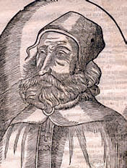
Conclusions
Il y a un avenir pour la CEC et la profession si et seulement si
Education
Recherche dépendant
Flexibilité, diversité
Industrie
Ingéniérie

Slide 30
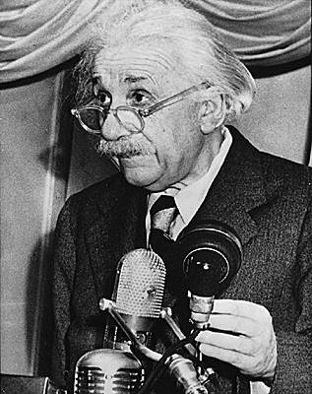
‘’L’imagination est plus importante que le savoir’’

