Slide 1


Synthesis and new definition of the areas included in the urban-rural gradient
S3: Modelling of urban ecosystems – new approaches
André M., Mahy G., Lejeune P., Bogaert J.
Notes:
I gonna present you a part of my thesis which aims to evaluate and quantify the resistence of landscape classes and ecosystems to the urbanization process, comparing a dozen cities in sub-saharan Africa. Important for what follows: diachronic landscape evolution analysis using satellite imagery.

Slide 2
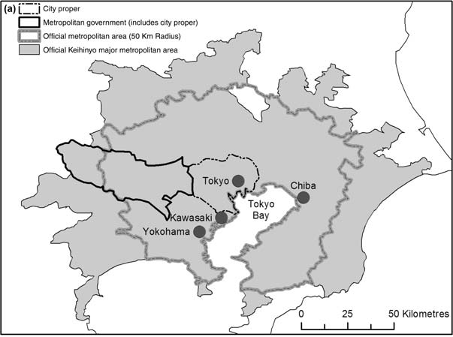
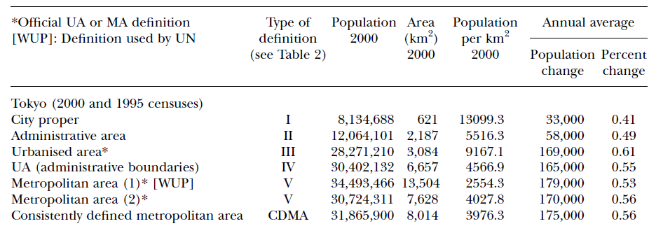
1/3 Introduction: variable définitions
Forstall et al, 2008
Notes:
One of the most crowded city of the world.
According to the definition and to the delimitation of the urban area used, population increases from 8 million to thirty-two million people.
But different definitions of zones can also cause problems when scientists want to compare results. So we see that the definitions are not a negligible thing.

Slide 3
2/3 Aims of the study
Identify the areas in the urban-rural gradient
Notes:
Firstly, …

Slide 4
2/3 Aims of the study
Identify the areas in the urban-rural gradient
Evaluate the relative importance of characteristics and types of characteristics for every area and for the whole gradient
Notes:
Secondly,…

Slide 5
2/3 Aims of the study
Identify the areas in the urban-rural gradient
Evaluate the relative importance of characteristics and types of characteristics for every area and for the whole gradient
Evaluate the characteristics
Notes:
Thirdly,…

Slide 6
2/3 Aims of the study
Identify the areas in the urban-rural gradient
Evaluate the relative importance of characteristics and types of characteristics for every area and for the whole gradient
Evaluate the characteristics
Propose new definitions to the most cited areas using the retained characteristics
Notes:
Fourth,…

Slide 7
2/3 Aims of the study
Identify the areas in the urban-rural gradient
Evaluate the relative importance of characteristics and types of characteristics for every area and for the whole gradient
Evaluate the characteristics
Propose new definitions to the most cited areas using the retained characteristics
Translate definitions to landscape metrics (following studies based on satellite imagery)
Notes:
Fifth,…

Slide 8
3/3 Method and results:
1. Identify the areas in the urban-rural gradient
urban
suburban
rural
Notes:
Consensus about …
Cited: pron. caïted

Slide 9
3/3 Method and results:
1. Identify the areas in the urban-rural gradient
rural
urban
suburban
?
Notes:
Fouiller: to dig

Slide 10
3/3 Method and results:
1. Identify the areas in the urban-rural gradient
suburban
rural
urban
periurban
?

Slide 11
3/3 Method and results:
1. Identify the areas in the urban-rural gradient
suburban
rural
urban
periurban
?
sprawl

Slide 12
3/3 Method and results:
1. Identify the areas in the urban-rural gradient
suburban
rural
urban
periurban
?
sprawl
exurban

Slide 13
3/3 Method and results:
1. Identify the areas in the urban-rural gradient
suburban
rural
urban
periurban
?
sprawl
exurban
rurban

Slide 14
3/3 Method and results:
1. Identify the areas in the urban-rural gradient
suburban
rural
urban
periurban
?
sprawl
wildlands
exurban
rurban

Slide 15


3/3 Method and results:
2. Evaluate the relative importance of characteristics and types of characteristics for every area and for the whole gradient
Literature review
Citation index If (%) for each area and each characteristic
With i = characterictic for which the index is calculated
z = area for which the index is calculated
f_{iz} = citation frequency of the characteristic i in the area z
n_{c} = total number of characteristics used to describe the area
Relative frequency index Ifr (%) for the whole urbanization gradient
selection of the 10 most cited for each area
Notes:
We conducted a literature review and recorded all terms and all characteristics relating.
Then we developed two indexes:
… is the ratio between
… the ratio between the previous and the maximum one
If: 0 (jamais citée) -> 100 (citée à chaque fois pour décrire la zone)
If: 0 (jamais citée) -> 100 (la plus citée pour décrire les zones du gradient d’urbanisation)
Pron. Type: taïpe

Slide 17
3/3 Method and results:
3. Evaluate the characteristics
According to:
The field of study of the author
The technic of study used
The context of the study area

Slide 18
3/3 Method and results:
3. Evaluate the characteristics
According to:
The field of study of the author
The technic of study used
The context of the study area
In our study, the perfect characteristic is (at least 3):
(1) Quantitative, (2) integrative, (3) consensual,
(4) discriminative, (5) easy to obtain
Notes:
Integrative: includes several other variables
Discriminative: not a continuum

Slide 20
Notes:
Pink

Slide 21
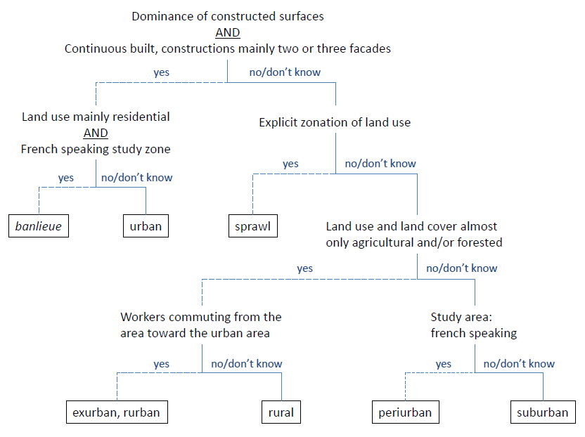
3/3 Method and results:
4. Propose new definitions to the most cited areas using the retained characteristics
Notes:
No or unknown
< relevant characteristics according to the previous step of selection.
From top to bottom, each step corresponds to a discriminant characteristics which will be part of the definition of the term.
Une flèche: an arrow
Our new definitions are based on a decision tree constructed with the

Slide 22
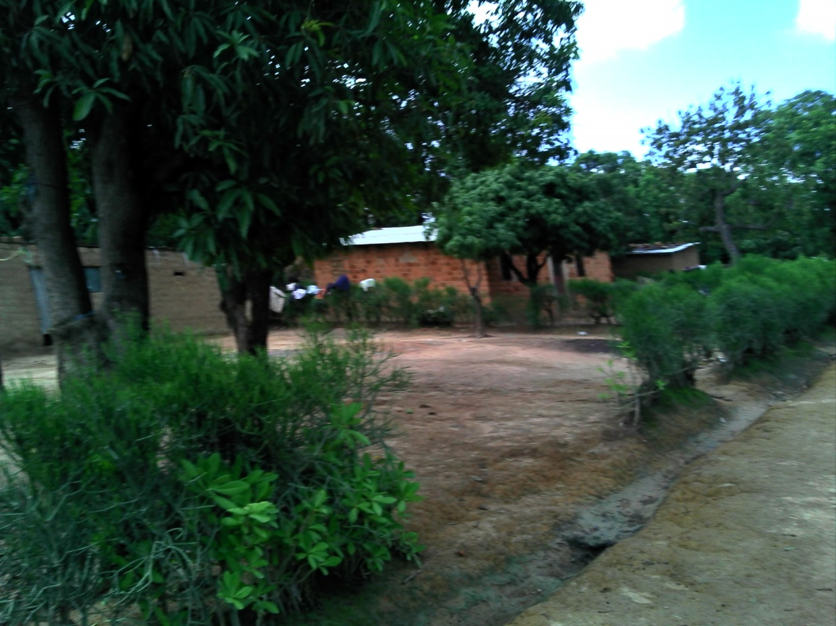
Lubumbashi, RDC

Slide 23
Lubumbashi, RDC

Slide 24
Lubumbashi, RDC

Slide 25
Lubumbashi, RDC

Slide 26
Lubumbashi, RDC

Slide 27
Lubumbashi, RDC

Slide 28
3/3 Method and results:
5. Translate definitions to landscape metrics (following studies based on satellite imagery)
Dominant class index
Dominant index
Proportion of built area index
Patch density (ρ)
Edge to nearest neighbor edge distance (z)
Agregation index (R)
Proximity index (PX)
Dominant class index
Dominant index
Proportion of built area index
Notes:
No or unknown
< relevant characteristics according to the previous step of selection.
From top to bottom, each step corresponds to a discriminant characteristics which will be part of the definition of the term.
Une flèche: an arrow
Our new definitions are based on a decision tree constructed with the

Slide 29
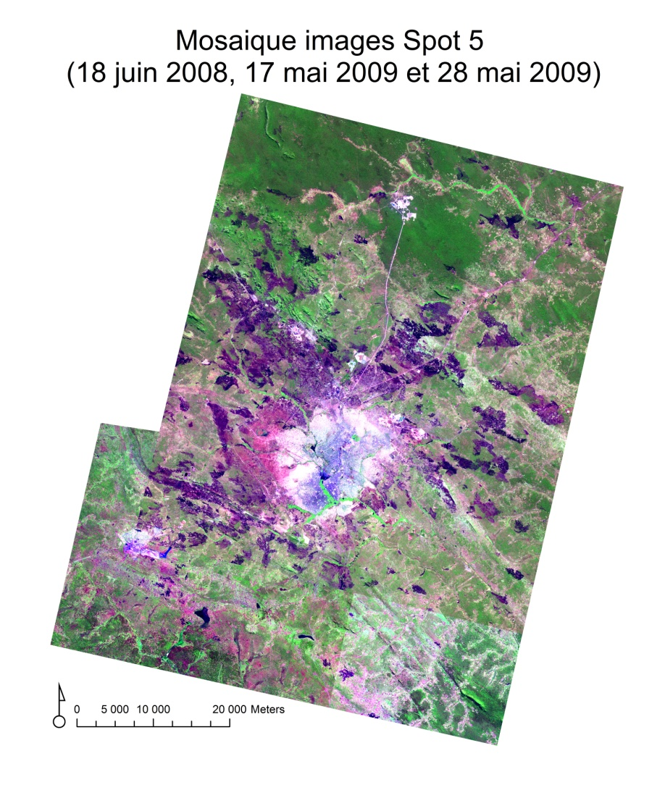

Slide 30
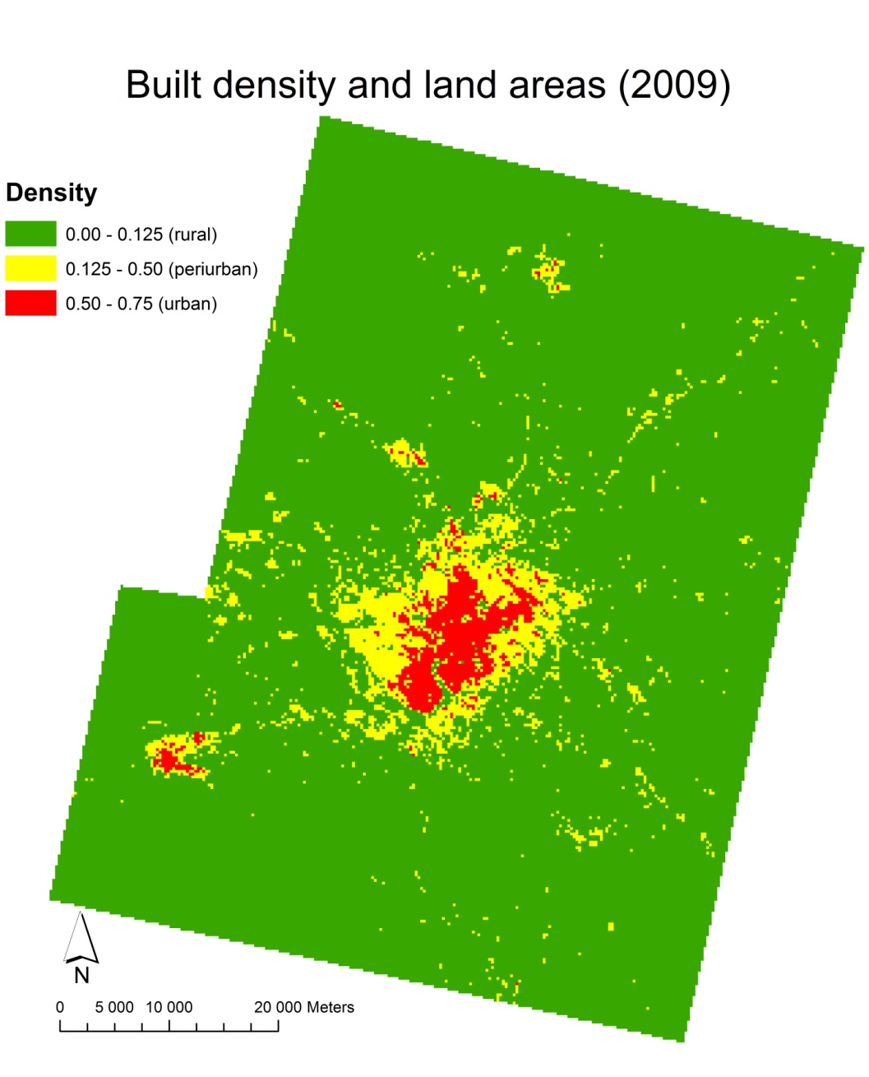

Slide 31
Thanks for your attention
Images Spot © CNES (2012), distribution Spot Image S.A.

