Slide 1
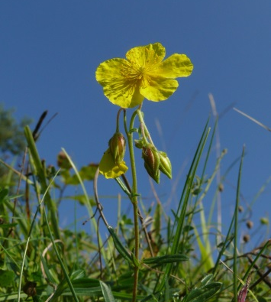
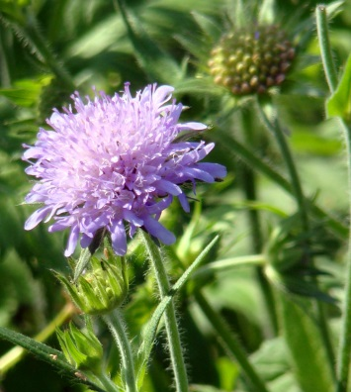
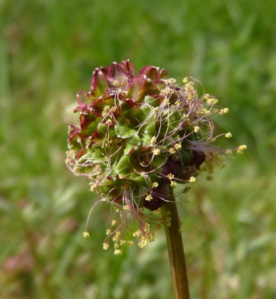
Extent of intra-population functional variability along a local environmental gradient for four calcareous grasslands species
Harzé Mélanie*, Monty Arnaud
and Mahy Grégory
University of Liege, Gembloux Agro-Bio Tech, Biodiversity and Landscape Unit
Augustus 2013
*melanie.harze@ulg.ac.be
Notes:
Good morning everyone. I’m very honored to have the opportunity to present my results here. I’ll present you the first results of my PhD research in functional ecology. The title of my presentation is a little bit different that the one announced and is about the extent of intra-population functional variability along a local environmental gradient for four calcareous grasslands species.

Slide 2
Context
Aims
Methods
Results
Take home message
1
Notes:
First a rapid context of this study.
Ecosystems have been largely transformed by human activities since the nineteenth century, and over the last three decades these changes are occurring at an unprecedented rate. This global change creates new environmental conditions and new selective pressure affecting species in various ways.

Slide 3
Context
Aims
Methods
Results
Take home message
Trait-based analysis to assess response of species to environmental changes
2
Notes:
Trait-based analyses are increasingly used to assess and predict the likely responses of species and ecosystems to environmental changes.

Slide 4
Context
Aims
Methods
Results
Take home message
Trait-based analysis to assess response of species to environmental changes
In general : species = mean trait value
2
Notes:
In functional ecology, analyses generally assume that differences in trait values among species are larger than within species. Therefore species have been characterized by their mean trait values.

Slide 5
Context
Aims
Methods
Results
Take home message
Trait-based analysis to assess response of species to environmental changes
In general : species = mean trait value
Intraspecific functional variability = a concern for ecologist
2
Notes:
However recent advances have demonstrated that intraspecific trait variation in response to environmental factors is greater than previously assumed.
Intraspeciﬁc variability of traits enables plant species to survive, grow and reproduce under new environmental conditions. It may modulate the response of populations and species to environmental changes. Intraspecific functional variability is therefore a concern for ecologists, …

Slide 6
Context
Aims
Methods
Results
Take home message
Trait-based analysis to assess response of species to environmental changes
In general : species = mean trait value
But Intraspecific functional variability = a concern for ecologist
Especially at very local scale
2
Notes:
…, especially at very local scale when the interspecific functional variability is expected to be much lower.

Slide 7
Context
Aims
Methods
Results
Take home message
To explore the extent of intraspecific functional variability at the population level (intra-population functional variability) along a natural environmental gradient
To highlight study species functional response to the same local environmental gradient
3
Notes:
In this context, we aim to study the extent of intraspecific functional variability at the population level (the intra-population functional variability) along a natural environmental gradient and to highlight the functional response of study species along this gradient.
We aim to study species functional variability at very local scale and in a second time to try understand sources of observed intraspecific variability. This study is the first part of the work.

Slide 8
Context
Aims
Methods
Results
Take home message
Our model :
4 Calcareous grasslands species
4
Notes:
Our study models are four calcareous grasslands species that you can see here : Helianthemum nummularium, Potentilla neumanniana, Scabiosa columbaria and Sanguisorba minor.

Slide 9
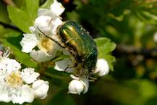
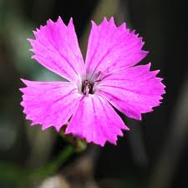
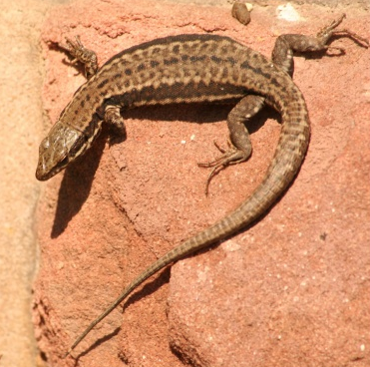
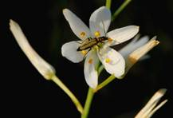
Context
Aims
Methods
Results
Take home message
Calcareous grasslands
5
Notes:
For the one who do not know those ecosystems, calcareous grasslands are semi-natural habitats that are among the most species-rich in Western Europe.

Slide 10
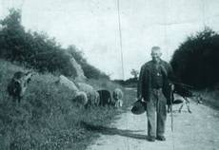
Context
Aims
Methods
Results
Take home message
Calcareous grasslands
6
Notes:
They were well developed in Europe at the end of the 18th (eighteen) century thanks to traditional agropastoral practices and mainly extensive grazing that maintain those habitats open.

Slide 11
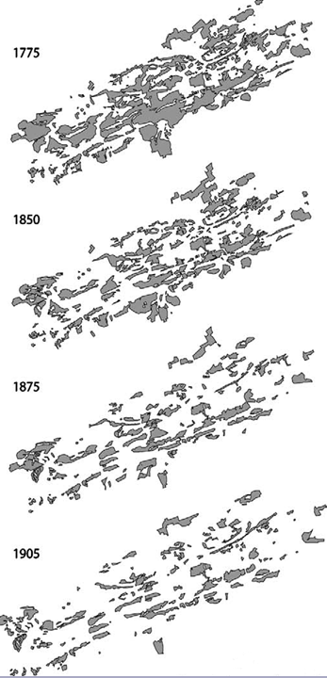
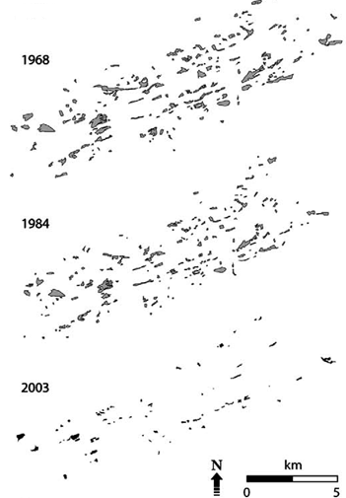
Context
Aims
Methods
Results
Take home message
Calcareous grasslands
6
Notes:
In the 19th (ninetieth) and 20th (twentieth) century, calcareous grasslands suffered intensive fragmentation due to abandonment of those practices but also because of encroachment due to natural succession, reforestation, urbanization or transformation into arable lands. You can see here the fragmentation of calcareous grasslands in our study region between 1775 (seventeen seventy-five) and 2003 (two thousand and three).

Slide 12
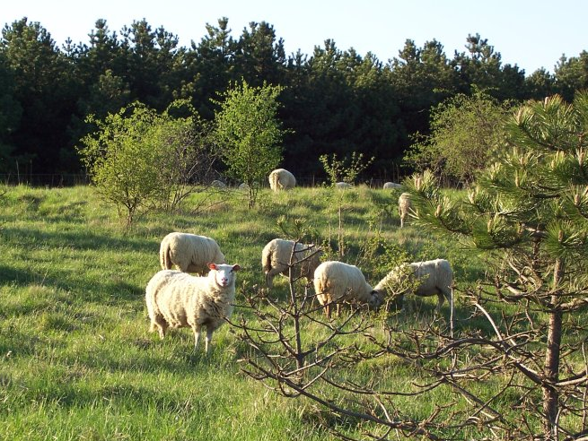
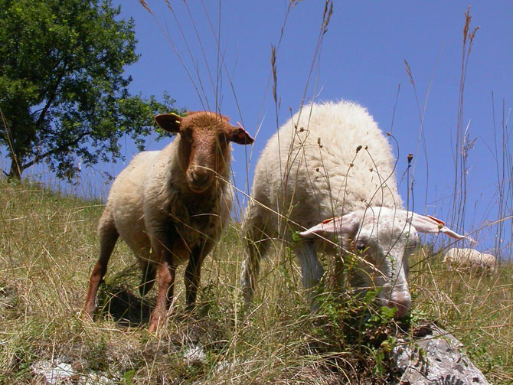
Context
Aims
Methods
Results
Take home message
Calcareous grasslands
6
Notes:
A part of those habitats have been restored since 2000 (two thousand) in our study region and are now managed in order to protect the incredible flora and fauna it contains. The management in mainly realized with sheep and goat grazing parcels.

Slide 13
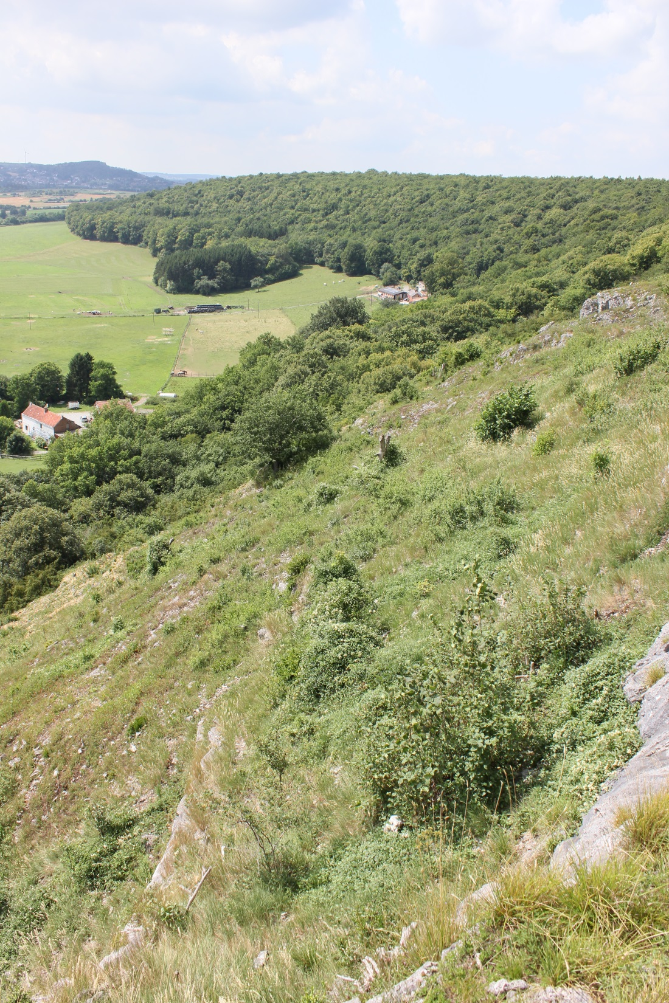
Context
Aims
Methods
Results
Take home message
7
Notes:
Calcareous grasslands are well suited ecosystems for ecological studies along an local environmental gradient because calcareous grasslands species are present on contrasted environment, notably distinguish by differences in soil depth, soil moisture, and slope with more xerophilous grasslands having superficial soils with low water content and steeper slopes like in this picture

Slide 14
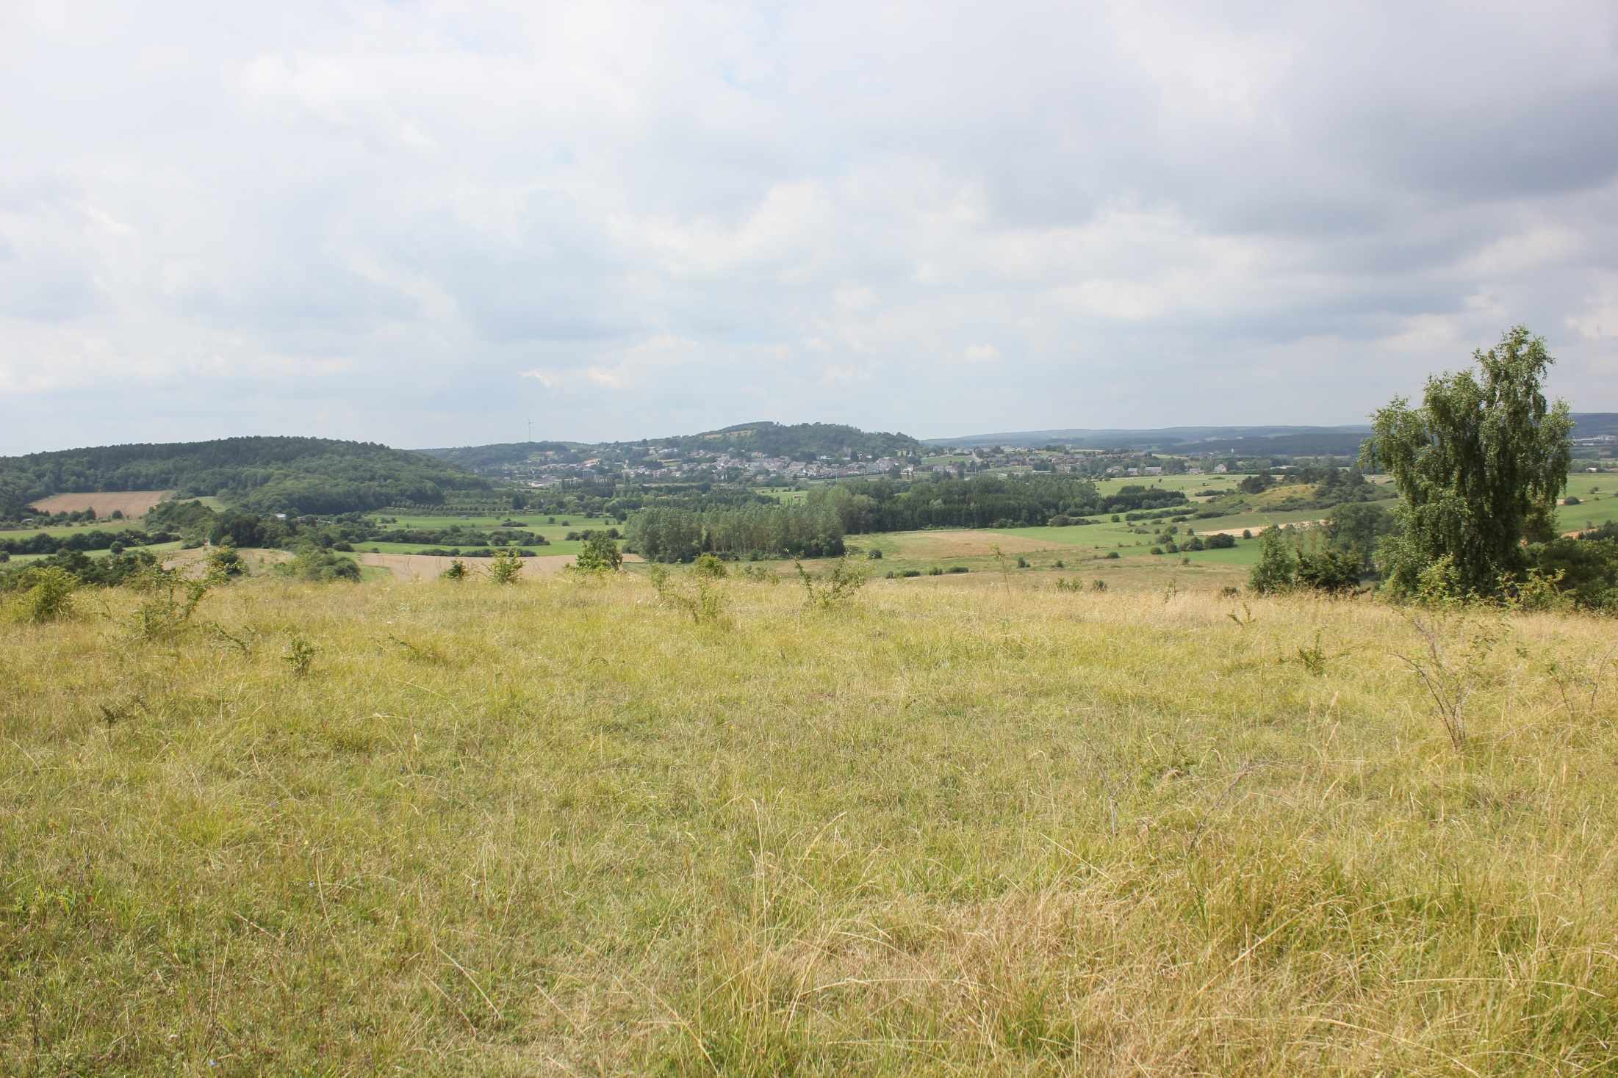
Context
Aims
Methods
Results
Take home message
8
Notes:
and mesophilous ones having less superficial soils and situated on plateaus like this one.
Those ecosystems represent a natural stressful environment for plants species especially for water.
Indded shallow soils reduce the availability of water and topography and exposure are other decisive factors influencing water supply in calcareous grasslands because it influence solar radiation.

Slide 15
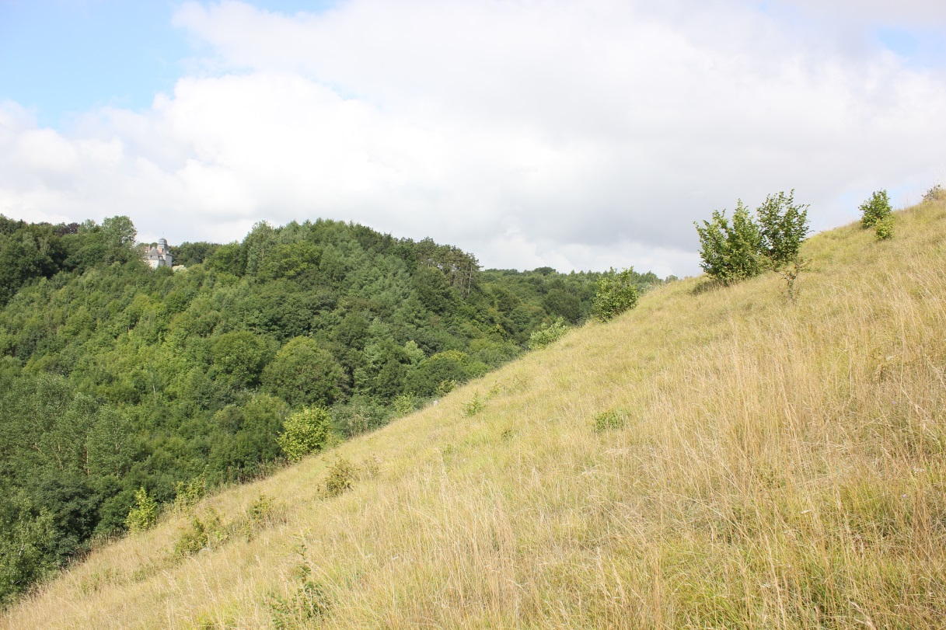
Context
Aims
Methods
Results
Take home message
Gradient
Soil depth (cm)
Heat load (PDIR)
slope degree, slope orientation and latitude
[0.03-1.11]
4
9
Notes:
The gradient was measured thanks to two criteria:
The soil depth (in cm)
The heat load. This index is the potential direct incident radiation index (PDIR) based on slope degree, slope orientation and latitude. It is dimension less and takes values from 0.03 to 1.11 with higher values for high potential direct incident radiation. It takes into account the fact that a slope with afternoon sun will have higher temperature than equivalent slope with morning sun. In this index, folded aspect is scaled to a minimum in the coolest slope (Northeast).

Slide 16
Context
Aims
Methods
Results
Take home message
Traits
Maximum vegetative height (MVH)
Specific leaf area (SLA)
Leaf dry matter content (LDMC)
10
Notes:
Three functional traits reﬂecting the ecological strategies of species were measured: the Maximum vegetative height (MVH) is the distance between the top of photosynthetic tissue and the ground, the Specific leaf area (SLA) is the one sided area of a fresh leaf divided by its oven-dry mass and the Leaf dry matter content (LDMC) is the oven-dried mass of a leaf divided by its water-saturated fresh mass.
The focused traits reflect important functions of plants and are known to vary with environmental changes.

Slide 17
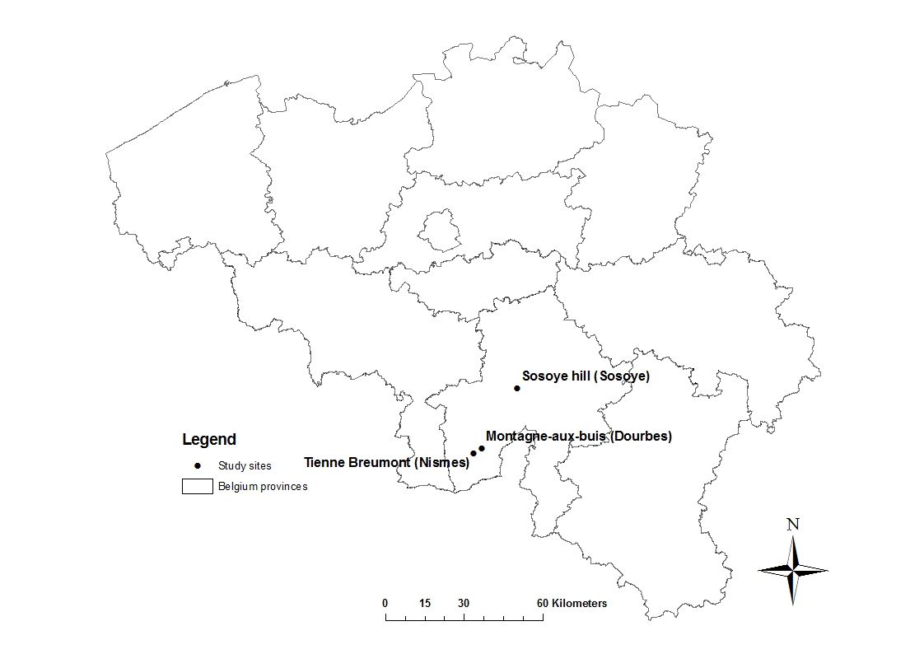
Context
Aims
Methods
Results
Take home message
Study sites
11
Notes:
Our gradient was measured on three calcareous grasslands sites located here in southern Belgium.

Slide 18
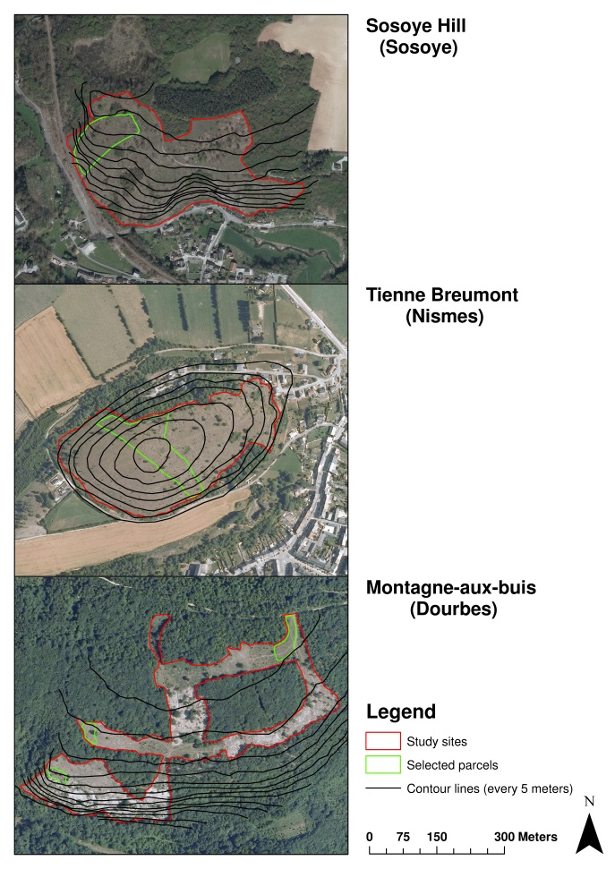
Context
Aims
Methods
Results
Take home message
Study sites
12
Notes:
Those sites were selected because of the variability of environmental conditions create by slope inclination and exposure was important at short distances. You can have an idea of slope variation at short distance thanks to contour lines.
In order to avoid the impact of restoration measure on our study we selected historical calcareous grasslands parcels (namely calcareous grasslands known to have existed for more than two centuries).
As leaf traits and plant size may also be directly affected by grazing, we selected parcels that are submit to the same grazing pressure and frequency.

Slide 19
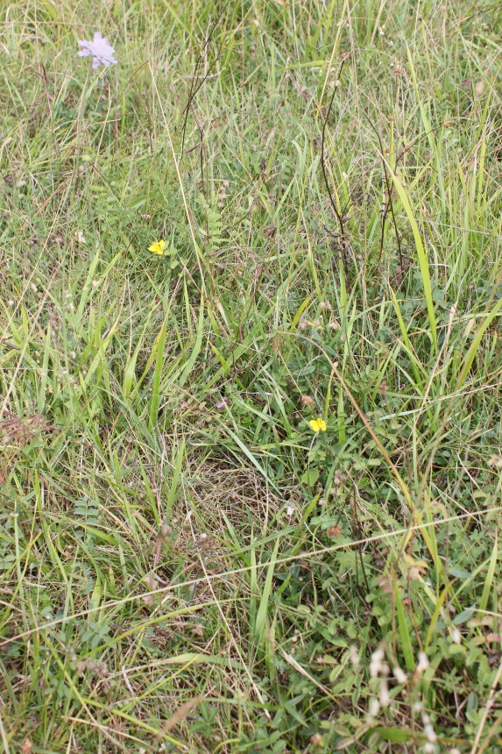
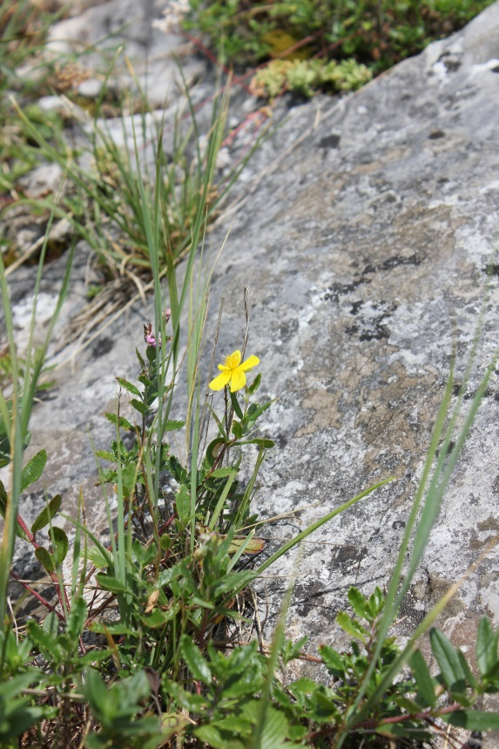
Context
Aims
Methods
Results
Take home message
Species selection
Abundance
on selected sites
on mesophilous calcareous grasslands
on xerophilous calcareous grasslands
13
Notes:
Criteria to select species were mainly abundance criteria. The four study species are abondant on study sites and both on mesophilous and xerophilous grasslands.

Slide 20
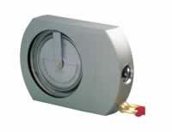
Context
Aims
Methods
Results
Take home message
Field methods
~80 indiv./species on each site → MVH
2 leaves/indiv. → SLA and LDMC
Around each indiv : soil depth, slope and orientation
14
Notes:
On each site, we randomly selected about 80 (between 85 and 91) individuals of each study species.
On each selected individual we measured the maximum vegetative height (MVH) and we collected 2 leaves in order to measure the specific leaf area (SLA) and the leaf dry matter content (LDMC).
To characterize the gradient, the orientation and the slope was measured around each individual and the soil depth was measured at the four corner of a plot centered on each selected individual in order to calculate a mean value for each individual.

Slide 21
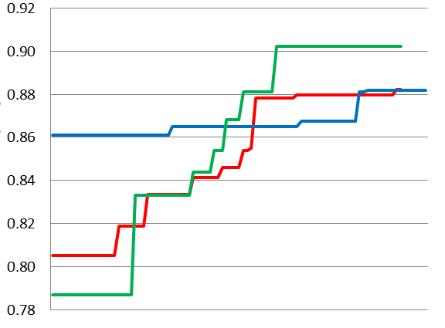
Context
Aims
Methods
Results
Take home message
Gradient
Soil depth gradient on study sites
Soil depth (cm)
Heat load gradient on study sites
Heat load
15
Notes:
Now the results of this study. The gradient measured is represented here for each sites and for all sites together in black. The soil depth range between 0.5 and 11.8 cm and the heat load between 0.79 and 0.90.

Slide 22
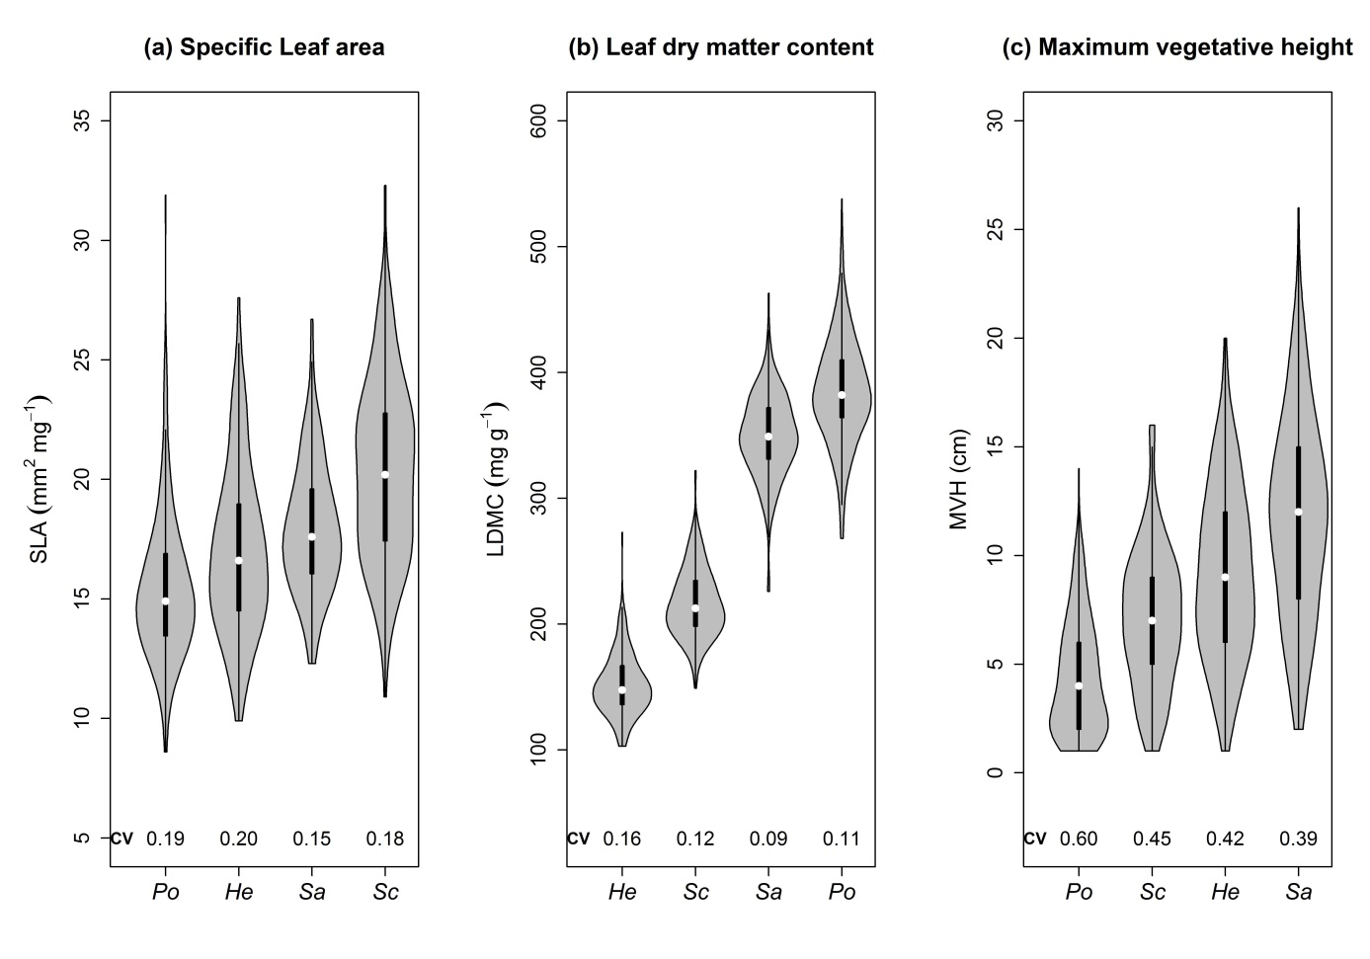
Context
Aims
Methods
Results
Take home message
Extent of intrapopulation functional variability:
Violin plot and coefficient of variation
16
Notes:
Extent of intrapopulation functional variability is illustrated by violin plots. The four species are represented for each study trait. In the centre we have a boxplot and in grey a plot that show density of data. Coefficients of variation are presented here.
Each species showed a large variability of traits, particularly for SLA and MVH. LDMC is less dispersed around the median.
SLA was highly variable for all species. For example, the mean SLA for P. neumanniana is 15.4 but it range between 8.6 and 31.9.
Maximum vegetative height was particularly variable for each study species with coefficients of variation (CV) running from 0.39 to 0.60 while SLA and LDMC tended to be less variable. For each study species, the MVH was more variable than SLA and the SLA was more variable than LDMC as showed by CV.
This variability is also species dependant with S. minor less variable for all traits than other study species.
When compared with other studies dealing with interspecific variation we found that intraspecific is really not negligible in our case.
For example, a study of Jung et al. in 2010 describe intraspecific variability of the same traits with coefficients of variation and found CV ranged between 0.01 and maximum 0.27 (depending of the species) with mean CV of 0.08 for SLA, 0.07 for LDMC and 0.10 for height what is much lower that the intraspecific variability we found.

Slide 23
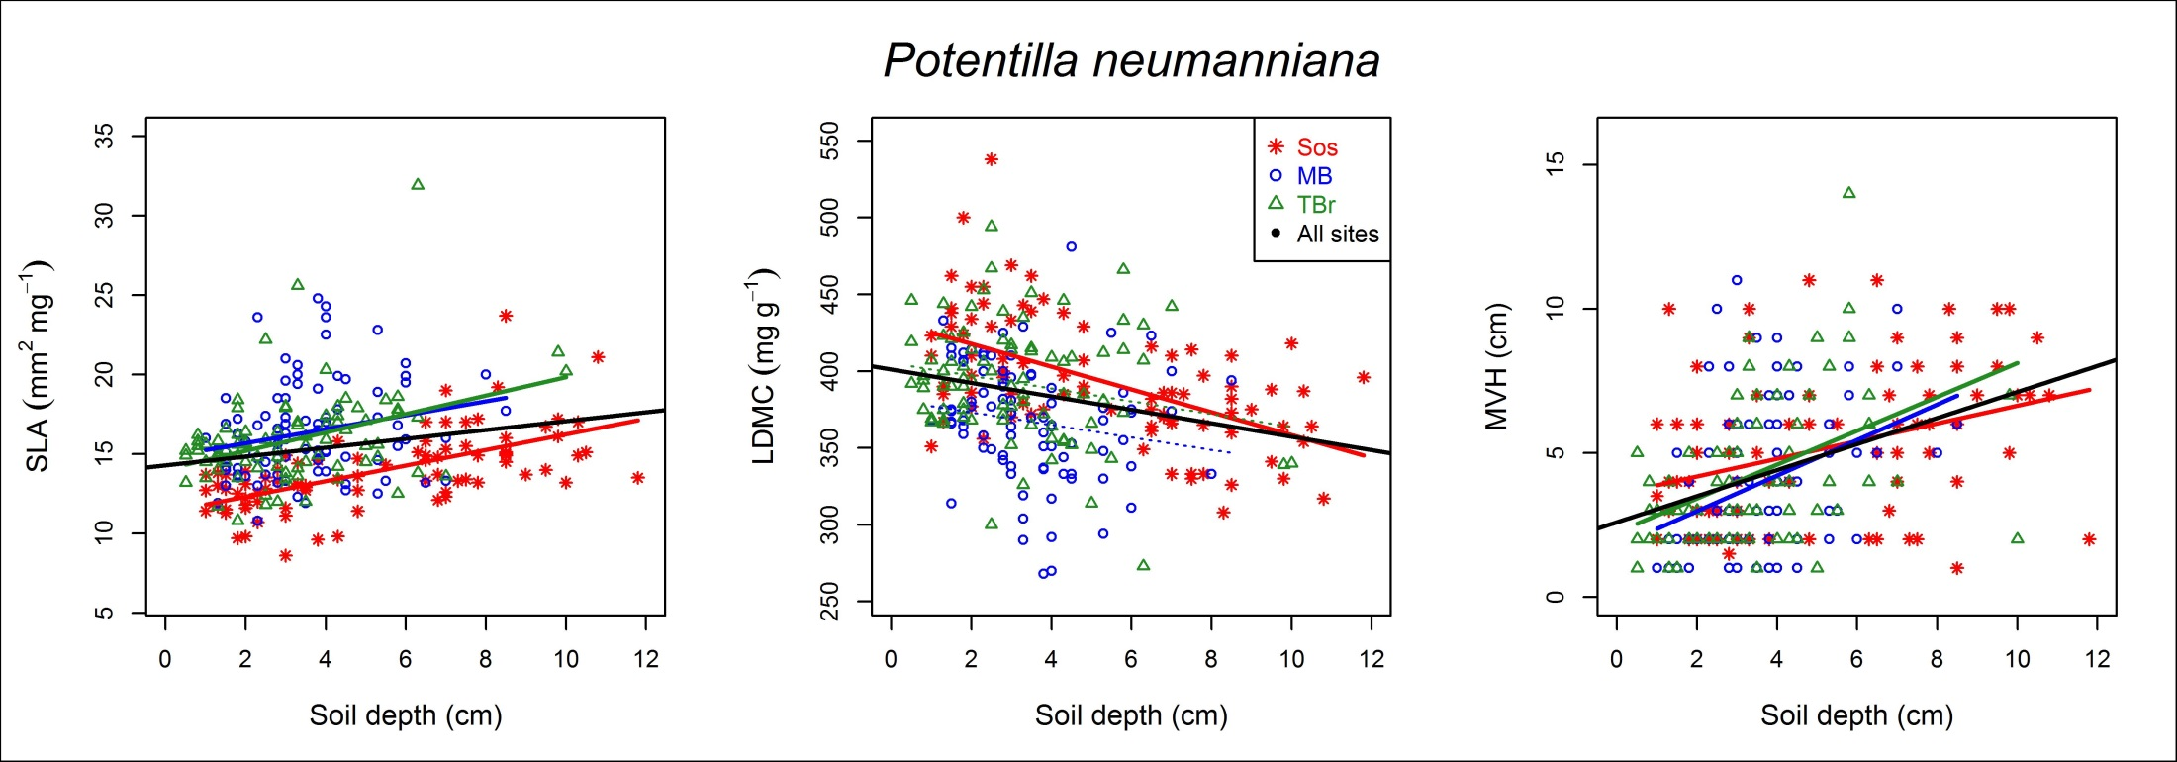
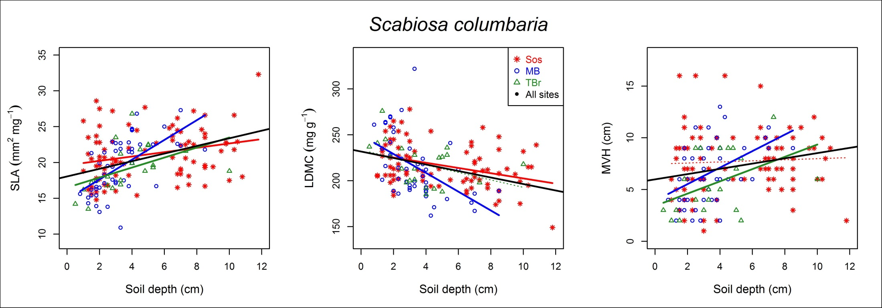
Context
Aims
Methods
Results
Take home message
17
Notes:
Here linear regressions of traits along the gradient of soil depth for 2 species, Potentilla and Scabiosa. Red, green and blue lines represent linear regressions for the 3 study sites and the black line is linear regression for all site put together.
We can see that SLA increase, LDMC decrease and MVH increase when soil is deeper.

Slide 24
Context
Aims
Methods
Results
Take home message
Species response to the gradient : soil depth (cm)
Linear regression coefficients
Species | Functional traits | SLA (mm²mg⁻¹) | LDMC (mg g⁻¹) | MVH (cm)
H. numm. | p-value | <0.001 | 0.284 | <0.001
 | R² | 0.05 | 0.00 | 0.08
 | Coef. | 0.331 | -0.689 | 0.480
P. neum. | p-value | <0.001 | <0.001 | <0.001
 | R² | 0.05 | 0.07 | 0.17
 | Coef. | 0.279 | -4.376 | 0.452
S. mino. | p-value | 0.047 | <0.001 | 0.101
 | R² | 0.01 | 0.05 | 0.01
 | Coef. | 0.136 | -3.135 | 0.192
S. colu. | p-value | <0.001 | <0.001 | 0.006
 | R² | 0.15 | 0.13 | 0.05
 | Coef. | 0.532 | -3.542 | 0.254
18
Notes:
Regression p-values are significant for all species when regarding all sites together for SLA but not for one species for LDMC and MVH. Significant p-values always showed the same relation namely that SLA always increase with soil depth, LDMC always decrease and MVH increases with soil depth.
Overall, individual species responses to gradient were similar.

Slide 25
Context
Aims
Methods
Results
Take home message
19
Notes:
If we look at the graphs again.
The functional response of study species is not surprising as SLA generally declines along gradients of decreasing soil depth. We can explain it by a moisture gradient as xeric conditions favor lower SLA and higher LDMC. Deeper soil represent xeric conditions. MVH clearly decrease in shallow soil where water resources are fewer.

Slide 26
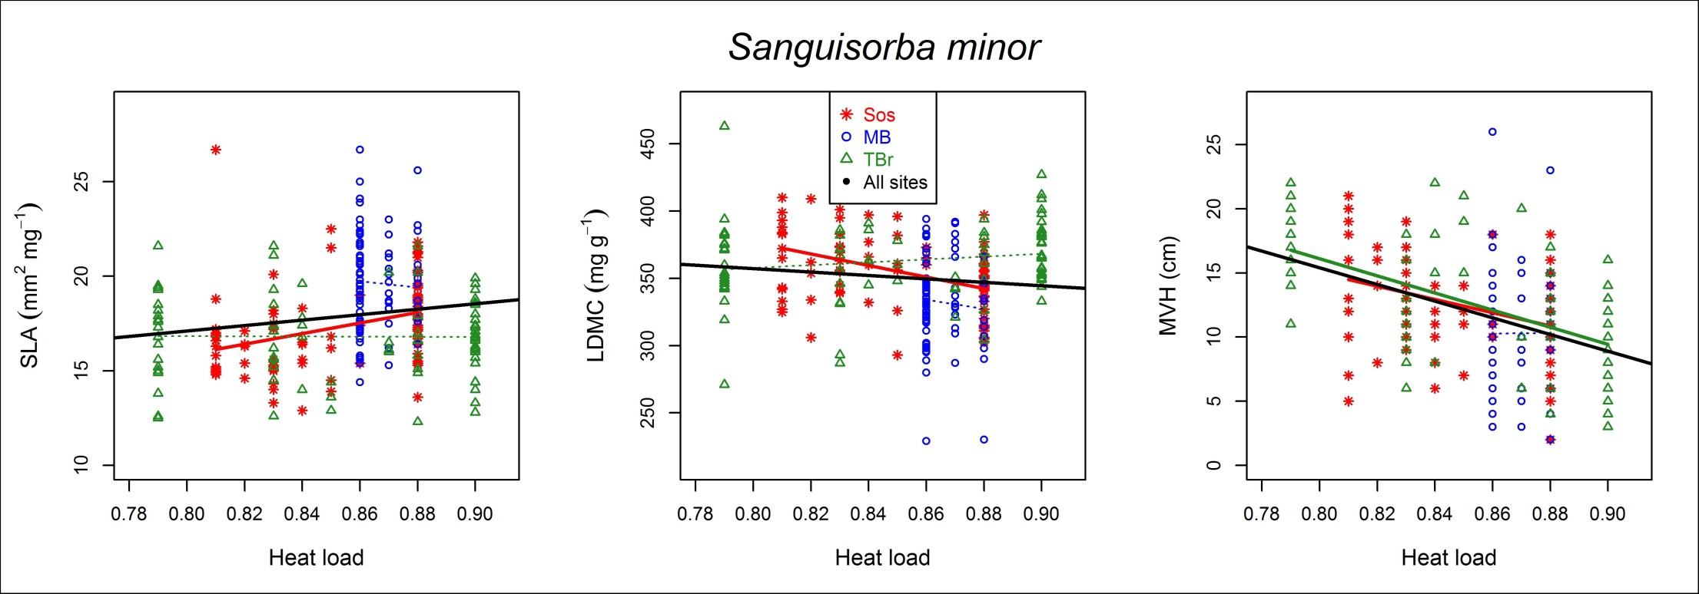
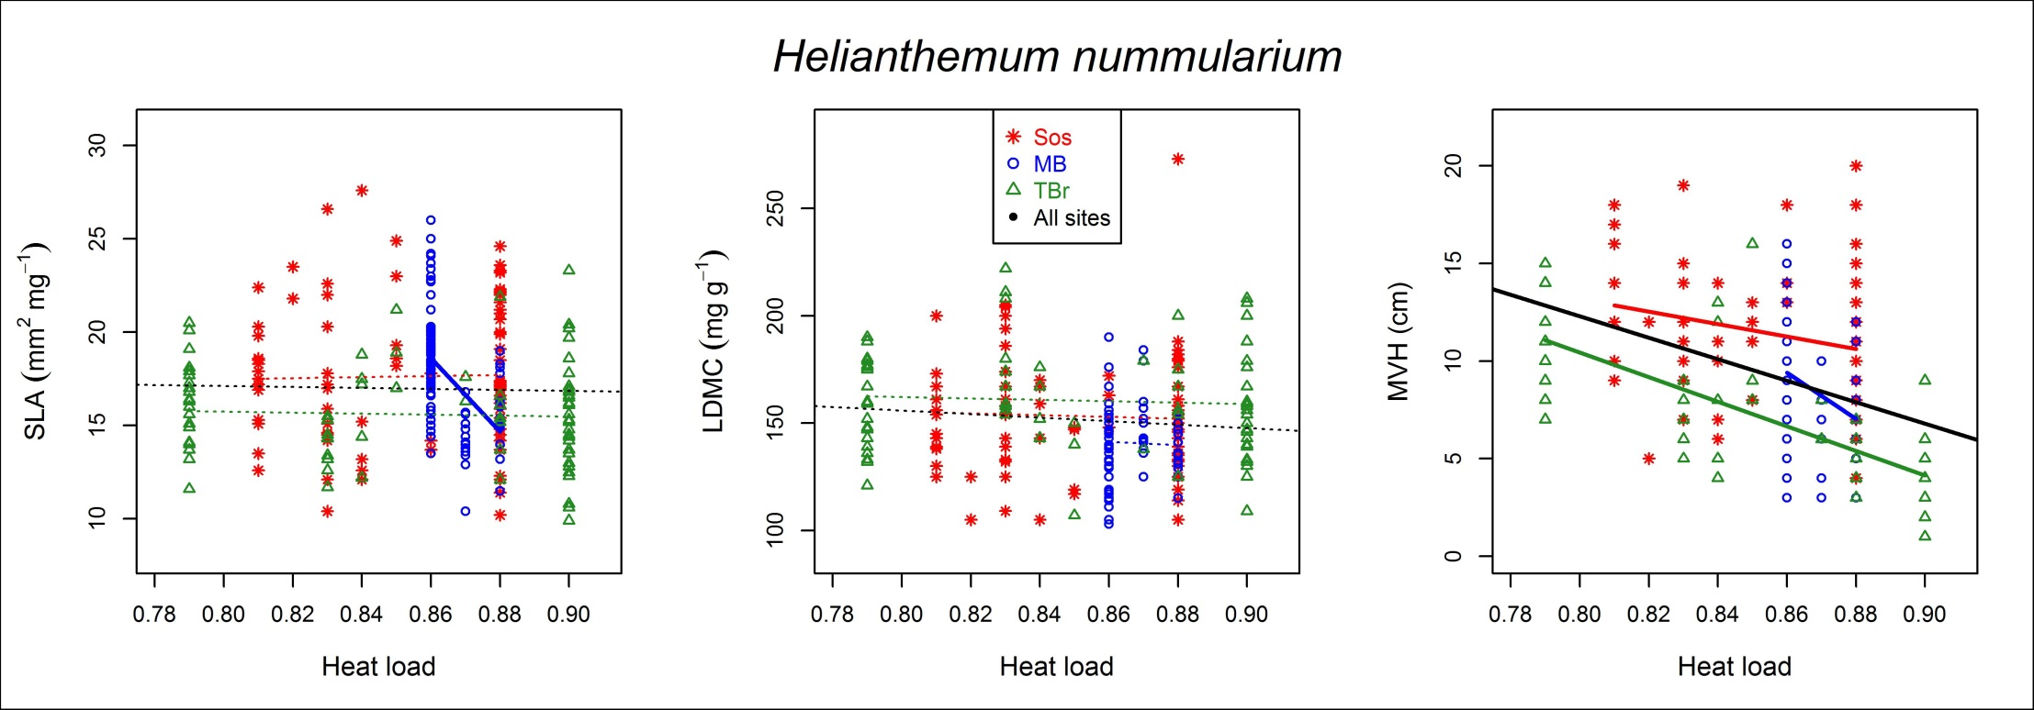
Context
Aims
Methods
Results
Take home message
20
Notes:
Results along heat load gradient are similar but less significant than along soil depth gradient. Hard slope represent xeric conditions with lower MVH, LDMC and higher SLA. Results along heat load gradient are les clear or at least less contrasted certainly because the gradient is also less contrasted compared to soil depth gradient.

Slide 27
Context
Aims
Methods
Results
Take home message
Intraspecific functional variability is high even at very short scale and along very short gradient
Extent of intraspecific functional variability is trait and species dependant
Species functional response along gradient is the same
Perspective : sources of variability?
21
Notes:
The take home message concerning our study : Intraspecific functional variability is high even at very short scale and along very short gradient.
The extent of intraspecific functional variability is trait and species dependent.
Species functional response along gradient is the same for the four study species.
Our perspectives are to try determine what are the major source of observed intraspecific variability.

Slide 28
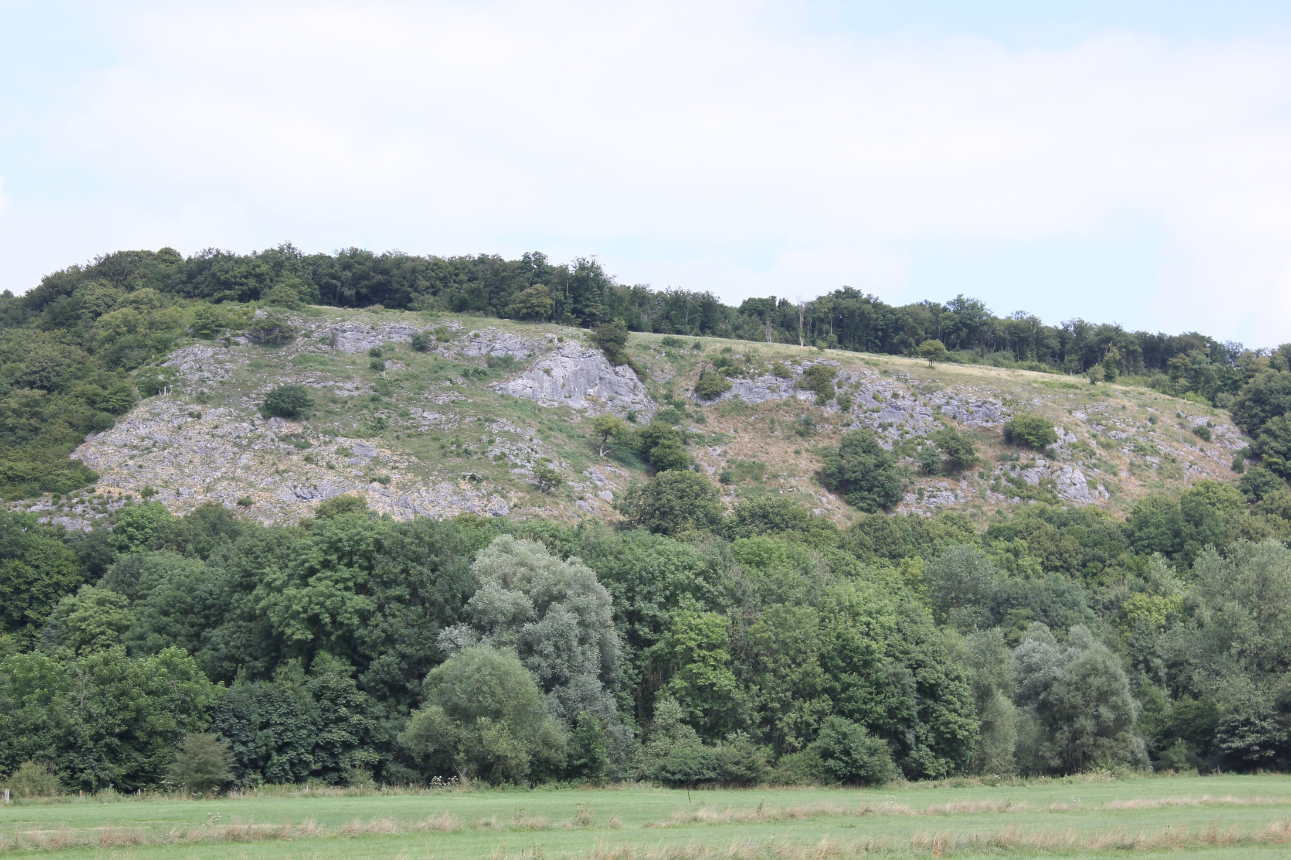
Thank you for your attention
22
Notes:
I thank you a lot for your attention.

