Slide 1
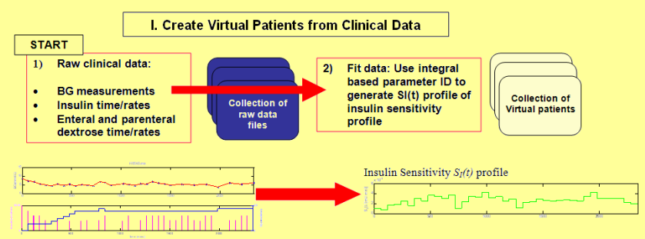



Insulin Sensitivity during Hypothermia in Critically Ill Patients
A. Sah Pri (1), J. Geoffrey Chase (1), Aaron J. Le Compte (1), Geoffrey M. Shaw (2),
Jean-Charles Preiser (3), Fabio Taccone (3), Sophie Penning (4), Thomas Desaive (4)
(1) Center for Bio-Engineering, University of Canterbury, Christchurch, New Zealand.
(2) Department of Intensive Care, Christchurch Hospital, Christchurch, New Zealand.
(3) Dept of Intensive Care, CUB Hospital Erasme, University of Brussels, Brussels, Belgium
(4) Cardiovascular Research Center, Universite de Liege, Liege, Belgium
INTRODUCTION
RESULTS
Background: Critically ill patients often experience stress-induced hyperglycaemia and high levels of insulin resistance, increasing the risks of further complications and mortality. Hypothermia treatment is often used to treat out of hospital cardiac arrest (OHCA) and these same patients simultaneously receive insulin.
Objective: This study analyzes clinically validated insulin sensitivity (S_{I}) profiles of patients undergoing hypothermic treatment for cardiac arrest to assess its impact on metabolism.
METHOD
Fig. 3 Cumulative distributions function (CDF) of SI for all cohort patients in the periods, at cool and warm after. The plot shows that both are statistically different (p < 0.001) and S_{I} level during warm after period is higher than cool period.
Fig. 4: Cumulative distributions function (CDF) of percentage delta S_{I} for all cohort patients. Cool patients are more variable hour to hour as a cohort (p < 0.001). 65% of %ΔS_{I} are positive rising S_{I} in cool period compared to 50% in warm period.
Glycaemic control data from 49 OCHA patients (2068 hours) treated with hypothermia in the Intensive Care Unit (ICU) from various hospitals in Belgium. Patients were on the SPRINT glycaemic control protocol. Blood glucose (BG) and temperature readings were taken 1-2 hourly. Clinically validated glucose-insulin system simulation model were run on these patients, generating insulin sensitivity (S_{I}) profiles.
Fig. 5: Cumulative distributions function (CDF) of median S_{I} per-patient in the periods, at cool and warm after and the difference (cool – warm).The plot shows that both are statistically different (p < 0.001) .
Overall, majority (~75%) of patients had higher median S_{I} during warm after compared to cool period. However, there are about 25% (12 patients) of patients in contrary to this trend.
Fig. 6: Cumulative distributions function (CDF) of SI area under the curve (AUCi-SI) for each patient in the periods, at cool and warm after and the patient-specific paired differences (cool – warm). The plot shows that both are statistically different (p < 0.001) .
Most of the patients (~85%) have greater S_{I} range during warm after period compared to cool period. However, only 15% of patients have a contrary trend although these positive differences were relatively small compared to the other.
Fig. 1: Glucose-insulin system simulation method. Virtual patients are created from clinical records, generating Insulin Sensitivity SI(t) profile which describes patients’ physiological behavioral model.
Data were divided into two periods: 1) cool (T<=35ºC); and 2) warm after (T>35ºC). To minimize outliers with little data, selection criteria stated that each patient have a minimum of 15 hours for both the cool and warm after periods. A maximum of 24 hours each for the cool and warm after period was considered. This rule ensures the balance of data between cool and warm after period for each patient, ignoring unnecessary hours that might affect results per cohort and per patient basis.
Fig. 7: Cumulative distributions function (CDF) of percentage delta SI area under the curve (AUCi- %ΔS_{I} ) for each patient in the periods, at cool and warm after and the patient-specific paired difference AUCi_%ΔS_{I} (Cool – Warm After). The S_{I} hour-to-hour variability over the period is statistically different (p < 0.001) .
Cool period is more variable hour to hour than warm after period. However, ~25% of patients are more hour-to-hour variable, although these patients have relatively small (negative) changes.
CONCLUSIONS
S_{I} level rises over time for these cohorts,transitioning from cool to warm after treatment, matching reports from other studies for the first 48 hours treatment. S_{I} level is much lower during initial hours and keeps improving over time.
The range of S_{I} is unchanged in each period, but that hourly variability is much higher when hypothermia. These results have significant clinical impact on the metabolic treatment of these patients, and the changes required to safely treating patients in each period. The overall feasibility study results justify a larger prospective trial.
Fig. 2: Output of where patient no128 was used as an example. The temperature plot shows the patient was initially warm and suddenly cool (Temperature below 35º Celsius – blue background) after 1 hour of therapy for 19 hours. Then the temperature rise again slightly above 35º Celsius at 20th hours and continuously stable within body temperature (36.5º C – 37.5º C ) – red background.

