Slide 1



"Where are my Marc records?"
IGeLU 2013 Conference Berlin
8 – 10 September 2013
Librarians' perception of discovery tools
François Renaville, Laurence Richelle, Paul Thirion
University of Liege Library

Slide 2
Abstract
In February 2013, the ULg Library launched a new portal where the new library website and Primo were closely integrated. Three months before the official launch to the public, Primo FE was shown to library colleagues to get the first professional feedback. Several training sessions were organized for the library staff to focus on the differences between discovery tools and traditional opacs and to explain how our Primo would function (local data vs PCI, pipe process, normalization rules, deduplication, FRBRization...) .Then, a survey was organized among the library staff to get their feelings and perceptions about discovery tools in general, and the impacts that such tools have, according to them on the users' habits and searches. Our presentation will explain how our library colleagues (directors, service heads, cataloguers, trainers, circulation staff, e-librarians, secretaries...) felt apprehensive and/or enthusiastic about switching to a discovery tool in general (not specifically Primo).

Slide 3
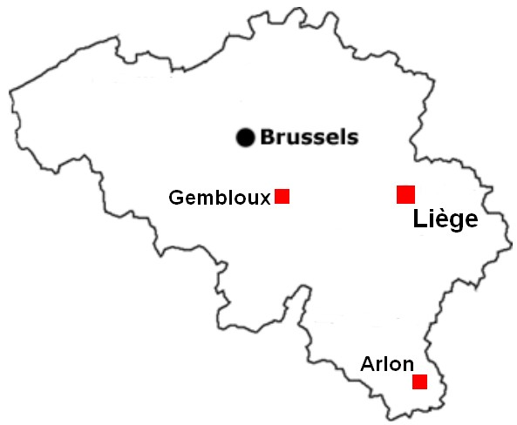
University of Liege (ULg) Library
5 main libraries:
  Arts & Humanities Library
  Agronomy Library
  Law & Social Sciences Library
  Life Sciences Library
  Science & Technology Library
4 campuses:
  Liège Sart-Tilman (main campus)
  Liège City centre
  Gembloux
  Arlon
Staff: about 115 people
(ca 82 FTE)
17 library facilities

Slide 4

Migrating to Primo: context
Project started in March-April 2012
Data
  Local data (Jan 2013)
    Aleph: 1,200,000 bib records
    SFX: 55,000 serials and 66,500 ebooks
    ORBi: institutional repository (http://orbi.ulg.ac.be)
      91,000 archived references (55,500 with a full text)
  Primo Central Index
Two-phased launch:
  Internal launch end of November 2012:
    Only for librarians
    To get used with Primo before the public launch
  Official public launch on 20 February 2013: Life with Primo v4.1

Slide 5
Training sessions
Training sessions given to library staff:
  Dec 2012 - Jan 2013: 10 sessions for max 10-12 people
  Feb 2013: 1 global session with additional Q&A time
    Kind of “everything you ever wanted to know about Primo at ULg”
    About 60 participants
  Audience: anyone working at ULg Library:
    Librarians
    Directors, heads of section, managers
    Secretaries, accountants, computer specialists…
  Content:
    General aspects regarding discovery tools (trends, evolution, advantages…)
    Technical aspects: how Primo works (local data vs PCI, normalization rules, FRBR, Pnx structure…)

Slide 6
Survey
About
  Librarians’ feelings and perceptions about discovery tools in general
    Not about our Primo at ULg!
    Even if it was difficult to avoid in the survey
    What impacts do such tools have on end-users’ habits and searches?
How
  22 statements on discovery tools
    Some of them inspired by:
        Jody Condit Fagan (2012): Top 10 Discovery Tool Myths, Journal of Web Librarianship, 6:1, 1-4 (http://dx.doi.org/10.1080/19322909.2012.651417)
  7 questions on the profile of respondents (functions, degrees, experience…)
  With SurveyMonkey
  Sent by the Primo Team to the whole Library staff
When
  Organized between the training sessions and the official public launch:
    After colleagues have had some experience (but not too much)
    Before colleagues have had contacts and exchanges with end-users.

Slide 7
Respondents
  Survey sent to the whole Library staff: 115
  Really concerned people: ca 100
    < holiday, illness, sabbatical year, Primo Team…
  72 responses  72%: high participation rate!
    3 uncompleted responses (no profile information)
    69 full and exploitable responses

Slide 8

Profile of respondents

Slide 9
Profile of respondents

Slide 10
Survey statements (1/3)
S1: Discovery tools will one day search all of a given library’s collections.
S2: Discovery tools compete with Google.
S3: A single search box (without any possibility of searching through any logical base [scope]) is a plus.
S4: End-users don’t need any training to use discovery tools.
S5: Discovery tools are only useful for beginners and freshmen.
S6: With a discovery tool, end-users will less often ask librarians for help.
S7: With a discovery tool, the use of print resources is going to…
S8: With a discovery tool, the number of loans is going to…

Slide 11
Survey statements (2/3)
S9: With a discovery tool, the number of ILL outgoing requests is going to…
S10: With a discovery tool, the number of ILL incoming requests is going to…
S11: Catalog data (Aleph) cannot be easily identified in the ULg Library Primo.
S12: The fact that Aleph records are not displayed in Marc21 format is a problem.
S13: Given the high number of results, end-users will often be lost when results display.
S14: Having records from Aleph, SFX and ORBi mixed with Primo Central records will be confusing for end-users.
S15: It is not very interesting to allow users to find, through a single interface, additional records to those from the catalog.

Slide 12
Survey statements (3/3)
S16: With a discovery tool, the usage of specialized databases will...
S17: Specialized databases are doomed because of discovery tools.
S18: Advanced Search is essential.
S19: The number of Advanced Searches will be almost as high as the number of Simple Searches.
S20: End-users will have difficulty to know how to get the item they want.
S21: Metadata that discovery tools offer are of less good quality (compared to metadata of specialized databases) and this will lead to searches of less good quality.
S22: Using now a discovery tool in the library will positively change my work.

Slide 13
S1
Discovery tools will one day search all of a given library’s collections.

Slide 14
S1
Comments:
  Print resources will remain!
  Discovery tools will never be able to make complete searches like in special databases (thesauruses…)
  Some databases are very specific and with a very limited number of users. Their content will never interest discovery tools vendors.

Slide 15
S2
Discovery tools compete with Google.

Slide 16
S3
A single search box (without any possibility of searching through any logical base [scope]) is a plus.

Slide 17
S3
→ Infolit subgroup is rather apprehensive (66,6%)

Slide 18
S4
End-users don’t need any training to use discovery tools.
→ 79,7% (strongly) disagree.

Slide 19
S4
From the 24 involved in information literacy…
Percentage of colleagues who disagree is lower (70,9%).

Slide 20
S4 - Comments
Trainings are not so necessary anymore if the discovery tool correctly works.
It depends of the end-users and of how good they can use electronic resources.
With Google, end-users are anyway used to search without any training.
Trainings are not necessary for a basic usage, but trainings remain useful if one wants to use discovery tools properly.
Trainings are useful at the beginning: to unlearn the way it works with the traditional opac.

Slide 21
S5
Discovery tools are only useful for beginners and freshmen.

Slide 22
S6
With a discovery tool, end-users will less often ask librarians for help.

Slide 23
S6

Slide 24
S7
With a discovery tool, the use of print resources is going to…

Slide 25
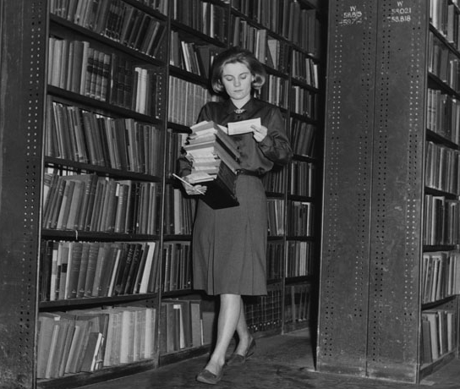
S7 - Comments
Since there are some many more e-resources in the discovery tool than print resources, end-users will certainly be satisfied with e-content.
Print resources are less visible than e-resources.
The decrease of the use of print materials is not directly linked with discovery tools.
Not in my discipline (French language and literature)!
It’s very satisfactory that end-users find useful content without going physically to the library.
Collecting books for readers in the reserve stacks (1964)
http://archives.lse.ac.uk/record.aspx?src=CalmView.Catalog&id=IMAGELIBRARY%2f131

Slide 26
S8
With a discovery tool, the number of loans is going to…

Slide 27
S8 – Fact checking
Decrease?
NB: Spring 2008: huge flood on the main campus, fungal contamination in several libraries → tens of thousands of books placed in quarantine.

Slide 28
S9
With a discovery tool, the number of ILL outgoing requests is going to…

Slide 29
S9 – Fact checking
2013 =
extrapolation

Slide 30
S10
With a discovery tool, the number of ILL incoming requests is going to…

Slide 31
S10 – Fact checking
2013 =
extrapolation

Slide 32
S11
Catalog data (Aleph) cannot be easily identified in the ULg Library Primo.

Slide 33
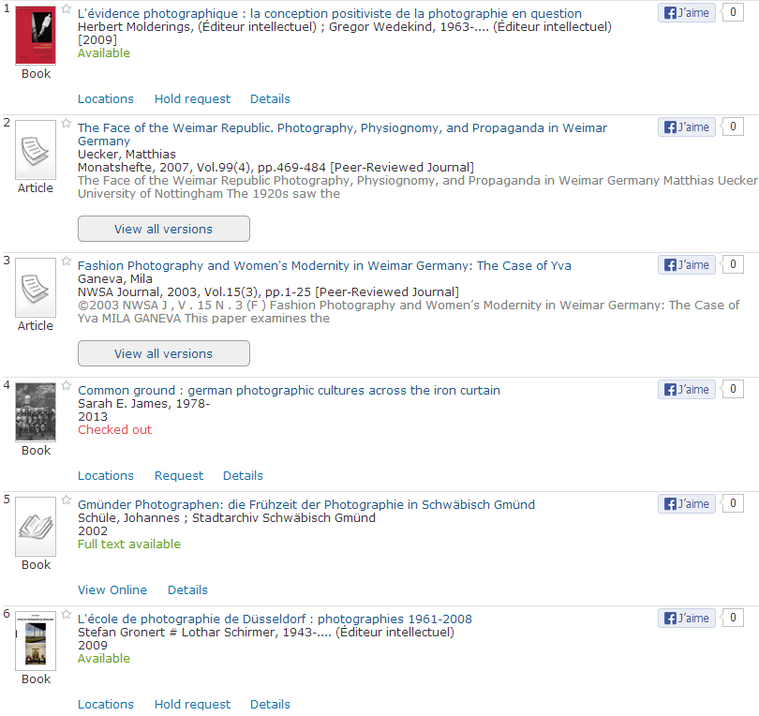
Online records from PCI or SFX

Slide 34
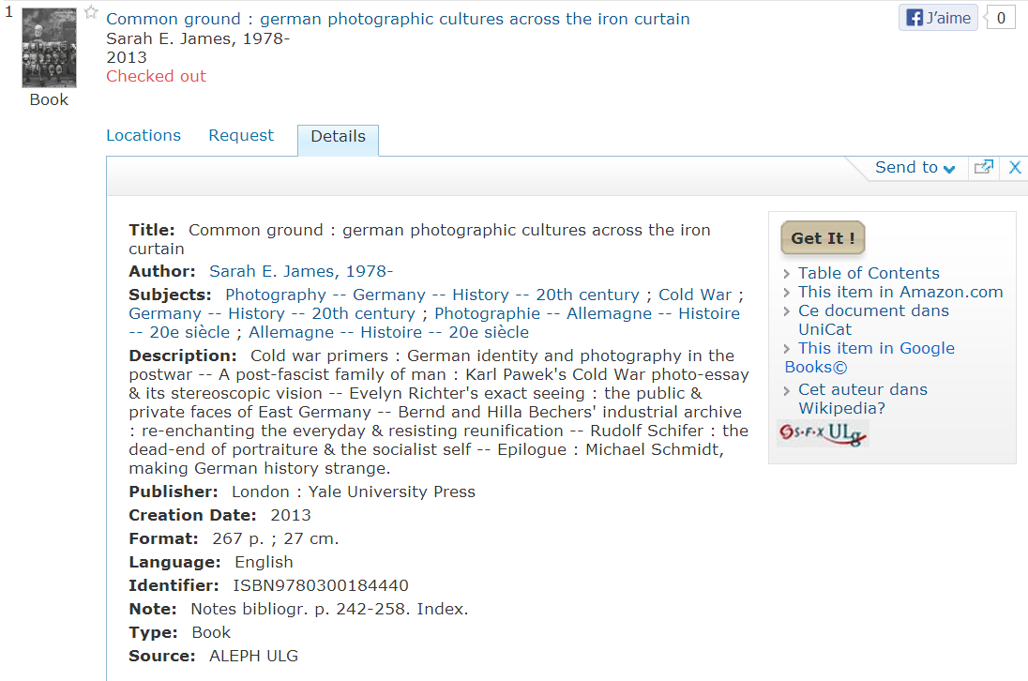
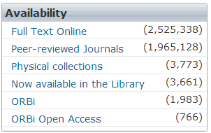
Facets help…
Source indicated in each record!!

Slide 35
S12
The fact that Aleph records are not displayed in Marc21 format is a problem.

Slide 36
S12

Slide 37
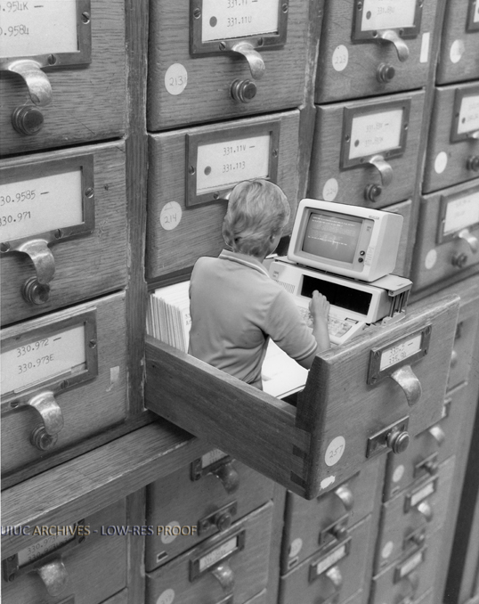
S12 – Comments
Only librarians use them!
Only a problem for librarians.
It might be a problem for librarians from other institutions.
Who cares??? Marc records are not for students or faculty staff. OPACs are not made for librarians!
Woman on Computer in Card Catolog | University of Illinois Archives
http://archives.library.illinois.edu/archon/index.php?p=digitallibrary/digitalcontent&id=6117

Slide 38
S13
Given the high number of results, end-users will often be lost when results display.

Slide 39
S13

Slide 40
S14
Having records from Aleph, SFX and ORBi mixed with Primo Central records will be confusing for end-users.

Slide 41
S14

Slide 42
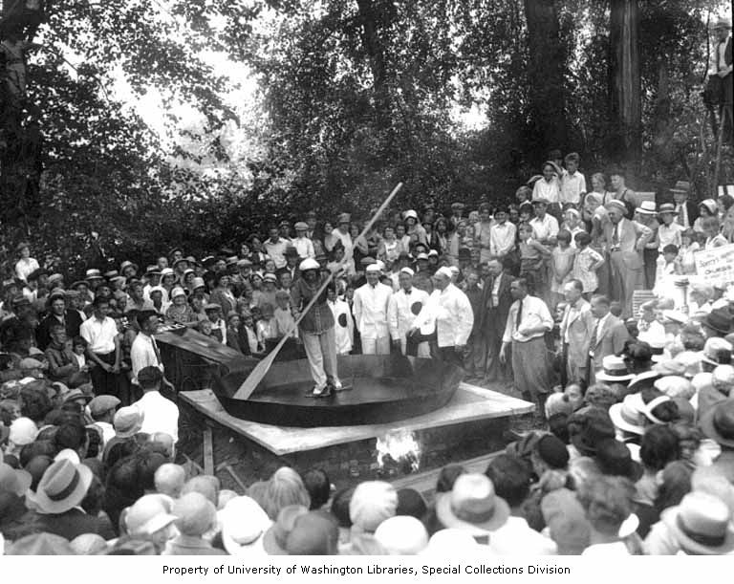
S14 - Comments
Maybe at the beginning, but users will get used to it.
End-users won’t get confused if they attend training sessions.
That’s why training sessions remain important!
Users don’t care about the origin of the records: they only want to access what is interesting to them.
It is genial to have those records mixed. Finding and quickly getting access to the content is the most important. No matter where records come from!
Crowd surrounding a woman skating around a giant skillet with slabs of bacon tied to her feet, holding a giant wooden spatula, Chehalis (WA), ca. 1929-1932 | University of Washington Library
http://content.lib.washington.edu/u?/social,1442

Slide 43
S15
It is not very interesting to allow users to find, through a single interface, additional records to those from the catalog.

Slide 44
Mixed content? Interesting & confusing
S15: Interesting?
S14: Confusing for users?

Slide 45
S16
With a discovery tool, the usage of specialized databases will...

Slide 46
S16 – Fact checking
Searches from March to July
 | % 2010-2011 | % 2011-2012 | % 2012-2013
Ebsco Academic Search Premier | 33% | -49% | -43%
Ebsco Business Source Premier | -3% | -34% | -54%
CAB Abstracts | 109% | -6% | -18%
Ebsco Communication & Mass Media Complete | 33% | -50% | -54%
EconLit | 52% | -61% | -49%
FRANCIS | 30% | -50% | -38%
GeoRef | 56% | -36% | -65%
Historical Abstracts | 56% | -54% | -50%
Index Islamicus (*) | 161% | 13% | 7%
Linguistics and Language Behavior Abstracts (*) | 23% | 111% | 115%
MLA International Bibliography | 71% | -31% | -44%
Philosopher's Index | 56% | -59% | -47%
PsycINFO | -10% | 63% | 12%
ProQuest Sociological Abstracts (*) | -23% | 203% | 46%
(*) New platform for 2012
A significant decrease already occured in 2012.
Impossible to deduce the impact of Primo for 2013!

Slide 47
S17
Specialized databases are doomed because of discovery tools.

Slide 48
S18
Advanced Search is essential.

Slide 49
S19
The number of Advanced Searches will be almost as high as the number of Simple Searches.

Slide 50
S19 – Fact checking
Simple Search vs Advanced Search in our Primo
(from March 2013 until August 2013)
We know that Advanced Search is used by many colleagues!!

Slide 51
S20
End-users will have difficulty to know how to get the item they want.

Slide 52
S21
Metadata that discovery tools offer are of less good quality (compared to metadata of specialized databases) and this will lead to searches of less good quality.

Slide 53

S21
Comparing S21 results with respondents’ experience with discovery tools…
9
How many times have you been using a discovery tool within the last 12 months?

Slide 54
S22
Using now a discovery tool in the library will positively change my work.
44,9% don’t know!
Cause of concern or of expectation?
Are they lost?
Do they puzzle about the change?

Slide 55
Conclusions
Participation rate: 72% -> representative of ULg Library
Rather positive reception of DTs :
  DTs are not strongly criticized or discredited.
  Some perceptions are probably based on own experiences with ULg Primo.
Sometimes perplexity and distrust:
  Single search box (S3)
  Some nostalgy for catalog data (Marc records [S12], identifying catalog records [S11])
Contradictions:
  Single search box (S3) vs « DTs are only for beginners » (S5)
  Content: DTs are at the same time useful (S15) and confusing (S14).
Sometimes too early to draw clear conclusions (loans [S8], ILL [S9, S10], databases usage reports [S16]…)
No real discrepancy between the 24-infolit specialists and the rest of the group.
According to respondents, trainings for end-users remain necessary.
Advanced Search seems to have a future (S18, S19)… But how will it be after using Primo for 2-3 years?
For respondents, specialized databases have a future too (S16, S17, S21).
What about a similar survey (in a similar context) at other libraries?

Slide 56
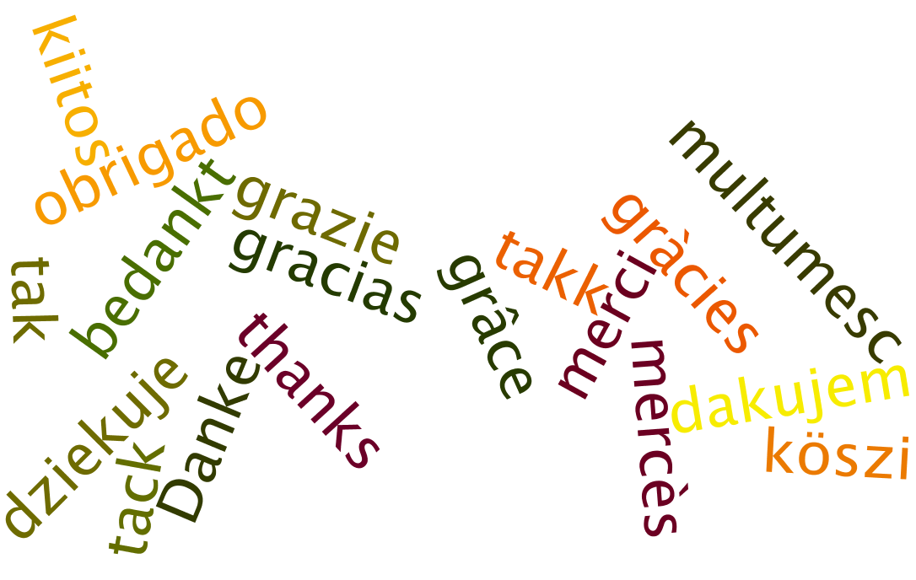
francois.renaville@ulg.ac.be | laurence.richelle@ulg.ac.be | paul.thirion@ulg.ac.be
Presentation available at http://hdl.handle.net/2268/154833

