Slide 1
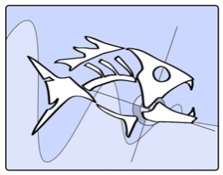
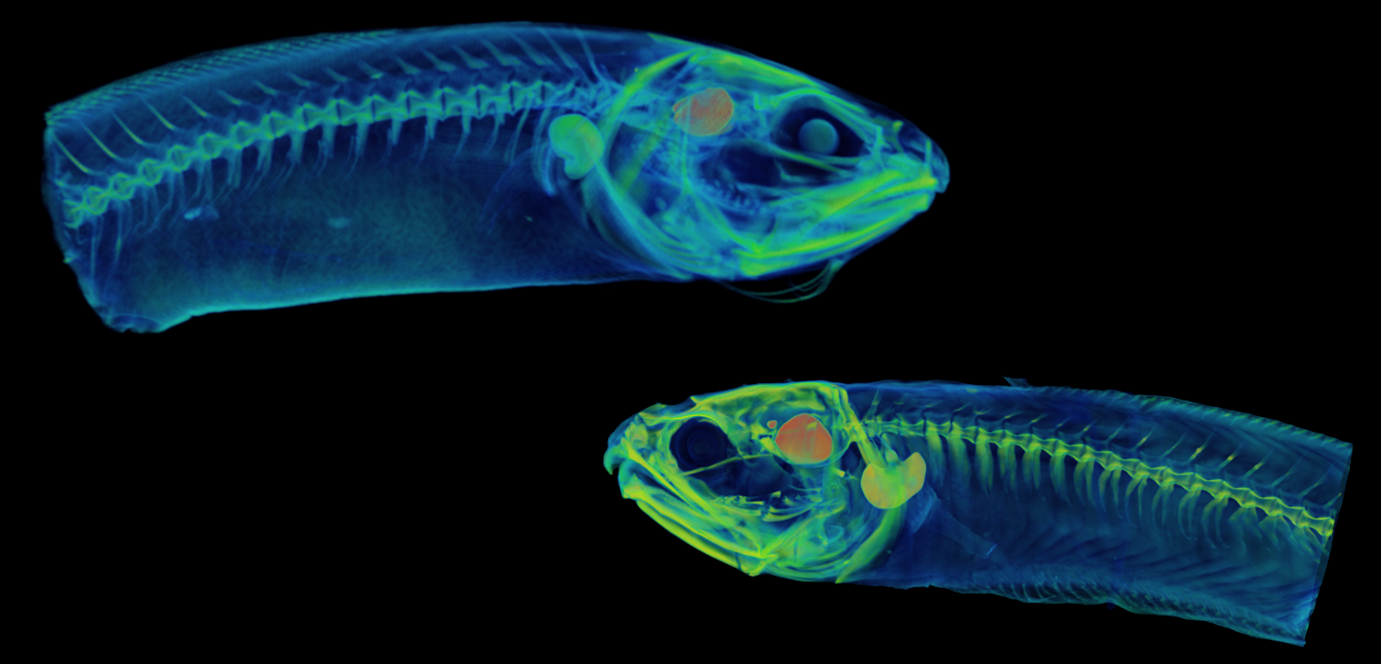
Sound Characteristics and Complex Sonic Apparatus Morphologies in Two Ophidiiformes:
Ophidion rochei (Ophidiidae) and Onuxodon fowleri (Carapidae)
Loïc Kéver*, Orphal Colleye, David Lecchini, Franck Lerouvreur, Eric Parmentier
* e-mail address: Loic.kever@ulg.ac.be

Slide 2
BACKGROUND
Ophidiiformes
( ≥ 350 species)
Ophidioidei
Bythitoidei
Bythitoidei
Ophidiidae
Ophidiidae
Carapidae
Carapidae
Bythitidae
Aphyonidae
Bythitidae
Aphyonidae

Slide 3
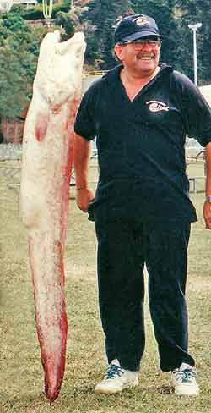
BACKGROUND
Ophidiidae (cusk-eels)
Benthopelagic, shallow to hadal depths
Abyssobrotula galatheae: 3110-8370 m (WR for a fish)
Genypterus blacodes: 200-650 m, max. TL: ≥ 2 m
Ophidion rochei: 0-150m, nocturnal and burrowing behavior
…
Drawing of A. galatheae (FAO)
ACTIVE IN THE DARK
O. Rochei that burrows into the sand
G. blacodes

Slide 4
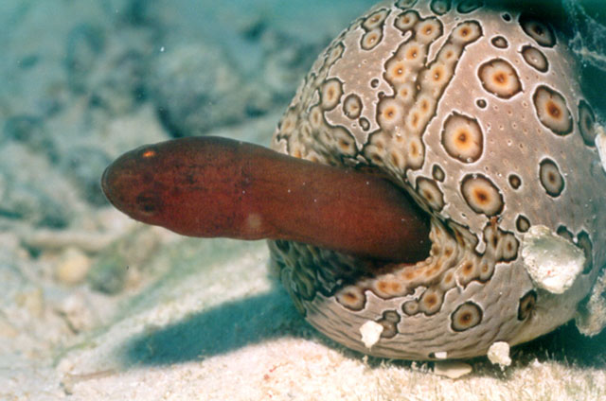
BACKGROUND
Carapidae (pearlfish)
Tropical reefs and warm-temperate waters
Shallow waters to continental slope
Symbiosis with invertebrates is common:
Sea cucumbers: Carapus spp., Encheliophis spp.
Bivalves: Onuxodon spp. and C. dubius
Sea stars: Carapus mourlani
…
Parasites or commensals
(chase during the night)
C. boraborensis entering a sea cucumber
ACTIVE IN THE DARK
Onuxodon fowleri entering a pearl oyster
Notes:
Carapidae has over 30 species that mostly inhabit warm to temperature shallow waters. Adults from many species live in symbiosis with invertebrates. These are generally sea cucumbers, bivalves, or starfish. Onuxodon spp for example live in association with pearl oysters. Symbiotic species parasite their host or feed during the night.
Thus, as Ophidiidae, they are mainly active in the dark.

Slide 5
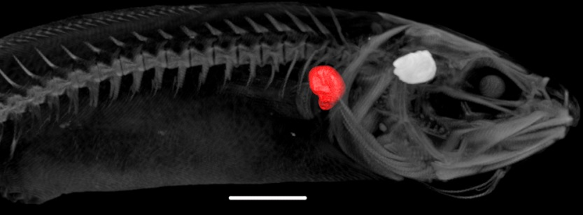
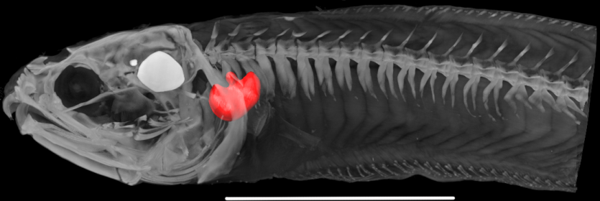
SPECIES CHOICE
Ophidion rochei
Onuxodon fowleri
Ophidiidae
Mediterranean and Black seas
Burrowing behavior
3 pairs of sonic muscles
Rocker bone (RB)
≠
Carapidae
Pacific Ocean
Symbiosis (pearl oysters)
2 pairs of sonic muscles
Rocker bone (RB)
≠
≠
≠
Rocker bone (RB)
=
Rocker bone (RB)
Rocker bone
Rocker bone
10 mm
10 mm
3D reconstruction of an O. rochei
3D reconstruction of an O. fowleri
Convergent evolution?
Function(s) in sound production?
Notes:
The two species we studied differed at many points: family, geographical localistion, habitat, ecology, … However, they are equiped with a unique mineralised structure: the rocker bone. In Ophidiidae, it is present only in males of some Ophidion species. In carapidae, this structure is only observed in the three Onuxodon species.
We hypothized that rocker bone could results from convergent evolution and thus started to investigate advantages it could confers.

Slide 6
AIMS
Sound production in Ophidion rochei (Ophidiidae) and Onuxodon fowleri (Carapidae)
Sonic apparatus morphology in both species
Role(s) of the rocker bone?
Notes:
The two species we studied differed at many points: family, geographical localistion, habitat, ecology, … However, they are equiped with a unique mineralised structure: the rocker bone. In Ophidiidae, it is present only in males of some Ophidion species. In carapidae, this structure is only observed in the three Onuxodon species.
We hypothized that rocker bone could results from convergent evolution and thus started to investigate advantages it could confers.

Slide 7
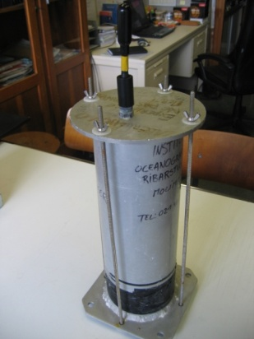
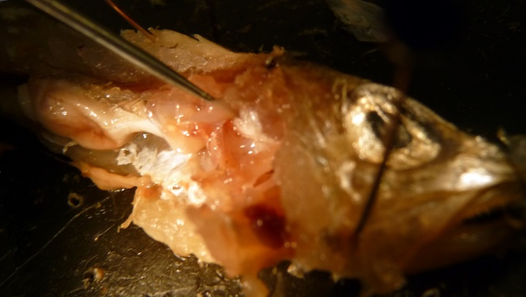
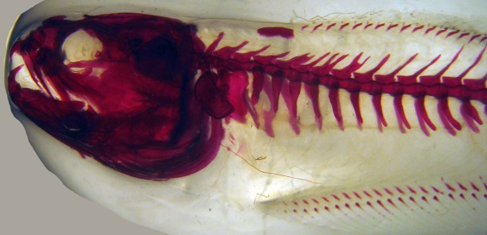
METHODS
Sound recordings: hydrophones
Morphology of sound production mechanism
Alizarin red
Dissections
X-ray
µCT-scan
Notes:
We studied sound production of both species with hydrophones and described their sonic apparatus thanks to dissections, staining techniques, radiographs and µCT-scans.

Slide 8
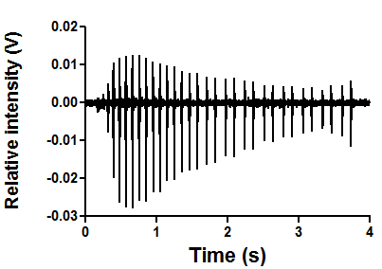
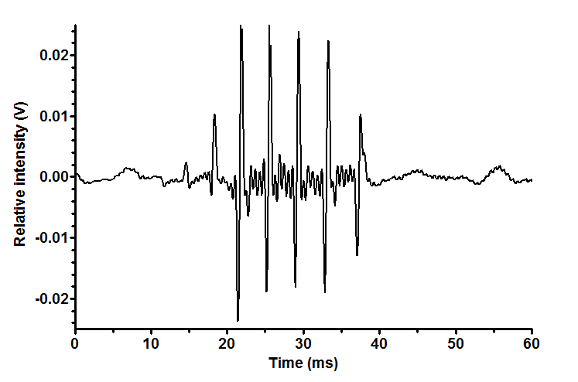
Ophidion rochei: sound production
Type 1 sound = male
Type 2 sound = female and juvenile
Pulse duration: ca. 15-20 ms
1 to 55 pulses
>20 pulses: unique pattern in period
Pulse duration: ca. 1 ms
2 to 21 pulses
No specific pattern in period
Relative intensity (V)
Relative intensity (V)
#
#
Time (s)
Time (ms)
Variations in pulse period duration in a male O. rochei sound
Ocillogram of a typical male O. rochei sound
Variations in pulse period duration in a female O. rochei sound
Ocillogram of a typical female O. rochei sound
Notes:
Sounds recorded for Ophidion rochei can be divided in two principal types: Type 1 sounds often last several seconds while type 2 sounds are much shorter and last generally between 15 and 30 ms. In addition the pulses or peaks differed greatly. Mean was circa 15ms in type 1 sound and circa 1 ms in type 2 sounds. I’ll make you listen to these sounds (play sounds).
Type 1 sounds displayed a very intersting characterisitic at the level of its pulse period. The pulse period correspond to the time from the beginning of peak the the beginning of the next one. The duration of period first rise than in alternates between long and short duration in type 1 sounds but not in type 2 sound.
The specific pattern of type 1 sounds were only observed on long sound (generally longer than 15 pulses). However, pulse number can vary from 1 to 55 pulses.
Type 1 sounds were only produced by males while female and juvenile produce type 2 sounds.

Slide 9
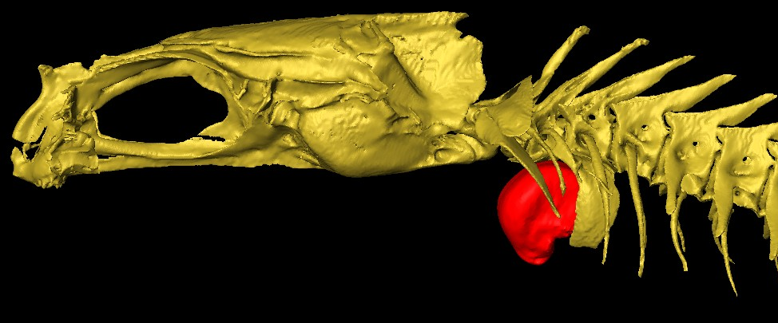
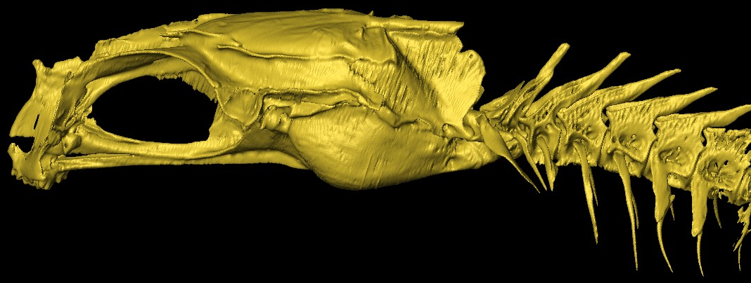
Ophidion rochei: morphology
≠ mineralized structures
Neurocranium
Neural rocker
II
Neurocranium
III
IV
Neural rocker
I
V
VI
Rocker bone
2mm
2mm
Swimbladder plate
Swimbladder plate
Neurocranium
Neural rocker
Neurocranium
II
III
Neural rocker
I
IV
V
VI
2mm
Swimbladder plate
2mm
Swimbladder plate
Left lateral views of neurocranium and anterior vertebral column of male and female O. rochei
Dorsal views of neurocranium and anterior vertebral column of male and female O. rochei
Notes:
Important differences were also observed in sonic apparatus morphology. Despite all morphotypes had 3 pairs of sonic muscles, these muscles differed in shapes, sizes, and insertion points. The ventral sonic muscle insert on rocker bone in males while it inserts directly on the swimbladder in other morphotypes. Important differences were laso observed at the level of the first ribs and vertebrae.

Slide 10
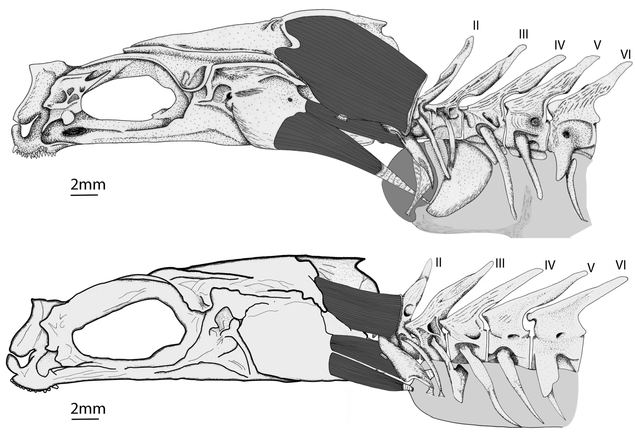
Ophidion rochei: morphology
≠ shapes
≠ sizes
≠ insertion points
Neurocranium
Dorsal sonic muscle
I
Intermediary sonic muscle
Ventral sonic muscle
Parmentier et al. 2010
Rocker bone
Neurocranium
Dorsal sonic muscle
Swimbladder
I
Intermediary sonic muscle
Ventral sonic muscle
Kéver et al. 2012
Swimbladder
Left lateral views of neurocranium, anterior vertebral column, swimbladder and sonic muscles in male and female O. rochei
Notes:
Important differences were also observed in sonic apparatus morphology. Despite all morphotypes had 3 pairs of sonic muscles, these muscles differed in shapes, sizes, and insertion points. The ventral sonic muscle insert on rocker bone in males while it inserts directly on the swimbladder in other morphotypes. Important differences were laso observed at the level of the first ribs and vertebrae.

Slide 11
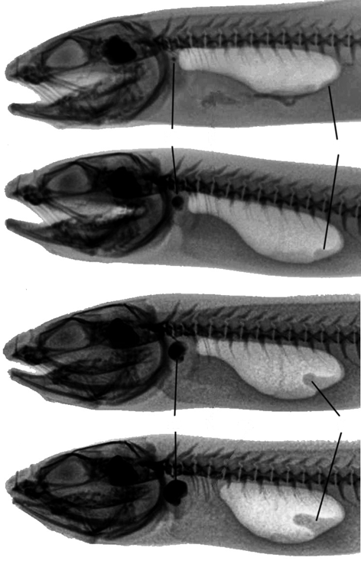
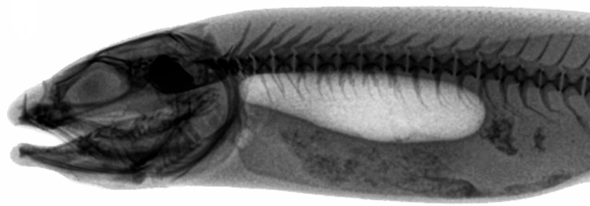
Ophidion rochei: morphology
Juvenile
Juveniles
Puberty
Swimbladder
Adults
Sonic apparatus complexity
Radiograph of a typical juvenile O. rochei
Swimbladder
M
A
T
U
R
A
T
I
O
N
Rocker bone
Internal tube
Ontogeny
Rocker bone
Internal tube
Swimbladder
1cm
1cm
Radiographs of male O. rochei
during its sexual maturation and at maturity
Radiograph of typical female O. rochei
at maturity
Notes:
In Ophidion rochei rocker bone is clearly appear and grow during male sexual maturation. Other strcutres as the internal tube of male swimbladder also appear during maturation.

Slide 12
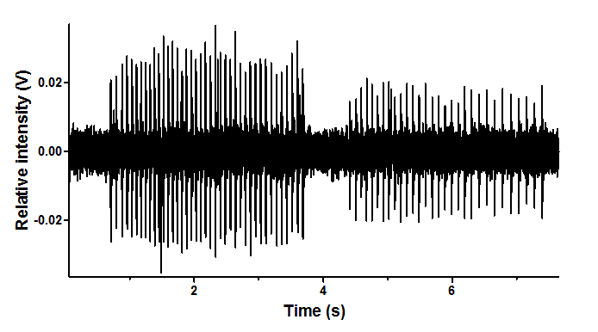
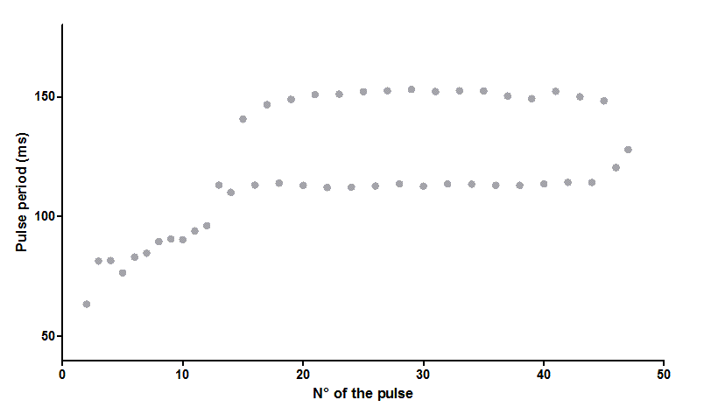
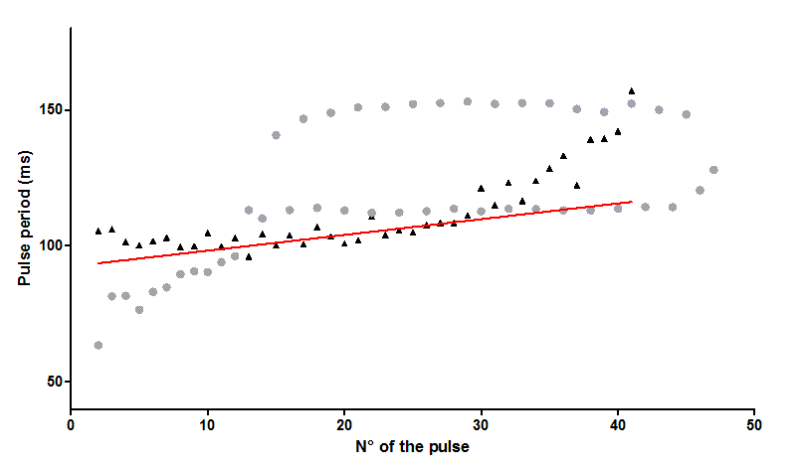
Onuxodon fowleri: sound production
1 sound type:
- Pulse duration: ca. 20 ms
- 1 to 41 pulses
Ophidion rochei
> 20 pulses
Onuxodon fowleri
y = 92.5 + 0.6x
#
(s)
#
Variations in pulse period duration in Onuxodon fowleri and male O. rochei sounds
Notes:
Nowadays, only a single type of sounds was recorded. The number of pulse could show great variations however sounds could last for several seconds. Pulses in these sound last for ca. 20 ms.
No specific pattern was observed in period duration except that is became slighlty longer along the sound.

Slide 13
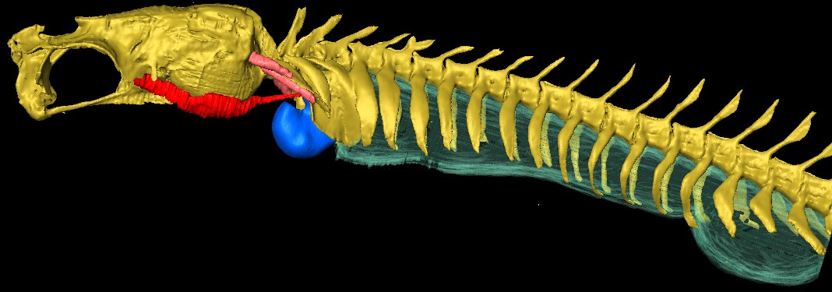
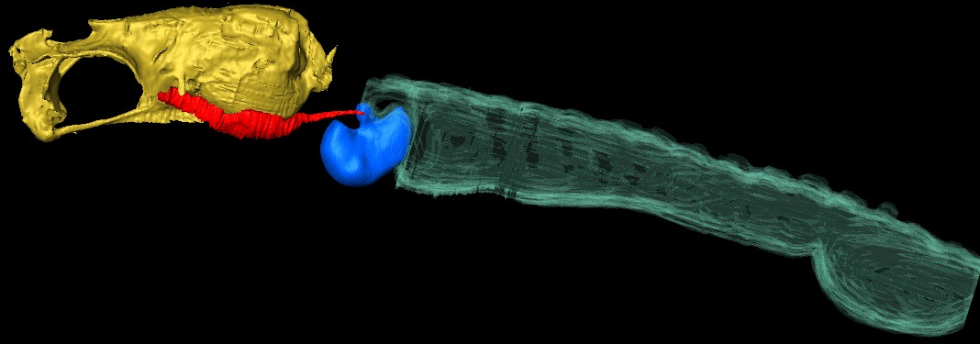
Onuxodon fowleri: morphology
Neurocranium
II
III
I
IV
V
VI
Primary sonic muscle
Secondary sonic muscle
Rocker bone
Swimbladder
Secondary sonic muscles
Plates
Primary sonic muscles
2 mm
Left lateral and ventral views of neurocranium, vertebral column, swimbladder, rocker bone, and sonic muscles of Onuxodon fowleri
Notes:
The Onuxodon we captured were between 59.5 mm and 80 mm in TL. All fish investigated to date had a rocker bone. However, this structure could show small differences in its shape from one specimen to an other. Courtenay in 1970 also mention modification with size but no sexual dimorphism. As you can the primary sonic muscle of Onuxodon originate in the orbit and insert on the rocker bone. As male O rochei, O. fowleri also had huge swimbladder plate. A second pair of muscle is also consider as a part of the sonic apparatus it is the secondary sonic muscle which insert on the 1st pair of ribs

Slide 14
Comparison between O. fowleri and O. rochei
 | O. Fowleri (Carapidae) | Male O. rochei (Ophidiidae) | Female O. rochei (Ophidiidae)
Sounds up to several seconds | YES | YES | NO
Sounds over 30 pulses | YES | YES | NO
Pulse duration over 10 ms | YES | YES | NO
Period over 50 ms | YES | YES | NO
Unique period pattern | NO | YES | NO
3 pairs of sonic muscles | NO | YES | YES
Rocker bone | YES | YES | NO
Very large plates | YES | YES | NO
Notes:
This table allow a rapid comparison between O. fowleri and O. rochei. It is clear that sounds of male O. rochei resssemble more the sound of O. fowleri than those of female O. rochei. As shown by the 4 first line in the table, male O. rochei and O. fowleri are able to produce long sound composed of numerous large pulses that are well isolated. Despite the differences in period pattern and number of sonic muscles, they also show similarities in their sonic apparatus morphology. Both have a rocker bone and large swimbladder plates witch is not the case in female O. rochei.

Slide 15
Discussion & conclusions
RB evolved under strong physical constraints… long sounds
long pulses
Higher intensity?
Juvenile and female O. rochei
Neurocranium
Tendon
Tendon
Sonic muscle
Swimbladder (Sb)
Sb
Schematic representation (left lateral and frontal views) of sonic muscle insertion on the swimbladder in female and juvenile Ophidion rochei
Male O. rochei and Onuxodon fowleri
Neurocranium
Tendon
Tendon
Swimbladder
Sonic muscle
Swimbladder
Rocker bone
Rocker bone
Schematic representation (left lateral and frontal views) of sonic muscle insertion on the rocker bone in Onuxodon fowleri and male Ophidion rochei
Notes:
Note that the presence of the rocker bone is paralleled with long pulse period in O. fowleri and male O. rochei . It suggest longer rest between muscle contraction and thus lower the cost of long soun production.
We suggest that the rocker bone and large swimbladder plate evolved in response to high physical contraints caused by long and intense sound production.

Slide 16
Discussion & conclusions
Presence of a rocker bone
Caused by constraints related to sound production
Convergent evolution
Additional studies are needed…
Notes:
Note that the presence of the rocker bone is paralleled with long pulse period in O. fowleri and male O. rochei . It suggest longer rest between muscle contraction and thus lower the cost of long soun production.
We suggest that the rocker bone and large swimbladder plate evolved in response to high physical contraints caused by long and intense sound production.

Slide 17
Thank you for your attention…
Funds: FRIA (F.R.S.-FNRS)
e-mail address: Loic.kever@ulg.ac.be

Slide 18
Conclusions
Rocker bone might evolve to ameliorate swimbladder physical resistence to long and intense sound production…
Rocker bone could lower the cost of long sound production…
Swimbladder plate could affect resonance of sound apparatus.
Further studies are needed…

Slide 19
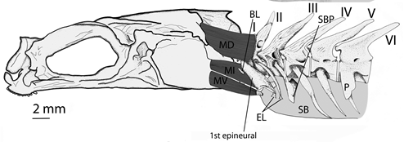
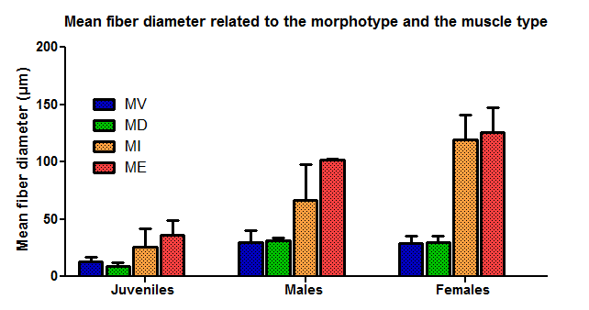
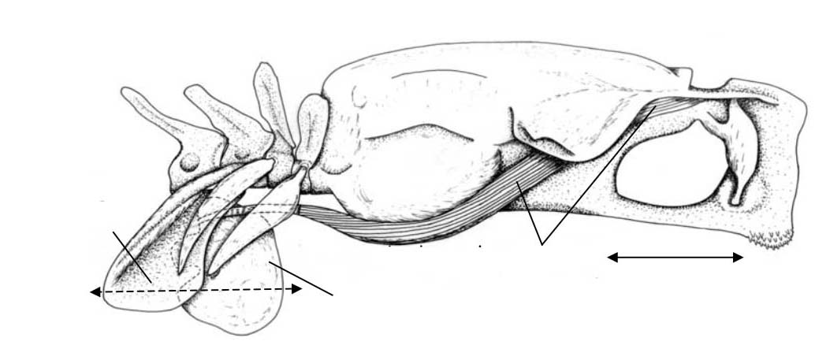
Annex 1

Slide 20
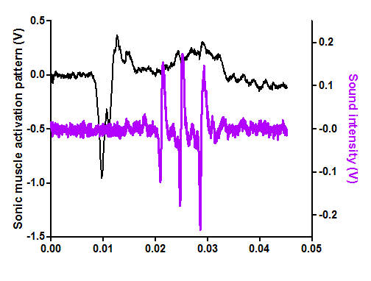
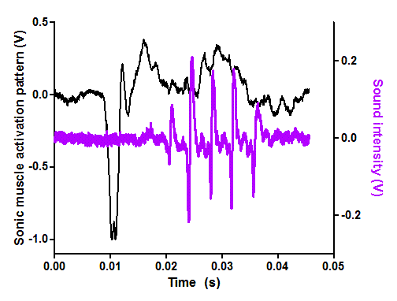
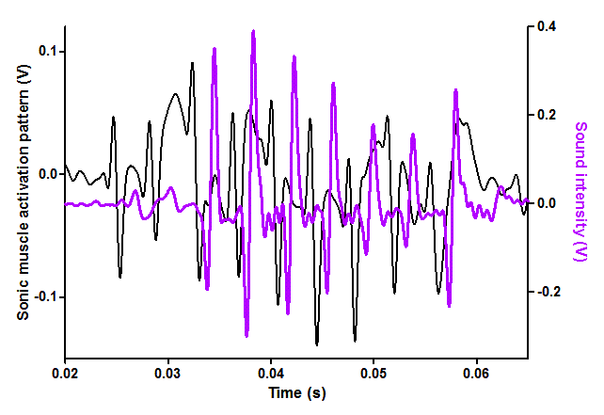
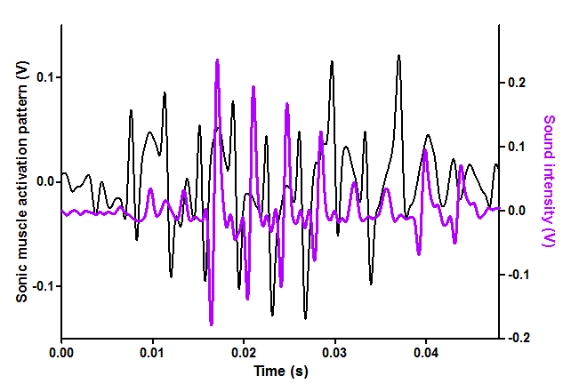
Annex 2
1 female:
MSD
MSV

Slide 21
Comparison with other Ophidioidei
 | Carapidae |  |  |  |  | Ophidiidae
 | E. gracilis | C. acus | C. homei | C. mour. | C. bora. | O. margi.
Sound duration (s) | ca. 0,2 | ca. 0,035 | 3-5 | ca. 0,05 | 3-14.5 | ca. 1
Number of pulses | 5-6 | 1 | ca. 10 | 1-2 | 10-83 | 1-27
Pulse durartion (ms) | ca. 20 | ca. 35 | ca. 200 | ca. 25 | ca. 100 | ?
Period (ms) | ca. 40 | / | ca. 330 | ca. 35 | ca. 200 | 50
Swimbladder plate | Large | Large | ? | ? | LARGE | ?
Rocker bone | NO | NO | NO | NO | NO | NO
THS | NO | YES | NO | YES | YES | NO
SWP: swimbladder plate. Pulse dur.; pulse duration. E. gracilis: Encheliophis gracilis. C. acus: Carapus acus. C. homei: Carapus homei. C. mour.: Carapus mourlani. C. bora: Carapus boraborensis. O. margi.: Ophidion marginatum
Notes:
Sons Homei et bora: Lagardère 2005
Bora morpho: Parmentier 2006
Presence of THS: Parmentier et al 2008

Slide 22
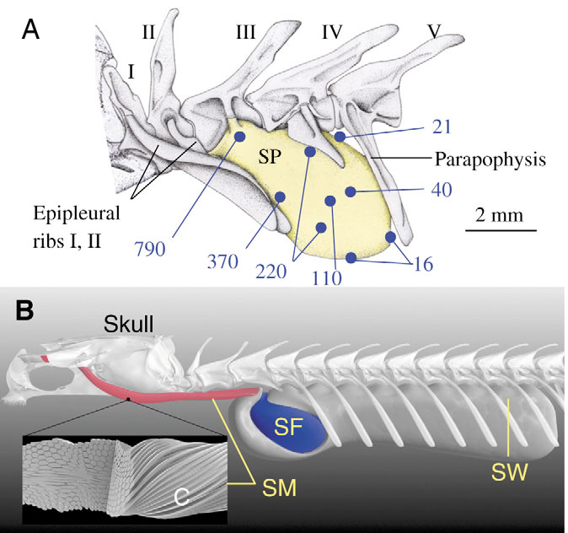
Comparison with other Ophidioidei
Notes:
Sons Homei et bora: Lagardère 2005
Bora morpho: Parmentier 2006
Presence of THS: Parmentier et al 2008

Slide 23
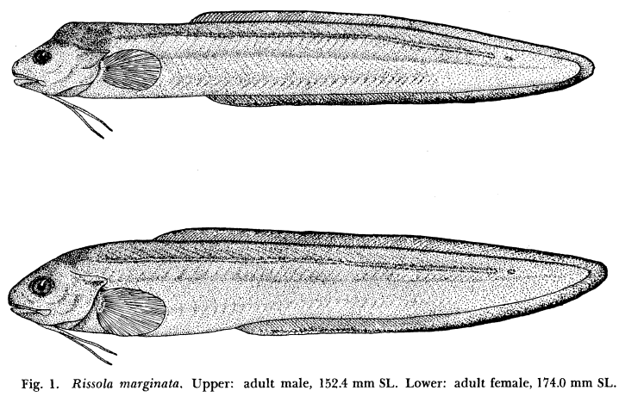
Comparison with other Ophidioidei
Notes:
Sons Homei et bora: Lagardère 2005
Bora morpho: Parmentier 2006
Presence of THS: Parmentier et al 2008

Slide 24
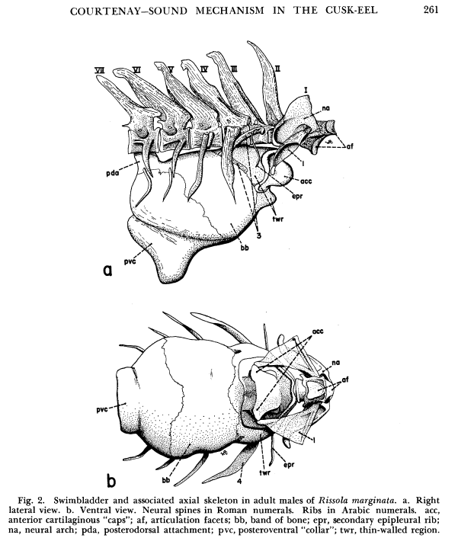
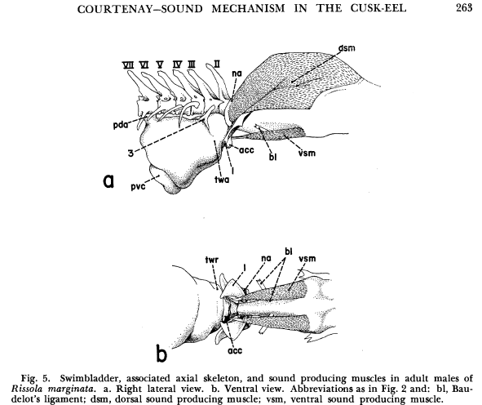
Comparison with other Ophidioidei
Notes:
Sons Homei et bora: Lagardère 2005
Bora morpho: Parmentier 2006
Presence of THS: Parmentier et al 2008

Slide 25
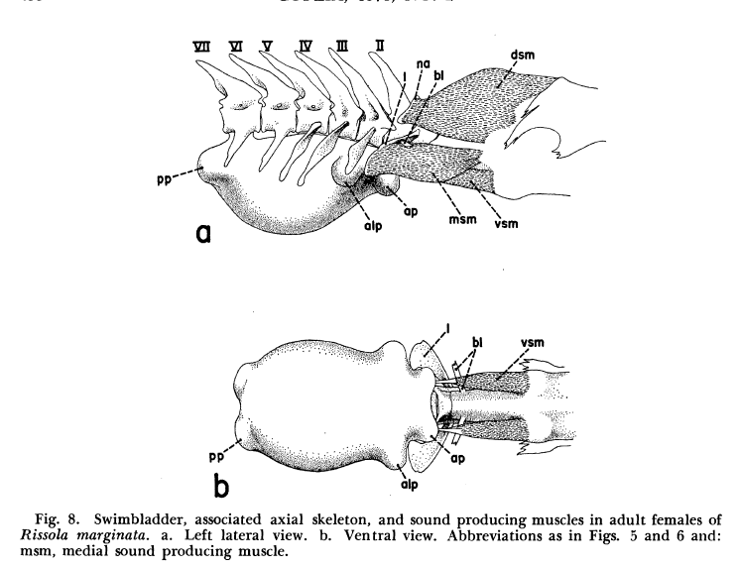
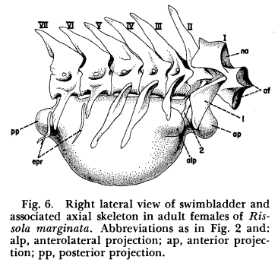
Comparison with other Ophidioidei
Notes:
Sons Homei et bora: Lagardère 2005
Bora morpho: Parmentier 2006
Presence of THS: Parmentier et al 2008

Slide 26
Discussion and conclusions
Rocker bone:
Adaptation to produce long pulsed sounds (high mechanical constrains)
However Ophidiiformes species with different no RB but other modifications also produce long pulsed sounds
Sound intensty?
High sound production rate? (Higher resistence to physical constrains)
…
Sexual dimorphism in O. rochei but not in O. fowleri.
If rocker adapted for sound production:
-their should be differences in role of soundS?
- Male O. rochei attract female for reproduction thanks to their sound
- Unknown in O. fowleri
Differences in swimbblader resistence
- O. rochei have reltively thick swimbladder wall
- O. fowleri have thin swimbladder wall

Slide 27
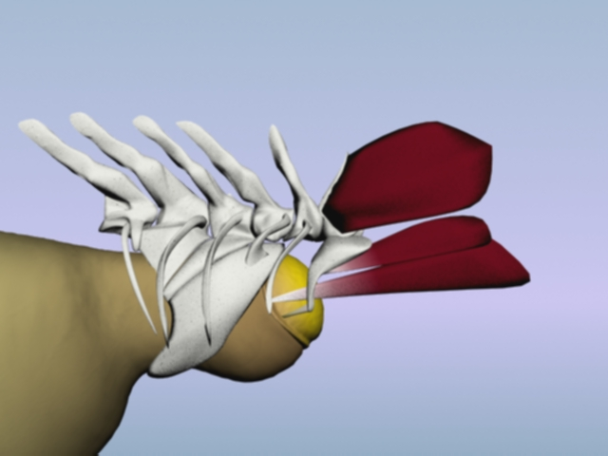
BACKGROUND
Ophidiidae & Carapidae
Complex and diversified sound production mechanisms:
> 1 pair of sonic muscles
modified anterior vertebrae and ribs
modified swimbladder
Swimbladder plate
Sonic muscles
Tail
V
Skull
Swimbladder
Sonic apparatus of male O. rochei
Notes:
The sonic apparatus has been described in many Ophidiidae and Carapidae. It is based on sonic muscles associated with the swimbladder. This is common in teleosts, however, there is a higher degree of complexity in the present families. Their sonic apparatus is generally composed of two or three pairs of sonic muscles, and highly modified vertebrae, ribs, and swimbladder.

