Slide 1
Dihydrogen Storage & distribution
Frédéric Stevens
Thesis seminar
LCIS-GREENMat

Slide 2
Presentation’s main points
Introduction
Targets and problems
Storage & Distribution method
Materials for solid storage
Conclusions

Slide 3
Introduction
Etymology
Dihydrogen
Dihydrogen
H
H
Dihydrogen
Hydro = water
Gen ← genan = to generate
History
Luft erhebt sich und bricht herfdir gleichwie ein Wind
(‘Archidoxa‘, Paracelsus (1493-1541))
Cavendish Henry : Inflammable air (1766)
Lavoisier Antoine: Hydrogen (1783)
2 H₂ + O₂ → H₂O
Notes:
idem

Slide 4
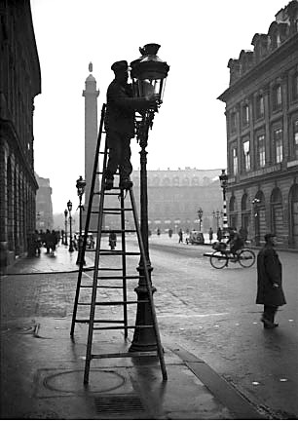
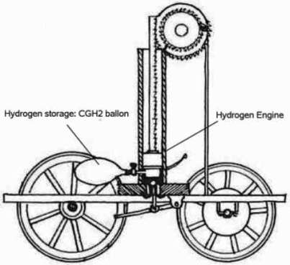
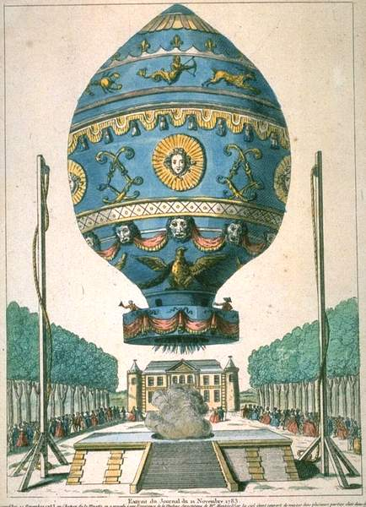
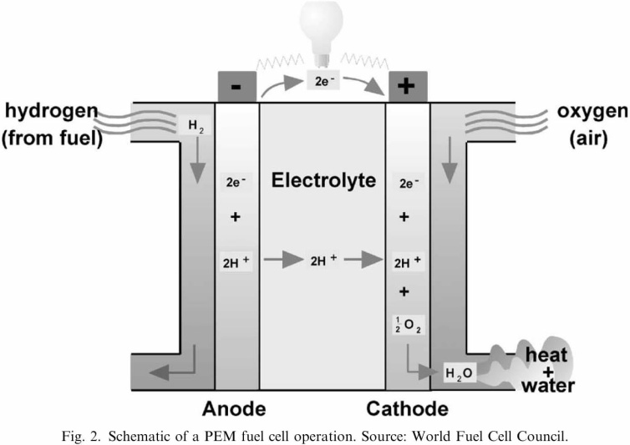
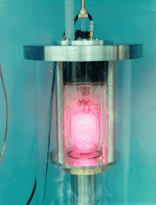
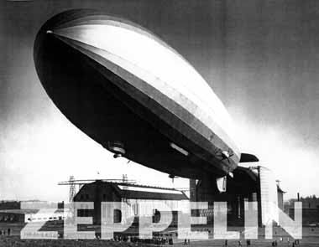
Introduction
Applications
Internal combustion engine
(1806 Rivaz)
Streetlight in Paris
(P. Lebon 1786)
Montgolfier brother (1783)
Hydrogen maser
1952 :Pr Robert H. Dicke
Hydrogen fuel cell
(W. R.G roove 1839)
Zeppelin 1900
Notes:
idem

Slide 5
Introduction
Popular reactions
1897 - Paul Sabatier
1901 - Wilhelm Normann
N₂ + 3H₂ → 2 NH₃
1910 - Fritz Haber
1923 - BASF
C₂H₅-S-C₂H₅ + 2 H₂ → H₂S + 2 C₂H₆
1949 - Hydrodesulfuration
Notes:
Le secteur de la chimie exploite l’hydrogène dans de nombreuse réaction:
Les premières réactions consistent à cliver une double liaison C-C que ce soit via sabatier ou normann
Depuis 1910 haber synthétise l’ammoniac
Viendront ensuite la synthèse du metanol et le procédé d’hydrodésulfuration

Slide 6
Introduction
57,6.10⁶ ton/year ¹
¹ AFH2 feb 2008
Notes:
Consommation répartie comme telle
Quantitée consommée =

Slide 7
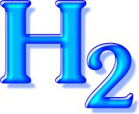
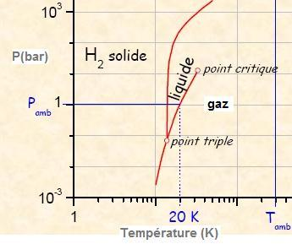
Introduction
Phase diagram
Fuel Type | Energy Content (kJ/g)¹
dihydrogen | 120
Natural gas | 50
Kerosene | 46
Methanol | 20
H₂ + ½ O₂ → H₂O
∆H= -285,97 kJ/mol at 25°C
 | H₂ | CH₄
Flammability limit | 4-76% | 5-15%
density | 0,09 kg/m³ | 0,67 kg/m³
Notes:
Mais après toutes ces applic et ces réaction, il serait p-ê temps de s’intéresser à ses propr…
Voici un diag
Si on est a T et P amb, H2 = gaz
Pour avoir le liq à P amb, il faut descendre à 20K
Vous savez dèjà que bruler de l’hydrogène produit de l’eau, maintenant, vous voyez que cette réaction est exothermique
Donc cette molécule contient de l’E, qui plus est, c’est un des fuel le plus énergétiques que nous connaissons
De plus, il est non toxic
En fait le principal problème de l’hydrog c’est son inflammability qui se passe dès qu’on atteind les 4% en ??
Mais rassurez vous, cette qtt n’est que très rarement atteinte car sa densité est vraiment trop faible et en cas de fuite il ne fait que se diluer.

Slide 8
Targets and problems
Why H₂ is not use as fuel for our cars?
➔ Production
➔ distribution and storage

Slide 9
Targets and problems
H₂ is too volatile → unexploitable quantities in the nature
→ Must be produced

Slide 10
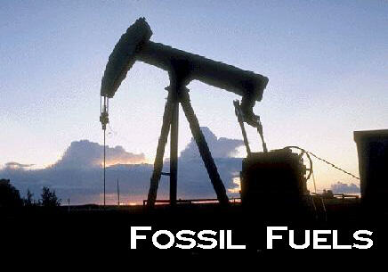
Targets and problems
Produced from other compounds
CH₄
C_{n}H_{m}
H₂O

Slide 11
Production: Synthesis
Steam reforming
CH₄ + H₂O ⇌ CO + 3 H₂
CO + H₂O → CO₂ + H₂
Partial oxidation
C_{n}H_{m} + n/2 O₂ → nCO₂ + m/2 H₂
Plasma reforming
CO₂ + CH₄ → 2CO + 2H₂
Coal gasification
3C + O₂ + H₂O → 3CO + H₂
Electrolysis
E= external applied voltage
Thermolysis
E= heat
Thermochemical process
E= heat + other molecules
E= sun
Catalyst = biomolecule
Photobiological water splitting
E= sun
Catalyst = inorganic compound
Water
Photocatalytic water splitting
2H₂O + Energy → O₂ + 2H₂

Slide 12
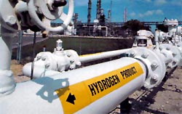
Targets & Possibilities
100 kg - 1 ton and more
Immobile and huge quantities
Pipelines

Slide 13
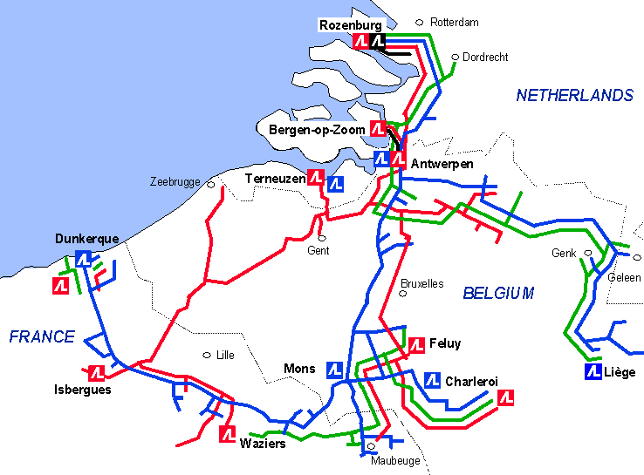
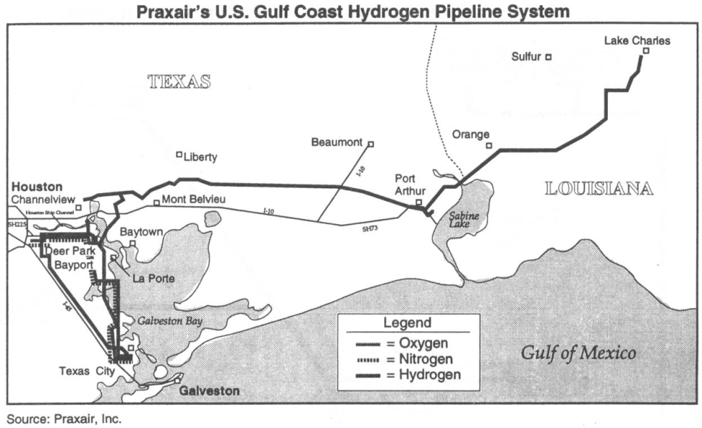
Pipelines
Old technology (1938)
Underground steel pipes (50 years old)
No famous damage registered
For more than 1 ton
P= 3.4 to 100 bars
Ø = 10 – 300mm
Under development:
To reduce the cost
To reduce the weakening of steel provoked by H₂
To improve the soldered joints
To improve the compression technology
H₂
O₂
N₂
EU: 1500km
USA: 1150 km

Slide 14
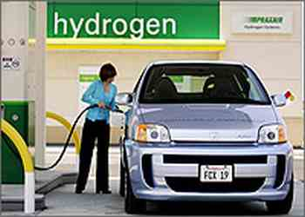
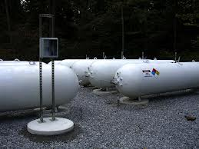
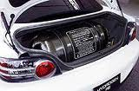
Targets & Possibilities
100 kg - 1 ton and more
100 kg -1 ton
< 100kg
Immobile and huge quantities
Mobile and/or limited quantities
Pipelines
Tanks

Slide 15
Requirements for cars
Cars

Slide 16
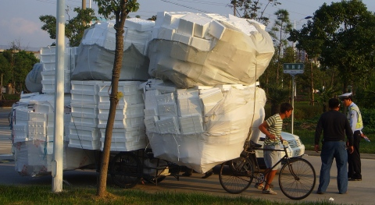
Summary of the requirements
Cars
500km /full tank
Storing device (to compete fossil fuel)
6kg d’H₂/100kg of storing device
45kg d’H₂/m³ of storing device
Working temperature: -30°C to 150°C
Suitable pressure

Slide 17
Possibilities
Gas, supercritical fluid
700 bar
High pressure hydrogen storage
Liquid
Cryogenic hydrogen storage
Phase diagram
Organic liquid
Solid state hydrogen storage
Min 6 wt. %

Slide 18
Gas storage: Composite pressurized tank
Internal pressure: 700 bar but still too voluminous
most developed technology

Slide 19
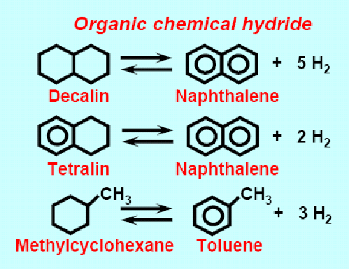
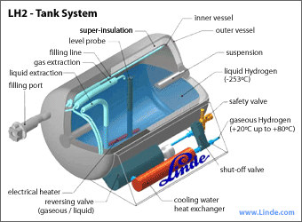
Liquid storage:
Cryogenic hydrogen storage
Organic liquid
70.8 kg/m³
Liquefaction require too much energy
Loss of efficiency due to evaporation
Voluminous insulation
6,1 wt %
Rest products must be recycled in plants for rehydrogenation
Conversion Yield <<100%
Expensive
Dirty
Conclusions
Unprofitable from practical and economical point of view at least for on-board storage system

Slide 20
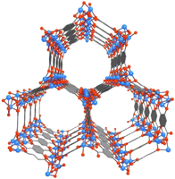
Solid state hydrogen storage
Adsorbed on surfaces
metallic glasses
carbon-based compound
Zeolithe
MOFs
Structural
hydrides

Slide 21
Adsorption on surface
Solid state hydrogen storage
Zr_{52.5}Cu_{17.9}Ni_{14.6}Ti₅Al₁₀ alloy*
Morphology of metallic glass
Amorphous storage capacity ~ micro-structure
too high desorption temperature
* Cheng 2009

Slide 22
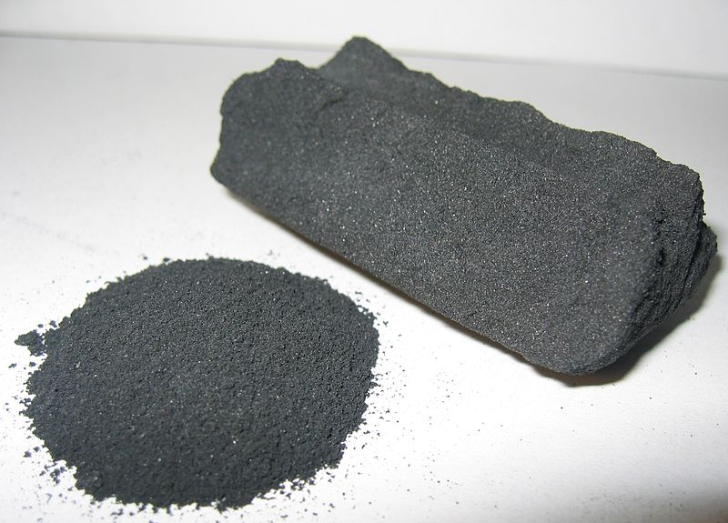
Adsorption on surface
Solid state hydrogen storage
Active carbon
Synthesis
Anaerobic pyrolysis of wood or other C-based compound
* Physical Activation: 950°C + pressurized water steam ➔ small pores
* Chemical activation: 450°C + H₃PO₄ ➔ big pores
conclusion
partially controlled porosity storage capacity
1315 m²/g 2 wt. % (not enough)

Slide 23
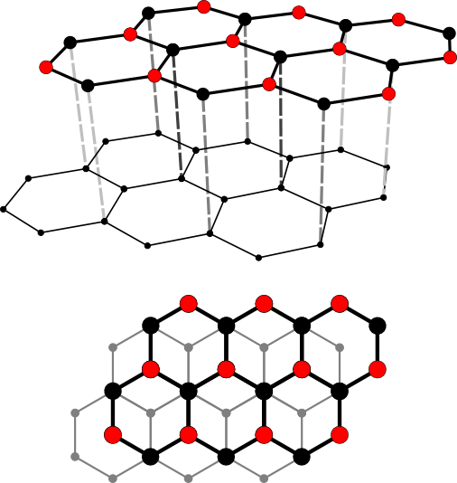
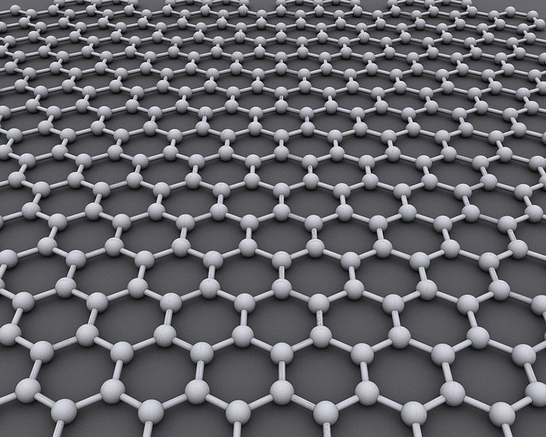
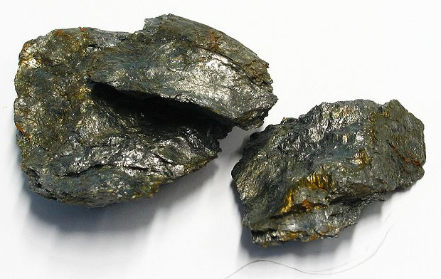
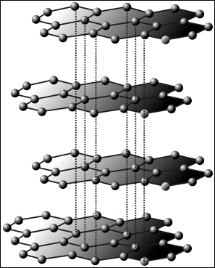
Adsorption on surface
Solid state hydrogen storage
Graphite
Native element
No intercalation
- - - - - - - - - - -
0,3355 nm
- - - - - - - - - - -
H-H
0,4059 nm
1315 m²/g
➔ 3,3 wt. %
- - - - - - - - - - -
OK

Slide 24
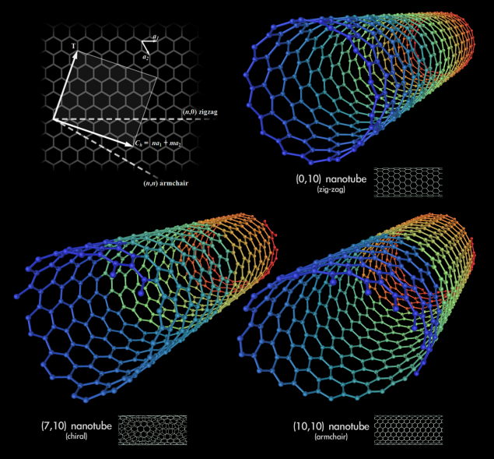
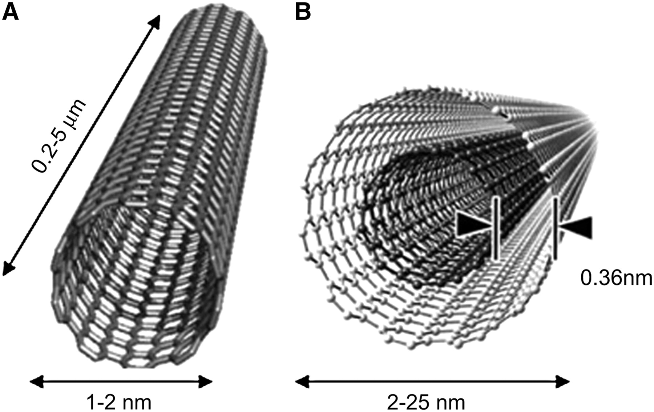
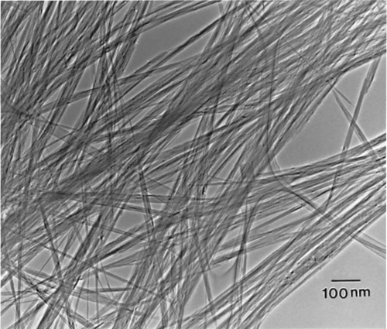
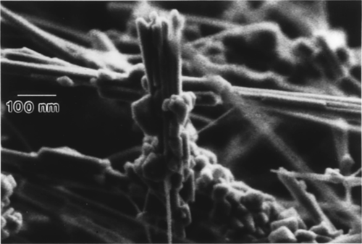
Adsorption on surface
Solid state hydrogen storage
Carbon Nanotube
SWCNT (zig-zag, armchair, chiral)
MWCNT
Synthesis
A) High Temperature
vaporisation → condensation
Electric arc, T= 6000°C
Laser, T= 4800°C
MWCNT
plasma
Pyrolysis (750°C) + air
graphite

Slide 25
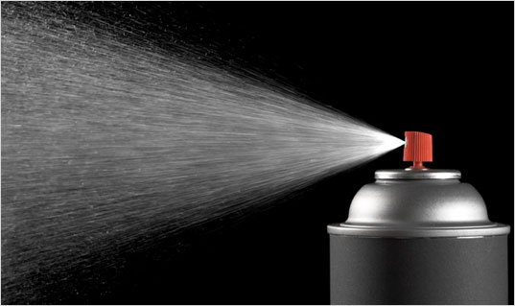
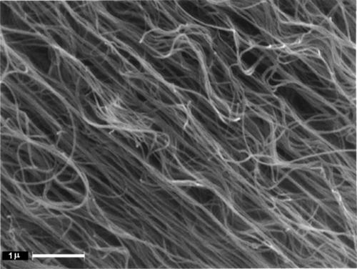
Adsorption on surface
Solid state hydrogen storage
Carbon Nanotube
SWCNT
B) CVD
800°C
CH₄,C₂H₂, C₆H₆, …
+
Metallic precursor
(Co, Ni, Fe, Pt or Pd)
Ar
C) Catalysis
CO, C₂H₂, CH₄, …
Pyrolysis
700-1200°C
Fe, Ni,Co,…
Fe, Ni,Co,…
MWCNT/Co

Slide 26
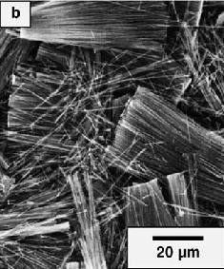
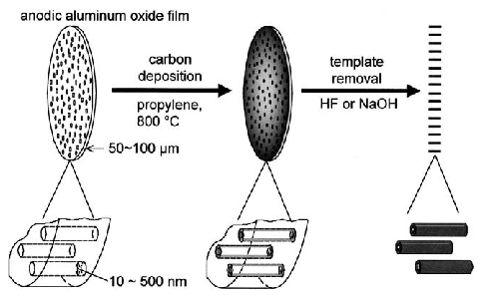
Adsorption on surface
Solid state hydrogen storage
Carbon Nanotube
dissolution du
template Al
MWCNT

Slide 27
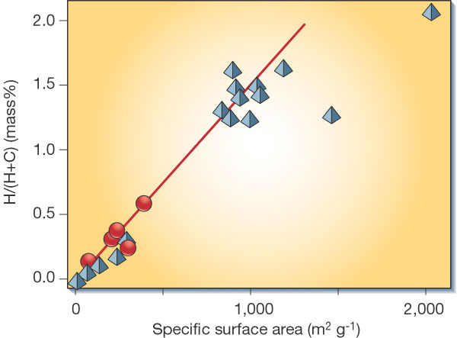
Carbon-based compound
Solid state hydrogen storage
Adsorption on surface
SWCNT and MWCNT (zig-zag)
Red circle = CNT
Blue triangle = Nanostructured carbon sample
Wt. % too small for on-board storage system

Slide 28
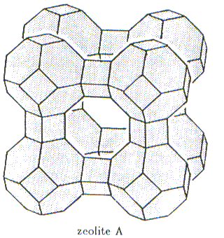
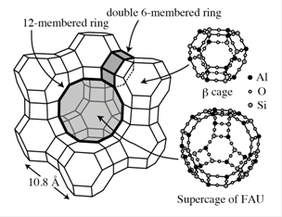
Solid state hydrogen storage
Adsorption on surface
Zeolithe
Aluminosilicate: [Al_{x}Si_{y}O_{2x+2y}]^{x-}
Variables
Pore size → size of organoamonium
Si/Al ratio
Synthesis
Na₂SiO₃ + Al(OH)₃
Low Si/Al ratio
(Me₄N)OH
100-200°C
High Si/Al ratio
(n-Pr₄N)OH
100-200°C
Sodalite
Na₆Al₆Si₆O₂₄.2H₂O
ZSM-5
Na₃Al₃Si₉₃O₁₉₂.16H₂O

Slide 29
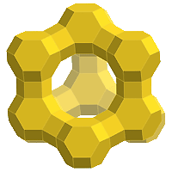
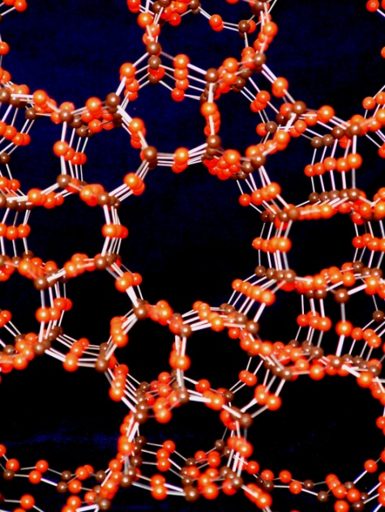
Solid state hydrogen storage
Adsorption on surface
High P and/or Low T
Zeolithe
Zeolite + H₂
Zeolite-H₂
70bar, 20°C
High T and/or Low P
NaX
ZSM-5
NaA
Sodalite:
0,40 wt.%
0,38 wt.%
0,27 wt.%
1,1 wt.%
1,1 wt. % < 6 wt. % (not enough)
Xiao-ming Du, 2006

Slide 30
Solid state hydrogen storage
Adsorption on surface
MOFs
Mg(NO₃)₂ / DMF
Autoclave
150°C
linear bpdcH₂ / DMF
Huaxue 2011
Notes:
Biphenyl dicarboxilic acid
dimetylformamide

Slide 31
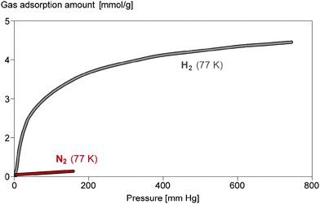
Solid state hydrogen storage
Adsorption on surface
MOFs
N₂- and H₂-adsorption isotherms (Mg-MOF, Basolite M050)
Best MOFs for hydrogen storage:- Mg
- smallest pores
- 77K
Huaxue 2011

Slide 32
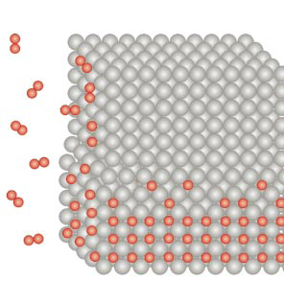
Solid state hydrogen storage
Structural
Simple Metal hydride: MHx where M = Li, Na, Mg
Hydrolysis MHx + xH₂O → M(OH)x + xH₂
reversibility protected by US patent
Pyrolysis 2M + xH₂  2MH_{x}
Reversibility for MgH₂: 300°C, 1 bar
Kinetic too slow
7,6 wt. %
structural deformation

Slide 33
Solid state hydrogen storage
Structural
Complex metal hydride: MXH₄ where X=trivalent element
Alanates (MAlH₄)
Borohydrides (MBH₄)
1st Decomposition: 3MAlH₄ → 3 H₂ + M₃AlH₆ + 2Al
2nd Decomposition: M₃AlH₆ → 3/2 H₂ + 3 MH + Al
3rd Decomposition: MH → ½ H₂ + M
Metal | Li | Na | K
T_{dec1} | 100°C | 100°C | 300°C
T_{dec2} | 120°C | 150°C | 340°C
T_{dec3} | 650°C | 425°C | -
Wt.% _{th} | 10,6 | 7,5 | 5,7
Wt. % _{real} | 7,9 | 5,6 | 4,3
Global reaction
3 MAlH₄ → 3 M + 3 Al + 6 H₂
Reversible reaction
3 MAlH₄  3 MH + 3 Al + 9/2 H₂
LiBH₄: T_{dec1}= 320°C, T_{dec2} = 600°C,…., wt.%_{th} = 18,4, wt.%_{real} = 8%

Slide 34
Solid state hydrogen storage
Structural
Intermetallic compounds
Metal | Hydride | Mass %
Pd | PdH_{0.6} | 0.56
LaNi₅ | LaNi₅H₆ | 1.37
ZrV₂ | ZrV₂H_{5.5} | 3.01
FeTi | FeTiH₂ | 1.89
Mg₂Ni | Mg₂NiH₄ | 3.59
TiV₂ | TiV₂H₄ | 2.6
Not suitable for on-board storage system

Slide 35
Solid state hydrogen storage
Conclusion
Adsorption on surface
Small pores (high specific surface)
Mg
In the structure
Best results with complex metal hydride

Slide 36
Conclusion
?
Fuel Type | Energy Content (kJ/g)¹
dihydrogen | 120
Storage problem !!!
Pipelines

Slide 37
Conclusion
& perspectives
Pressurized Gas
>700 bar
Liquid H₂
Volume not suitable
Solid state storage
Adsorption on surface
In the structure
metallic glasses
carbon-based compound
Zeolite
MOFs
Simple metal hydride
Complex metal hydride
Intermetallic
Best results with complex metal hydride
Small pores (high specific surface)
Mg

Slide 38
Thanks for your attention !
If « Water is life » and « hydrogen generates water »… Does hydrogen generate life?

