Slide 1



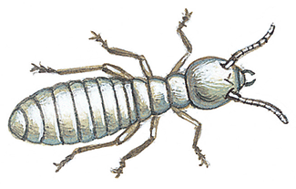
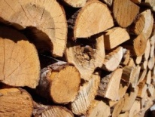

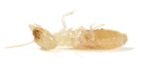
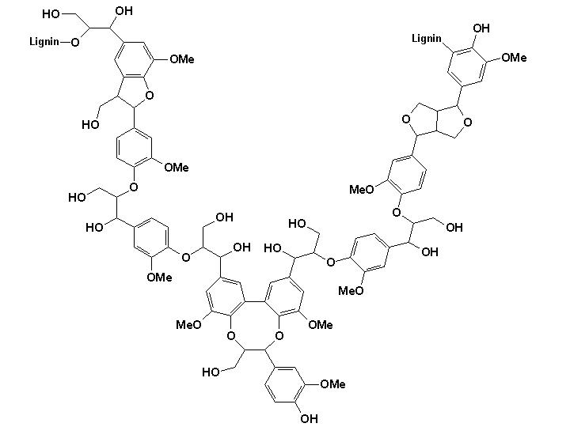
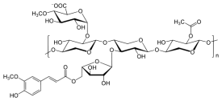
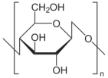
Research of New Enzyme Producing Strains in the Gut of the Termite Reticulitermes santonensis
Tarayre Cédric¹, Bauwens Julien², Mattéotti Christel³, Brasseur Catherine⁴, Millet Catherine³, Guiot Pierre¹, Vandenbol Micheline³, Portetelle Daniel³, De Pauw Edwin⁴, Haubruge Eric², Francis Frédéric^{2,} Thonart Philippe¹ and Destain Jacqueline¹
1 - Bio-Industries unit – University of Liege Gembloux Agro-Bio Tech
2 - Functional and evolutionary entomology unit – University of Liege Gembloux Agro-Bio Tech
3 - Animal and microbial biology unit – University of Liege Gembloux Agro-Bio Tech
4 - Mass spectrometry laboratory – University of Liege
Termites contain a complex microflora inside of their guts. Inferior termites contain bacteria, mycetes and protists that interact to degrade vegetable components. These strains act as consortia to break natural materials by secreting various enzymes. Our aim was the isolation and cultivation of microorganisms in order to produce new enzymes that can be further used in green chemistry. Termites were fed with different diets: pinewood, microcristalline cellulose (added with lignin or not), α-cellulose (added with lignin or not) and birchwood xylan. Then, dissections were realized to isolate interesting strains. All the microorganisms were subjected to enzyme assays. That technique allowed us to isolate and to cultivate various strains of bacteria, molds and protists. Three strains of bacteria, two strains of molds and one strain of protist were isolated and displayed different enzymatic activities. The bacteria Bacillus subtilis strain ABGx, Bacillus sp. strain CTGx and Chryseobacterium sp. strain CTGx displayed amylase, cellulase and xylanase activities. The molds Trichoderma virens strain CTGx and Sarocladium kiliense strain CTGx were also able to produce those enzymes. However, the protist Poterioochromonas sp. was found to produce only amylase. In conlusion, the termite gut is a complex culivation medium that provides a habitat for many microorganisms that show interesting enzymatic activities.
Introduction
The lower termites contain a highly diversified microbial community inside of their guts
Artificial diets allow to select interesting enzyme-producing microorganisms
Diet 1
Diet 2
Diet 3
Diet 4
Diet 5
Diet 6
Reticulitermes santonensis (lower termite)
Wood
Wood
(usual
diet)
Xylan
Cristal-
Line
cellulose
Lignin +
cristalline
cellulose
α-
cellulose
Lignin +
α-
cellulose
Microoxic zone
Termite
Anoxic zone
Consortium
A
Consortium
B
Consortium
C
Consortium
D
Consortium
E
Consortium
F
Mold
Yeast
Dissection
Wood particles
Endogenous bacterium
Free bacterium
Medium 1
Medium 2
Medium 3
Medium 4
Medium 5
Medium 6
Bound protist
Free protist
Bound bacterium
Enzymatic assays on Petri dishes
The gut consortium is able to break the vegetable components
Strain
β-glucosidase
activity
Cellulase
activity
Xylanase
activity
Amylase
activity
Sarocladium kiliense
strain CTGx
Positive test
Positive test
Positive test
Positive test
Wood
=
Cellulose
+
Lignin
+
Hemicelluloses
Trichoderma virens
strain CTGx
Positive test
Positive test
Positive test
Positive test
Bacillus sp.
strain CTGx
Not detected
Positive test
Not detected
Not detected
Chryseobacterium sp.
strain CTGx
Positive test
Positive test
Positive test
Positive test
Bacillus subtilis
strain ABGx
Not detected
Not detected
Positive test
Positive test
Poterioochromonas
sp. strain CTGx
Not detected
Not detected
Not detected
Positive test
Microbial consortium
In conclusion, the termite Reticulitermes santonensis contains many
interesting strains that can hydrolyze the components of vegetable
materials and be used in the field of green chemistry.
- Glucose
- Cellobiose
- Glucose oligomers
- Lignin fragments
- Xylose
- Glucose
- Mannose, etc.
Acknowledgements
This work was supported by an ARC contract (Action de Recherche Concertée; agreement Gembloux Agro-Bio Tech no. ARC 08-13/02).

