Slide 1
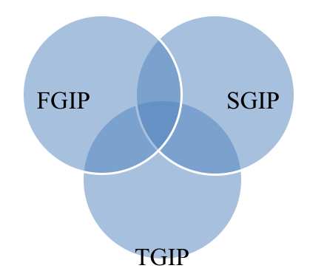
Science and Technology Governance in Japan and Belgium:
Building on Experiments with Technology Assessment and TA-like Activities
Michiel van Oudheusden (University of Liège)
Go Yoshizawa (Osaka University)
Asia-Pacific Science, Technology & Society Network (APSTSN)
Biennial Conference 2013: Knowing, Making, Governing
National University of Singapore, 15-17 July 2013
Research objectives
Cost-benefit
To describe how TA concepts and practices, as well as related TA activities, have emerged in Japan, Wallonia, and Flanders since the 1960s-70s, and in what particular forms.
To describe how TA has evolved with, sustained, and/or countered, science, technology, and innovation policies on the regional, national, and international level.
To compare and contrast how TA is, or is not, institutionalized in the countries and regions, notably by taking into account initiatives to initiate or abolish parliamentary TA forms.
To situate the processes that are discerned through empirical analysis within a broader theory of, and movement towards anticipatory governance, and to assess the potential of TA of enhancing novel governance forms.
A non-directional cycle of assessment mechanisms within the policy making process fed by knowledge assessment process
Foresight
Type of measures
Defining acceptability
Choice of regulatory framework
(von Schomberg 2012)
To make the participatory approach more reflective and critically discursive, pTA must acknowledge power dimensions in participation such as conflict, politics, and bargaining, and it must expose participants’ different ways of seeing and acting if ‘participation’ is to incite mutual learning beyond the interests of dominant actors.
Early-warning TA
Bottom-up TA
Interactive TA
TA waves in relation to Generations of Innovation Policy
Innovation Policy | First Generation (FGIP) | Second Generation (SGIP) | Third Generation (TGIP)
Time period | 80s | 90s | ?
View of innovation process | Linear, from research to market | Nonsequential feedback loops | Complex, nonlinear, interactive
Main actors | Scientists and government | As in FGIP plus “nontechnical” actors, e.g. ‘social partners’; government as innovation mentor/enabler | Actors from all policy domains and all relevant stakeholders; includes social scientists and lay publics
Types of relations among agents | Vertical, hierarchical | Networked (“horizontal”) | Integrated, cooperative
Key concepts and metaphors | Picking winners, technology push | Systems, clusters, networks, bottom up | Interaction, learning, knowledge-based economy
Main emphasis | Science and technology | Innovation systems and networks | Knowledge, collaboration, and process
Flemish Foundation for Technology Assessment (STV)
Flemish Institute for Science and Technology Assessment (viWTA)
Institute Science and Technology (IST)
Flemish Institute for Technological Research (VITO)
1970s
1980s
1990s
2000s-
Flanders
Pursuing its own innovation policy
1984
1982
2006
2009
2011
2013
Lacked consideration of social dimension in innovation …
Third Industrial Revolution Flanders (DIRV)
Knowledge-based economy
Nanotechnologies for Tomorrow’s Society (NanoSoc)
Co-responsibility towards innovation
Walloon Council for Science Policy
PTA pilot project
Wallonia
Failed attempt
1994
2002
2011
Science and Technology Basic Law
STA/MITI’s pilot study
Failed attempt
Innovation and Institutionalization of TA (i2TA) project
Japan
1971
PTA movement in parliament
STS & pTA movement
1977-78
1995
2007
2011
Recheck for technology
National technology strategy
Science for society
Science for policy

