Slide 1
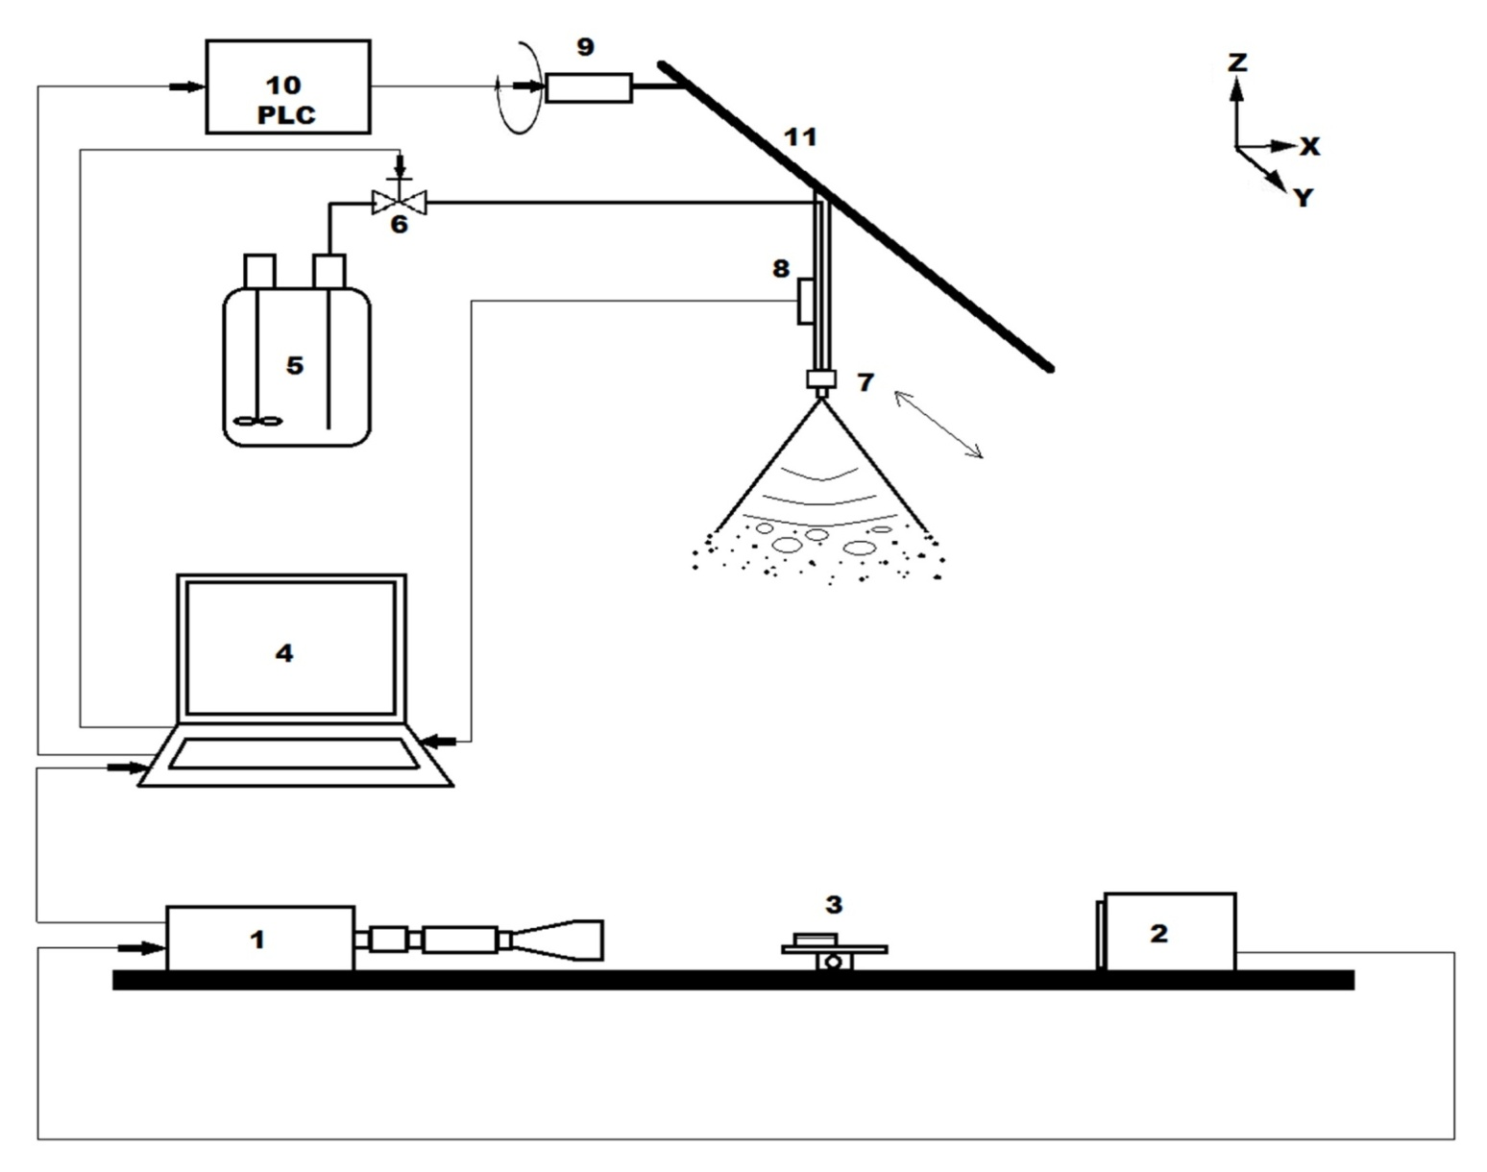
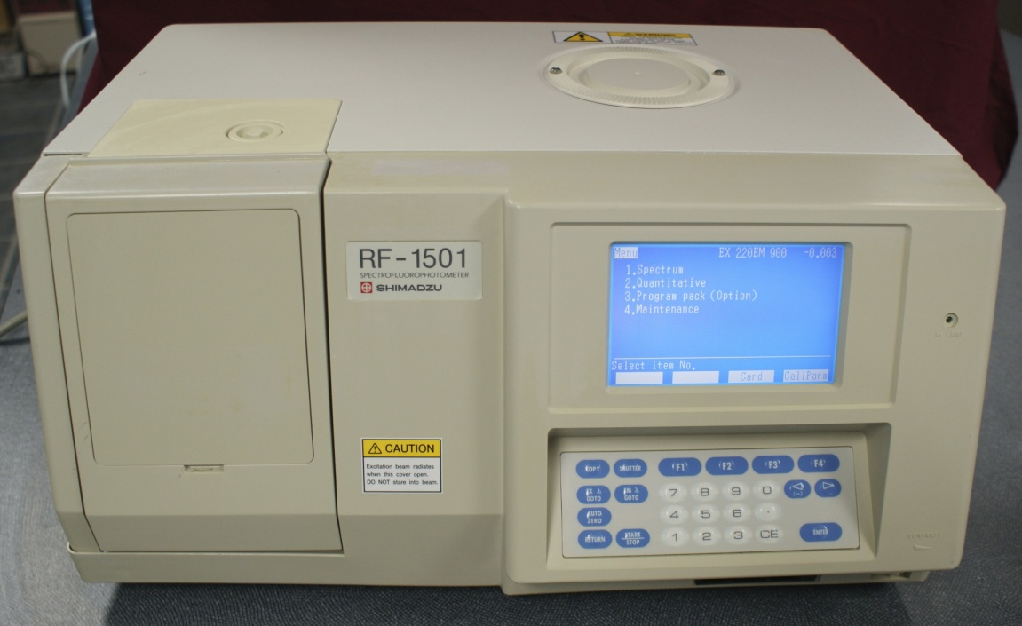
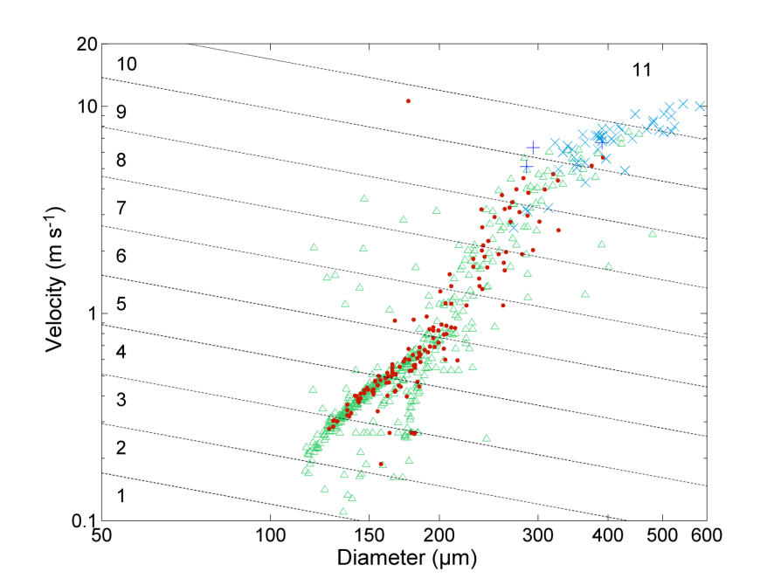
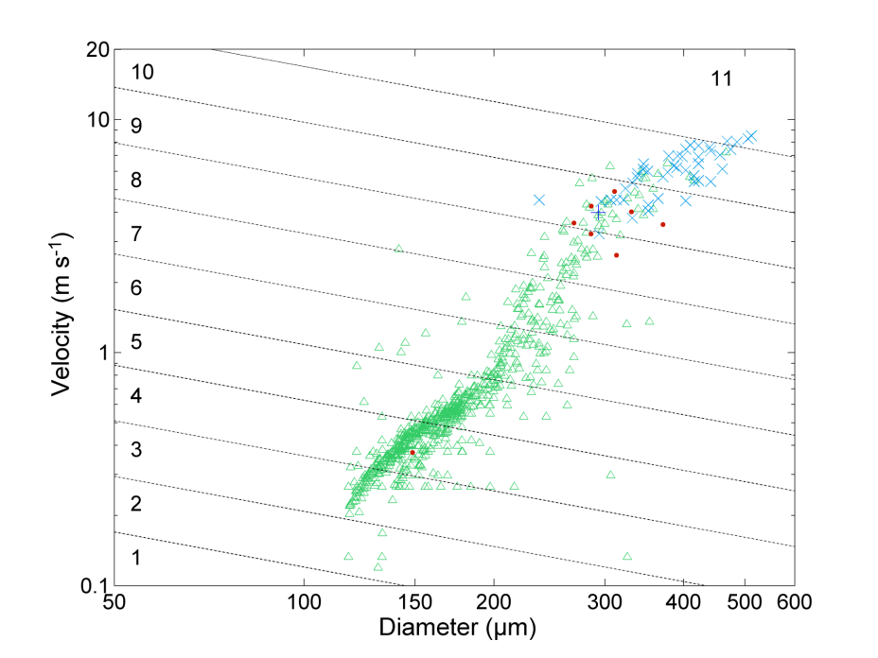
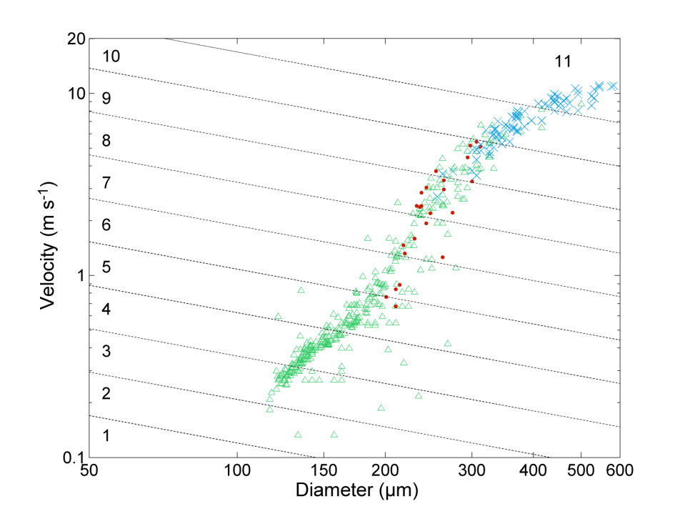
USE OF HIGH-SPEED IMAGING TO PREDICT SPRAY RETENTION ON BARLEY LEAVES
H.H. Boukhalfa, M. Massinon, F. Lebeau, M. Belhamra
SUMMARY
Laboratory studies were conducted to validate the effectiveness of using high-speed imaging method to replace chemical analysis by fluorometry. Measurements were performed with a high-speed camera coupled with a retro-LED lighting.
Sizes and velocities of the drops were extracted by image analysis. Drop impact types were determined by the operator. Sprays were produced with a flat-fan nozzle mounted on a movable ramp. Two surfactant (Break-Thru® S240 and Li700) were sprayed to highlight the effect of the reduction of the surface tension. Relative volume proportions were computed within of an energy scale divided into 11 classes based on the Weber number. Results are compared to the results of the chemical analysis by spectrofluorometry.
INTRODUCTION
Barley foliage is oriented mainly vertically and the leaves are difficult to wet because of their dense covering of microcrystalline epicuticular wax. And that affect spray retention. Drop behaviour during impact affects also retention.
The increase of adhesion is usually seen as the objective when applying crop protection products, while bouncing and shattering are seen as detrimental to spray retention. However, observation of drop impacts using high speed imaging shows that bouncing and fragmentation can occur in Cassie-Baxter as well as in Wenzel wetting regime. In this last regime, a part of the drop sticks on the surface, what contributes to retention.
Using simultaneous measurements of drop impacts with high speed imaging and of retention with fluorometry for 3 spray mixtures on excised barley leaves, we should relate the behaviour impacts on the leaves to the spray retention in order to highlight how spray droplets can be retained by plant leaves and what is the effect of surfactants.
MATERIAL AND METHODS
Simultaneous measurements of retention were done for two surfactants and compared to water on excised (0,3 cm²) barley leaves (BBCH12) using two methods, high-speed shadowgraphy and spectrofluorometry. Break-Thru® S240 (Organosilicone surfactant) at the concentration of 0,1% and Li700® (Phospholipid surfactant) at the concentration of 0,25% were applied to foliage in aqueous sprays. The three tank mixtures were marked by fluorescein tracer at a concentration of 1g/l
The sprays were produced by a flat-fan nozzle Teejet 11003 and a pressure of 2bars, mounted 50cm height above the target on a ramp moving at a speed of 2m/s. Sprayings were performed in laboratory at a temperature of 18°C and relative humidity of 40%.
Figure1 Dynamic spray application bench:
(1)high-speed camera
(2) LED lighting
(3) target surface on linear stage
(4)computer
(5) pressurised tank
(6) solenoid valve
(7) nozzle
(8) pressure gage
(9)servomotor
(10) programmable controller
(11) linear stage
RESULTS AND DISCUSION
The imaging method provides information on the quality of impact on barley leaves. It appears that rebound has been considerably decreased by Break-Thru® and the adhesion increased greatly. The addition of Li700® increased the fragmentation and decreased the rebound relatively. The VMD (Volume Median Diameter) has been increased by Li700® addition, which can promote the fragmentation .
it is observed that about 50% of the drops fragmented in Wenzel state remain on the leaf. Depending on spray mixture, these impact outcomes accounted for 25 to 50% of retention, the higher contribution being correlated with bigger VMD (Volume Median Diameter).
Δ adhesion
●rebound
+fragmentation (Cassie-Baxter)
x fragmentation (Wenzel)
Water Break-Thru® S240 0,1% v/v Li700® 0,25% v/v
Retention observed by high-speed imaging is very close to retention measured by spectrofluorometry. which encourages us to adopt the first method for measuring retention without going through chemical manipulation. This method provides more explicit information on the interaction spray-target. The link between retention assessed by spectrofluorometry and that determined by high speed imaging confirm the possibility of using the last one in retention studies and the efficiency of its results.
Because tank-mix adjuvants affect the physicochemical properties of spray droplets in terms of their size and velocity, so it can determine their impact behavior.
Contribution of drops fragmented in Wenzel state in retention is non-negligible and should be considered when a modelling of spray retention process is performed.
REFERENCES
Butler Ellis, M.C., Tuck, C.R., 1999. How adjuvants influence spray formation with different hydraulic nozzle. Crop Prot. 18, pp. 101 109.
Butler Ellis, M.C., Tuck, C.R., Miller, P.C.H., 1997. The effect of some adjuvants on sprays produced by agricultural flat fan nozzles. Crop Prot. 16, pp. 41 50.
Cox, S.J., Salt, D.W., Lee, B.E., Ford, M.G., 2000. A model for the capture of aerially sprayed pesticide by barley. J. Wind Eng. Ind. Aerodyn. 87, pp. 217 230.
Forster, W.A., Kimberley, M.O., Zabkiewicz, J.A., 2005. Auniversal spray droplet adhesion model. Transactions of the ASAE, 48(4), pp. 1321 1330.
Holloway, P.J., Butler Ellis, M.C., Webb, D.A., Western, N.M., Tuck, C.R., Hayes, A.L., Miller, P.C.H., 2000. Effect of some agricultural tank-mix adjuvants on the deposition efficiency of aqueous sprays on foliage. Crop Prot. 19, pp. 27 37.
Massinon, M., Lebeau, F., 2012. Experimental method for the assessment of agricultural spray retention based on high-speed imaging of drop impact on a synthetic superhydrophobic surface. Biosystems Engineering, 112, pp. 56 64.
Mercer, G.N., Sweatman, W.L., Forster, W.A., 2010. Amodel for spray droplet adhesion, bounce or shatter at a crop leaf surface. Mathematics in Industry 15, pp. 945 951.

