Slide 1
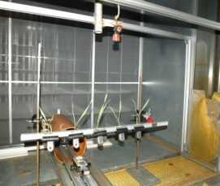
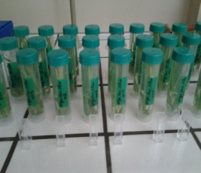
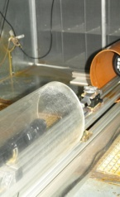
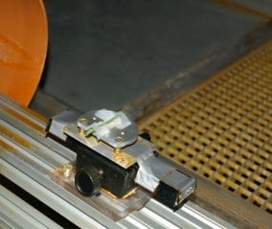
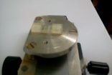
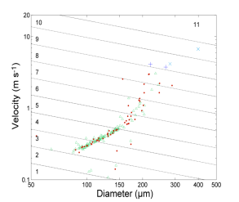
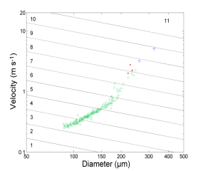
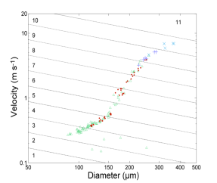
EFFECT OF TWO SURFACTANTS ON THE SPRAY JETS RETENTION BY BARLEY LEAVES
H.H. Boukhalfa, M. Massinon, F. Lebeau, M. Belhamra
SUMMARY
Surfactants are nowadays very useful additives to improve the effectiveness of phytosanitary treatments. They contribute to change the types of impact and thus the amount of spray retained by the leaves of the treated plant.
We performed tests of retention on whole barley plants on BBCH-scale 12 and small pieces of barley leaves at the same stage of growth. Spraying was done in three ways: water without surfactant, water with Break-Thru S240 and water with Li700.
The three slurries of fluorescein contained in an amount of 0.2 g / l. Fluorescein retained by the leaves in both cases is then measured by a spectrofluoremeter. The retention tests on whole plants show that it is tripled by the first surfactant and doubled by the second. By cons on small pieces of barley leaves, the amount was increased by the use of surfactants but not to the same scale.
This study concluded that the use of surfactants in spray pesticides may increase the amount of retention as a function of leaf area and the surfactant used.
INTRODUCTION
The most obvious priority of spraying is to achieve a distribution of pesticide such that sufficient active ingredient reaches the sites required for effective pest control. Wastage occurs from material reaching the ground and from off-target drift have a large potential for environmental damage. So their reduction is not just an economic demand but is deemed necessary both in good practice and in legislation.
Surfanctants are used in spraying to increase deposits on foliage. These products are often described in the technical literature as wetting and/or spreading agents. On these basis, the aim is to investigate the eventual effect of changes in spraying operations upon retention efficacy with two approaches: spectrofluorometry and high-speed shadowgraphy.
MATERIAL AND METHODS
Retention, defined as the amount of spray retained by plant leaves, and drop impact types were studied for two surfactants and compared to water on barley leaves (BBCH12). Break-Thru® S240 (Organ silicone surfactant) at the concentration of 0,1% and Li700® (Phospholipid surfactant) at the concentration of 0,25% were applied to foliage in aqueous sprays. The sprays were produced by a flat-fan nozzle Teejet 11003 and a pressure of 2bars, mounted 50cm height above the target on a ramp moving at a speed of 2m/s. Sprayings were performed in laboratory at a temperature of 24°C and relative humidity of 60%.
Retention was quantified on whole plants using fluoroscein tracer at a concentration of 0,2 g/l. The results were compared to those of a spray of water with fluoroscein (Figure 1).
Figure1 Figure2
Impact types were determined on exiced leaves (0,3 cm²) using a high-speed camera coupled with a retro-LED lighting. The size and velocity of drops were extracted by image analysis, and the impact type was determined by the operator. Volumetric proportions of the three impact types adhesion, rebound and fragmentation were determined (Figure 2).
RESULTS AND DISCUSION
The spectrofluorometry provided that the quantity of retention on Barley leaves were doubled by addition of Li700 comparing to water, while Break-Thru triple it.
The imaging method provides information on the quality of impact on barley leaves. It appears that rebound has been considerably decreased by Break-Thru® and the adhesion increased greatly. The addition of Li700® increased the fragmentation and decreased the rebound relatively.This method allowed us to observe that VMD has been increased by Li700® addition, which can promote the fragmentation .Spray retention was better increased by the organ silicone surfactant (Break-Thru) than by the phospholipid one (Li700).
Δ adhesion
●rebound
+fragmentation (Cassie-Baxter)
x fragmentation (Wenzel)
Water Break-Thru® S240 0,1% v/v Li700® 0,25% v/v
Our results corroborate those of Holloway and al. (1999): there was complete leaf coverage from sprays containing organosilicone surfactants, as would be predicted from their high surface-active nature, while the phospholipid surfactants gave 20% less spray coverage.
Because leaf pieces were mounted horizontally, impaction volume was greater than the retention volume obtained by spectrofluorometry on vertical plants in the first experimentation. It should be regarded only as comparative indicators of impact types and qualitative effect of surfactants used.
The high-speed imaging method support chemical results and provide a better understanding of spray retention phenomenon. It can determine the impact behavior, the size and velocity of spray droplets .
The results confirmed that tank-mix surfactants can have a considerable influence on the delivery efficiency of aqueous sprays. However, the magnitude of this effect is dependent on the nature of the additive. It affects the physicochemical properties of droplets.
REFERENCES
Butler Ellis, M.C., Tuck, C.R., 1999. How adjuvants influence spray formation with different hydraulic nozzle. Crop Prot. 18, pp. 101 109.
Butler Ellis, M.C., Tuck, C.R., Miller, P.C.H., 1997. The effect of some adjuvants on sprays produced by agricultural flat fan nozzles. Crop Prot. 16, pp. 41 50.
Cox, S.J., Salt, D.W., Lee, B.E., Ford, M.G., 2000. A model for the capture of aerially sprayed pesticide by barley. J. Wind Eng. Ind. Aerodyn. 87, pp. 217 230.
Holloway, P.J., Butler Ellis, M.C., Webb, D.A., Western, N.M., Tuck, C.R., Hayes, A.L., Miller, P.C.H., 2000. Effect of some agricultural tank-mix adjuvants on the deposition efficiency of aqueous sprays on foliage. Crop Prot. 19, pp. 27 37.
Massinon, M., Lebeau, F., 2012. Experimental method for the assessment of agricultural spray retention based on high-speed imaging of drop impact on a synthetic superhydrophobic surface. Biosystems Engineering, 112, pp. 56 64.
Stock, D., 1997. Do we need adjuvants? Mechanistic studies and implications for future developments. Proc. 50th N.Z. Plant Protection Conf. pp. 185 190.

