Slide 1
THE NUMBER OF STRUCTURES COMPATIBLE WITH ANY SPECIFIED CORRELATION FUNCTION
Cedric Gommes
Department of Chemical Engineering
University of Liège
Kaiserslautern, July 12th 2013

Slide 2
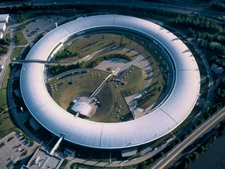
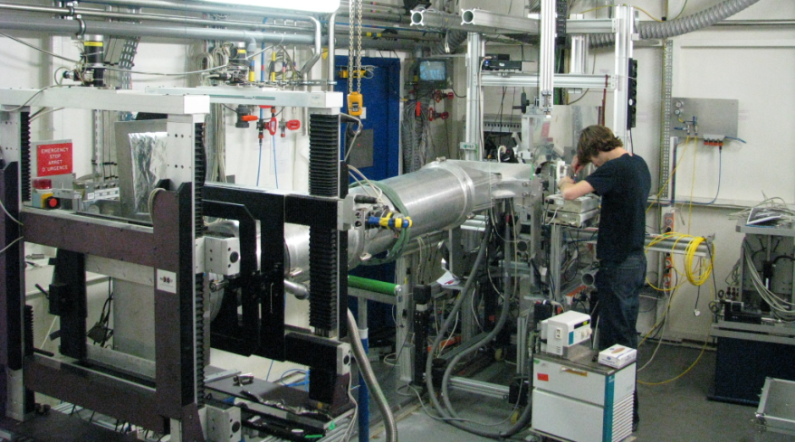
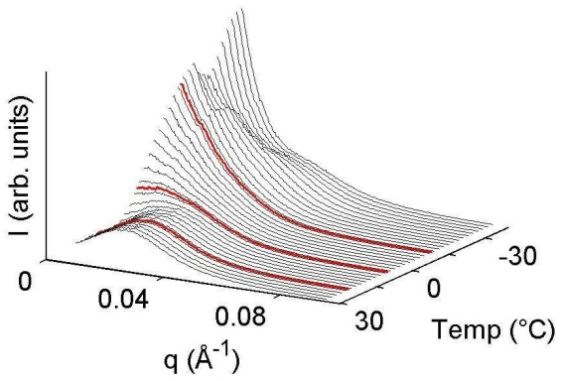
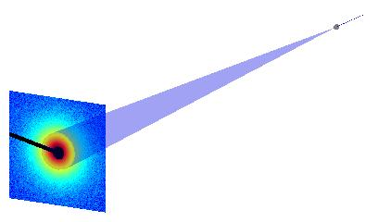
The context: Small-Angle Scattering
Dutch-Belgian beamline (BM26@ESRF)

Slide 3
Small-Angle Scattering Patterns = Correlation Functions = Distance Statistics
C(r), γ(r) (Debye), p(r) = r² γ(r), K(r), g(r), S₂(r), etc.

Slide 4
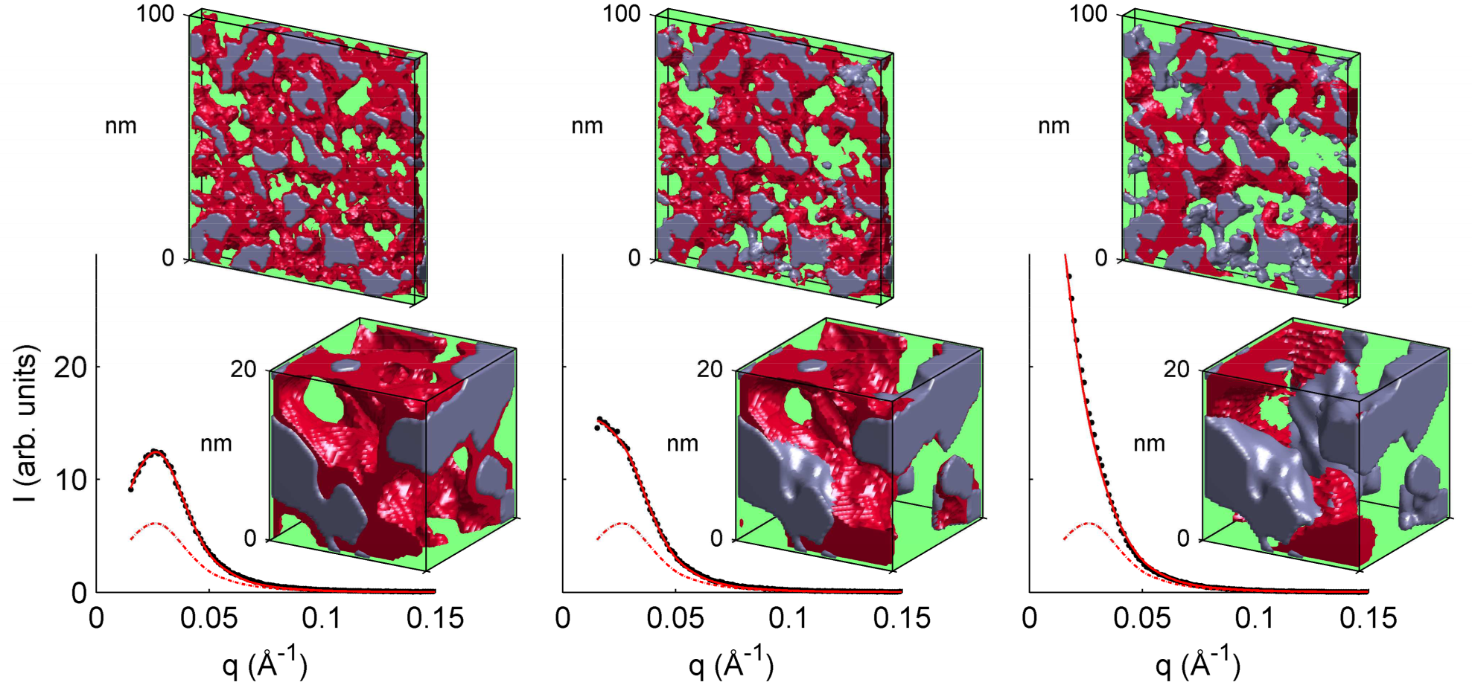
SAXS data is analyzed through the fitting of the correlation function

Slide 5
N(N-1)/2 distances
How well do you know a structure if all you have is the set of distances between all its points?

Slide 6
Homometric structures have identical two-point functions
Kite
Trapezoid
The Kite & Trapezoid configurations cannot be discriminated with small-angle scattering

Slide 7
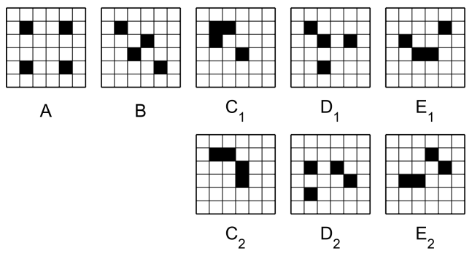
Trivial degeneracy
Non-trivial degeneracy
Ω₀ = N
Ω₀ = 2*N
Ω₀ = 2*4*N
Ω₀ = (2*4+2*4)*N
Ω₀ = (4 +2*4)N

Slide 8
Morphological Reconstruction
Consider discrete structures and look for the pixel configuration that minimizes
$$E=\sum_{r}{{\left[S_{2}\left(r\right)−{\hat{S}}_{2}\left(r\right)\right]}^{2}}$$
Target two-point correlation function
Two-point correlation function of the current configuration

Slide 9
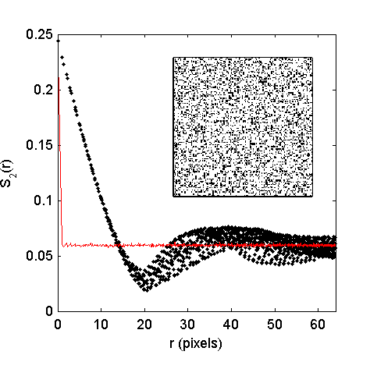
Simulated Annealing
Yeong & Torquato, Phys. Rev. E 57, 495 (1998)
Svergun, Biophys. J. 76, 2879 (1999)
Aubert & Jeulin, Pattern Recogn. 33, 1083 (2000)

Slide 10
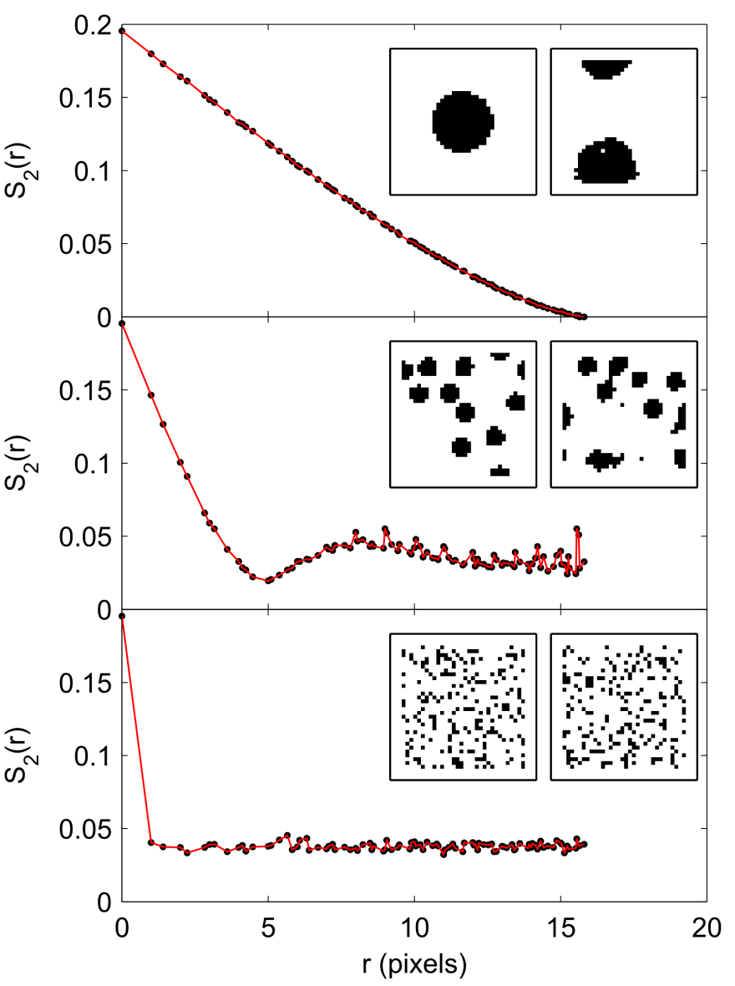
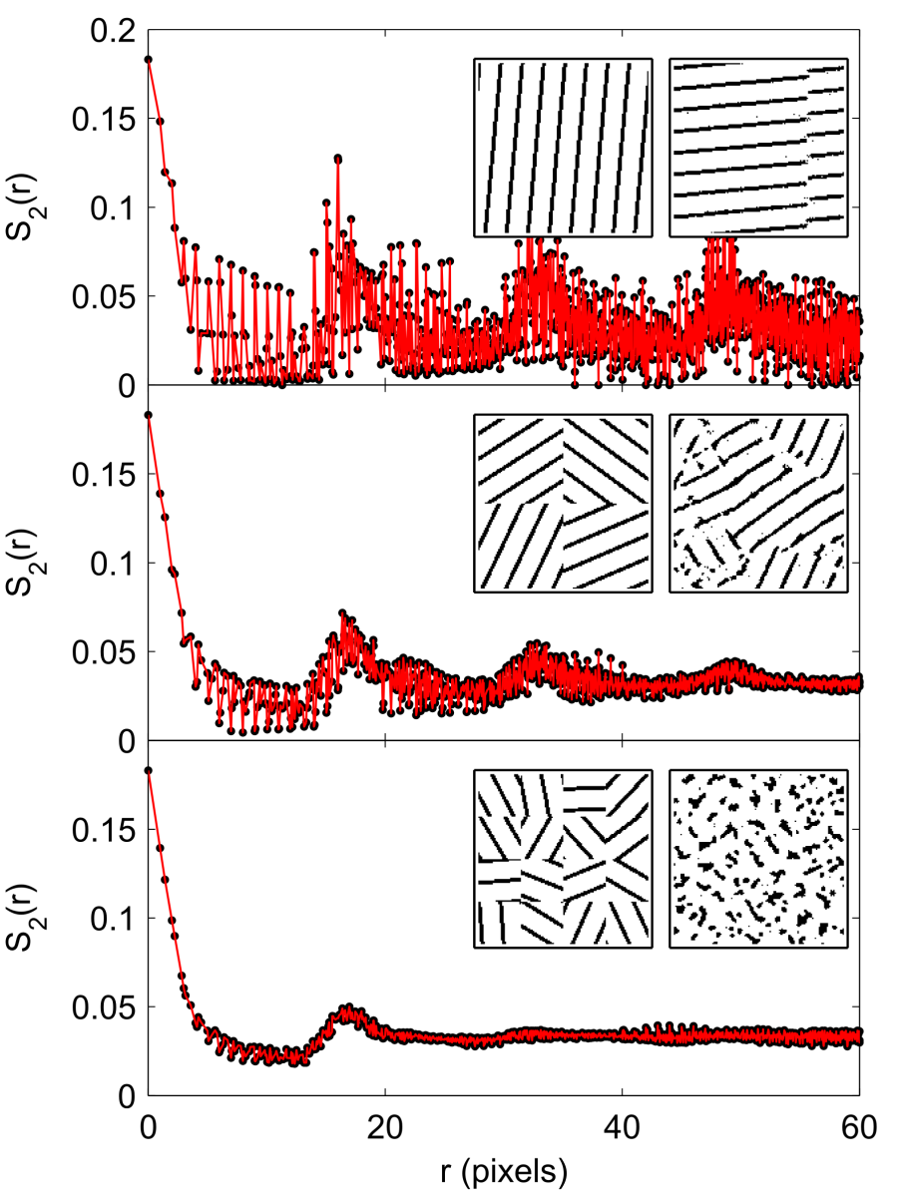
The reconstruction is seldom unique

Slide 11
Monte Carlo calculations of the density of states
$$E=\sum_{r}{{\left[S_{2}\left(r\right)−{\hat{S}}_{2}\left(r\right)\right]}^{2}}$$

Slide 12
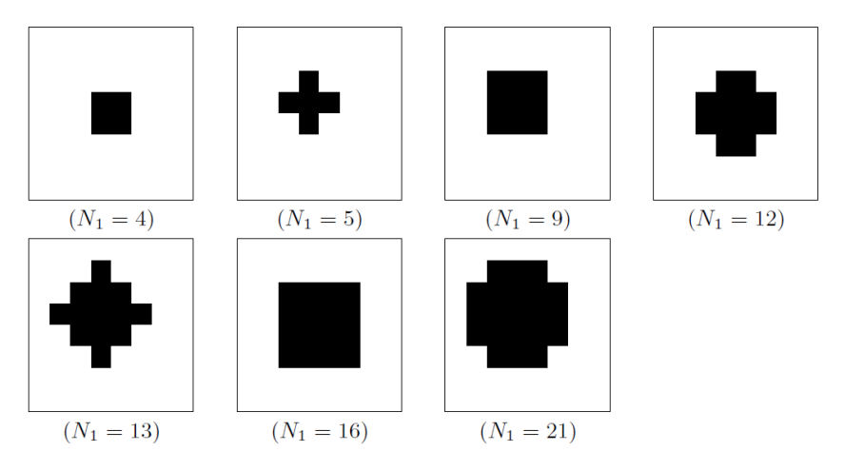
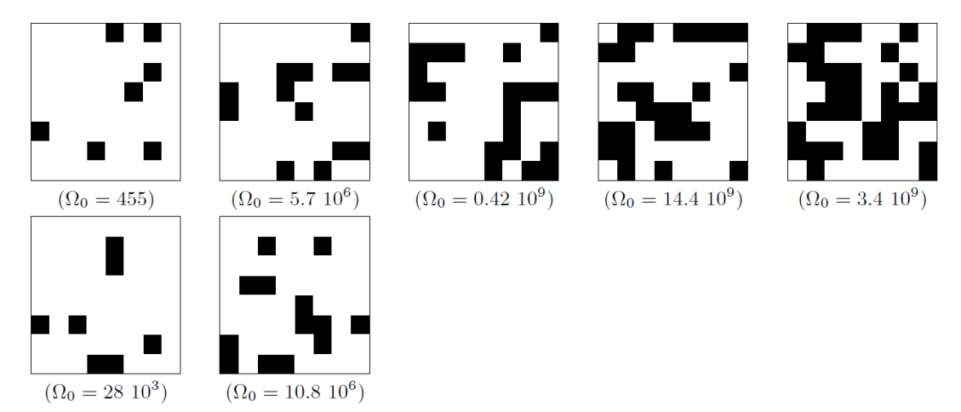
How to explain the results?

Slide 13
Throughout physics, large ground-state degeneracies are always associated with rough energy landscapes
The configuration space of a reconstruction problem is a high-dimensional hypercube

Slide 14
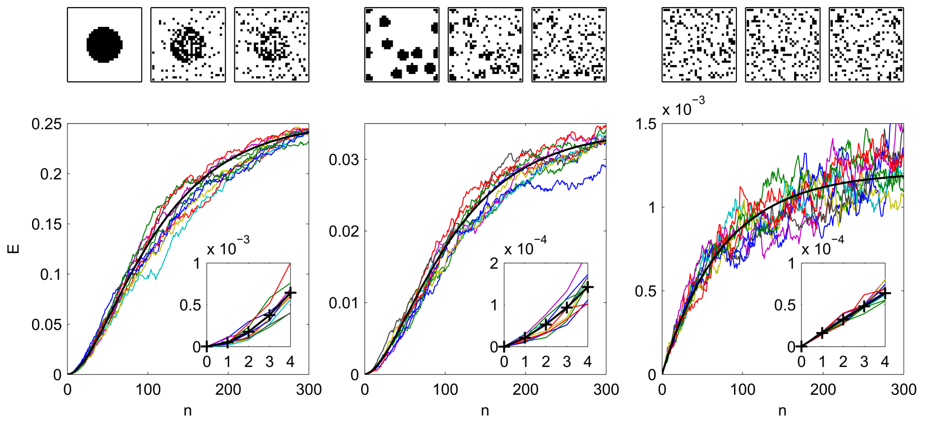
Energy landscape characterization using a random walk

Slide 15
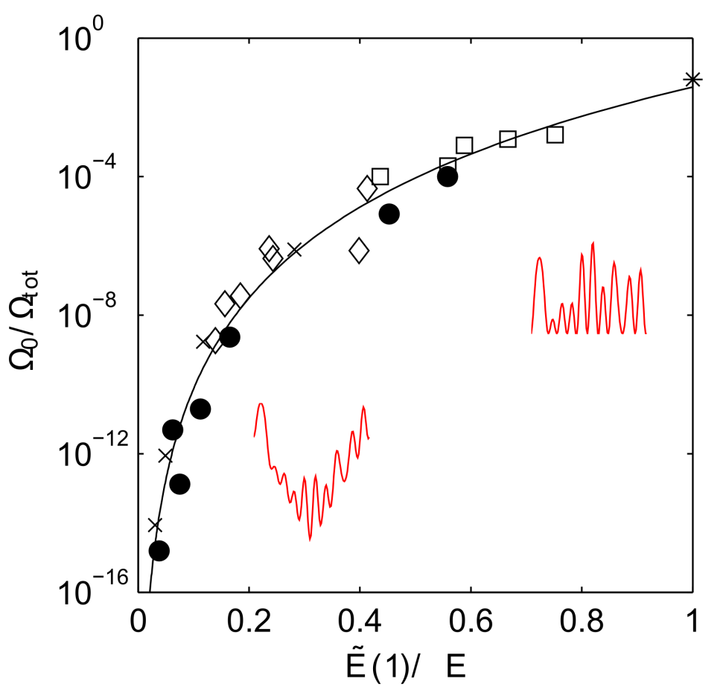
The roughness-degeneracy relation

Slide 16
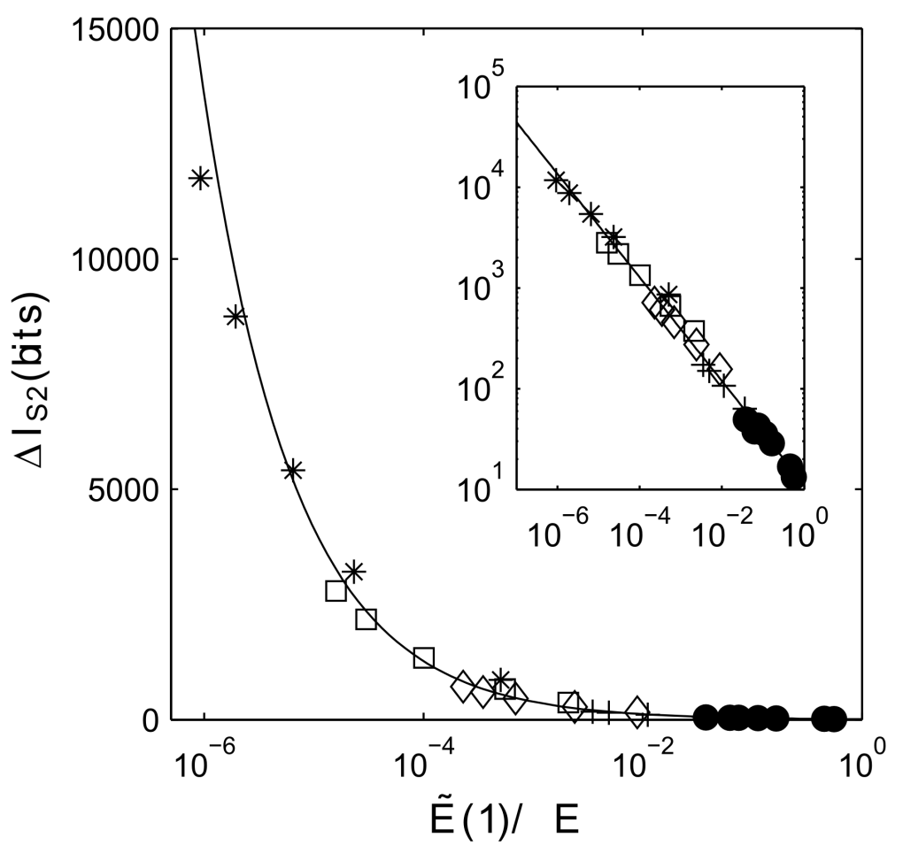
The roughness-degeneracy relation is easily obtained for systems of any size and dimensionality
$$\log_{2}\left(Ω_{tot}/Ω_{0}\right)$$

Slide 17
Information-theoretic formulation of degeneracy
If nothing is known, a structure is a draw out of 2^{N} possibilities
$$I={−log}_{2}\left(1/2^{N}\right)=N$$
If the volume is known, a structure is a draw out of $Ω_{tot}=\left(\begin{matrix}N \\ N_{1}\end{matrix}\right)$ possibilities
$$∆I_{S1}=N{−log}_{2}\left(Ω_{tot}\right)$$
If the correlation function is known, a structure is a draw out of $Ω_{0}$ possibilities
$$∆I_{S2}=\log_{2}\left(Ω_{tot}\right)−\log_{2}\left(Ω_{0}\right) ≈11.2 {\left(\frac{E(1)}{<E>}\right)}^{−0.51}$$

Slide 18
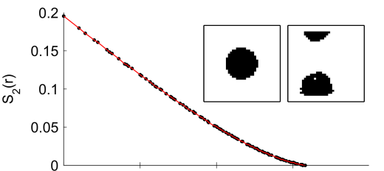
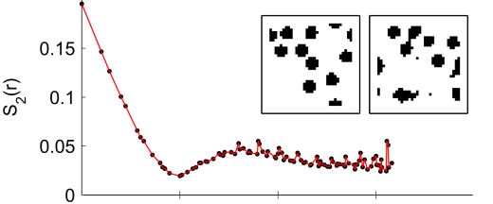
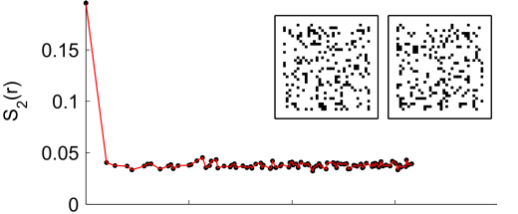
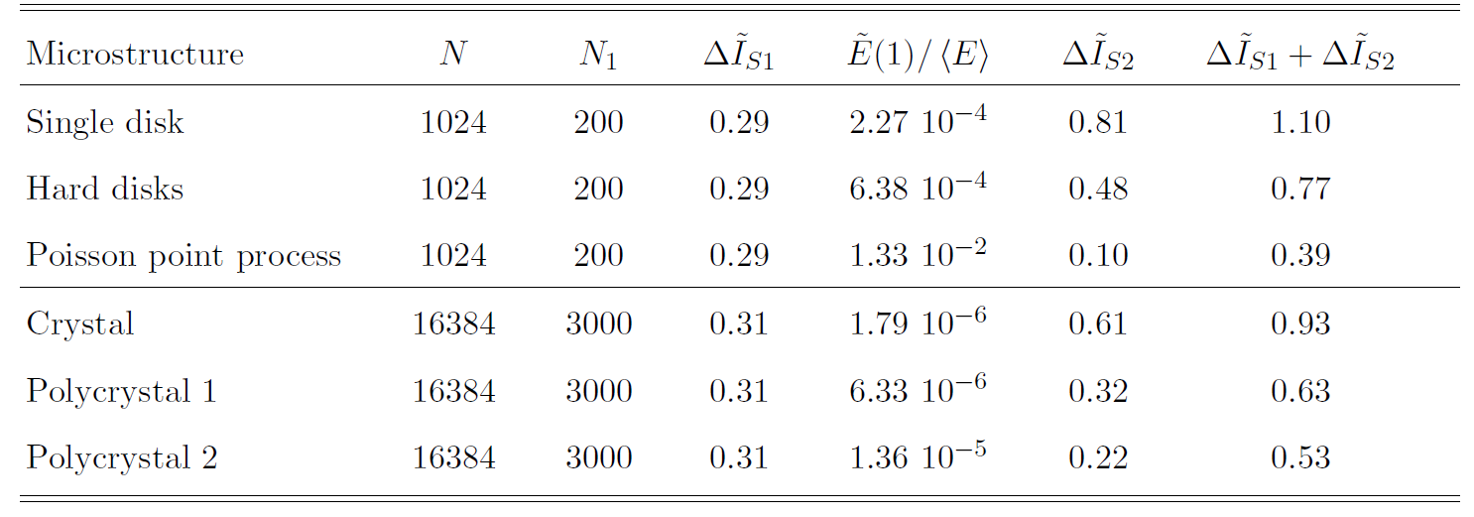
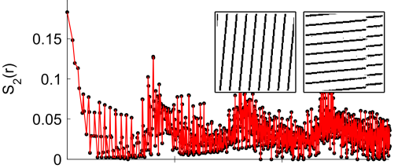
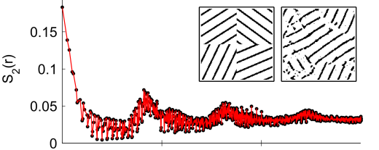
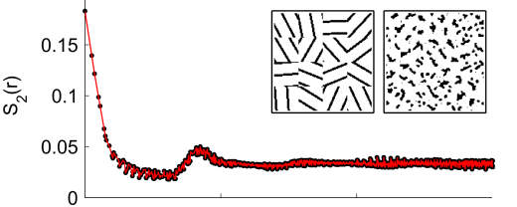
Information-theoretic analysis of morphological reconstruction

Slide 19
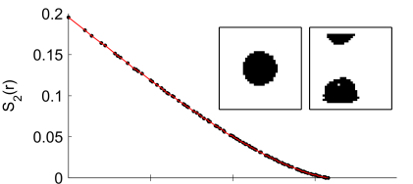
Conclusions
The enumeration of homometric structures is a problem formulated 70 years ago by Patterson
The problem can be mapped to the characterization of an energy landscape
We derive a roughness metric - calculated from the correlation function alone - that can be used as a proxy for the degeneracy

Slide 20
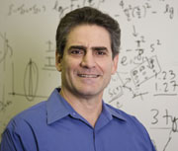
This work was done in collaboration with Salvatore Torquato and Yang Jiao Department of Chemistry, Princeton University
Gommes, Jiao & Torquato, Phys. Rev. Lett. 108 (2012) 080601
Gommes, Jiao & Torquato, Phys. Rev. E 85 (2012) 051140

Slide 21
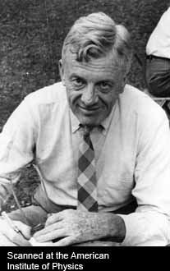
Thank you!
Arthur Lindo Patterson
1902-1966

