Slide 1
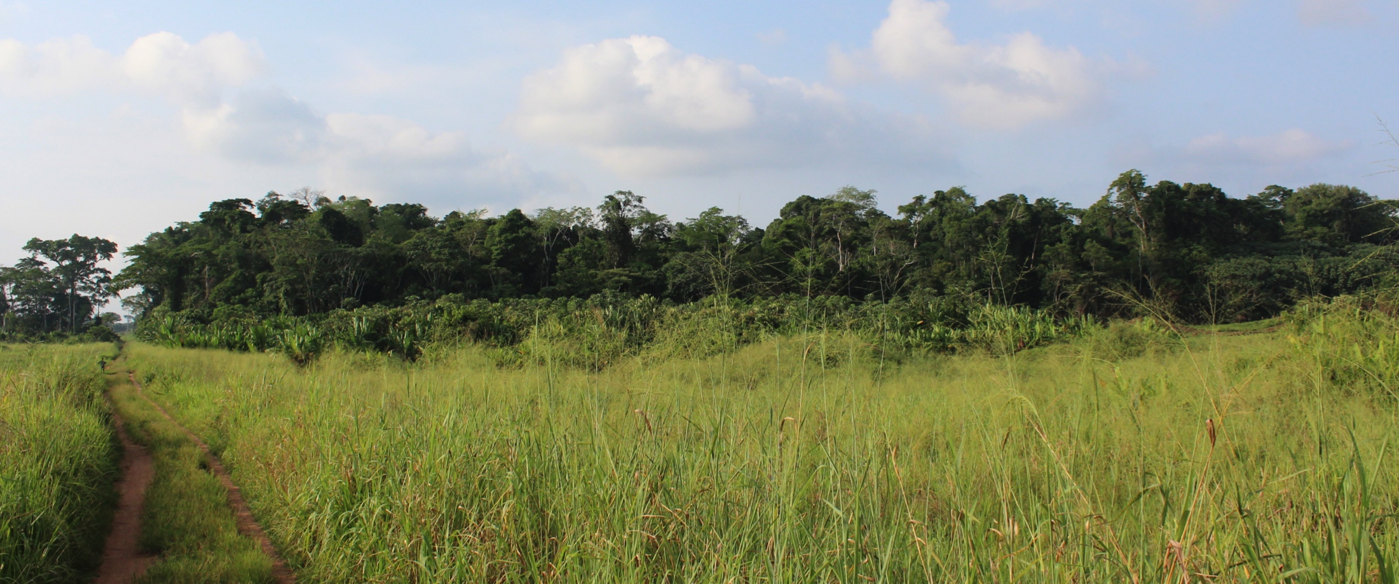
Investigation of edge effect on wood density in recent tropical forest edges in Yangambi Man and Biosphere Reserve
Thalès de Haulleville
Thalès de Haulleville 2013
Notes:
Hello my name is TdH. I’m a PhD student from beglium. I have to port of call : the Africa museum in Tervuren, and Gembloux Agro-biotech in Gembloux. I’m financed by the Belgian Science Policy.
and I would like to show you some of the first results I got from my reasearch in yangambi reserve.

Slide 2
Context
Logging activities in tropical forested area is a major environmental issue, for conservation and carbon emissions.
UN-REDD: UN Collaborative Programme on Reducing Emissions from Deforestation and Forest Degradation in Developing Countries
Congo : one of the leader country on UN-REDD implementation.
Development of accurate and quick Above Ground Biomass (AGB) estimation techniques is needed to implement the program.
Thalès de Haulleville 2013
Notes:
I’m pretty sure I’m not gonna rock your world upside down, if I tell you that logging activities in tropical forest are a major concern for the environment. Not only in for conservation, but as well in regards of carbon emissions.
To face theses new environemental challenges the UN decide to creat a collaborative Programme between 3 of it’s agency : FAO, UNDP and UNEP.

Slide 3
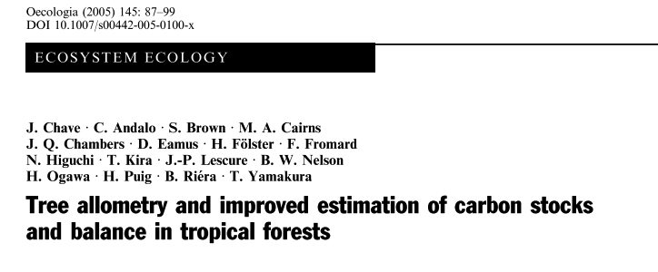
WSG & Edge effect
WSG is the second most important predictor of a tree AGB (after the DBH) (Chave et al. 2005)
Edge areas can be perceived as stressed ecosystems (as opposed to the core areas.)
This stress can induce variations on Plant Functional Traits (PFT), such as Wood Standard Gravity (WSG).
Forest EDGE area
Forest CORE area
Thalès de Haulleville 2013

Slide 4
WSG & Edge effect
WSG is the second most important predictor of a tree AGB (after the DBH) (Chave et al. 2005)
Edge areas can be perceived as stressed ecosystems (as opposed to the core areas.)
This stress can induce variations on Plant Functional Traits (PFT), such as Wood Standard Gravity (WSG).
Forest degradation
Deforestation
Thalès de Haulleville 2013

Slide 5
Pattern/Process Paradigm
Composition, configuration and functions of an ecosystem are interdependent.
The question is : in what extend a shift in the composition and the configuration of a ecosystem will have an effect on a particular function : the WSG.
Composition
Configuration
Functions
Adapted from Noon & Dale, 2002.
Thalès de Haulleville 2013
Notes:
Meaning : if there’s a structural or floristic composition shift between Edge and Core area, on what extend this shift effect the general WSG of the Edge Area. Will it be higher? Lower?

Slide 6
Site location
Thalès de Haulleville 2013

Slide 7
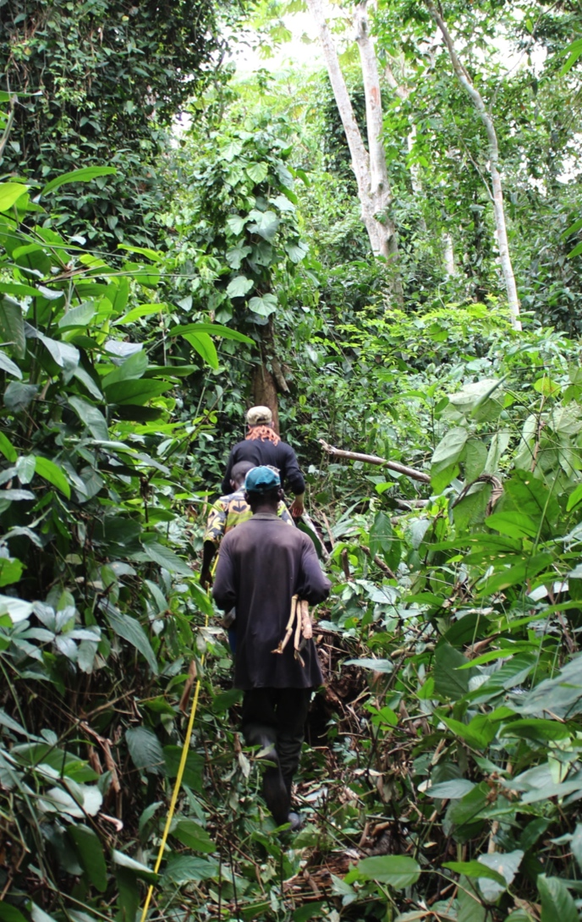
Database
22 square one hectare permanent sampling plots installed amongst 6 forest types, between Feb. and May 2012 (8197 trees)
Young Regrowth forests (yR), 5 plots.
Old regrowth forests (oR), 1 plot
Core semi-deciduous forest (Csd), 5 plots
Edge semi-deciduous forest (Esd), 5 plots
Climax mono-dominant Gilbertiodendron dewevrei forest (cG), 5 plots
Climax mono-dominant Brachystegia laurentii (cB), 1 plot.
Measurements (RAINFOR protocol) : DBH, Trunk shape, some total and trunk heights (580 trees)
Thalès de Haulleville 2013

Slide 8
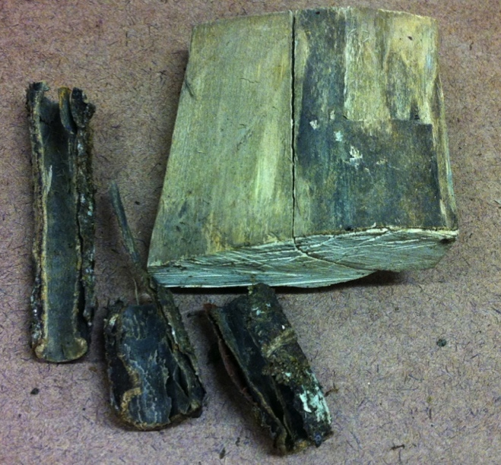
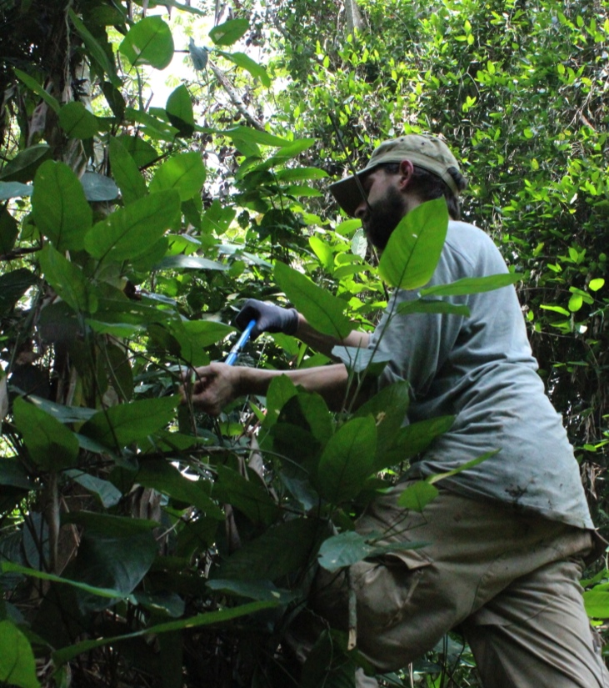
Database
Samples : Bark and sapwood samples (1204), wood cores (312)
Lab measurements : fresh and oven dry bark density and wood density (1204).
Thalès de Haulleville 2013

Slide 9
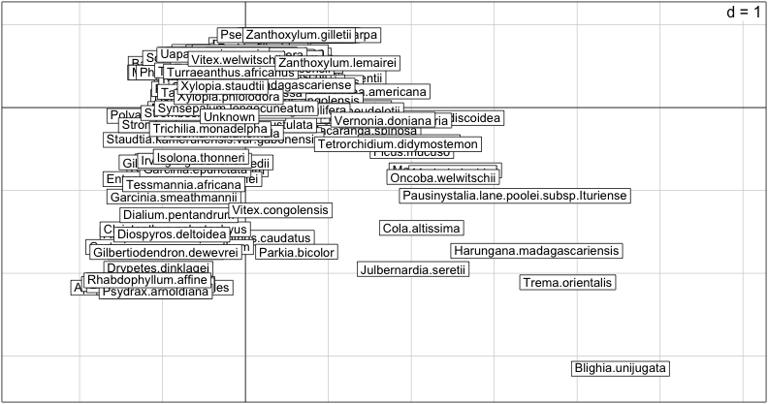
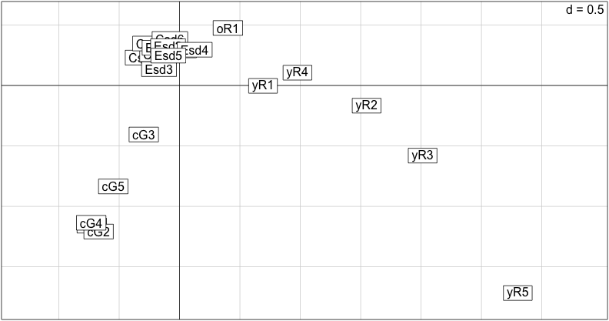
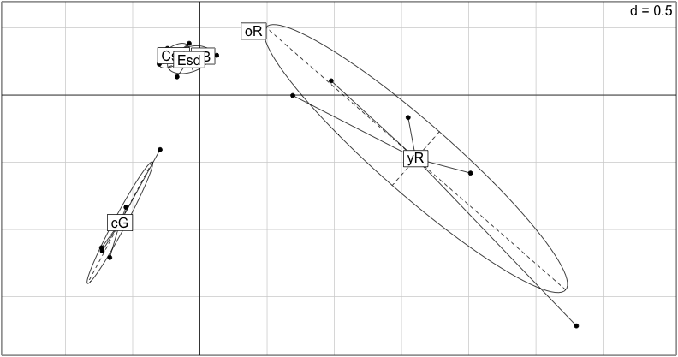
Correspondence analysis : Composition and structure - Basal area
 |  | sp. 1 | sp. 2 | sp. 3 | sp. 4 | … | sp. 127
Plot 1 | Forest Type 1 | 5 | 4 | 1 | 14 | … | 0
Plot 2 | Forest Type 1 | 7 | 13 | 8 | 13 | … | 3
Plot 3 | Forest Type 1 | 3 | 2 | 6 | 13 | … | 12
Plot 4 | Forest Type 1 | 2 | 0 | 8 | 3 | … | 9
Plot 5 | Forest Type 2 | 9 | 5 | 3 | 15 | … | 5
Plot 6 | Forest Type 2 | 14 | 15 | 15 | 10 | … | 14
Plot 7 | Forest Type 3 | 6 | 7 | 2 | 14 | … | 8
Plot 8 | Forest Type 3 | 1 | 3 | 15 | 9 | … | 11
… | … | … | … | … | … | … | …
Plot 21 | Forest Type 6 | 4 | 0 | 3 | 14 | … | 8
Thalès de Haulleville 2013

Slide 10
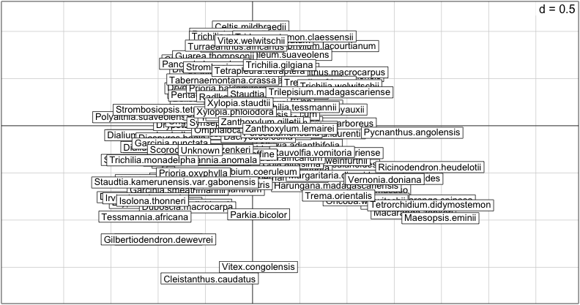
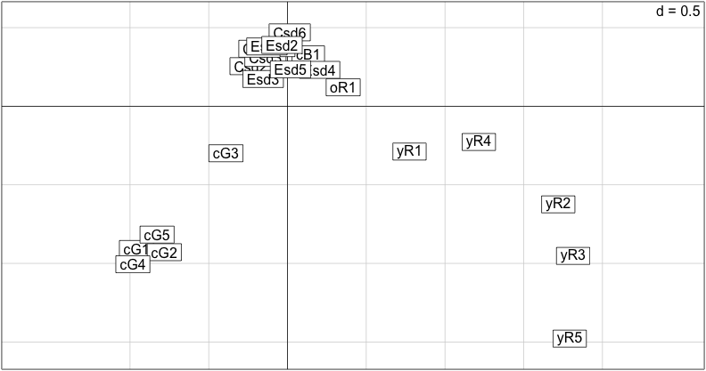
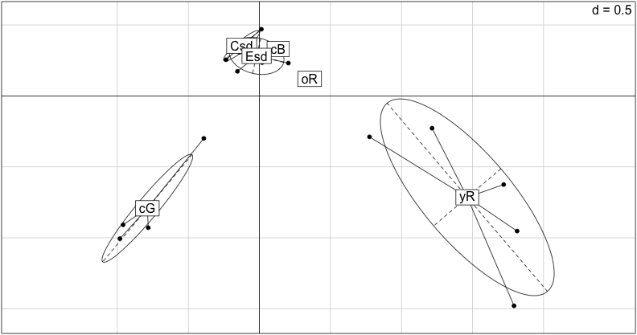
Correspondence analysis : Composition
 |  | sp. 1 | sp. 2 | sp. 3 | sp. 4 | … | sp. 127
Plot 1 | Forest Type 1 | 0 | 0 | 1 | 0 | … | 0
Plot 2 | Forest Type 1 | 0 | 1 | 1 | 1 | … | 0
Plot 3 | Forest Type 1 | 1 | 1 | 1 | 0 | … | 1
Plot 4 | Forest Type 1 | 0 | 0 | 1 | 0 | … | 0
Plot 5 | Forest Type 2 | 0 | 1 | 1 | 1 | … | 1
Plot 6 | Forest Type 2 | 1 | 1 | 0 | 0 | … | 1
Plot 7 | Forest Type 3 | 0 | 1 | 0 | 0 | … | 1
Plot 8 | Forest Type 3 | 1 | 0 | 1 | 0 | … | 1
… | … | … | … | … | … | … | …
Plot 21 | Forest Type 6 | 1 | 0 | 1 | 0 | … | 0
Thalès de Haulleville 2013

Slide 11
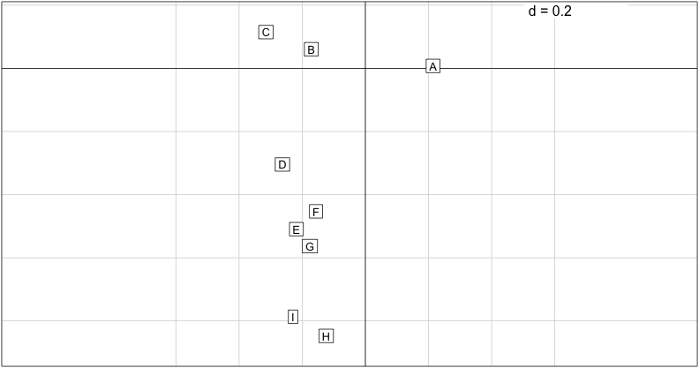
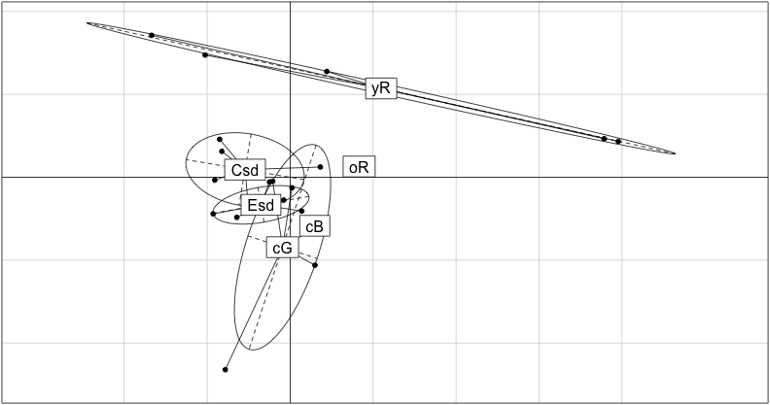
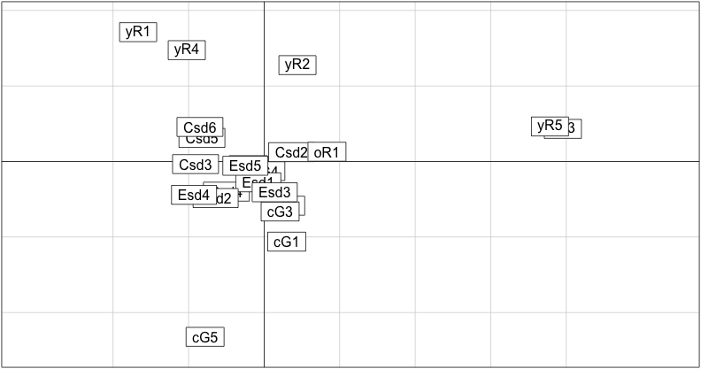
Correspondence analysis : Structure
 |  | Dclass A (10-20 cm) | Dclass B (20-30 cm) | Dclass C (30-40 cm) | Dclass D (40-50 cm) | … | Dclass F ( >80 cm)
Plot 1 | Forest Type 1 | 3 | 9 | 9 | 16 | … | 15
Plot 2 | Forest Type 1 | 18 | 10 | 8 | 17 | … | 18
Plot 3 | Forest Type 1 | 11 | 10 | 9 | 19 | … | 13
Plot 4 | Forest Type 1 | 19 | 14 | 5 | 22 | … | 14
Plot 5 | Forest Type 2 | 9 | 0 | 11 | 10 | … | 18
Plot 6 | Forest Type 2 | 11 | 13 | 11 | 0 | … | 23
Plot 7 | Forest Type 3 | 22 | 24 | 3 | 17 | … | 24
Plot 8 | Forest Type 3 | 4 | 7 | 0 | 24 | … | 18
… | … | … | … | … | … | … | …
Plot 21 | Forest Type 6 | 10 | 12 | 0 | 18 | … | 22
Thalès de Haulleville 2013

Slide 12
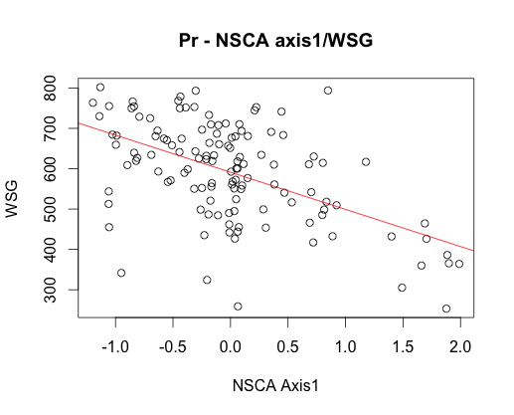
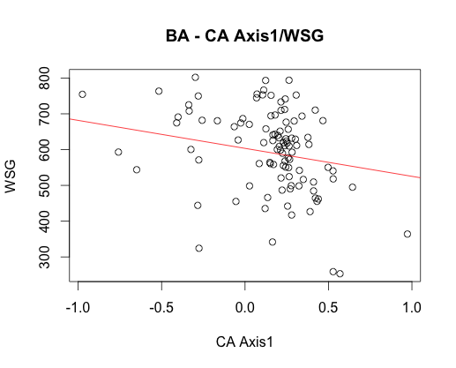
Function - WSG
(NS)CA | Parametric corr. | Non parametrical Corr. (Spearman)
pres./abs. | -0,42 | -0,46
BA | -0,46 | -0,49
Mild Correlation between presence/absence and BA 1st axis and WSG.
Thalès de Haulleville 2013

Slide 13
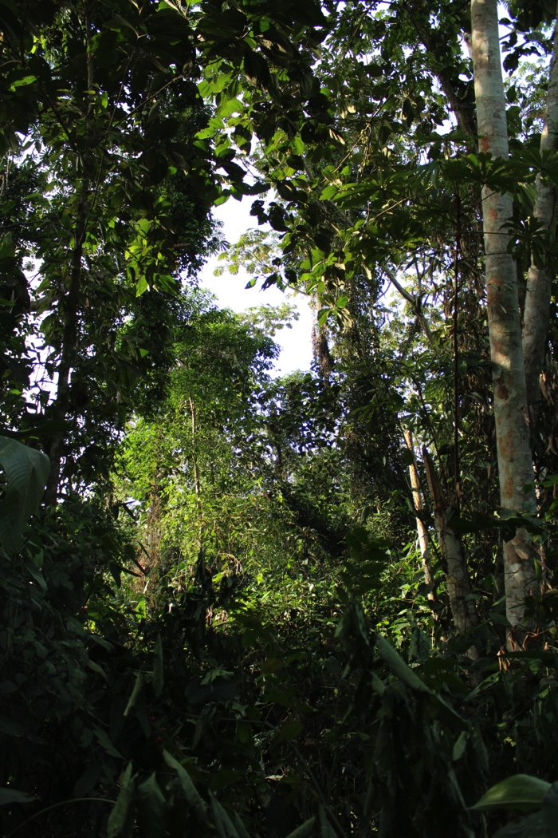
Conclusions, so far…
Composition & configuration
When exposed to an edge, semi-deciduous forests of Yangambi reserve undergo changes.
On a structural level, the diameter distribution tend to shift to bigger diameters.
On a floristic level, edge zone tends to demonstrate a slight shift from core composition toward regrowth composition. Although those species do appear in the edges, this shift is not significant regarding the basal area representation of the invading spp.
Function
The spp. distribution in each forest type seems to follow a general density gradient, from high density spp. in climax forest to low density spp. for regrowth forest. Yet, this is not the whole picture.
Thalès de Haulleville 2013

Slide 14
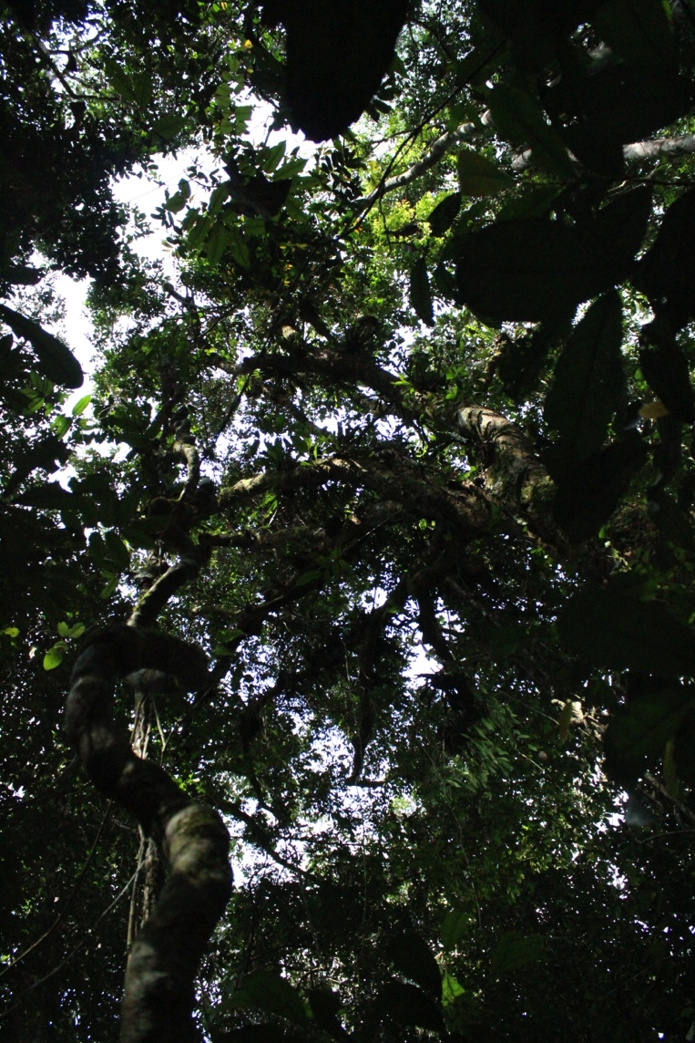
Next steps
Now that we know that there are changes between edges and cores, what about the species? What are the appearing/disappearing species?
to this point we only used mean spp. WSGs. What about the intra-specific variation? is it affected by the forest type in which the tree is growing?
Some old trees in an edge area may have known an unstressed core situation. Thus, it is possible that we could find marker of the edge creation in the tree dendrochronology (pics in growth, reaction wood…)
Thalès de Haulleville 2013

Slide 15
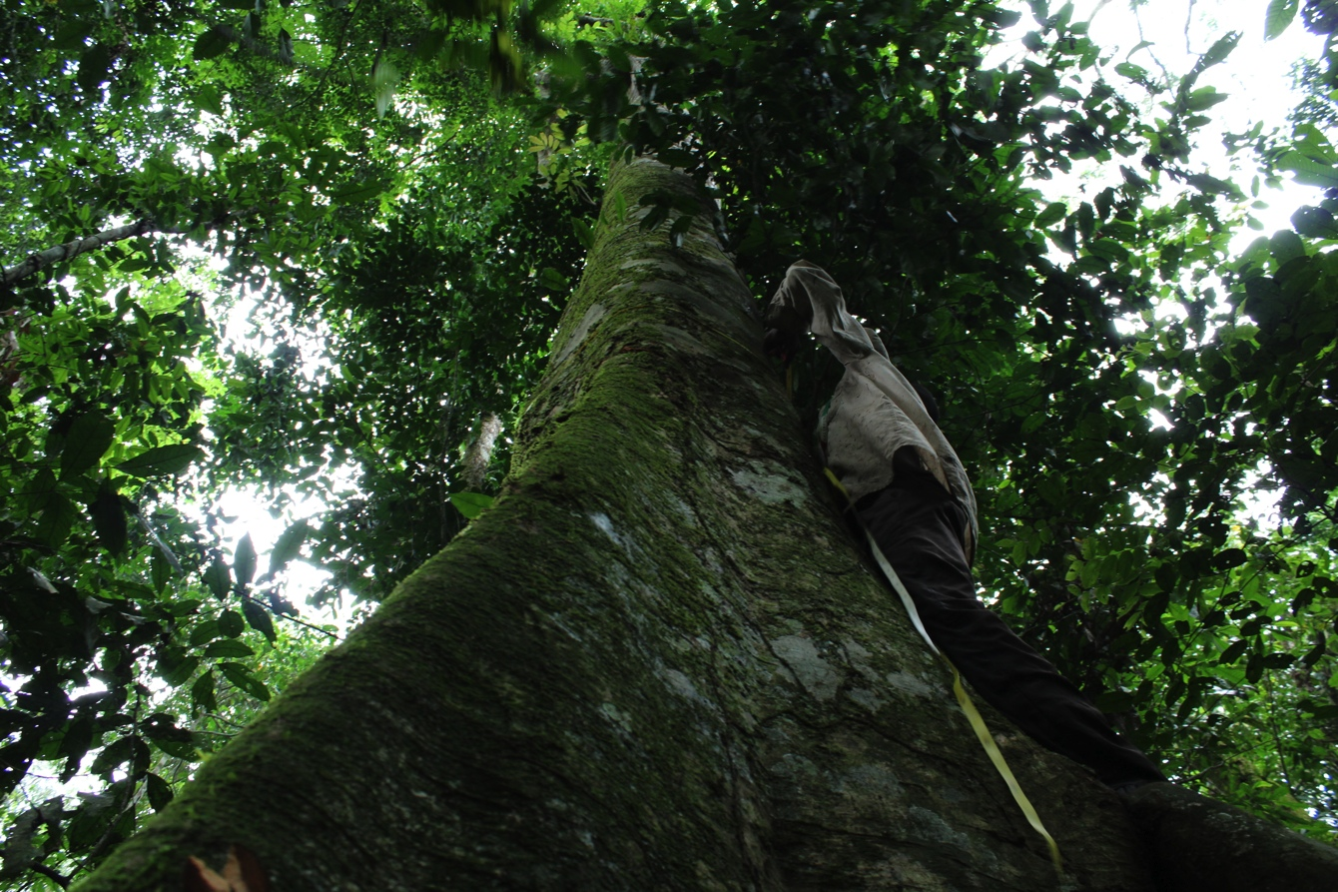
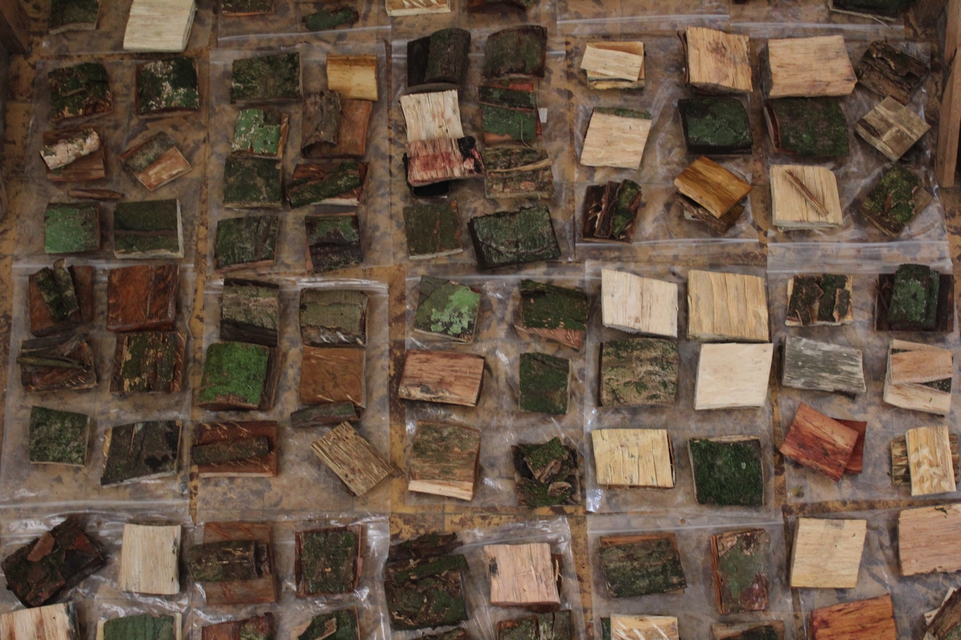
Thank you for your attention
Special thanks to Giovanna & veronica and the WSE committee for having me here
And Thanks to G. Battipaglia, W. Finsinger, M. Saurer for letting me close this session
Thalès de Haulleville 2013

