Slide 1

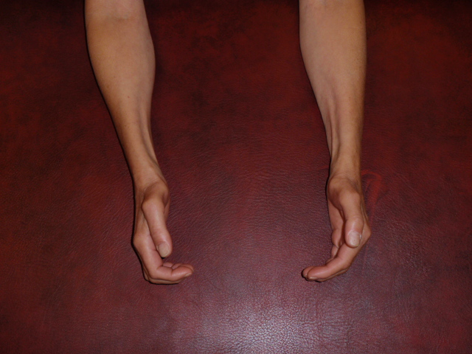
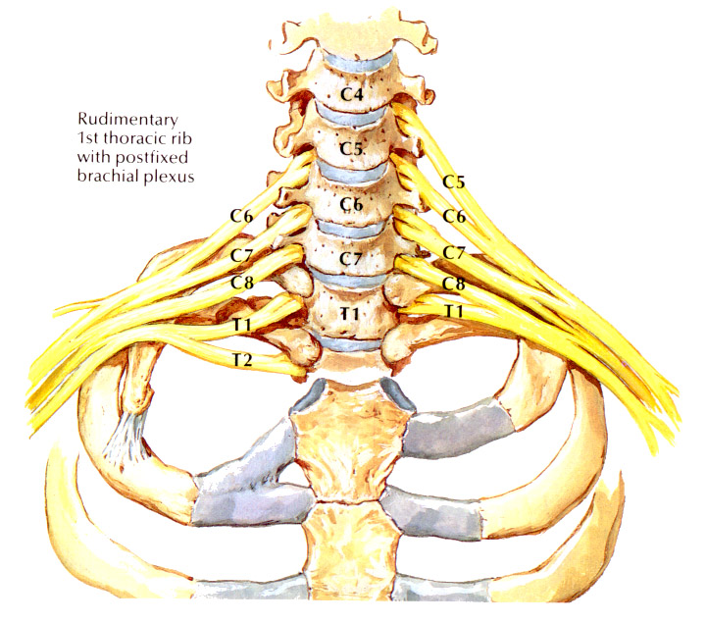
ENMG et TOS

Slide 2
ENMG et TOS
 | TOS | SCC | C8 | Ulnaire coude
Réd. Ampl PEM C.Abd.I | Oui +++ | Oui | Oui | Non
Réd. Ampl PEM Abd V | Non | Non | Oui | Oui
Réd. Ampl PEM 1er IO | Non | Non | Oui | Oui
Aug. LDM médian | Non | Oui | Oui/Non | Non
Aug. LDM ulnaire | Non | Non | Oui/Non | Non
Altération médian sensi. | Non | Oui | Non | Non
Altération ulnaire sensi. | Oui + | Non | Non | Oui
Altération BCI | Oui +++ | Non | Non | Non
C.Abd.I neurogène +++ | Oui +++ | Oui | Oui | Non
Abd V et 1er IO neurogène | Oui ± | Non | Oui | Oui

Slide 3
Neurographie sensitive
 | Amp (μV) | VC (m/s)
Médian droit | 48 | 53
Médian gauche | 66 | 56
Ulnaire droit | 21 | 57
Ulnaire gauche | 17 | 60
BCI droit | 0
BCI gauche | 0
Neurographie motrice
 | Amp (mV) | F-M (ms)
Médian droit | 8,0 | 24,3
Médian gauche | 3,4 | 29,3
Ulnaire droit | 9,1 | 25,5
Ulnaire gauce | 7,4 | 23,5

Slide 4
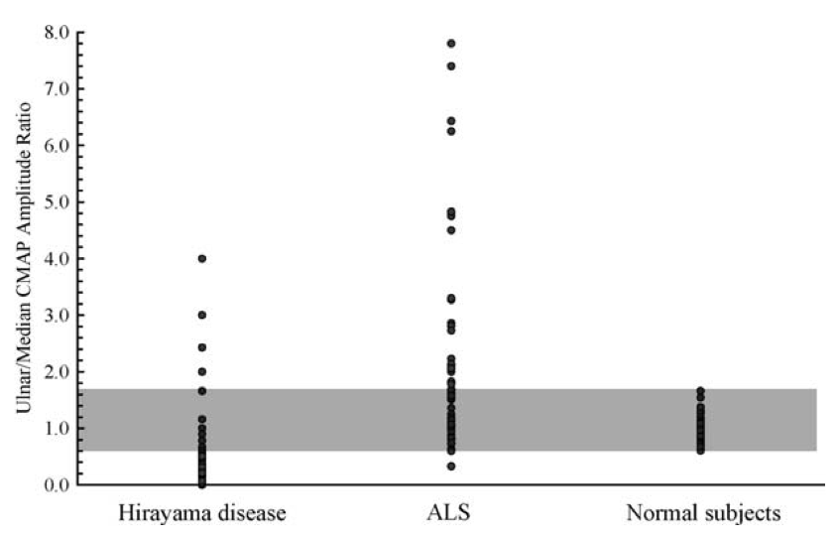
Ratio d’amplitude motrice ulnaire/médian
Médian moteur > Ulnaire moteur
Ratio d’amplitude motrice ulnaire/médian (Lyu et al, 2011) [0.6 – 1.7] : sujets normaux > 1.7 : SLA (< 0.6 in 1/60), TOS < 0.6 : Maladie d’Hirayama (34/46)
7,4 : 3,4 = 2,2

Slide 5
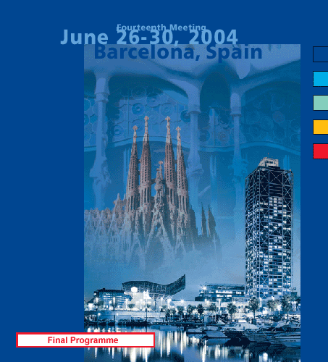
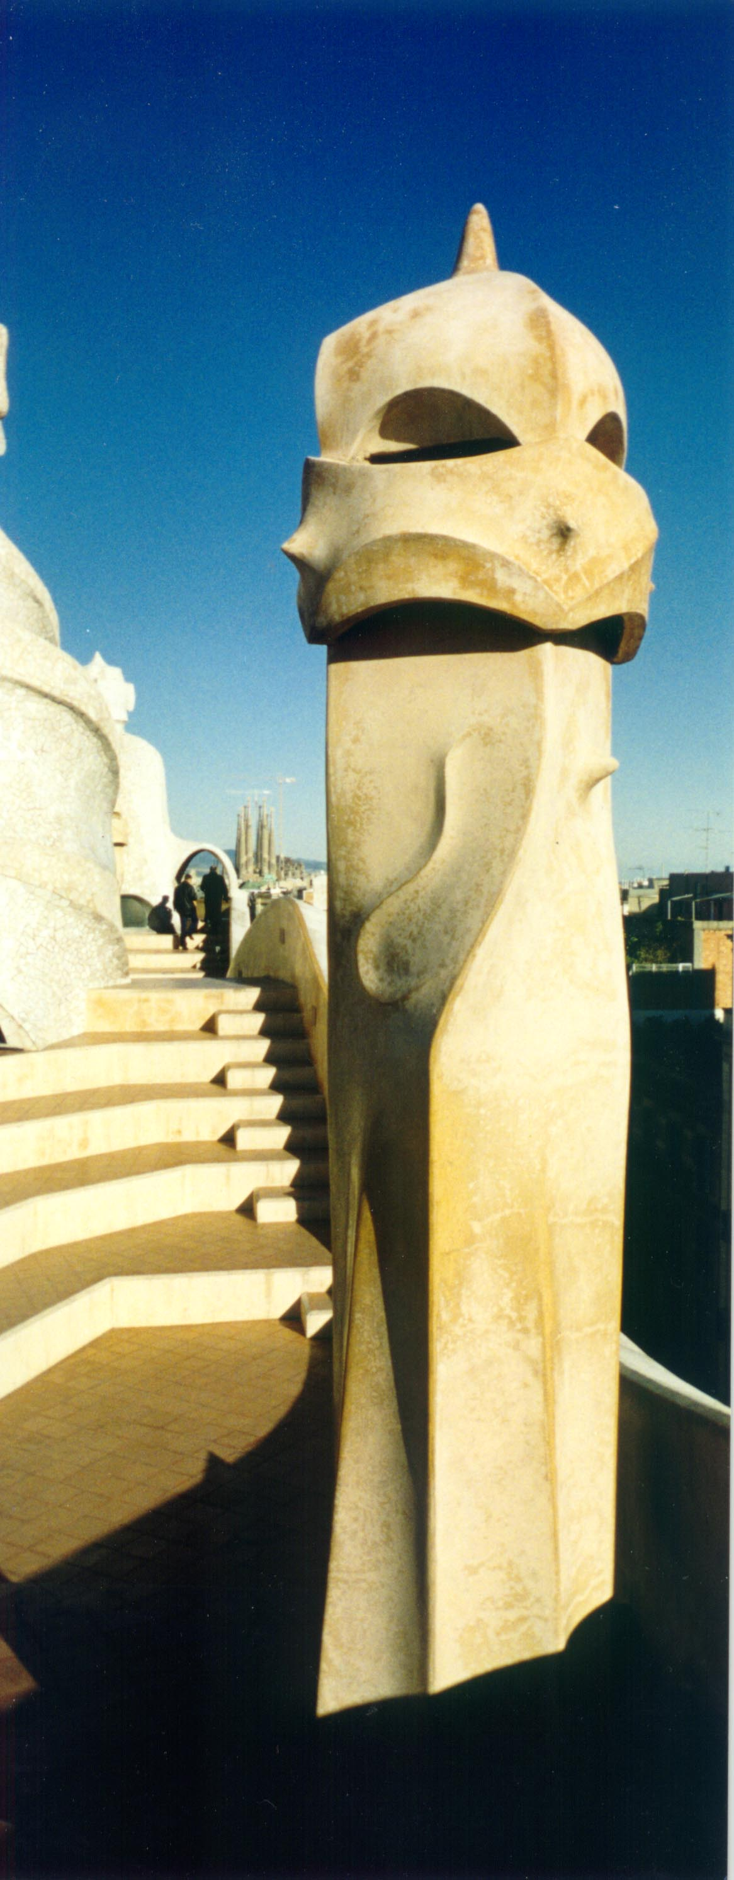
Early neurophysiological diagnosis of true neurogenic "thoracic outlet syndrome" (TOS)
M.T. Hua, A. Dubuisson, B. Zeevaert, F.C. Wang (Liège, B)
Table 2
Patients and methods
Twenty-seven patients, diagnosed as having a TOS, were studied. The diagnosis was previously made by clinicians unrelated to our electrophysiological laboratory.
Each patient was called back. History taking, physical examination and neurography evaluation were systematically performed. All had a cervical spine radiograph and a vascular-doppler flow study, otherwise the request was made. No other entrapment neuropathy was diagnosed in these 27 patients.
According to their history, clinical features and vascular-doppler (Table 1), 3 groups were established : UNLIKELY TOS (n = 7, 4 women and 3 men, mean age = 48.7), VASCULAR TOS (n = 10, 8 women and 2 men, mean age = 41.6) and NEUROGENIC TOS with or without a vascular component (n = 10, 10 women, mean age = 44.8).
We studied the medial antebrachial cutaneous nerve amplitude (MACN SNAP amplitude), radial SNAP amplitude/MACN SNAP amplitude ratio and the difference between minimal F-M latenties of median and ulnar nerves (F ulnar - F median) in these 3 groups (in bilateral TOS, only the worst side was considered) and in a group of 52 healthy subjects.
Results Control subjects: mean MACN amplitude was 18 ± 5 µV, lower limit of normal (LN) was 7.7 µV ; mean amplitude ratio was 2 ± 1 , upper LN was 3.8 ; mean F ulnar – F median was 1.1 ± 0.8 ms, lower LN was -0.4 ms (Table 3).
Pathologic features were distributed as follows : 1) C7 transverse process hypertrophy or cervical rib : 0/7 case in UNLIKELY TOS, 2/10 cases in VASCULAR TOS and 4/10 cases in NEUROGENIC TOS ; 2) MACN amplitude < 7.7 µV : 1/7 case in UNLIKELY TOS, 2/10 cases in VASCULAR TOS and 3/10 cases in NEUROGENIC TOS ; 3) amplitude ratio > 3.8 : 1/7 case in UNLIKELY TOS, 2/10 cases in VASCULAR TOS and 7/10 cases in NEUROGENIC TOS ; 4) F ulnar – F median < -0.4 ms : 1/7 case in UNLIKELY TOS, 1/10 cases in VASCULAR TOS and 5/10 cases in NEUROGENIC TOS (Tables 2 and 3).
BARCELONA 2004
Table 1
Table 3
X-ray + = C7 transverse process hypertrophy or cervical rib
MACN : medial antebrachial cutaneous nerve
Uln : ulnar ; Med : median ; M : man ; W : woman
Conclusion Our results suggest that the amplitude ratio (radial SNAP amplitude/MACN SNAP amplitude) is more sensitive than the MACN amplitude for the diagnosis of TOS. The difference between F-wave latenties of median and ulnar nerves (F median 0.4 ms longer than F ulnar) can strengthen the presumption of TOS, as far as there is no associated carpal tunnel syndrome.

Slide 6
Nouvelle neurographie sensitive
Branche terminale sensitive du nerf radial : - 8 cm entre stimulation et détection
BCI/nerf cutané antebrachial médial : - 8 cm entre stimulation et détection - 4 cm de part et d’autre du pli du coude

Slide 7
Nouvelle neurographie sensitive
N=50 | Moyenne | Médiane | ET | Min | Max | LN
Age | 44 |  | 14,3 | 10 | 93
Taille | 168 |  | 9,4 | 145 | 192
VC radial | 62 | 63 | 6,1 | 46,8 | 72,7 | 52,4
Amp radial | 48 | 50 | 14,5 | 17 | 84 | 24,5
VC BCI | 66 | 66 | 5,8 | 55,6 | 80 | 56,6
Amp BCI | 20 | 20 | 6,4 | 10 | 42,7 | 9,5
Radial/BCI | 2,5 | 2,6 | 0,8 | 1 | 4,4 | 3,8

Slide 8
BCI vs Taille

Slide 9
Radial/BCI vs Taille

Slide 10
BCI vs Age

Slide 11
Radial/BCI vs Age

Slide 12
BCI vs périmètre du bras

Slide 13
Radial/BCI vs périmètre du bras
LN : 3,8 => 4,4

Slide 14
BCI : différence G/Dr
10 μV
50%

