Slide 1
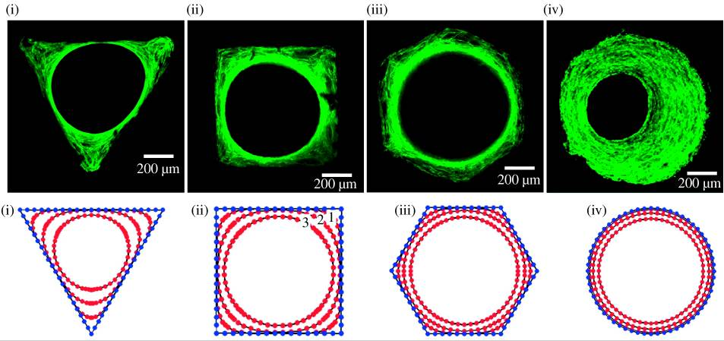
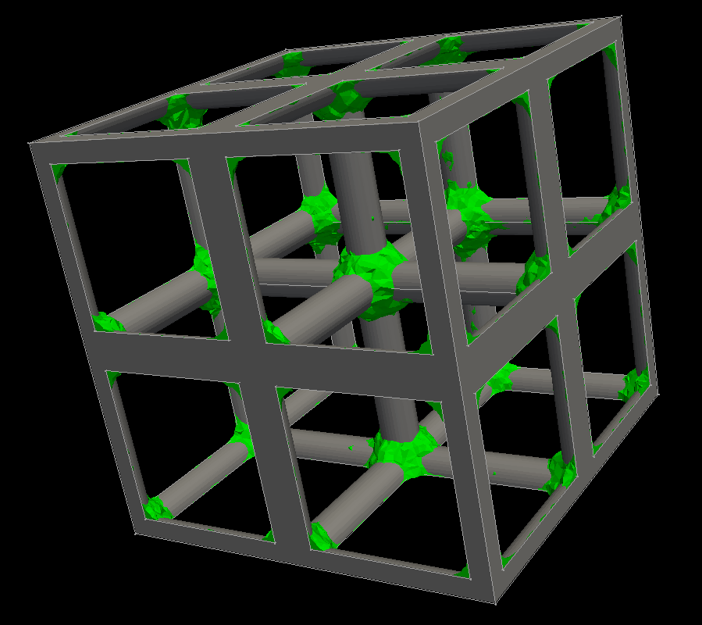
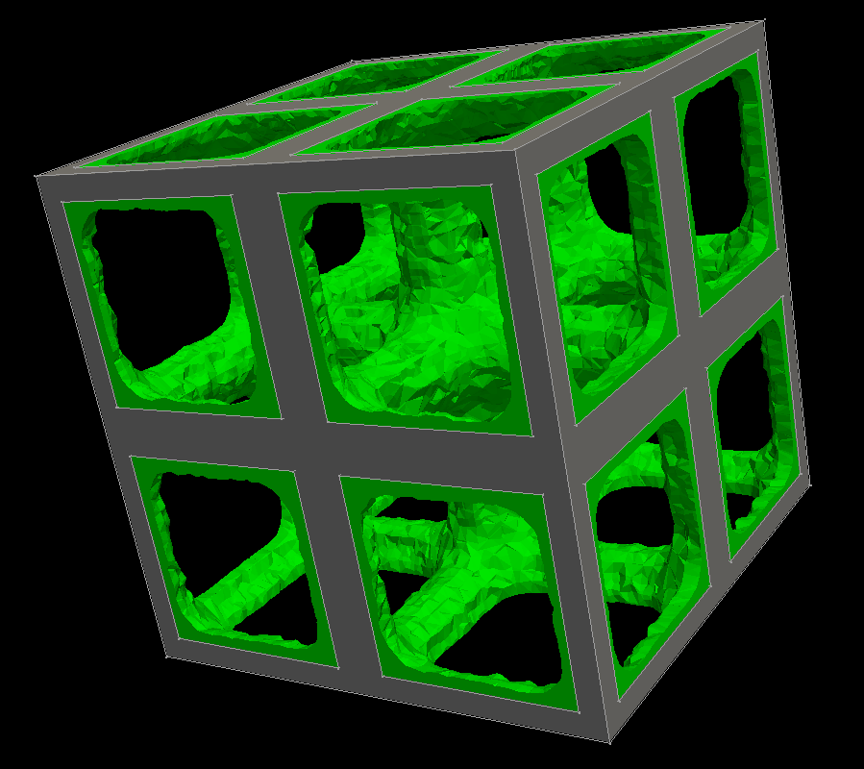
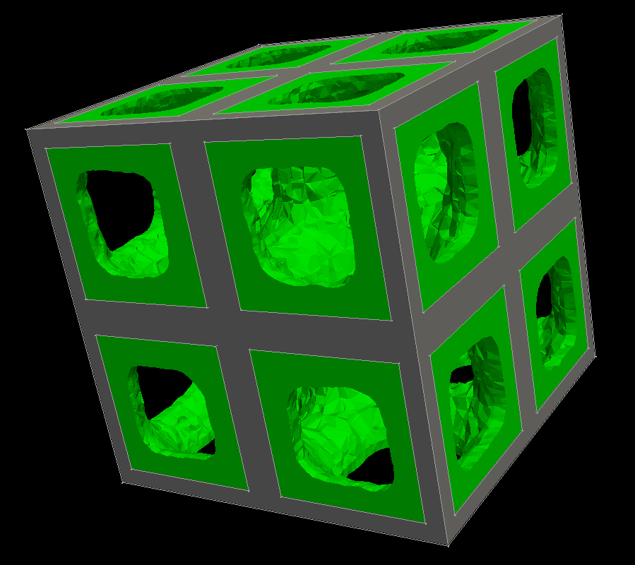
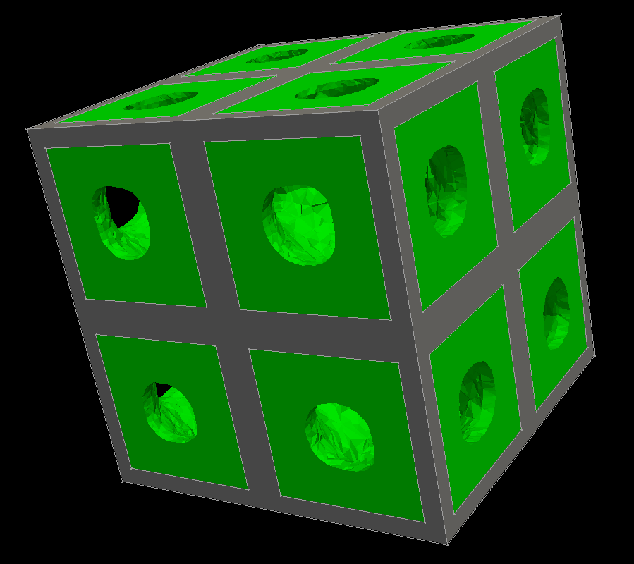
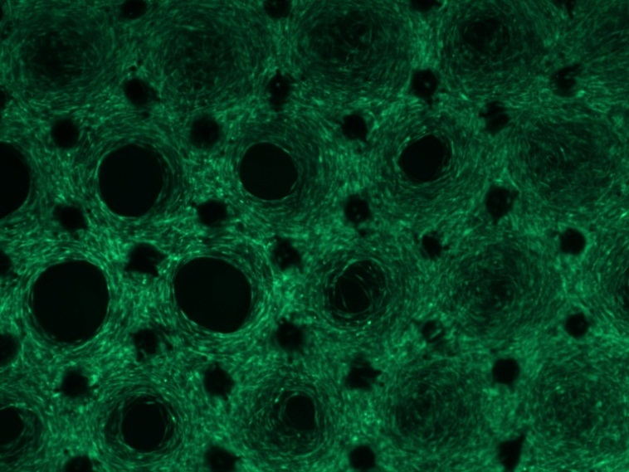
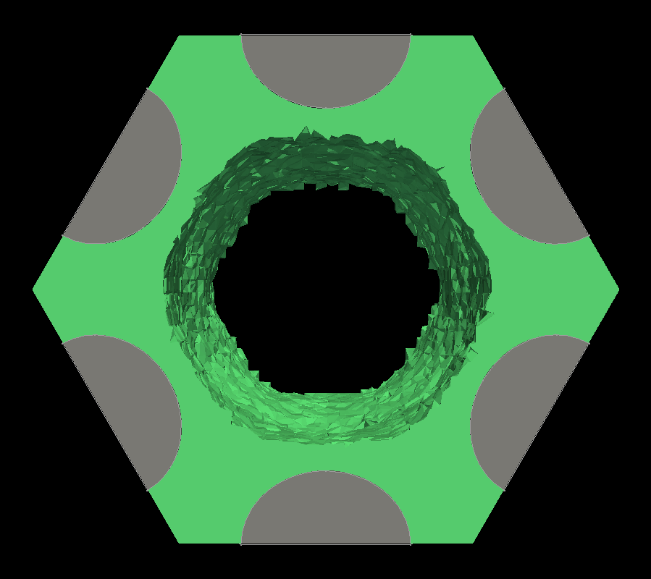
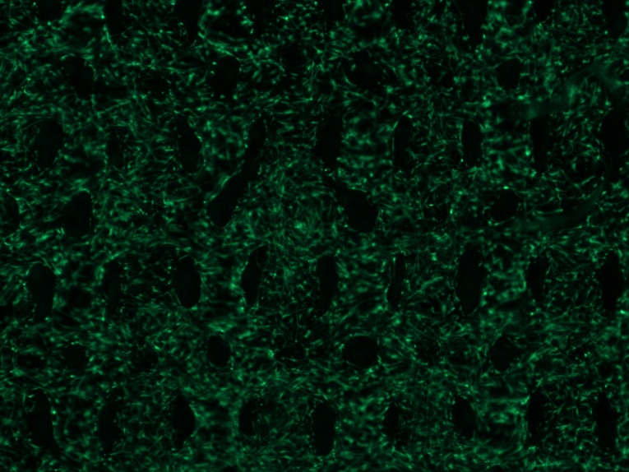
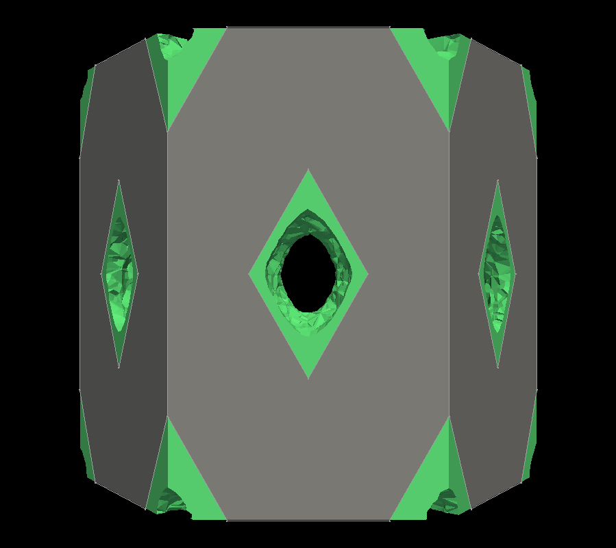
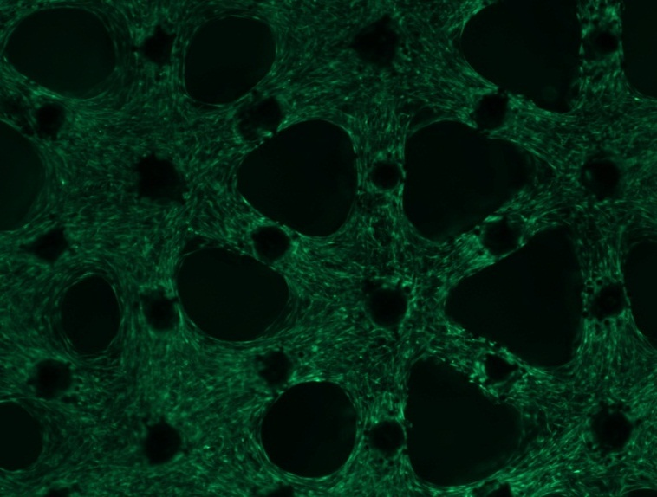
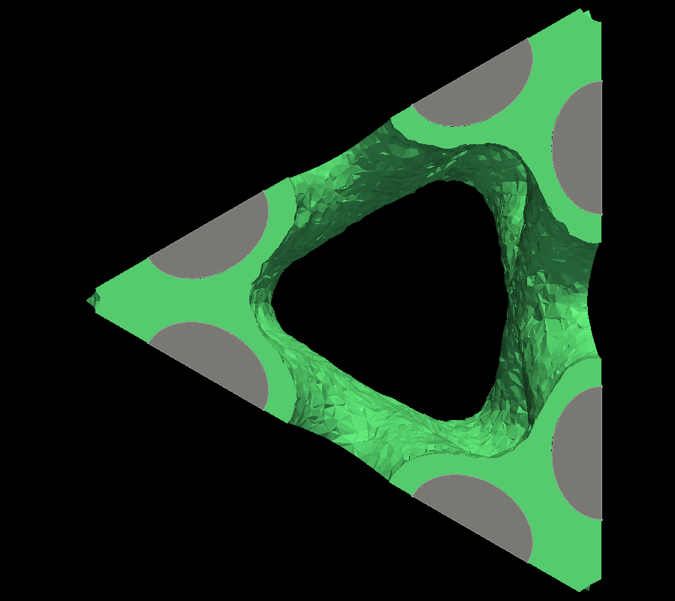
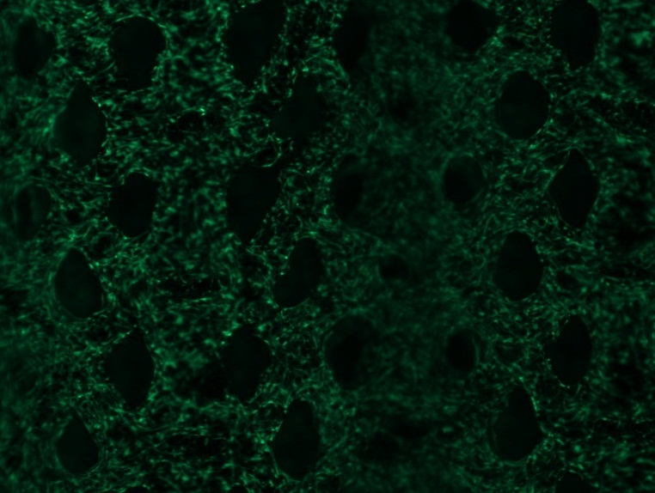
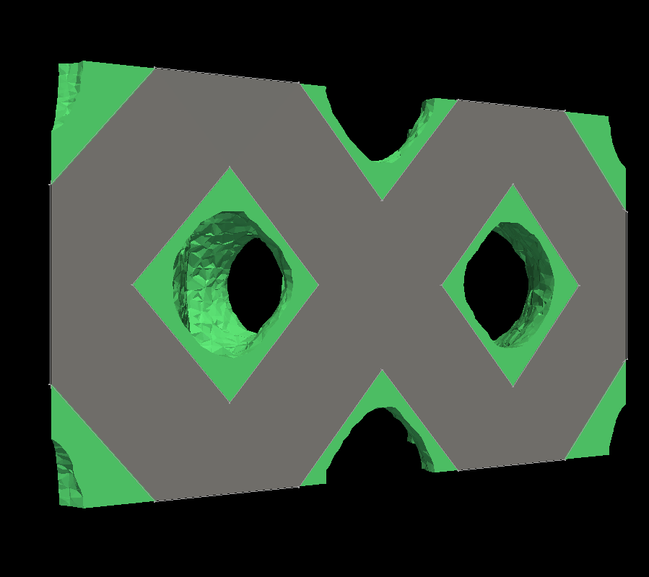
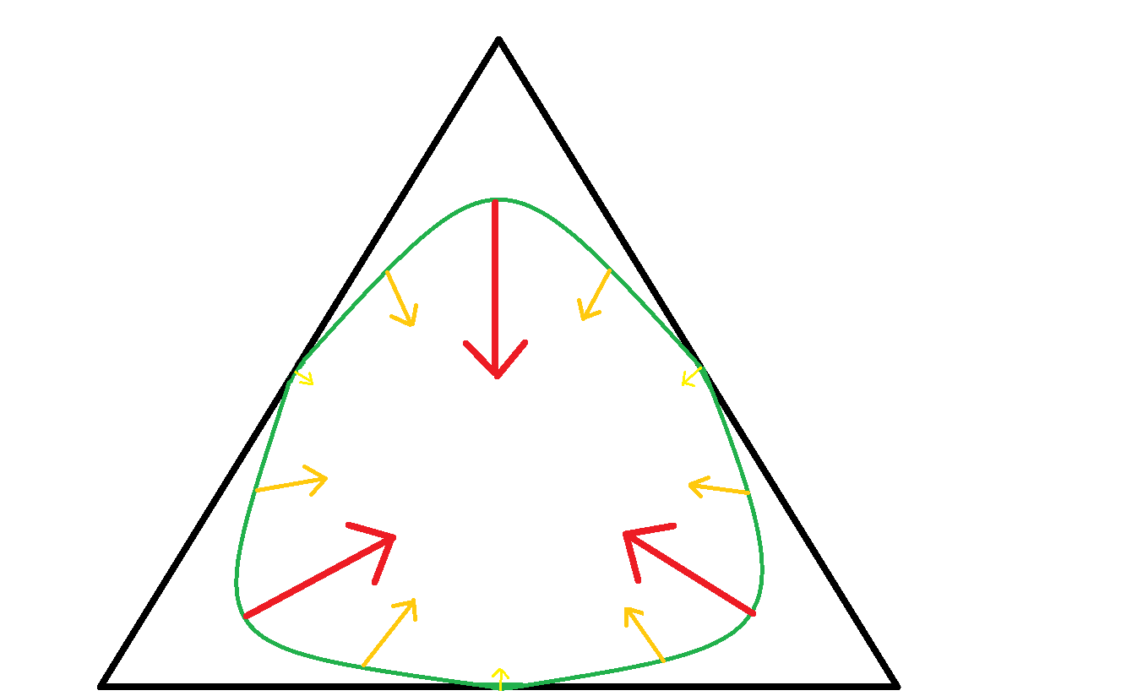
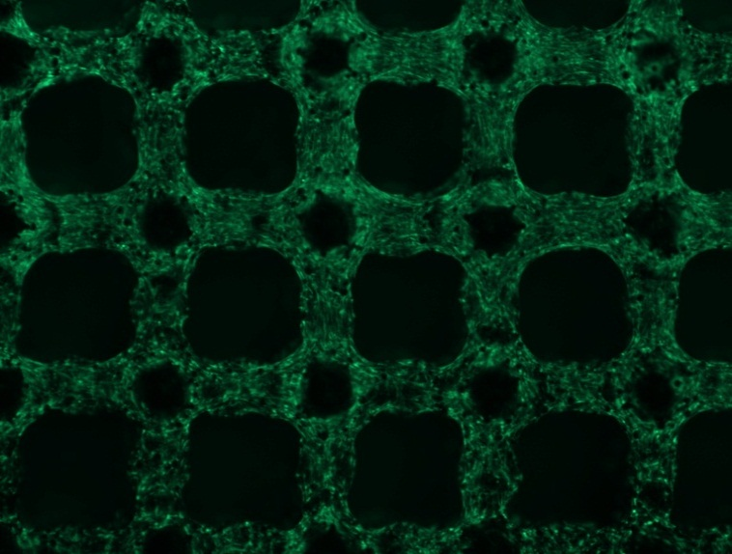
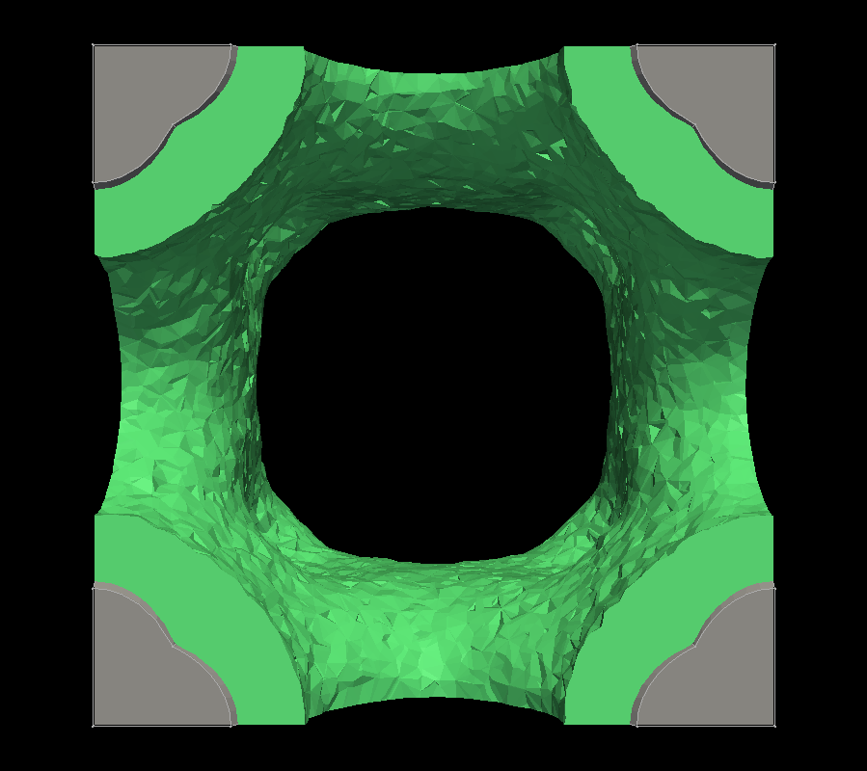
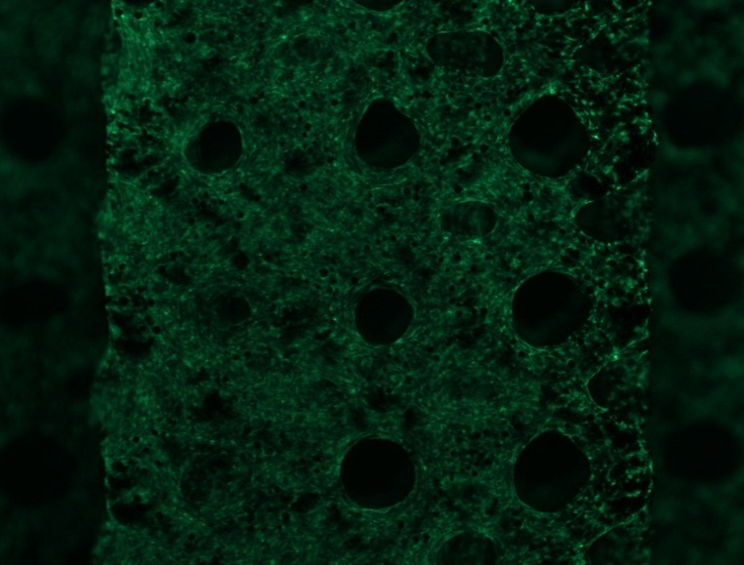
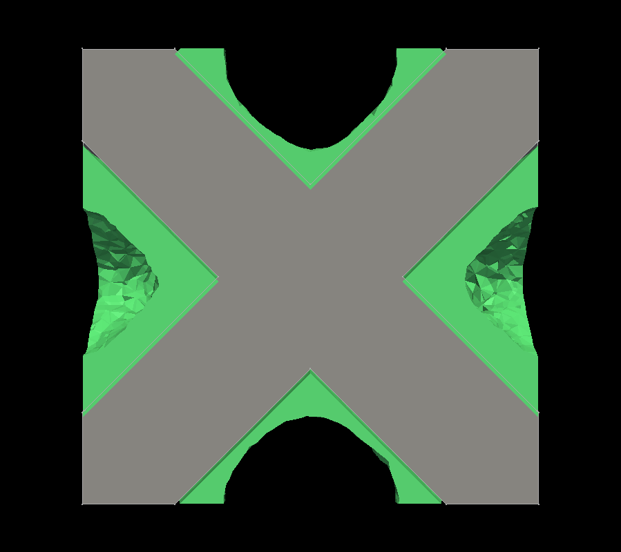
Mathematical Level-Set Modeling of Cell Growth on 3D Surfaces
Y. Guyot^{1,5}, I. Papantoniou^{2,5}, Y. C. Chai^{2,5}, S. Van Bael^{3,5}, J. Schrooten^{4,5}, L. Geris^{1,5}
¹Biomechanics Research Unit, University of Liège, Chemin des Chevreuils PB 1-BAT 52/3, 4000 Liège, Belgium; ²Laboratory for Skeletal Development and Joint Disorders, KU Leuven, Belgium; ³Department of Mechanical Engineering, Division of Production Engineering, Machine Design and Automation, KU Leuven, Belgium; ⁴Department of Metallurgy and Materials Engineering KU Leuven, Belgium; ⁵Prometheus, Division of Skeletal Tissue Engineering, KU Leuven, Belgium.
INTRODUCTION
Inspired by the results of Rumpler et al, [1], the work presented here aims to extend their model to 3 dimensions 3D in vitro cell growth, in this case applied for cell-seeded open porous scaffolds cultured under static conditions.
The kinetics of in vitro cell growth has been shown to depend on the local surface curvature of the substrate, an observation that lead to the description of curvature-controlled cell growth [1].
Additionally, Rumpler et al [1] proposed a 2D computational model capable of capturing in vitro cell growth with a curvature-driven velocity advecting the cell surface (see fig.1)
Fig 1. Tissue growth and numerical results. Rumpler et al, [1]
MATERIALS AND METHODS
RESULTS
The main idea of this model is to use the Level-Set method to catch the cell/matrix interface and the curvature.
Initially, a signed distance function ϕ is projected on the mesh, with the zero-level corresponding to the interface; and at each time step, the curvature of ϕ is computed in order to update the growth velocity.
The velocity is as follows :
In a first step, this model was applied to simulate cell growth in a cell-seeded regular scaffold with a squared unit cell cultured under static conditions (see fig.3). The model was able to simulate 3D cell/matrix growth in this scaffold. A preliminary qualitative assessment has been carried out using in vitro experimental data [2].
$$v=\left\{\begin{aligned}−λnε if κ≤0 \\ −λn\left(κ+ε\right) if κ>0\end{aligned}\right.$$
Fig .3: Cell/Tissue interface on a squared scaffold over time
With :
ε = constant corresponding to a layer by layer growth
κ = the curvature
n = the normal of ϕ
λ = a function (for biological and physical dependences)
In a second step six other regular scaffold geometries (with unit cells ranging from hexagonal to triangular [3]) were implemented. Qualitatively the model was also able to predict cell growth under static conditions in these six additionally tested geometries.
And then the motion equation
$\frac{∂φ}{∂t}$ + $v∙∇φ=0$
is solved with finite element method and the dedicated language based on C++ (Freefem++).
In this prospective study, the value of the constant part of the velocity ε was chosen to be independent of the actual in vitro culture conditions and λ equal to 1.
$$φ>0$$
Fig .2: Schematic representation of the model, the zero-level of $φ$ represents the cell/matrix interface.
Arrows represent the curvature-controlled velocity
$$φ=0$$
$$φ<0$$
Fig .4: Cell/Tissue interface on different scaffold geometries (hexagon, triangle and square) in top view (left) and side view (right)
DISCUSSION
[1] Rumpler M. et al J. Roy Soc Interface, 2008; [2] Papantoniou I. et al, in prep. 2012 ;[3] Van Bael S. et al Acta Biom, 2012.
REFERENCES
The proposed model is an interesting computational tool to investigate the behavior of 3D cell/tissue growth in regular scaffolds with different unit cell geometries. In a next step, the velocity of cell growth will be made dependent on specific culture conditions (e.g. fluid flow for perfusion culture), and the computational tool can then be used as a tool to design optimal combinations of in silico scaffold geometry and culture conditions to, e.g., maximize in vitro cell growth.
Yann GUYOT, PhD student, Biomechanics department, University of Liège
eMail : yguyot@ulg.ac.be
CONTACT
This work is part of Prometheus, the Leuven R&D Division of Skeletal Tissue Engineering of the K.U.Leuven: http://www.kuleuven.be/prometheus.
This study was supported by the Belgian National Fund for Scientific Research (FNRS) grant FRFC 2.4564.12 and the European Research Council under the European Union's Seventh Framework Program (FP7/2007-2013)/ERC grant agreement n°279100.

