Slide 1
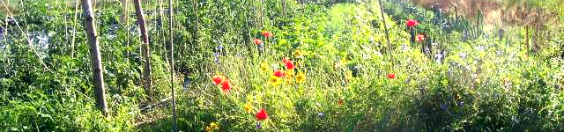
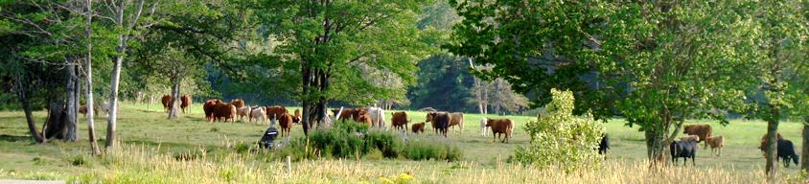
Ecosystem Services: an opportunity for agroecology?
ES and Agroecology
Marc Dufrêne and Nicolas Dendoncker

Slide 2
Ecosystem Services: Ecosystems’ dependencies for human well-being
ES and Agroecology
FOSSIL FUELS
SUPPORTING
-Soil fertility and structure
-Nutrient cycling
-Water cycling
-Genetic biodiversity
PROVISIONING
-Food
-Fibres
-Agro-fuels
FOR
BY
AGROECO-SYSTEMS
REGULATING
-Soil maintenance
-Pollination
-Pest control
-Habitat for crop auxiliaries
-Water purification
-Air quality
NOT IN MARKET
-Water conservation
-Soil conservation
-Carbon storage
-Landscape aesthetics
-Spirituality
-Habitats for Fauna and Flora
FOR
BY
Notes:
When putting agroecosystems at the centre: two types of ES: essential FOR and produced BY.
Fossil Fuels: on substitue aux services rendus normalement gratuitement par des écosystèmes (services écosystémiques) en bonne santé l’énergie pétro-chimique. Un exemple: engrais minéraux compensent les déficits en matière organique qu’on retrouve normalement dans un sol vivant. Autre exemple: les pesticides se substituent à certains insectes acteurs de la lutte biologique.
Le problème: si les agriculteurs perçoivent les bénéfices des hauts rdts générés par les fertilisants chimiques ils ne payent pas le coût environnemental engendré par la perte d’azote dans les nappes phréatiques et dans l’atmosphère (les fameuses externalités) (non-respect du principe pollueur payeur, un des principes du DD)Inversement: Les externalités peuvent aussi être positives -par ex : le stockage du CO2 dans le sol des prairies. Comme ce service n’est pas reconnu ni rémunéré (internalisé; Service Hors Marché), il est produit en quantité sub-optimale par les agents.>> Logique économique actuelle: maximiser les services d’approvisionnement (pour lesquels un marché existe) au détriment des autres.

Slide 3


Ecosystem Services: Why should we care?
ES and Agroecology
Because everybody else does!
Notes:
Everybody else does it: but not always in an ethical way.
I believe we can and should be critical, but we need to take part!
Huge opportunity > even to get funding.
Bring it back to its sustainability roots: cf bees book

Slide 4
Ecosystem Services: Why should we care?
ES and Agroecology
Because an ES assessment framework can provide a comprehensive yet operational tool for natural resource management and land use (including agricultural) planning
Analytical-deliberative frameworks need to be developed, e.g. in the context of land consolidation plans
The links between agroecology and ES have however yet to be unraveled
Notes:
Everybody else does it: but not always in an ethical way.
Huge opportunity > even to get funding.
Bring it back to its sustainability roots: cf bees book
Unraveling the links > a first attempt in this presentation

Slide 5
ES and Agroecology
Impacts
Drivers
Pressures
Ecosystems
Services
Society
Many publications on direct impact of agroecological practices on (functional) biodiversity and ecosystems
Only very few on final and global impact on a large diversity of ES
Notes:
Comment s’articule les deux interventions => ici ? ES cascade avec surtout beaucoup de papiers pour mesurer l’impact de l’agriculture en général et l’intérêt des pratiques agro-écologiques sur la biodiversité et les écosystèmes fait avec finalement très peu de publications de synthèse sur les SES (personnellement, je dois en avoir trouver 3 ou 4 … mais ils concernent surtout l’agriculture biologique). Il y en a qd même pas mal qui traitent de biodiversité fonctionnelle (FAB) ou d’un ou l’autre SES visant par exemple le contrôle biologique ou la pollinisation par exemple.

Slide 6
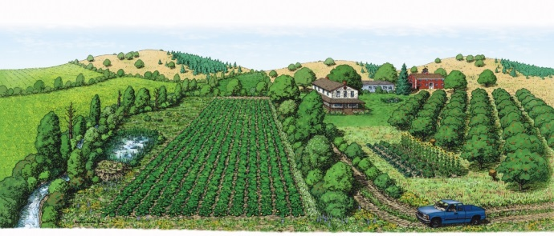




ES and Agroecology
One meta-analysis on 12 ES :
Kremen and Miles, 2012. Ecosystem services in biologically diversified versus conventional farming systems: benefits, externalities, and trade-offs. Ecology and Society.
biodiversity
soil quality
nutrient management
water-holding capacity
control of weeds
control of diseases
control of pests
pollination services
carbon sequestration
energy efficiency
resistance to climate change
crop productivity
Weak evidence
Positive effect but not sufficient
Strong evidence
Conclusions :
more research and field experience need to be conducted
as one practice influences multiple ES, research must be holistic
detailed agroecological research is needed to develop crop productivity and region-specific approaches to control of weeds, diseases and pests
Notes:
A recent paper highlights the role of agro-ecological practices in diversified farming systems on twelve ES CLICK.
They found that compared with conventional farming systems, diversified farming systems support substantially greater biodiversity, soil quality, water-holding capacity, carbon sequestration, energy-use efficiency, and resistance and resilience to climate change. CLICK
Diversified farming systems also enhance control of weeds, diseases, and arthropod pests and they increase pollination services but may often be insufficient.
CLICK
For crop yield, some works identify a reduction of yield, others not. CLICK
As many factors should be considered to a have a strong answer, the authors claims that more research and field experience need to be conducted, that we need to always adopt a holistic approach to have a global analysis and that research should focus on improving yields in crops and to control weeds, diseases and pests.

Slide 7
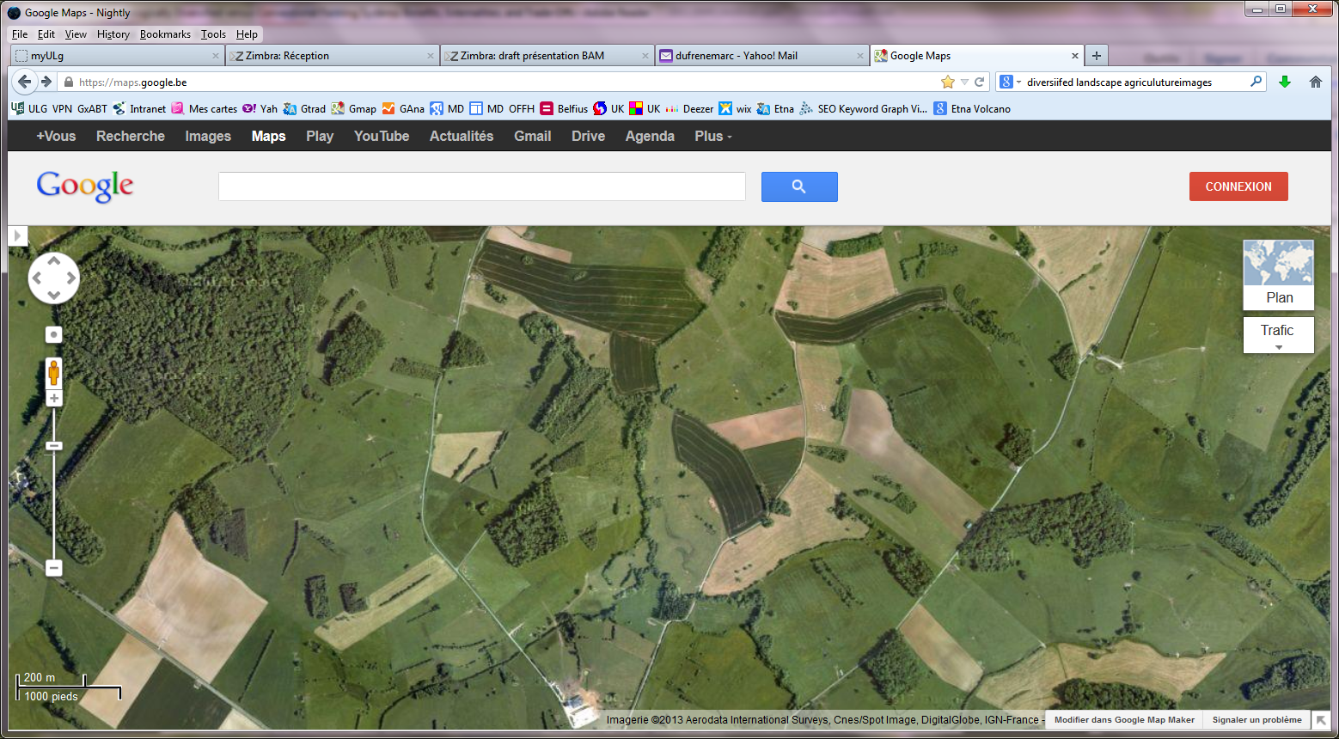
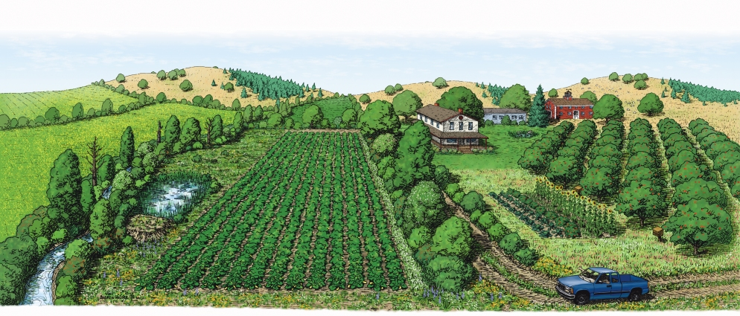
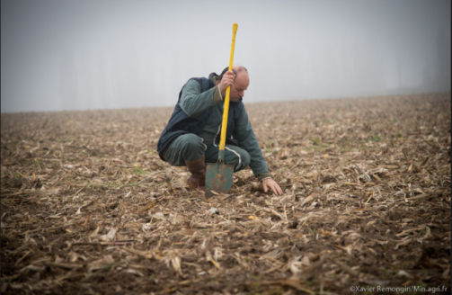
ES and Agroecology
Holistic approach : nested structure and processes
Plot
Farm
Landscape
Multiscalar effect of agroecological methods on ES
Notes:
One key feature of the expected holistic approach which complicates the analysis is the combination of scales going from landscape to farm CLICK and to plot scale CLICK.
Farm is a strategic level of organisation well known in agricultural system analysis but indeed each one is a crucial level. We need to consider multiscalar effect of agroecological methods on ES.
+ I would even argue that other LU play a role at the landscape scale and compete with agriculture hence agriculture cannot be considered in isolation from other land uses

Slide 8
ES and Agroecology : what are the links ?
Notes:
One key feature of the expected holistic approach which complicates the analysis is the combination of scales going from landscape to farm CLICK and to plot scale CLICK.
Farm is a strategic level of organisation well known in agricultural system analysis but indeed each one is a crucial level. We need to consider multiscalar effect of agroecological methods on ES.
+ I would even argue that other LU play a role at the landscape scale and compete with agriculture hence agriculture cannot be considered in isolation from other land uses

Slide 9
Agroecological methods
Mixed varieties
Mixed crops
Livestocks
Capital, work, energy
Hedgerows
Buffer strips
Natural areas
Plot - fields
Farm
Landscape
Crop rotation
Cover crops
Fallow fields
Riparian corridors
Woodlots
Meadows
Abiotic factors
s
s
Biotic factors
Ecosystem services
Functional agrobiodiversity
Soil structure & fertility, water supply, pollination, genetic diversity, biological control, …
Provisioning
Nutrition, water supply, materials, energy
Regulating
Pollution, water & mass flow, climate, biotic
Cultural
Recreational, aesthetic, symbolic values
(Supporting services)
Well-being (benefits and values)
Neutral biodiversity
Farmer
Community
Society
Notes:
What are the links between agroecology and Ecosystem services ? To produce Ecosystem services, we need capital, work, energy, abiotic but also biotic factors. Biotic factors are generally subdivided in functional agrobiodiversity that is playing a role for Ecosystem service production and neutral biodiversity. CLICK Agroecological methods act at multiple scales. By example, mixed crops play a role on the plot scale, followed by hedgerows and buffer strips between fields and we have more important green infrastructures as riparian corridors, small woodlands and natural areas at the landscape scale. These methods impact almost all ecosystem services as CLICK provisioning, CLICK regulating and CLICK cultural services. CLICK They have also a strong influence on functional biodiversity that is indeed the energy for supporting services. CLICK Ecosystem services provide a large diversity of benefits and values but the target public is also scale dependent going from farmer for provisioning services to local community for regulating services or even the society for cultural services.

Slide 10
ES and Agroecology
Agro-ecological practices and ES | supporting |  | provisioning |  |  |  | regulating |  |  |  | cultural |  |  |  | other benefits
 | Soils | Functionnal biodiversity | Food | Water | Materials | Energy | Pollutions | Floods | Climate | Biological processes | Natural surroundings | Non-rival activities | Rival activities | Symbolic values | Neutral biodiversity | Insurance value | Farmer health | Empowering people
Plot scale
Species association | X | X | X |  |  |  | X |  |  | X | X |  |  |  |  | X
Permanent cover | X | X |  | X |  |  | X | X | X |  | X |  |  |  | X | X
Mulching, compost | X | X | X | X |  |  | X | X | X | X |  |  |  |  | X | X | X
Integrate livestock | X |  |  |  |  | X | X |  |  |  |  |  |  |  |  | X | X | X
Aerial nitrate fixation | X |  |  |  |  |  | X |  |  |  |  |  |  |  |  | X | X
Biological control |  | X |  |  |  |  | X |  |  | X |  |  |  |  | X | X | X | X
Agroforestry | X | X |  | X | X | X | X | X | X | X | X | X | X | X | X | X |  | X
Reduced tillage | X | X |  |  | X | X |  | X |  | X |  |  |  |  |  | X
Genetic diversity |  | X |  |  |  |  |  |  |  |  |  |  |  |  | X | X |  | X
Interfaces
Tree strips | X | X | ● | X | X | X | X | X | X | X | X | X | X |  | X | X |  | X
Grassland strips | X | X | ● | X | X |  | X | X | X | X | X | X |  |  | X | X |  | X
Nature protection | X | X | ● | X |  |  | X | X | X | X | X | X | X | X | X | X |  | X
Farm scale
Polycultures | X | X | X |  | X | X | X | X | X | X | X |  |  | X | X | X |  | X
Alternative markets |  |  | X |  | X | X |  |  |  |  |  |  | X | X |  | X |  | X
Organic farming | X | X |  |  |  |  | X |  |  | X |  |  |  |  | X | X | X | X
Agrotourism |  |  |  |  |  |  |  |  |  |  | X | X | X | X |  | X |  | X
Local knowledge | X | X |  |  |  |  | X | X | X | X | X |  |  | X |  | X |  | X
Adapted from Gliessman (2007)
●
Potentially negative effect
X
Adapted from Kremen & Miles (2012) or expected trends
Notes:
This table summarizes the multiple positive impacts of agroecological methods on ecosystem services. Some other benefits are added as the effect on neutral biodiversity, on insurance value, on farmer health and on empowering people. We will not explore all boxes of the table but it is clear that each method impacts indeed a large diversity of Ecosystem services, regardless of the scale at which it operates. A lot of them concerns logically regulation services while cultural services are mostly influenced by the structure of landscapes.

Slide 11
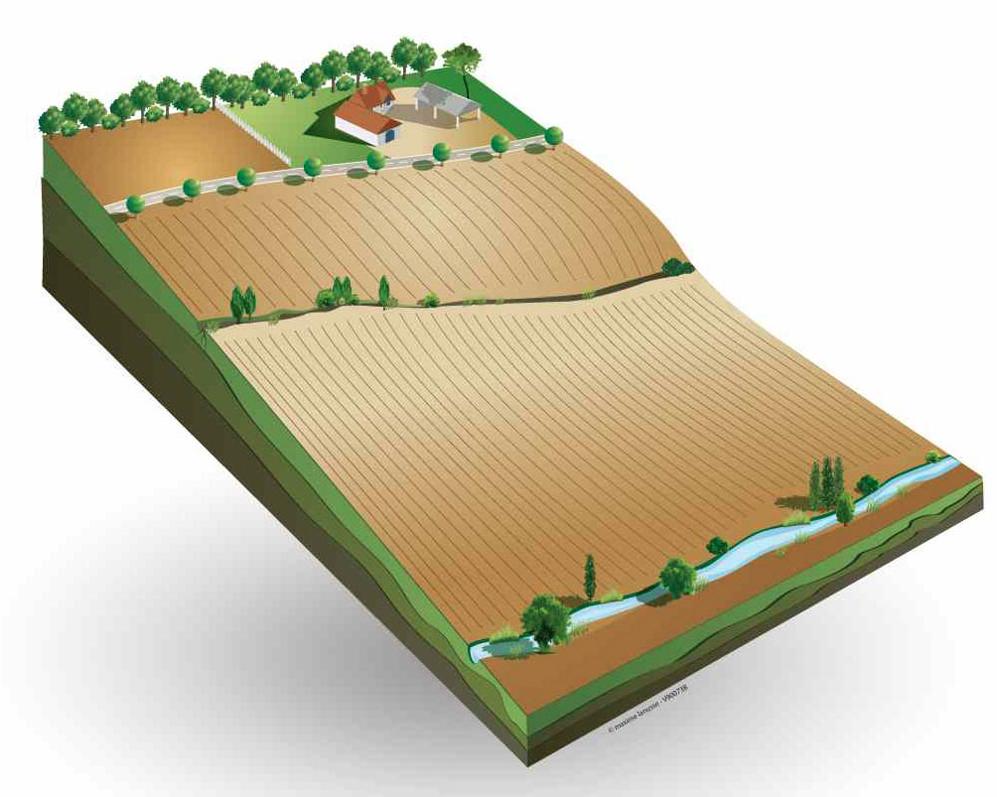
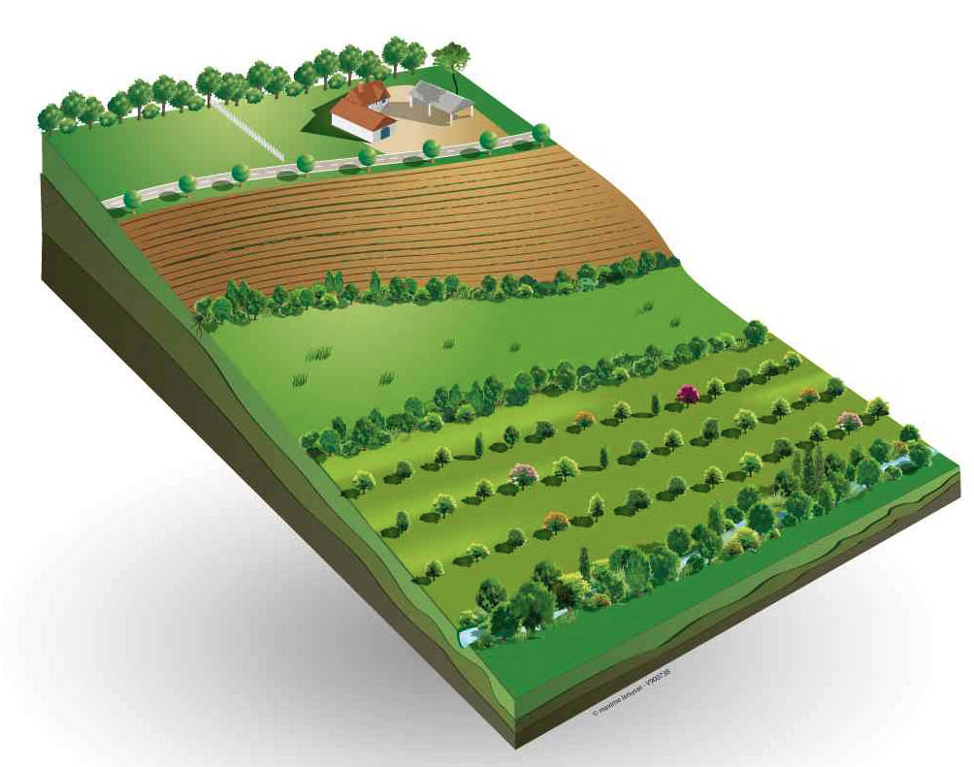
ES and Agroecology
Agroecology improve ES bundles
From
mono-functional landscape
Soil quality regulation
Water provision
Livestock
Water regulation
Storm
protection
Erosion control
Timber production
Climate regulation
Crop
capacity
Air quality
to multi-functional
landscape
Pollination
Adapted from Maes et al. (2011). European assessment of the provision of ES.
Notes:
If we plot the relationships between ecosystem services, in a mono-functional landscape like this one there is a clear opposition between crop production and some regulation services. By developing agroecological methods CLICK at field, farm and landscape scales, we could obtain more independence between food production and other services. CLICK The best solution is to arrive to produce almost all ecosystem services at the same time with a multifunctional landscape that is optimised for this purpose.

Slide 12





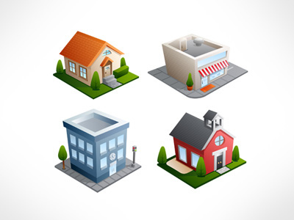
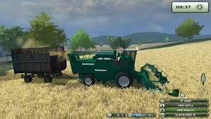

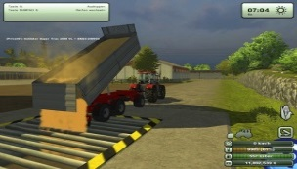



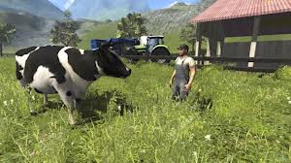

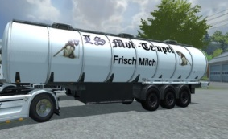


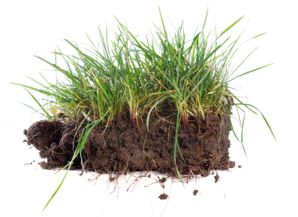
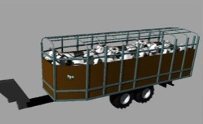
ES and Agroecology
There are significant correlations between the need of
autonomy at farm level and
Landscape consolidation
ES balance at landscape level
Plot
Farm
Landscape
Harvest
Provisioning ES
Regulating ES
Establish
Food
Energy
Fibers
Grazing
Supporting ES
Cultural ES
Milk
Animal
Manure
Notes:
The general framework of life in rural landscape is to struggle against a lot of uncontrolled global and local competitive constraints CLICK like input and energy costs, CLICK urbanization pressures and CLICK global market prices. CLICK They are indeed significant correlations between the economic need of autonomy at farm or local level and CLICK the need of ecosystem services balance at landscape level. CLICK To be efficient, landscapes should be regenerated taking in account these two systems of opportunities.

Slide 13
ES and Agroecology
Research proposal : unraveling the links between agroecology and ecosystem services to facilitate an agroecological transition
Research and field experience on agroecological methods
Notes:
How to unravel the links between ecosystem services and agroecology ? The first step is to increase research and local field experience on agroecological methods to improve the knowledge system.

Slide 14
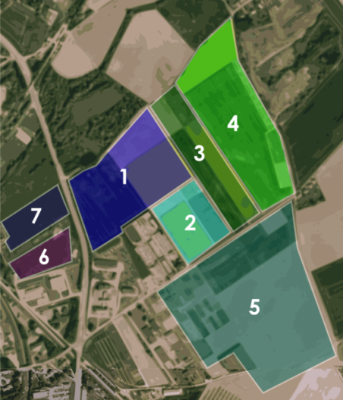

ES and Agroecology
One example : AgricultureIsLife project at Gx-ABT
Performance of non-conventional agro-ecosystems ?
Valorisation of field residues ?
Tools and methods ?
Alternative valorisation of agricultural products ?
Food
Biodiversity
Water supply
Outdoor
Materials
activities
Natural
Energy
surroundings
Biological
Pollution
control
Climate regulation
Erosion regulation
regulation
=> 15 PhD working together on 40 ha of experimental fields
1. Agroforestry
2. Intercropping
3. Agrosylviculture
4. Herbaceous strips
5. Residue management
& cover crops
Notes:
One example is the AgricultureIsLife project launched this year at Gembloux Agro-Bio Tech. Fifteen Phds are working together on a forty hectare experimental field CLICK to assess the performance of non-conventional agro-ecosystems as by example agroforestry, intercropping, the use of herbaceous strips and permanent cover crops.
They are developing multidisciplinary analyses on the same experimental platform and they are working together in a landscape office. Ecosystem service evaluation will be the common framework for analyses.

Slide 15
ES and Agroecology
Research proposal : unraveling the links between agroecology and ecosystem services to facilitate an agroecological transition
Research and field experience on agroecological methods
Holistic monitoring of large case studies (mid and long term)
Holistic monitoring of large case studies (mid and long term)
Economic analyses of farms and (local) food systems
Economic analyses of farms and (local) food systems
Research to optimise landscape structure to maximise ES, farm or local community autonomy
Research to optimise landscape structure to maximise ES, farm or local community autonomy
PES analyses to evaluate when to support farm constraints
PES analyses to evaluate when to support farm constraints
Thank you for your attention !
Notes:
Other thematic issues would be CLICK the holistic monitoring of large case studies at landscape level, CLICK the economic analyses of farms and their position in food systems, CLICK the optimization of landscape structure with land consolidation procedures to maximise ecosystem services and farm autonomy. CLICK A last point could be devoted to evaluate when it is useful to support farm constraints with payments for ecosystem services.

