Slide 1
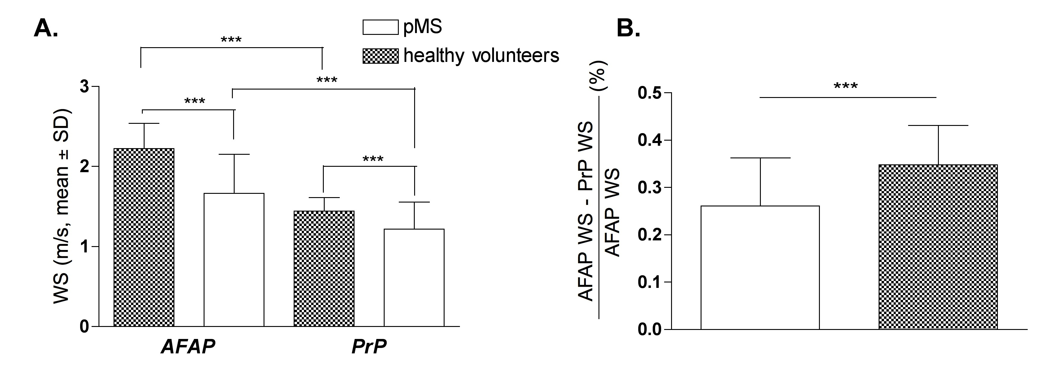
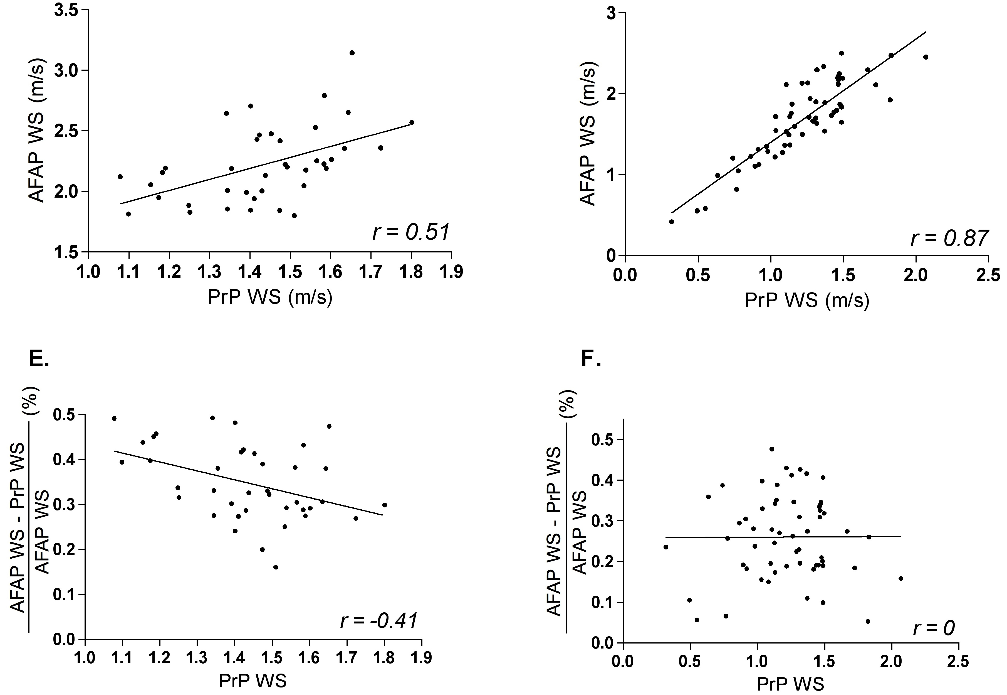
P557
23rd Meeting of the European Neurological Society
8-11 june 2013, Barcelona, Spain
Influences of the mode of walk on walking speed in multiple sclerosis - are you walking comfortably ?
R. Phan-Ba¹, MD, G. Delrue, M. Sc.¹, S. Pierard², M.Sc., E. Lommers¹, MD, P. Calay¹, M. Van Droogenbroeck² and V. Delvaux¹, MD, PhD
1: CHU of Liège, Department of Neurology (Liege, BE); 2: INTELSIG Laboratory, Montefiore Institute, University of Liège (Liege, BE)
Abstract:
Introduction : Walking speed (WS) is the most frequent gait variable taken into account when measuring gait dysfunction in neurological diseases. Influences of the mode of walk instructed to the subject, i.e. « as fast as possible » (AFAP) or « at a preferred pace» (PrP) have not been well characterized in multiple sclerosis (MS)
Objectives : To compare those 2 mode of walk in a population of persons with MS (pMS) and healthy volunteers (HV)
Methods: WS was measured with a new automated device along a 25 foot distance (T25FW) as part of a multimodal evaluation of gait in an MS ambulatory department
Results: Baseline demographics between HV and pMS were comparable except for age. Our first results demonstrate that (i) WS is significantly higher in AFAP than in PrP both for pMS and HV (p < 0.001 for all comparisons) and (ii) the relative difference between AFAP and PrP WS is significantly higher in HV than in pMS (p < 0.001). The AFAP-PrP WS correlation is higher in pMS (r = 0.87, p < 0.001) than in HV (r = 0.51, p < 0.001). Finally, the relative difference between AFAP and PrP WS is significantly and negatively correlated with the PrP WS in HV (r = -0.41, p < 0.001) but not in pMS (r = 0).
Conclusions : these results suggests that heatlhy subjects have access to a higher range of PrP WS than pMS and questions the regulation of PrP WS that might be under psychological or behavioural influences. The demonstration of a lower PrP-AFAP difference in MS suggests that pMS are either adopting a natural WS closer to their maximum WS, or alternatively that they can’t reach their maximum WS because of neurological impairments. Our results also emphasize the importance of the instructed mode of walk in the quantification of gait disorders both for routine clinical practice and clinical trials.
Introduction and Purpose
Gait dysfunction evaluation of persons with multiple sclerosis (pMS) is paramount both for clinical care and clinical trials in MS and is mainly characterized through the use of Walking Speed (WS) (1, 2)
The interference of the mode of walk appears as an obvious bias in the measure of WS.
The « as fast as possible » instruction (AFAP) is widely used in MS Timed Walked Tests (2) and is generally assumed to be representative of the best performances a subject can achieve. The « preferred pace » instruction (PrP) is more ambiguous and is rarely used. Some have argued that it is more representative of the « real life » gait function (3).
Our objectives were (i) to study the correlation between the AFAP and PrP WS measured both in pMS and in heatlhy volunteers (HV), (ii) to study the relationship between the PrP WS and the relative difference between PrP and AFAP WS and (iii) to evaluate a potential difference of this relationship between pMS and HV.
Methods
Cross-sectionnal, retrospective design
55 pMS and 37 HV assessed
Each subject performed several timed walk tests as part of a multimodal evaluation of gait in an outpatient MS clinic
Study procedure approved by the local ethic committee
Start and stop instructions were given by a human rater, but start and stop times were recorded by an automated system (temporal resolution of 15Hz)
Subjects were asked to walk the T25FW⁺ twice in PrP, and then twice in AFAP according to the same protocol as in (2)
WS were automatically generated and expressed in m/s. The mean WS of the two walk tests performed either in PrP or in AFAP were kept for analysis
Non-parametric unpaired t-tests were used for between group comparisons, non-parametric paired t-tests were used for within group comparisons, and Pearson’s correlation coefficient was used to assess the strength of the observed associations. All statistical tests were applied with a two-tailed analysis and 0.05 as a level of significance, and were performed using GraphPad Prism, version 4.0b for Macintosh, GraphPad Software, San Diego California USA (www.graphpad.com).
Results
Baseline characteristics of the subjects were not significantly different except for the age which was higher in the pMS group (Table 1)
WS measured with the T25FW in AFAP were within expected values and were significantly slower for pMS as compared to HV (1.67 ± 0.49 vs 2.22 ± 0.3, p < 0.001, m/s, mean ± SD, Fig 1A). The same was also true for the WS measured with the T25FW in PrP (1.21 ± 0.33 vs 1.43 ± 0.17, p<0.001, m/s, mean ± SD, Fig 1A).
WS was significantly higher in AFAP as compared to PrP in both groups (p<0.001, Fig 1A)
Relative difference between AFAP and PrP WS was significantly reduced in pMS compared to HV (26 ± 1.5 vs 35 ± 1.3, %, mean ± SD, p<0.0001), respectively (Figure 1B).
Higher correlation between AFAP and PrP WS in pMS (r = 0.87, Fig 2A) compared to HV (r = 0.51, Fig 2B)
Significantly negative correlation between the AFAP and PrP relative difference (AFAP-PrP) and the PrP WS in HV (r=-0.41, p<0.01, Fig 2C) but no correlation in pMS (r=0, Fig 2D)
Figure 1
Healthy subjects
persons with MS
Discussion
The higher correlation between the WS measured according to both instructions in the pMS subjects could be explained by the fact that across the different pace one individual can naturally adopt, pMS have a restricted range of possibilities, and tend to already walk nearby their AFAP mode of walk when walking in PrP. This is supported by the lower relative difference between PrP and AFAP WS in pMS as compared to healthy subjects.
This finding argues against the idea that the slower WS of pMS is an adaptative strategy to minimize the risk of fall due the neurological deficits (4)
No correlation can be found between PrP WS and the relative difference between PrP and AFAP WS in pMS. This finding needs further investigation (difference according to disability?). On the other hand, we believe that the demonstration of a moderatly negative correlation between those parameters in the healthy volunteers population reflects a wider range of PrP WS accessible to normal subjects.
The mechanisms regulating the PrP WS is unknown, but one might hypothesize that behavioral and psychological influences have a role in addition to fitness and walking habits, so that the somehow stressful environment of a gait lab might influence certain subjects to adopt a faster PrP WS, hence limiting their access to a higher WS when asked to walk AFAP.
Our findings further emphazise the need to consider the type of mode of walk chosen before administering a walk test and to refine the path of neurological testing through walk evaluation.
Figure 2
A
B
C
D
References:
1. Cohen JA, Reingold SC, Polman CH, Wolinsky JS. Disability outcome measures in multiple sclerosis clinical trials: current status and future prospects. Lancet Neurol. 2012;11(5):467-76. Epub 2012/04/21.
2. Phan-Ba R, Calay P, Grodent P, Delrue G, Lommers E, Delvaux V, et al. A corrected version of the Timed-25 Foot Walk Test with a dynamic start to capture the maximum ambulation speed in multiple sclerosis patients. NeuroRehabilitation. 2012;30(4):261-6. Epub 2012/06/08
3.. Cutter GR, Baier ML, Rudick RA, Cookfair DL, Fischer JS, Petkau J, et al. Development of a multiple sclerosis functional composite as a clinical trial outcome measure. Brain. 1999;122 ( Pt 5):871-82. Epub 1999/06/04.
4. Remelius JG, Jones SL, House JD, Busa MA, Averill JL, Sugumaran K, et al. Gait Impairments in Persons With Multiple Sclerosis Across Preferred and Fixed Walking Speeds. Arch Phys Med Rehabil. 2012. Epub 2012/05/09.
Disclosures
R. Phan-Ba serves on scientific advisory boards for Genzyme-Sanofi Aventis and has received funding for travel from Genyzme-Sanofi Aventis, Bayer Schering Pharma and Biogen Idec.
G. Delrue, S. Pierard, E. Lommers, P. Calay and V. Delvaux have nothing to disclose.

