Slide 1
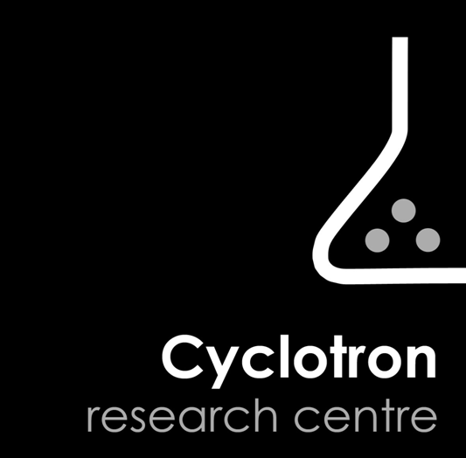


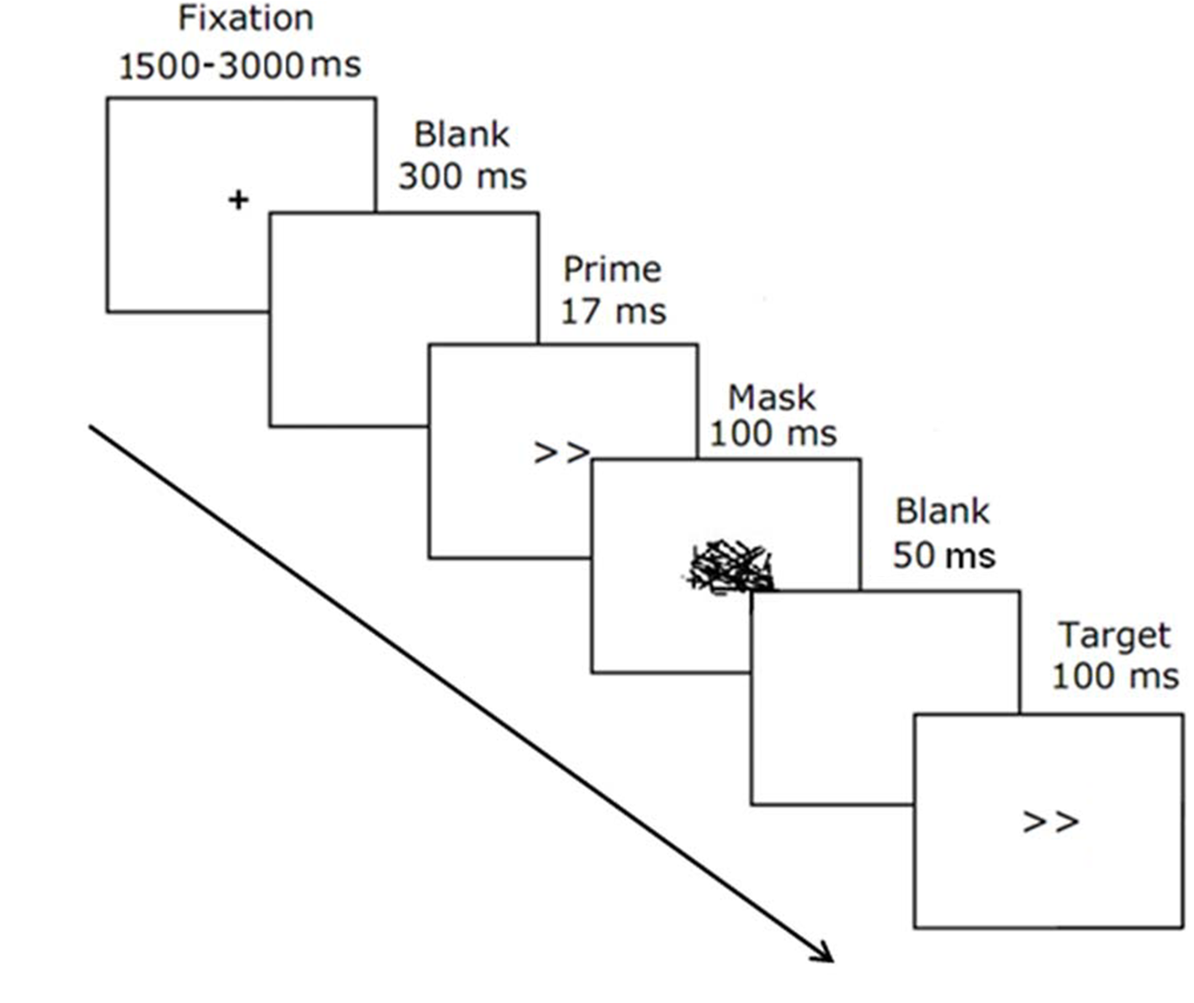
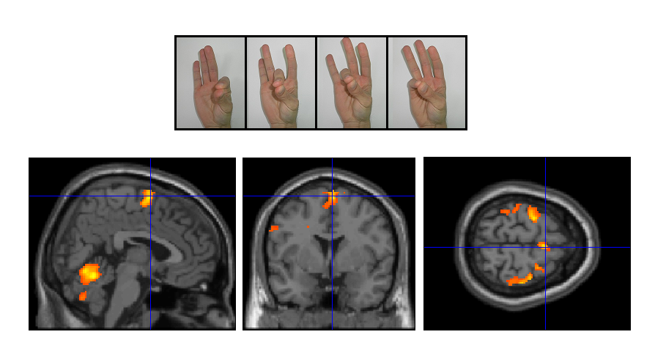
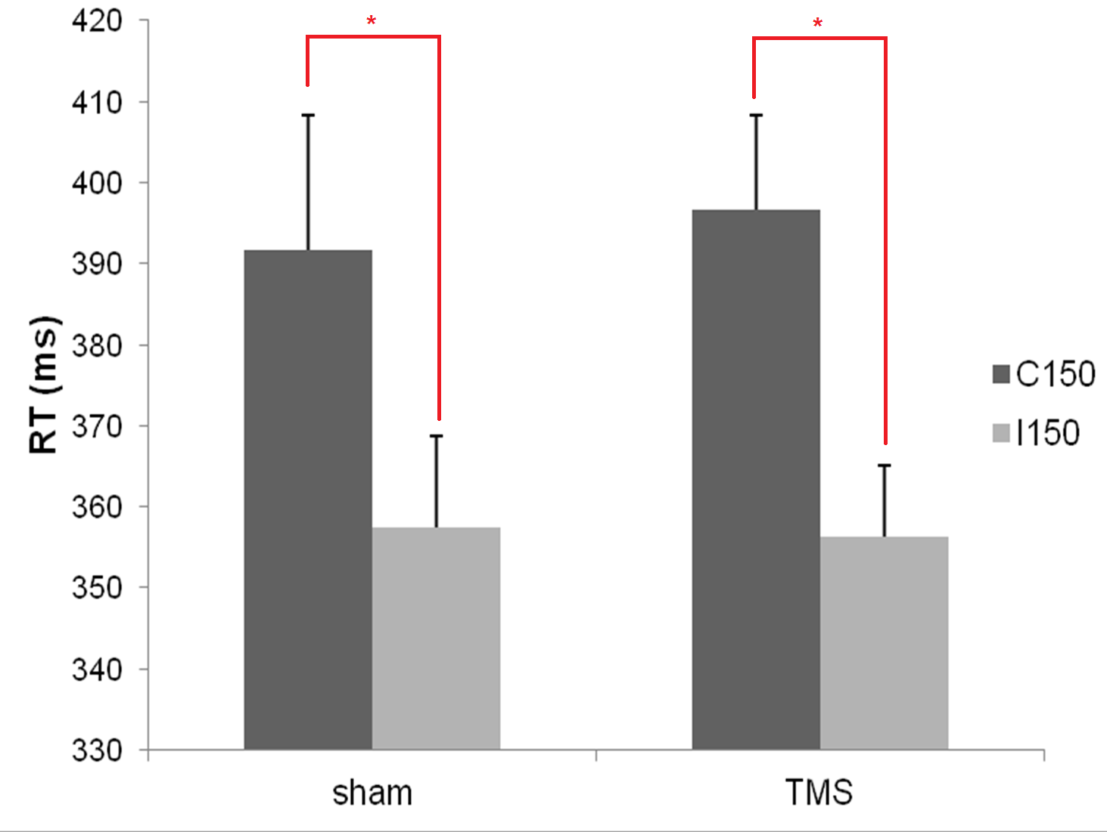
Preserved automatic inhibition effect after 1 Hz repetitive transcranial magnetic stimulation over the supplementary motor area
D’Ostilio, K. ¹, Cremers, J. ^{1,2}, Delvaux ^{1,2}, V., & Garraux, G. ^{1, 2}
¹MoVeRe Group, Cyclotron Research Centre, University of Liège, Belgium
²Department of Neurology, Liège University Hospital, Belgium
.
Introduction
.
It is widely accepted that medial frontal regions are involved in voluntary action control. Indeed, Sumner et al. (2007) have recently suggested that one of the mechanisms through which the supplementary motor area (SMA) contributes to voluntary control is automatic and unconscious motor inhibition. In this study, they administered a visuo-motor subliminal masked prime task (Eimer & Schlaghecken, 1998) to two patients with micro-lesions of the SMA and demonstrated an absence of automatic and unconscious inhibition (i.e. Negative Compatibility Effect) as evoked by masked prime stimuli. This finding has been supported by neuroimaging data (D'Ostilio et al., 2012). Here, the aim of our research was to corroborate this result by means of a “virtual lesion” approach.
Methods
Results
We examined the effects of 1 Hz rTMS (train of 20 min; stimulus intensity 120 % of resting motor threshold) over the SMA of 10 healthy volunteers (previously localized by fMRI), on reaction time (RT) performance in the subliminal masked prime task.
ISI of 150 ms:
Negative compatibility effect (NCE)
= > automatic motor inhibition
(RT compatible > RT incompatible).
The functional localizer experiment consisted of four blocks of sequential finger tapping and 15 s of rest after each block. Imaging data were analyzed with SPM 8 and then were imported into the Brainsight software version 2.1.5. The peak voxel in the SMA for each subject (at a statistical threshold of p < 0.05 uncorrected) was used as a target point for the rTMS session.
Mean RMT: 50,9 ± 4.9 %
NCE: Significant effect of compatibility for RT & accuracy rate
Automatic inhibition
No difference between sessions
Time course and distribution analysis did not show any difference
NCE in T1 seems to be linked to BOLD activity in the SMA
Conclusions
Long trains of low intensity 1 Hz rTMS did not affect the modulation of RT by subliminal stimuli, suggesting that the SMA might not be mandatory for the implementation of this automatic process, probably mediated by subcortical structures, such as the striatum (Aron et al., 2003; D’ostilio et al., 2012). The limitation of this study is relative to the neural efficacy argument because we are not sure that stimulations were strong enough to disturb the redundant organizational processing in the SMA or that other regions were not able to compensate for the virtually lesioned area.
Aron, A.R., Schlaghecken, F., Fletcher, P.C., Bullmore, E.T., Eimer, M., & al. Brain 126, 713-723
D’Ostilio, K., Collette, F., Phillips, C., & Garraux, G. PLos One 7, e48007
Eimer, M., & Schlaghecken, F. (1998). J Exp Psychol Hum Percept Perform 24, 1737-1747
Sumner, P., Nachev, P., Morris, P., Peters, et al. (2007). Neuron 54, 697-711.
MoVeRe Group| www.movere.org| kevin.dostilio@ulg.ac.be

