Slide 1


Miospores from Ordovician-Silurian Argentinean basins: evolution and relationships with other South American basins
Claudia V. Rubinstein
Victoria J. García Muro
Unidad de Paleopalinología
Departamento de Paleontología
Instituto Argentino de Nivología, Glaciología y Ciencias Ambientales
CCT CONICET Mendoza
Argentina
Philippe Steemans
Paléobotanique, Paléopalynologie, Micropaléontologie (PPM)
Department of Geology
University of Liège
Belgium

Slide 2
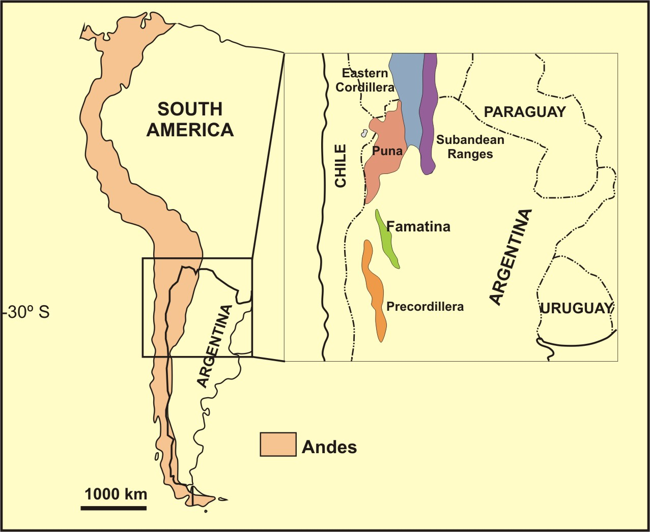
Central Andean Basin
Palynology
Sedimentology
Facies analysis
Evolution of different geodynamic environment
Notes:
Palynological data considered herein came from two of the main Lower-Middle Palaeozoic Basins of Argentina: the Central Andean Basin and the Precordillera, located at northwestern and central-west Argentina respectively. Palynological research is complemented with sedimentology and facies analysis, as well as palaeontological studies, taking into account the geodynamic of the Argentinean basins, developed in an active margin.

Slide 3
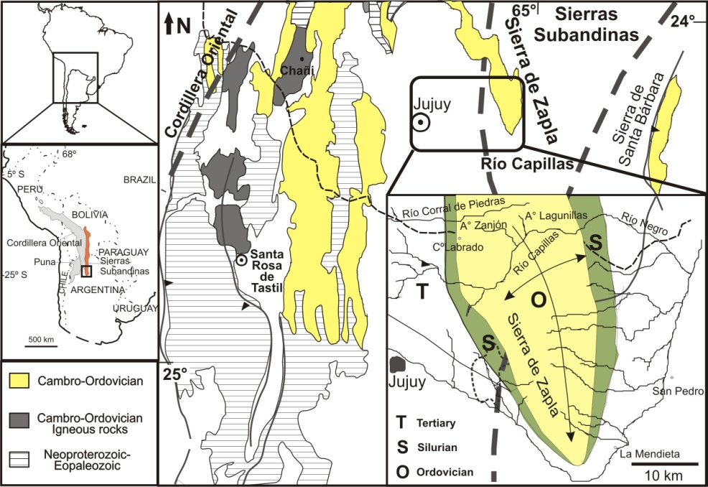
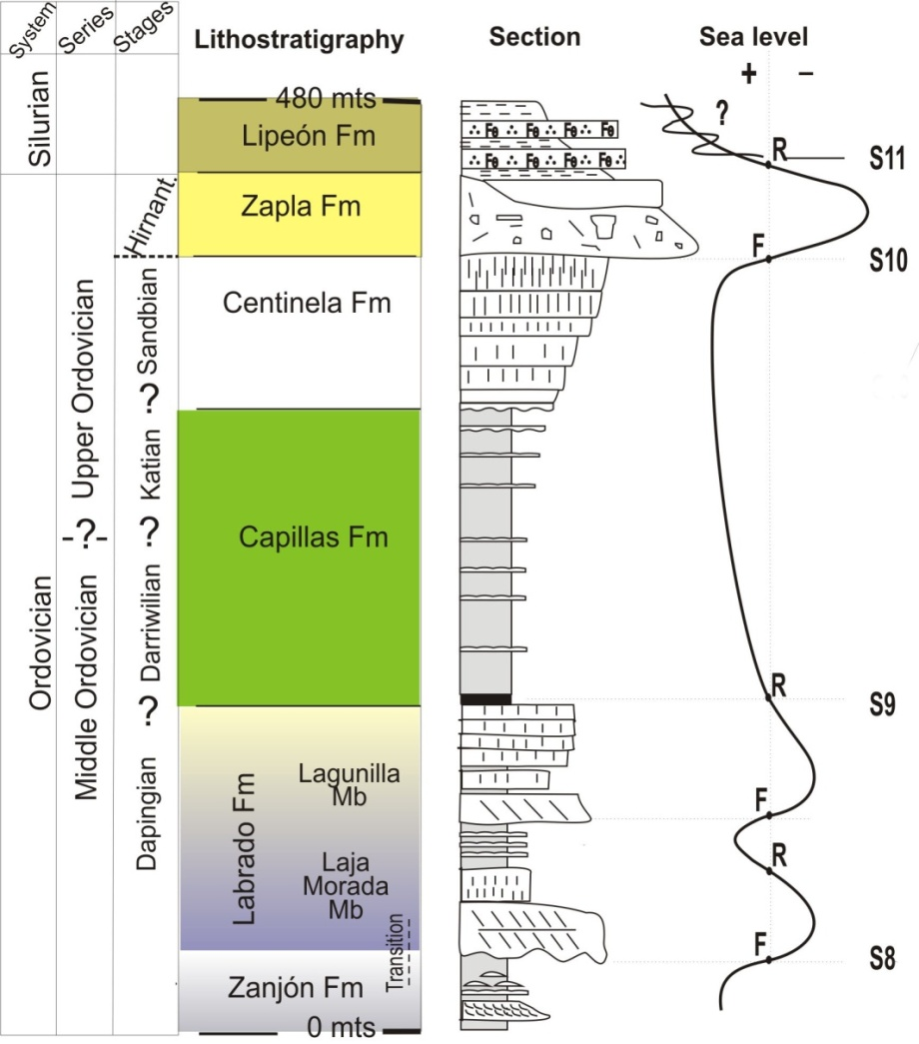
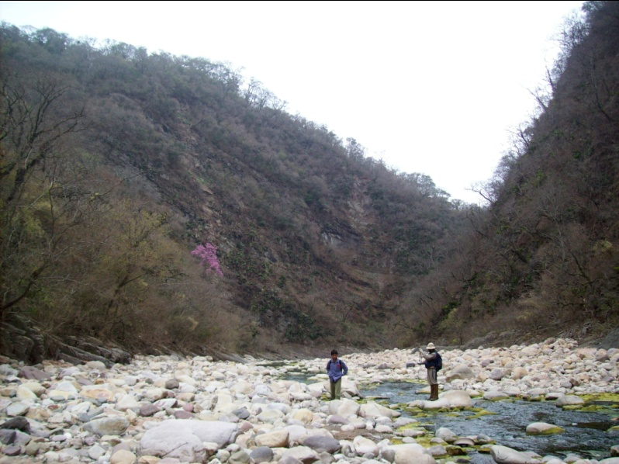
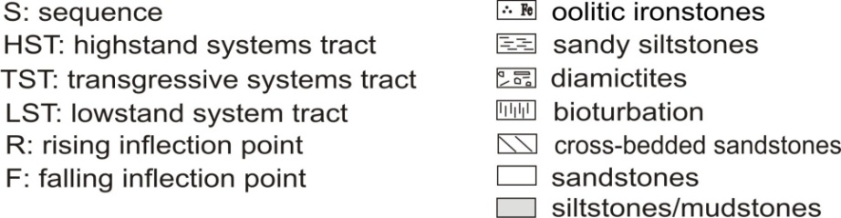
Sierras Subandinas
Río Capillas Section
transgression after the glaciation
glacial marine
deltaic
transgressive platform
fluvial-estuarine facies
tidal facies
Notes:
Ordovician to Lower Silurian clastic sediments of the Central Andean Basin were deposited in a proto-Andean foreland basin on the margin of Gondwana. Proximal environmental settings are represented in the Sierras Subandinas that constitutes the outermost portion of the foreland basin. It is characterized by alternating shallow-marine deltaic systems and estuarine environments, with frequent changes in the coast line induced by fluctuations in sea-level. This palynological study is particularly significant because it involves a section with frequent subaerial exposures and largely marginal marine settings, almost devoid of fossils.

Slide 4
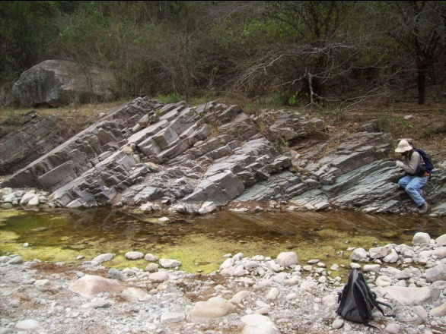
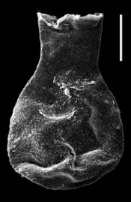
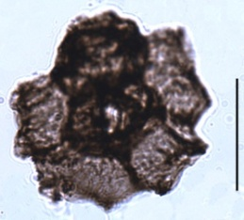
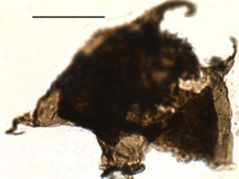
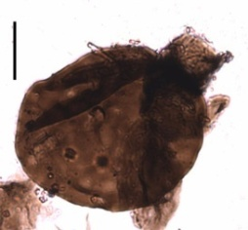
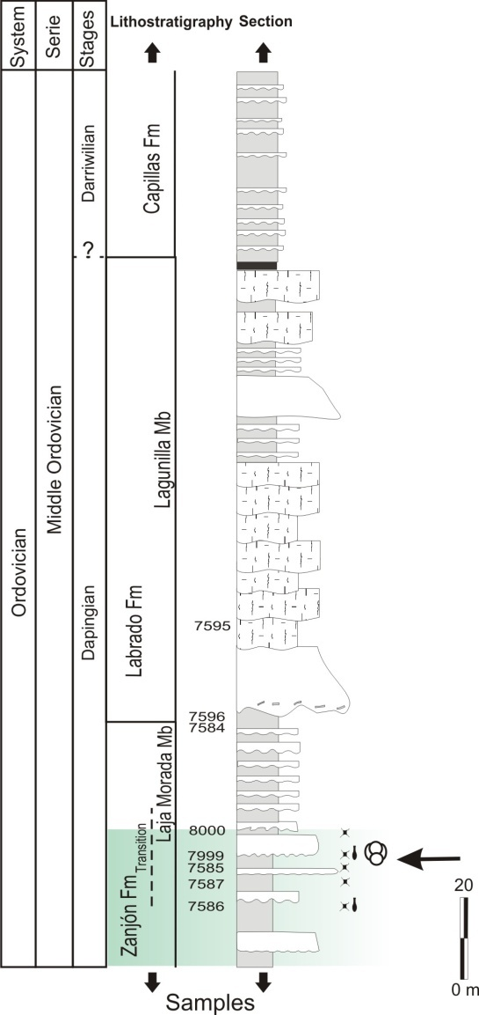
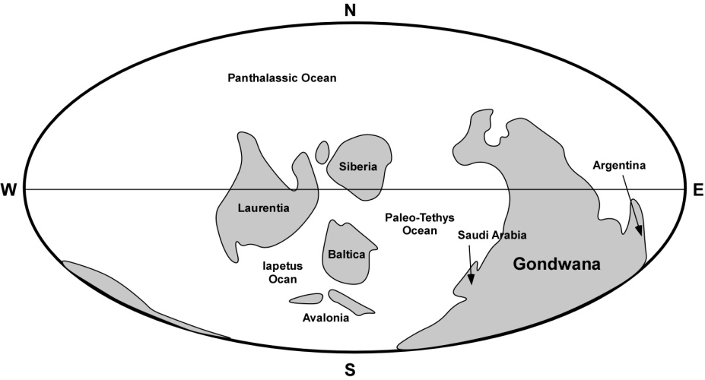
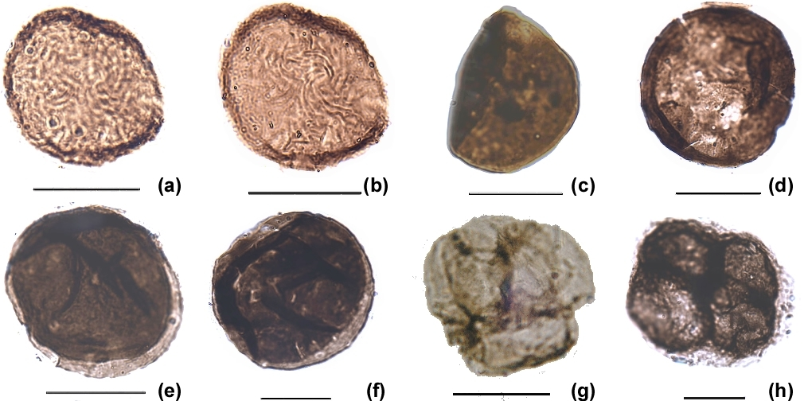
Sierras Subandinas
Ericanthea pollicipes
Aremoricanium sp.
A. cf. tosotrichion
Lagenochitina combazi emend. (de la Puente, 2010).
Dapingian of China (Chen et al., 2009)
Chomotriletes? sp. (a, b)
Gneudnaspora (Laevolancis) divellomedia or G. (Laevolancis) chibrikova (c)
Sphaerassacus glabellus (d-f)
Tetrahedraletes cf. medinensis (g)
new genus (h)
Rubinstein, Gerrienne, de la Puente, Astini i & Steemans, 2010
Notes:
The lowermost stratigraphic unit, the Zanjón Formation. Samples were collected from upper part of the Zanjón Formation and its transition to the Laja Morada Member of the Labrado Formation that are assigned to the early to middle Dapingian on the basis of the presence of the chitinozoan biostratigraphic marker Lagenochitina combazi. This age is consistent with the presence of the acritarch genus Aremoricanium, which has a FAD in the Dapingian (Brocke et al., 2000).
The moderately diverse cryptospore assemblage assemblage includes the 5 taxa. Among them, Chomotriletes? sp. is an ornamented hilate monad, distally sculptured by convolute muri. The specimens are close to Chomotriletes? sp. A from the Late Silurian of the Urubu area, Brazil.
The Argentinean cryptospores predate other cryptospore occurrences by c. 8–12 million yr, and are currently the earliest evidence
of plants on land.

Slide 5
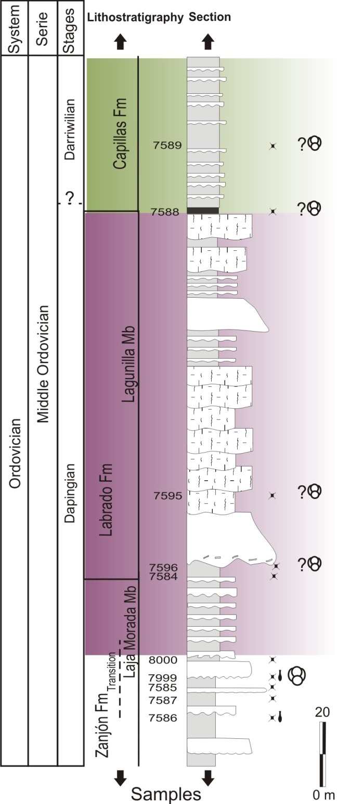
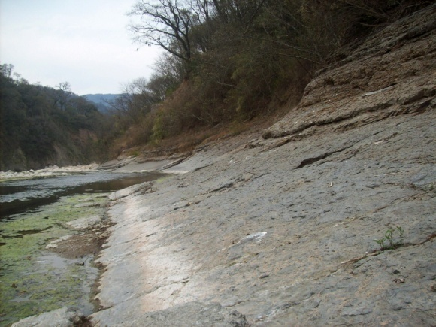
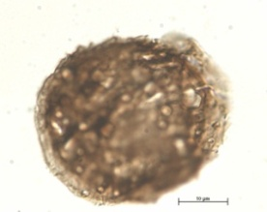
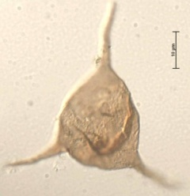
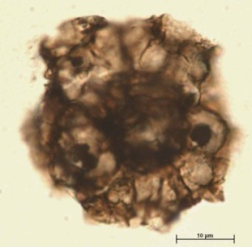
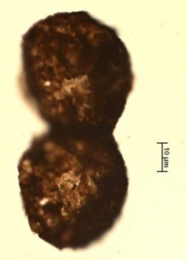
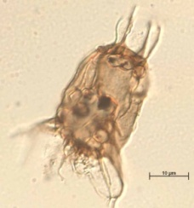
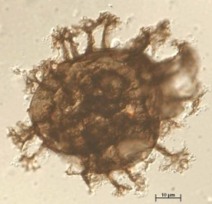
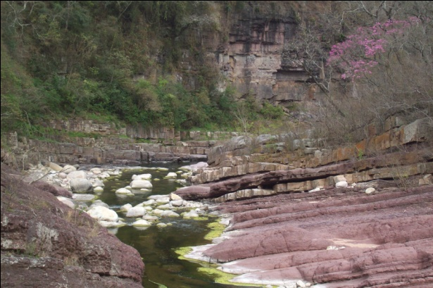
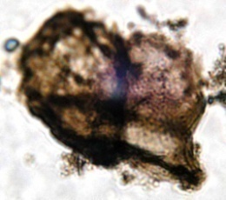
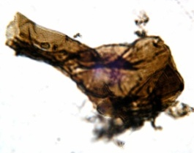
Sierras Subandinas
Cryptospore?
Arkonia tenuata Ericanthea pollicipes
?Morphon Dyadospora
murusattenuata
Barakella cf. B. rara Liliosphaeridium intermedium
Lagunilla Member
Cryptospore?
Aremoricanium sp.
Laja Morada Member
Rubinstein, Vecoli & Astini, 2010
Notes:
The Labrado Formation, particulary its upper Lagunillas Member could be interpreted as Dapingian, based on the occurrence of the genus Aremoricanium. The Capillas Formation begins with a maximum flooding surface and represents the only open marine deposits of the study section. The most relevant acritarch to constrain the age of the basal part of the Capillas Formation is the genus Arkonia.
The spore-like palynomorphs recovered from the Labrado and Capillas formations , occur as single individuals or as clusters, in planar tetrads, probably dyads and most of them enclosed within envelopes or with marginal thickening and thus approach to the morphological definition of cryptospores, but at this time, because of their preservation we didn’t considered them as cryptospores (sensu Steemnas 2000).
After the cryptospore finding in the Zanjón Formation, we think that most of this specimens can be positive assigned to land-plants.

Slide 6
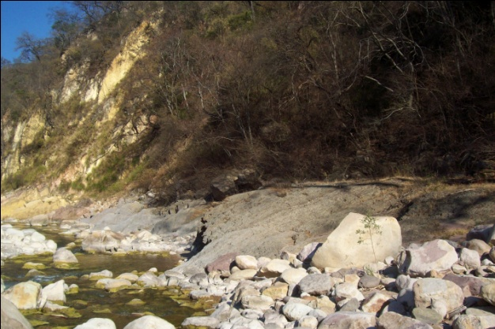
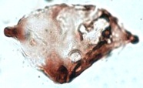
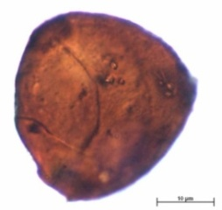
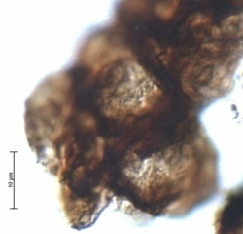
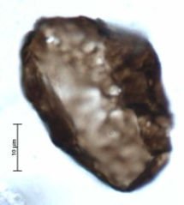
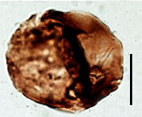
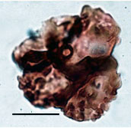
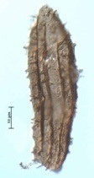
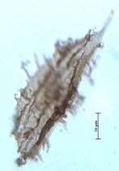
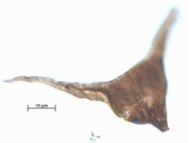
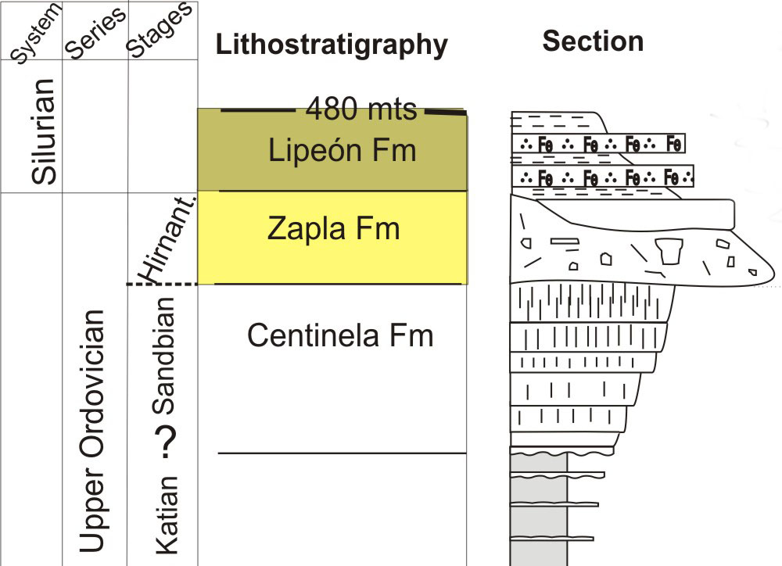
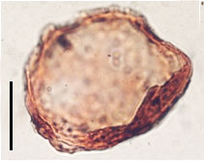
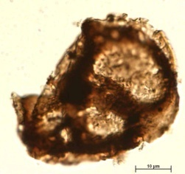
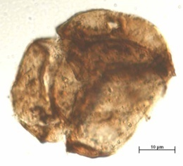
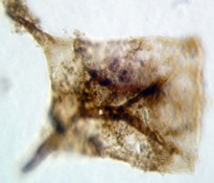
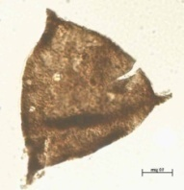
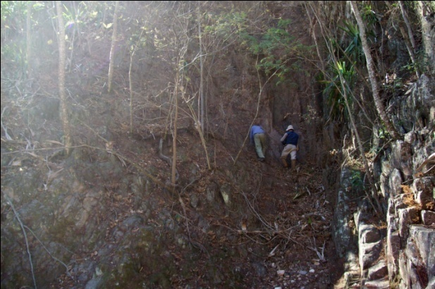
Sierras Subandinas
Los Colorados-Chamarra area
Lipeón Fm
Cordillera
Oriental
Crassiangulina variacornuta
Imperfectotriletes vavrdovae
Tetrada
Gneudnaspora chibrikovae
Aeronian/Telychian
Morphon Dyadospora murusattenuata
Ornamented tetrad
with coarse verrucae
in Le Hérissé et al., 2001
Dactylofusa maranhensis
Beromia rexroadii
late Aeronian
Gneudnaspora
divellomedia
Tetrades
Neoveryhachium sp. A In Molyneux, 1988
Villosacapsula sp
Notes:
The palynomorph assemblages of the Zapla glacial horizon are dominated by marine elements such as Villosacapsula sp., Neoveryhachium and subordinate acanthomorphitic acritarchs (Polygonium, Micrhystridium, Multiplicisphaeridium) and leiospheres, but also contain terrestrial cryptospores (mainly tetrads). Chitinozoan such as Spinachitina cf. oulebsiri support an Hirnantian age. Lower Silurian cryptospores are known from the Central Andean Basin and the Precordillera Basin, where they are preserved in marine sediments. The cryptospores are rare and no trilete spores have been observed. The low diversity of miospores is most probably due to the marine nature of the environment of deposition. Miospores diversity of the Lipeón Formation reaches 13% of the palynological assemblage, indicating a low terrestrial input.

Slide 7
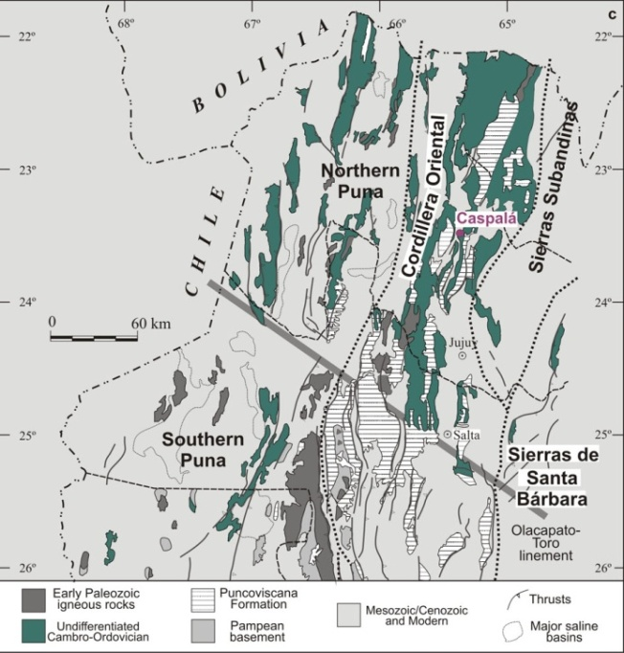
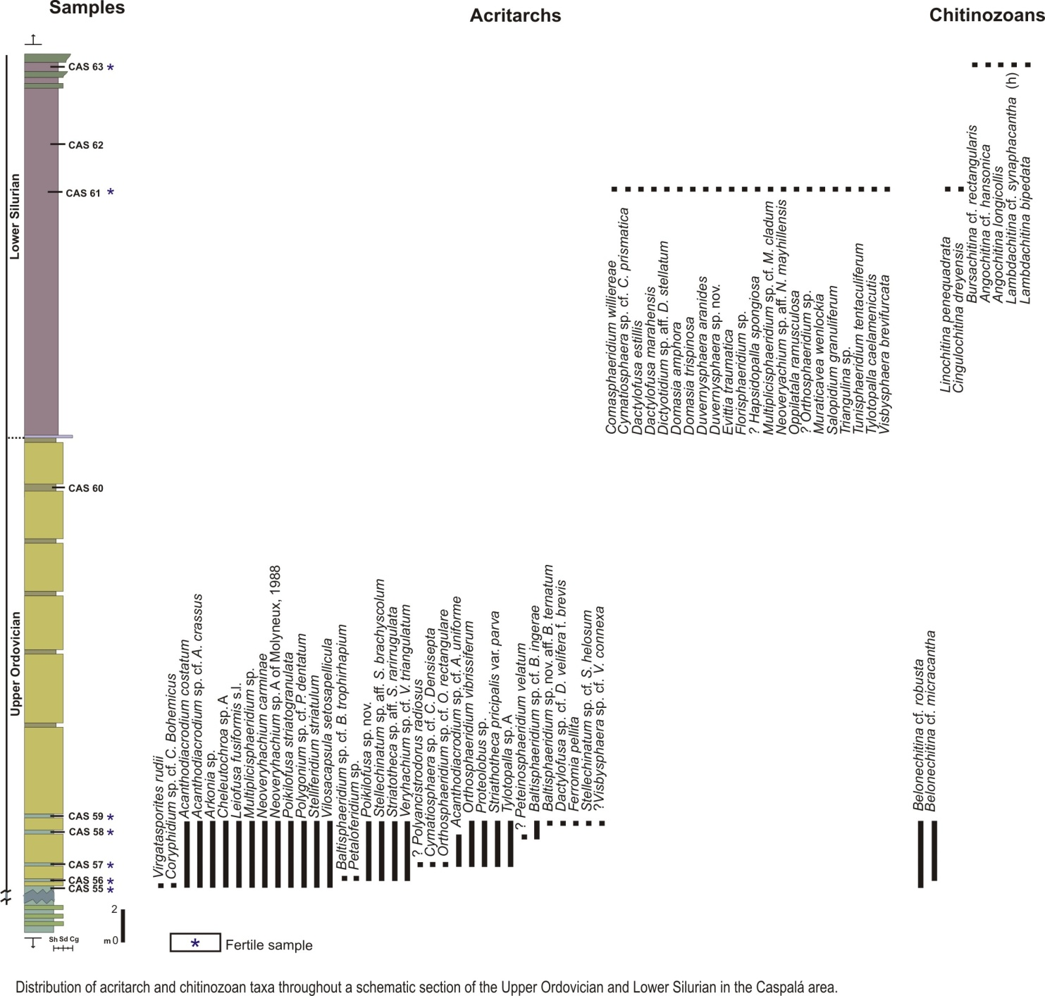
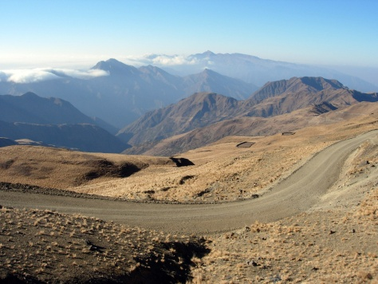
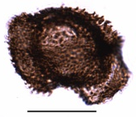
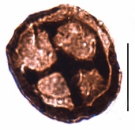
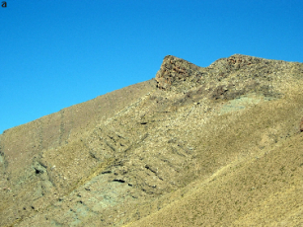
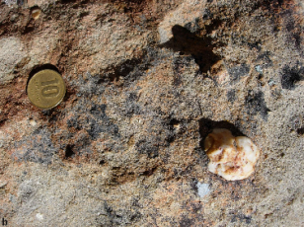
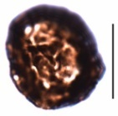
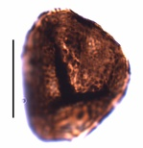









Cordillera Oriental (Caspalá)
Ornamented tetrad
(CAS 61)
Tetrahedraletes medinensis
(CAS 61)
Morphon
Ambitisporites avitus dilutus
(CAS 57)
Scolecodont (CAS 58)
Velatitetras
retimembrana
(CAS 57)
Chelinohilates?
(CAS 57)
Morphon
Dyadospora murusattenuata (CAS 56)
Segestrespora
laevigata (CAS 56)
Rimosotetras
problematica
(CAS 55)
Tetrahedraletes
medinensis
(CAS 55)
glacial horizon
Rubinstein, de la Puente, Delabroye, Astini, 2008 & unpubublished
Notes:
The 5 productive samples from the base of the glacial horizon yielded reworked acritarchs and chitinozoans, mainly of late Ordovician age, in coincidence with an important soft-sediment deformation that indicate strong reworking of previous sedimentary record. Dyads and tetrads from these levels are naked or enclosed within a smooth or ornamented envelope. Surprisingly, we found in this section the earliest record of trilete spores from Argentina as well as South America. The Lower Silurian (probably Telychian) yielded only a few cryptospores, such as simple and ornamented tetrads.

Slide 8



Puna (Salar del Rincón Fm)
Rubinstein & Vaccari, 2004
Notes:
Rich, diverse and well-preserved cryptospore assemblages were recorded from probably Hirnantian post-glaciation levels. The studied samples correspond to a level 10 m above the base of the upper Member of the Salar del Ricón Formation, and a level close to the top of the unit. This member has been deposited in a litoral marine environment. Cryptospores dominate the lower stratigraphic level and their abundance decrease toward the top.

Slide 9
















Puna (Salar del Rincón Fm)
Gneudnaspora
divellomedia
(9425)
Tetrahedraletes
medinensis
(9426)
Velatitetras
retimembrana
(9420)
Cheilotetras sp.
(9417)
Segestrespora laevigata
(9420)
Envelope-enclosed alete
in Vecoli et al. 2011 (9418)
Scale bar 20 µm
Velatitetras rugulata
(9416)
Crowned monad
in Steemans et al. 2000 (9416)
Velatitetras laevigata
(9415)
Cyathochitina kuckersiana (9411)
Cyathochitina latipatagium (9412)
Spinachitina verniersi (9407)
Spinachitina sp. aff. oulebsiri
in Paris y Bourahrouh, 2000 (9407)
Tetrahedraletes medinensis
(9413)
Morphon Dyadospora murusattenuata (9413)
Imperfectotriletes patinatus
(9412)
de la Puente et al., 2010 & unpub.
Murornate tetrad
(9410)
Rimosotetras problematica
(9413)
Sphaerasaccus? sp
(9410)
Notes:
New and more detailed investigations, in the same section, allow us to recognize 19 productive levels, situated between both of the first study. All of them containing cryptospores and acritarchs and most of them also with chitinozoans. Cryptospores are diverse and fairly well-preserved. There are monads, dyads and tetrads, naked or enclosed within an envelope smooth or ornamented. Palynomorphs, as well as graptolites recovered from the upper part of the upper member, indicate an age close to de O/S boundary, although the precise location of this boundary is still unknown.

Slide 10

Ludlov.
Dev. Inf..
Silurian
Llandov.
Wenlock.
Pridol..
Although miospores assemblages from the Palaeozoic Argentinean basins are still scarce, diversity trends have been drawn. The peak of diversity during the Hirnantian, as well as the dramatic decrease during the early Silurian seem to mach with the global tendency.
Evolution of miospore biodiversity (number of species per stratigraphic level) through the Ordovician and Llandovery, and stratigraphic distribution of the most common miospore morphologies (Steemans & Wellman, 2004)
Cryptospores of the Zanjón Fm
Hirnant.
Ordovician
Daping.
Darriwil.
CÁMBR.
Tremad.
Floian.
Sand.
Kat.
Notes:
Comparing global data of the evolution of miospore diversity during the Ordovician and lower Silurian, with Argentinean data, we realize that although miospores assemblages from the lower Palaeozoic Argentinean basins are still scarse, we find some coincidences as in the diversity peak during the Hirnantian and the subsequent dramatic decrease during the early Silurian.

Slide 11










Precordillera (Río de las Chacritas Section)
Chelinospora cf. hemiesferica
in Richardson et al 2001
Synorisporites verrucatus
Amicosporites cf. miserabilis
Cymbohilates cf. hystricosus
late Ludlovian
Pridoli?
early Devonian
Pridoli
early Devonian
Chelinospora poecilomorpha
Artemopyra robusta
Amicosporites cf. strelii
Zonotriletes cf. sp. 3 in Jardiné & Yapaudjian , 1968
Notes:
Los Espejos Formation, in the Precordillera Basin, represent a muddy shelf to inner shelf exposed to storm activity, and storm-dominated shoreface towards the top. It yielded rich and diversified palynomorph assemblages, in different sections, throughout the basin. Its age, probably Wenlock to Pridolian and Lochkovian locally, is mainly based on the distribution of brachiopod faunas. Graptolites and conodonts are scarce and they do not help to constrain the overall age of the formation. However, the distribution of phytoplankton and miospores is similar from the base to the middle-upper part of the formation, with a clear predominance of the marine fraction. The marine phytoplanton indicate an un undifferentiated Ludlovian age, from the base to the top of the unit.

Slide 12

















Precordillera (Quebrada Ancha Section)
Amicosporites sp. 1
Emphanisporites sp. D
in Richardson et al., 1981
Pridoli
Synorisporites verrucatus
Clivosispora verrucata var. verrucata
Retusotriletes cf. amazonensis
Archaeozonotriletes chulus
early Devonian
Pridoli
Pridoli
Leonispora argovejae
Chelinospora cf. hemiesferica
in Richardson et al 2001
Artemopyra urubuense
Brochotriletes foveolatus
late Ludlovian
Chelinospora sanpetrensis
Coronaspora cromatica
Chelinospora cantabrica
Amicosporites cf. miserabilis
Notes:
The stratigraphic range of miospores present throughout the Los Espejos Formation suggests an age closer to the Ludfordian-Pridoli or even younger, showing a divergence with phytoplankton. This diachronism between marine and terrestrial palynomorphs could reflect local miospore assemblage peculiarities. This could be the reason why the assemblage is poorly diversified even if the assemblage is rich in specimens. The Prercordillera is far away to many other continental area. It was most probably a large island isolated in the ocean. Therefore local conditions may have triggered evolutionary innovations of spores.

Slide 13


Evolution of the Precordillera Basin during the Silurian and the Devonian.
A: Silurian basins of northwestern Argentina showing studied localities. Modified from Benedetto (2010).
B: Location map of the Precordillera Basin showing Silurian and Devonian studied localities. Modified from Keller (1999) and Edwards et al. (2009).
C: Palaeogeographic maps of the Late Silurian and Early Devonian (upper map) and of the Early Middle-Devonian (lower map), showing the location of studied basins. Continental land areas are indicated in grey. Modified from Cocks and Torsvik (2002) and Benedetto (2010).
Rubinstein & García Muro, in press
Diversity trends of acritarchs, chlorophytes, total phytoplankton, and miospores. Composite species diversity values are plotted by series.

Slide 14
Evolution of miospores in Argentina
diverse trilete spore assemblages (Argentina) spores which their FAD is Pridolian or early Devonian suggest that evolutionary innovations could be appeared firstly in the Precordillera Basin than in other regions, possibly triggered by local palaeoenvironmental conditions.
?
previous oldest ornamented trilete spores
no records of land-derived palynomorphs (Argentina)
exclusively cryptospores (Argentina)
Morphon Ambitisporites avitus-dilutus from NW Argentina
earliest record of trilete spores from South America
diverse and well-preserved cryptospores (Argentina)
oldest laevigate trilete spores from Turkey (Steemans et al.,1996)
ornamented trilete spores (Steemans et al., 2010)
Steemans et al., 2009
cryptospores (Argentina)
oldest cryptospores (Strother et al., 1996, Vavrdová, 1990)
Cryptosporas from northwestern Argentina (Rubinstein et al., 2010)
Notes:
Up to now Argentina provide the most complete stratgraphic scale of South America. The most two important discoveries is the observation of the oldest assemblage of cryptospores and the presence of simple spores. Both observations confirm that the first emergence of land-plants would appears on the Gonfwana plate.

Slide 15
Comparisons with other South American Basins
Riche diverse assemblage of trilete spores and cryptospores, Amazon Basin, Brazil, (Steemans et al. 2008).
?
no records of land-derived palynomorphs
oldest Archaezonotriletes chulus-nanus morphon, Paraguay and Nortern Brazil (Le Hérissé et al. 2001; Steemans & Pereira, 2002, ). This important species for the biostratigraphy as not been observed in Argentina.
oldest laevigate trilete spores, Ambitisporites avitus-dilutus morphon
Paraguay (Steemans & Pereira, 2002)
?
no records of land-derived palynomorphs
Steemans et al., 2009
Notes:
The assemblages of Llandoverian crypotospores and trilete spores are identical to those observed in the Landovery from Avalonia. Numerous South American samples from the Llandovery have been independantly dated by chitinozoans and acritarches allowing to date accurately the important first apperance of Ambitisporites and Archaeozonotriletes. However, there are no data from the Ordovician. Late Silurian and earliest Devonian assemblages look like a mixing of typical assemblages from Avalonia/Baltica with North Gondwana and their terranes.The late Silurian Assemblage seems to be very different to the one observed in the Precordillera.

Slide 16
Puna (Salar del Rincón Fm)
Rubinstein & Vaccari, 2004

Slide 17
Puna (Salar del Rincón Fm)
Gneudnaspora
divellomedia
(9425)
Tetrahedraletes
medinensis
(9426)
Velatitetras
retimembrana
(9420)
Cheilotetras sp.
(9417)
Segestrespora laevigata
(9420)
Envelope-enclosed alete
in Vecoli et al. 2011 (9418)
Scale bar 20 µm
Velatitetras rugulata
(9416)
Crowned monad
in Steemans et al. 2000 (9416)
Velatitetras laevigata
(9415)
Cyathochitina kuckersiana (9411)
Cyathochitina latipatagium (9412)
Spinachitina verniersi (9407)
Spinachitina sp. aff. oulebsiri
in Paris y Bourahrouh, 2000 (9407)
Tetrahedraletes medinensis
(9413)
Morphon Dyadospora murusattenuata (9413)
Imperfectotriletes patinatus
(9412)
de la Puente et al., 2010 & unpub.
Murornate tetrad
(9410)
Rimosotetras problematica
(9413)
Sphaerasaccus? sp
(9410)

Slide 18
Precordillera (Río de las Chacritas Section)
Chelinospora cf. hemiesferica
in Richardson et al 2001
Synorisporites verrucatus
Amicosporites cf. miserabilis
Cymbohilates cf. hystricosus
late Ludlovian
Pridoli?
early Devonian
Pridoli
early Devonian
Chelinospora poecilomorpha
Artemopyra robusta
Amicosporites cf. strelii
Zonotriletes cf. sp. 3 in Jardiné & Yapaudjian , 1968

Slide 19
Precordillera (Quebrada Ancha Section)
Amicosporites sp. 1
Emphanisporites sp. D
in Richardson et al., 1981
Pridoli
Synorisporites verrucatus
Clivosispora verrucata var. verrucata
Retusotriletes cf. amazonensis
Archaeozonotriletes chulus
early Devonian
Pridoli
Pridoli
Leonispora argovejae
Chelinospora cf. hemiesferica
in Richardson et al 2001
Artemopyra urubuense
Brochotriletes foveolatus
late Ludlovian
Chelinospora sanpetrensis
Coronaspora cromatica
Chelinospora cantabrica
Amicosporites cf. miserabilis

Slide 20
Evolution of the Precordillera Basin during the Silurian and the Devonian.
A: Location map of the Precordillera Basin showing the localities studied herein. Modified from Keller (1999) and Edwards et al. (2009).
B: Silurian basins of northwestern Argentina showing the localities studied herein. Modified from Benedetto (2010).
C: Palaeogeographic maps of the Late Silurian and Early Devonian (upper map) and of the Early Middle-Devonian (lower map), showing the location of studied basins. Continental land areas are indicated in grey. Modified from Cocks and Torsvik (2002) and Benedetto (2010).
Rubinstein & García Muro, in press
Diversity trends of acritarchs, chlorophytes, total phytoplankton, and miospores. Composite species diversity values are plotted by series.

Slide 21
Ludlov.
Dev. Inf..
Silurian
Llandov.
Wenlock.
Pridol..
Although miospores assemblages from the Palaeozoic Argentinean basins are still scarce, diversity trends have been drawn. The peak of diversity during the Hirnantian, as well as the dramatic decrease during the early Silurian seem to mach with the global tendency.
Steemans et al., 2004
Cryptospores of the Zanjón Fm
Hirnant.
Ordovician
Daping.
Darriwil.
CÁMBR.
Tremad.
Floian.
Sand.
Kat.

Slide 22
Evolution of miospores in Argentina
diverse trilete spore assemblages (Argentina)
?
previous oldest ornamented trilete spores
no records (Argentina)
exclusively cryptospores (Argentina)
Laevigate trilete spores from northwestern Argentina
oldest laevigate trilete spores from Turkey (Steemans et al.,1996)
ornamented trilete spores (Steemans et al., 2010)
oldest cryptospores (Strother et al., 1996).
Steemans et al., 2009
Cryptosporas from northwestern Argentina (Rubinstein et al., 2010)

