Slide 1


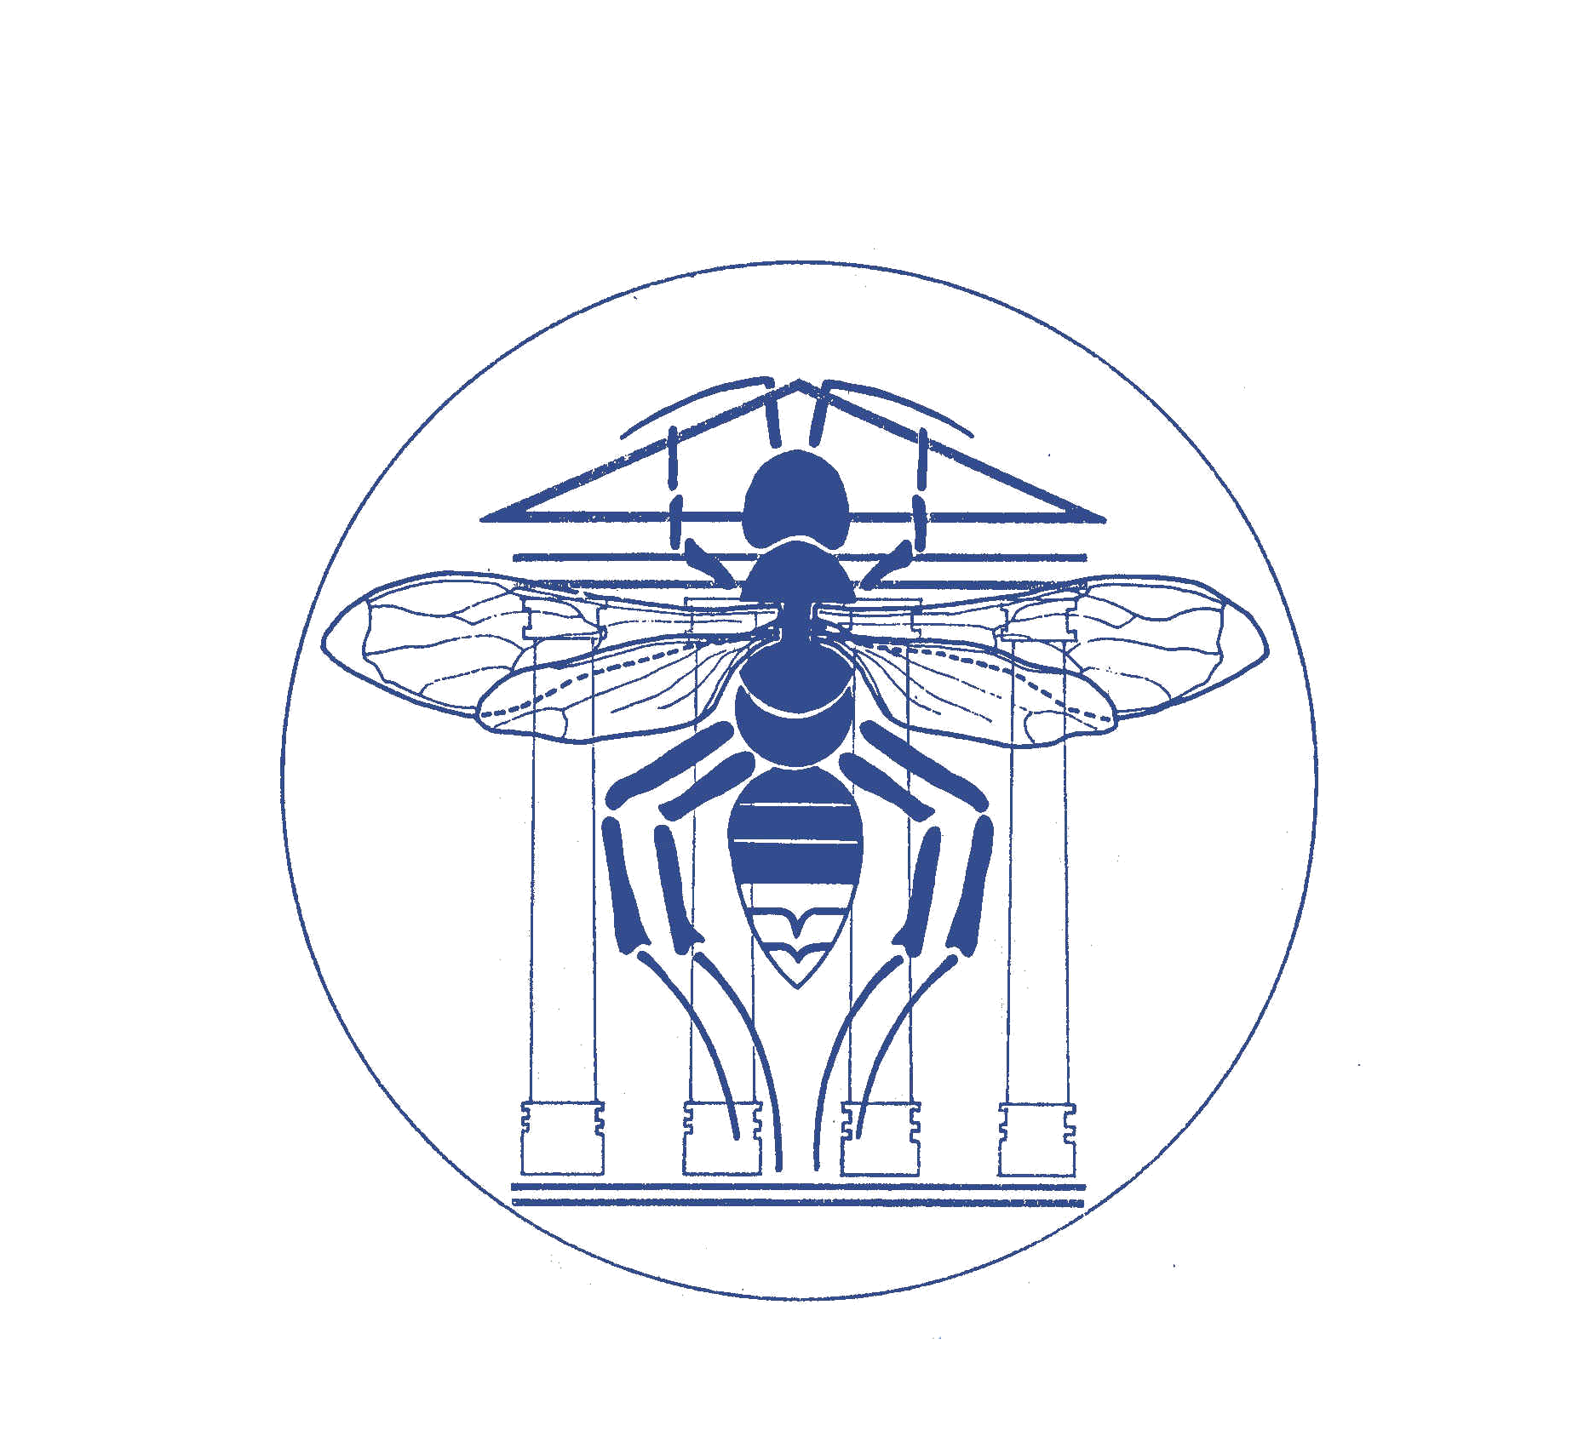
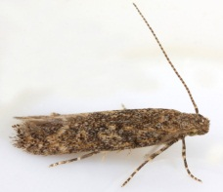
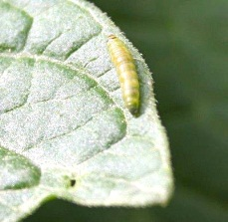
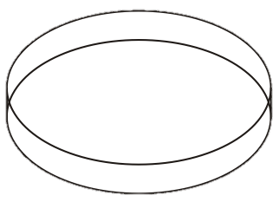

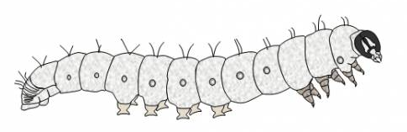
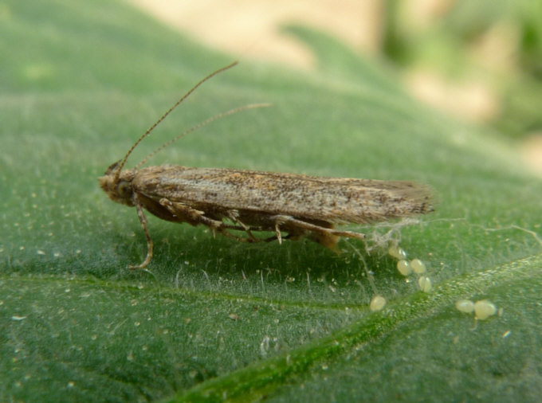
The tomato leafminer reproduces without a mate
New case of parthenogenesis in Lepidoptera
R. Caparros ; E. Haubruge and F. J. Verheggen
Department of Functional and Evolutionary Entomology. University of Liege – Gembloux Agro Biotech – Passage des déportés 2, B-5030, Gembloux (Belgium).
Contact : entomologie.gembloux@ulg.ac.be
Introduction
A
C
The tomato leafminer, Tuta absoluta Meyrick (Lepidoptera: Gelechiidae), is considered to be a key pest of the tomato (Solanum lycopersicum L.) (Fig 1.), under both field and greenhouse cultivation, in South America, Europe and Mediterranean countries. The preventing pest mating control methods such as sex pheromone management and sterile insect techniques are widely use against T. absoluta. These methods are based on an important biological trait: the insect must breed through sexual reproduction. Here, we report for the first time, laboratory evidence of deuterotokous parthenogenesis, an asexual reproduction where both males and females are produced from unfertilized eggs.
Materials and methods
B
D
Fig. 1: Tuta absoluta. A: Adult, B. Larva, C. Tomato fruit damages and
D. Tomato Leaf damages
Source: www.la-clau.net; www.tutaabsoluta.com
X 20
…
Virgin females were isolated. 19 laid unfertilized eggs with an abundance ranging from 1 to 95 eggs;
(Fig. 2 / Table 1)
At the egg stage, a survival rate of 39.9 % was observed.
In comparison, at the egg stage, a survival rate of 74,9 % was observed for fertilized eggs
(Table 1)
Monitoring of the larval development from eggs to pupation
Chrysalis were sexed and females are isolated
From larvae to adults, a survival rate of
70.4 % was observed with a sex ratio of 1/1.5 (male/female).
On the other hand, a survival rate of 62,7 % was observed with a sex ratio of 1/2 (male/female) for individuals from fertilized eggs
(Table 1)
The mean number of eggs laid between the parthenogenetic generation was found to be statistically similar
3 generations were performed in laboratory condition with only individuals coming from unfertilized egg
Results
E
Conclusion
Fig. 2: Tuta absoluta. E: Adult and eggs
Source: www.bcpcertis.com
The development of both male and female adults from unfertilized eggs demonstrated deuterotokous parthenogenetic reproduction of T. absoluta under laboratory conditions. To respond to environmental requirements, several programs based on mating management (such as mass trapping, mating disruption, and male sterility programs) are under development but asexual reproduction in natural populations of T. absoluta could have strong implications for the efficiency of these management strategies. However, although T. absoluta is able to reproduce parthenogenetically, sexual reproduction seems to lead to a better overall fitness, as mated females lay more eggs than unmated ones, as suggested by our laboratory observations. Unfertilized egg mortality was also found to be higher than that of fertilized eggs. Further studies on the fitness of T. absoluta parthenogenetic lineages are clearly needed to confirm the adaptive character of this type of reproduction.

