Slide 1
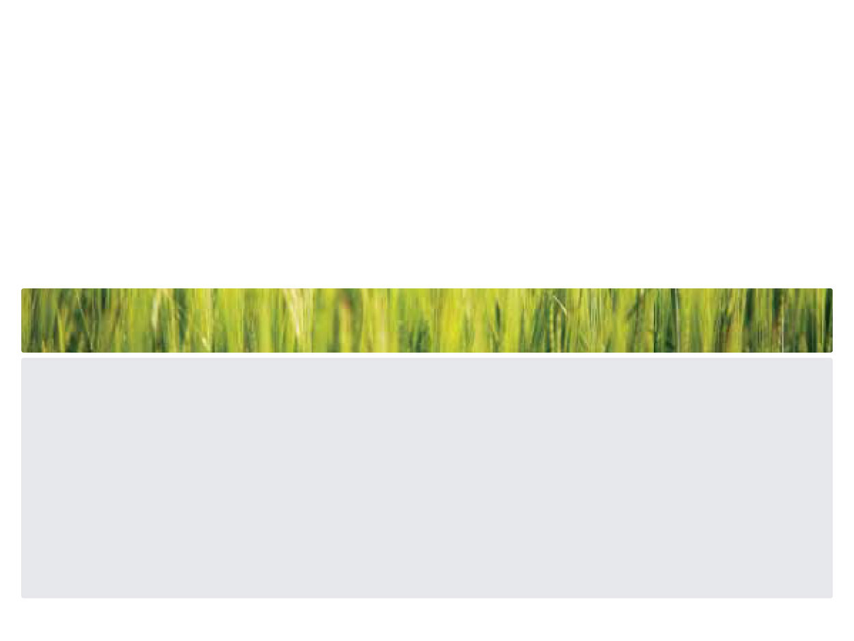


Nutritive value of four tropical forage legume hays fed to pigs in the Democratic Republic of Congo
Kambashi B., Boudry C., Picron P., Kiatoko H., Théwis A., Bindelle J.
University of Liege, Gembloux Agro-Bio Tech
University of Kinshasa

Slide 2
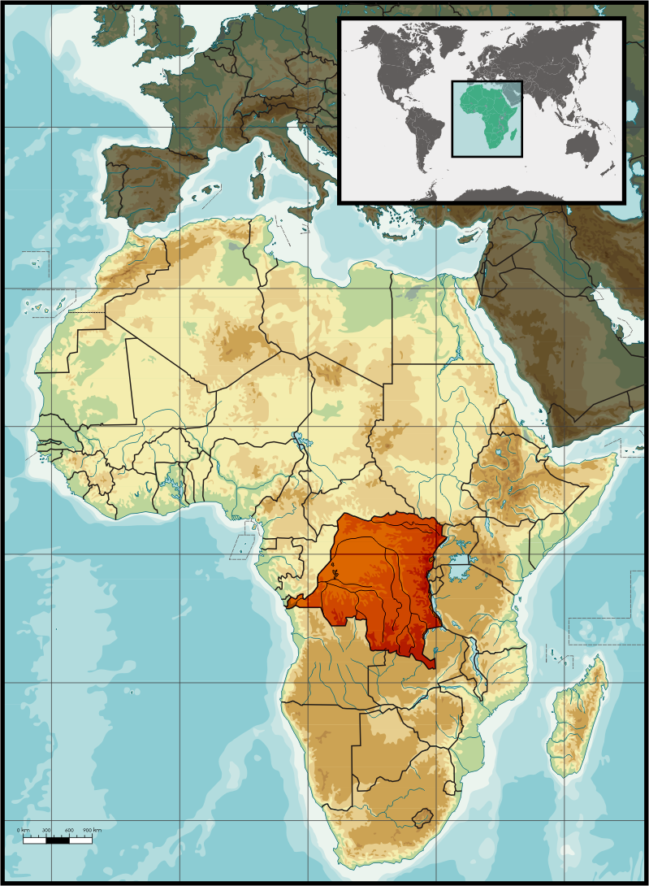
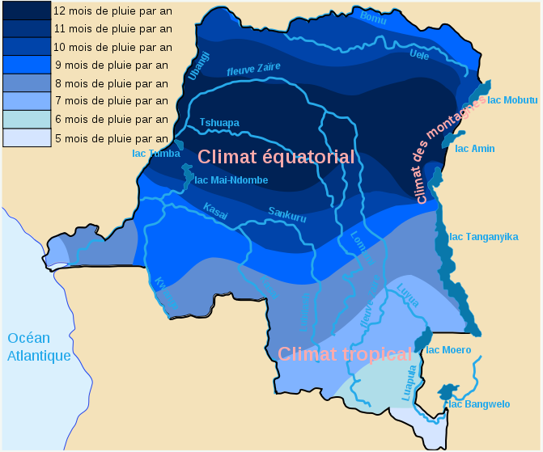
Pig breeding in Kinshasa and Bas-Congo
Total area : 2 345 000 km ²
Forests: about 145 million hectares
arable land : 80 million hectares
Varied climates
Dense river network
2 / 3 population agriculture (animal husbandry )
Kambashi & al.
2

Slide 3
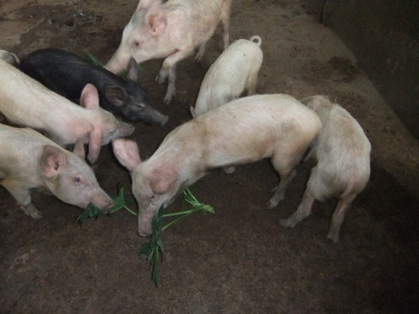
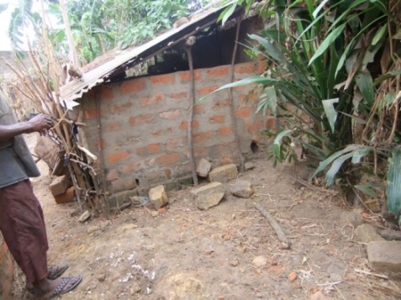
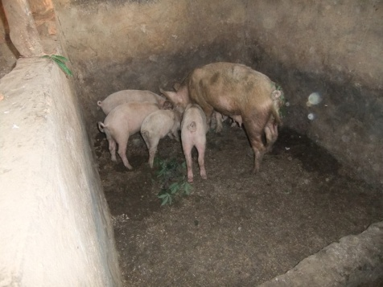
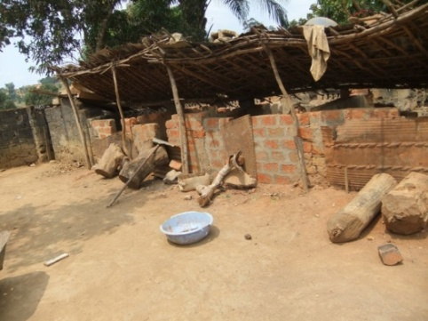
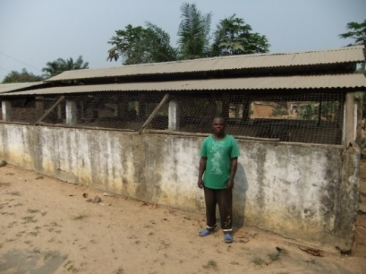
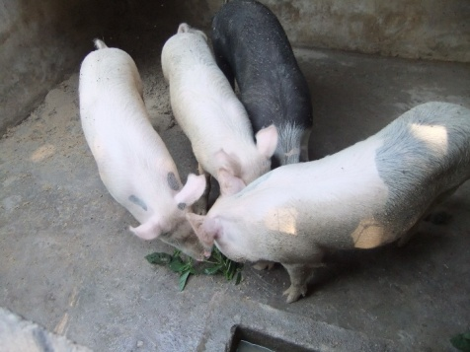
Pig breeding in Kinshasa and Bas-Congo
Survey of 319 households
Pig breeding
Around of towns
Villages
Role in farming system
Source of cash
improving livelihood
nutritional security of poor people
Kambashi & al.
3

Slide 4


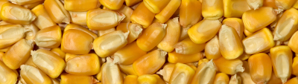

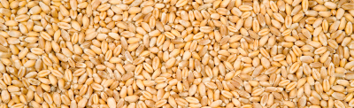
Commercial pig feeds
Soya
75 % feed meal
Barley
Maize
Pea
Wheat
Minerals
Kambashi & al.
4

Slide 5
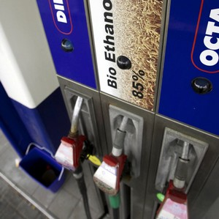
Cereals
Price Volatility
Low and insufficient grain production
Net importers of food
Kambashi & al.
5

Slide 6
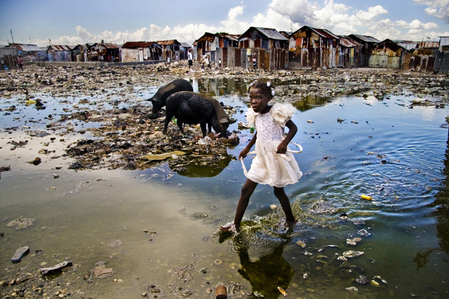
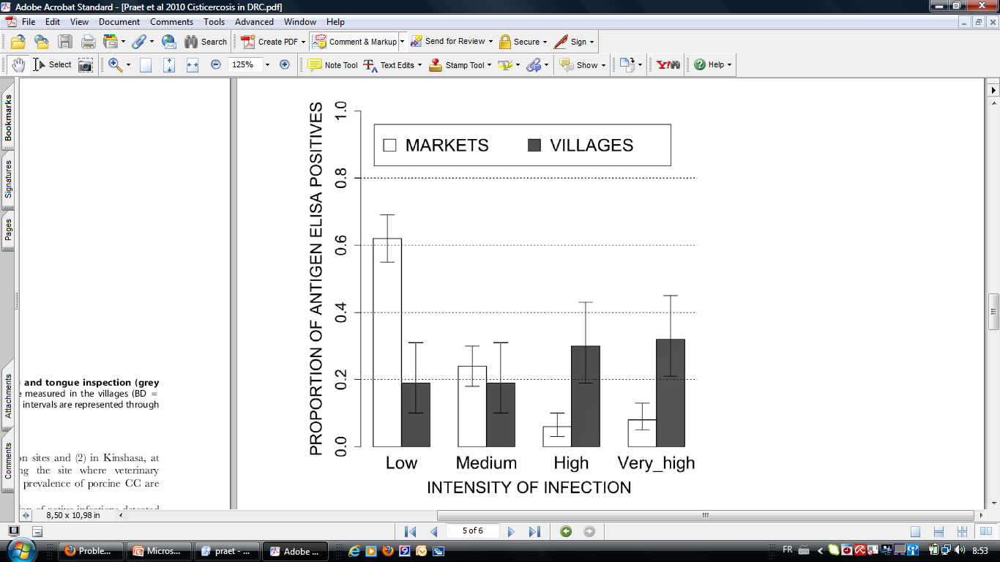
Free-range pig keeping and its results
Rubbish
Range
Bare ground
Pens
3%
12%
18%
67%
(Buldgen et al., 1992)
Time spent on feed resources
Impact on sanitation
Taenia solium Cysticercosis in the Democratic Republic of Congo: How Does Pork Trade
Affect the Transmission of the Parasite?
Kambashi & al.
6
Notes:
6

Slide 7
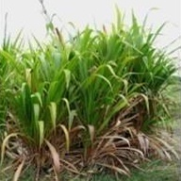
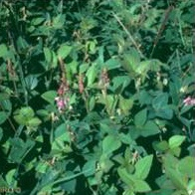
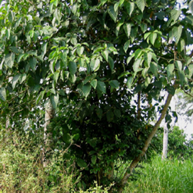
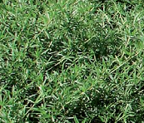
Aim of my research project
Develop sustainable feeding practices for stall fed pigs raised by smallholders based on unconventionnal locally produced feed ingredients
Kambashi & al.
7

Slide 8
Methodology
3 Steps
What is / could be distributed? What seems interesting, what does not seem interesting?
Investigations
Lab analyzes and in vitro test
What is the nutritional value of feeds most promising ?
Ingestibility tests
Digestibility tests
What are the performance achieved by the pigs ?
Growth tests
Related reseaches
Impact on health (protein, lactate, etc.)
Conservation practices and anti-nutritional factors (eg silage)
Kambashi & al.
8

Slide 9
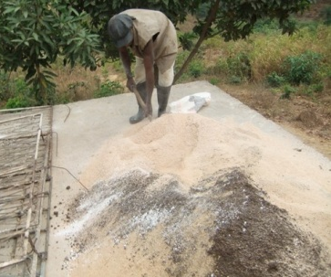
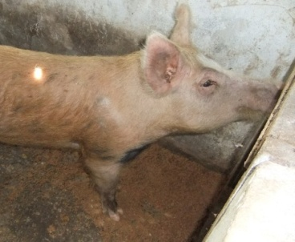
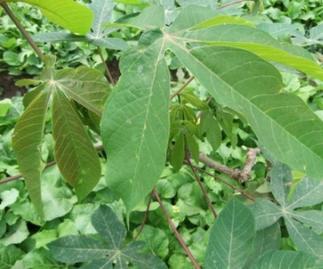
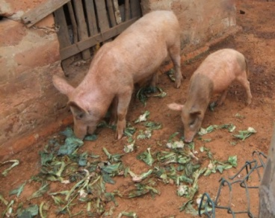
Feedstuffs for pigs
Use frequency
Concentrate feeds (> 30 ingredients)
Wheat bran 80 %
Palm kernel meal 73 %
Brewers grain 50 %
Corn 38 %
…
Commercial concentrate diets 4 %
Green plants 90 % (> 40 plants)
Manihot esculenta leaves 32 %
Ipomoea batatas leaves 29 %
Leafy vegetables 25 %
Eichornia crassipes 23 %
Psophocarpus scandens 22 %
…
Kambashi & al.
9

Slide 10
Chemical composition
Samples
Part
Dry
Crude
Ca
P
Matter
Protein
NDF
(g/kg)
(g/kg)
Acacia mangium
Leaves
34
16
47
6,8
1,2
Amaranthus hybridus spp
Plant
7
25
28
22,9
7,8
Brachiaria ruziziensis
Plant
18
12
62
6,2
2,1
cajanus cajan
Leaves
44
18
41
7,4
1,6
Calopogonium muconoi
des
Plant
20
23
41
17,4
1,8
Centrosema pubescens
Plant
14
25
40
15,8
2,0
Eichornia crassipes
Plant
10
12
49
10,8
1,4
Ipomea batatas
Leaves
9
23
30
15,7
3,6
Leucaena leucocephala
Leaves
35
20
29
24,2
1,2
Manihot esculenta
Leaves
17
26
22
20,7
4,1
Mo
ringa oleifera
Leaves
23
26
20
28,3
3,3
Mucuna pruriens
Plant
24
25
27
26,3
2,0
Panicum maximun
wild cultivar
Plant
22
16
66
7,4
2,8
Panicum maximun V
ar
. T58
Plant
21
16
65
7,4
3,2
Pennisetum purpureum
Plant
24
11
62
3,6
1,5
Psophocarpus scandens
Plan
t
15
33
32
14,5
3,4
Pueraria phaseoloides
Plant
23
22
49
10,5
2,7
Saccharum offi
ci
narum
Leaves
29
4
58
4,6
0,9
Stylosanthes guianensis
Plant
26
21
38
21,9
4,8
Trypsacum laxum
Plant
28
12
63
4,0
2,0
Vigna unguiculata
Plant
12
28
21
37,0
3,4
(Kambashi et al., 2010)
Kambashi & al.
10

Slide 11
Results of screening
Ingredients
IVDMD
(-)
DP
(g/kg)
A
(ml/g)
Rmax
(ml/g.h)
Part
Acacia mangium
leaves
0.31
32
39
1
Amaranthus hybridus spp
plant
0.56
188
215
18
Brachiaria ruziziensis
plant
0.34
86
235
8
Cajanus cajan
leaves
0.32
34
53
2
Calopogonium muconoides
plant
0.37
144
136
12
Centrosema pubescens
plant
0.42
173
119
5
Eichornia crassipes
plant
0.31
59
92
3
Ipomea batatas
leaves
0.45
144
203
17
Leucaena leucocephala
leaves
0.37
103
85
4
Manihot esculenta
leaves
0.43
176
169
15
Moringa oleifera
leaves
0.43
179
168
13
Mucuna pruriens
plant
0.46
187
155
9
Panicum maximum wild cultivar
plant
0.29
101
170
5
Panicum maximum var. T58
plant
0.25
77
196
6
Pennisetum purpureum
plant
0.30
68
207
7
Psophocarpus scandens
plant
0.49
247
155
8
Pueraria javanica
plant
0.38
156
122
8
Saccharum officinarum
leaves
0.42
30
88
3
Stylosanthes guianensis
plant
0.25
101
173
11
Trypsacum laxum
plant
0.27
60
183
5
Vigna unguiculata
plant
0.48
221
183
12
(Kambashi et al., 2010)
Kambashi & al.
11

Slide 12
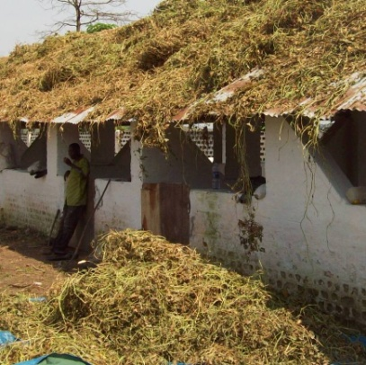
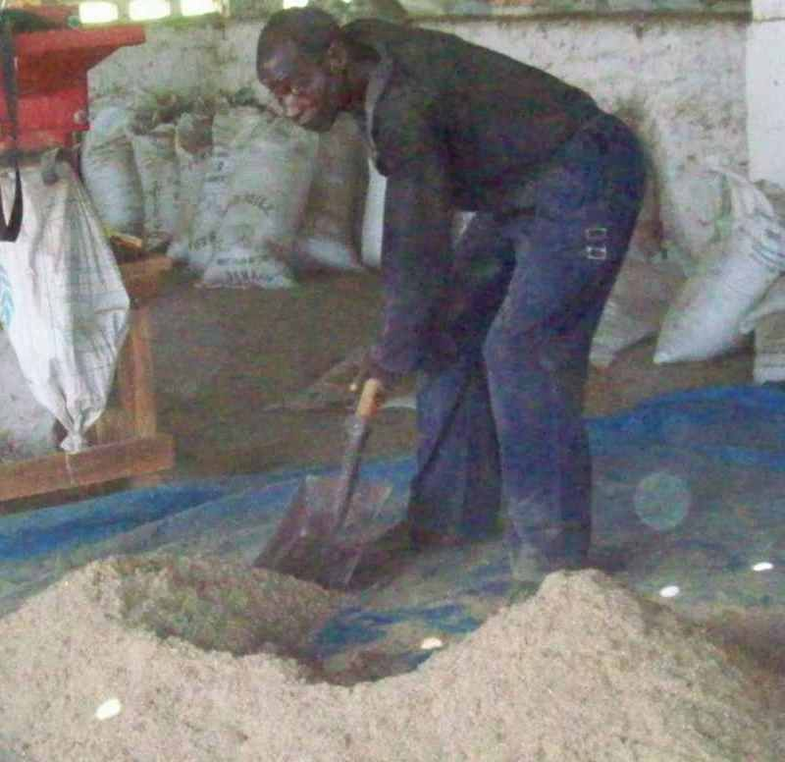
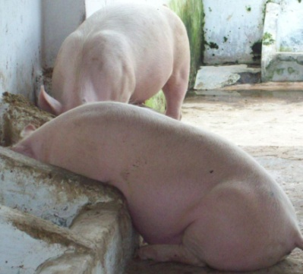
Voluntary feed intake (vfi)
P < 0.05
Kambashi & al.
12

Slide 13
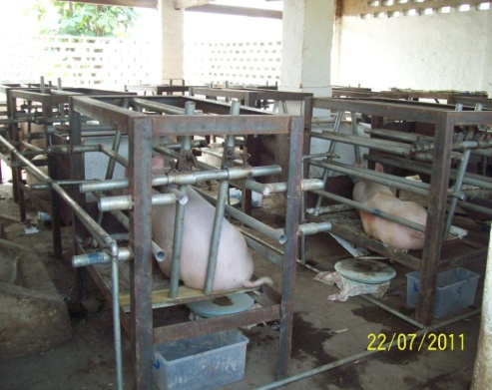
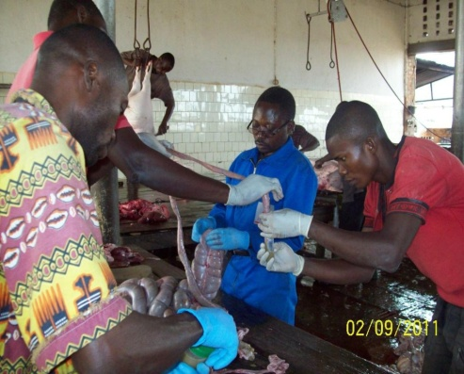
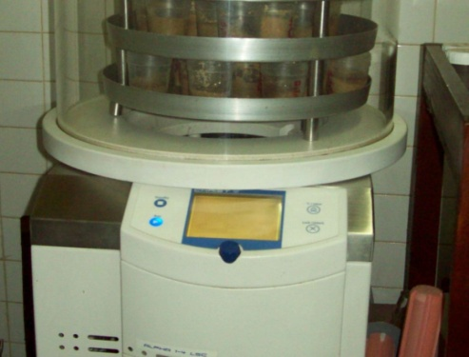
Digestibility test
All 4 forage species decreased the total tract apparent digestibility (TTAD)
but forage species differed in the way they influenced DM (P<0.040) and NDF (P<0.020) digestibilities.
No differences in CP and gross energy digestibilities of forage-based diets were observed between species. TTAD of DM and NDF were, on average, higher for Psophocarpus scandens and Vigna unguiculata.
Kambashi & al.
13
Notes:
13

Slide 14
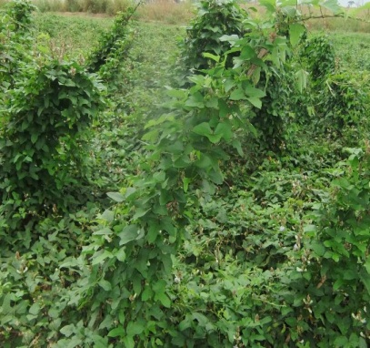
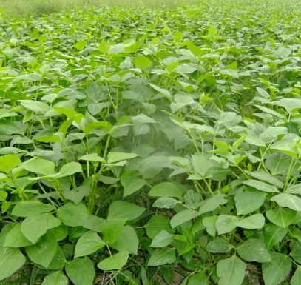
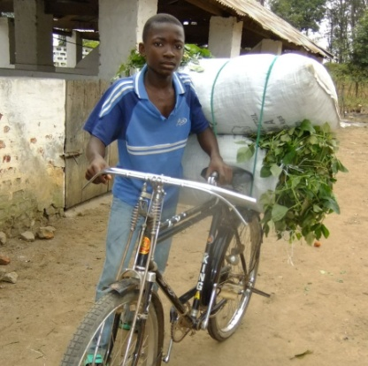
Conclusion
In case of scarcity or lack of protein source, P. scandens and V. unguiculata are an option.
Preferably in adult pigs.
Due to their negative effect on the overall digestibility of the diets, the rate of TFL in the diet should not exceed 25 %.
Further work required :
forage on quality of meat and animal performance
the impact of storage and antinutrients on the nutritional value
Kambashi & al.
14

Slide 15
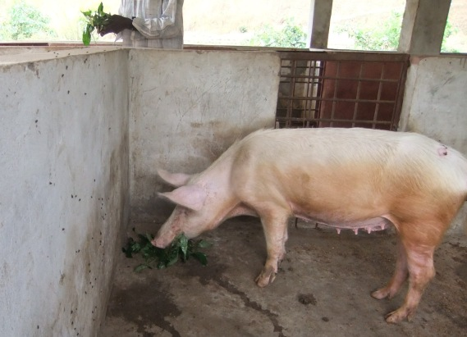
Thank you for your time!
I like eating forages
Jérôme Bindelle & Bienvenu Kambashi
15

