Slide 1



Study of the microbial flora of freshwater and seawater fish filets in different packaging conditions by metagenomic analysis targeted on the 16S ribosomal DNA
Notes:
I would like to thank the organization comittee to give me the opportunity to present results from works of the food science department and Quality Partner
The title of this presentation is « Study of the microbial flora of freshwater and seawater fish filets in different packaging conditions by metagenomic analysis
The aim of this presentation is to give you an example of the potential of this technique. In 15 minuts I don’t have time to explain all the techniques and bioformatics.
It gives a simple example just to focus on the application of metagenomics.

Slide 2
Plan
General Context
Aim of the study and analyzed samples
Results
Others samples
Conclusions
Notes:
The plan of the presentation is divided in 5 parts
A brief introduction on food spoilage and an overview of the metagenomic technique
Aim of the study and analyzed samples
Results
Others samples that we have alerady tested on metagenomics
Conclusions

Slide 3
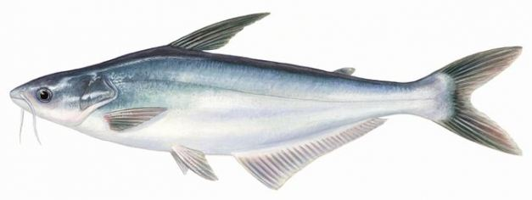
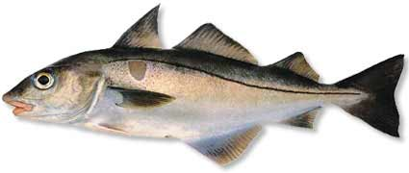
Context
Fish is spoiling rapidely
caused by bacterial flora
Pangasius
Haddock
Notes:
In general, fish and seafood are spoiling more rapidly than other meat food, and such spoilage is bacterial in nature.
Due to their compositions, bacteria can grow to unacceptable levels contributing to deterioration or spoilage.
Food spoilage damaged the texture, flavour of the food
Foods become harmful to people and unsuitable for consumption.
The spoilage depends of the initial flora
and the environmental conditions during the sheldf life (as packaging, temperature.
For this study we have chosen two fish filets. A fish from fresh water and a fish from sea water

Slide 4
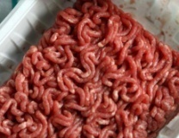
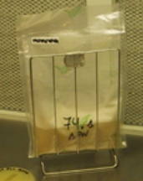
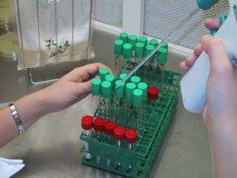
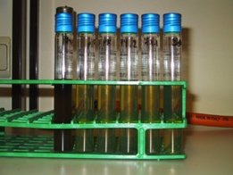
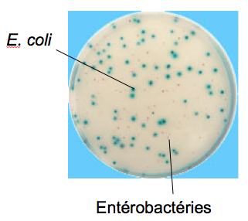
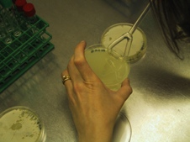
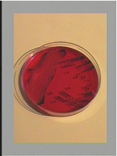
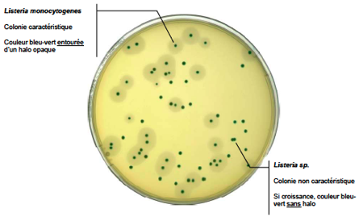
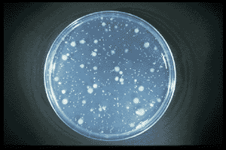
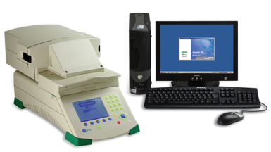
Food microbiological analysis
Detection methods (P/A in x g))
Only for bacterial pathogens
Always enrichment necessary
Counting methods (cfu/g)
Available for some indicator flora
Available for some bacterial pathogens
Counting
Detection
3-7 J
24 H
Notes:
Surveillance of spoilage during storage of food is mainly based on the enumeration of total viable counts and some specific flora growing in selective media. We have also detection methods used for the pathogens
Classical microbiology have several limitations
- It takes time to have a result,
- It need al lot of labour
- There is no identification of the different species of culturable bacteria
- The performance of the selective media is questionable
- Etc.
Culture media is not enough to understand the modifications of the microbial ecology on foods in response to different conditions.

Slide 5
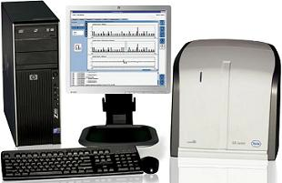
Metagenomics
Food samples
- 40 Mb data
- 100.000 sequences / run
- 3 days for one run
DNA extractions
Classical microbiological analysis
Amplification/preparation of libraries
Bacterial 16S rRNA gene amplification and barcoded pyrosequencing
High throughput DNA sequencing
Raw data
Mothur
Blast
Bioinformatic analysis
Perl script
Normalisation
Data analysis
Notes:
Molecular technologies can give microbial community structure, including the identification and quantification of culturable and non-culturable organisms, at a much higher resolution than was previously possible with culture-based methods.
Among the culture-independent techniques, the metagenomic analysis targeting the 16S ribosomal DNA has appeared a powerful tool to study bacterial composition of various ecosystems like seas , soils but also rumen or sludge Its interest has started to appear in food microbiology.
Briefly
The bacterial V1-V3 regions of the 16S rRNA gene were amplified by PCR using a home made primer.
The PCR products were checked by electrophoresis and purified.
Equal amounts of each of the PCR products were pooled and amplified by emulsion PCR before sequencing.
Pyrosequencing was performed with the Roche 454 GS Junior
The bioinformatic pipeleine make a treatment on the sequnces from the Gs Junior.. The sequences that passed the quality check were aligned to the SILVA and NCBI 16S database

Slide 6
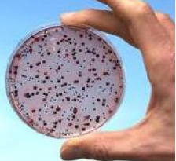
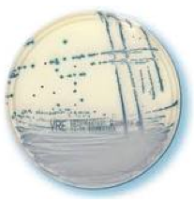
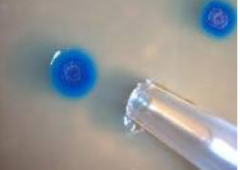
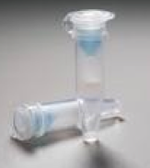
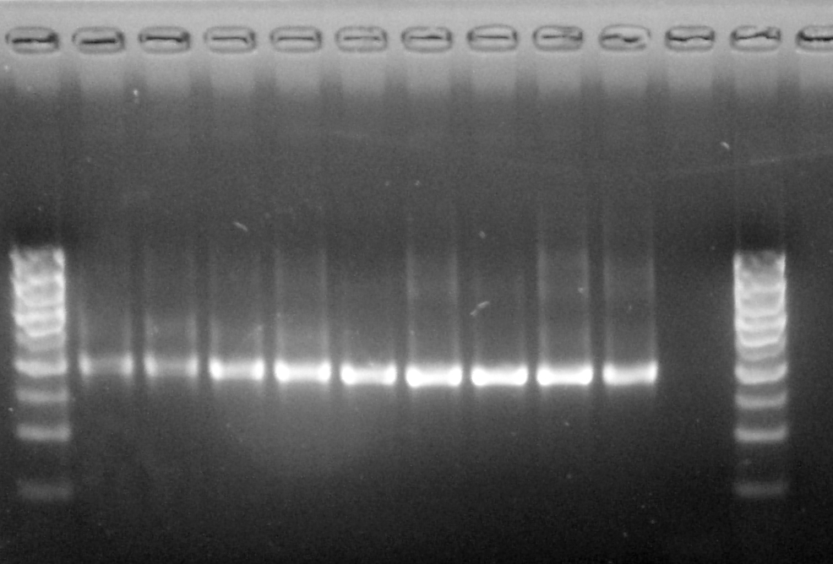
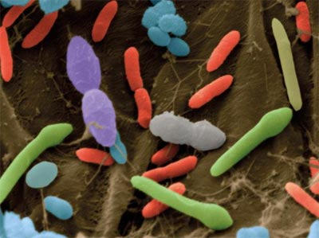
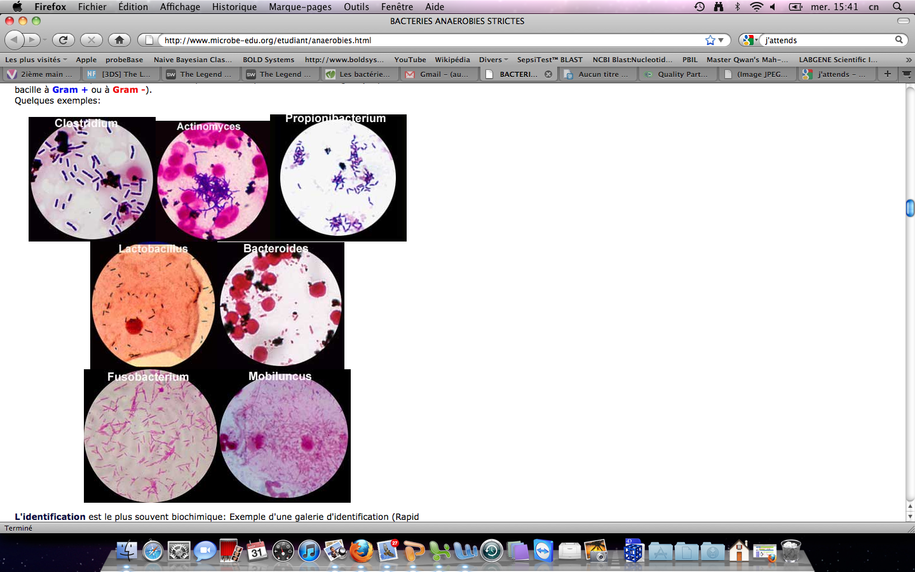
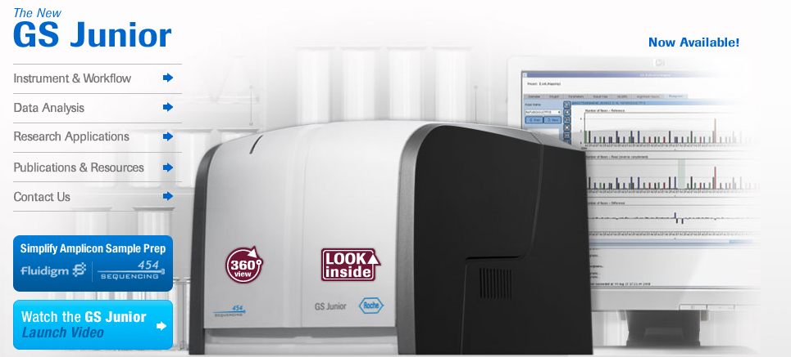
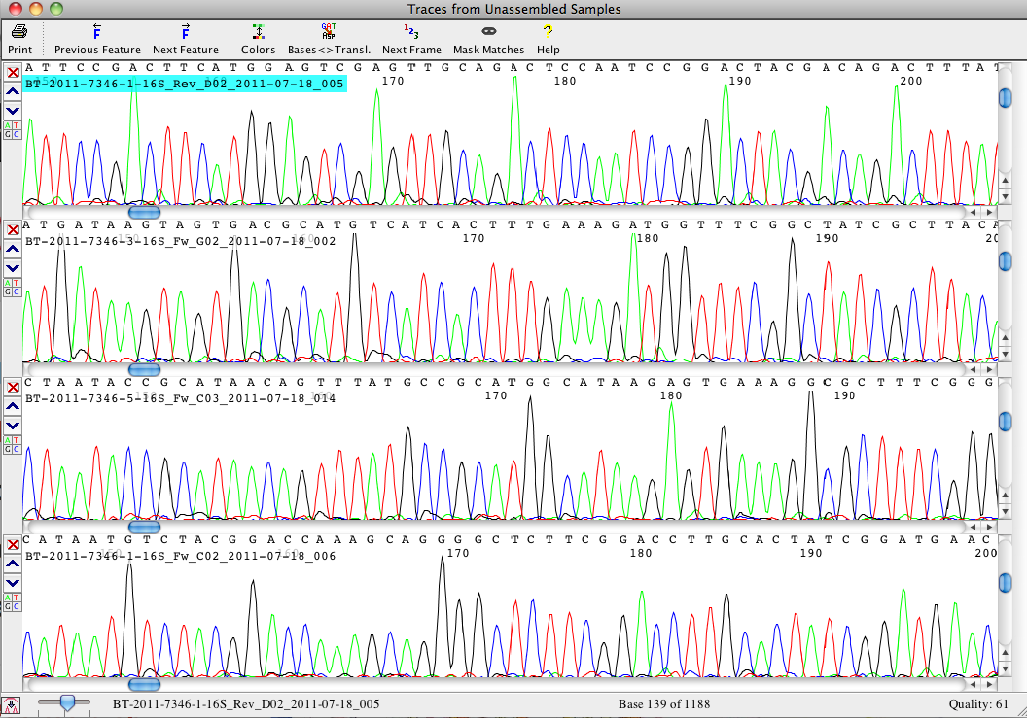

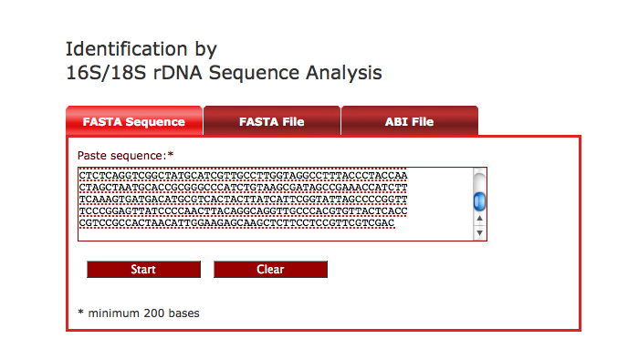
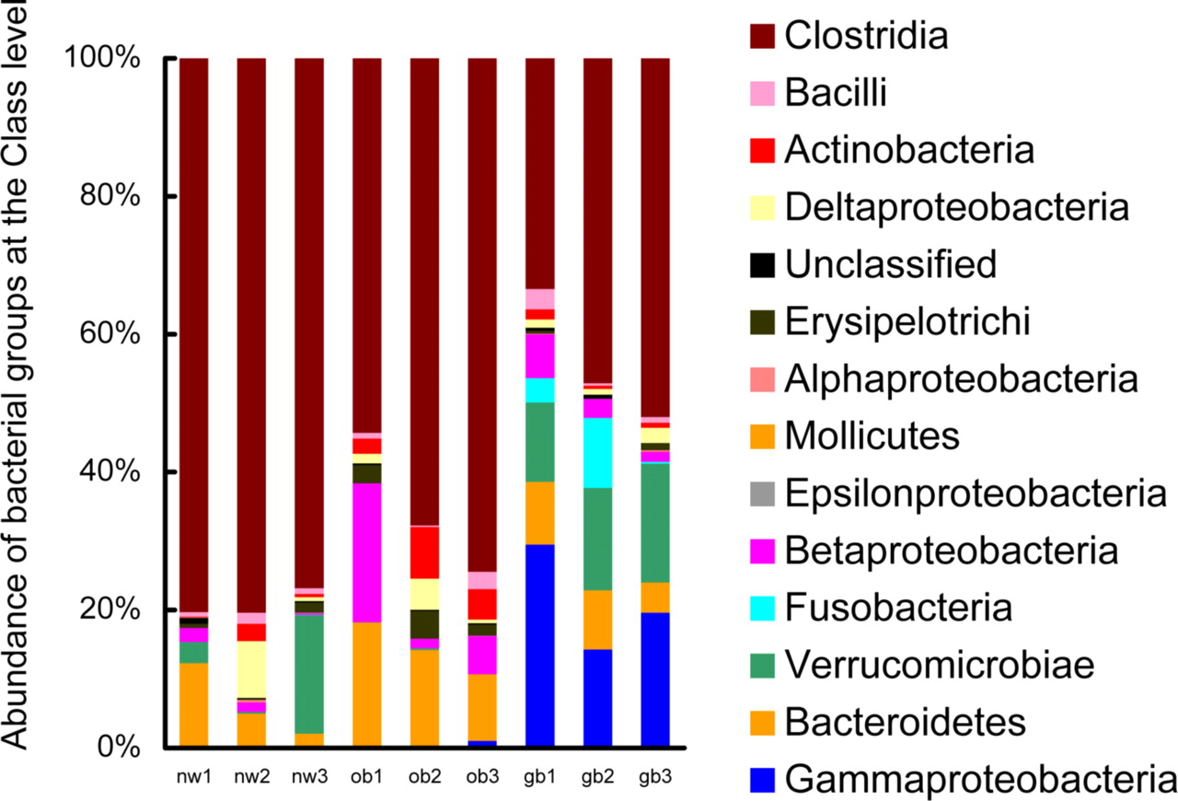
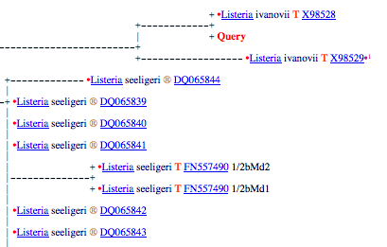
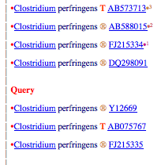
Why metagenomics ?
Classical microbiology
Metagenomics
5 à 10.000 sequences /
sample
Bacterial diversity profile
1 colony 1 analysis 1 bacterial identification
20 colonies 20 analysis 20 bacterial identifications
But are they the ones being sought ??
1 analysis 10.000 bacterial identifications
Notes:
Classical microbiologu is long, expensive , time consuming technique.
If you want to identify one colony, you need to isolate and to send this colony for sequencing.
If you want more colonies, you have to repeat operations
The metagenomic analysis gives much more informations than the classical microbiology on the bacterial flora.
You get thousands sequences from a sample
It allows the full characterization of the total flora in only one analysis.
This approach allows to highlight the presence of less known or yet un-described bacteria.

Slide 7
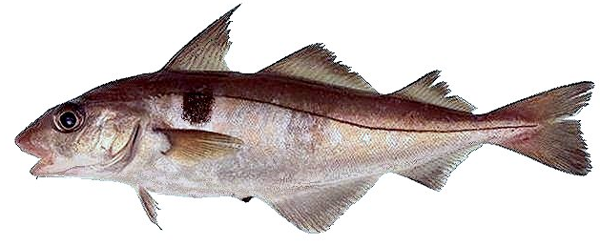

Analyzed samples:
classical microbiology and metagenomic analysis
Seawater: Eglefin
Day of packaging
End of the shelf life
End of the shelf life
Day 0
Plastic wrap
MAP
Day 2
Day 6
Freshwater: Pangasius
Day of packaging
End of the shelf life
End of the shelf life
Day 0
Plastic wrap
MAP
Day 5
Day 8
Notes:
Following the guidelines to conduct an ageing study, fishfilets (haddock and pangasius) samples were analyzed the day of receipt and at the end the shelf life after storage at 4°C and 8°C For all the food samples, packagings were made in atmosphere permeable food wrap (FW) for atmospheric air condition and in trays under modified atmosphere (MAP).

Slide 8
The aim of the study
Identification of flora involved in the fish from
freshwater and seawater
Day of packaging
End of the shelf life
End of the shelf life
Pangasius
Plastic wrap
MAP
Eglefin
Validation of the shelf life
Notes:
The aim is to study to assess the bacterial community dynamics during the shelf life. Classical microbiology was performed on the same samples in order to compare the results between the two approaches.

Slide 9
Results
With classical microbiology:
And that’s it…
Notes:
As expected, bacteria grow on PCA between day 0 and at the end of the shelf life for the two fish.
For the pangasius samples, the lactic acid bacteria grow between day 0 and at the end of the shelf life especially for the MAP sample.
The Pseudomonadaceae and Enterobacteriaceae increase respectively of ∼4 log CFU/g and ∼2 log CFU/g between day 0 and at the end of the shelf life for the two types of packaging.
For the haddock, the Pseudomonadaceae grow of ∼2 log CFU between day 0 and at the end of the shelf life for the two types of packaging.

Slide 10
Results
With metagenomics :
45 different bacteria species identified for the pangasius
43 different bacteria species identified for the haddock
Significant variations of the initial flora at the end of the shelf life depending of the fish and packaging
Relation between spoilage and the activity of some bacterial species
Notes:
A total of 45 and 43 bacterial species were identified for the pangasius and the haddock, respectively. Variations in the initial flora were observed depending on the packaging conditions and the fish species.
Some bacterial strains are over the acceptable limit of spoilage (6 log) at the end of the shelf life
Gram-negative bacteria are always predominant in the initial flora and at the end of the shelf life in all samples.

Slide 11
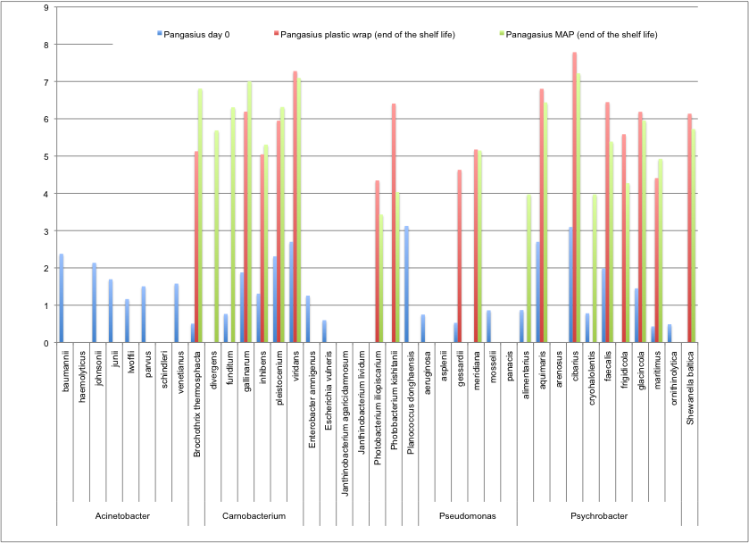
Pangasius (freshwater)
Spoilage flora
Lactic Acid Bacteria
Undesired volatil coumpounds
H₂S producing strain
Notes:
This the metagen,omic results for the pangasius
On the x axis you have the diffrenet bacterial species identified
On the y axis, you have the estimated concentration in log
In blue you have the estimated concentration of each species at Day 0
In red, in FW
In green in the Map
Planococcus donghaensis is only present before the fish is packed with 31% of the sequences and it could be a freshness indicator
At day 0, Carnobacterium and Psychrobacter are the most important genus
Brochothrix thermosphacta with 55 % for the MAP and Psychrobacter sp with 77% for the FW
MAP can favor the dominance of a facultative anaerobic population including LAB and Brochotrix thermosphacta
An another important group at the end of the shelf life is Carnobacterium for the FW and MAP, respectively.
Carnobacterium sp is associated with the spoilage of refrigerated meat
.However, depending on species, they may be responsible for spoilage and, in certain cases, they may have a bioprotective effect

Slide 12
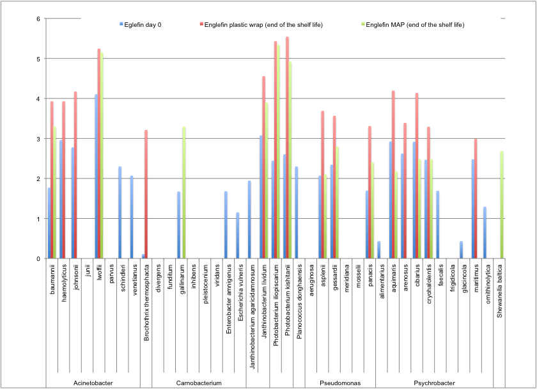
Haddock (seawater)
Freshness indicator
Spoilage flora
Plastic wrap
MAP
Notes:
For the haddock,
At day 0. Acinetobacter and Photobacterium are the most prominent genus with 10% and 80%.
For the FW, the flora is composed by Acinetobacter, Chryseobacterium and Psychrobacter
For the MAP, Acinetobacter and Photobacterium compose mainly the flora with 10 and 70%, respectively.
Photobacterium contribute to the off-flavours and taste associated with spoiled seafood
Shewanella baltica and Brochothrix thermosphacta were found in the two fish filets.
Shewanella baltica gived bad odours (hydrogen sulfyde)
Brochothrix thermosphacta produces volatile compounds such as acetoin, diacetyl (aerobic growth), or lactic acid and ethanol (anaerobic growth)

Slide 13
Conclusions
Few informations with classical microbiology
Identification and quantification of all bacteria species is now possible with metagenomics
Evaluation of specific function of micro organisms on food products => expertise
Metagenomic tools could adequately determine the duration of shelf-life
Notes:
The metagenomic analysis offers a new tool to identify microorganisms present in perishable food and their evolution depending of environmental conditions. The informations given by metagenomics analysis provide a clear picture of the microbial community.
Microbiological ecology studies have shown that the bacterial world on perishable foods are much more diverse than bacteria studied by culture media..
food manufacturers, government agencies, retailers, distribution, quality laboratories and researchers use general culture media without knowing the bacterial communities inside the food.
Compare to previous independent culture techniques, Metagenomic gives more valuable information and its use could be considered as a technique for quality control, to determine adequately the shelf life or to develop new food products

Slide 14
Perspectives
Knowing and controlling the total supply chain who can influence the total shelflife
Raw material biology ( wild catch – farmed )
Hygiene ( PR programs)
Temperature ( PR programs)
Carnobacterium strains could be added on such lightly preserved product
Environmental factors could be modified (pH, lactic acid, packaging)
-> A NEW APPROACH OF FOOD QUALITY
Notes:
The perspectives are numerous
We can get many valuable informations on
- the flora of raw material,
- the influence of extrinsec factors as temperature, packaging,
- the effect of bio preservation
etc

Slide 15
Others samples
Food samples
Sillages
Intestinal flora from guts of animals
Sea water
Seeds
Virus
…
Notes:
Finally, we have already nice collaborations with others department of the faculty and research centers on different matrix as
Food samples
Sillages
Intestinal flora from guts of animals
Sea water
Seeds
And we begin a collaboration to study virus

Slide 16
Acknowledgments
Pr Georges Daube
Dr Carine Nezer
Dr Bernard Taminiau
Mlle Celine Ferauche
Mr Jean Yves François
Dr Jean Baptiste Poullet
Notes:
I would like to thank Pr Daube and all the team who was implied in the development of metagenomics analysis

Slide 17
Thank you

