Slide 1






Case study of contamination by Listeria monocytogenes in raw goat milk cheese: development of a quantitative risk assessment model of the production chain
KORSAK Nicolas, DAUBE Georges & DELHALLE Laurent
University of Liège, Faculty of Veterinary Medicine,
Department of Food Science, Sart-Tilman, B43bis, 4000 Liege, Belgium
Tel: +32 4 366 40 40, fax: +32 4 366 40 44
Web: http://www.dda.ulg.ac.be/

Slide 2
Plan of the presentation
Introduction
Risk analysis and Listeria monocytogenes
Milk products and Listeria monocytogenes
Contamination of goat milk products
Anamnestic elements
Building-up of a risk assessment model
Main results of the model
What-if scenarios
Conclusions

Slide 3
Risk Analysis
Risk analysis
Codex Alimentarius (WTO)
Risk Assessment
Assessment of likelihood of an event and the severity of effects on human health, following exposure.
1. Hazard Identification
Risk assessment (EFSA)
Risk management (executive)
2. Exposure assessment
3. Hazard Characterization
Risk Communication (EFSA)
4. Risk Characterization
In Europe:

Slide 4
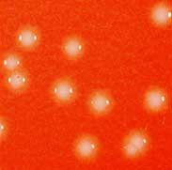
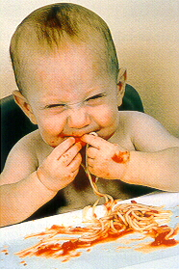
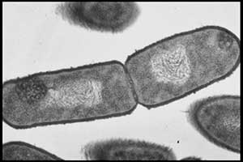
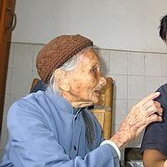
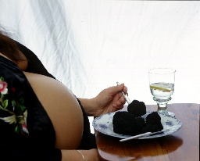
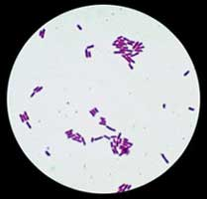
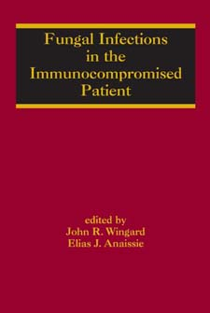
Listeria monocytogenes
Ubiquitous, short rod, catalase-neg, Gram pos.
Special motility at 25 °C
Intracellular pathogen
High-risk population : > 60y, immuno-compromised, pregnant women
Long incubation period : 3 to 60d
Mandatory surveillance in EU
Food safety criterion in RTE

Slide 5
Listeria monocytogenes: reported incidence in the EU in 2009
EU notific. rate : 0.4 per 100,000 population
EFSA

Slide 6
Listeria monocytogenes : reported incidence in Belgium
notific. rate : 0.54 per 100,000 population

Slide 7
Isolated strains in Belgium in 2008: clustering by age and serovar
Notes:
Rapport de l’ISP : chiffres de 2008
18 / 53 = serovar 4b

Slide 8
Listeria monocytogenes and milk products
% of outbreaks implicating milk products: from 2 to 6 % (De Buyser et al., 2001)
% of outbreaks implicating milk and milk products (France, 1988-1997, n=177):

Slide 9
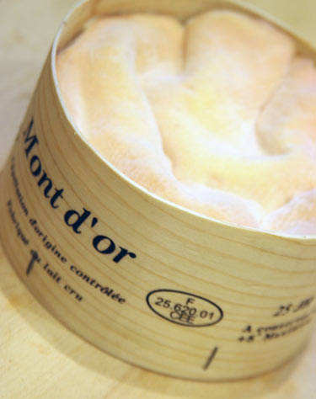

Listeriosis outbreaks linked to milk products (1/2)
year | Country of origin | Milk product | Type of milk | Cases (deaths)
1983-1987 | Switzerland | Soft cheese (Vacherin Mont d’Or) | Unpasteurized | 122 (33)
1983 | USA | Milk | Pasteurized | 49 (14)
1985 | USA | Mexican-style soft cheese | pasteurized milk | 142 (48)
1987 | USA | Butter | unspecified | 11
1989 | Luxembourg | Camembert | unspecified | 2
1989-1990 | Denmark | Hard and blue cheese | unspecified | 26 (6)
1994 | USA | Chocolate milk | Pasteurized | 56 (1)

Slide 10
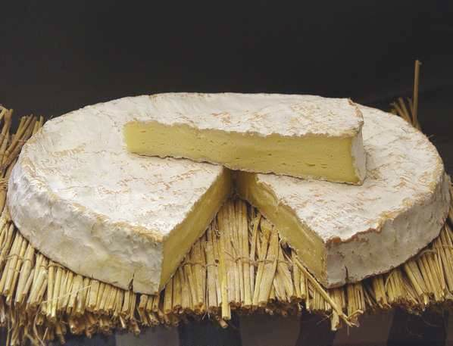
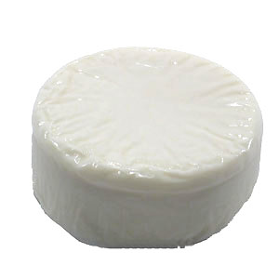
Listeriosis outbreaks linked to milk products (2/2)
year | Country of origin | Milk product | Type of milk | Cases (deaths)
1995 | France | Brie de Meaux | raw | 37 (11)
1997 | France | Livarot, Pont-l’évêque | raw | 14
1988-1999 | Finland | Butter | Pasteurized | 18 (4)
2000 | USA | Mexican-style soft cheese | Raw milk | 13
2001 | Sweden | Soft cheese | unspecified | 33
2005 | Switzerland | Soft cheese | unspecified | 12 (3)

Slide 11
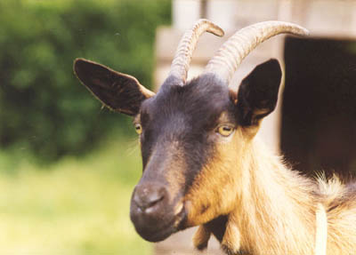
Case of listeria contamination in cheese made raw goat milk – anamnestic elements
Herd: 350 goats, Alpine breed
Births from October to March
2.3 kids / female
Culling after 5 lactations periods (3.11 l/goat/day)
Feed: hay and herb silage
Historic of clinical animal listeriosis in the herd (nervous signs, abortions…)

Slide 12
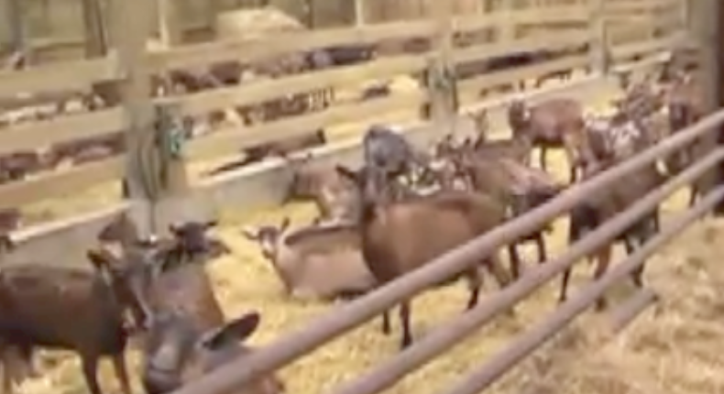
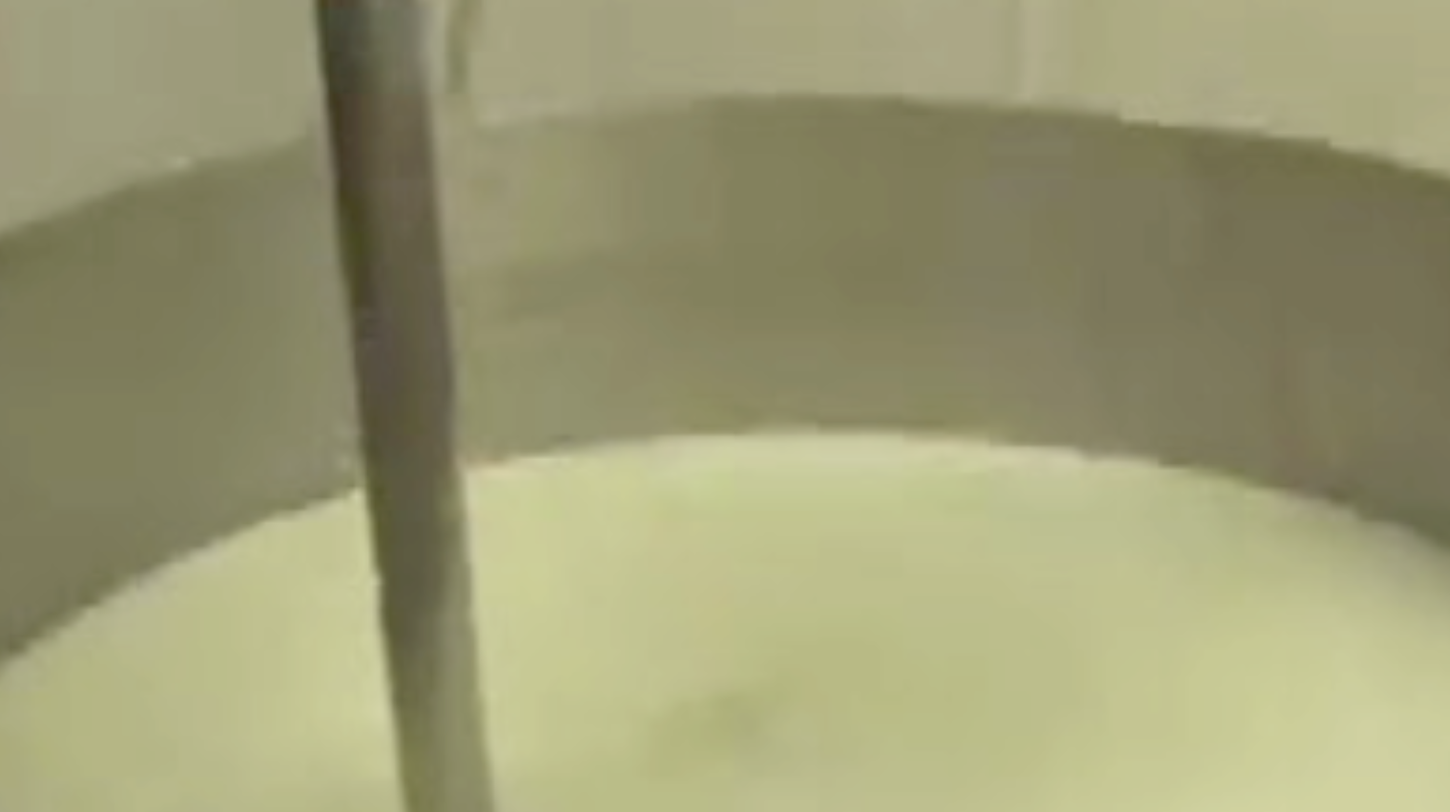
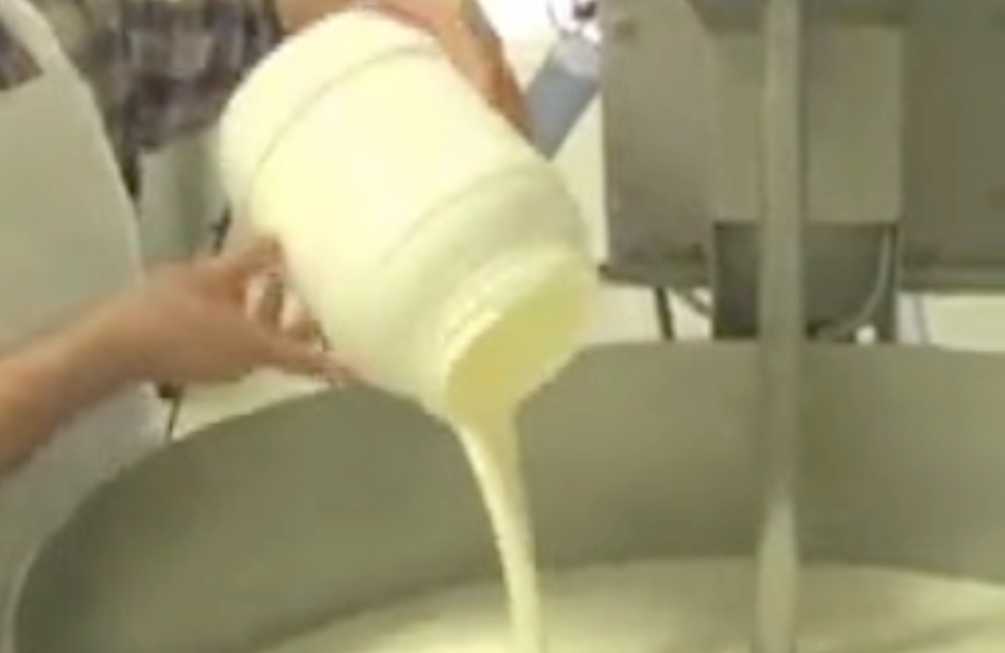
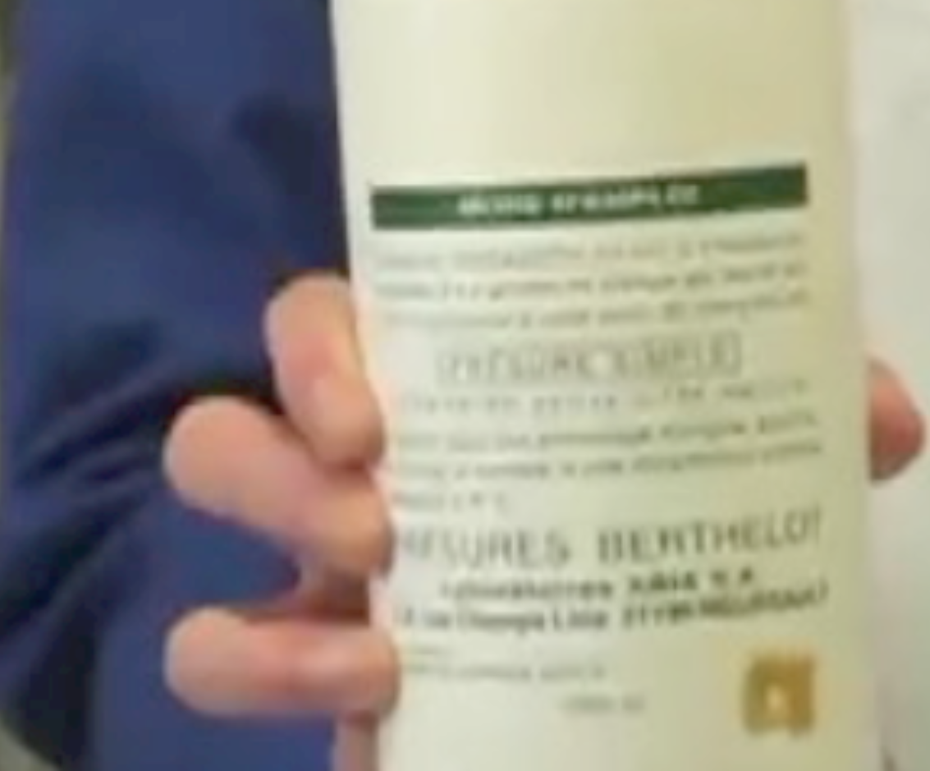
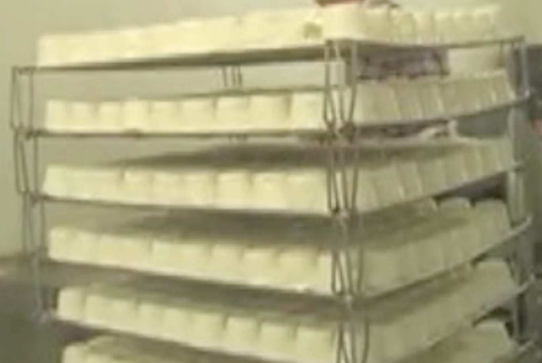
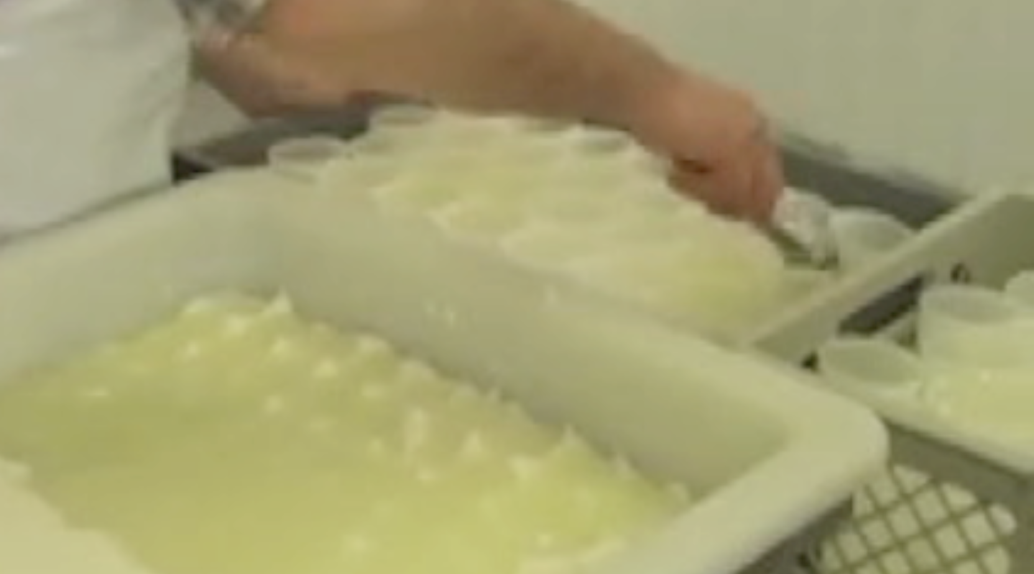
Process of cheese making
Herd of goats
1. Storage of the evening milk
2. Storage of the
morning milk
3. Mixing of milk
4. Adjunction of starter to milk
5. Adjunction of rennet to milk
6. Draining off of curdles
7. Salting 1 and 2
8. Cooled storage and wrapping
 | pH | a_{w} | Salt content (%)
Fresh goat milk | 6.63 | 1 | 0
Goat milk with adjunction of ferment and rennet (24h) | 6.58 | 1 | 0
Curdles (24h) not drained off | 4.41 | 0.987 | 0
Curdles drained off (48h after adding the ferment) | 4.28 | 0.987 | 0
Fresh cheese salted in the mass (24h) | 4.42 | 0.977 | 1.42

Slide 13
Time line: case of Lm contamination (1/3)
11 July 05
12 July 05
20 March 05
New analyses upon request in an external laboratory.
Numbers of Lm in different final products.
no L. monocytogenes in the products
Lm in the products (in 25g). The herd is then blocked and the sale. The farmer himself performs the recall of products.
fresh cheese not ripened: 4.3.10³ cfu/g ;
goat cheese ripened: 6.5.10³ cfu/g
goat cheese ripened and coated with charcoal: 5.1.10³ cfu/g
March 05
Dropping of the “shedder” goat
22 Feb 04
birth of the shedder goat
Serotype 1/2a with a β-hemolysis.

Slide 14
Time line: case of Lm contamination (2/3)
15-18 July 05
19 July 05
End July 05
pools of 20 samples of milk from goats directly after milking.
14-22 Sept July 05
Transfer of the goat to the faculty veterinary medicine.
Re-start of the fabrication process with mandatory analyses
Milk samples taken on the hospitalized goat
Only 1 pool positive + only one clearly excreting goat in the herd.
5 samples on the 1st batch of the final products, then 1 sample each [for the next] 5 batches of final products – both ripened goat cheese and not ripened.
No clinical signs observed
4.3.10² cfu L. monocytogenes/ml for the right part. Absence of L. monocytogenes in 25 ml for the left part of the mammary gland
no L. m found in the products

Slide 15
Time line: case of Lm contamination (3/3)
11 Oct – 3 Nov 05
Serotyping, antibiogram and PFGE on both strains and human strains
Sept-Dec 05
From January 06
Request of surveillance of final products in the herd at a frequency of 1 analysis/15 days of production
Request of surveillance of final products in the herd at a frequency of 1 analysis/6 months of production (with the following parameters: Listeria, Salmonella, E. coli and coagulase – positive staphylococci).
no L. monocytogenes found in the products
4 Oct 05
confirmation of serotype 1/2a, with a β-hemolysis
no L. monocytogenes found in the products
Strain sent to the (NRL) in Brussels. Meanwhile, another strain (from the cheese) was also sent.

Slide 16
To sum up (1/2)
Analyses in cheese
fresh cheese not ripened: 4.3.10³ Lm (3.63 log) cfu/g
goat cheese ripened: 6.5.10³ Lm (3.81 log) cfu/g
goat cheese ripened and coated with charcoal: 5.1.10³ Lm (3.7 log) cfu/g
Analyses of milk from the hospitalized goat
4.3.10² cfu Lm/ml for the right part
Absence of Lm in 25 ml for the left part of the mammary gland

Slide 17
To sum up (2/2)
Cheese
Cheese
milk
milk
Strains isolated from milk and cheese
Sensitive to the 10 antimicrobials tested
Sensitive to Arsenic and Cadmium
Serotype 1/2a with a β-hemolysis
PFGE : Pulsovar A, no matching with the 40 human strains collected at the NRL in 2005 (16 strains of serovar 1/2a, of which 7 sensitive to As and Cd)
AscI
ApaI

Slide 18
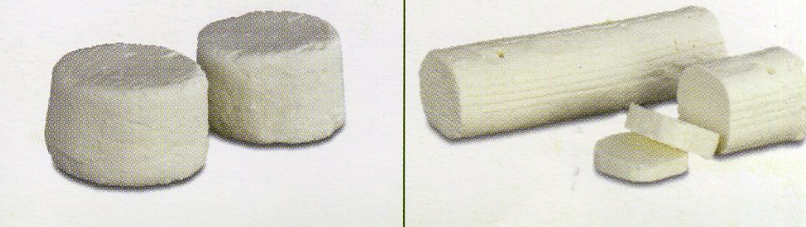
Building-up of the model
Principles of the modular process risk model
On the 8 modules: (1) storage of the evening milk, (2) storage of the morning milk, (3) mixing of the morning and evening milk, (4) adjunction of the starter to the milk, (5) adjunction of rennet to the milk, (6) draining off of curds, (7) salting at ambient temperature and (8) cooled storage.
On fresh unripened cheese
Characterization of the model inputs:

Slide 19
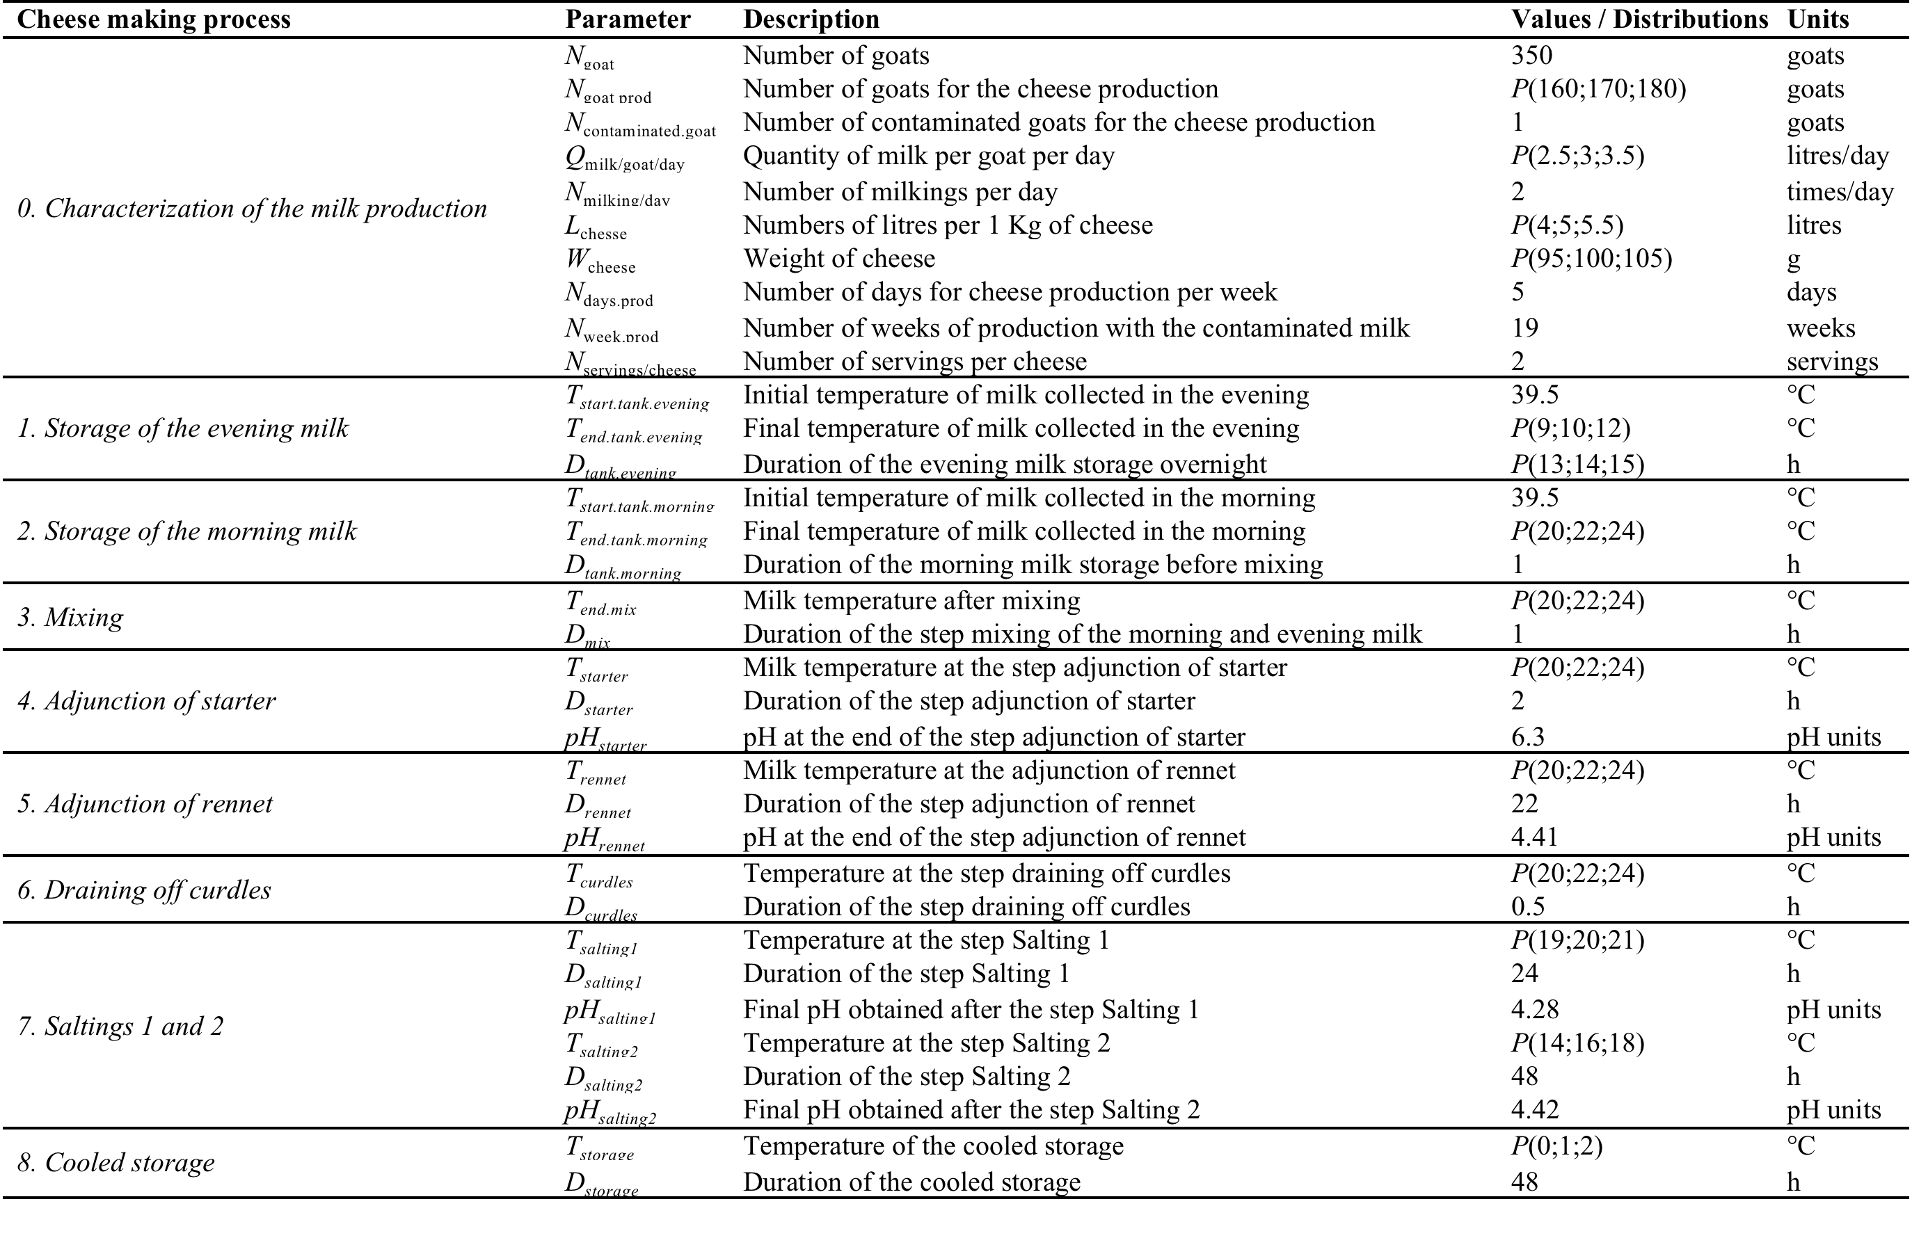
Characterization of the model inputs
Notes:
Insister sur les températures de refroidissement te le pH qui décroît

Slide 21
Baseline results of the exposure assessment and the risk characterization modules
fresh cheese not ripened: 4.3.10³ (3.63 log) cfu/g

Slide 22
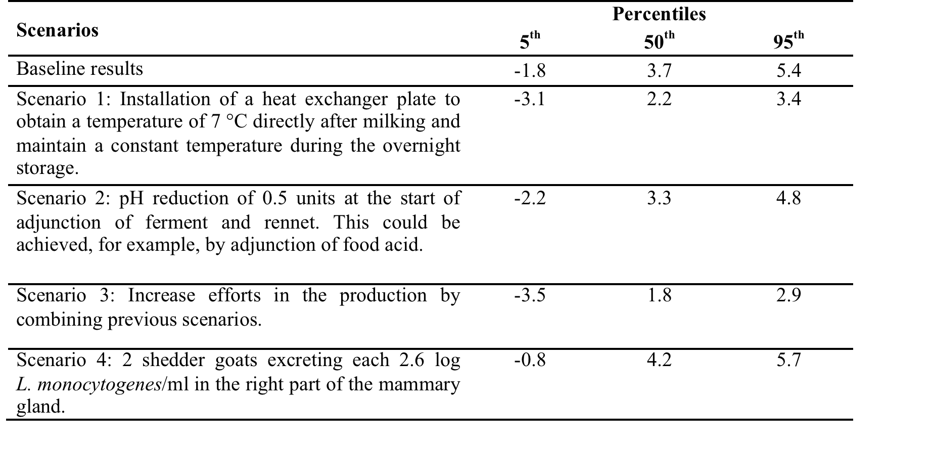
Results of the scenarios analysis (Concentration of L. monocytogenes in a cheese (log cfu/g))

Slide 23
Conclusions
The process does not prevent the contamination by Listeria monocytogenes
The model seems to correctly estimate the fate of Lm
Surveillance in the primary sector difficult but may be improved
No reported human listeriosis connect to this contamination
Risk analysis can be useful in a HACCP process

Slide 24

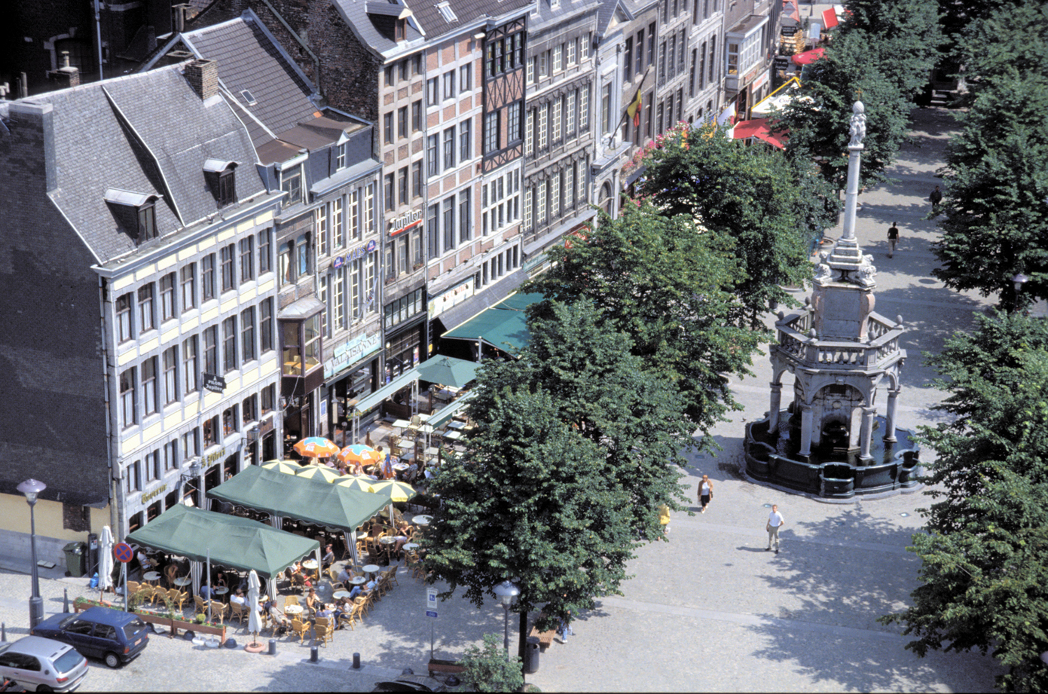

Acknowledgements
Laurent Delhalle
Mariem Ellouze
Marc Yde
Antoine Clinquart
Georges Daube
Alexandrine Florentin

