Slide 1
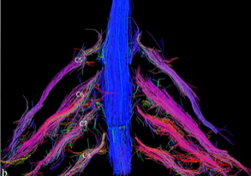
ENMG of Brachial Plexus
F. Wang
To exclude
To localize
To assess severity
Notes:
In Brachial plexus lesion, EMG is used to localize the lesion accurately, to exclude a disorder of the nerve roots, which may closely resemble brachial plexopathy clinically and to assess its severity

Slide 2
Easy diagnosis ?
Post- ganglionic multitroncular mononeuropathy
Sensory and motor neuropathy or pure motor neuropathy
(Parsonage & Turner, MMN)
Axonal or demyelinating neuropathy (dysimmune neuropathies)
SNAP/CMAP : absent or reduced in amplitude
MCV & distal latency : usually normal
Erb’s point stimulation : sometimes prolonged latency or conduction block (MMN, plexopathy due to radiations)
F wave : prolonged if demyelination in C7-D1 territory
EMG : acute, subacute or chronic neurogenic traces
Notes:
In complete brachial plexus injury or dysimmune neuropathies, the EMG diagnosis might be considered quite easy. You have to document :

Slide 3
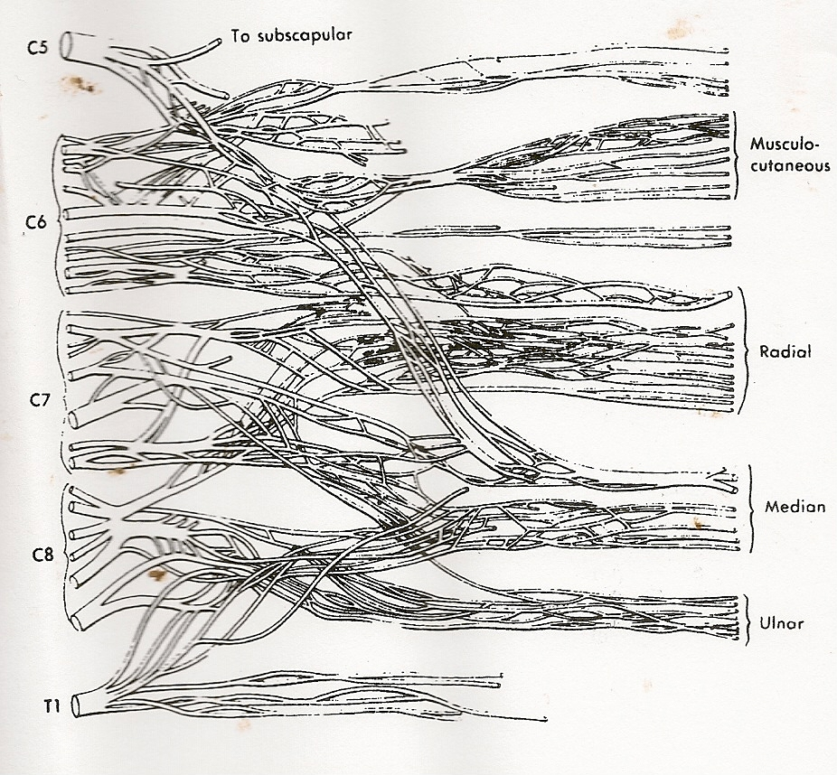
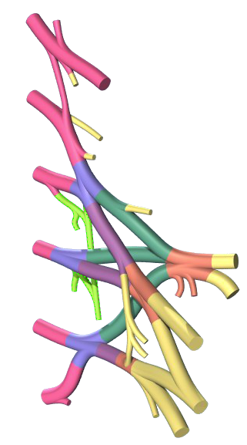
Tricky diagnosis ?
The main difficulty
is related to :
Anatomy
Notes:
However, in more focal injury, the diagnosis is often tricky

Slide 4
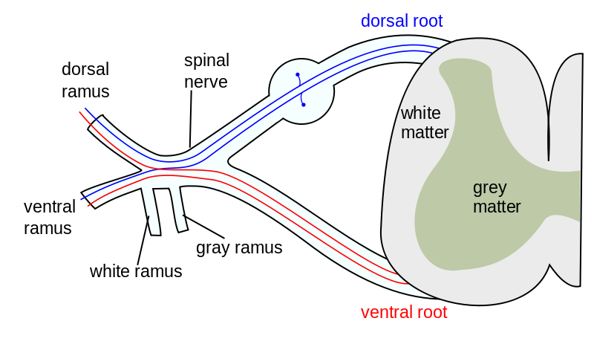
Three
questions
Pre- or post-ganglionic lesion ?
Spinal nerve or plexus ?
Trunk or cord ? or
SUPER root or SUPER nerve ?
And then you realized that things are more complicated…
Notes:
You have to answer 3 questions

Slide 5
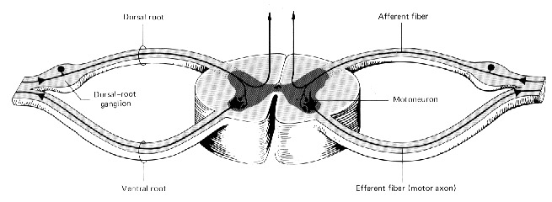
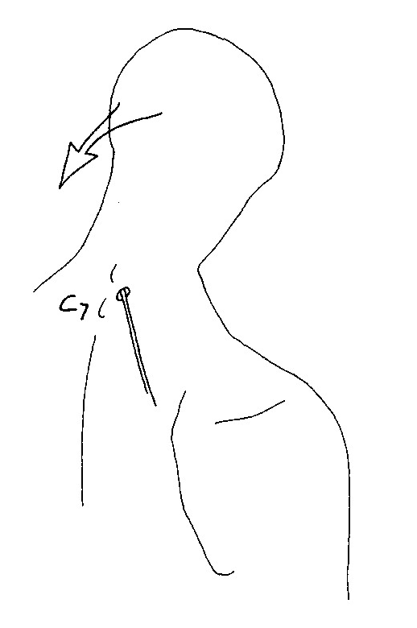
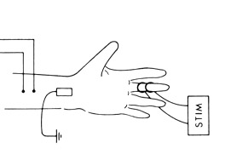
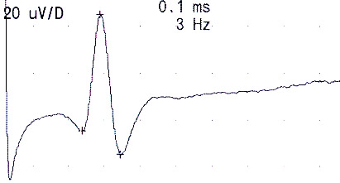
Pre- or post-ganglionic lesion ?
Paravertebral muscles
SNAPs
There is not sensory axonal degeneration in the case of pre-ganglionic lesion, even if this nervous lesion is complete.
1 or 2 cm out of
the median line
At the intervertebral space
Notes:
Paravertebral muscles may help you to answer the first question. If there are fibrillations in paravertebral muscles, you can be sure that it’s a pre-ganglionic lesion. But in absence of fibrillation, the question remains opened. For paravertebral muscle mapping, the needle electrode has to be introduced at the intervertebral space, 1 or 2 cm out of the median line. In practice, SNAPs are more useful, except for C5 lesion. Indeed, as you know

Slide 6
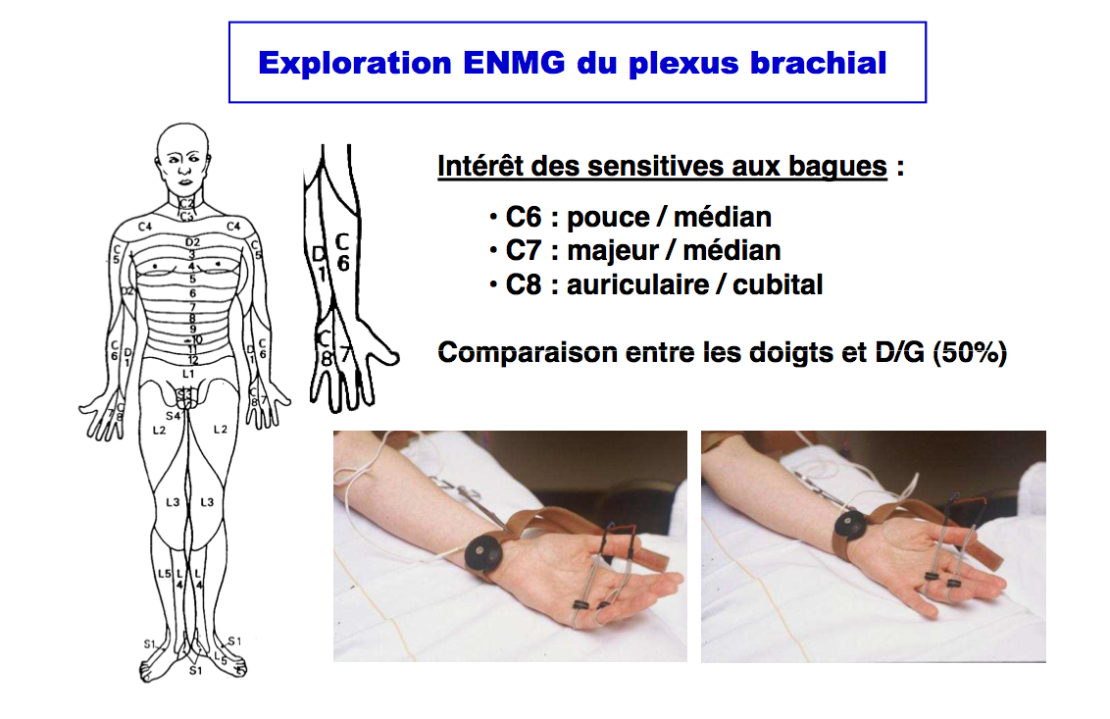
Pre- or post-ganglionic lesion ?
SNAPs
Radial nerve – Posterior cord – Upper/Middle trunks – C6(C7)
Thumb – Radial nerve – posterior cord – upper trunk – C6
LABC nerve – Lateral cord – Upper trunk – C6
MABC nerve – Medial cord – Lower trunk – C8
Thumb – Median nerve – Lateral cord – Upper trunk – C6
3rd finger – Median nerve – Lateral cord – Middle trunk – C7
5th finger – Ulnar nerve – Medial cord – Lower trunk – C8
Right/Left difference in amplitude : ≥ 50% is abnormal
TPS
TSAE
TPM
TSAE
TPI
TSAI
Notes:
Of course, you have to know that sensory fibers from radial nerve pass in posterior cord, upper and middle trunk and C6C7 roots etc…
Usually, we consider that a right/left difference of amplitude equal or more than 50% is abnormal
Finger SNAP interpretation may be tricky because of median nerve neuropathy at the wrist or ulnar nerve neuropathy at the elbow

Slide 7
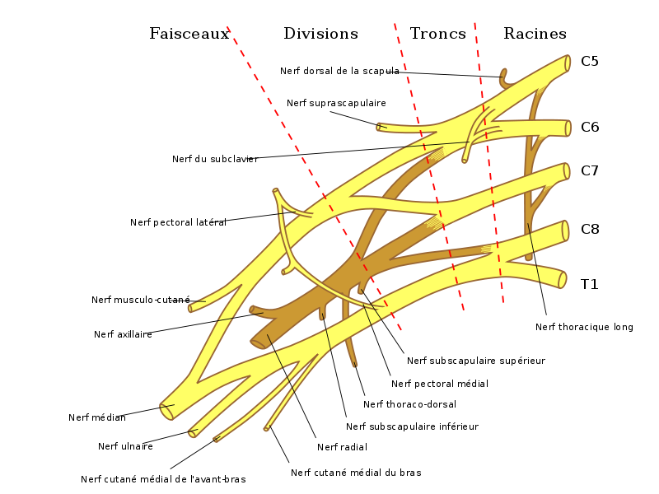
Spinal nerve or plexus ?
Ventral rami
Dorsal scapular nerve
Nerve to subclavius muscle
Long thoracic nerve
Notes:
To answer the second question, you have to pay a particular attention to the dorsal scapular nerve and the long thoracic nerve. If they are involved, it is not a plexus lesion.

Slide 8
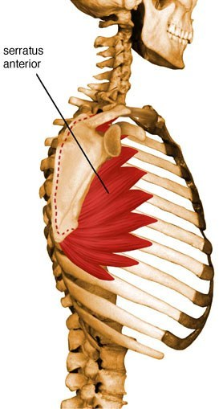
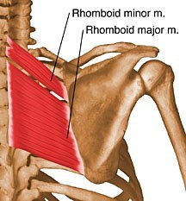
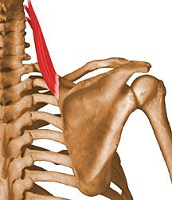
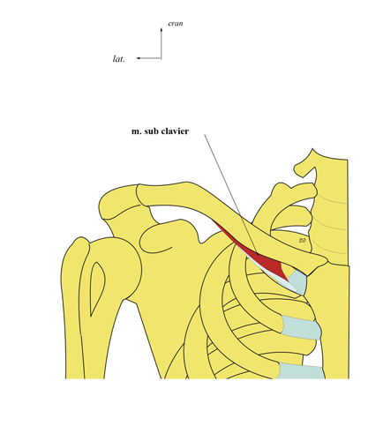
Spinal nerve or plexus ?
Long thoracic nerve (C5,C6,C7) : serratus anterior
Dorsal scapular nerve (C5) : rhomboid minor and major and levator scapulae
Nerve to subclavius muscle (C5,C6)

Slide 9
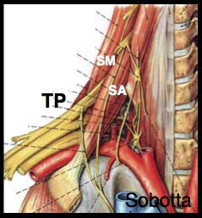
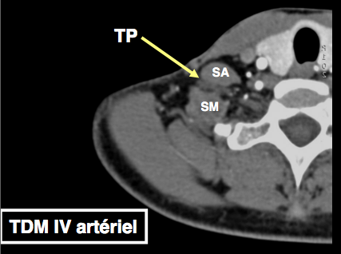
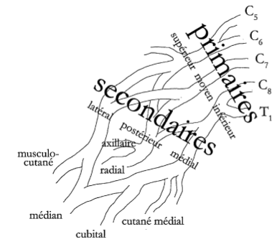
Trunks or Cords ?
Anatomical classification of lesions
Trunks : supraclavicular and pass between scalenus medius and scalenus anterior
Cords : infraclavicular
Divisions (between trunks & cords) : retroclavicular
Notes:
It’s much more tricky to answer the third question
Firstly, you have to know that

Slide 10
SUPER root or SUPER nerve ?
Simplified view
C5
C6
C7
C8
T1
Musculocutaneous
Median (C6-C7)
Radial
Axillary
Ulnar
Median (C8-T1)
Medial antebrachial
cutaneous
Upper trunk
Middle trunk
Lower trunk
Lateral cord
Posterior cord
Medial cord
TPS
TSAE
TPM
TSP
TPI
TSAI
Notes:
Secondly, you have to keep in mind the simplified view. Trunks are considered as super roots and cords as super nerves.

Slide 11
Upper trunk
C5 + C6
C5
C6
Suprascapular nerve
Notes:
Now, let’s go a liitle bit deeper in the brachial plexus anatomy
The upper trunk territory corresponds to C5 + C6 with suprascapular nerve

Slide 12
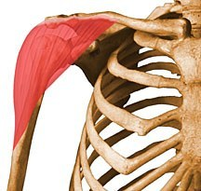
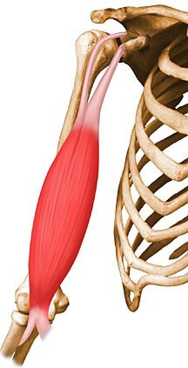
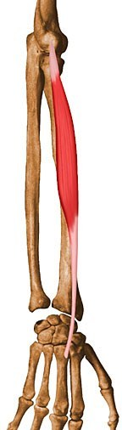
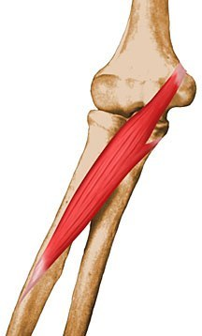
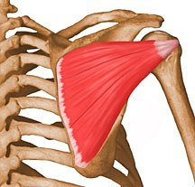
Upper trunk
C5 + C6
C5 & C6 post-ganglionic lesion
With suprascapular nerve lesion (most often)
Without involvement of long thoracic & dorsal scapular nerves

Slide 13
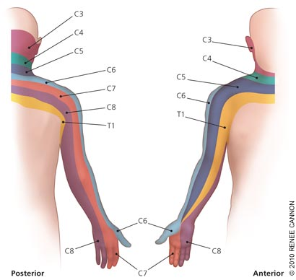
Upper trunk
C5 + C6
C5 mot.: deltoid (CMAP)
C6 mot.: biceps (CMAP,T), ext.
carpi rad. brevis, pronator teres
C5/C6 SNAPs: radial, median/R1
lateral antebrachial cutaneous
Suprascapular nerve (C5,C6)
Tendon reflex: biceps & brachioradialis
Notes:
The first choice for EMG investigation is indicated in yellow
On the motor side
On the sensory side
Biceps & brachioradialis tendon reflex may be decreased or abolished

Slide 14
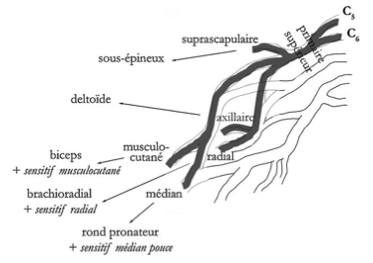
Upper trunk lesions
C5 + C6
Moto crash
Obstetrical trauma
Parsonage & Turner
Infiltrative plexopathy
Rucksack paralysis
“Burner syndrome
(sport trauma)
Post-anesthesia
Infection : Lyme
Vasculitis
Heroin

Slide 15
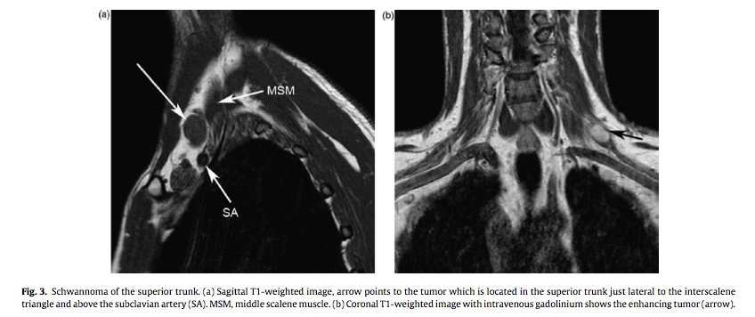
Upper trunk lesions
C5 + C6
Schwannome

Slide 16
Lateral cord
musculocutaneous + median (C6C7) nerves
Lateral pectoral nerve
Musculocutaneous nerve
Median nerve
Notes:
The lateral cord territory corresponds to musculocutaneous + median (C6C7) nerves with lateral pectoral nerve

Slide 17
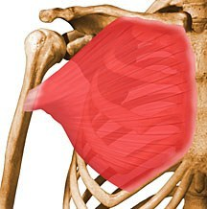
Lateral cord
musculocutaneous + median (C6C7) nerves
Musculocutaneous mot.: biceps (CMAP), brachialis
Median (C6C7) mot: pronator teres, flexor carpi radialis (H)
Median R1-R4/lateral antebrachial cutaneous SNAPs
Lateral pectoral nerve : pectoralis major
Tendon reflex: biceps
Notes:
On the motor side
On the sensory side
The biceps reflex may be decreased or abolished

Slide 18
Middle trunk
C7
C7
Notes:
Middle trunk lesion is a C7 post-ganglionic lesion

Slide 19
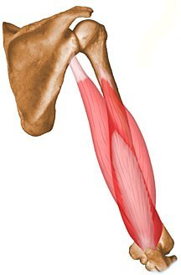
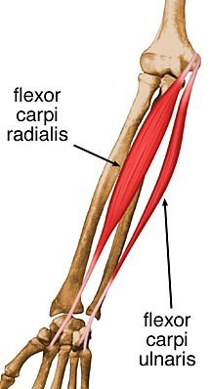
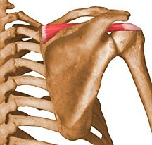
Middle trunk
C7
C7 post-ganglionic lesion

Slide 20
Middle trunk
C7
C7 mot.: triceps (T), flexor carpi radialis (H), extensor digitorum, anconeus (CMAP/F)
C7 SNAPs: median/R2+R3, radial, PABC
Tendon reflex: triceps
Notes:
It’s important to document the median C7 involvement to exclude a radial nerve lesion
On motor side
On sensory side
The triceps reflex may be decreased or abolished

Slide 21
Posterior cord
radial + axillary nerves
Axillary
Radial
Axillary nerve
Thoracodorsal nerve
Lower subscapular nerve
Radial nerve
Notes:
The posterior cord territory corresponds to radial + axillary nerves with thoracodorsal and lower subscapular nerves

Slide 22
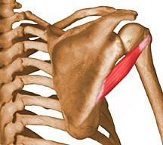
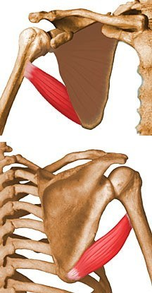
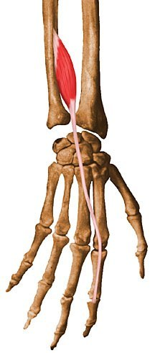
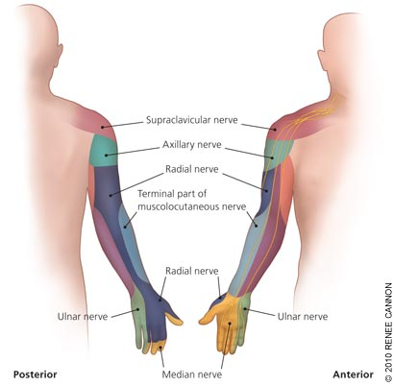
Posterior cord
radial + axillary nerves
Radial mot: triceps (T), extensor digitorum, extensor indicis, ECU(CMAP), anconeus (CMAP/F)
Axillary mot: deltoid (CMAP), teres minor
Thoracodorsal mot: latissimus dorsi
Lower subscapular mot: teres major, (subscapularis)
Radial SNAP
Triceps and brachoradialis reflexes are abnormal
Notes:
On the motor side
On the sensory side
Triceps and brachoradial may be decreased or abolished

Slide 23
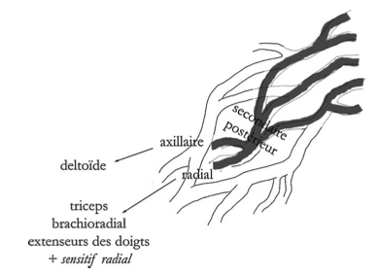
Posterior cord lesions
radial + axillary nerves
Humeral head fracture/luxation
Supra-clavicular wounds

Slide 24
Lower trunk
C8 + D1
C8
D1
Medial pectoral nerve
Medial antebrachial cutaneous nerve
Medial brachial cutaneous nerve
Notes:
The lower trunk territory corresponds to C8 + D1 which includes the territory of medial pectoral nerve, MABC and MBC nerves

Slide 25
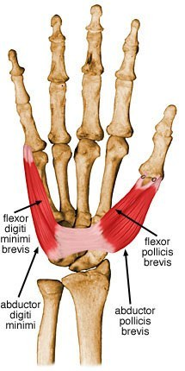
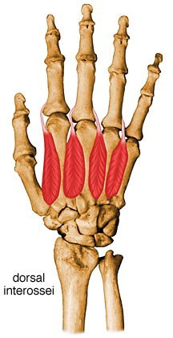
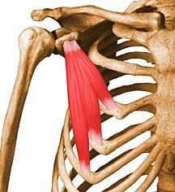
Lower trunk
C8 + D1
C8 & D1 post-ganglionic lesion
With medial brachial & antebrachial cutaneous
With medial pectoral
Reminder : APB & medial brachial cutaneous D1 > C8
ulnar nerve C8 > D1

Slide 26
Lower trunk
C8 + D1
C8/D1 mot.: APB (CMAP/F), ADM (CMAP/F) Interosseous I, extensor indicis, pectoralis minor & major (sternocostal portion)
C8/D1 SNAPs: ulnar/R4+R5, medial brachial & antebrachial cutaneous
No reflex abnormalities

Slide 27
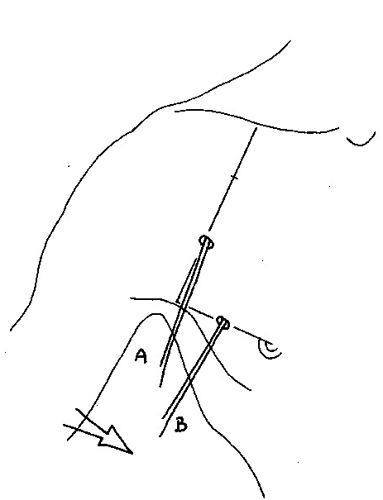
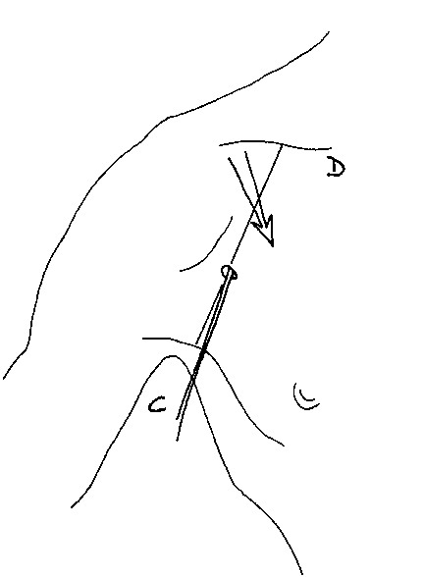
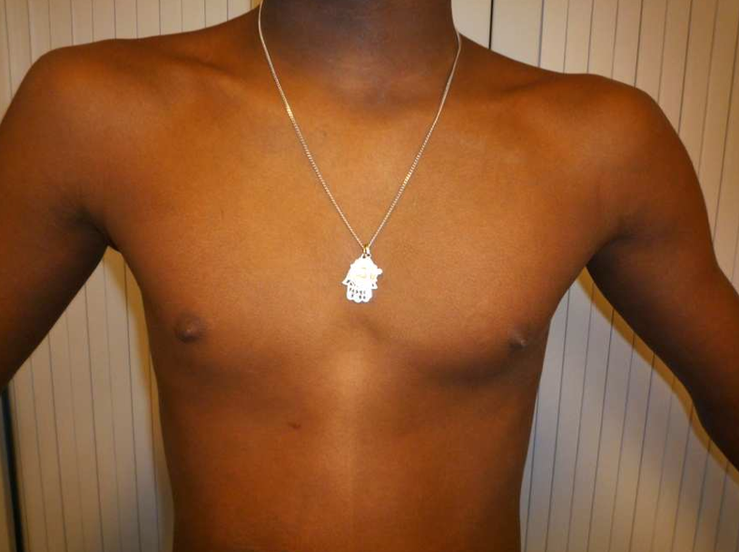
Lower trunk
C8 + D1
1 Clavicula
2 Nipple
3 anterior axillary line
4 Pectoralis major
(clavicular part, C5C6)
5 Pectoralis major
(sternocostal part, C7C8)
6 Pectoralis minor (C7C8)
Pectoralis major
Pectoralis minor
1
1
4
6
5
2
3
3
Right TOS
Notes:
At the middle of the anterior axillary line for the sternocostal part of the pectoralis major
At point 4 for the clavicular part of the pectoralis malor and more deeply for the pectoralis minor

Slide 28
Medial cord
Ulnar + median (C8D1) nerves
Medial pectoral nerve
Median nerve
Ulnar nerve
Medial antebrachial cutaneous nerve
Medial brachial cutaneous nerve
Notes:
The medial cord territory is identical to lower trunk with exception for C8 radial muscles

Slide 29
Medial cord
Ulnar + median (C8D1) nerves
Ulnar & median (C8D1)
With medial brachial & antebrachial cutaneous (sometimes)
With medial pectoralis nerve (sometimes)
Without C8 radial muscles

Slide 30
Medial cord
Ulnar + median (C8D1) nerves
C8/D1 mot.: APB (CMAP/F), ADM (CMAP/F) Interosseous I, pectoralis minor
C8/D1 SNAPs: ulnar/R4+R5, medial brachial & antebrachial cutaneous
No reflex abnormalities

Slide 31
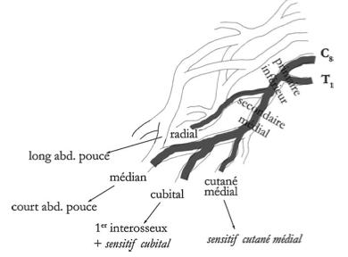
Lower trunk or medial cord lesions
TOS
Pancoast Tobias
Metastatic
Neurofibroma
Schwannoma
Meningioma
Trauma in abd.
Post-sternotomy
Radiotherapy
Dys. neuropathy

Slide 32
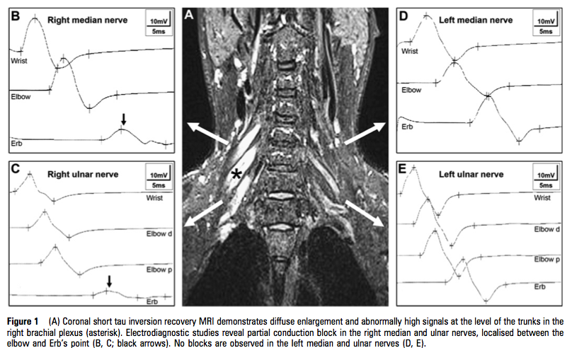
Lower trunk or medial cord lesions
Dys. neuropathy

Slide 33
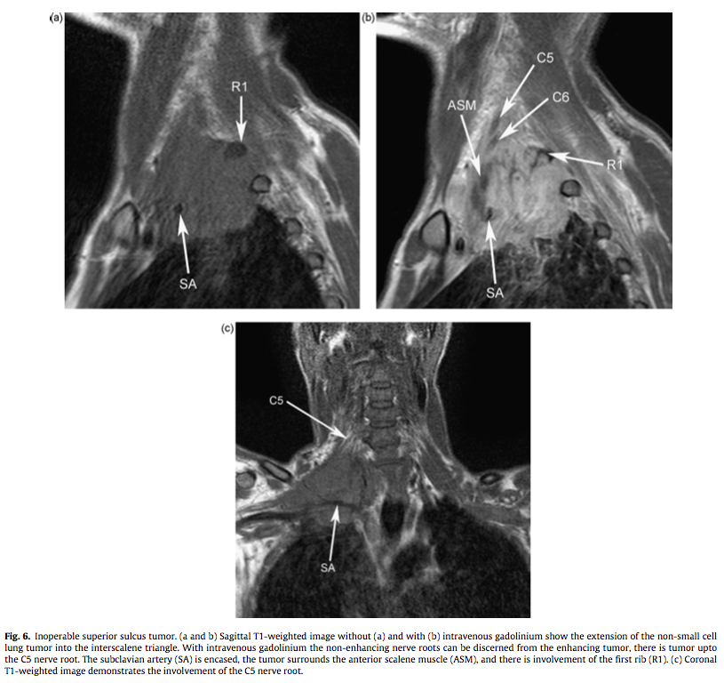
Lower trunk or medial cord lesions
Non small-cell lung tumor

Slide 34
 | Upper T | Middle T | Lower T | Lateral C | Posterior C | Medial C
1. Deltoid (C5C6) : CMAP, EMG |  |  | _ | _ |  | _
2. Infraspinatus (C5C6) : CMAP (needle), EMG |  |  | _ | _ |  | _
3. Biceps (C5C6) : CMAP, T, EMG | + | _ | _ |  | _ | _
4. Pronator teres (C6C7) : EMG | + |  | _ |  | _ | _
5. Flexor carpi radialis (C6C7) : H, EMG |  |  | _ | + | _ | _
6. Triceps (C6C7C8) : T, EMG |  |  |  | _ | + | _
7. Extensor indicis (C7C8D1) : EMG | _ |  |  | _
8. Abductor pollicis brevis (C8D1) : CMAP, F, EMG | _ | _ |  | _ | _
9. Abductor digiti minimi (C8D1) : CMAP, F, EMG | _ | _ |  | _ | _
10. Pectoralis major (C5C6C7C8) : EMG |  |  |  | + | _
11. Pectoralis minor (C7C8) : EMG | _ |  | + | _ | _ | +
12. Teres major (C5C6C7) : EMG |  |  | _ | _ | + | _
1. Radial (C6C7) : SNAP |  |  | _ | _ |  | _
2. R1/median (C6) : SNAP | + | _ | _ | + | _ | _
3. R3/median (C7) : SNAP | _ | + | _ | + | _ | _
4. Medial antebrachial cut.(D1) : SNAP | _ | _ |  | _ | _
5. R5/ulnar (C8) : SNAP | _ | _ | + | _ | _ | +
6. Lateral antebrachial cut. (C6) : SNAP | + | _ | _ |  | _ | _
Notes:
In summary, this is the complete view
In green the involved territories
In red the non involved territories

Slide 35
Simplified view
Lesion | Motor | Sensory | Tendon Reflex
LOWER TRUNK C8 + D1 | APB-ADM Extensor indicis | MABC R5 | No reflex abnormalities
MEDIAL CORD Ulnar + Median C8D1 | APB-ADM | MABC R5 | No reflex abnormalities
UPPER TRUNK C5 + C6 | Deltoid Infraspinatus | Radial R1/LABC | Biceps Brachioradialis
POSTERIOR CORD Radial + Axillary | Deltoid Extensor indicis | Radial only | Brachioradialis Triceps
MIDDLE TRUNK C7 | Triceps FCR | Radial R3 | Triceps only
LATERAL CORD Musculocutaneous + Median C6C7 | Biceps Pronator teres | Median (R1-R4) LABC | Biceps only

Slide 36
The simplest view
Inferior plexus : hand intrinsic muscles
APB, ADM, MABC, R5
with EI => LT
without EI => MC
Superior plexus : elbow and wrist flexion
BB, FCR, PT
with D and radial SNAP => UT
without D, with median SNAP => LC
Middle/posterior plexus : elbow and wrist extension
TB, radial SNAP
without EI => MT
with D => PC

Slide 37
Thanks
E Fournier
JF Camdessanché
AL Derelle et al
A Echaniz-Laguna
HW van Es et al
MI Vargas et al
http://www.rad.washington.edu
http://enmgblog.blogspot.com

