Slide 1



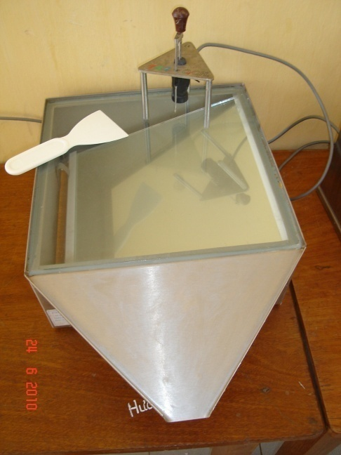

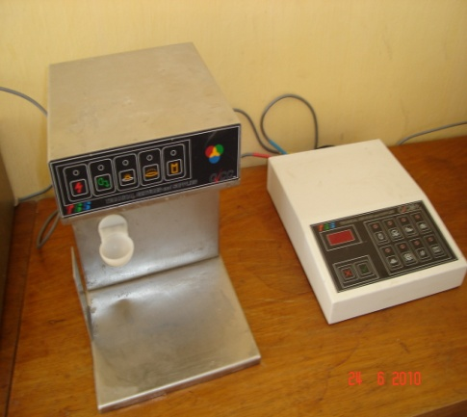
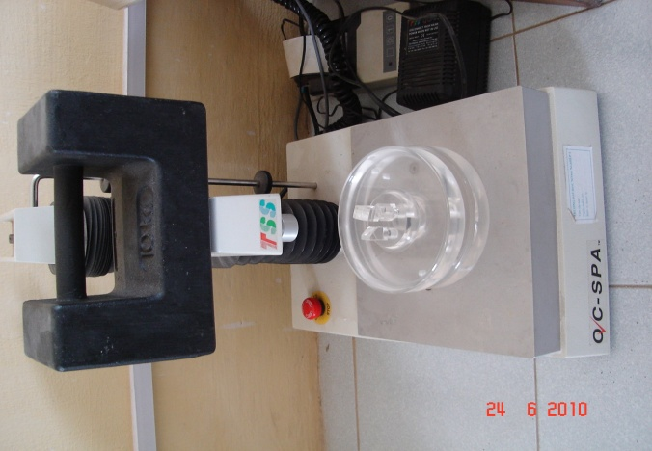
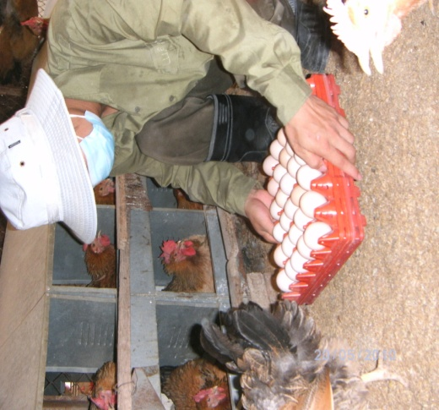
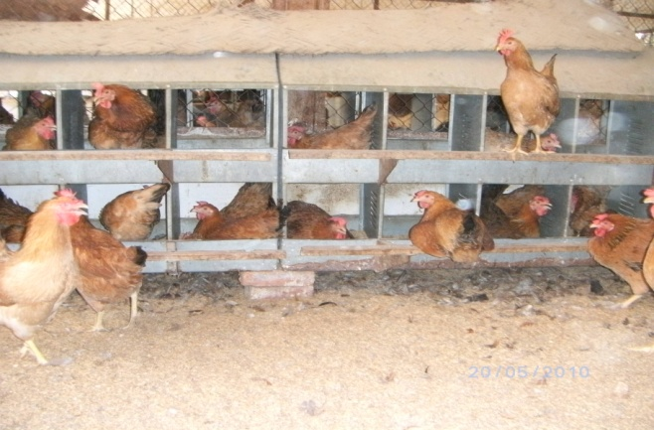

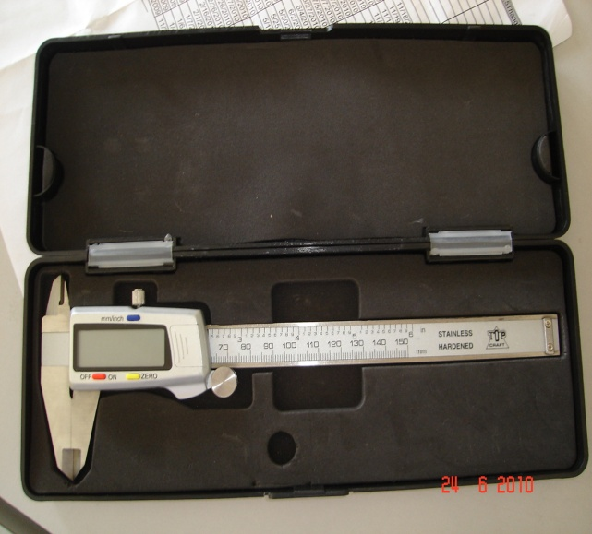
Egg quality comparison of two Vietnamese chicken breeds (Ri and Mia)
Nassim Moula¹, Nicolas Antoine-Moussiaux¹, Do Duc Luc^{1,2}, Nguyen Chi Thanh², Pham Kim Dang²,
Vu Dinh Ton², Dang Vu Binh², Pascal Leroy¹ and Frédéric Farnir¹
¹ Department of Animal Production, Faculty of Veterinary Medicine, University of Liege, Liege 4000, Belgium.
² Faculty of Animal Science and Aquaculture, Hanoi University of Agriculture, Trau Quy, Gia Lam, Hanoi, Vietnam.
INTRODUCTION
Aviculture is a very important sector of livestock in Vietnam, occupying the 2nd position after the swine sector. It is dominated by local breeds with 158 millions local poultry. The local hen breeds combined with the local duck breeds, represent over 89% of the total national Vietnamese avian population (Eaton et al., 2006). In the context of the valorization of poultry biodiversity, this work represents a step toward a better knowledge of the production abilities of Vietnamese local chicken breeds. Local chicken breeds are indeed particularly well suited for low-input rearing systems, as widely practiced in rural households of Vietnam. The socio-economic importance of these breeds might be underpinned by a market valorization through the mounting of differentiated quality value chains. Such a strategy needs the production potential of these local breeds to be assessed from parameters of egg quality and quantity. This study presents data about egg quality traits in two chicken breeds, the Ri and the Mia. The former is the most widespread breed of Vietnam, while the latter is known to be in danger of extinction. Quality of the eggs is assessed through the freshness of the eggs, represented in this study by Haugh’s units (HU), the soundness of the shell, which is the second most important economic quality of eggs, represented by the eggshell thickness and by the maximal breaking force of the shell (Moula et al., 2010), and the yolk to albumen ratio, for which high proportion of yolk are sought because it has a significant impact on the dry matter content of eggs, which is an essential criterion in the industry.
MATERIAL AND METHODS
Egg quality traits (egg weight, yolk weight, egg shell weight, albumen weight, percentage of albumen, percentage of yolk, percentage of egg shell, yolk-albumen ration, albumen height, Haugh’s units, yolk diameter and yolk color) were taken the day after egg collection in the laboratory of Department of Animal Breeding and Genetics, the Faculty of Animal Science and Aquaculture, Hanoi University of Agriculture (Vietnam). The analyses were conducted using 40- and 60-weeks old hens. Egg quality traits were measured according to the method described by Moula et al. (2010). The SAS Software (Statistical Analysis System, 2001) was used for all statistical analyses. Breed and age effect on each parameter was assessed using the following general linear model:
y_{ijk}=µ + A_{i} + B_{j} + (AB)_{ij} + e_{ijk}
where y represent the studied parameters measured on the egg; µ the mean; A the effect of breed (i= Mia and Ri); B the effect of age (j= 40 and 60 weeks); AB the interaction between breed and age; and e the residual effect.
RESULTS
Table 2. Least square means (lsmean ± SE) for exterior egg quality traits
Paramètres | Age (weeks) | Breeds |  | Level of signification |  |  | R²
 |  | Mia | Ri | Age | Breed | Age*Breed
Egg length (mm) | 40 | 50.73±0.36ª | 48.86±0.28^{b} | *** | *** | ns | 0.32
 | 60 | 52.56±0.36ª | 50.70±0.31^{b}
Egg widh (mm) | 40 | 39.15±0.24ª | 37.89±0.19^{b} | *** | * | ** | 0.27
 | 60 | 39.53±024 | 39.76±0.21
Egg Shape | 40 | 76.85±0.57 | 77.51±0.45 | ns | ** | * | 0.10
 | 60 | 75.65±0.57ª | 78.56±0.49^{b}
Eggshell thickness (x10⁻²) | 40 | 32.09±0.57 | 32.50±0.45 | *** | *** | *** | 0.40
 | 60 | 32.31±0.58ª | 26.56±0.51^{b}
F max (newton) | 40 | 36.50±1.21 | 36.66±0.95 | * | ns | ns | 0.06
 | 60 | 40.79±1.23ª | 37.89±1.05^{b}
Table 1. Least square means (lsmean ± SE) for interior egg quality traits
Parameters | Age (weeks) | Breeds |  | Level of signification |  |  | R²
 |  | Mia | Ri | Age | Breed | Age*Breed
Egg weight (g) | 40 | 42.79±0.69ª | 38.79±0.54^{b} | *** | *** | * | 0.41
 | 60 | 46.60±0.69ª | 45.21±0.60^{b}
Yolk weight (g) | 40 | 14.08±0.37ª | 12.32±0.27^{b} | *** | *** | ns | 0.33
 | 60 | 15.76±0.34ª | 14.67±0.30^{b}
Egg shell weight (g) | 40 | 4.21±0.10ª | 3.80±0.08^{b} | *** | *** | ns | 0.45
 | 60 | 5.08±0.10ª | 4.59±0.08^{b}
Albumen weight (g) | 40 | 24.23±0.68 | 22.73±0.51 | *** | ns | ns | 0.15
 | 60 | 25.76±0.63 | 26.04±0.56
% Albumen | 40 | 56.90±0.83 | 58.22±0.62 | ns | ** | ns | 0.74
 | 60 | 55.03±0.77ª | 57.43±0.68^{b}
% Yolk | 40 | 33.20±0.78 | 31.82±0.58 | ns | * | ns | 0.04
 | 60 | 34.08±0.73 | 32.45±0.65
% Egg shell | 40 | 9.86±0.18 | 9.83±0.14 | * | * | * | 0.14
 | 60 | 10.90±0.18 | 10.15±0.16
Y:A ratio (%) | 40 | 0.58±0.02 | 0.55±0.01 | ns | ** | ns | 0.10
 | 60 | 0.64±0.02ª | 0.57±0.02^{b}
Albumen height (.01mm) | 40 | 5.51±0.25 | 5.67±0.20 | * | ns | ns | 0.06
 | 60 | 4.78±0.25 | 5.27±0.22
Haugh’s units | 40 | 78.92±1.75 | 80.88±1.36 | ** | * | ns | 0.10
 | 60 | 72.49±1.72 | 76.14±1.51
Yolk diameter (mm) | 40 | 39.12±0.40ª | 36.53±0.30^{b} | * | *** | * | 0.23
 | 60 | 39.05±0.37ª | 38.13±0.32^{b}
Yolk coloration | 40 | 10.89±0.18 | 10.55±0.13 | * | ** | ns | 0.10
 | 60 | 10.72±0.17ª | 10.08±0.15^{b}
On a same row, values bearing a same letter are statistically not different (p < 0.05). ***: P < 0.001; **: P < 0.01; *: P < 0.05; P ≥ 0.05. R²: coefficient of determination
Quantitative traits measured on eggs of 40-weeks and 60-weeks old hens are presented in Table 1 and 2. Mean egg weight of Mia was significantly (p<0.001) higher than that of Ri. The yolk to albumen ratio was significantly different (p<0.01) between the two breeds. No significant difference (p>0.05) was recorded between the two breeds for egg freshness assessment (Haugh’s units) and eggshell resistance (maximum breaking force).
In the present study, egg weight, yolk weight, egg shell weight and albumen weight increase according to age. However the difference is not very important for the main quality traits of eggs (freshness, egg shell strength, and the ratio yellow/white and egg weight).
Egg weight in this study was lower than industrial egg while the yolk weight and yolk-albumen ratio was higher. The soundness of the shell was similar (De Ketelaere et al., 2002). The freshness of the egg is represented in class AA according to USDA grade (USDA, 1975).
CONCLUSION
The performances of both breeds appear to be highly interesting since market demand is for eggs with a higher yield in dry mater (high yolk to albumen ratio) and eggs with strong shell (maximal breakage force); this observation is of particular interest when considering that none of these breeds underwent any previous selection process, which possibly implies that even more benefits could be obtained after selection. Further breeding for these traits could thus be considered in these local breeds.
REFERENCES
De Ketelaere, B., T. Govaerts, P. Couke, E. Dewil, J. Visscher, E. Decuyperre and J. DeBaerdemaeker. 2002. Br. Poult. Sci., 43: 238-244.
Eaton, D., Windig J., Hiemstra S.J., Van Veller M., Trach N.X., Hao P.X., Doan, B.H. and R. Hu. 2006. Report 2006/05, Center for Genetic Resources Netherlands/DLO Foundation, Wageningen. 2006.
Moula, N., Antoine-Moussiaux N., Decuypere, E., A, Farnir, F, Mertens, K., De Baerdemaeker, J. and P. Leroy. 2010. Archiv Für Geglügelkunde, 74 (3), 164–171.
USDA: Egg grading manual. Agricultural Marketing Services, Washington, DC. 1975.
Corresponding author: f.farnir@ulg.ac.be

