Slide 1

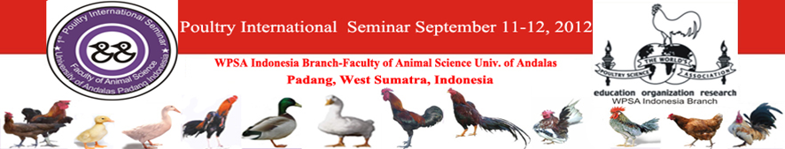


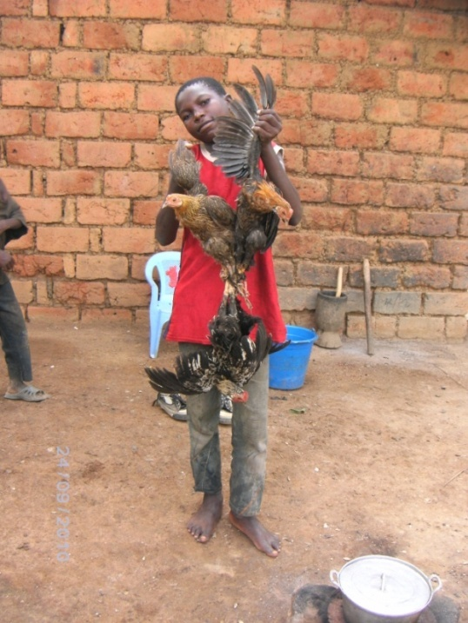
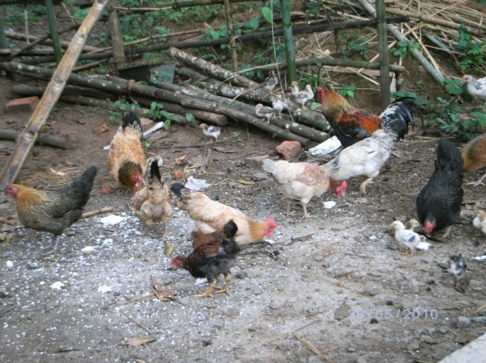
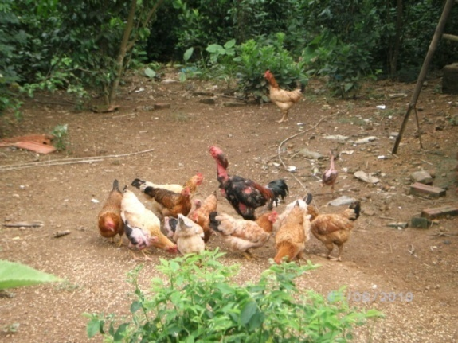

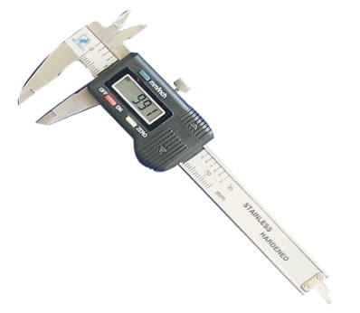
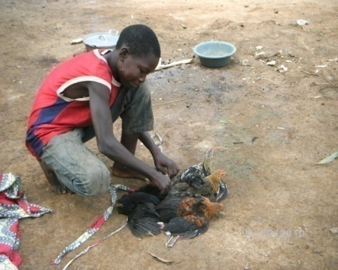
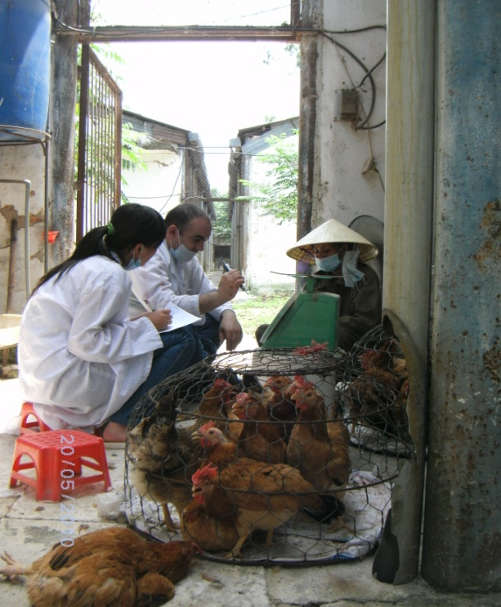
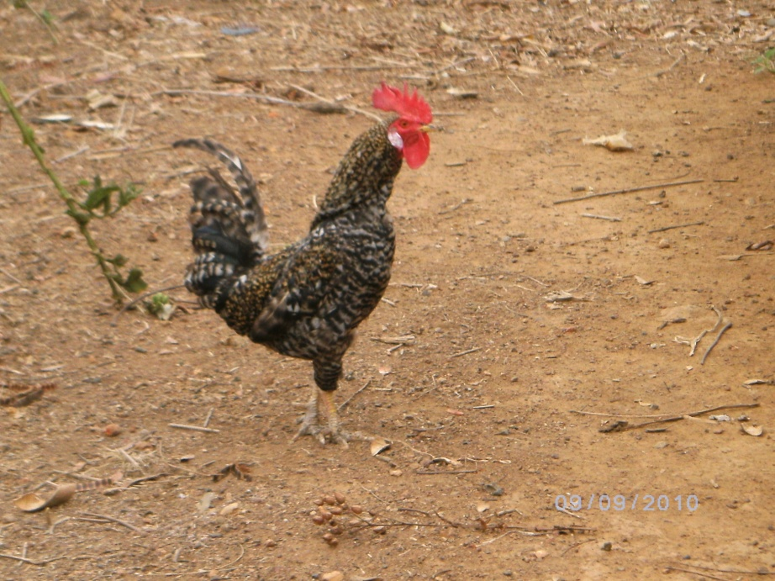
COMPARATIVE EVALUATION OF LOCAL POULTRY BREEDS STATUS
IN ALGERIA, VIETNAM AND THE DEMOCRATIC REPUBLIC OF CONGO
Nassim Moula¹, Frédéric Farnir¹, Abdellah Salhi², Do Duc Luc^{1,3}, Vu Dinh Ton³, Pascal Leroy¹ and Nicolas Antoine-Moussiaux¹
¹ Department of Animal Production, Faculty of Veterinary Medicine, University of Liege, Liege 4000, Belgium.
² Departments of Mathematical Sciences, University of Essex, Wivenhoe Park, Colchester, CO4 3SQ, United Kingdom.
³ Department of Animal Breeding and Genetics, Faculty of Animal Science and Aquaculture, Hanoi University of Agriculture, Trau Quy, Gia Lam, Hanoi, Vietnam.
INTRODUCTION
Animal genetic resources are crucial to the sustainable development of poultry production. However, a gradual and relentless depleting of available breeds is now rife at the global scale. Local chicken breeds contribute significantly to the world production of meat and eggs. Indigenous breeds represent 80% of the world poultry population. However, the majority of these breeds has not been recorded and studied (Besbes, 2009). About 40% of poultry breeds have an unknown risk status and considerable efforts are necessary to evaluate them (FAO, 2008). Backyard poultry farming plays an important role in poverty alleviation and in providing food security in developing countries. In some African and Asian countries, the local chicken breed is the sole source of animal protein to be found in the diet of rural dwellers. On top of being a source of income, the backyard chicken represents a form of holding in those areas. The management of animal genetic resources in general and poultry in particular requires the identification of the phenotypes, population sizes and geographical distribution, as well as the genetic diversity within and between breeds using molecular biology methods. Nevertheless, without understanding the breeding contexts within which this genetic diversity is found, no sustainable management strategy can be set up.
MATERIAL AND METHODS
A. Survey of households keeping backyard poultry
This study investigates backyard and small-scale poultry keeping characteristics in Algeria, Vietnam and in the Democratic Republic of Congo (DRC). A survey has been carried with 90 local chicken breeders from 10 districts of Kabylia region (Algeria), 52 local chicken breeders from 3 districts of Hanoi and Hoa-Binh province (Vietnam) and 77 local chicken breeders from 3 districts of Bas-Congo province (DRC). The semi-structured interviews covered household characteristics, poultry keeping practices and motives as well as breed description, management and perceived evolution.
B. Morpho-biometric characterization
Adult males and females (Algeria: 162 and 153, Vietnam: 187 and 59; DRC: 351 and 140, respectively) were used for morpho-biometric characterization. The different body measurements were recorded in accordance with the FAO recommendations (1981), by means of a digital balance, an electronic sliding caliper and a tape measure. The data collected were sex, body weight and reported age of animal, thoracic girth, feathers type and color, the comb’s type, length, height and color, wattles height and color, tarsus length and diameter, wings length as well as the length and color of the beak.
RESULTS
Table 1. Relative livestock distribution (%) by species in the surveyed households
Species | % households - (n)
 | Algeria (n=90) | DRC (n=77) | Vietnam (n=52)
Chicken | 100 (23) | 100 (36) | 100 (77)
Sheep | 86.67 (12) | 7.79 (4) | -
Rabbit | 64.44 (12) | 7.79 (4) | -
Goat | 44.44 (8) | 44.20 (3) | -
Cattle | 37.78 (8) | - | 11.54 (8)
Turkey | 25.56 (10) | - | -
Duck | 20.00 (6) | 7.79 (9) | 13.46 (11)
Pig | - | 13.0 (5) | 67.31 (10)
Guinea pigs | - | 20.80 (8) | -
Pigeons | - | 2.60 (8) | -
Buffalo | - | - | 50.00 (6)
Dog | - | - | 26.92 (8)
Survey of households keeping backyard poultry
The livestock portfolio of poultry farmers is diversified in all three regions (Table 1). In Algeria, poultry keepers mostly keep sheep (86.7%). In the DRC and Vietnam, respectively 44.2% and 67.3% of poultry farmers keep pigs.
In Algeria and DRC, women are in charge of poultry breeding in 81.1% and 42.9% of interviewed households whereas in Vietnam, all family members are involved in this activity in most cases (90.4%). How the first chickens are obtained differs from region to region. In the DRC, they are mainly bought (45.5%) and shared (29.9%); in Algeria, they are obtained as gifts (40.0%) and through inheritance (35.5%) and in Vietnam it is more through inheritance (67.0%) and buying (25.0%).
Motives of farmers for keeping backyard poultry are egg production (Algeria: 57.8%, Vietnam: 23.1%, DRC: 0%) and meat (Algeria: 52.2%; Vietnam: 96.1%, DRC: 45.5%). The choice of the native breed was most often motivated by tradition (Algeria: 53.3%; Vietnam: 80.8%, DRC: 59.7%), the culinary and nutritional quality of chicken meat and eggs (Algeria: 88.9%; Vietnam: 65.4%; DRC: 15.6%), resilience of animals (Algeria: 73.3%; Vietnam: 88.5%; DRC: 53.3%) and ease of care (Algeria: 65%; Vietnam: 90.4%; DRC: 75.3%).
All farmers in Algeria and Vietnam and 77% in DRC provided supplementary feeding to their chickens as follows: kitchen leftovers (97.8%, 88.5% and 65.5%), crops and their residuals (2.2%, 65.5% and 94.2%). In the DRC, 10.4% of chicken breeders use a nutrition formula: 50% of corn, 30% of soya and 20% of manioc (10% of leaves and 10% of spuds), suggested by a locally active NGO, while 22.1% of farmers do not feed their chickens.
The majority of backyard chicken keepers in Vietnam (84.6%) never provide water to the birds; only 20.8% of farmers being in that case in the DRC. In Algeria, all farmers provide water to the birds.
Drinking water sources cited are the water tap (Algeria: 43.3%; Vietnam: 5.8%; DRC: 5.2%), the well (Algeria: 47.8%; DRC: 16.9%) and other sources (streams, springs, fountains…) (Algeria: 8.9%; Vietnam: 52.2%; DRC: 9.6%).
The mainly cited constraints on the productivity of small-scale poultry are predators (Algeria: 50.0; Vietnam: 73.5%; DRC: 93.5%), diseases (Algeria: 5.6%; Vietnam: 26.9%; DRC: 80.5%), expensive chicken feed (Algeria: 57.8%; Vietnam: 25%; DRC: 22.1%) and theft, cited by 26% of the chicken farmers of the DRC.
Table 2. Phenotypic characteristics of local chicken population evaluated in Algeria, Vietnam and DRC
Variable | Algeria | DRC | Vietnam
Feather colors
Number of colors (n) | 17 | 20 | 13
Normal distribution (%) | 95.9 | 85.3 | 100
Bare-neck (%) | 4.1 | 6.1 | 0
Smooth type (%) | 100 | 98.4 | 100
Weight and age of slaughter and diameter of tarsus
Weight (kg) | 1.46 | 0.93 | 1.56
Age of slaughter (month) | 9 | 14 | 9
Diameter of tarsus (mm) | 13.7 | - | 13.6
B. Morpho-biometric characterization
Color diversity has been observed in the three countries (Table 2). White, black, silver, golden and brown represent 65% of the colors of the subjects studied in Algeria. In the DRC, mottled, tan, white, golden, black, golden salmon, and brown represent 65%. Tan, golden salmon and wheat represent 65% of the colors of the subjects studied in Vietnam. Plumage showed a normal coverage of the body. Only 4.1% of bare-neck chickens have been observed in Algeria and 6.1% in the DRC and none in Vietnam.
Plumage is exclusively of the smooth type (Table 2). Weight and age of slaughter as well as the diameter of tarsus are highlighted in Table 2.
The comb is almost exclusively of the simple type (Algeria: 93.3%; Vietnam: 90.7%; DRC: 92.4%) and red (Algeria: 83.8%; Vietnam: 100%; DRC: 90.4%).
CONCLUSION
Chicken genetic diversity has to be managed in diverse socio-economic and cultural contexts. Full account should be taken of these contexts in order to evaluate the feasibility and opportunity for in-situ conservation and improvement schemes. Where in-situ conservation is not feasible, the peculiarity of a breed may justify ex-situ strategies.
REFERENCES
Besbes, B. Genotype evaluation and breeding of poultry for performance under sub- optimal village conditions. World’s Poult. Sci. J., 2009, 65: 260-271.
FAO. 2008. The stat of the world’s animal genetic resources for food and agriculture. B. Rischkowsky and D. Pilling, Eds., Food and Agriculture Organization. Rome, FAO.
Corresponding author nantoine@ulg.ac.be

