Slide 1

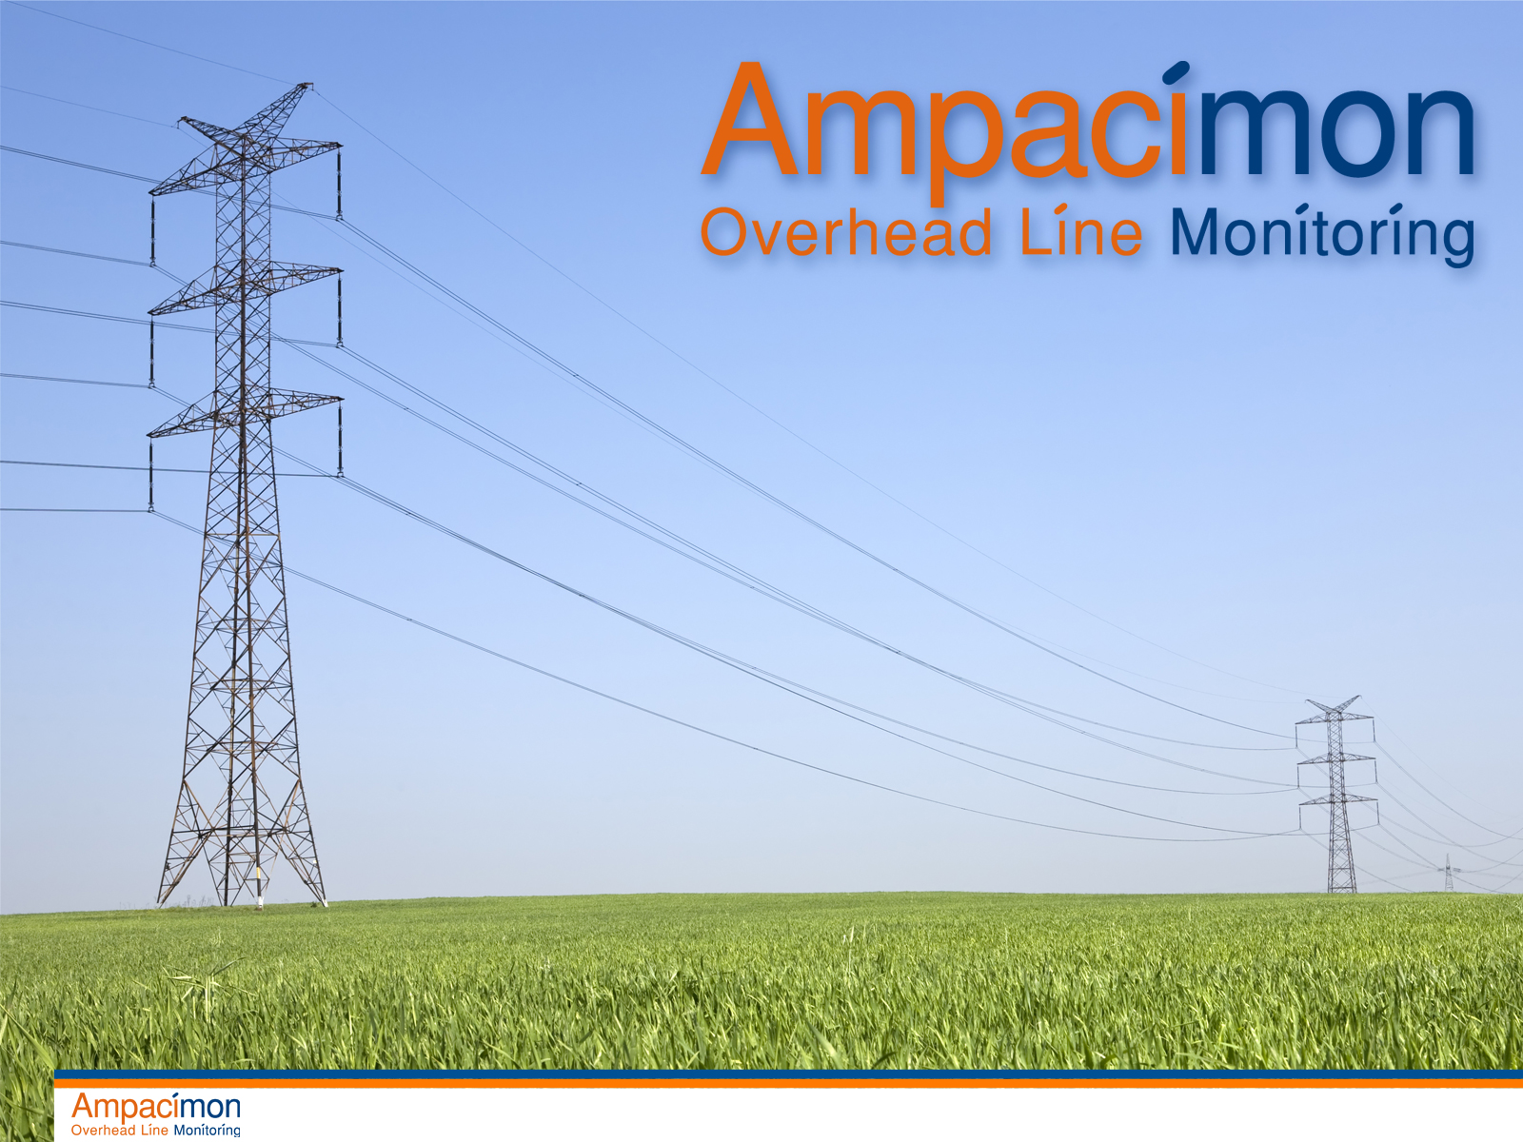
TWENTIES : EU project Massive integration of renewable T&D Smartgrids How cable dynamics may help ?
ISCD 2011- Shanghai- October 18th, 2011
Jean-Louis Lilien

Slide 2
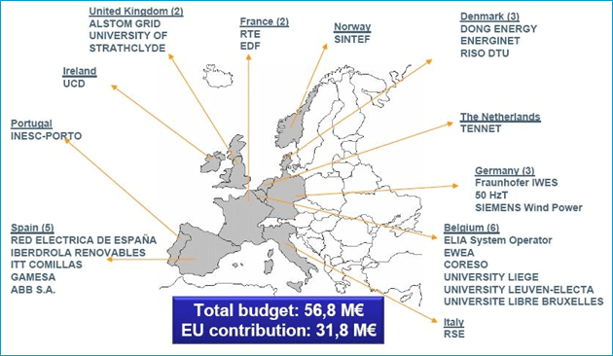
Real-life examples: Twenties
TWENTIES EU project
Largest EU funded project in electricity sector ever
Focused on the technologies that will allow the large scale integration of renewable energy sources
Real-life demonstrations
www.twenties-project.eu

Slide 3

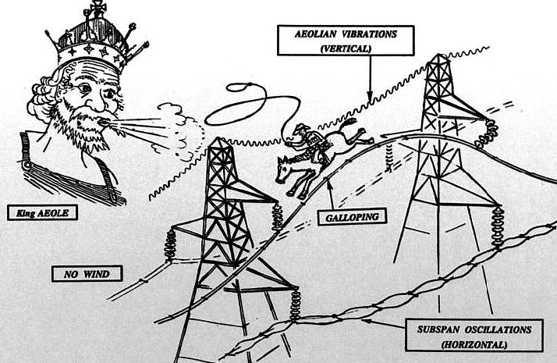
Power lines basic principles (1)
Power lines similar to violoncello
=
The wind is the bow

Slide 4
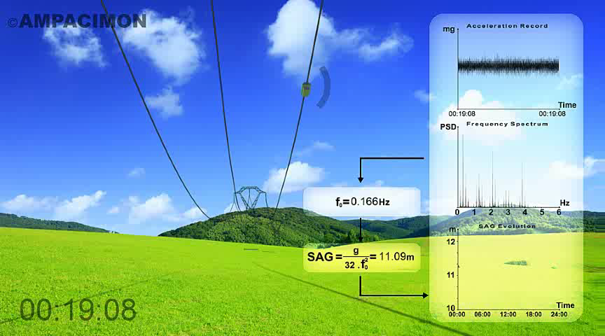
Power lines basic principles (2) power line similar to pendulum
=
M
The mass does not influence the frequencies, only sag does

Slide 5
Power lines and sag limit
Clearance required
sag

Slide 6

Key Information
Power transfer on a line is constrained by considerations of stability, voltage but most generally by thermal/clearance limitations.
The current rating is determined by the sag or annealing properties of the conductor.
For public safety, clearance above ground or obstacles must always be met.

Slide 7
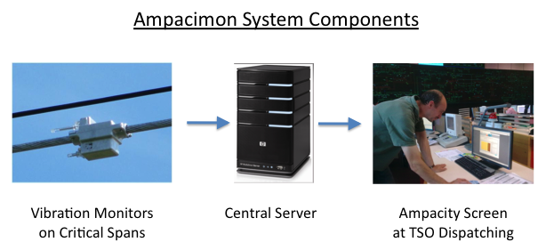
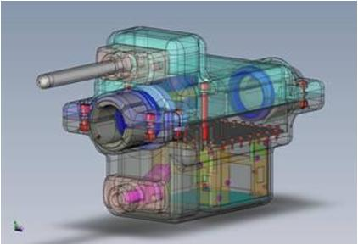
Smart sensor for RTM System Components
7

Slide 8
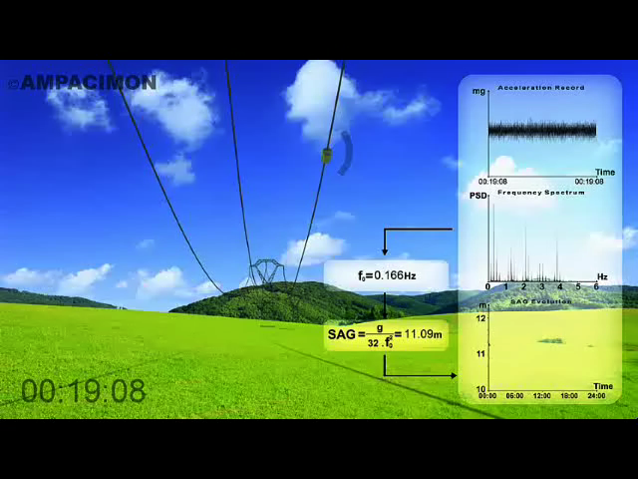
Live !

Slide 9
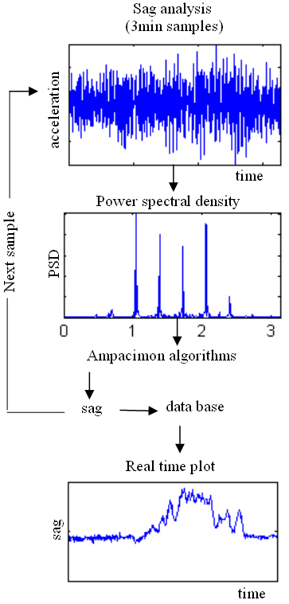
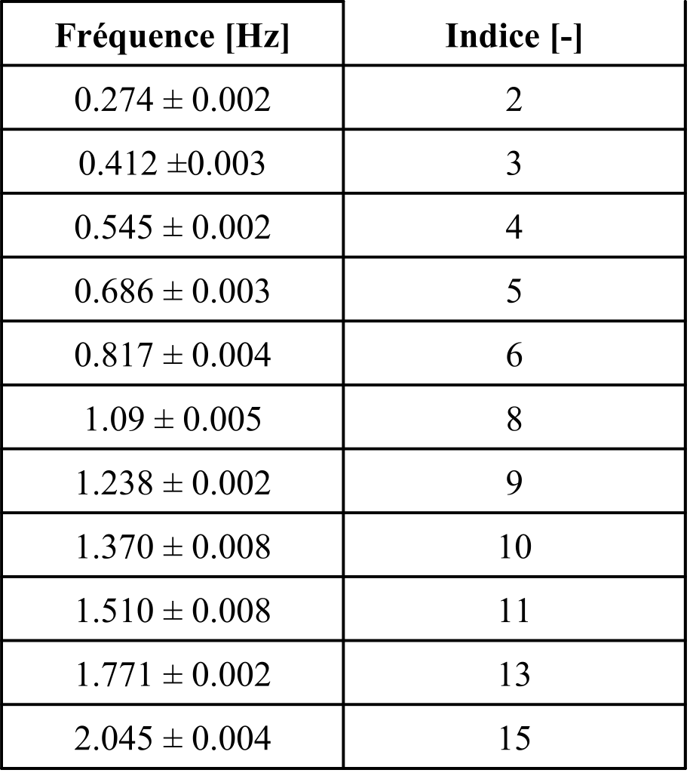
Vibration Analysis → Sag !
No conductor data
No topological data
No sagging data
No weather data
= No Calibration !
Fundamental Frequency [Hz] | Sag [m]
0.1367 ± 4 10⁻⁴ | 16.40 ± 0.1
f
=
k
T
k
2
L
m
s
=
g
=
m
g
L
2
32
f
1
2
s
8
T
9

Slide 10
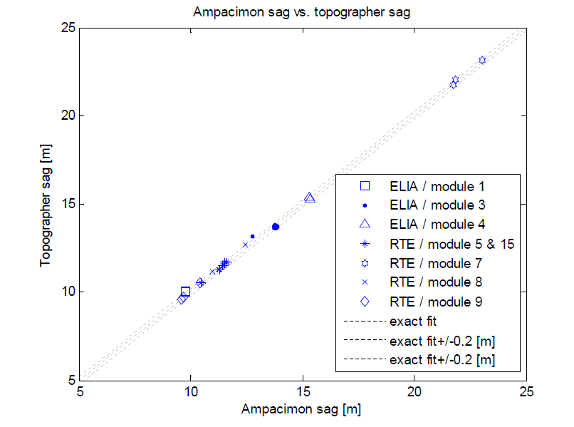
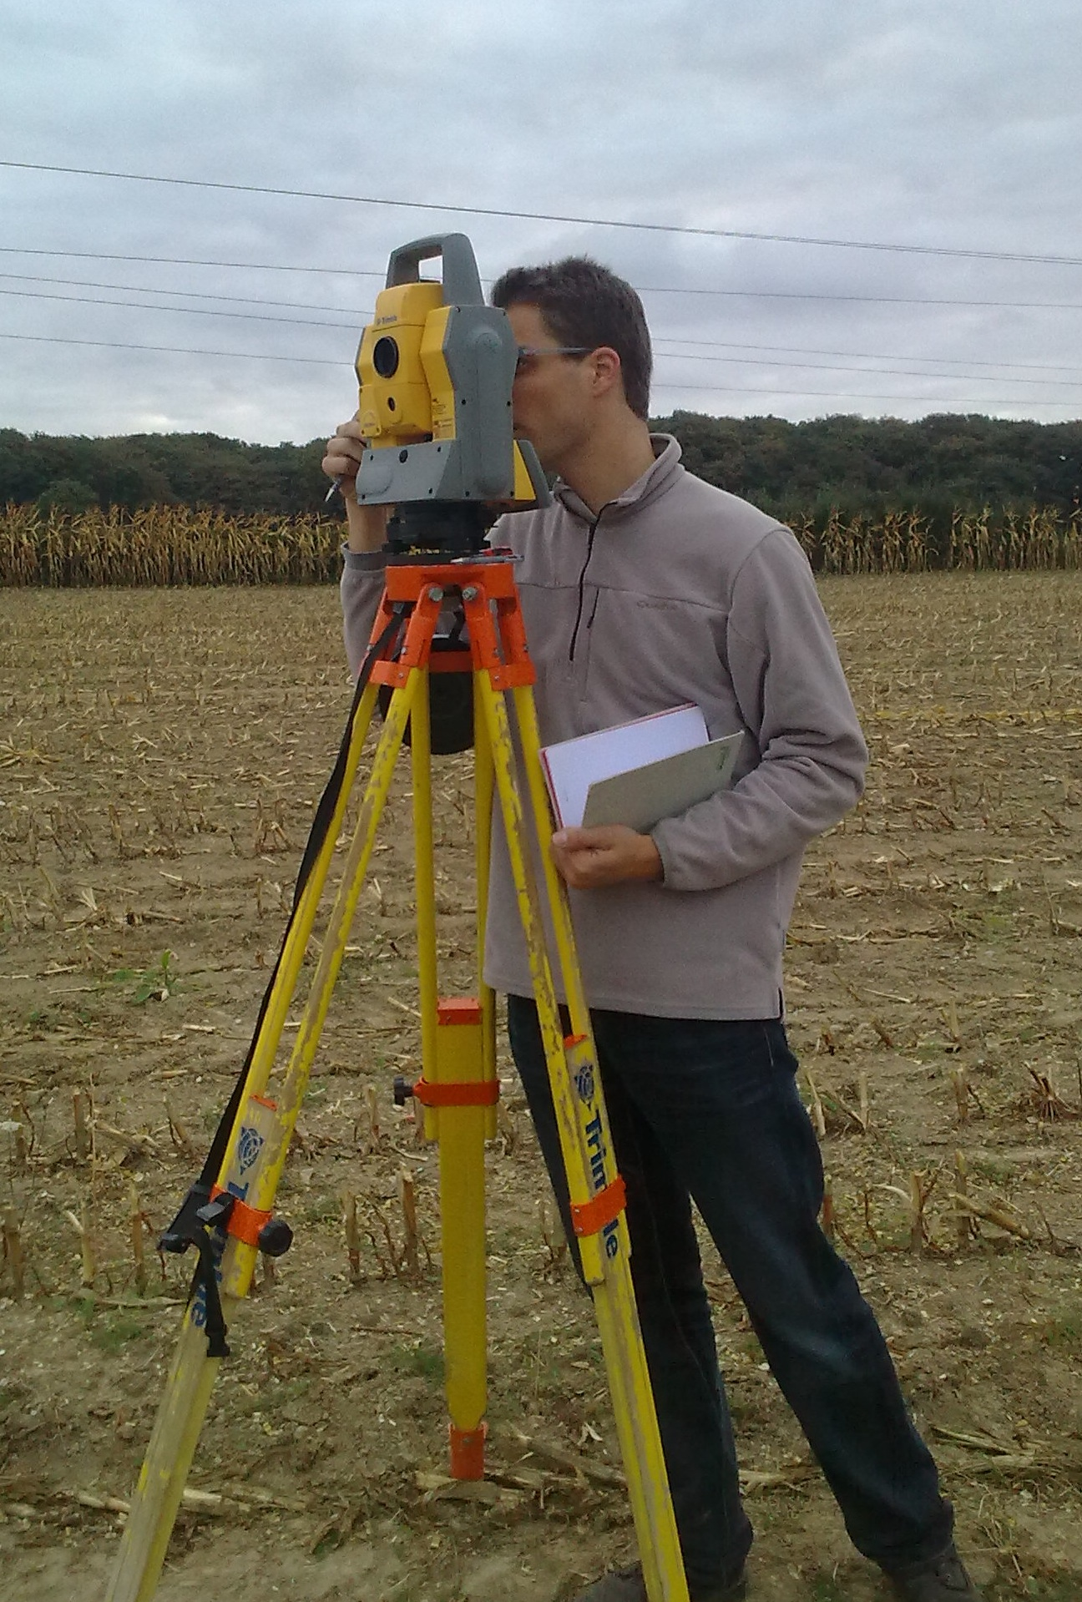
Sag Validation by Topography
10

Slide 11
Sag Evolution over one Month
11

Slide 13
Ampacimon RT Ampacity
Ampacimon determines RT Ampacity using the IEEE thermal model with adjusted effective ambient parameters (wind speed), making full profit of the intrinsic accuracy of the Ampacimon vibration monitors to measure the Sag.
The sag - conductor temperature equation (State Change Equation)is set by recent measured values instead of installation values that may have become inaccurate.
Ampacimon integrates the Ruling Span concept while measuring locally on potentially critical spans for optimum accuracy.
Ampacimon RT Ampacity is dynamic, assisting the dispatching operator safely and efficiently in Congestion Management & DLR.
Commissioning is fast: < 4 weeks with no calibration needs towards transit intensity.
13

Slide 14
Season Histogram Actual Current & Ampacity
14

Slide 15
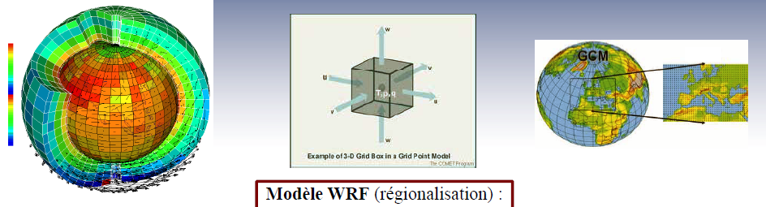
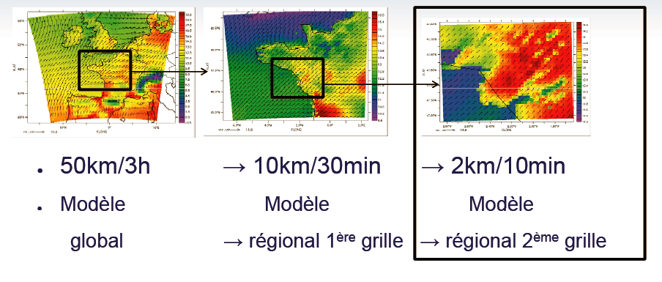
48 hours météo forecasting, from worldwide available data to local data simulation

Slide 16

Advantages of smart sensors
DIRECT Monitoring of Critical spans using Vibration Monitors to measure the Sag
Intrinsic Accurate Sag measurement:
NO calibration, NO parameters
SAFETY garanty
REAL Ampacity determination, with short term prediction
FAST installation on LIVE Lines – no line modification, no maintenance
16

Slide 17
Advantages of the smart sensor
Autonomous Electrical power from line by magnetic induction
Secure data communication over GPRS / internet to TSO dispatching (TASE2 / Modbus / IEC61850 / DNP3)
Easy scada integration
17

Slide 18
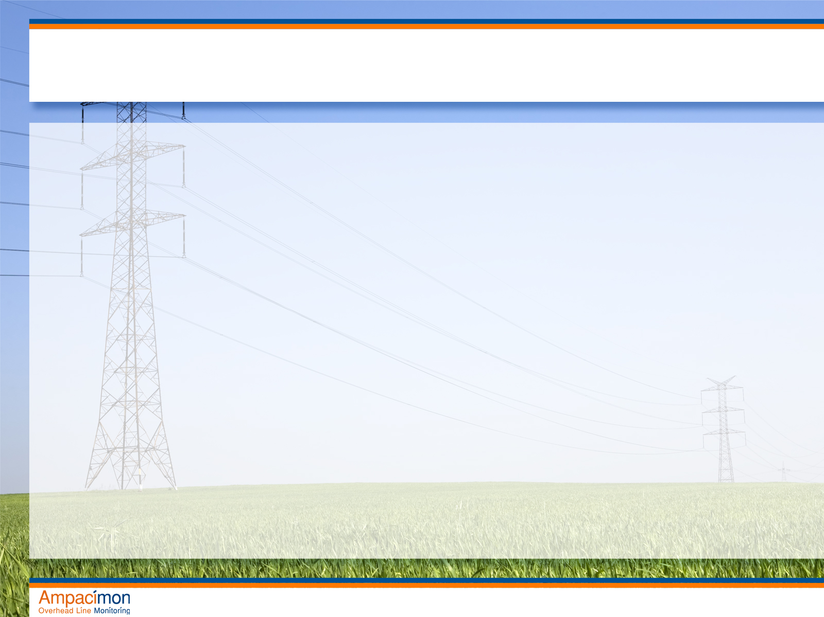
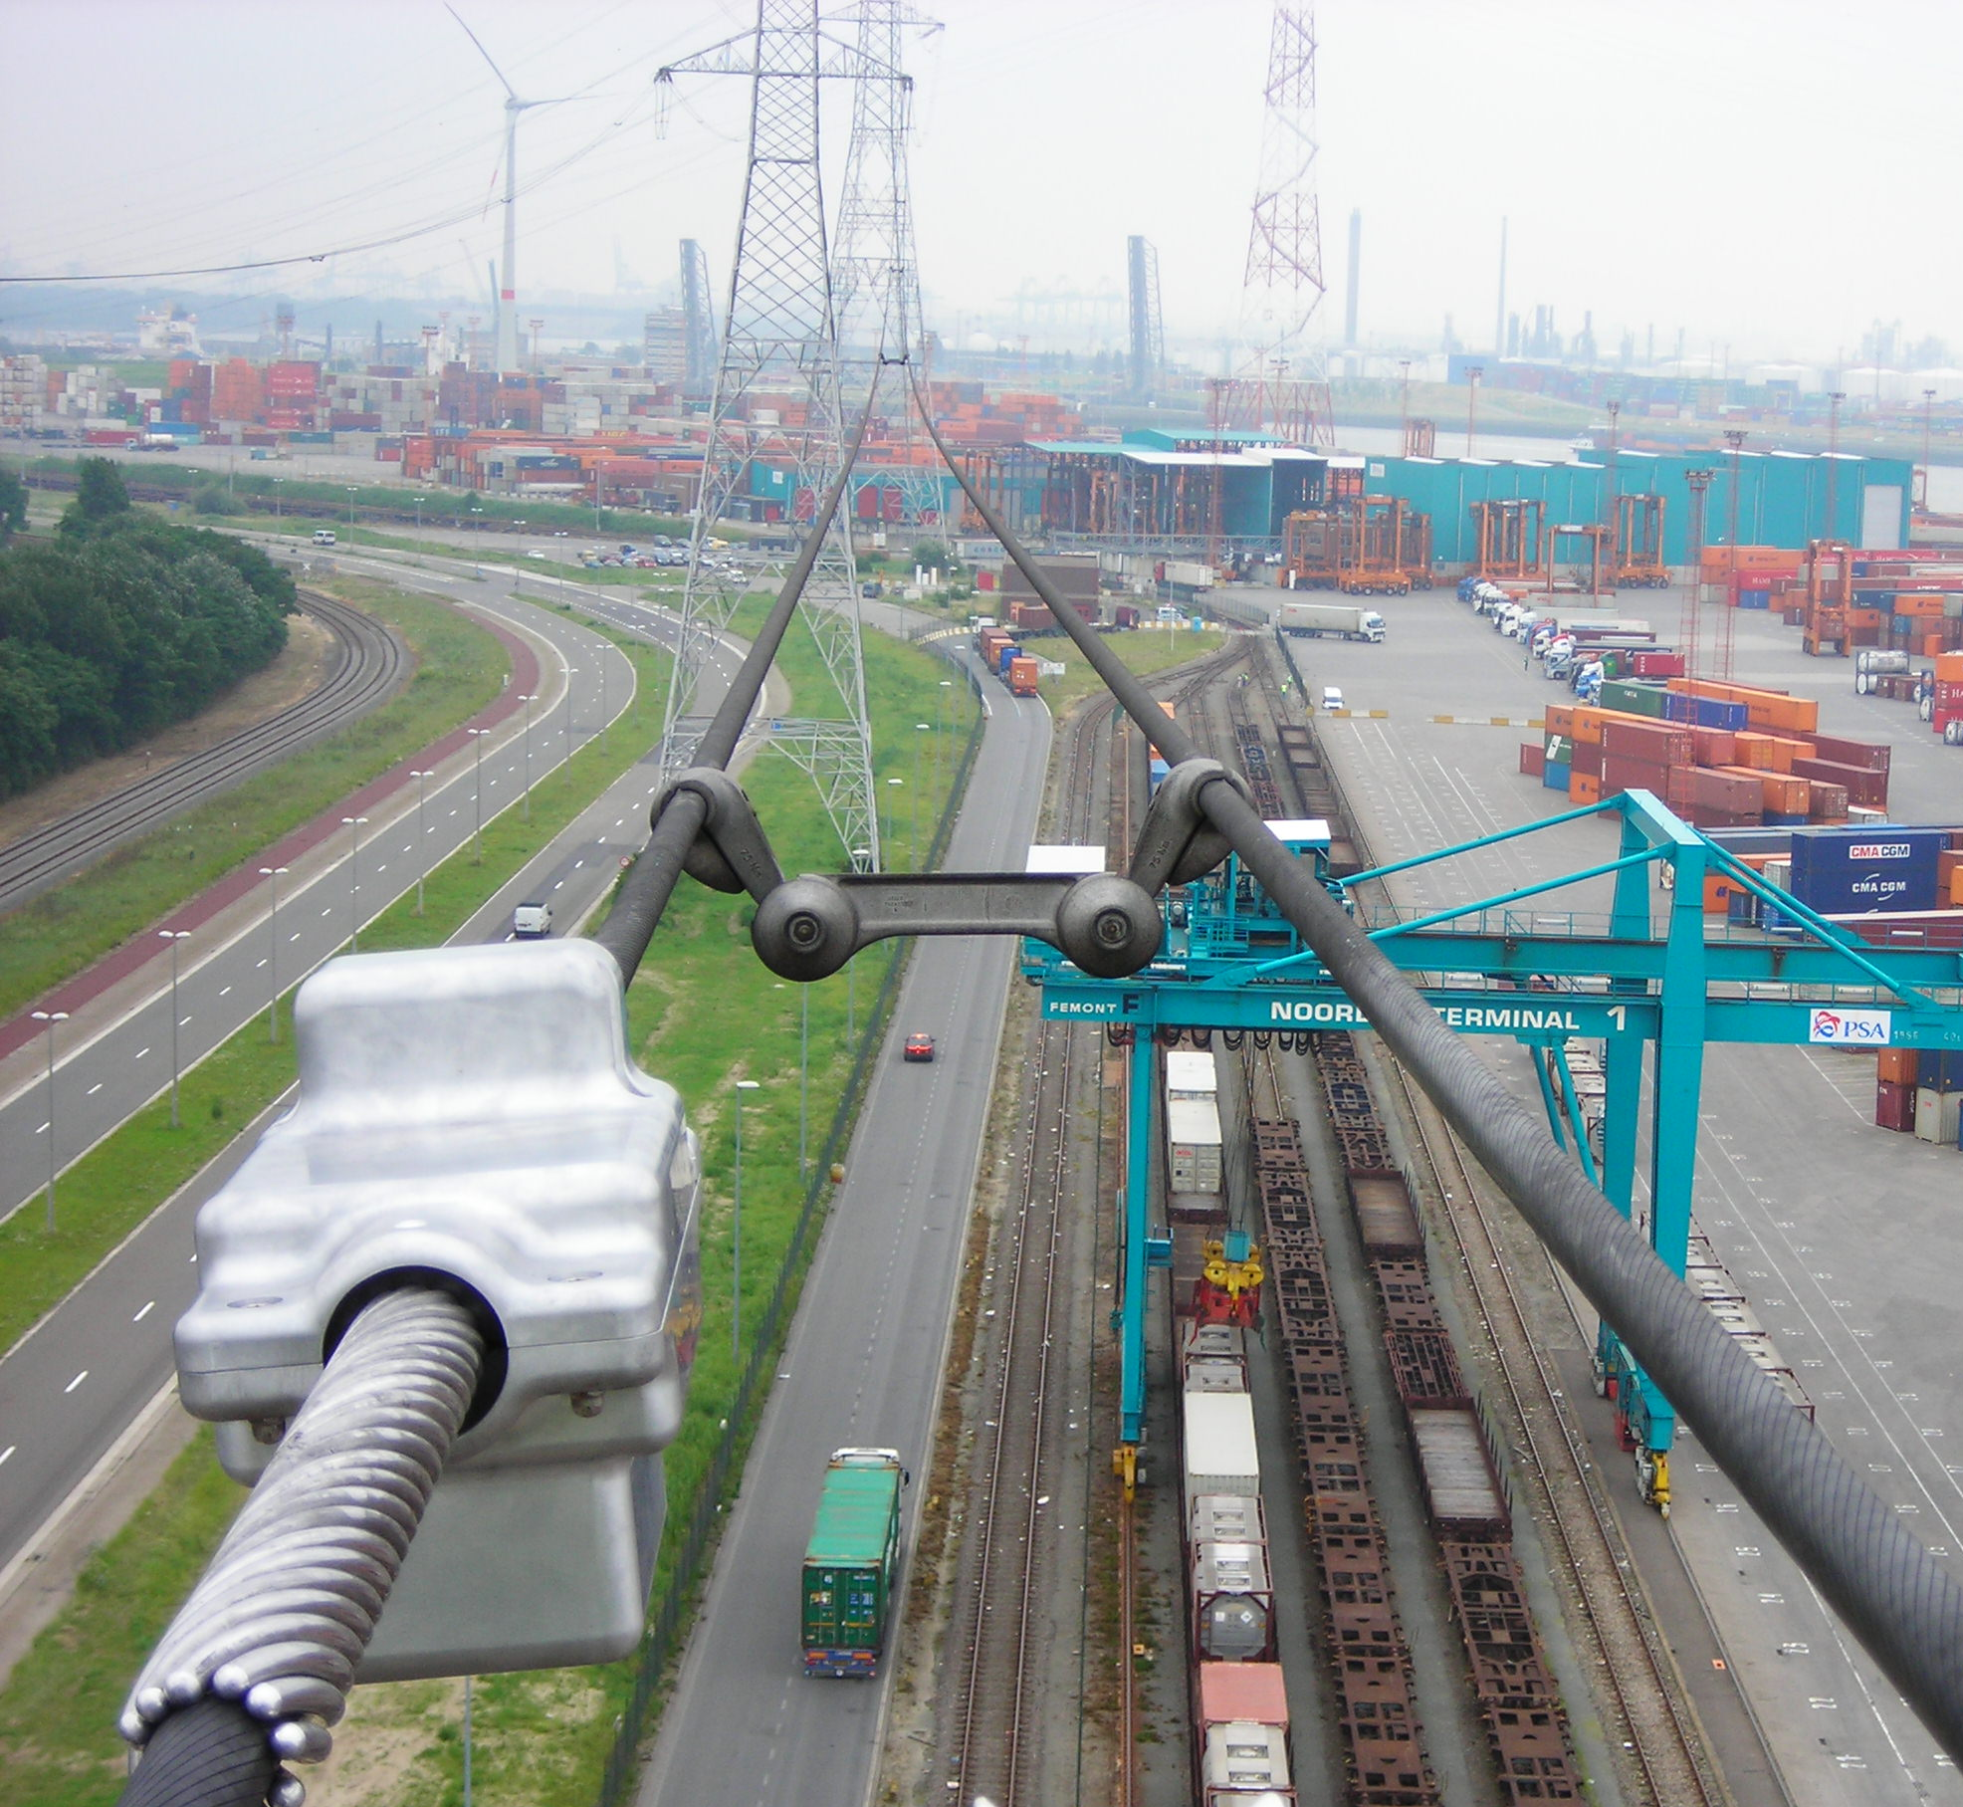
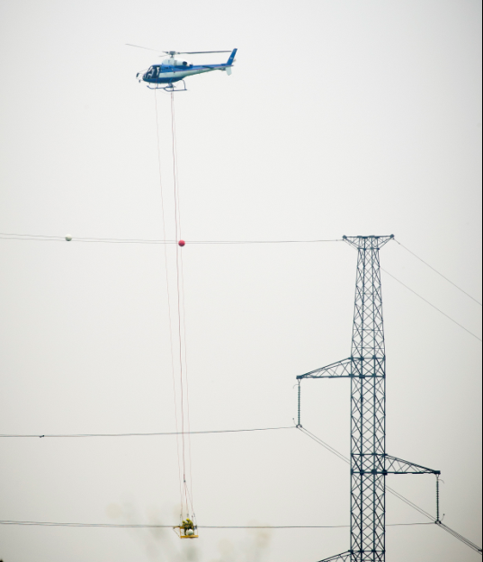
Experience at ELIA (BE) 400 kV

Slide 19
Conclusions
Cable dynamics can be used for integration of renewable into the power network which helps to do :
Dynamic online managment of your Transportation networks
Improvement of the profitability of your investments
Facilitate the introduction of renewable producers
Reliable input for forecasting tools
19

