Slide 1

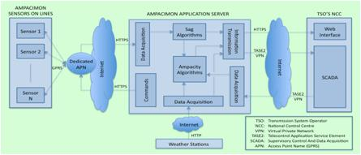
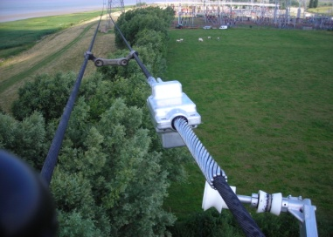
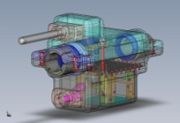
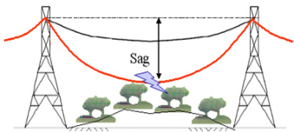
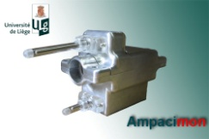
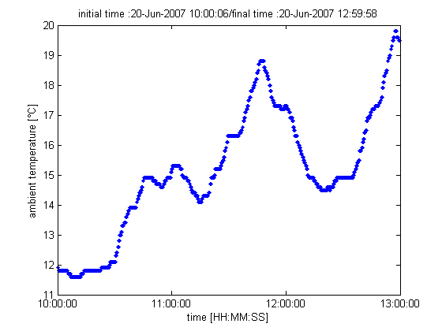
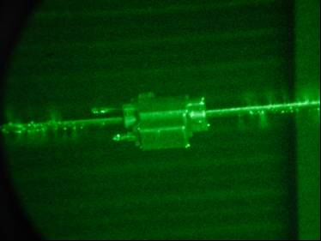
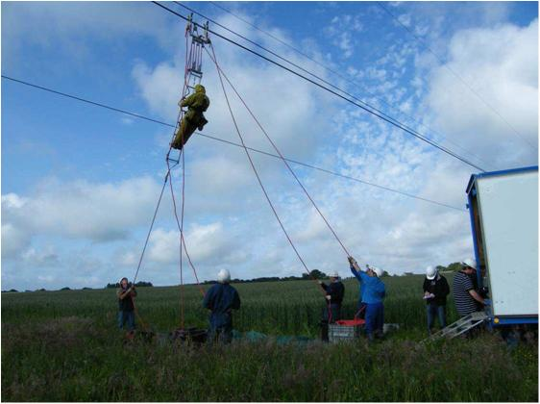
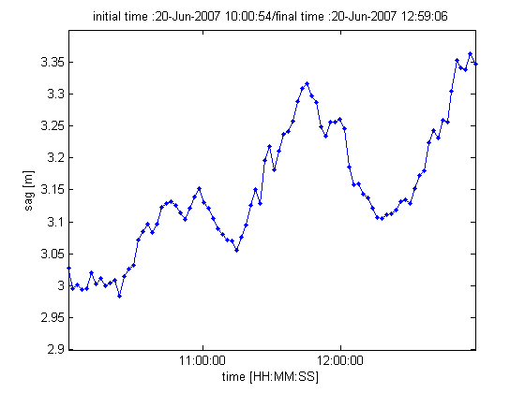
How to use existing power lines to evacuate twice as much wind power ?
Huu-Minh Nguyen (University of Liège) , Jean-Jacques LAMBIN (ELIA) and Jean-Louis Lilien (Ampacimon SA)
Introduction: Ampacimon for live Ampacity Monitoring
The ampacity of a conductor is that current which will meet the design, security and safety criteria line on which the conductor is used. Actual ambient conditions are less constraining 98% of the time than those envisaged in the standards.
In order to reach the European mains 20 20 20, it has become necessary for each country to promote the installation of renewable production units. For some countries wind energy is now the main means to produce important quantities of renewable energy. Wind farm are growing but with the existing infrastructure and the exploitation norms currently valid, several of those plants could not be connected to the grid. Reinforcements, mainly of the High Voltage overhead lines, would be necessary to be able to accept those new injections. But reinforcement of an overhead line is a very long procedure with multiple issues like administrative obligations, local opposition to any action on the lines.
In operational exploitation, for security reasons TSO’s can’t allow that the flows (current) in the lines exceed the static rating. This rating depending of the thermal load in the line based on potential peak power evacuation during unfavorable weather conditions. This static rating is a conservative value that often leads to higher security margins than needed. Indeed, wind blowing over the overhead lines is assumed to increase significantly these lines capacity and there is also a correlation between wind blowing in wind farms and the wind blowing over the overhead lines.
To obtain a more efficient use of transmission lines, by reducing the existing margins while keeping a safe
exploitation of the grid, it is necessary to know in real time the exact capacity of the involved lines.
Ampacimon assets:
Energetically autonomous
Real time device based on vibration analysis
- Can be installed everywhere along the span
No need of calibration in relation with
the line to get the sag
No need of environmental data to get the sag
Easy installation in roughly 15 minutes
Provides sag values and ampacity
Measurement/Processing/Communication system
Ampacimon product:
The Ampacimon product is a complete system for real time monitoring of high voltage lines.
All aspects are considered:
Electronics and mechanics of the autonomous
units placed on high voltage lines
Embedded software
- Software on the ground
Communication
Integration with dispatching
Communication:
The GSM module operates the GPRS standard and can be used in a private
network (closed user group).
Power supply circuitry validated up to 63kA @ 50Hz
Installation cases
Data processing
Ampacimon unit (380 kV, Doel-Zandvliet, BE) ; ELIA, running system from July 2008.
CAD view and actual view of an Ampacimon unit, 2010.
Temperature at no load
Ampacimon during heavy rain corona test at “Les Renardières” (France).
Ampacimon live line installation (220 kV) RTE network. Running system form June 2009.
Sag at no load
Contact: info@ampacimon.com

