Slide 1




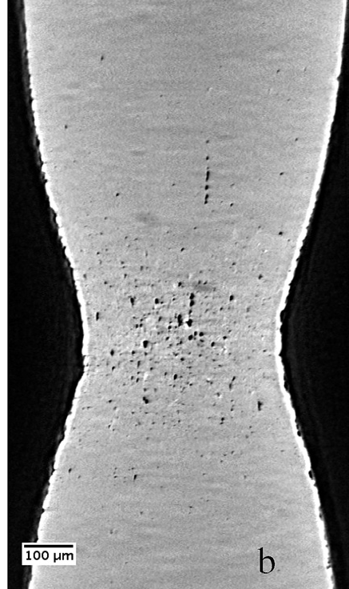
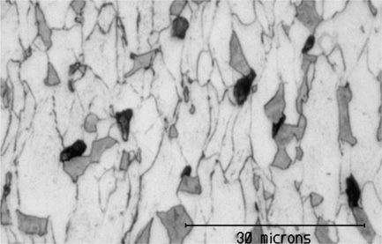
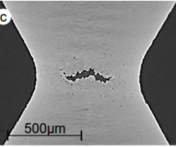


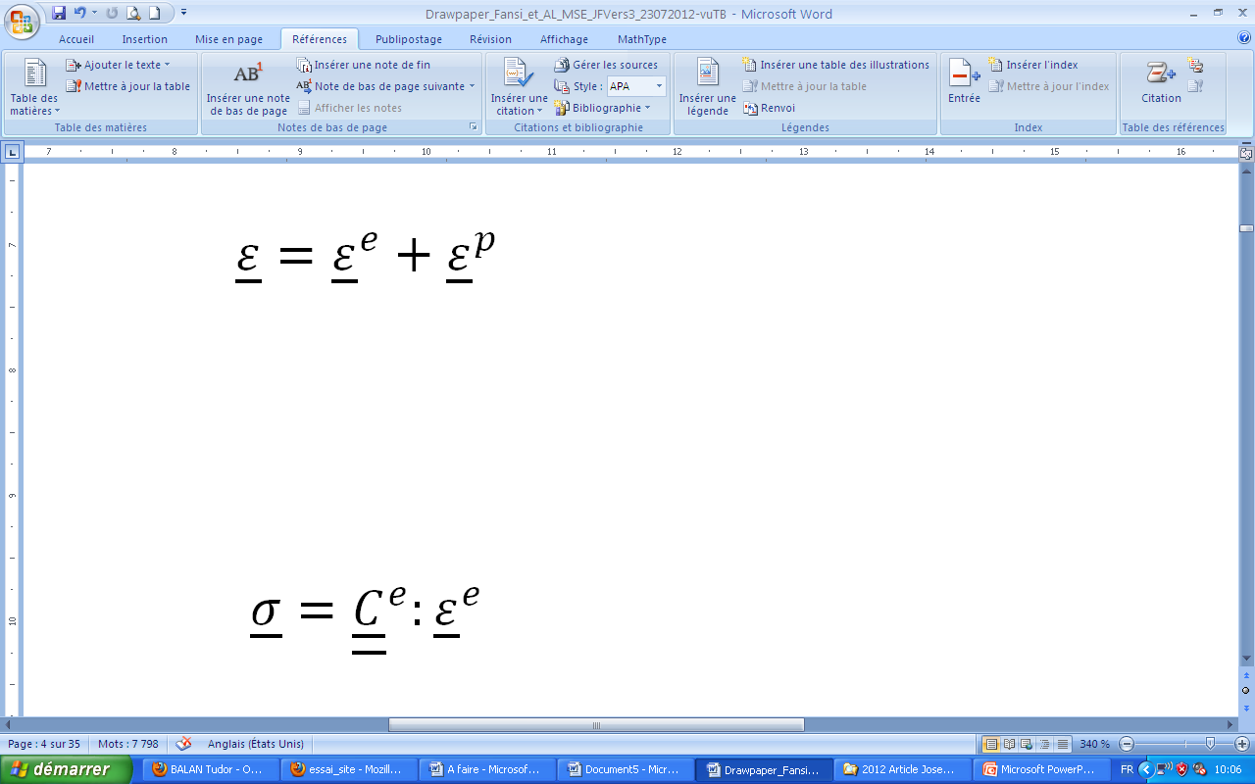
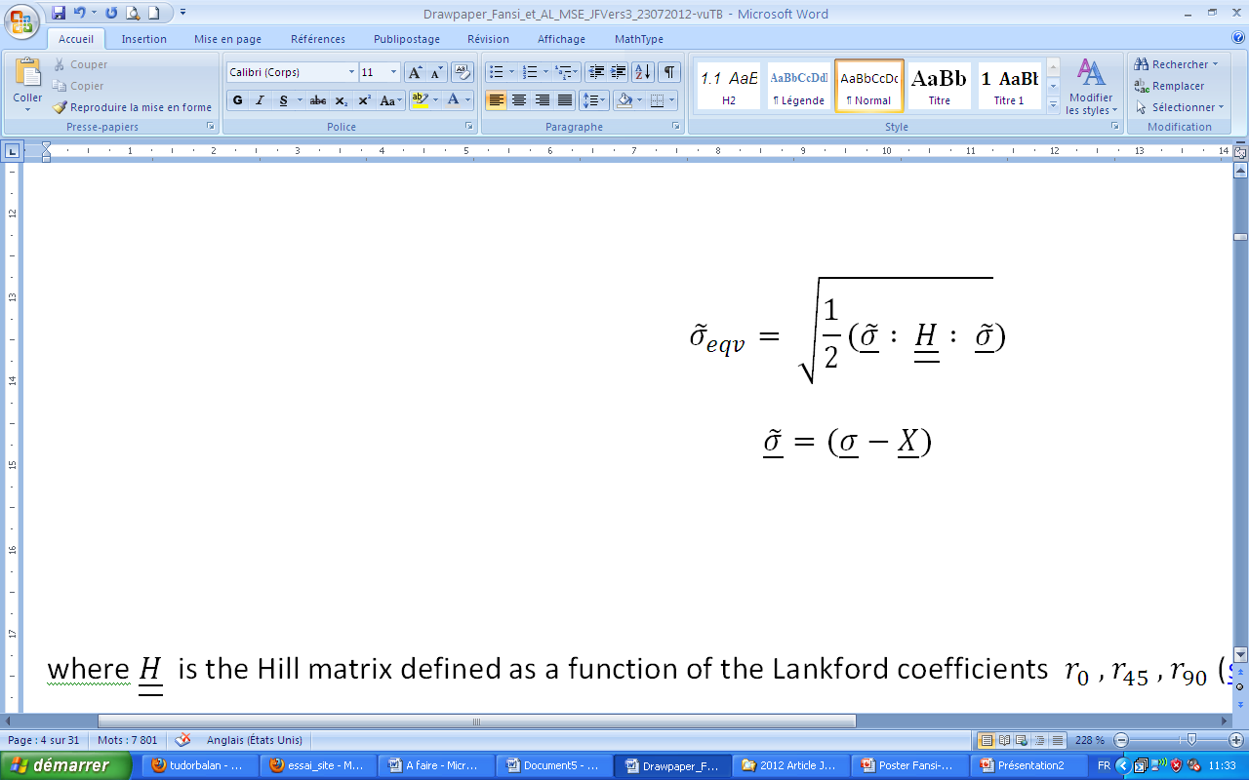
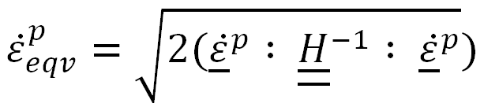
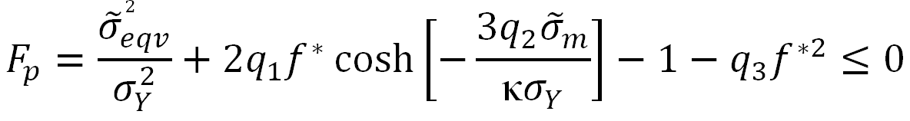
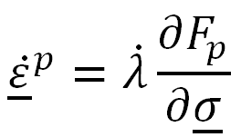
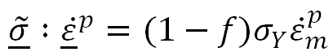
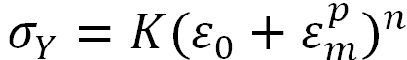
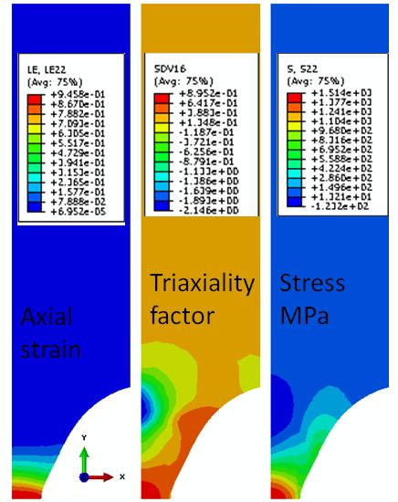
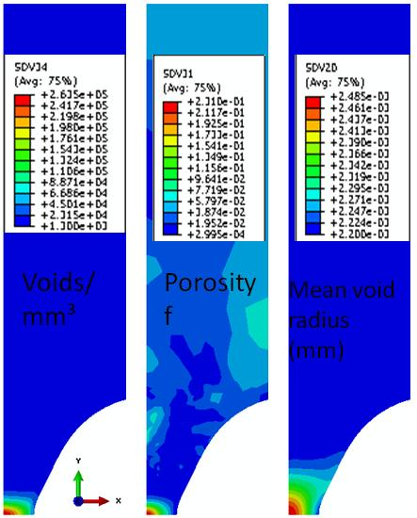
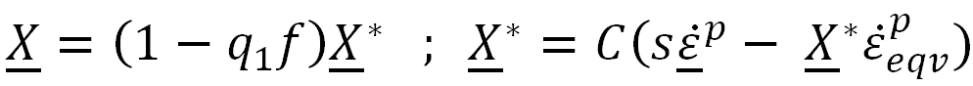
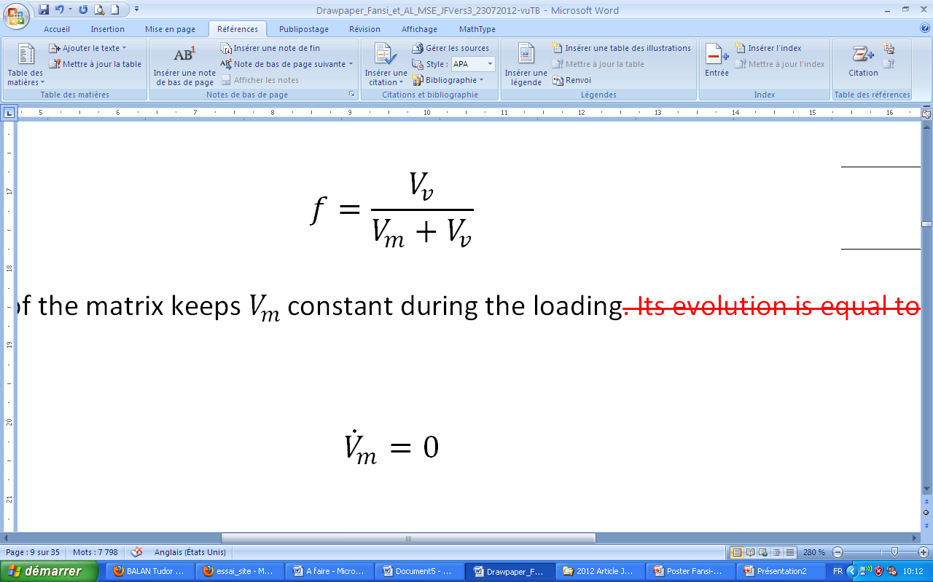
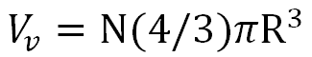
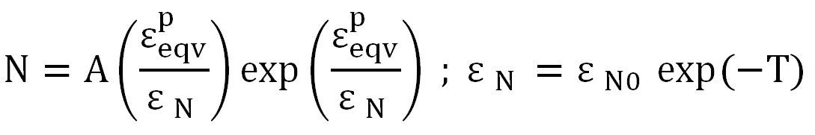
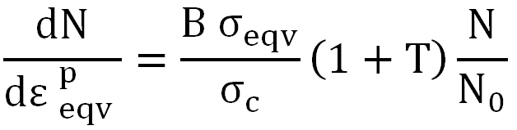
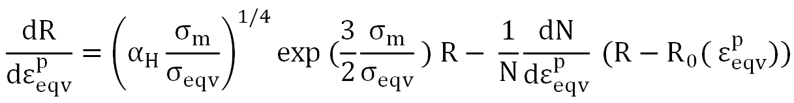
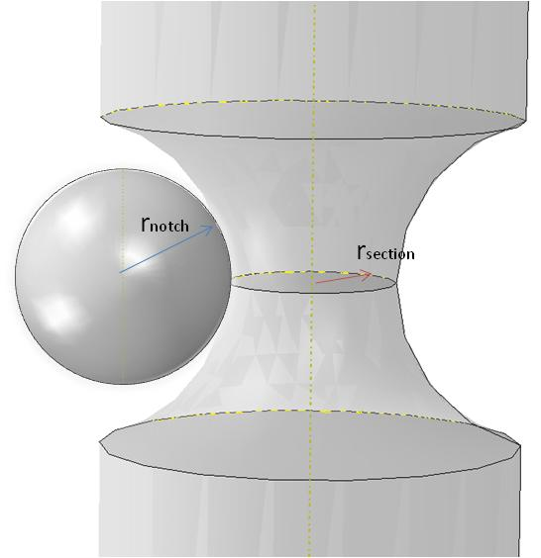
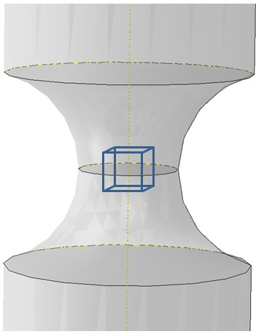
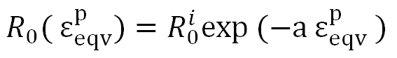
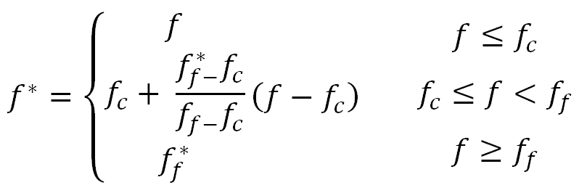
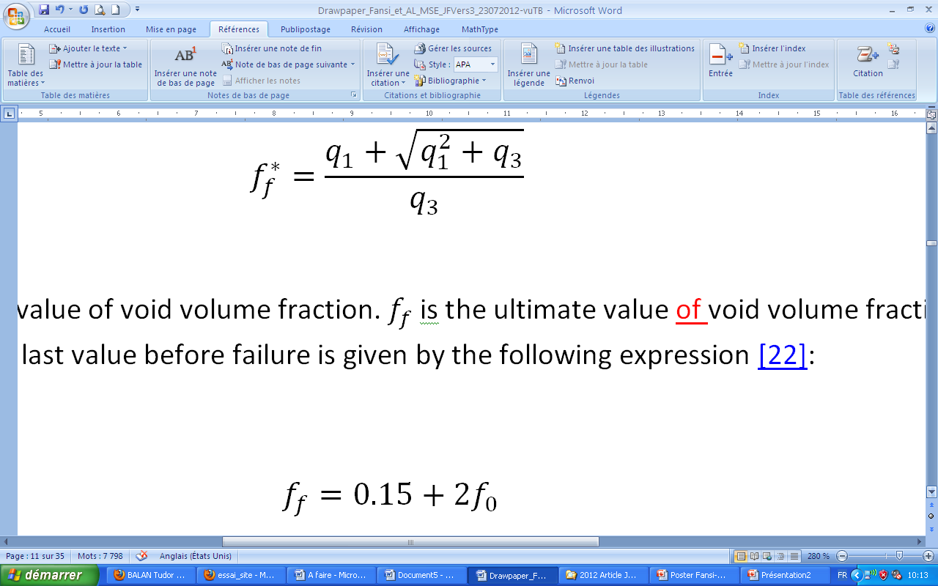
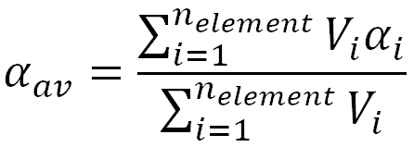
Numerical simulation of DP steel damage
using a physically-based GTN model
Joseph Fansi^{a,b,c}, Anne-Marie Habrakenª, Tudor Balan^{b}, Xavier Lemoine^{b,c}
ª Departement ArGEnCo, Division MS²F, University of Liège, Belgium
^{b} LEM3, Arts et Métiers ParisTech, Metz, France
^{c} ArcelorMittal R&D Global Maizières S.A., Maizières-Lès-Metz, France
jfansi@doct.ulg.ac.be; Anne.Habraken@ulg.ac.be; tudor.balan@ensam.eu; xavier.lemoine@arcelormittal.com
German-French Summer School, September 3-7, 2012, Dortmund, Germany
Hardening and Damage of Materials under Finite Deformations: Constitutive Modeling and Numerical Implementation
Motivations and objectives
Material parameters and identification
Results and discussion
Damage (voids) is experimentally observed
In DP steels, damage seem related to the presence of a hard phase
[Maire et al., 2008, Acta Mat]
Experiments used for the material parameter identification:
  tensile tests along RD, TD, DD
  monotonic and reverse shear tests
  X-ray tomography measurements on in-situ tensile test
Macroscopic quantities fit the experimental ones, within an error range.
Porosity f and its components (N, R) can be compared to experiments, before coalescence starts
identification of
damage-related
parameters
ferrite
martensite
[Landron et al., 2010, Scripta Mat]
void
Elasticity |  | Isotropic Hardening |  |  | Kinematic Hardening |  | Anisotropy
E (MPa) | ν | K (MPa) | n | ε₀ | C | s (MPa) | r₀, r_{45,} r₉₀
2×10⁵ | 0.35 | 1 | 0.245 | 0.02 | 92.04 | 58.02 | 1
X-Ray tomography recently allowed for more physical analyses:
  Physically-based scalar models of nucleation and growth
  Experimental porosity measurement for damage model validation
GTN damage parameters |  |  |  |  | Nucleation law #1
f₀ | f_{c} | q₁(t=0) | q₂(t=0) | q₃ | ε_{n0} | A (mm⁻³) | R₀^{i} (mm) | a | α_{H}
2×10⁻⁵ | 0.001 | 1.5 | 1 | 2.25 | 0.8 | 5000 | 0.0021 | 0.25 | 0.55
Objectives of this work :
implement an advanced GTN model in Abaqus/Explicit, based on the previous work of Ben Bettaieb et al. [2010, 2012]
enrich this model with physically-based nucleation / growth models
validate the model with X-Ray tomography data
apply the model to sheet forming problems
Nucleation law #2
B (mm⁻³) | σ_{c} (MPa) | N₀ (mm⁻³)
4500 | 1100 | 1300
Constitutive model
Experiments selected for the validation
  X-ray tomography measurements on in-situ notched tensile test
Elasto-plasticity, Hill’48 anisotropy:
[Landron, 2012]
GTN, normality rule:
experimental set-up
sample
proposed 2D mesh
Combined isotropic-kinematic hardening:
  Simulation results (example):
.
Conclusions and future work
Physically-based void nucleation and growth:
FE implementation of a complete, up-to-date GTN-type damage model with anisotropy and isotropic-kinematic hardening
Incorporation of recent models of nucleation and growth
Confrontation to X-Ray tomography experimental results
Mesh and post-treatment consistent with experiments
Future work:
  Validation in other conditions (triaxiality, strain-path change)
  Application to simple sheet forming processes
plastic incompressibility of metal matrix
number of voids in reference volume
average void radius
Physically-inspired evolution of the numerical void density N :
Law #1, [Bouaziz et al., 2008]
  Experimentally measured quantities available (time evolutions):
  tensile load
  radius of minimum cross-section (r_{section})
  radius of the notch (r_{notch})
  number of voids in a reference volume at the centre of the specimen
  average radius of the voids in the reference volume
References
Law #2, [Landron, 2011]
M Ben Bettaieb, X Lemoine, O Bouaziz, A-M Habraken, L Duchêne (2010) Mech of Materials 139-156
M Ben Bettaieb, X Lemoine, L Duchêne, A-M Habraken (2012) Int J Num Meth Engng 85, 1049-1072
O Bouaziz, E Maire, M Giton, J Lamarre, Y Salingue, M Dimechiele (2008) Rev Métallurgie 2, 102-107
C Landron, O Bouaziz, E Maire, J Adrien (2010) Scripta Mat 63, 973-6
C Landron (2011) Ductile damage characterization in Dual-Phase steels using X-ray tomography, PhD thesis, INSA-Lyon
E Maire, O Bouaziz, M Dimechiele, C Verdu (2008) Acta Mat 56, 4954-64
Physically-inspired evolution of R [Bouaziz et al., 2008]:
Phenomenological coalescence modeling (optional):
Acknowledgements
This work is supported financially by ArcelorMittal, via the Agence Nationale de la Recherche et de la technologie (F)
AMH thanks the Interuniversity Attraction Poles Program - Belgian State – Belgian Science Policy P7 INTEMATE and the FRS-FNRS for financial support
The authors thank Eric Maire and Caroline Landron from INSA Lyon (F) and Olivier Bouaziz from ArcelorMittal (F) for fruitful discussion, experimental data, damage models.
  Post-treatment of numerical results for confrontation to experiments:
  average values over a pre-defined fixed volume
  average values over the central cross-section

