Slide 1


Dynamic modeling and control strategies for Organic Rankine Cycle systems
Sylvain Quoilin, Vincent Lemort
Thermodynamics Laboratory, University of Liège
September 13th 2012
International Symposium on Advanced Waste Heat Valorisation Technologies, Kortrijk,

Slide 2
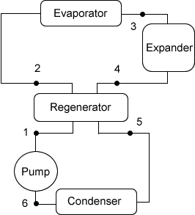
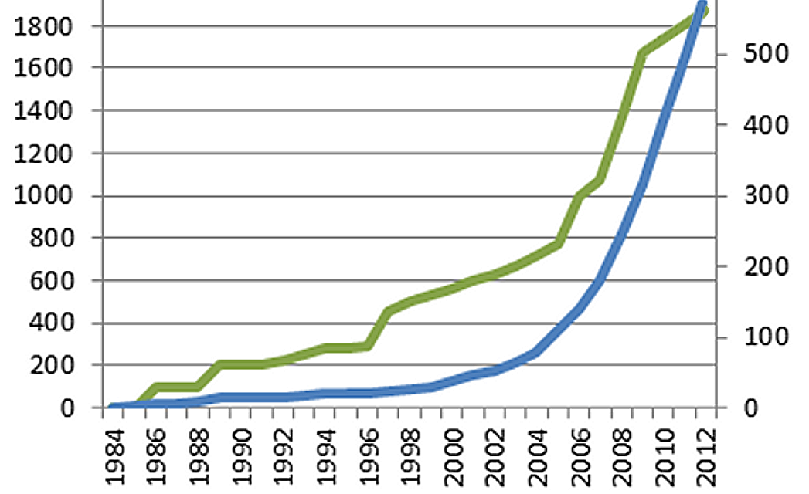
Introduction
Waste heat recovery or renewable energies: solar, biomass, geothermal
Electricity/mechanical power
Heat

Slide 3
Content of the presentation
Introduction
Optimization of WHR ORC cycles
Dynamic modeling
Controlling ORC cycles under transient heat source
Predictive controllers
Conclusions

Slide 4
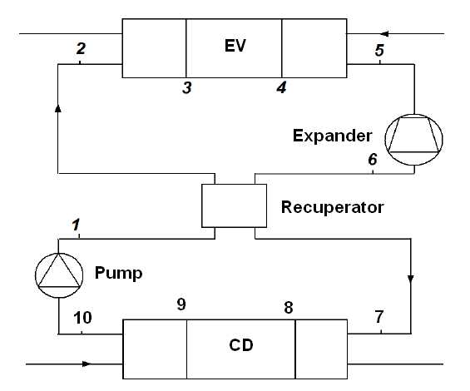
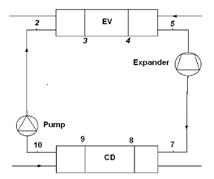
Cycle optimization
Optimum design/operating conditions for WHR:
Recuperator
Condensing pressure:
Superheating at the evaporator exhaust :
Subcooling at the condenser exhaust:
Pressure drops:
Evaporating temperature:
Not necessary in WHR (if no lower limit on T)
Recuperator?
Output power:
no change
Efficiency:
+ 12%

Slide 5
Cycle optimization
Optimum design/operating conditions for WHR:
Recuperator
Condensing pressure:
Superheating at the evaporator exhaust :
Subcooling at the condenser exhaust:
Pressure drops:
Evaporating temperature:
Not necessary in WHR (if no lower limit on T)
As low as possible
Condensing pressure:
As low as possible, but tradeoff between
cycle efficiency and auxiliary consumption:
  Fan consumption if direct air heat exchanger
  Circulating pump consumption

Slide 6
Cycle optimization
Optimum design/operating conditions for WHR:
Recuperator
Condensing pressure:
Superheating at the evaporator exhaust :
Subcooling at the condenser exhaust:
Pressure drops:
Evaporating temperature:
Not necessary in WHR (if no lower limit on T)
As low as possible
Superheating?
(from 5 to 25K)
Output power
Efficiency

Slide 7
Cycle optimization
Optimum design/operating conditions for WHR:
Recuperator
Condensing pressure:
Superheating at the evaporator exhaust :
Subcooling at the condenser exhaust:
Pressure drops:
Evaporating temperature:
Not necessary in WHR (if no lower limit on T)
As low as possible
As low as possible
Subcooling?
(from 5 to 20K)
Output power
Efficiency

Slide 8
Cycle optimization
Optimum design/operating conditions for WHR:
Recuperator
Condensing pressure:
Superheating at the evaporator exhaust :
Subcooling at the condenser exhaust:
Pressure drops:
Evaporating temperature:
Not necessary in WHR (if no lower limit on T)
As low as possible
As low as possible
As low as possible
Pressure drops
(500 mbar)
Output power
Efficiency

Slide 9
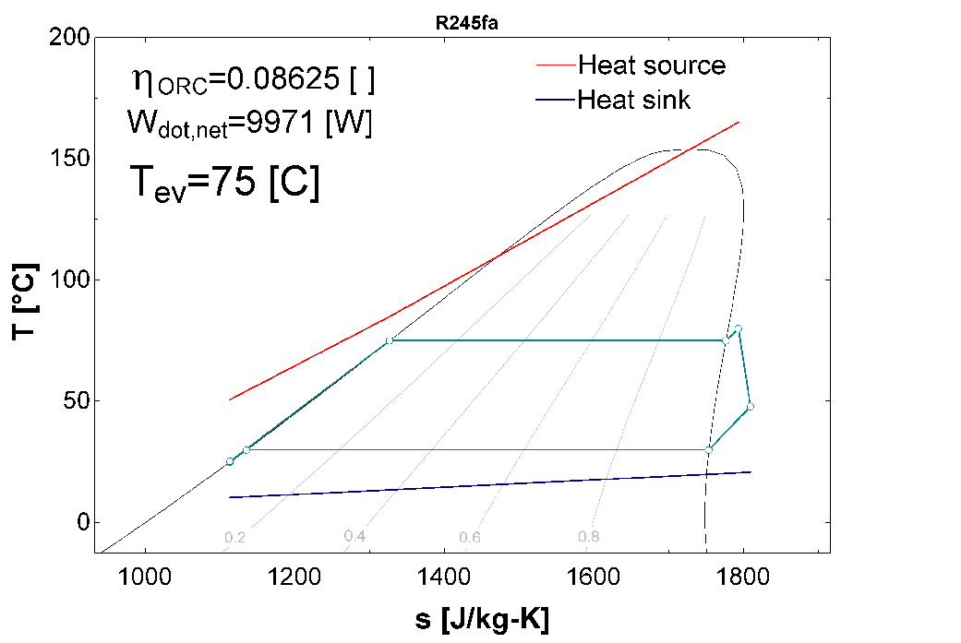
Cycle optimization
Optimum design/operating conditions for WHR:
Recuperator
Condensing pressure:
Superheating at the evaporator exhaust :
Subcooling at the condenser exhaust:
Pressure drops:
Evaporating temperature:
Not necessary in WHR (if no lower limit on T)
As low as possible
As low as possible
As low as possible
As low as possible
Main optimization parameter!

Slide 10
Subcooling
Subcooling after the condenser should be minimum but sufficient to avoid pump cavitation:

Slide 11
Subcooling
Subcooling after the condenser should be minimum but sufficient to avoid pump cavitation:

Slide 12
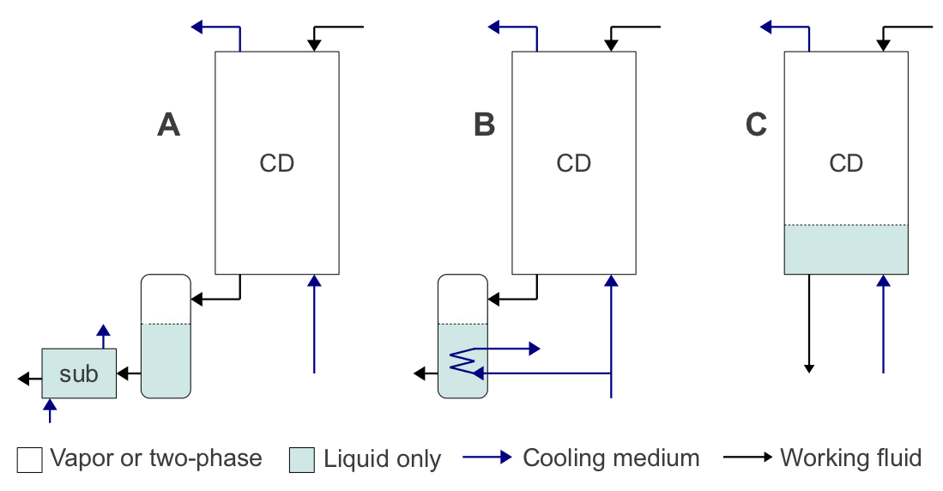
Subcooling
Subcooling after the condenser should be minimum but sufficient to avoid pump cavitation:

Slide 13
Subcooling
Subcooling after the condenser should be minimum but sufficient to avoid pump cavitation.
Addition of non-condensing gases:
Source: Orcan Energy, THERMODYNAMIC MACHINE AND METHOD FOR THE OPERATION THEREOF, German Patent, 2011

Slide 14




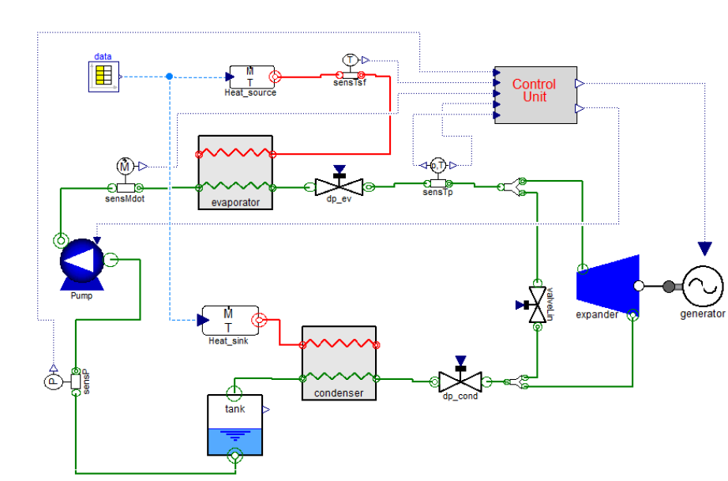
Degrees of freedom
Controlled variables:
Degrees of freedom:

Slide 15
Content of the presentation
Introduction
Optimization of WHR ORC cycles
Dynamic modeling
Controlling ORC cycles under transient heat source
Predictive controllers
Conclusions

Slide 16
Simulation platforms
Matlab/Simulink
  Causal modeling: well adapted to control
  Fluid properties: Refprop of Fluidprop through Matlab S-Functions
  Less flexible, uses ODE solvers²
Modelica
  Acausal modeling: well adapted to thermo-flow problems
  Fluid properties: ExternalMedia, TILMedia, Airconditioning
  9 to 13 times faster than Simulink for a heat pump system¹ ²
  Required DAE solvers
GT Power
  Fluid properties: Refprop
AmeSim
¹Hongtao QIAO, Vikrant AUTE, Reinhard RADERMACHER, Comparison of Equation-Based and Non-Equation-Based Approaches for Transient Modeling of a Vapor Compression Cycle, Purdue Conference, 2012
²F Casella, JG. Van Putten, P. Colonna, Dynamic simulation of a biomass-fired steam power plant: a comparison between causal and a-causal modelar modeling, IMECE 2007

Slide 17
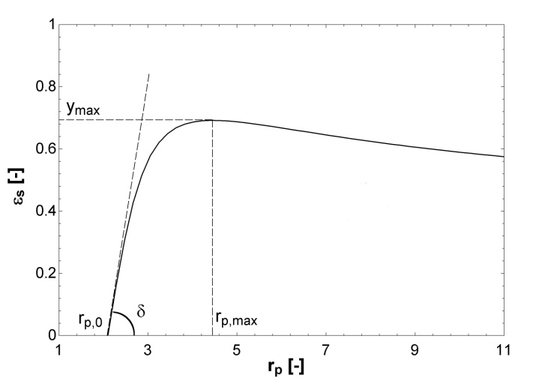

Expander and pump models
Dynamics of the heat exchangers larger than that of the expansion machine
  not necessary to use a detailed simulation model
  an empirical model is sufficient
Parameters identified based on experimental data

Slide 18
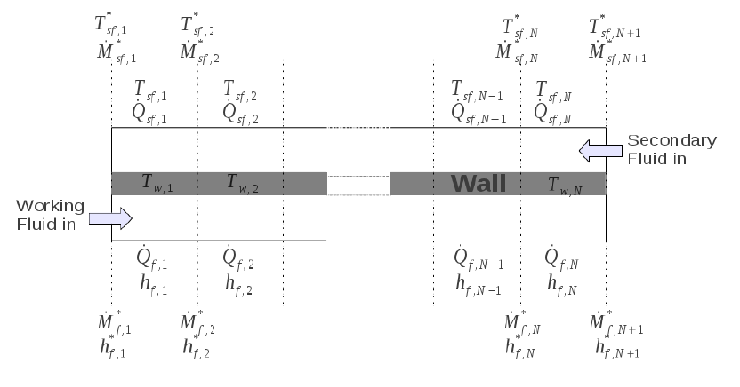





Heat exchangers:
Finite volume models
Simplified heat transfer and pressure drop laws:
:
---
Conservation of
energy:
Conservation of
mass:
Metal wall:

Slide 19
Heat exchangers:
Moving-boundaries models
Compared to the finite-volumes models:
About 3 times faster
Robustness is lower in fast transients
Charge prediction is less accurate
Not subject to chattering
Source : Satyam Bendapudi, James E. Braun, Eckhard A. Groll, A comparison of moving-boundary and finite-volume formulations for transients in centrifugal chillers, International Journal of Refrigeration, Volume 31, Issue 8, December 2008, Pages 1437-1452

Slide 20
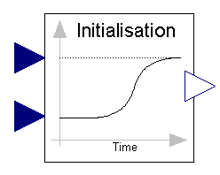
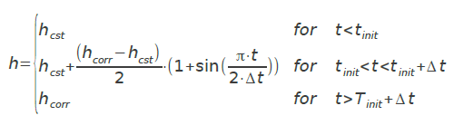
Numerical issues: Initialization
Especially important for acausal solvers
Newton solver can fail to converge towards an initial solution, especially in complex models
Importance of start values
Initiate simulation with a simplified model

Slide 21
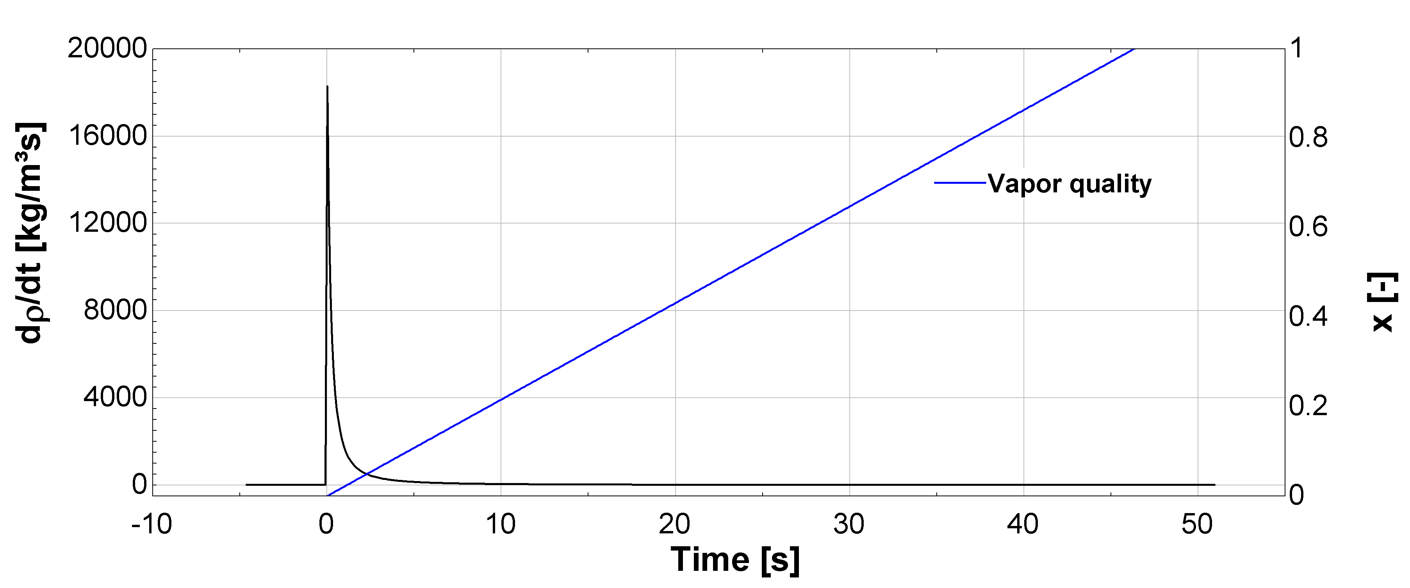
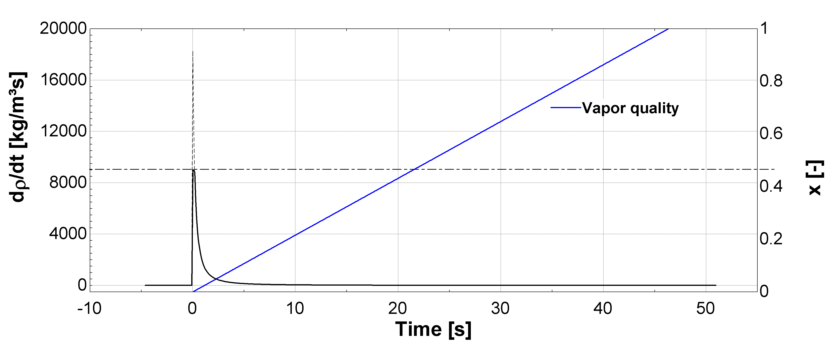
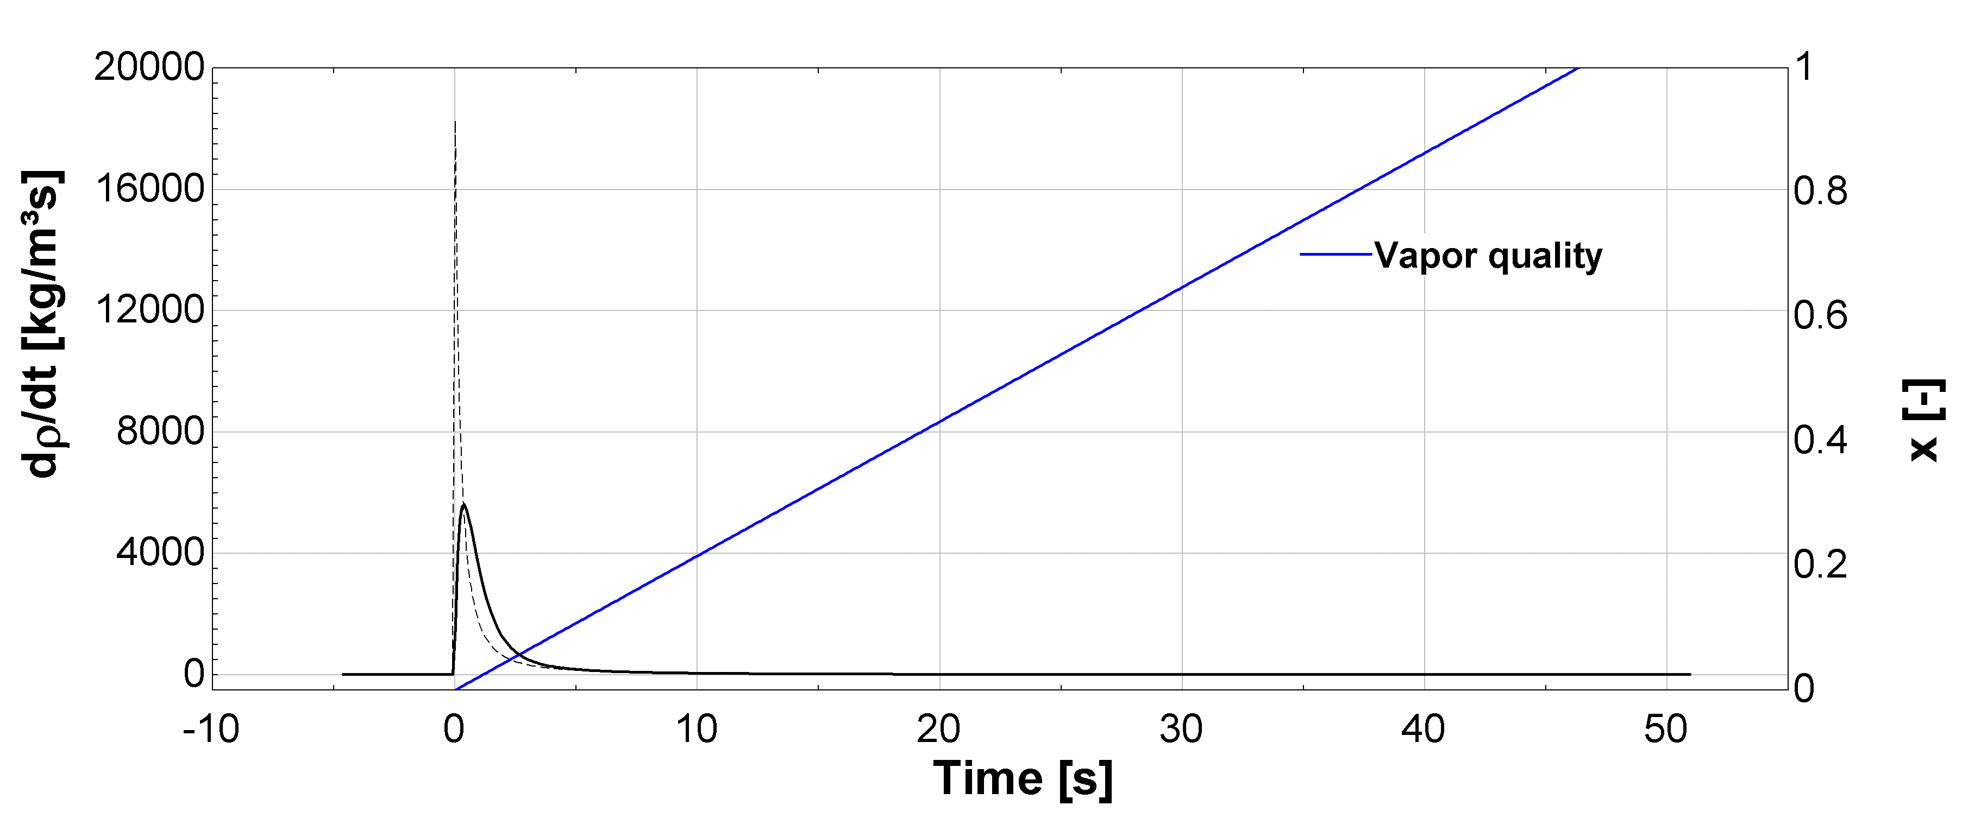


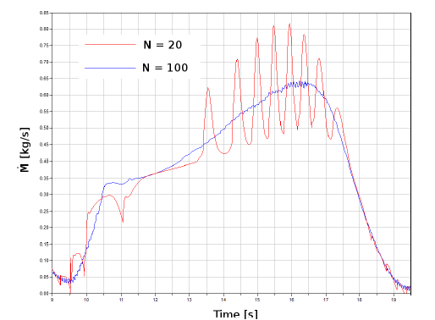
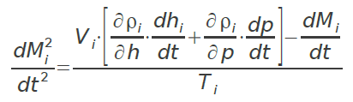

Numerical issues: Chattering
Chattering is likely if:
Chattering is likely if:
Stability criteria:
Proposed solutions:
1. Truncated density derivative
2. Filtered density derivative
3. Constant node flow rate
4. High number of cells

Slide 22
Numerical issues: Chattering
Chattering is likely if:
Stability criteria:
Proposed solutions in the literature:
Switch to moving-boundary models
Modify the equation of state to smooth it down
Use Chattering detectors

Slide 23
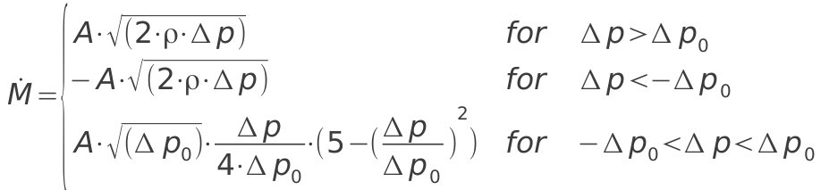
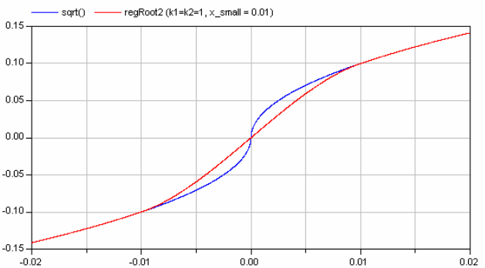
Numerical issues: Stiffness
Difference of orders of magnitude between time constants in the system
Stiff system: fast systems requiring very low time steps.
In thermo-fluid problems, very often linked to pressure states. Possible solution: assume p or dp/dt constant in each cell of the heat exchanger.
Infinite derivative of the flow rate close to zero pressure drop in a valve model.
Source : Casella, 2006

Slide 24



Cycle model
Performance indicators:

Slide 25
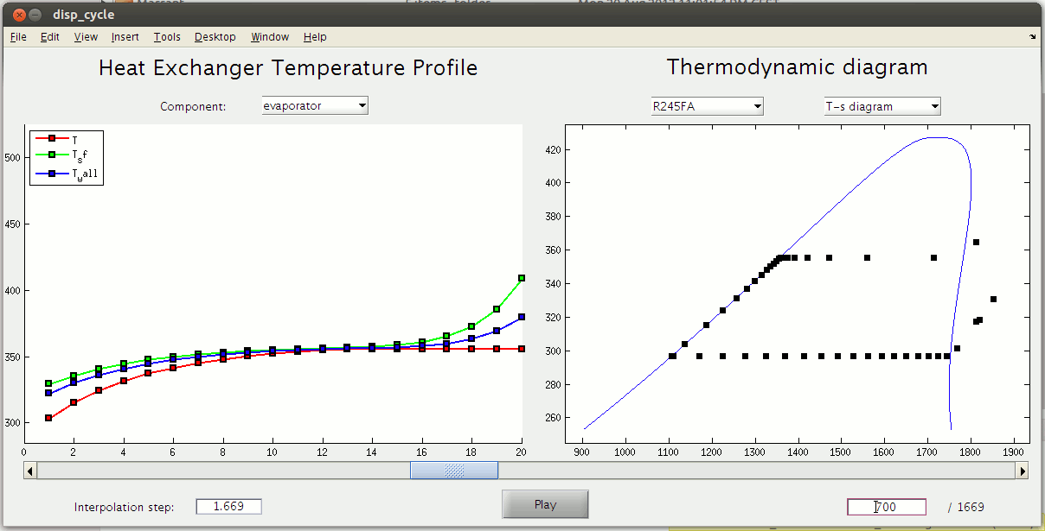
Simulation display

Slide 26
Content of the presentation
Introduction
Optimization of WHR ORC cycles
Dynamic modeling
Controlling ORC cycles under transient heat source
Predictive controllers
Conclusions

Slide 27
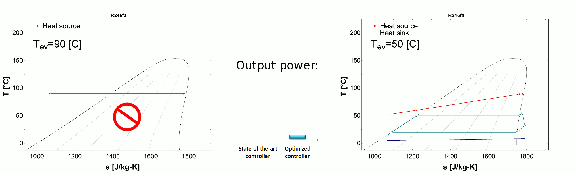
Transient regime analysis
Why controlling?
Main optimization parameter: the evaporating pressure (controlled by means of the expander speed or turbine vanes)
Traditional Control:
Optimized control

Slide 28
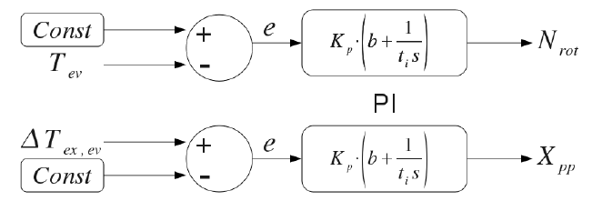
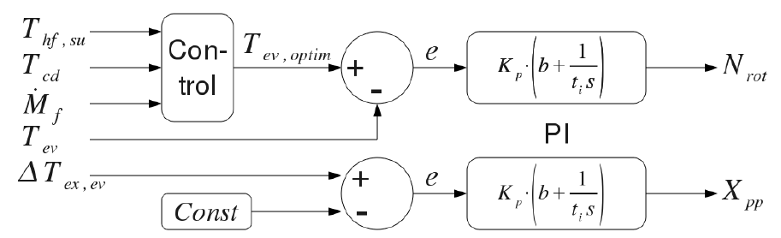
Feedback control strategies

Slide 29
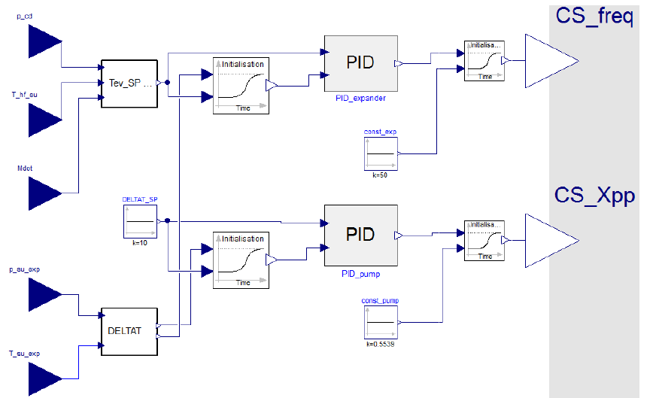
Modelica implementation

Slide 30
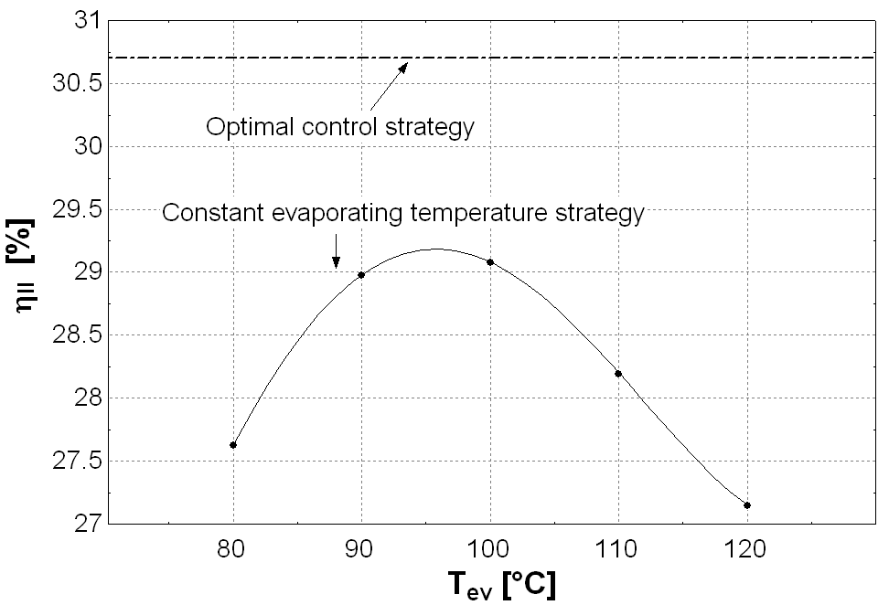
Simulation results

Slide 31
Content of the presentation
Introduction
Optimization of WHR ORC cycles
Dynamic modeling
Controlling ORC cycles under transient heat source
Predictive controllers
Conclusions

Slide 32
Model predictive control
Future action on the manipulated variable is based on a model.
Balance between two different approaches:
  model evaluation of the manipulated variable to reach the set point on a certain horizon time
  Constant rectification of the trajectory by measurement of the control variable.
Anticipates the effects of external perturbations
Well-performing with constrained processes

Slide 33
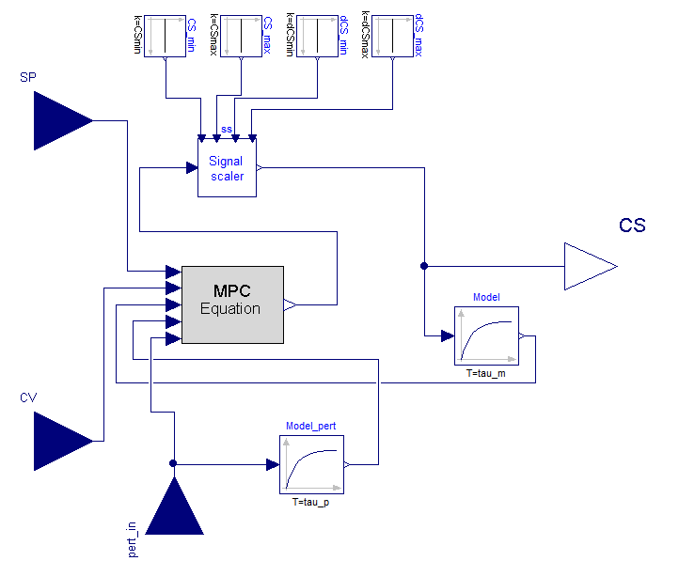
Modelica implementation

Slide 34
Simulation results

Slide 35
Content of the presentation
Introduction
Optimization of WHR ORC cycles
Dynamic modeling
Controlling ORC cycles under transient heat source
Predictive controllers
Conclusions

Slide 36
Summary
Control of ORC cycles can be a key issue, especially under transient heat source conditions
Dynamic models must be developed to implement control strategies
Model robustness and speed can considerably be reduced by numerical issues
A varying set-point control strategy allows increasing the output by more than 4%
MPC controllers follow the superheating set point in a much better way than PI-based controllers.
Future work will focus on the implementation and the improvement of MPC controllers with delayed processes, during start & stop procedures and in more severe conditions.

Slide 37
Thank you!

