Slide 1



Autofill remote storage form on the OPAC holdings page
IGeLU Conference 2012
Zürich, 11–13 September 2012
François Renaville, Sylvain Danhieux
University of Liège Libraries

Slide 2
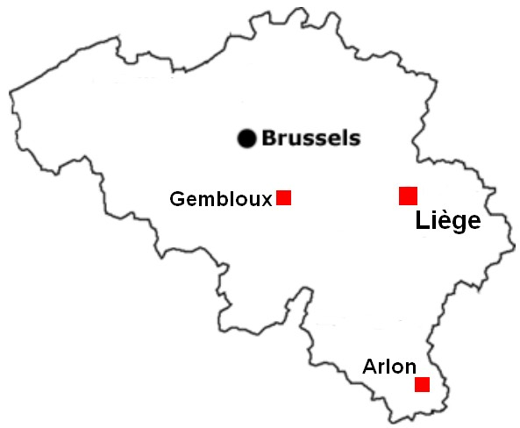
Our Library Network
5 main libraries:
Arts & Humanities Library
Agronomy Library
Law & Social Sciences Library
Life Sciences Library
Science & Technology Library
17 library facilities
+ 1 Remote Storage
4 campuses:
Liège Sart-Tilman (main campus)
Liège City centre
Gembloux
Arlon

Slide 3

Remote Storage
Managed by the Arts & Humanities Library
Collections mainly for A&H researchers and students
Far from 12 km from the Library, on 2 campuses:
A&H Library : Liège City centre
Remote Storage : Liège Sart-Tilman
RS Collections in numbers:
More than 280,000 catalogued books
More than 700,000 uncatalogued books (no item in the ILS)
About 25,000 serials titles (50% of the whole serials collections)
Less than 30,000 ISSUE items created

Slide 4
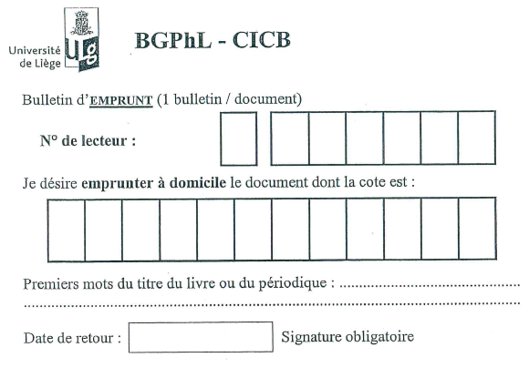
Ordering items from the RS
Exclusively with the good old call slip

Slide 5
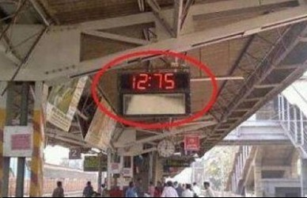
Ordering items from the RS
What about Ex Libris’ documentation « Remote Storage Setup and Management » ?
We failed using it! Why?
Probably PEBKAC error ("Problem Exists Between Keyboard And Chair“)…
ID-10T error
We tried
another way…
maybe not the best one
or the only one

Slide 6
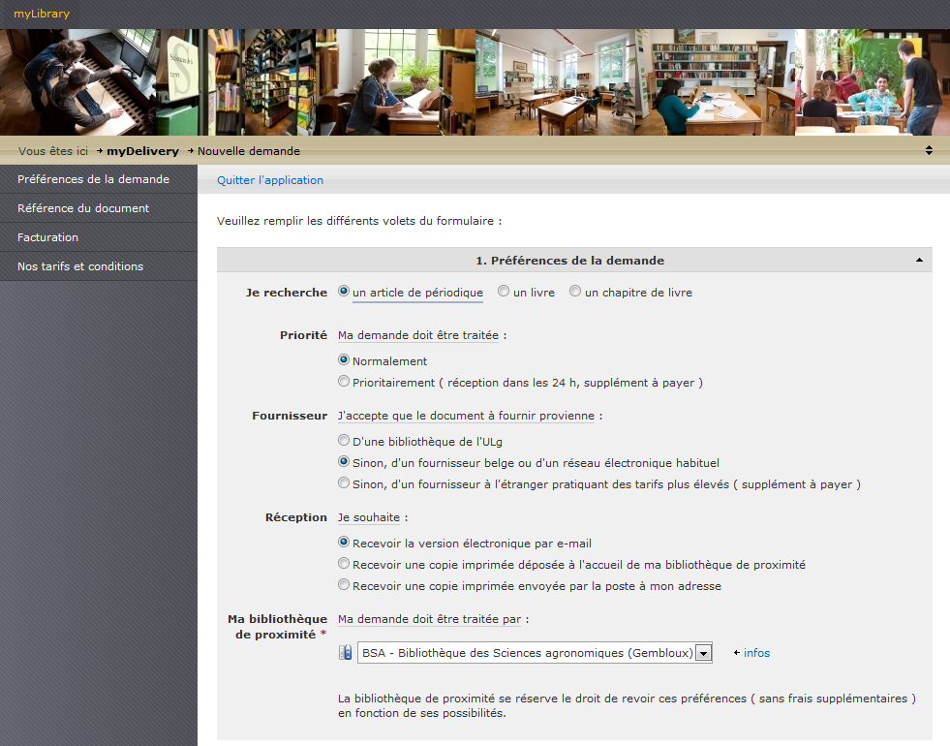
To a solution that
Is not time-consuming for the staff (IT & Aleph administrators)
Could be quickly deployed:
Request from the A&H Library for a better service (less restricting)
Anytime: open hours are not a problem anymore
Anywhere: no need to go the Lib to fill in a paper form
Claims from patrons
Would be temporary on Aleph opac
Working at the same time on
Primo Implementation Project
A new ILL & Document Delivery application

Slide 7

So, we deployed « Get it! »
request form
PHP + Javascript + mailer
Accessible on the item-global Aleph opac page
Already filled in with information about:
the Requester (< cookies)
the Document (short bibliographic references)
the Item (barcode, item status, call number, call number 2)
Available for
Items (= with a Z30)
Non itemized volumes (= no existing Z30)
Many serials holdings
Serials issues that haven’t been requested from the RS for about 20 years

Slide 8

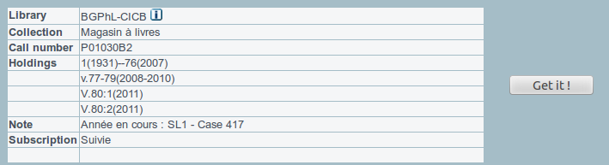
Two cases: Z30 or no Z30?
“Get it!” button:
in item-global-body for items (Z30)
in item-global-tail-2 for non itemized serials volumes (no Z30)
no Z30

Slide 9
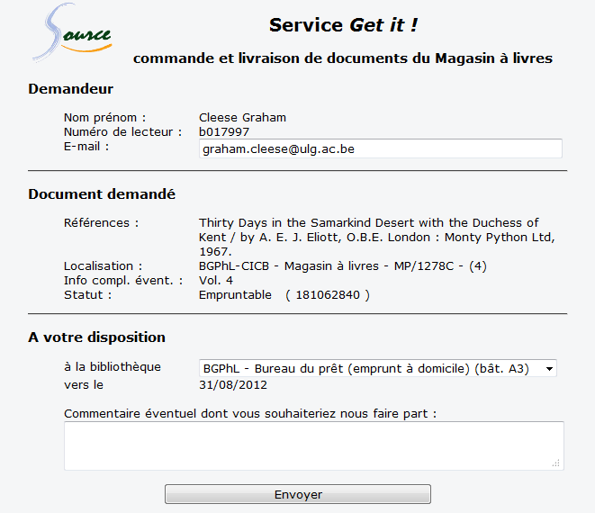
Z30
Requester
Document + Item
Delivery

Slide 10
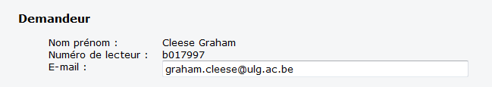
Requester
Information retrieved from the opac cookies
Name
Patron’s barcode
Only the e-mail address can be changed

Slide 11
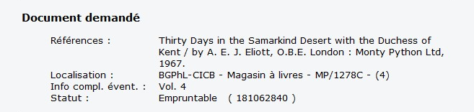
Document + Item
Références = Basic bibliographic info
Localisation = Sublibrary + Collection + Call Number (+ Call Number 2)
Info compl. évent. = Item Description
Statut = Item Status + ( Barcode )

Slide 12
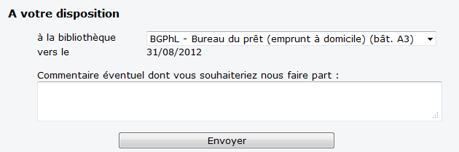
Delivery
Requester selects the pickup library
Estimated arrival date
Any additional comments

Slide 13
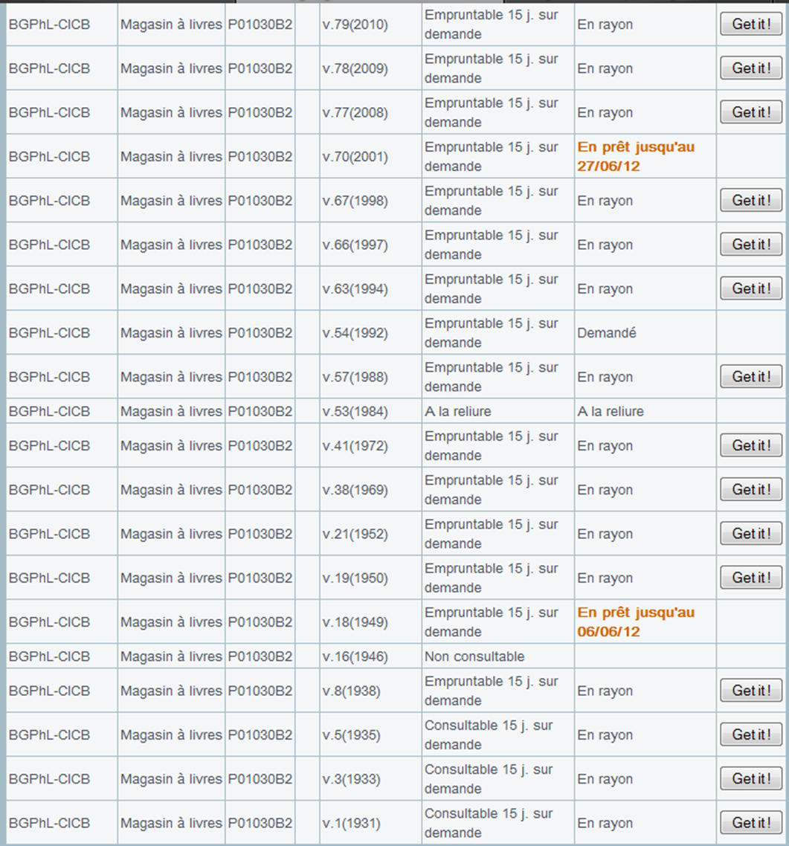
Not always
a “Get it!” button
Already on loan
Hold request
Process Status
Specific Item Status
(here: can not be loaned or consulted)
Javascript → extremely well modifiable

Slide 14
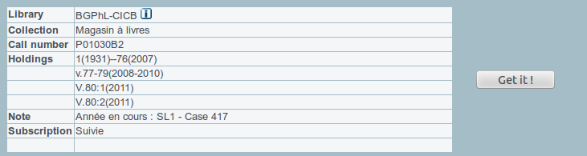
No Z30
About 25,000 serials titles in RS
Less than 30,000 ISSUE items created
How to request all those non itemized serials volumes?
no Z30
Z30

Slide 15
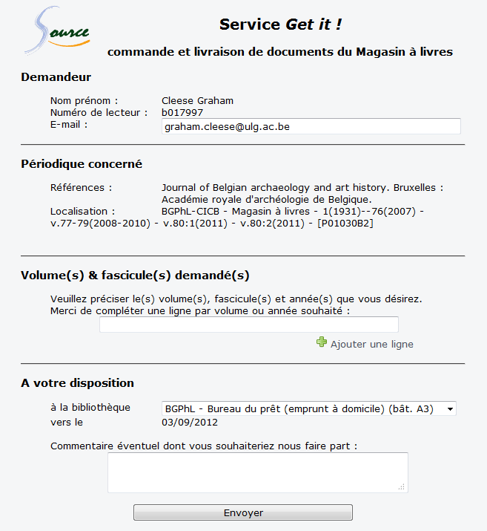
No Z30
Only for serials
Serials info
Holdings:
Library
+ Collection
+ complete holdings
+ [Call Number]
Volumes to request

Slide 16
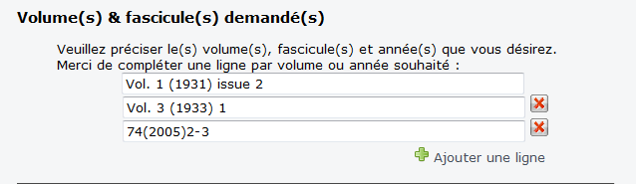
No Z30
Requester can add as many lines as needed
1 line per requested issue

Slide 17

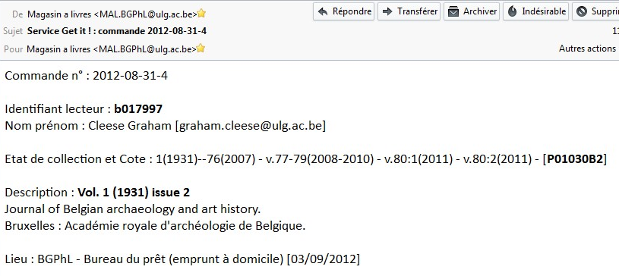
Request sent to RS
As an e-mail
Requests get an ID: aaaa-mm-dd-sequential nber
1 e-mail per requested item (= per line)
E-mail content duplicated :
delivery slip within the phyical item
slip on the shelf, where item is located

Slide 18
Usage statistics: requests
“Get it” service launched on 16th April 2012
Real tendency to use it

Slide 19
Usage statistics: requests
No appreciable increase of requests

Slide 20
Usage statistics: who?

Slide 21
Usage statistics: when?

Slide 22
Usage statistics: Z30 or no Z30?

Slide 23

Code…
PHP & Javascript
Available on EL Commons: http://www.exlibrisgroup.org/display/AlephCC/Autofill+remote+storage+form+on+the+OPAC+holdings+page
Developed for our own institution & needs  very oriented

Slide 24

francois.renaville@ulg.ac.be | s.danhieux@ulg.ac.be
Paper available at http://hdl.handle.net/2268/130093

