Slide 1
Experimental and numerical investigations of stationary mixed flows in 2D flume
N.V. Nam, F. Kerger, S. Erpicum, B. Dewals, P. Archambeau & M. Pirotton
Hydrology, Applied Hydrodynamics
and Hydraulic Constructions (HACH)
Liège,14/11/2011

Slide 2
Outline Acomen 2011
Introduction
Methodology
Physical experiment
Numerical modeling
Conclusions

Slide 3
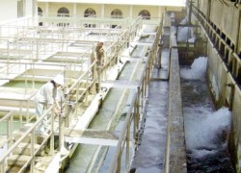
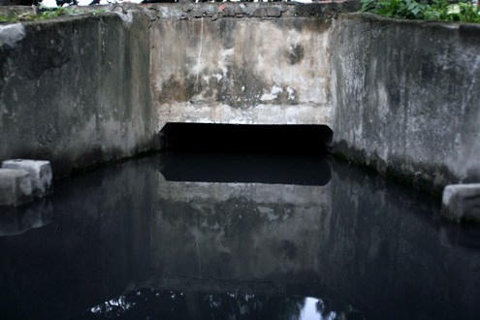
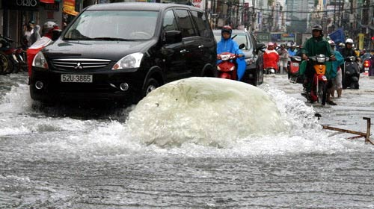
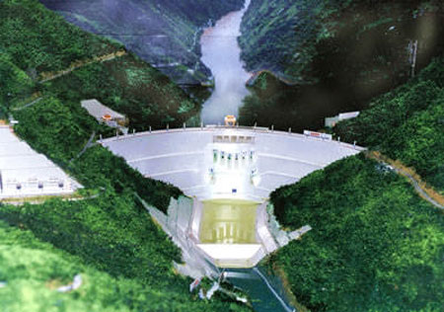
Introduction Acomen 2011
Mixed flows: are known as the simultaneous occurrence of free-surface and pressurized flows.
  1- Water supply systems 2- Sewer systems
  3- Storm water systems 4- Hydroelectric systems
  and so on.

Slide 4
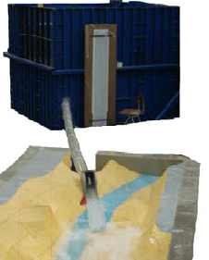
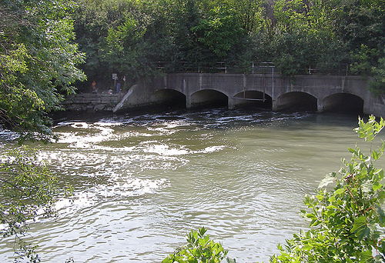
Introduction Acomen 2011
Mixed flows: have been investigated mainly for 1D configurations (Wiggert (1972), Cardle et al. (1989), Gómez and Achiaga (2001), Vasconcelos and Wright (2005), Erpicum et al. (2008), Kerger et al. (2008), Wright et al. (2008), etc.)
But mixed flows present often 2D characteristics
→ experimental and numerical investigation of 2D mixed flows
1st step: - simple configurations
- steady flow

Slide 5
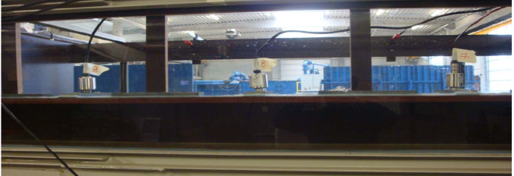
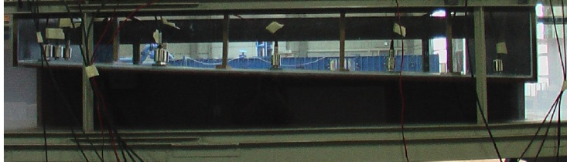
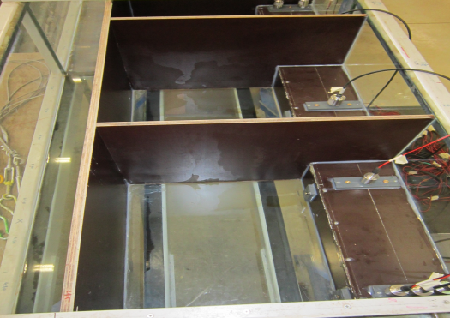
Methodology Acomen 2011
2D rectangular cross-section channels connected by a conduit
  Three geometries
  Model A: Uniform rectangular cross-section conduit
  Model B: Convergent rectangular cross-section conduit
  Model C: Parallel an uniform rectangular cross-section pressure conduit and an uniform rectangular cross-section free surface channel.

Slide 6
Methodology Acomen 2011
Geometries
Model A
Model B
Model C
Experiment
modeling
Numerical
modeling
Q=[5-45(l/s)]
(8-10) tests/model
Comparison of
flow characteristics

Slide 7
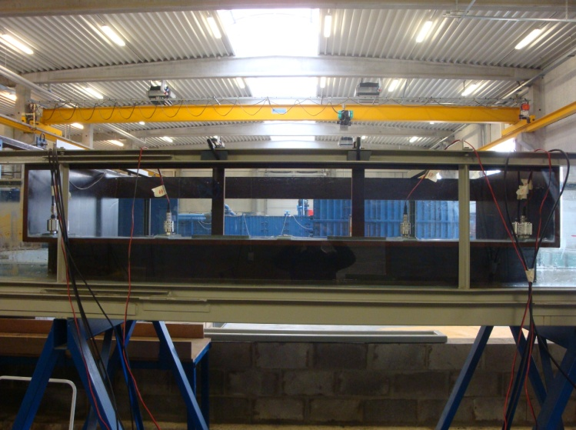
Physical experiments Acomen 2011
        1- Experiment facility:
        - two 4.2 m long channel reaches made
        of clear glass
        - a 2 m long closed conduit made of
        exterior type plywood
        - an upstream tank and a collection box
        - a gate made of thin steel plate
        - pumping and piping system, etc.
a) Sketch of physical model | b) Picture of physical model

Slide 8
Physical experiments Acomen 2011
2- Water alimentation and boundary condition
  Water alimentation system:
  Boundary condition:
    Upstream boundary condition is the discharge into the model
    Downstream boundary condition is a gate (used as an free-weir or a raising one)

Slide 9
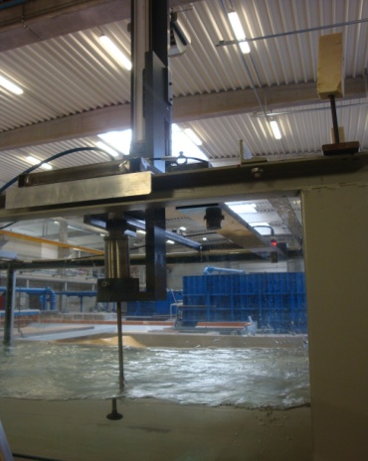
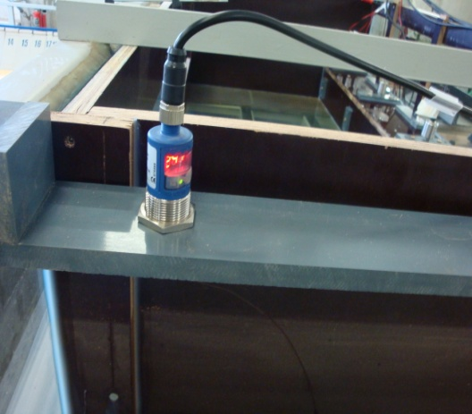
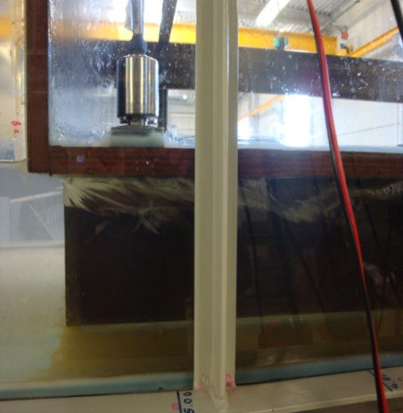
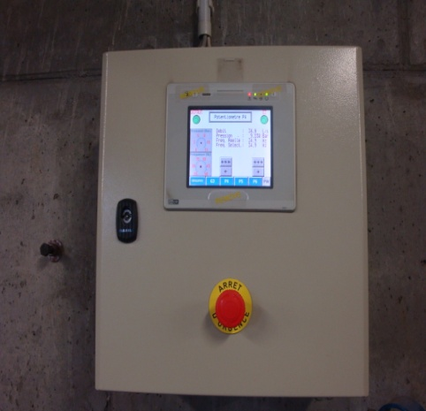
Physical experiments Acomen 2011
3- Measurement devices:
Using an electro magnetic (EM) probe to measure the velocity (fig a);
Using 8 ultrasound sensors to determine the water level (fig b);
Using 8 piezoresistive pressure transducers for pressure measuring (fig c);
Using an electromagnetic discharge meter to control the discharge (fig d);
(a)
(b)
(c)
(d)

Slide 10
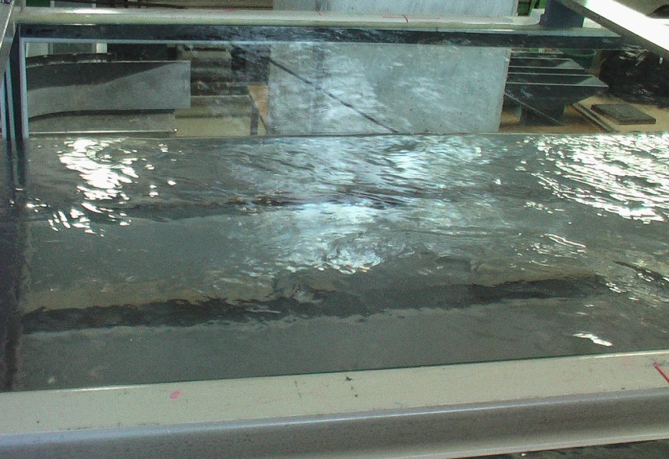
Physical experiments Acomen 2011
4- Example of results (model A)
- Velocity results with free weir, Q=10l/s

Slide 11
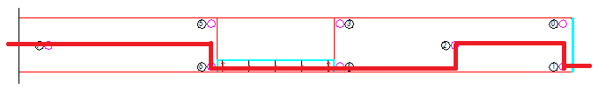
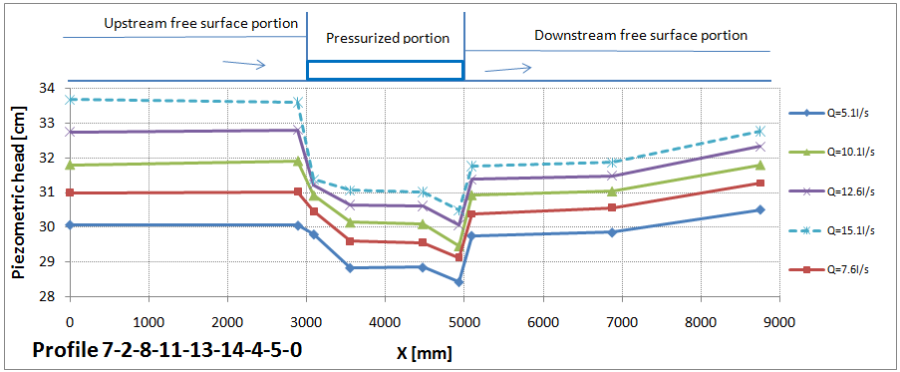
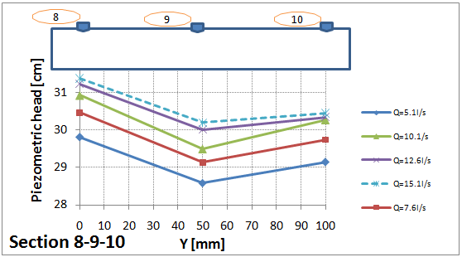
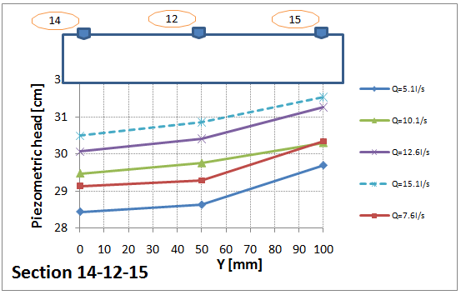
Physical experiments Acomen 2011
  Pressure field results with free weir

Slide 12
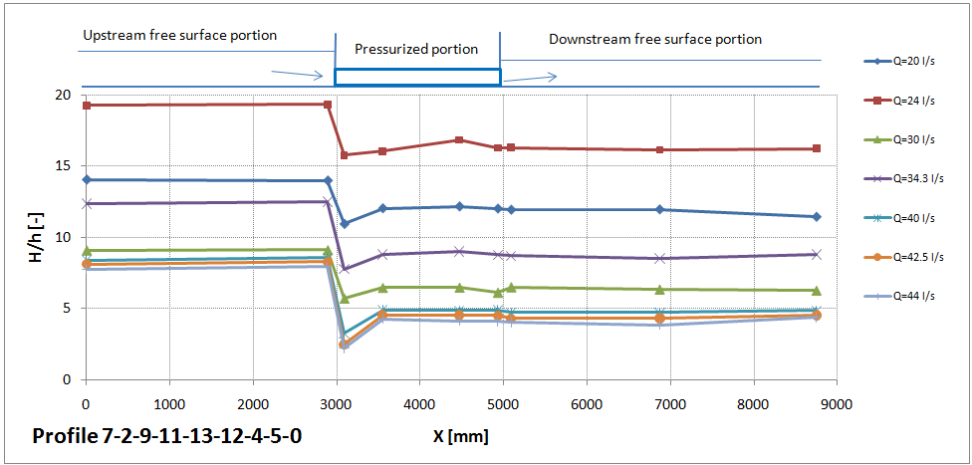
Physical experiments Acomen 2011
  Pressure field results with raising gate

Slide 13
Numerical modeling Acomen 2011
  1- Shallow water equations
  + Preissmann slot model:
      u, v: Velocity components
      h: Pressure
      b: Conduit height
      Zb, Zr: Bottom and roof elevations
      hb, hr, hJ: Equivalent pressure terms
      Jx, Jy: Friction slope components
Continuity
equation
Momentum
equations

Slide 14
Numerical modeling Acomen 2011
+ WOLF applicability
Finite volume discretization, with multiple blocks using constant space step (accuracy and computation time)
Original FVS (WOLF – HACH), upwinding regarding the flow velocity (momentum upstream, pressure terms downstream)
Bottom slope term discretized in agreement with the FVS (water at rest)
Bottom friction with Manning’s formula
Explicit RK time integration scheme with CFL number condition

Slide 15

Numerical modeling Acomen 2011
  2- Example of results (model A)
  Velocity field results with free weir, Q=10l/s
  Velocity field results with raising gate, Q=30l/s
  Pressure field results with free weir, Q=10l/s
  Pressure field results with raising gate, Q=30l/s

Slide 16
Conclusions Acomen 2011
Study aims at studying 2D mixed flows using
  - Experimental modeling
  - Numerical modeling
Choice of 3 configurations, tested with a wide range of steady discharges
Results for comparison:
  Velocity and pressure distribution in two directions
  Mixed flows visualization in detail
  Comparisons under progress…
Perspectives:
  Perform unsteady modeling
  Consider the effect of air entrainment

Slide 17
Acomen 2011
  Thanks For Your Attention!

