Slide 1



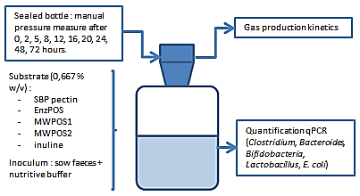
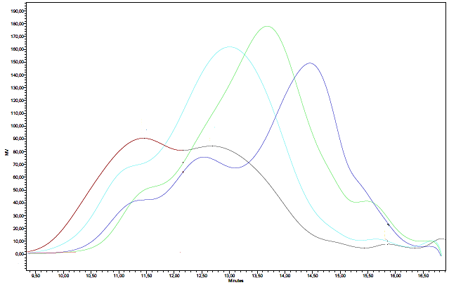
In vitro determination of prebiotic potential of sugar beet pulp extracted candidates and influence of production method
François E. *, Goffin D., Combo A. M.-M., Blaise Y., Bindelle J., Paquot M., Portetelle D., Thewis A., Boudry C.
University of Liège, Gembloux Agro-Bio Tech, Gembloux, Belgium. *Correspondance: efrancois@ulg.ac.be
Various prebiotic hydrolysates were produced starting from sugar beet pulp (SBP) using alternative solution to traditional acidic hydolysis. SBP pectin was first extracted by acid extraction and ethanol precipitation. Then two technics are used to produced pectic oligosaccharides (POS) : enzymatic hydrolysis (EnzPOS : Rapidase Smart (DSM) ; 50°C ; pH 5) and microwaves-assisted hydrolysis (MW1POS : 104°C/10min/pH 7; MW2POS : 110°C/15min/pH 7). Structural characterization of fractions gave rise to different structural profiles between the four products. Moreover, fermentation parameters obtained in-vitro (A, B, Rmax and Tmax) were also characteristic of the fractions and in favor of a tight relationship between POS structure and POS function. Finally, to avoid solvent use, POS production could be envisaged directly on SBP. Avoiding the step of acidic extraction will allow to meet the green chemistry principles.
SBP
SBP pectin
MWPOS
EnzPOS
140°C-10min-pH 7 (MW1)
110°C-15min-pH7 (MW2)
50°C-15min-pH5
Methods
In-vitro fermentation
Prebiotics production
Acid extraction (HCl; pH 1,25; 2h)
Results
MW1POS
Samples | MW (kDa) | DP
SBP pectin | 156 | 72
EnzPOS | 43 | 20
MW1POS | 33 | 15
MW2POS | 75 | 35
MW2POS
SBP pectin
EnzPOS
HPSEC profiles showed the influence of the production method on the oligosaccharide profiles.
EnzPOS and MW1POS total gas production (A) is comparable with inulin but MW1POS fermentation is delayed (high B and Tmax) while EnzPOS, MW2POS and inulin reach their maximal fermentation speed (Tmax) closely in time. Maximal fermentation rate (Rmax) is reached by inulin followed by EnzPOS and MWPOS are lower. Moreover, higher molecular weights correspond with smaller A (Pectin and MW2POS). Concerning bacterial profiles, pectin has the less interesting prebiotic effect : Bacteroides, Clostridium C1, E.coli are the highest. While MW1POS has a positive effect : diminution in Bacteroides and increase in Bifidobacteria with comparable levels for other genera than others samples (p < 0,05).
Conclusions
POS production methods influence their structure and composition. It results in a direct impact on the gas production kinetics and on bacterial profiles of the studied genera. The control of POS, and in general prebiotics, structure allows to obtain prebiotic compounds which can be used by different species of bacteria, at a different speed and in different sections of the gut. As perspectives, further studies must be done to optimize MW-assisted hydrolysis conditions . Moreover, a more sustainable method should be developed using a direct hydrolysis on SBP while avoiding solvent extraction step. This alternative production method meets the green chemistry principles.
Acknowledgement : this work was supported by the Walloon Region

