Slide 1



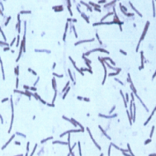
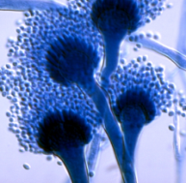
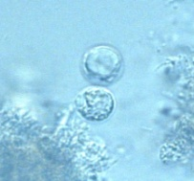

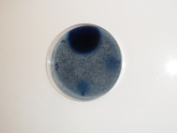
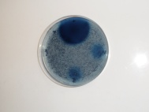
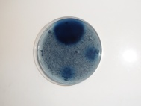

Selection and cultivation of hydrolytic microorganisms extracted from the digestive tract of the termite Reticulitermes santonensis (3DV.1.55)
Tarayre Cédric¹, Bauwens Julien², Mattéotti Christel³, Brasseur Catherine⁴, Destain Jacqueline¹, Vandenbol Micheline³, Portetelle Daniel³, De Pauw Edwin⁴, Haubruge Eric², Francis Frédéric² and Thonart Philippe¹
1 - Bio-Industries unit – University of Liege Gembloux Agro-Bio Tech
2 - Functional and evolutionary entomology unit – University of Liege Gembloux Agro-Bio Tech
3 - Animal and microbial biology unit – University of Liege Gembloux Agro-Bio Tech
4 - Mass spectrometry laboratory – University of Liege
Biofuel production can be based on the use of fermentable substrates issued from the hydrolysis of lignocellulosic biomass coming from agricultural residues and by-products. However, such substrates are not easy to degrade. Enzymes (cellulases, xylanases, etc.) can be used for this purpose and pre-treatments can increase their action by providing more available extremities. The digestive tract of the termite Reticulitermes santonensis contains various microorganisms (bacteria, molds, protists) able to degrade the wood components. These microorganisms act as consortia, leading to a better hydrolysis than in the cow rumen. It was possible to isolate such microorganisms from termite guts in order to evaluate their potential for hydrolysis of lignocellulosic materials. This approach led to the isolation of three microorganisms : Bacillus subtilis, displaying a xylanase activity, Aspergillus fumigatus, displaying a cellulase activity and a protist (related to the chrysophytes Ochromonas and Poterioochromonas) displaying an amylase activity.
INTRODUCTION
LIGNOCELLULOSE DEGRADATION IN LOWER TERMITES
SCREENING OF ENZYMATIC ACTIVITIES
Head
Foregut
Midgut
Hindgut
Faeces
Selection of hydrolytic microorganisms
O₂
Microoxic zone
Bacteria
Anoxic zone
Molds
Cellulose
Short chain fatty acids
Bacillus subtilis
Aspergillus fumigatus
Chrysophyte related to Ochromonas and Poterioochromonas
Mono-, di- and oligosaccharides
Symbiotic protists
H₂, CO₂
Organic acids
Positive control
Positive control
Positive control
Neg.
control
Neg.
control
CH₄
Acetate
Culture
samples
Culture
samples
Neg.
control
Culture
samples
Detection of a xylanase activity
Detection of a cellulase activity
Detection of an amylase activity
ISOLATION OF ENZYME-PRODUCING MICROORGANISMS
ENZYME PRODUCTION
Dissection
Optimization of enzyme production : measurement of enzymatic activities of Bacillus subtilis
FOREGUT
MIDGUT
HINDGUT
Tryptic soy broth
DISCUSSION
Isolation of one protist
Liquid medium containing starch and ciprofloxacin
Termite dissections led to the isolation of three hydrolytic microorganisms until now. The most interesting microorganism is Bacillus subtilis, producing an extracellular enzyme able to degrade xylans. Bacillus subtilis was able to develop a xylanase activity up to 15 I.U. (International Units)/mL. It was able to develop such activity in a liquid medium containing rape oil cake. Other microorganisms will also be tested.
Agar plates containing cellulose, carboxymethylcellulose
or cellobiose (microaerobic or
anaerobic atmosphere)
DISCUSSION
Isolation of
bacteria and
molds

