Slide 1
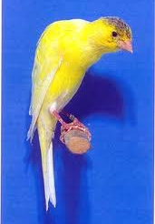
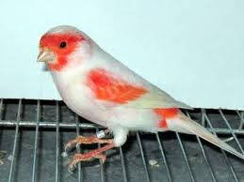
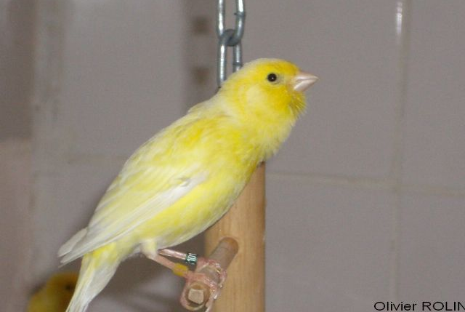
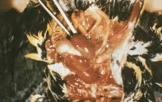
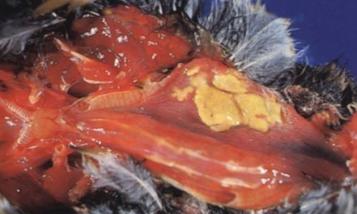
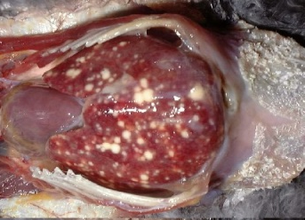
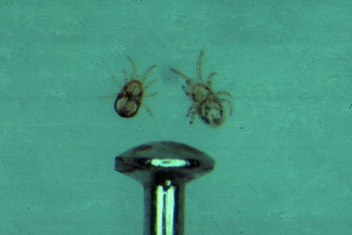
Zoonotic diseases in pet birds – a short review
BOSERET G (1), SAEGERMAN C (1).
⁽¹⁾Service d’épidémiologie et d’analyse de risque associée aux sciences vétérinaires
Département des maladies infectieuses et parasitaires, Faculté de Médecine Vétérinaire,
Université de Liège, Belgique
Corresponding author: claude.saegerman@ulg.ac.be
Introduction
The term « Pet bird » designates birds housed and breeded for an exclusively ornamental use. This category includes mainly Passeriformes (canaries, finches…) and Psittaciformes (parrots, parakeets…), and is a not-so-well known vet’s clientship fraction. Many families indeed own their « kitchen canary », which represent a lucrative business for pet shops or local breeders (e.a. via birds fairs and markets). Besides, some birds are bred for their very high value; for example, in the case of canaries, male and female reproductors with recognized genetic potential are presented in international contests for their posture (the Bossu Belge : fig 1a), their colour (red mosaic: fig 1b) and for their song (Harzer: fig 1c) and sold for rising prices. Finally, exotic birds like parrots (ara, cockatoo…), legally or illegaly traded from Asia, are however very popular pets and profusely represented in zoos and parks.
Notwithstanding these economic facts, these animals are potential carriers and/or transmitters of zoonotic diseases. Some of them could have an important impact on human health, like ornithosis, salmonellosis or even H5N1 high pathogenic avian influenza. This review, although non exhausive, has as aim to enlighten, by the description of several cases of birds-humans transmission the risks encountered by birds owners, including children, and on another point of view to assess the potential economic consequences.
Bacterial diseases
Chlamidiosis (Chl. Psittaci)
a
b
c
Figure 1: canaries (Serinus canaria) bred for international contests
One of the most threatening zoonotic diseases transmitted by birds to humans is chlamidiosis (also known as ornithosis or psittacosis), caused by the intracellular bacterium Chlamydophila psittaci. Human symptoms come from mild respiratory signs to severe pneumonia, with localization in several organs leading to diarrhoea, cunjunctivitis, arthritis and genital organs infection. The first people susceptible to be infected appears to be, as expected, veterinarians and birds breeders; this has been e.a. enlightened by a belgian epidemiological study which pointed out a percentage of 14,9% of human infection in owners and vets working in breeding psittacine facilities (Vanrompay et al., 2007). In the same line of reasonment, Belchior et collaborators reported a case study about an bird fair in France where 38% of exhibitors were tested positive for Chlamidophyla psittaci infection.
Salmonella species have been isolated from petbird facilities and cases of transmission to children are not uncommon (Hoelzer et al., 2011). On another point of view, wild songbirds are important Salmonella spp. carriers (Refsum et al., 2003); moreover,starlings have been demonstrated as potential spread agents of salmonellosis in cattle feeding operations, (Carlson et al., 2011).
Isolation of Mycobacterium tuberculosis or M. avium is a rather not rare event in pet birds. A particularly interesting case is described by Washko and collaborators, concerning an Ara (Ara chloroptera) diagnosed positive for Mycobacterium tuberculosis in New York City (Washko et al., 1998). This bird seemed to have been infected by their human owners, but lived a sufficient time to have been a potential transmitter of the infection among others humans.
Salmonellosis
Tuberculosis
Fig 2: left:chlamidiosis; center: salmonellosis: right: tuberculosis
Avian influenza
Viral diseases
Highly pathogenic avian influenza (H5N1) has been frequently showed to be related with living exotic birds international trade (Brooks-Moizer et al., 2009), favorisating then the disease spread among the world, for example via zoos or markets. Asian owners seemed to be, even in the middle of the 2007 H5N1 outbreak, unaware of the zoonotic risks this kind of business could cause, and in a certain proportion, so are occidental breeders, as hybrids (wild passerine, e.a. siskins) are today still crossbred with domestic canaries and sold on sunday markets. In addition, some unofficial bird trade movement can be induce detrimental effect in human (e.g. H5N1, van Borm et al., 2005)."
The West Nile Fever is an emergent vector-borne zoonosis with birds, e.a. house sparrows as main and amplifying reservoir hosts
(Nemeth et al., 2009). Open air aviaries are common in our countries and could be then constitute an important feeding source for mosquitoes, which could then inoculate the virus in human population.
West Nile Fever
Parasitic diseases
Fungi
Fig 3 Dermanyssus gallinae. Left: size; center: colony; right: anemic newborn
Aspergillosis, cryptococcosis and candidosis are often reported in petbirds, both in chronic and in acute infections. Transmission to human often results in faeces manipulation or lack of hygiene (Evans et al., 2011). Other parasitic agents such as Giardia or Cryptosporidium have been also mentioned.
Toxoplasmosis is a well-known human disease, responsible for abortion or congenital malformations in human. Toxoplasma gondii has also
been described as an important pathogen for canaries and finches (Dubey, 2002), inducing blindness among other symptoms. However, very rare awareness mention is given to pregnant women or bird-workers, despite the serious consequences such a disease could have in term of human health.
Ectoparasites, also known as « poultry mites » (Dermanyssus gallinae, Ornithonyssus sylvarium), even if exhaustively described in poultry breedings, are also a petbird pathogen rather underestimated. However, their presence in both petbirds family household and intensive breedings are quite frequent. Dermanyssus gallinae in particular, in addition to cause an important debilitation by exsanguination, has been proved to transmit pathogens such as Chlamydophila psittaci (Circella et al., 2011). Moreover, evidence of transmission to humans has been described, with apparition of a dermatological pruritic syndrome (Akdemir et al., 2009).
Toxoplasmosis
Ectoparasites
Conclusions
This review has as aim to present case reports on pet bird-to-human infection, in order to sensitivitize the owners and the vet to potential threats related to birds. Different situations have been illustrated towards this short review: familial household, breeding or selling facilities, bird fairs, international trade and the wildbirds’problematic of reservoirs. Although this represents a minor part of the companion animals’ vet clientship, petbirds’ diseases with zoonotic potential shouldn’t be neglected or underestimated, considering the major health impact on the population, including children. On an another point of view, pathogens’ shedding by wild passerine birds could be responsible of maintaining infection in domestic birds pools, such as openair aviaries or poultry breedings, and could have important economic impacts. Dermanyssus gallinae e.a., both as debilitating agent than as potential vector of zoonotic diseases, is an underestimated concern – probably too many times misdiagnosed - in petbird medicine as well as economic poultry breedings, as the parasite could be carried and transferred from one species to another. In conclusion, sanitary state of petbird owning and trade is rather unclear in Belgium. Therefore, investigate the health status of pet birds, facilities, avian exploitations and in human should be an interesting starting point to define risks encountered (from family to breeding scale), propose economic and sanitary prevention (e.g. biosecurity) measures, in an interest of health prevention and economic improvement.
Akdemir C, Gülcan E, Tanritanir P. Case report : Dermanyssus gallinae in a patient with pruritus and skin lesions. Turkiye Parazitol Derg. 2009;33(3):242-4.
Brooks-Moizer F, Roberton Scott I, Edmunds K, Bell D. Avian Influenza H5N1 and the Wild Bird Trade in Hanoi, Vietnam. Ecology and Society 2009; 14 (1) ,28.
Carlson JC, Franklin AB, Hyatt DR. Pettit SE, Linz GM. The role of starlings in the spread of Salmonella within concentrated animal feeding operations . Journal of Applied Ecology 2011 ; 48 (2) : 479-486.
Circella E, Pugliese N, Todisco G, Cafiero MA, Sparagano OA, Camarda A. Chlamydia psittaci infection in canaries heavily infested by Dermanyssus gallinae. Exp Appl Acarol 2011 Dec;55(4):329-38.
Dubey JP. A review of toxoplasmosis in wild birds. Vet Parasitol. 2002 Jun 3;106(2):121-53.
Evans EE. Zoonotic diseases of common pet birds: psittacine, passerine, and columbiform species. Vet Clin North Am Exot Anim Pract. 2011 Sep;14(3):457-76, vi.
Hoelzer K, Switt AIM, Wiedmann M. Animal contact as a source of human non-typhoidal salmonellosis . Veterinary Res 2011; 42
Nemeth N, Young G, Ndaluka C, Bielefeldt-Ohmann H, Komar N, Bowen R. Persistent West Nile virus infection in the house sparrow (Passer domesticus). Arch Virol. 2009;154(5):783-9.
Refsum T, Vikøren T, Handeland K, Kapperud G, Holstad G. Epidemiologic and pathologic aspects of Salmonella typhimurium infection in passerine birds in Norway. J Wildl Dis. 2003 Jan;39(1):64-72.
Van Borm S, Thomas I, Hanquet G, Lambrecht B, Boschmans M, Dupont G, Decaestecker M, Snacken R, van den Berg T. Highly pathogenic H5N1 influenza virus in smuggled Thai eagles, Belgium. Emerg Infect Dis. 2005 May;11(5):70.
Vanrompay D, Harkinezhad T, van de Walle M, Beeckman D, van Droogenbroeck C, Verminnen K, Leten R, Martel A, Cauwerts K. Chlamydophila psittaci transmission from pet birds to humans. Emerg Infect Dis. 2007 Jul;13(7):1108-10.
Washko RM, Hoefer H, Kiehn TE, Armstrong D, Dorsinville G, Frieden TR. Mycobacterium tuberculosis infection in a green-winged macaw (Ara chloroptera): report with public health implications. Clin Microbiol. 1998 Apr;36(4):1101-2.

