Slide 1

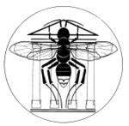
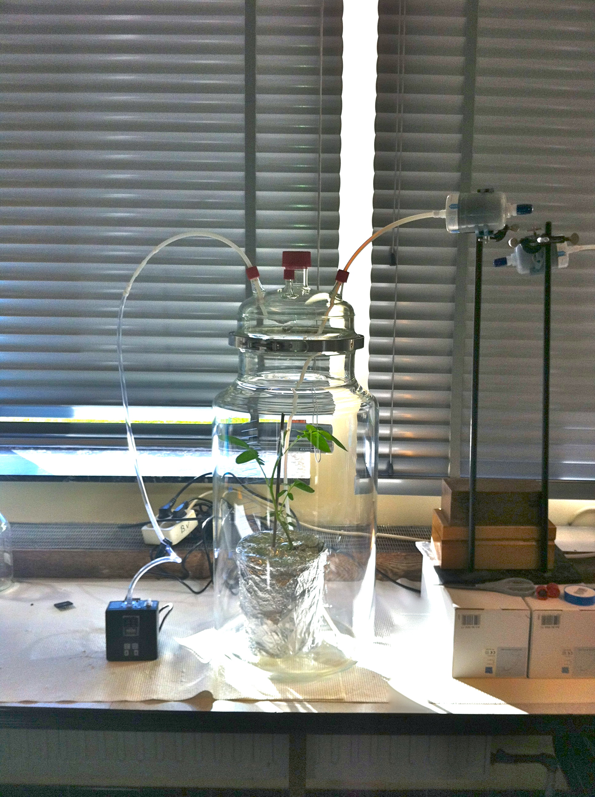
Introduction
The tomato miner, T. absoluta (Meyrick), is detected for the first time, in 2006, in Spain. In 2008, this pest invaded all the countries from the Maghreb as well as France. Since this invasion the insect does not stop spreading northward and it could now settle down in Belgium. We are actually working on the development of new strategies against T. absoluta by selecting the most resistant varieties among two model of solanaceous species (potato and tomato). Precisely, we are working on (1) the characterization of “ the odour “ of different varieties of potatoes and tomatoes and on (2) the insect capacity to develop on the different tested varieties.
Potential of Tuta absoluta to infest potatoes (Solanum tuberosum) in Belgium
R. Caparros¹; F. J. Verheggen¹; P. Delaplace²; A. Borensztein¹ and E. Haubruge¹
1: Department of Functional and Evolutionary Entomology and 2: Department of Plant Biology. University of Liege – Gembloux Agro Biotech – Passage des déportés 2, B-5030, Gembloux (Belgium).
Contact : entomologie.gembloux@ulg.ac.be
Volatile collection
Fitness
The airflow previously crosses throughout a carbon cartridge in due to be filtered. Plant volatiles are capted on Super Q cartridge during 4 hours. Cartridge are eluted with hexane and samples are injected into GC/MS.
This table is the result of preliminary test of fitness on tomato and two varieties of potatoes (Bintje and Spunta). The development of hundred insects were recorded. The longer of larvae development were longer on tomato than on potatoes but the longer of pupae development was similar on the three plants. It is not possible to conclude something before new replicates.
The preliminary results on healthy potatoes indicate the presence of volatiles organic compounds usually found in potatoes like Alpha-pinene and Beta-caryophyllene.
This table corresponds to the mortality at the different developmental stages. We obtain similar pattern between the three plants.
Perspective
In the future, we shall test different varieties of potatoes in due to find some varieties which will be more resistent to the pest than the others. We want to link the results of fitness experimentations to the volatiles organic compounds emitted by different varieties of potatoes in due to bringing to light substances which would may repel the insects or prevent their development. Some volatile collections of infected potatoes in various degrees are planned to bring to light volatiles which would be emitted with the aim of attracting natural enemies

