Slide 1
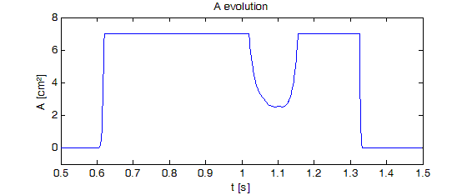
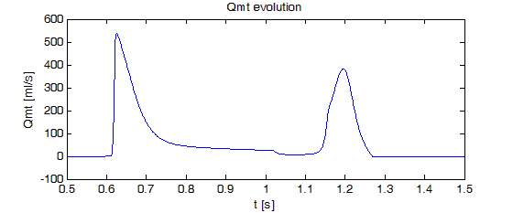
Structural model of the mitral valve
included in a cardiovascular closed loop model
S. PAEME¹, K. MOORHEAD¹, J.G. CHASE², C.E. HANN², B. LAMBERMONT¹, P. KOLH¹,
M. MOONEN¹, P. LANCELLOTTI¹ , P.C DAUBY¹, T. DESAIVE¹
¹ Cardiovascular Research Center, University of Liege, Belgium
² Centre for Bio-Engineering, University of Canterbury, Christchurch, New Zealand
Introduction
A minimal cardiovascular system (CVS) model including mitral valve dynamics has been previously validated in silico [1]. However parameters of this model are difficult to link with structural and anatomical components of the valve.
This research describes the integration of a structural model of the mitral valve in an existing closed-loop cardiovascular system (CVS) model.
Methods
This research uses a simple dynamic model of the stiffness of the valve leaflets to characterize their fundamental effects on flow and pressure. The valve is described as a non-linear rotational spring or a ‘hinge’ with the angle change under pressure driven flow being related to the stiffness and the damping of the valve.
This model is included in a CVS model consisting of 7 elastic chambers [1].
Fig. 1 : Closed loop CVS model consisting of 7 elastic chambers.
Results
Figure 2 shows the evolution of mitral valve area during one cardiac cycle. The maximum mitral valve values reached during the E-wave and A-wave as well as timing of these two periods correspond to the physiological data [2,3]. Figure 3 shows the evolution of transmitral blood flow during one cardiac cycle with the E-wave amplitude nearly 1.5 times bigger than the A-wave amplitude as expected physiologically [3,4].
Fig. 2 : Mitral valve area evolution during one cardiac cycle
Fig. 3 : Transmitral flow evolution
Conclusions
References
This study shows that this valvular model included in a CVS closed loop model gives physiological results.
This proof-of-concept study demonstrates that this generic structural valve model could be used to investigate the hemodynamic repercussions of several pathological conditions, such as mitral regurgitation or stenosis.
[1] Paeme, S. et al. Mathematical multi-scale model of the cardiovascular system including mitral valve dynamics. Application to ischemic mitral insufficiency. Biomed Eng Online, 10, 86, 2011
[2] Saito, S. et al. Mitral valve motion assessed by high-speed video camera in isolated swine heart. Eur J Cardiothorac Surg, 30, 584-91, 2006
[3] Flewitt, J.A. et al. Wave intensity analysis of left ventricular filling: application of windkessel theory. Am J Physiol Heart Circ Physiol, 292,6, 2817-23, 2007
[4] Nelson, M.D. et al. Increased left ventricular twist, untwisting rates, and suction maintain global diastolic function during passive heart stress in human. Am J Physiol Heart Circ Physiol, 298, 930-937, 2010
Acknowledgements
This work was financially supported in part by the FNRS (FRIA PhD grant), the University of Canterbury, the French Community of Belgium (Actions de Recherches Concertées – Académie Wallonie-Europe).
Sabine.paeme@ulg.ac.be tdesaive@ulg.ac.be

