Slide 1
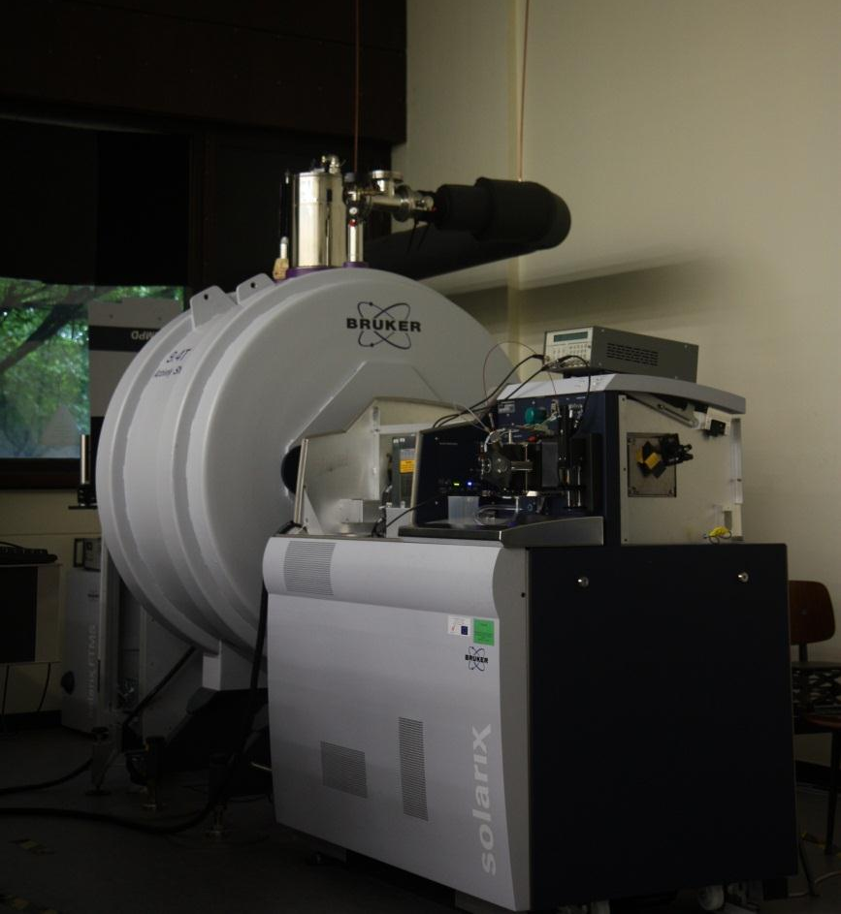



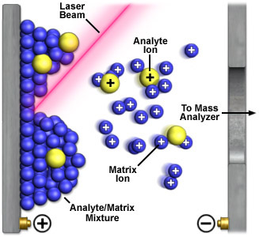
CONTRIBUTION OF HIGH MASS RESOLUTION AND ACCURACY OF FTMS TO MOLECULAR IMAGING
Delphine Debois
Mass Spectrometry Laboratory, LSM-GIGA-R, Chemistry Department, University of Liege

Slide 2
OUTLINE
1. The concept of MALDI Mass Spectrometry Imaging
2. Identification methods in MALDI MSI
Small molecules
High molecular weight compounds
3. What FT-MS brings to MALDI MSI
High precision ISD: getting closer to protein extremities
Higher mass resolution for higher spatial resolution
Comparison between TOF/TOF and FT-ICR spectra
4. Summary & Perspectives
Wednesday, 4 April, 2012 - EFTMS 2012 - University of Warwick

Slide 3

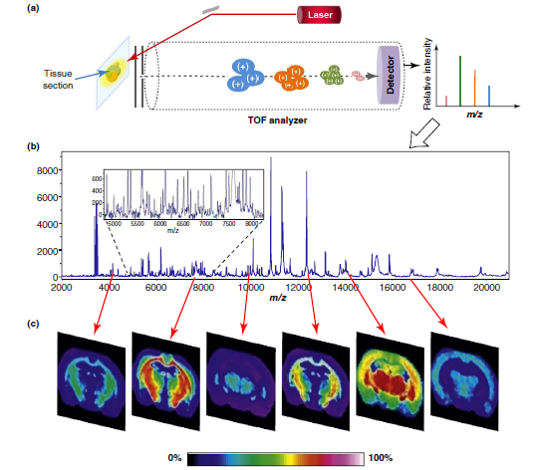

MALDI MASS SPECTROMETRY IMAGING
No need for any kind of probe
Good spatial resolution
High Dynamic range (proteomics, lipidomics, metabolomics,...)
Identification of detected compounds
Large signal suppression due to the variety of chemicals
Supressive effects prohibit direct quantitative analysis
E. Seeley and R.M. Caprioli, Trends Biotechnol. 2011, 29(3), 136
Wednesday, 4 April, 2012 - EFTMS 2012 - University of Warwick

Slide 4
2. IDENTIFICATION METHODS IN MALDI IMS
Small molecules
The same than for « regular samples »!
Accurate mass
Isotopic distribution
In case of trapping instuments, MS^{n}
Drift time separation (IMS)
Wednesday, 4 April, 2012 - EFTMS 2012 - University of Warwick

Slide 5
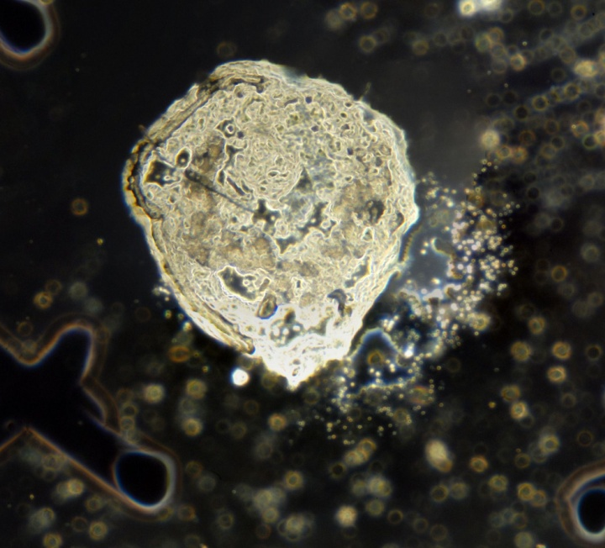
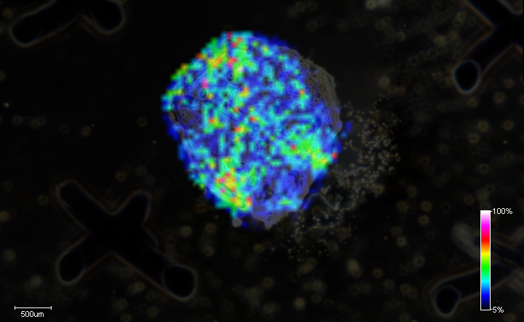
2. IDENTIFICATION METHODS IN MALDI IMS
On-tissue identification of the metabolite of methadone
Average mass spectrum of the « tox » larvae
a.u.
50
45
Matrix peaks
EDDP?
40
35
Picture of the « tox » larvae
Magnification x2.5
30
1 mm
25
278.1905
20
15
Lipids
10
5
m/z 278.1905
200
250
300
350
400
450
500
550
600
650
700
750
800
850
900
950
m/z
Wednesday, 4 April, 2012 - EFTMS 2012 - University of Warwick

Slide 6
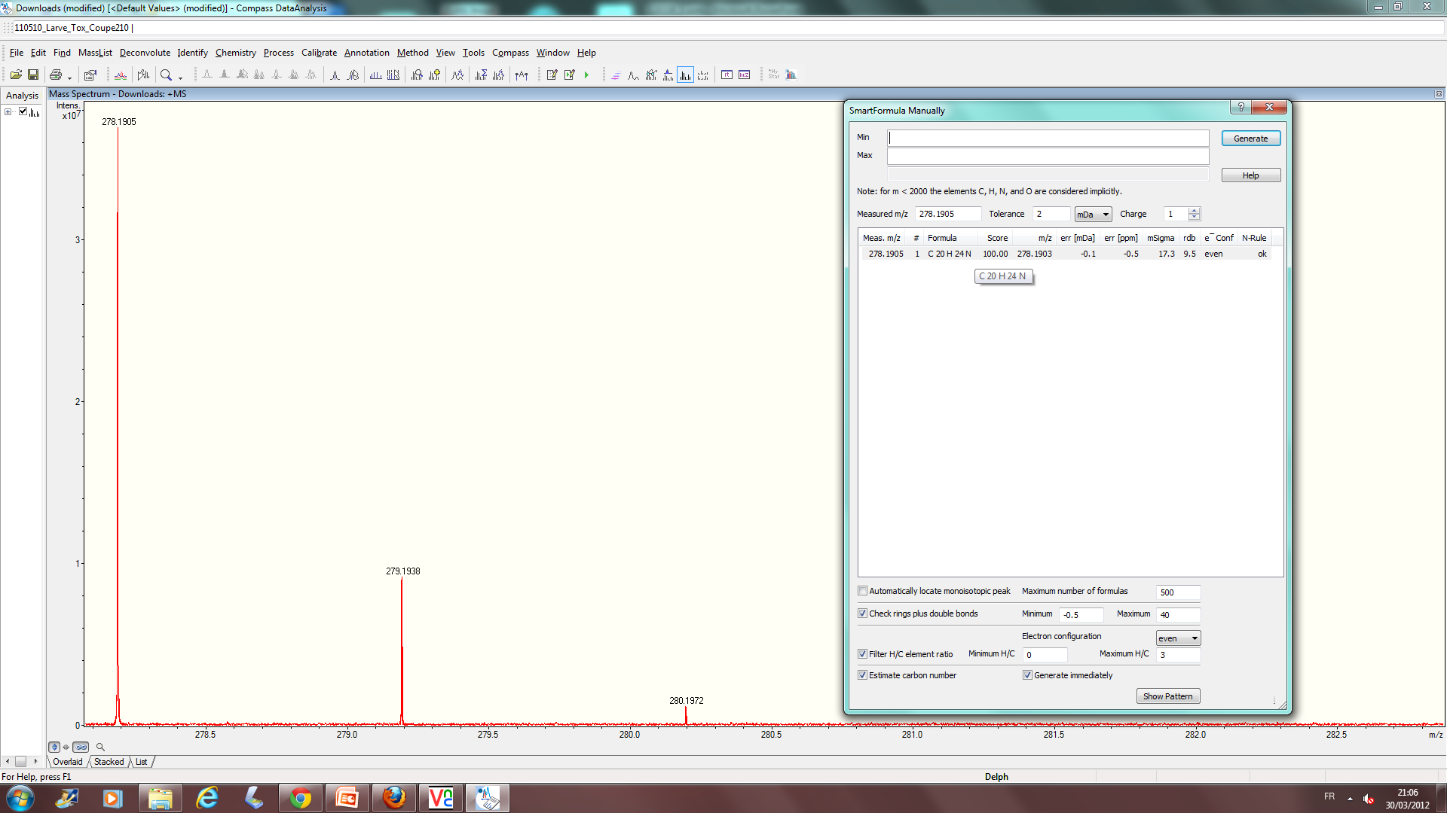
2. IDENTIFICATION METHODS IN MALDI IMS
On-tissue identification of the metabolite of methadone
Software interrogation for the exact m/z
278.1905
Identification of EDDP with the exact mass!
Score: 100%, only one candidate!
0.5 ppm error
Wednesday, 4 April, 2012 - EFTMS 2012 - University of Warwick

Slide 7
2. IDENTIFICATION METHODS IMPLEMENTED IN IMS
High molecular weight compounds
Bottom-Up Approach: On-tissue Digestion
Local or global application of a proteolytic enzyme on the surface of the tissue
Incubation for a period of 1h up to several hours (O/N) at temperatures ranging from RT to 37°C in a moist atmosphere
MS and MS/MS analysis of generated peptides
Interrogation of databases
Brings undetectable proteins into a convenient mass range
Allows for protein identification
Spatial resolution depends on the mode of deposition of the enzyme
Mass spectra from a digested tissue are more complicated
Several peptides may lead to isobaric ions
Shimma,S. et al. Surf. Interface Sci. 2006, 38(12-13), 1712
Groseclose, M.R. et al. J. Mass Spectrom. 2007, 42(2), 254
Chughtai, K. and Heeren, R.M.A. Chem. Rev. 2010, 110(5), 3237
Wednesday, 4 April, 2012 - EFTMS 2012 - University of Warwick

Slide 8
2. IDENTIFICATION METHODS IMPLEMENTED IN IMS
High molecular weight compounds
Top-Down Approach: MALDI In-Source Decay
MALDI plate
Free field region
Detector
Strong laser shot forms ions with an excess of internal energy. Some reactions with matrix molecules can lead to dissociation of molecules “inside the ionisation source”
The fragments formed before the delayed extraction can be detected directly at the right masses
Wednesday, 4 April, 2012 - EFTMS 2012 - University of Warwick
Notes:
8

Slide 9
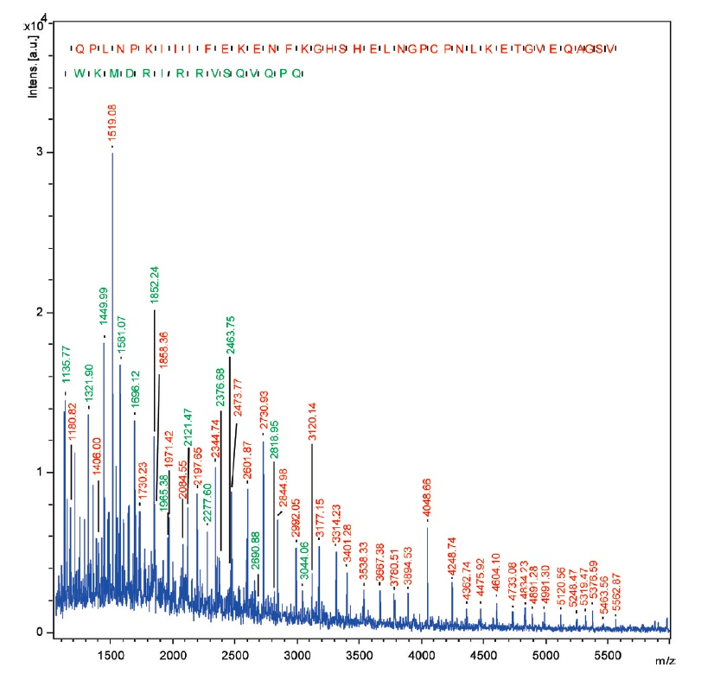
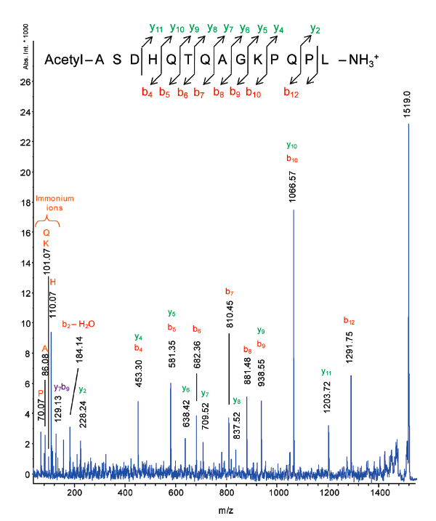
2. IDENTIFICATION METHODS IMPLEMENTED IN IMS
High molecular weight compounds
T3-sequencing mass spectrum
of the ion at m/z 1519.0
ISD mass spectrum recorded on a porcine eye lens slice with 1,5-DAN as the matrix. The tag and the masses indicated in red correspond to the N-terminus part of the -crystallin B2 (c-ions series) and the green ones to the C-terminus part (z-ion series)
Debois,D. et al. Anal. Chem. 2010, 82(10), 4036
Wednesday, 4 April, 2012 - EFTMS 2012 - University of Warwick

Slide 10
2. IDENTIFICATION METHODS IMPLEMENTED IN IMS
High molecular weight compounds
Top-Down Approach: MALDI In-Source Decay
Brings undetectable proteins into a convenient mass range
Allows for protein identification
No sample treatment needed, no incubation
Acquisition time
Mass spectra are complicated
No precursor ion selection
Difficulties to sequence extremities of proteins due to strong matrix clusters peaks
Wednesday, 4 April, 2012 - EFTMS 2012 - University of Warwick

Slide 11
3. WHAT FT-MS BRINGS TO MALDI IMS
High precision ISD: getting closer to protein extremities
3ppm
Would it be possible to assign smaller ions?
Wednesday, 4 April, 2012 - EFTMS 2012 - University of Warwick

Slide 12
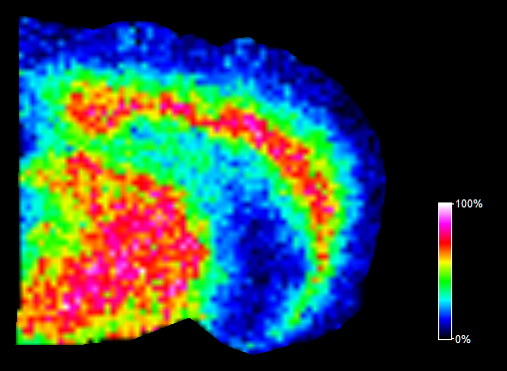
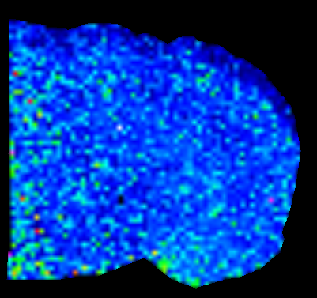
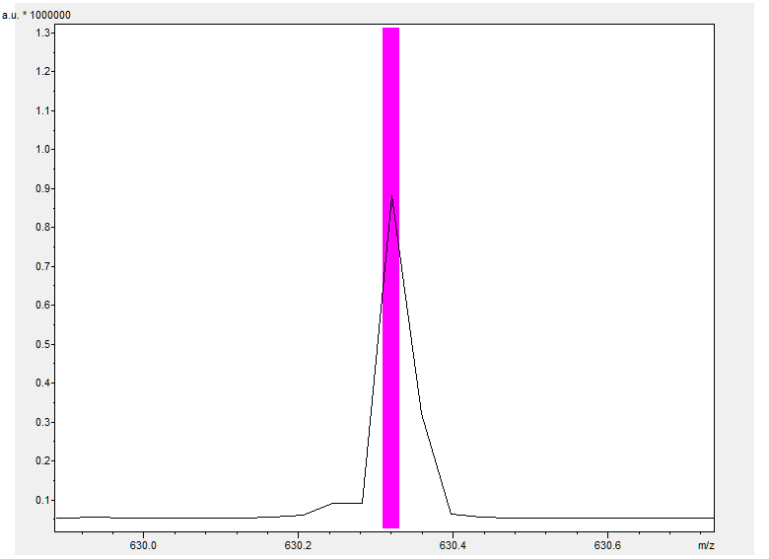
3. WHAT FT-MS BRINGS TO MALDI IMS
High precision ISD: getting closer to protein extremities
3ppm
c₈ ion
Matrix
m/z 942.512
Wednesday, 4 April, 2012 - EFTMS 2012 - University of Warwick

Slide 13
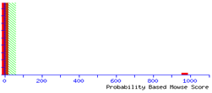
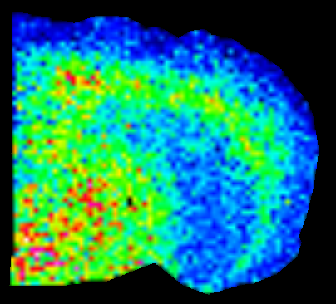
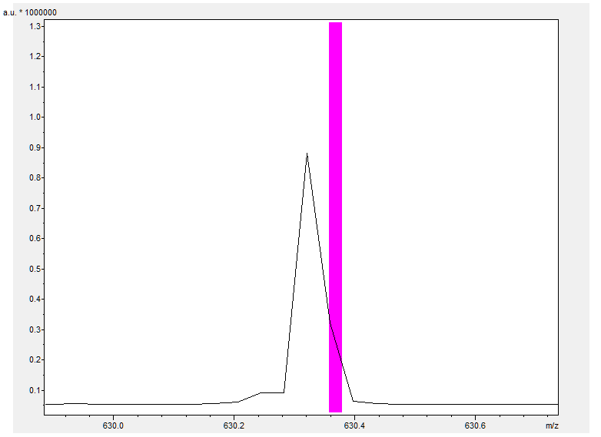
3. WHAT FT-MS BRINGS TO MALDI IMS
High precision ISD: getting closer to protein extremities
3ppm
Match to: gi|554196 Score: 963
myelin basic protein [Mus musculus]
c₈ ion
c₅ ion
Matrix
m/z 942.512
m/z 630.369
Wednesday, 4 April, 2012 - EFTMS 2012 - University of Warwick

Slide 14
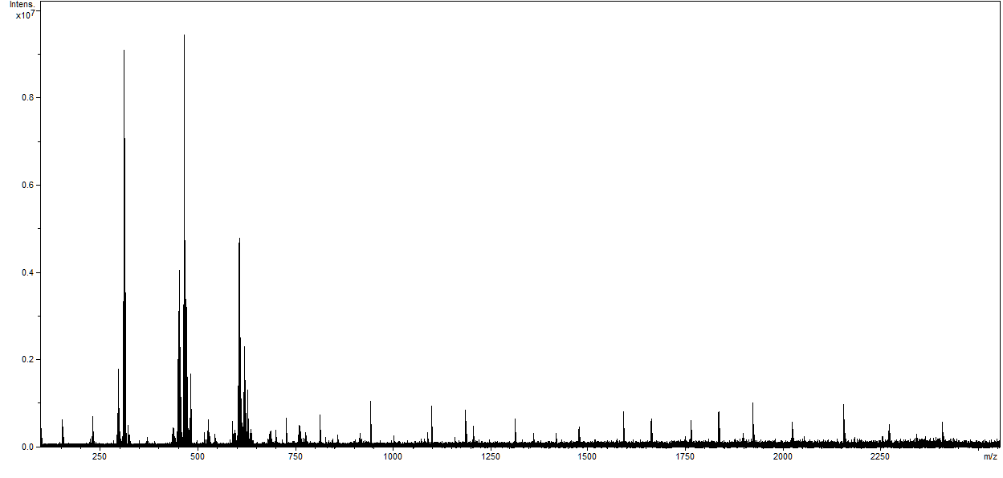
3. WHAT FT-MS BRINGS TO MALDI IMS
High precision ISD: getting closer to protein extremities
Peaks assignment (product ions from myelin ISD fragmentation) within matrix peaks
c₄
m/z 474.268
m/z 630.369
c₅
c₈
c₉
c₁₇
c₁₉
c₇
c₁₀
c₁₃
c₁₆
c₆
c₁₁
c₁₂
c₁₄
c₁₅
c₁₈
c₂₀
c₂₁
Wednesday, 4 April, 2012 - EFTMS 2012 - University of Warwick

Slide 15
3. WHAT FT-MS BRINGS TO MALDI IMS
High precision ISD: getting closer to protein extremities
How to improve the technique?
Acquire a second image, on a smaller region with an improved resolution
Improve ion transmission between MALDI source and ICR cell
Software for substraction of matrix peaks to vizualize peaks corresponding to ISD ions
…
A mass spectrometer with higher mass resolution : FTICR 15 Tesla!!!
Calligaris, D., Zimmerman, T.A., De Pauw, E. Anal. Chem. Submitted
Wednesday, 4 April, 2012 - EFTMS 2012 - University of Warwick

Slide 16
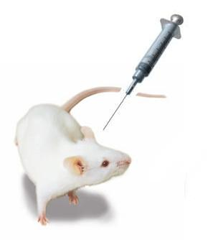
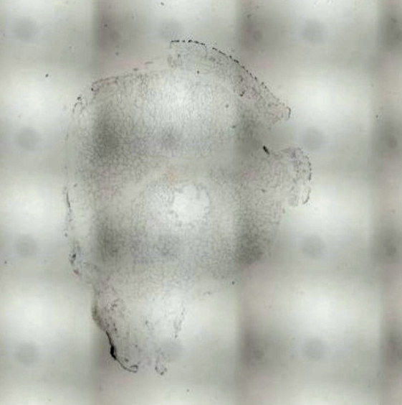
3. WHAT FT-MS BRINGS TO MALDI IMS
Higher mass resolution for higher spatial resolution
Vehicle
MALDI MSI
Tumor development
(7 days)
During 30 days
Sunitinib
Laser microdissection and subsequent proteomics guided by MALDI Mass Spectrometry Imaging
  MDA-MB-231 Luc+
2 mm
Matrix deposition by sublimation of 1,5-DAN
Raster 100 µm
Q1 mass: 400
TOF: 1 ms
Broadband, TD: 1M (0.37 s)
Acquisition with a 9.4T Solarix instrument
Wednesday, 4 April, 2012 - EFTMS 2012 - University of Warwick

Slide 17
3. WHAT FT-MS BRINGS TO MALDI IMS
a.u.
Higher mass resolution for higher spatial resolution
7.5
7.0
a.u.
6.5
Average mass spectrum of a tumor treated with sunitinib
6.0
65
5.5
60
5.0
4.5
55
4.0
50
3.5
45
3.0
2.5
40
2.0
35
1.5
1.0
30
0.5
25
770.0
770.5
771.0
771.5
772.0
772.5
773.0
773.5
774.0
774.5
m/z
20
15
10
5
200
300
400
500
600
700
800
900
1000
1100
1200
1300
1400
m/z
Wednesday, 4 April, 2012 - EFTMS 2012 - University of Warwick

Slide 18
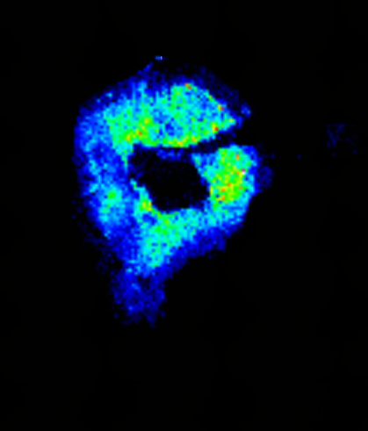
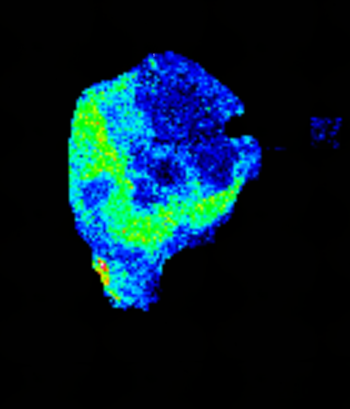
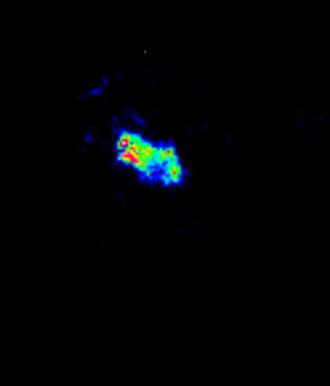

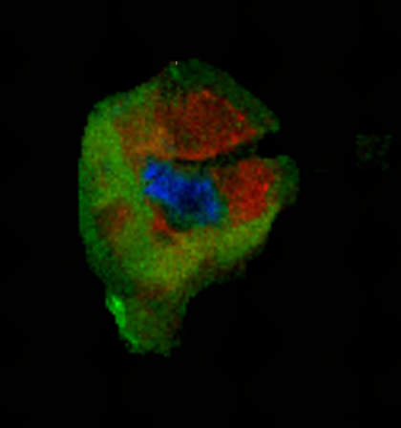
3. WHAT FT-MS BRINGS TO MALDI IMS
Higher mass resolution for higher spatial resolution
a.u.
7.5
7.0
6.5
DAN matrix peak
6.0
5.5
m/z 772.5424
m/z 772.6003
m/z 772.6390
5.0
4.5
4.0
3.5
3.0
2.5
2.0
1.5
1.0
0.5
772.00
772.10
772.20
772.30
772.40
772.50
772.60
772.70
772.80
772.90
m/z
Wednesday, 4 April, 2012 - EFTMS 2012 - University of Warwick

Slide 19
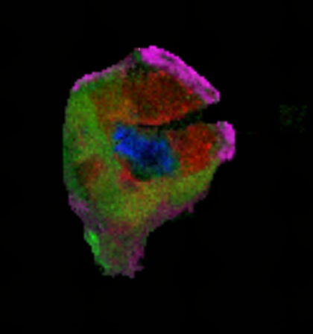
3. WHAT FT-MS BRINGS TO MALDI IMS
Higher mass resolution for higher spatial resolution
a.u.
7.5
7.0
6.5
DAN matrix peak
6.0
5.5
m/z 772.5424
m/z 772.6003
m/z 772.6390
5.0
4.5
4.0
3.5
3.0
2.5
2.0
1.5
1.0
0.5
772.00
772.10
772.20
772.30
772.40
772.50
772.60
772.70
772.80
772.90
m/z
Wednesday, 4 April, 2012 - EFTMS 2012 - University of Warwick

Slide 20
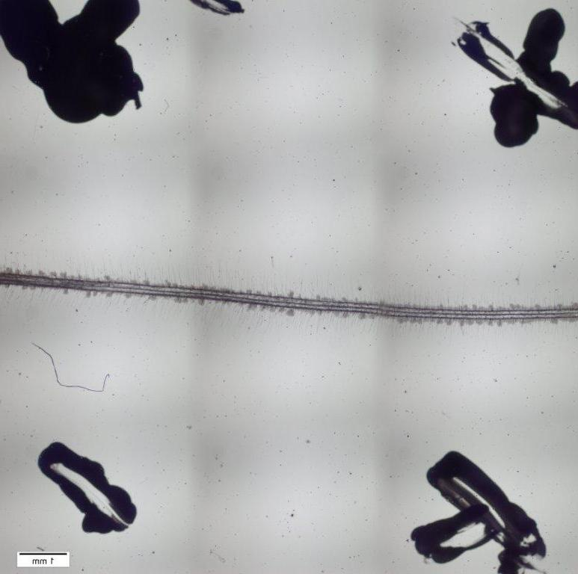
3. WHAT FT-MS BRINGS TO MALDI IMS
Comparison between TOF/TOF and FT-ICR spectra
Non pathogenic microorganisms can trigger a positive effect on plant by in situ producing active compounds
Model of interaction between a tomato root and a biofilm of Bacillus amyloliquefaciens
Two goals:
Map known Bacilli’s bioactive molecules
Screen and map unknown molecules exchanged between the root and the biofilm
FT-ICR analysis area
TOF/TOF analysis area
Raster 150 µm
Q1 mass: 400
TOF: 1 ms
Broadband, TD: 1M (0.37 s)
2 mm
Wednesday, 4 April, 2012 - EFTMS 2012 - University of Warwick
Notes:
20

Slide 21
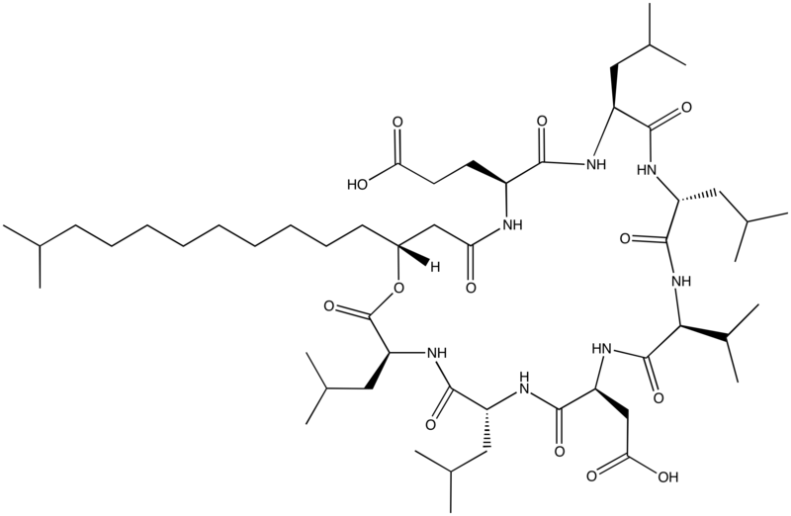
3. WHAT FT-MS BRINGS TO MALDI IMS
Comparison between TOF/TOF and FT-ICR spectra
a.u.
28
TOF/TOF mass spectrum
C₁₅ Surfactin
26
24
22
20
18
16
14
12
10
8
6
4
2
880
900
920
940
960
980
1000
1020
1040
1060
1080
1100
1120
1140
1160
1180
m/z
Wednesday, 4 April, 2012 - EFTMS 2012 - University of Warwick

Slide 22
3. WHAT FT-MS BRINGS TO MALDI IMS
a.u.
Comparison between TOF/TOF and FT-ICR spectra
11
a.u.
10
28
TOF/TOF mass spectrum
26
9
8
24
7
22
6
20
5
4
18
3
16
2
1
14
1070
1071
1072
1073
1074
1075
1076
1077
1078
1079
m/z
12
At m/z 1072.6, one peak, with a shoulder
10
8
6
4
2
880
900
920
940
960
980
1000
1020
1040
1060
1080
1100
1120
1140
1160
1180
m/z
Wednesday, 4 April, 2012 - EFTMS 2012 - University of Warwick
Notes:
22

Slide 23
3. WHAT FT-MS BRINGS TO MALDI IMS
a.u.
Comparison between TOF/TOF and FT-ICR spectra
12
a.u.
11
FT-ICR mass spectrum
45
FT-ICR mass spectrum
10
42
9
40
8
37
7
35
6
32
5
30
4
27
3
25
2
22
1
20
1070
1071
1072
1073
1074
1075
1076
1077
1078
1079
m/z
17
At m/z 1072.6, two peaks perfectly resolved
15
12
10
7
5
2
880
900
920
940
960
980
1000
1020
1040
1060
1080
1100
1120
1140
1160
1180
m/z
Wednesday, 4 April, 2012 - EFTMS 2012 - University of Warwick

Slide 24
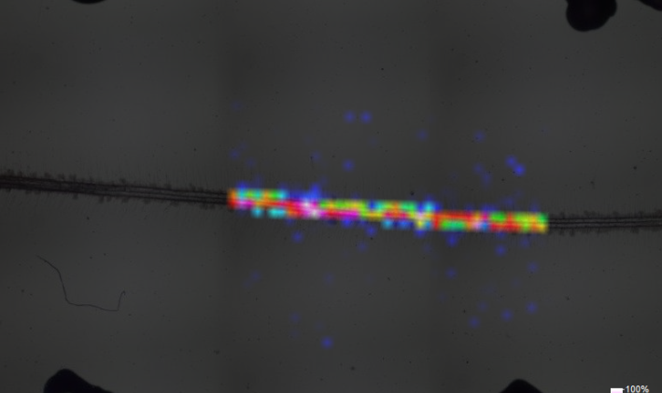
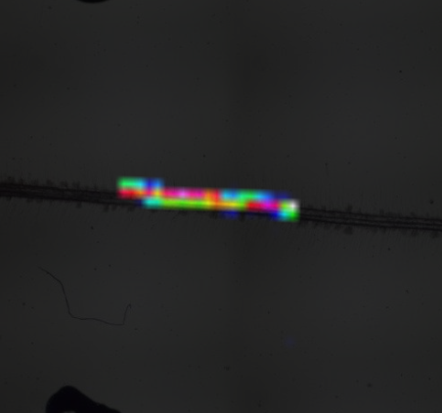
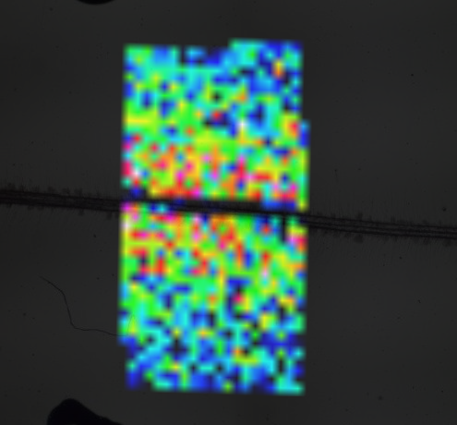
3. WHAT FT-MS BRINGS TO MALDI IMS
Comparison between TOF/TOF and FT-ICR spectra
a.u.
a.u.
11
12
10
11
9
10
8
9
7
8
6
7
5
6
4
5
3
4
2
3
1
2
1
1070
1071
1072
1073
1074
1075
1076
1077
1078
1079
m/z
1070
1071
1072
1073
1074
1075
1076
1077
1078
1079
m/z
m/z 1072.52
m/z 1072.5075
Only the high mass resolutionof FT-ICR allows for distinguishing
these two distributions!!!
m/z 1072.6878
Could this peak be assigned as to the sodium adduct of C₁₆-surfactin?
Wednesday, 4 April, 2012 - EFTMS 2012 - University of Warwick

Slide 25
3. WHAT FT-MS BRINGS TO MALDI IMS
Intens. x10⁶
Comparison between TOF/TOF and FT-ICR spectra
Simulated isotopic pattern of [C₁₆-surfactin +Na]⁺
Mass spectrum coming from the image data set
1.0
The mass spectrum perfectly matches with the simulated pattern. The assignement is confirmed!
0.8
1072.6878
1072.6880
0.6
1073.6913
0.4
0.2
1074.6946
0.0
1072.0
1072.5
1073.0
1073.5
1074.0
1074.5
1075.0
m/z
Wednesday, 4 April, 2012 - EFTMS 2012 - University of Warwick

Slide 26
4. SUMMARY AND PERSPECTIVES
FT-MS does bring a contribution to
MALDI Mass Spectrometry Imaging!!!
Now, high resolution and high mass accuracy allow for:
discriminating analyte peaks from matrix adduct peaks
separating analytes with close masses for precise definition of areas of interest
confident assignment and / or identification
In the future, the unique features of FT-ICR MS will allow for:
replace MRM or SRM to validate biomarkers directly on histological slices
Wednesday, 4 April, 2012 - EFTMS 2012 - University of Warwick
Notes:
26

Slide 27
ACKNOWLEDGEMENTS
ULg MS Lab
ULg Cytology and Histology Lab
Jonathan Cimino,
Dr David Calligaris,
Pr Edwin De Pauw
Virginie Bertrand,
Dr Marie-Claire Gillet-De Pauw
Collaborators
Dr Matthias Gosselin (National Institute of Criminalistic and Criminology)
Dr Emmanuel Jourdan (Centre Wallon de Biotechnologie Industrielle),
Dr Marc Ongena (ULg Gembloux Agro Bio-Tech)
Financial Support
ULg, FNRS, Walloon Region, FEDER, GIGA, CART
Wednesday, 4 April, 2012 - EFTMS 2012 - University of Warwick

Slide 28
THANK YOU FOR YOUR ATTENTION!!
QUESTIONS??
Wednesday, 4 April, 2012 - EFTMS 2012 - University of Warwick

Slide 29
Wednesday, 4 April, 2012 - EFTMS 2012 - University of Warwick
Notes:
And of course, I thank you for your attention!
29

Slide 30
CONTRIBUTION OF HIGH MASS RESOLUTION AND ACCURACY OF FTMS TO MOLECULAR IMAGING
High precision ISD: getting closer to protein extremities
Batch processing/exporting of peak lists into text files using DataAnalysis software
Mass tolerance window value is defined by user
RAW DATA
Subtraction/reduction of the matrix peak m/z values from the imaging data peak lists based on the chosen mass tolerance window
Importing of the MALDI matrix peak list into the MatrixPeaksRemover software
AND
Batch import of imaging data peak lists into the MatrixPeaksRemover software
Creation of the total ion current (TIC) mass spectrum by summing over all peak lists
Creation of MALDI-MS ion images of identified proteins from peak lists, without interference from the MALDI matrix peaks
Enhanced ISD sequencing of proteins without interference from MALDI matrix peaks
Wednesday, 4 April, 2012 - EFTMS 2012 - University of Warwick

Slide 31
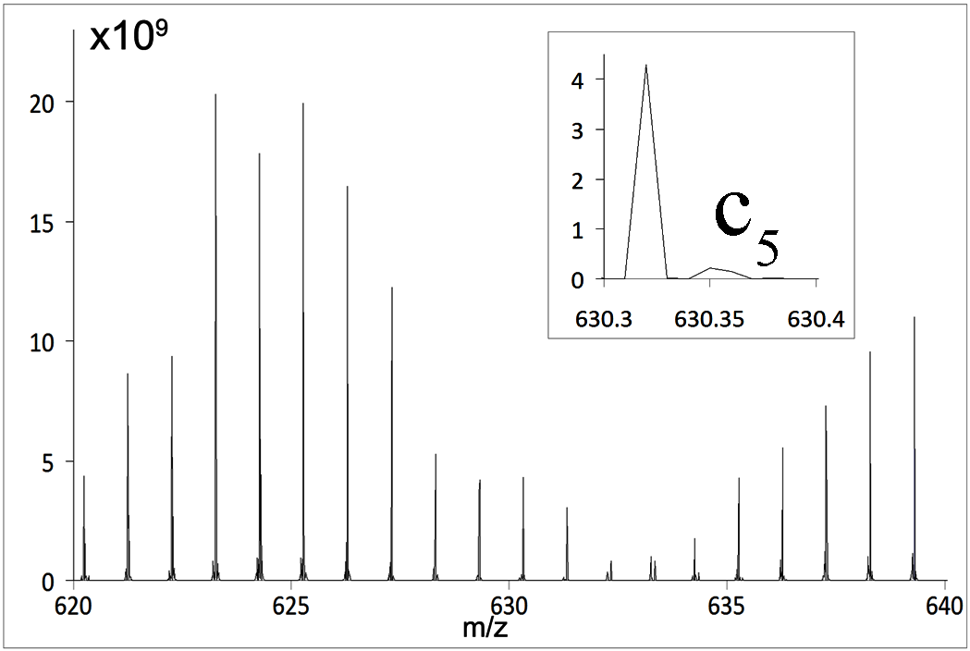
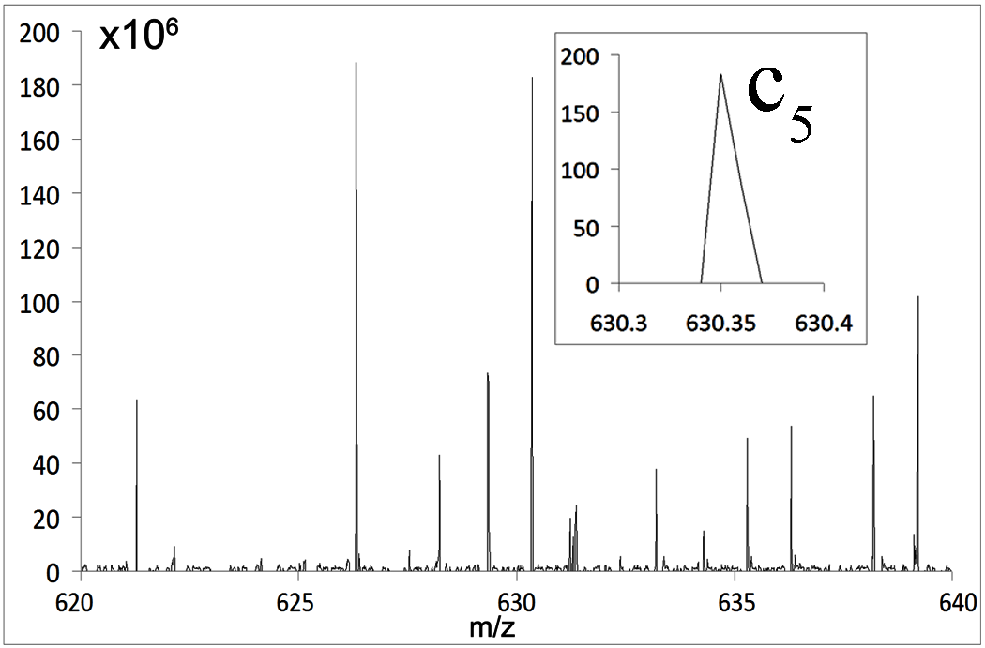
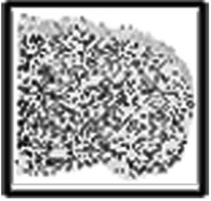
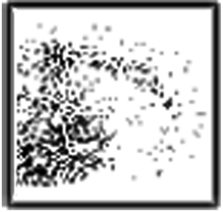
CONTRIBUTION OF HIGH MASS RESOLUTION AND ACCURACY OF FTMS TO MOLECULAR IMAGING
High precision ISD: getting closer to protein extremities
MALDI matrix peaks removal
M
c₅
c₅
Wednesday, 4 April, 2012 - EFTMS 2012 - University of Warwick

Slide 32
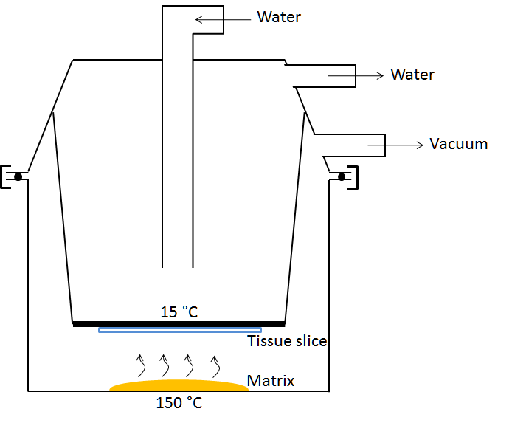
Wednesday, 4 April, 2012 - EFTMS 2012 - University of Warwick
Notes:
And of course, I thank you for your attention!
32

Slide 33
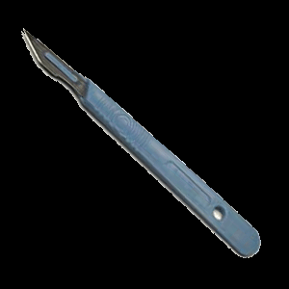

Germinated seeds of tomato + cells of Bacillus amyloliquefaciens S499
Covered with plant nutritive solution containing 1.75% of agar
        Drying under vaccuum during 1h30-2h
Incubation vertically during 10 days at 28°C
Pump
        Automated matrix deposition
        MALDI-TOF/TOF analysis
Wednesday, 4 April, 2012 - EFTMS 2012 - University of Warwick
Notes:
And of course, I thank you for your attention!
33

Slide 34
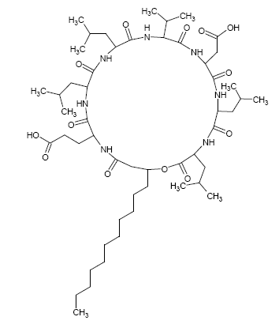
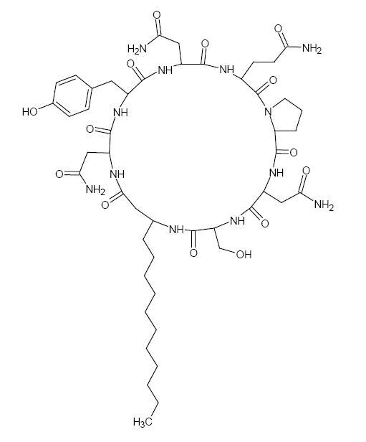
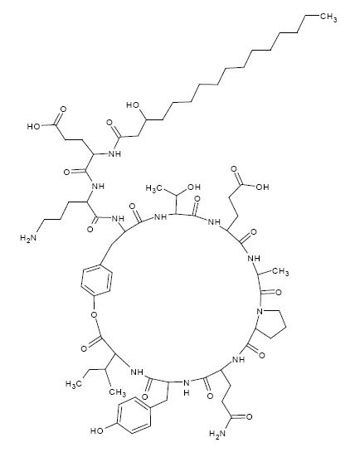
CONTRIBUTION OF HIGH MASS RESOLUTION AND ACCURACY OF FTMS TO MOLECULAR IMAGING
Lipopeptides
Surfactins
Heptapeptides
cyclic lactone ring
Iturins
Heptapeptides linked to a b-amino fatty acid
Fengycins
Lipodecapeptides, internal lactone ring
4 structural variants
Various homologues C₁₂ to C₁₆, linear, iso, anteiso
7 structural variants
Homologues C₁₄ to C₁₇
4 structural variants
Homologues from C₁₄ to C₁₈
Bonmatin, J.M. et al., Comb. Chem. High Troughput Screen., 2003, 6(6), 541.
Raaijmakers, J.M., et al., FEMS Microbiol. Rev. 2010, 34(6), 1.
Wednesday, 4 April, 2012 - EFTMS 2012 - University of Warwick

