Slide 1



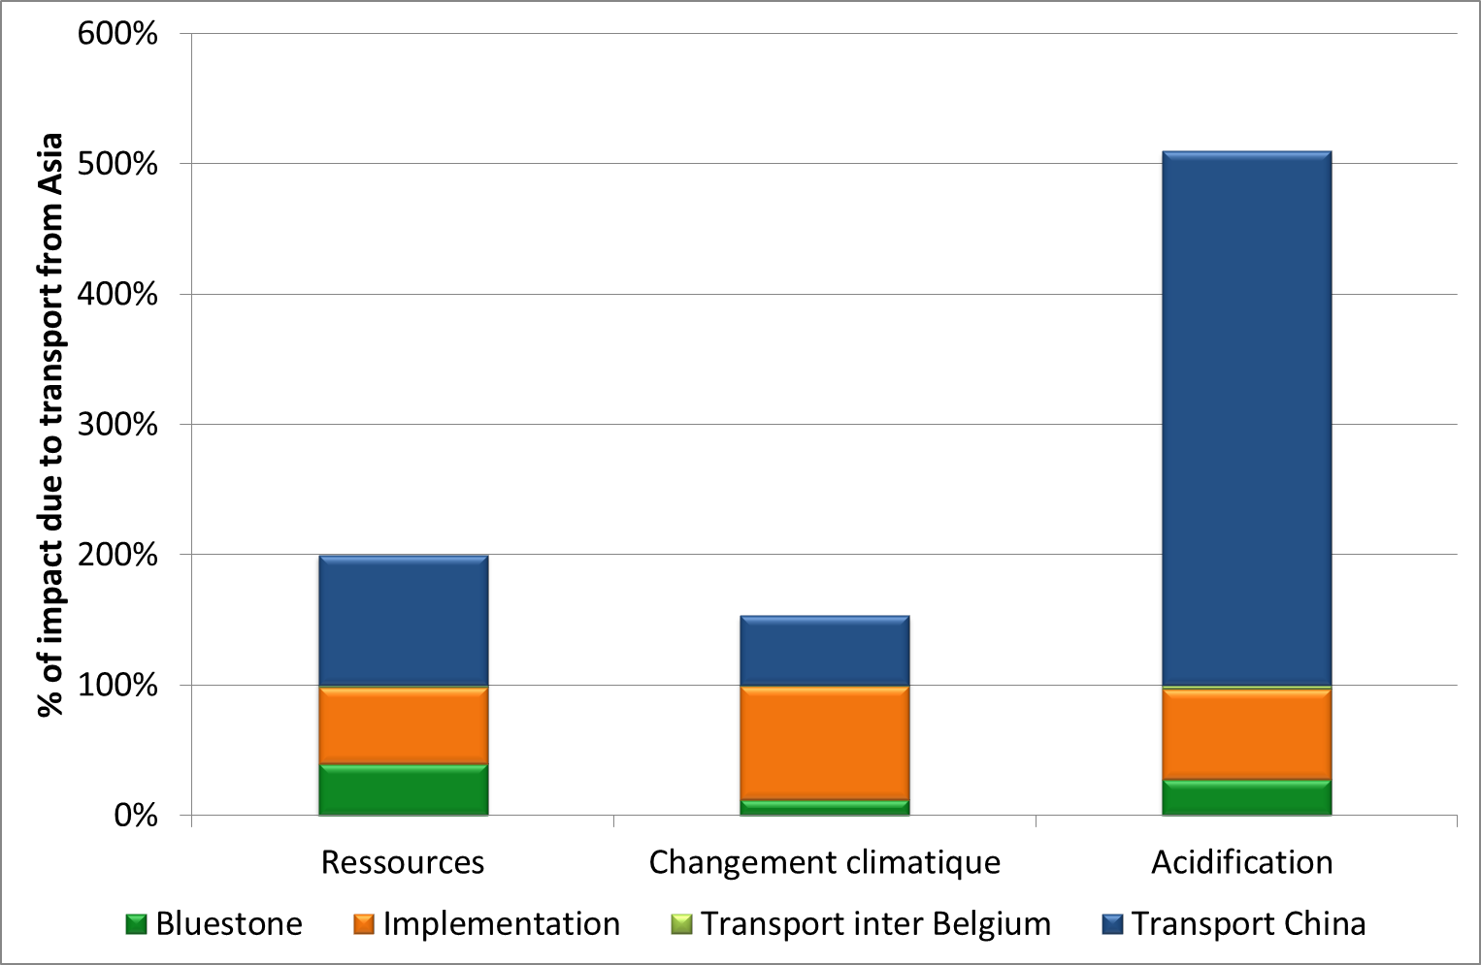
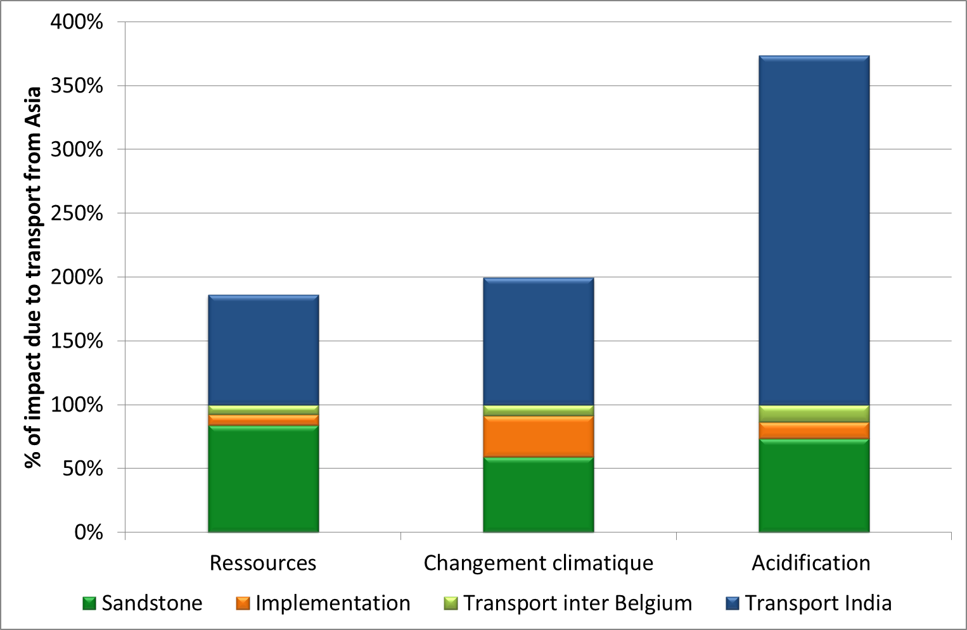
ENVIRONMENTAL PRODUCT DECLARATIONS
OF MINERAL PAVING, A TOOL FOR SUSTAINABLE PRODUCT CHOICES
S. BELBOOM¹, R. RENZONI¹, F. TOURNEUR ², A.LÉONARD¹
¹Department of Chemical Engineering, University of Liège (Belgium)
² Pierres et Marbres de Wallonie, Belgium
www.chimapp.ulg.ac.be – S.Belboom@ulg.ac.be; A.Leonard@ulg.ac.be
Introduction
Construction is a very important economical sector, including roads, buildings, houses, etc. A lot of materials are available for these works and tools are sometimes needed to help their selection. Environmental product declarations (EPD) are increasingly used in the construction field. These EPDs are based on a life cycle assessment in order to inform architects or customers about the environmental performances of the different materials.
Materials and Methods
Goal definition
This study was performed in order to establish environmental product declarations for three Belgian mineral products, two granite and one sandstone paving. Both main goals of this work were to obtain Belgian environmental product declarations to strengthen existing databases and to get similar information for their Asian counterparts. Indeed, competition with China for bluestone products and with India for sandstone pavement is very important due to very competitive prices despite their foreign origin and possibly higher induced environmental impacts.
Methods
The development of Belgian bluestone and sandstone products EPDs was made in accordance with the ISO standards 14025 [1], 14040 [2] and 14044 [3] and following the French standard NF P 01-010 [4]. CML 2001 method [5] was used to obtain environmental impacts for ten categories as climate change, acidification, abiotic resources depletion, etc. Boundaries of the Belgian systems are the same and the life cycle assessment comprises all steps from the extraction of minerals to the implementation on site including shaping and transportation to site. Use and end of life steps were neglected due to the low required maintenance and the inert nature of the paving. For Asian products, the analysis is reduced to the transportation of the functional unit, equal to 1000 m² of products, mainly due to the lack of reliable data concerning local production conditions.
Characteristic sizes of each studied products are presented in Table 1.
Producers provided the majority of the Belgian data and a national average was calculated for dry or underwater quarry. Other data came from scientific literature or ecoinvent databases v2.2 [6].
Table 1. Characteristic of studied products
Characteristic | Internal bluestone paving | External bluestone paving | External sandstone paving | Unit
Dimensions | 20×20×2 | 20×20×3 | 15×15×8.5 | cm
Results and Discussion
Main results
This work highlights the negative effect of long distance transportation of heavy and non-energetic products. Indeed, the environmental impacts of the sole transport of Asian products are at least as important as those obtained for the whole life cycle of Belgian products, whatever the category taken into account (climate change, acidification, air pollution, etc.).
Results are presented as a comparison of the Belgian product with its foreign counterpart to highlight the weight of the transportation step. No comparison between products is directly possible because of their different uses. An internal bluestone product is not used in the same way as an external bluestone paving or sandstone paving of 8.5 cm thick. To compare the products in an objective way, they must have the same application. Scores, presented in Figure 1, are expressed in percentage as the presented impact categories have different units. The life cycle score of the Belgian product is equal to 100%.
Figure 1. Impact of transportation step for bluestone and sandstone products
Conclusions
CML 2001 methodology was successfully applied to these five studies about three Belgian products and two abroad transportation steps. Comparison was accomplished between Belgian products and the transport of their foreign counterparts, allowing to highlight the importance of transport on environment and to promote, supposing equal performance, local products in a more environmental-friendly point of view.
References
[1] ISO, ISO 14025 : Marquages et déclarations environnementaux - Déclarations environnementales de Type III - Principes et modes opératoires. 2006.
[2] ISO, ISO 14040 : Management environnemental - Analyse du cycle de vie - Principes et cadre. 2006, ISO.
[3] ISO, ISO 14044 : Management environnemental - Analyse du cycle de vie - Exigences et lignes directrices. 2006, ISO.
[4] AFNOR, Déclaration environnementale et sanitaire des produits de construction, in Qualité environnementale des produits de construction. 2004.
[5] Center of Environmental Science University of Leiden, Life Cycle Assessment and operational guide to the ISO standard - final report may 2001, J.B. GUINEE, Editor. 2001, University of LEIDEN.
[6] ecoinvent Centre, The life cycle inventory data version 2.2. . 2010, Swiss Center for Life Cycle Inventories.
6th International Conference on Society & Materials, SAM6, Leuven, 30-31 May 2012

