Slide 1



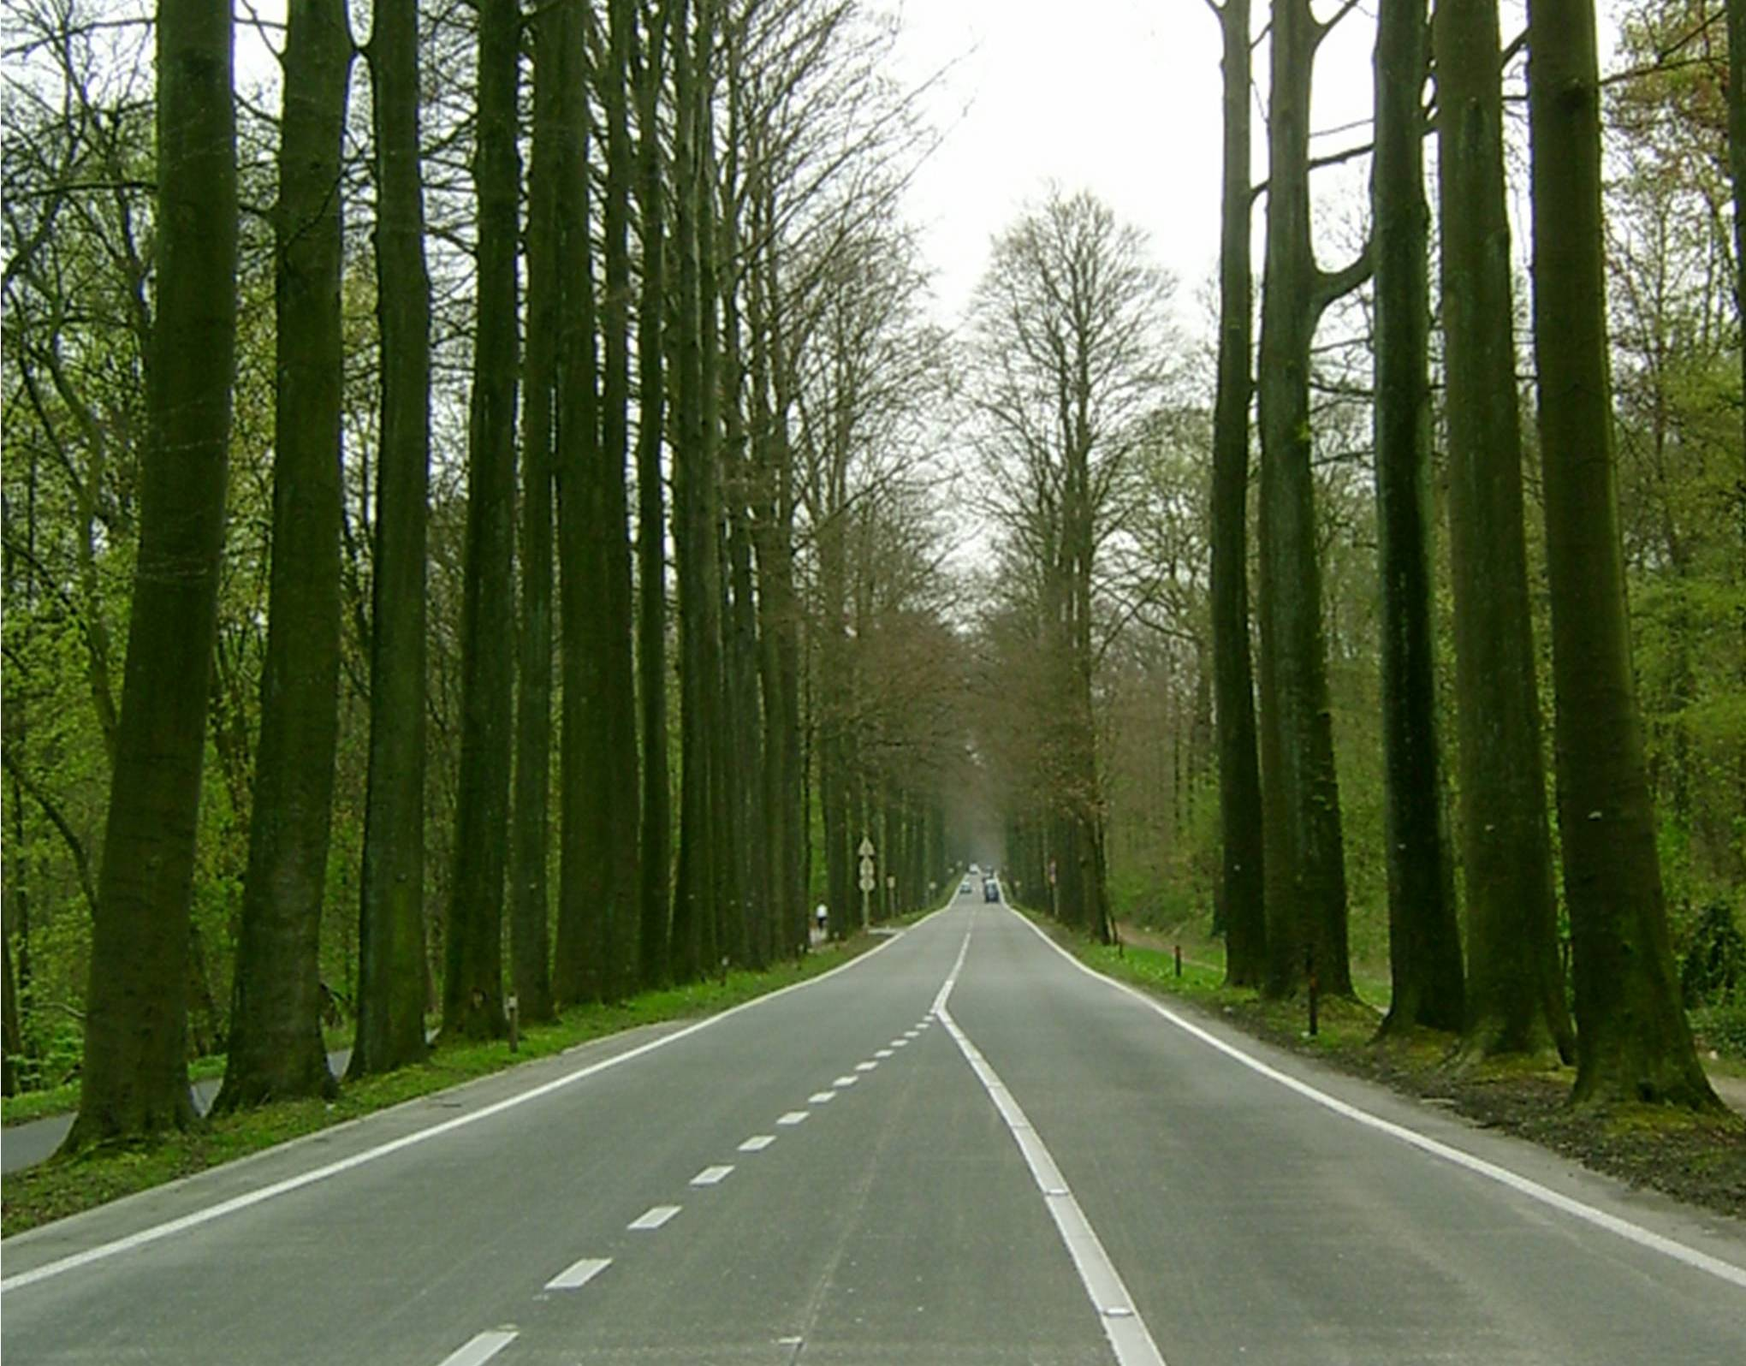
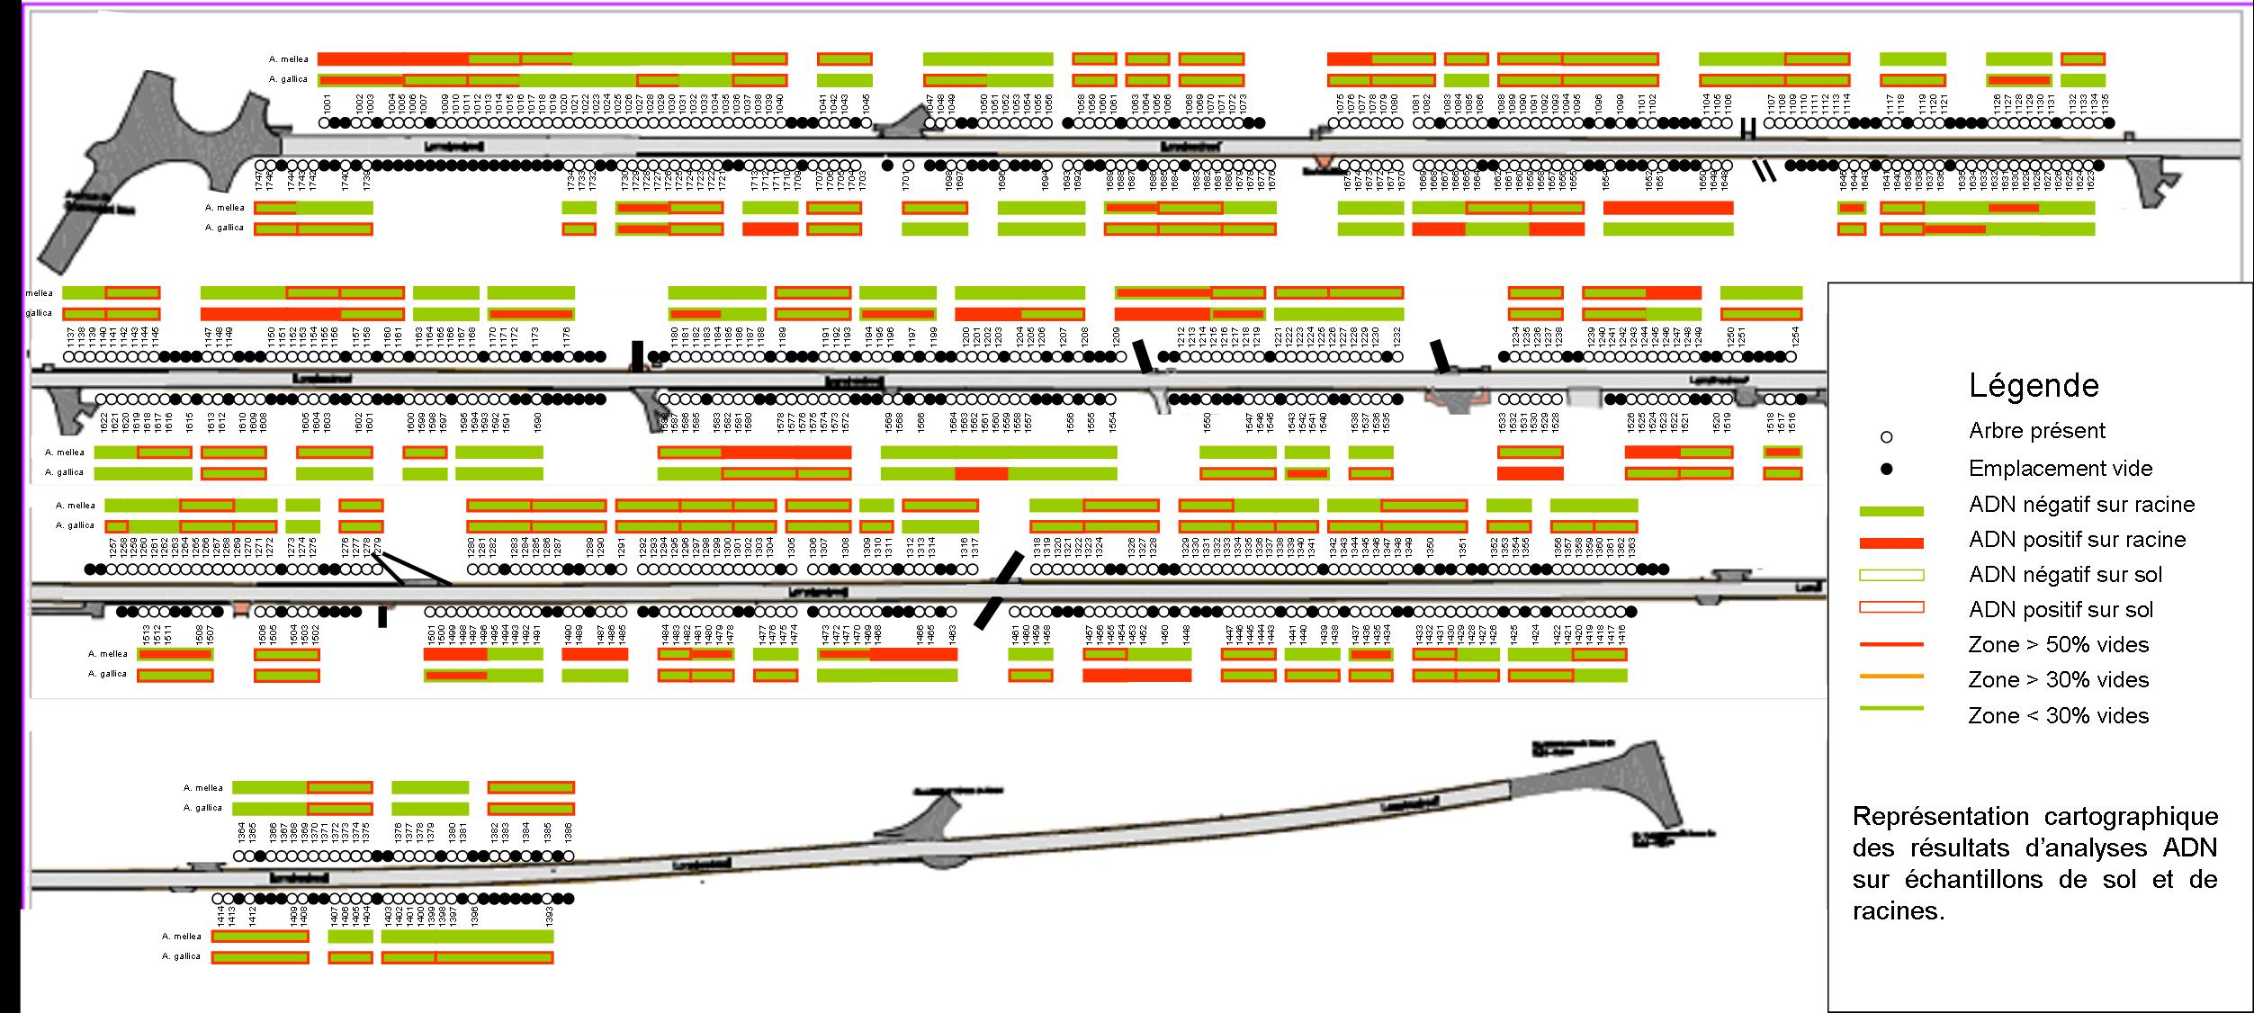
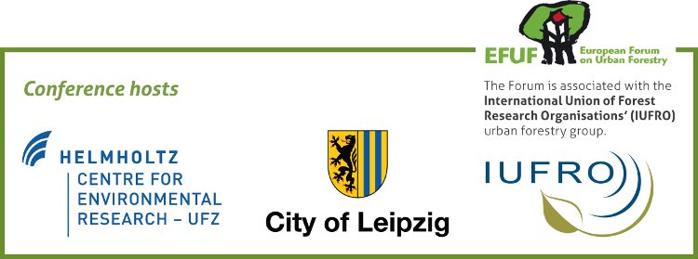
Distribution of Armillaria species along a purple beech (Fagus sylvatica L. atropunicea) tree line as an aid to management decision.
Campanella, Bruno. Laboratory for environmental toxicology. GxABT. Passage des Déportés, 2, 5030 Gembloux, Belgium bruno.campanella@ulg.ac.be
Schmitz, Sophie. Life Sciences Department. CRA-W. Rue de Liroux, 4, 5030 Gembloux, Belgium
Decoux, Valérie. Ministry of the Brussels-Capital Region, Brussels Mobility, Management and Maintenance of Roads, Planting department, Rue du Progrès, 80box1, 1035 Bruxelles, Belgium.
This research is focused on the decline of 730 Fagus sylvatica L. ‘Atropunicea’ (purple beech) constituting a 2.5 km tree line in the peri-urban Soignes forest (Lorraine drive, Brussels, Belgium, Fig. 1). Since their planting in 1886, trees have coped with important changes in their environment, namely road enlargement and increased occurrence of dry summers, which are not favorable for beeches. In 2006, a particularly important fruiting of Armillaria led us to study the influence of this pathogen on the tree line management. Samples were collected at the foot of each tree (1m from collar) and pulled to obtain a composite sample representing 6 trees. Two kinds of sub-samples (soil and roots) were analyzed in order to evaluate the invasive pressure of the fungi against tree roots. Presence of Armillaria only in soil samples could indicate a saprophytic behavior while detection in roots would establish a pathogenic character which could lead to root rot. DNA extraction followed by PCR-RFLP (Lochman et al., 2004) was carried out on soil and root samples from 137 tree groups and results provided a distribution map of Armillaria along the tree line (Fig. 2).
Fig. 1 : vue of the Lorraine Drive and the two F. sylvatica lines
Legend
Existing tree
Void in the line
Armillaria - on root
Armillaria + on root
Armillaria – on soil
Armillaria + on soil
Fig. 2 : cartographic presentation of results for Armillaria gallica and A. mellea
Among all the samples, 56.2 % were infected by Armillaria and three species were detected (Armillaria mellea, A. gallica and A. cepistipes). Soil samples were mainly infected by the weaken parasite A. gallica (65.7%) while the primary parasite A. mellea was detected in 50.4% of the cases. The species A. cepistipes was found in solely one soil sample. Concerning root samples, infection percentages of 17.5% and 14.6% were encountered for A. gallica and A. mellea respectively. Both species had a uniform distribution along the tree line except for zones where root extraction was performed after felling. In these zones, reduced presence of A. mellea enhances the positive effect of this recommendation. Presence of the species A. gallica in root samples suggest that the tree line decline might have been favored by a previous weakening. Relatively low percentages of root infections by Armillaria raise expectations of a slow evolution of the sanitary status of the tree line although presence of A. mellea in soil constitutes a major threat for weakened trees health. The entire tree line will be renewed within 10 years through 6 phases depending on the sanitary status of trees and their possible evolution. Tree groups were defined by combining void percentage and landscape units (Fig. 3). In this context, the study completes Visual Tree Assessment (VTA) diagnosis and is an aid to management decision by helping to determine the order of priority in tree replacement.
Legend
Existing tree
Void in the line
Void percentage > 50%
30%<v.p.<50%
Void percentage <30%
Fig. 3: cartographic presentation of renewal units
15th European Forum on Urban Forestry Conference : Leipzig, Germany, May 8 – 12, 2012
Urban Forests – Ecosystem Services and Sustainable Maintenance

